Slide 1



Impuls AgriTech 2026 · Part 2
Build Your Own Plan
Xavier Arola
Subvencionat pel Departament d'Empresa (Programa
Primer) i amb el cofinançament del Fons Social Europeu Plus

Slide 2

Part 2 · Today’s Journey
6
7
8
9
Costs
Cost structure + quick sort: fixed or variable?
Revenues & market
Revenue map, competitors, market sizing sprint, unit economics
The template
How it works + practice with RegaSmart (Levels 1 and 2)
Your own plan
Fill in the template with your project + exit ticket
25’
60’
1h45
open
Bring: a laptop with the Excel template and your project’s hypotheses (prices, volumes, costs, funding).
g-accelerator@global-business-school.org
+34 930 086 588
Notes:
Agenda. Every block = short theory + a hands-on activity. The green 'ACTIVITY' badge on a slide signals that participants have to do something. Part 1 uses RegaSmart as the worked example; Part 2 applies everything to each team's own project, first practising RegaSmart in the Excel template.

Slide 3
Cost Structure
All the most important costs to run the business need to be reported.
It is also better to briefly explain their characteristics.
    INITIAL COSTS TO OPERATE
      INVESTMENT PLAN
      OPERATIONAL PLAN
    WHICH COSTS AM I GOING TO INCURR IN?
    ARE THESE COSTS FIXED OR VARIABLE?
g-accelerator@global-business-school.org
+34 930 086 588

Slide 4
Cost Structure
To define your Cost Structure I want you to review again the main sections of your Business Plan and review also your Business Model Canvas and estimate the associated costs.
  Your Business model canvas and its building blocks should describe the most important costs incurred while operating under a particular business model. Creating and delivering value, maintaining Customer Relationships, and generating revenue all incur costs. Such costs can be calculated relatively easily after defining Key Resources, Key Activities, and Key Partnerships. Some business models, though, are more cost-driven than others. So-called “no frills” airlines, for instance, have built business models entirely around low-Cost Structures.
g-accelerator@global-business-school.org
+34 930 086 588

Slide 5
Cost Structure
A Cost Structures can have the following attributes:
Fixed cost
  Costs that remain the same despite the volume of goods or services produced. Examples include salaries, rents, and physical manufacturing facilities. Some businesses, such as manufacturing companies, are characterized by a high proportion of fixed costs.
Variable cost
  Costs that vary proportionally with the volume of goods or services produced. Some businesses, such as music festivals, are characterized by a high proportion of variable costs.
g-accelerator@global-business-school.org
+34 930 086 588

Slide 6
QUIZ · 10 MIN
Quick Sort: Fixed or Variable?
RegaSmart’s costs. Vote for each one: F = fixed, V = variable, ? = it depends
1
Warehouse rent
2
Sensor components
3
Founders’ salaries
4
Installation technician, paid per farm
5
Diesel for farm visits
6
Cloud hosting of the app
7
Stand at an agri fair
8
Card-payment fees
9
Accountant (monthly fee)
10
Seasonal sales reps on commission
Run it in Kahoot or with coloured cards. The most interesting answers are the “it depends” ones.
g-accelerator@global-business-school.org
+34 930 086 588
Notes:
ANSWERS
1 Warehouse rent: F
2 Sensor components: V
3 Founders' salaries: F
4 Installation technician paid per farm: V
5 Diesel for farm visits: V (grows with installations) – debate
6 Cloud hosting: semi-variable (base fee + grows with users) – debate
7 Agri fair stand: F (marketing budget, not linked to units)
8 Card-payment fees: V (% of sales)
9 Accountant monthly fee: F
10 Seasonal sales reps on commission: V (commission) – debate: base salary part is fixed
Key idea: the classification matters for the BEP – only variable costs enter the contribution margin.

Slide 7
Cost Structure
First of all, you should determine which is your venture cost structure.
There are two main categories of cost structure:
  Value-driven: The focus of value-driven cost structures is to create more value in the product itself, not necessarily producing the product at the lowest possible cost. Examples of this would be Prada, Rolex, or Ritz-Carlton.
  Cost-driven cost structures focus on minimizing the costs of the product or service as much as possible. Examples would be Walmart and Southwest Airlines.
g-accelerator@global-business-school.org
+34 930 086 588

Slide 8
Cost Structure
Be realistic and do a proper benchmarking with the market of your costs and expenses.
Marketing cost are especially important from ones of you based on a digital business with many barriers of entrance. You must communicate you value proposition and to try to differentiate from the existing competitors.
Your costs will have to be less than your revenue, which you determined in the Revenue Streams block of the canvas. If this is not the case, you will have to pivot and make adjustments.
g-accelerator@global-business-school.org
+34 930 086 588

Slide 9
Let’s start with the Hypothesis
Investment Plan
Fixed costs
People costs
Variable Costs
g-accelerator@global-business-school.org
+34 930 086 588

Slide 10
Revenue Streams
Every company can only exist because flow in. Therefore, this section is so important.
In this section the entrepreneur has the possibility to think on how much he will be able to sell and the revenues the company will have.
  WHICH PRODUCTS AND CHANNELS WILL BRING REVENUE IN?
  WHAT IS THE PRICE OF THE PRODUCT-SERVICE GOING TO BE?
  HOW MUCH CAN WE SELL EACH MONTH?
g-accelerator@global-business-school.org
+34 930 086 588

Slide 11
Incomes/Revenue Streams
Defining PRODUCTS &:
Types of Revenue Streams
Transaction revenues resulting from one-time customer payments
Recurring revenues resulting from ongoing payments to either deliver a Value Proposition to customers or provide post-purchase customer support
Pricing mechanisms, such as fixed list prices, bargaining, auctioning, market dependent, volume dependent, or yield management.
Payment Conditions, cash, 30-60-90 days
Discounts / offers policy / membership conditions
g-accelerator@global-business-school.org
+34 930 086 588

Slide 12
R$ Revenue Streams
There are several ways to generate Revenue Streams:
Asset Sale: selling ownership rights to a physical product, i.e., AMAZON
Usage Fee: generated using a particular service, i.e., Hotels/telecos
Subscription Fee: generated by selling continuous access to a service, i.e., gyms
Lending/Renting/Leasing: created by temporarily granting someone the exclusive right to use a particular asset for a fixed period in return for a fee, i.e., Avant car
Licensing: generated by giving customers permission to use protected intellectual property in exchange for licensing fee, i.e., Publishing company
Brokerage Fees: derives from intermediation services performed on behalf of two or more parties, i.e. Brokers and real state
Advertising: results from fees for advertising, i.e., Facebook
g-accelerator@global-business-school.org
+34 930 086 588

Slide 13
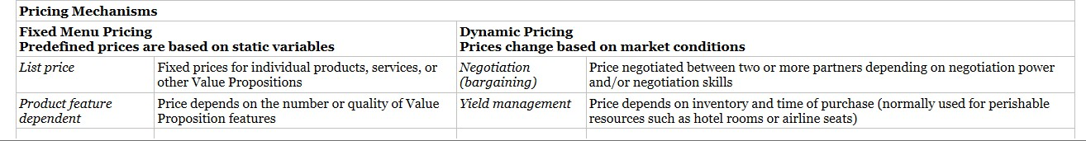
R$ Revenue Streams
Types of Pricing mechanism: fixes and dynamic pricing.
g-accelerator@global-business-school.org
+34 930 086 588

Slide 14
TEAM ACTIVITY · 15 MIN
Map Your Revenue Model
Revenue stream | Agritech example
Asset sale | Sensor kit sold to a farm
Subscription fee | Irrigation app, € per hectare per month
Usage fee | Drone spraying, € per hectare treated
Renting / leasing | Shared harvesting machinery
Brokerage fee | Marketplace for surplus fruit, % commission
Licensing | New seed variety licensed to nurseries
Advertising | Farmers’ community app sponsored by input suppliers
Your team
1 Choose your main and secondary revenue stream.
2 Write the price and the payment terms (cash, 30, 60, 90 days).
3 Post it on the board. Everyone gets 3 dots to vote for the most scalable model.
g-accelerator@global-business-school.org
+34 930 086 588
Notes:
Use a Padlet or a physical board with one column per revenue stream. Teams place a post-it with: product, stream, price, payment terms.
Debrief: which streams are recurring (subscription, usage, leasing) vs one-off (asset sale)? Recurring revenue lowers risk and the BEP (see RegaSmart bonus round). Payment terms written here feed directly into the treasury plan (collection days).

Slide 15
Competitor’s Analysis
In order to perform a competitor analysis, you need to identity at least three competitors in your market. For instance, if you are planning to open a restaurant, you need to focus on other 2/3 restaurants around you. It is better if they are in the same niche as you are, but other types of restaurants are competitors as well.
Give then yourself a grade for each category displayed in the following slide; try to do it in an honest way.
After that, try to research more about your competitors and give them a grade too.
In the end, the average of all the strengths and weaknesses will be displayed so that you can compare your results with your competitors. Try to identify parts of the project in which you are weak compared to others and see if you can improve them in some ways.
g-accelerator@global-business-school.org
+34 930 086 588

Slide 16
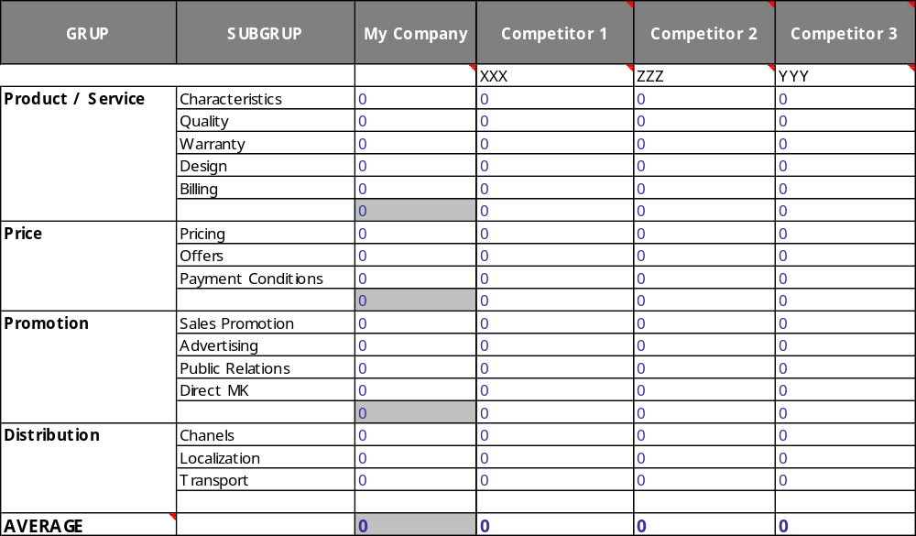
Competitor’s Analysis
g-accelerator@global-business-school.org
+34 930 086 588

Slide 17
TEAM ACTIVITY
EXERCISE
Do the competitors analysis and define your pricing strategy according to the analysis.
*Use Excel in Moodle Ocean Blue or Competitors Analysis
g-accelerator@global-business-school.org
+34 930 086 588

Slide 18
Incomes/Revenue Streams
STARTING WITH:
WHICH ONE IS YOUR MARKET?
TRY TO QUANTIFY YOUR CUSTOMER SEGMENTS:
  In order to research what is the size of a specific market and its evolution overtime, as well as obtain other important figures regarding the demographics of your customers, some of the most important Statistic websites are listed here:
  STATISTA https://www.statista.com/
  EUROSTAT https://ec.europa.eu/eurostat/home
  WTO WTO Stats
  IMF https://www.imf.org/en/Data
  OECD https://stats.oecd.org/
g-accelerator@global-business-school.org
+34 930 086 588

Slide 19
Incomes/Revenue Streams
USE GBSB / GBSB GLOBAL LIBRARY
g-accelerator@global-business-school.org
+34 930 086 588

Slide 20
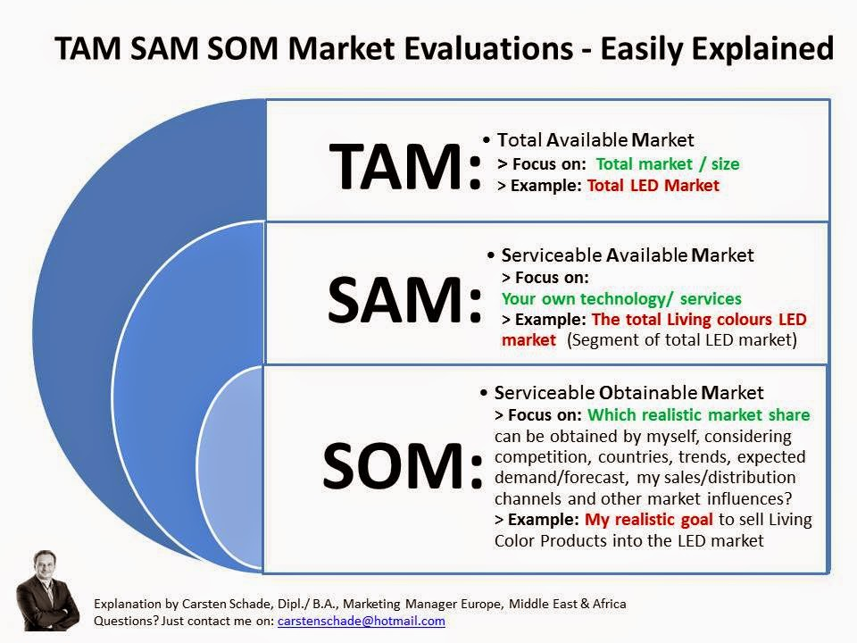
Calculate your TAM, SAM, SOM
g-accelerator@global-business-school.org
+34 930 086 588

Slide 21
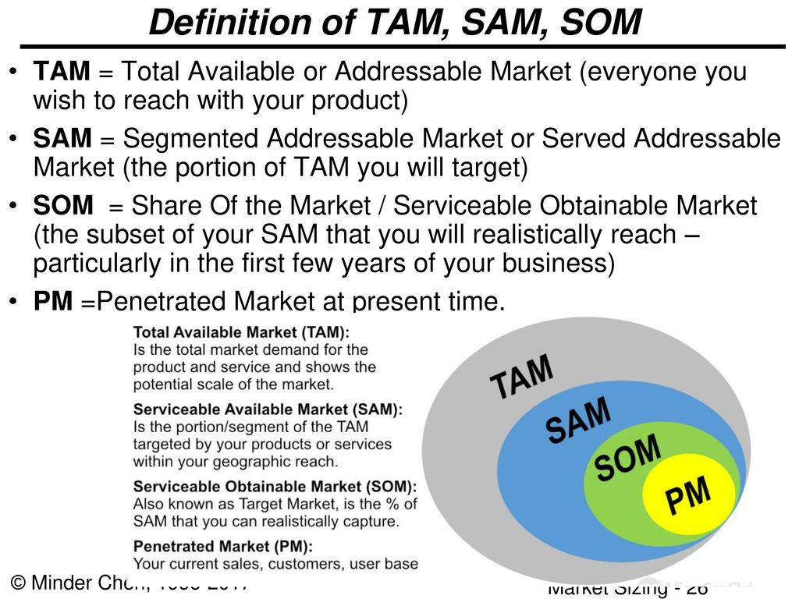
Calculate your TAM, SAM, SOM
g-accelerator@global-business-school.org
+34 930 086 588

Slide 22
Incomes/Revenue Streams
And then:
WHICH ONE IS YOUR MARKET SHARE?
  The market share is the percentage of a market covered by a specific company at a specific time.
  For instance, if the European car market has a size of 15 million cars sold in 2018 and the group XYZ sells 5 million cars in 2018 in that market, it has a market share of 5/15 = 0.33 = 33% in that specific year.
g-accelerator@global-business-school.org
+34 930 086 588

Slide 23
RESEARCH SPRINT · 20 MIN
Market Sizing Sprint
TAM RegaSmart: All irrigated fruit and nut farms in Spain
Sprint rules
10 min research your TAM, SAM, SOM
1 min pitch your funnel to the room
Others challenge: “What is your source?”
Agri data sources
Idescat · DACC (Generalitat) · MAPA: ESYRCE and Anuario de Estadística · Eurostat · FAOSTAT · GBSB Library
SAM RegaSmart: Farms in Catalonia and Aragon with drip irrigation, within reach of our sales team
SOM RegaSmart: Farms we can realistically win in 3 years through 5 partner cooperatives
g-accelerator@global-business-school.org
+34 930 086 588
Notes:
The RegaSmart funnel is an example of definitions only – no numbers are given on purpose: teams must find them.
Rules: every number must have a source and a year. SOM must be justified bottom-up (sales capacity x conversion), not just 'we will take 1%'.
Link to the next step: SOM / 3 years -> monthly units in the 'Revenues & Variable Costs' sheet of the template.

Slide 24
Revenue Streams in Digital Marketplaces
In MARKET PLACE business ideas, consider the traffic and conversion rates from your competitors:
  Traffic: compare with other platforms / on-line stores
  Conversion Ratio: 1-3%
  Average ticket: 20$ – 50$?
g-accelerator@global-business-school.org
+34 930 086 588

Slide 25
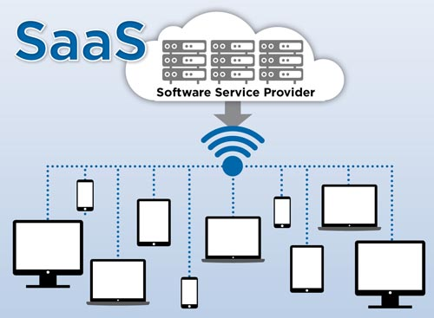
Revenues Indicators for SaaS Company
  SaaS company is a company that hosts an application and makes it available to customers over the internet.
  This infers that the software sits on a SaaS company's server while the user accesses it remotely.
g-accelerator@global-business-school.org
+34 930 086 588

Slide 26
Indicator – CLTV (Customer Lifetime Value)
Basic revenue metrics for SaaS:
CLTV is the positive cash flow the customer will generate while using the service of the Company minus the expenses to offer him the service.
For instance, the average customer of a company X uses the product for 3 years and over the period will provide 300 euro of revenues.
In order to offer the product, the Company will spend 200 euro during the period (depreciation, R&D, administrative costs…).
The CLTV is therefore 100 euro.
As long as the CLTV is higher than CAC the Company will make money.
g-accelerator@global-business-school.org
+34 930 086 588

Slide 27
Indicator – CLTV (Customer Lifetime Value)
In order to understand what is the CAC of the company, divide the marketing expenses of a given year for the number of new customers attracted during the period.
As long as the CLTV is higher than CAC the Company will make money.
Even though this metric isn’t exclusive to SaaS companies, it is widely used by SaaS because of its importance.
This ratio shows how much does it cost for the company to acquire a new customer.
It provides important insights on whether or not the company should further push to acquire new customers or if the cost is too high.
g-accelerator@global-business-school.org
+34 930 086 588

Slide 28
Indicator – Churn Rate
Churn rate the annual percentage rate at which customers stop subscribing to a service or employees leave a job..
For instance, a churn rate of 90% means that 90% of the customers stops using the Service even the year after they started using it.
This indicator is important as it indirectly shows how strong the service offered is and it is also a good indicator of the amount of competition that is present in that industry.
This indicator is also used to forecast the financial results the company will have and has also a big impact on the pricing and marketing strategy of the company.
g-accelerator@global-business-school.org
+34 930 086 588

Slide 29
QUIZ · 10 MIN
Quick Check: Unit Economics
RegaSmart, per farm
Kit margin: €500
App: €30 / month
Cost to serve the app: €10 / month
Average customer life: 3 years
Marketing budget: €24,000 per year, bringing 200 new farms
Q1 What is the CLTV of a farm?
A €500 B €1,220 C €1,580
Q2 What is the CAC?
A €120 B €240 C €1,200
Q3 If annual churn is 40%, the average customer life is…
A 1.5 years B 2.5 years C 4 years
g-accelerator@global-business-school.org
+34 930 086 588
Notes:
ANSWERS
Q1: B – CLTV = 500 + 36 months x (30 - 10) = 500 + 720 = €1,220. (C = 500 + 36 x 30 forgets the cost to serve; A forgets the subscription.)
Q2: A – CAC = 24,000 / 200 = €120.
CLTV / CAC = about 10x -> healthy (rule of thumb: above 3x).
Q3: B – average life = 1 / churn = 1 / 0.4 = 2.5 years. New CLTV = 500 + 30 x 20 = €1,100.
Ask: which of these metrics apply to your project?

Slide 30
Accountancy: The Basics of the Economic & Financial Plan
We are going to use a template (a tool) to create a complete financial simulation of the three first years of the life of the company.
You can use the proposed template or another as long as it includes:
  Investment and funding plan
  Profit and Losses
  Treasury Plan
Let’s now review the Financial template so that you can start to build your Economic-Financial Plan…
g-accelerator@global-business-school.org
+34 930 086 588

Slide 31
How the Template Works
1 · FILL IN
Orange tabs
– Investment Plan (start date + assets)
– Revenues & Variable Costs
– People’s Cost
– Fixed Costs
– Funding Strategy
2 · AUTOMATIC
Green tabs
– Depreciation (only check useful lives)
– Loans
– Grants
3 · RESULTS
Read them, don’t type in them
– P&L (+ 4 sensitivity levers)
– Cash flow (lowest cash + chart)
– Funding summary (funding gap diagnosis)
Golden rule
Fill in every input tab first. In P&L and Cash flow change only the yellow cells: levers, tax rate, payment days.
Add detail, then link it
Build any detail table you need and link its total to the summary with = (see the R&D example).
g-accelerator@global-business-school.org
+34 930 086 588
Notes:
Open the Excel template live and start from the 'Instructions' tab: order of the tabs, colours (yellow = input, green numbers = linked) and the golden rule.
Show the R&D example at the bottom of Investment Plan (rows 76-90): items with amount and date feed the R&D line automatically, and a check says OK.
Then show where the results appear: P&L (sensitivity levers C4:F4), Cash flow (lowest cash in row 81 + chart from row 87) and the FUNDING SUMMARY at the bottom of Funding Strategy.
Tip: the template works in any Excel language (Catalan, Spanish, English).

Slide 32
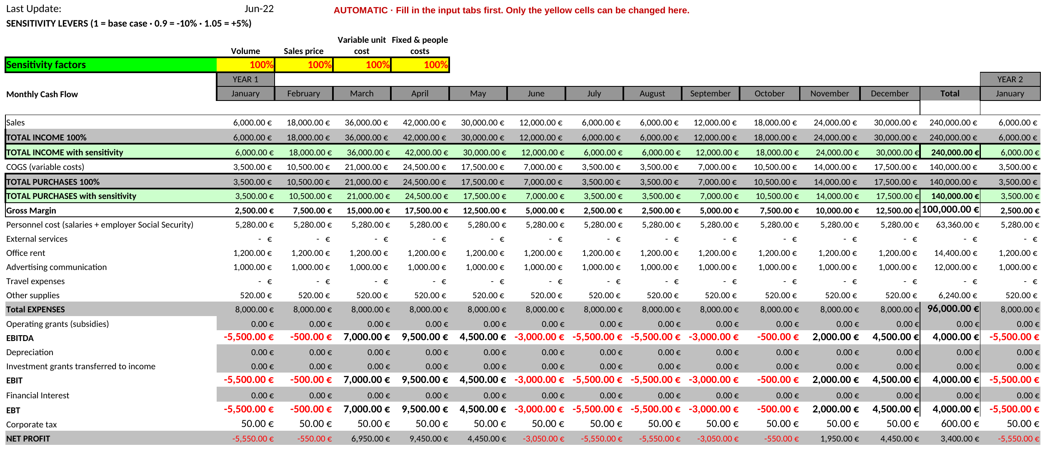
P&L in the Template
Notes:
Screenshot of the P&L tab with the RegaSmart example (year 1). Point out: the 4 sensitivity levers (yellow), the new lines for grants, depreciation and interest (all automatic), and the corporate tax calculated on the annual result.

Slide 33
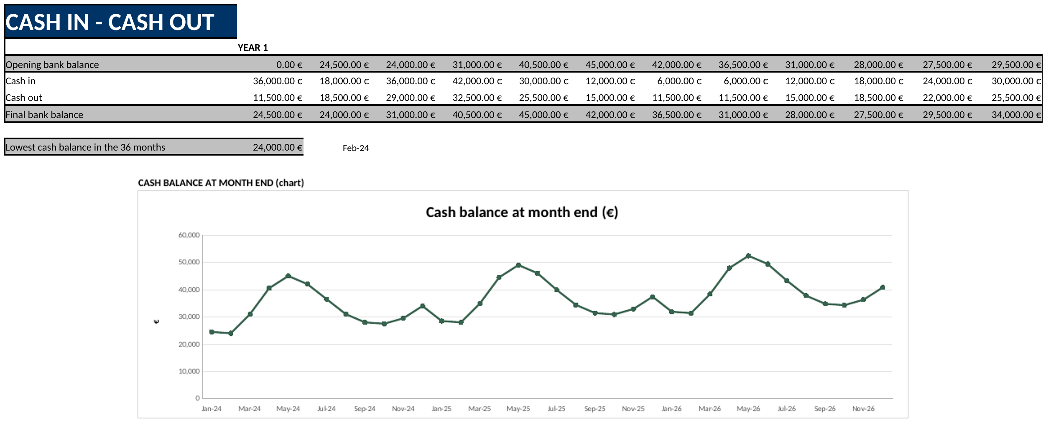
Treasury Plan in the Template
Notes:
Screenshot of the Cash flow tab with the RegaSmart example (cash sales). Point out: final bank balance per month, the lowest cash balance (row 81) and the chart. Then change collection days (C4) to 90 live and watch the chart dip below zero.

Slide 34
TEAM ACTIVITY · 1H45
Practice First: RegaSmart
Open the Excel template, tab ‘RegaSmart Case’: data step by step + checkpoints to verify your results.
Level 1 · Base case 45’
Steps 1–6: start date, kits per month, price and unit cost, two founders, fixed costs, founders’ equity.
Checkpoint: EBITDA year 1 = +€4,000 · lowest cash €24,000 (Feb-27).
Challenge: collection at 90 days → May-27 = –€63,000, as in Part 1.
Level 2 · Complete plan 60’
Steps 7–14: app subscription (detail row + link), technician, investments, R&D detail, loan, grants, business angel, 30-day terms.
Checkpoint: net profit year 1 = €28,143 · lowest cash €13,590 (Mar-27).
Then · Your own plan open
Same template, your numbers: follow the Instructions tab and the same order of tabs.
Every hypothesis with a source.
Bring it to your one-to-one session.
g-accelerator@global-business-school.org
+34 930 086 588
Notes:
Files: 'RegaSmart_Case_-_Team_Template.xlsx' for the teams (empty template + 'RegaSmart Case' tab) and 'RegaSmart_Case_-_Solved.xlsx' for the facilitator. If a checkpoint does not match, the team looks for the mistake before going on. Typical mistakes: typing in the Total columns, forgetting the units of row 15, dates outside the 36 months (the Funding summary flags them), investment grant without years. Level 1 challenge: why is the lowest cash at 90 days in May 2028 (–€85,700) and not in May 2027? Because sales grow: more money is pending collection. After the practice, teams start their own plan in a clean copy of the template.

Slide 35
WRAP-UP · 10 MIN
Exit Ticket & Next Steps
3 things I learned today
Bring to your one-to-one session
☐ Investment plan completed
☐ Funding sources with amounts and dates
☐ Price and volume hypotheses, each with a source
☐ Collection and payment days set in the treasury plan
☐ BEP calculated (units and €)
☐ Lowest-cash month identified, and how you finance it
☐ At least 2 sensitivity scenarios tested
☐ Funding summary: all checks OK, no funding gap
2 doubts I still have
1 number in my plan I must review
g-accelerator@global-business-school.org
+34 930 086 588
Notes:
Collect the exit tickets on post-its or in a Mentimeter open question. Re-run the warm-up poll question: 'Before your first sale, how many months can your project run with the money you have?' – now they should answer with a number from their treasury plan: the month the cash balance would turn negative without new funding.
Use the doubts to prepare the one-to-one sessions.

Slide 36
Thank you!
Subvencionat pel Departament d'Empresa (Programa
Primer) i amb el cofinançament del Fons Social Europeu Plus
g-accelerator@global-business-school.org
+34 930 086 588

