Slide 1
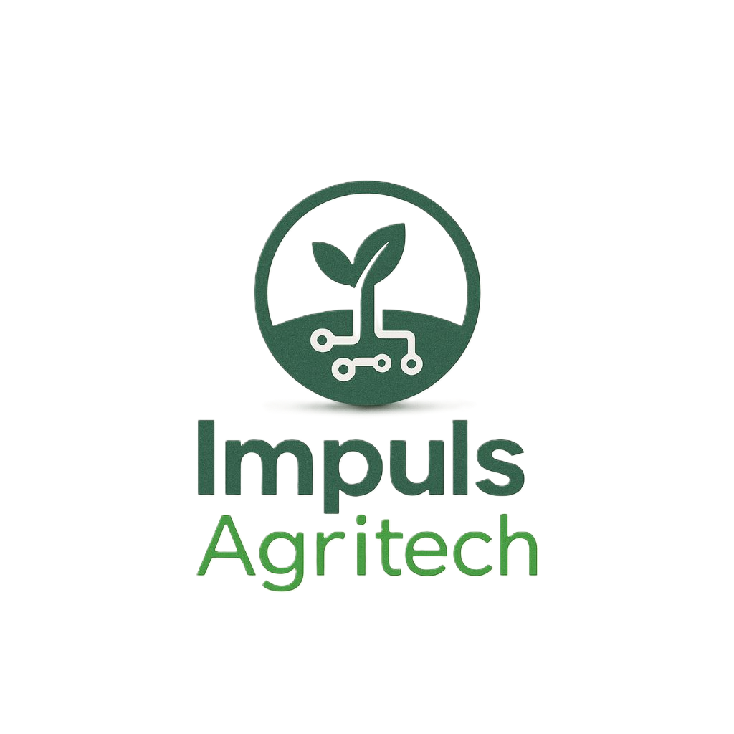
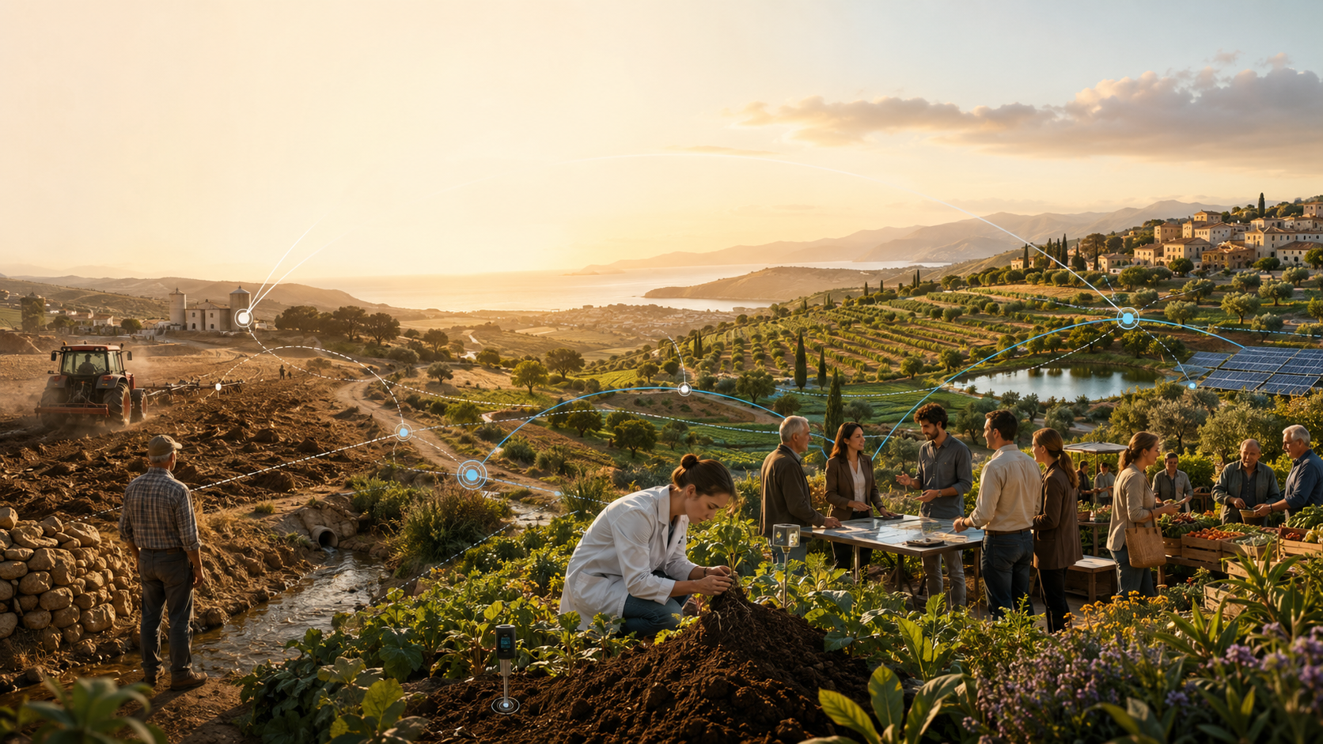

Impuls AgriTech Call 2026
Technology at the service of
systemic transformation
- Jess Padilla (IRTA) -
Session 2 · Online · 17:00–18:30
Session 2 of 2 · From Innovation ecosystems
for agri-food transformation
Subvencionat pel Departament d'Empresa (Programa Primer) i amb el cofinançament del Fons Social
Europeu Plus

Slide 2
CONTINUITY
From the system challenge to the ecosystem response
Session 1
Bridge
Session 2
Food-system challenges are complex. Technology matters, but technology alone does not transform systems.
A startup is not only a product. It is a hypothesis about how a practice could change.
Innovation ecosystems explain who must move together for adoption to happen.
From “what needs to change?” to “who needs to move, together, for change to happen?”
Impuls AgriTech 2026 · Technology at the service of systemic transformation · Session 2
Session 2
Notes:
Timing: 3 min.
Let me reconnect with the first session. We ended with a simple idea: food-system transformation is not linear. A startup may have a good technology, but it still needs farmers to trust it, cooperatives or advisors to introduce it, data and infrastructure to support it, regulators to accept it, buyers to value it, and investors to understand the adoption cycle.
That means that the key question changes. In session one, we asked: what needs to change in the food system? Today we ask: who needs to move, together, so that this change can actually happen?
This is why the ecosystem perspective matters. It helps us move from abstract ambition to practical adoption. It also helps avoid the feeling that a startup must solve everything alone. You do not need to control the whole system. But you do need to understand which parts of the ecosystem are essential for your next step.

Slide 3
ORIENTATION
How this session is organised
1 Core ecosystem lens
What an innovation ecosystem is — and why it is not only a stakeholder list.
2 Agri-food adoption
Why evidence, timing, risk, regulation and trust make adoption sector-specific.
3 Spanish AgrifoodTech ecosystem
Who the main actors are, what functions they provide and where the gaps remain.
4 From bottleneck to partner
How to decide where to go next: pilot, validation, regulation, first customer or finance.
No in-class exercise: today’s goal is to make the final task more actionable and ecosystem-specific.
Impuls AgriTech 2026 · Technology at the service of systemic transformation · Session 2
Session 2
Notes:
Timing: 3 min.
The session has four blocks. First, we will define what an innovation ecosystem is and what it is not. This is important because the term ecosystem can be too elastic. I want you to leave with a more operational definition.
Second, we will look at the agri-food sector specifically. Agri-food innovation has particular adoption conditions: field cycles, risk, trust, regulation, margins, standards, data fragmentation and strong territorial dynamics.
Third, we will look at open innovation as the mechanism through which ecosystems move. This includes pilots, living labs, operational groups, research partnerships, corporate-startup collaboration and public programmes.
Finally, we will connect the theory to the student task. We will not do the exercise during class. Instead, at the end I will explain how Phase 1 from the first session and Phase 2 from today fit together. Phase 1 helps you describe the transition your project supports. Phase 2 helps you identify who needs to move, what is blocking adoption, and what evidence would make the next step credible.

Slide 4
DEFINITION
An ecosystem is not a buzzword
An innovation ecosystem is the alignment problem around a value proposition.
Actors
Activities
Links
Who must participate for the value proposition to materialise?
What does each actor need to do, provide or change?
What dependencies, incentives and sequencing connect them?
A stakeholder list describes who is around you. An ecosystem map explains why they must align.
Source lens: Adner (2017), “Ecosystem as Structure”.
Impuls AgriTech 2026 · Technology at the service of systemic transformation · Session 2
Session 2
Notes:
Timing: 5 min.
Let us start with a more precise definition. In strategy literature, Ron Adner describes an ecosystem as an alignment structure: a multilateral set of partners that need to interact for a value proposition to materialise. I like this definition because it is practical.
It means an ecosystem is not simply everyone who might be interested. It is the structure of interdependence around a value proposition. If your value proposition requires a farmer, a cooperative, a data provider, a certification body and a buyer to act in a certain way, then the ecosystem is that alignment problem.
This is very different from saying: here is a list of stakeholders. A stakeholder list is descriptive. An ecosystem map should be strategic. It should tell you who must do what, in what sequence, and what dependency exists between them.
For example, a soil data startup may need sensors, farmers, agronomists, data standards, researchers, carbon protocols, buyers and public incentives. If one of those pieces is missing or misaligned, the value proposition may not materialise, even if the technology works. That is ecosystem strategy.

Slide 5
VOCABULARY
Four concepts that often get confused
Market
Who pays?
Exchange and price
Value chain
Where does value flow?
Sequence of activities
Cluster
What regional assets exist?
Geographic concentration
Entrepreneurial ecosystem
What helps ventures emerge?
Talent, capital, networks
Innovation ecosystem
What must align for adoption?
Interdependent complements
Your project may need all five lenses, but the ecosystem lens explains adoption interdependence.
Impuls AgriTech 2026 · Technology at the service of systemic transformation · Session 2
Session 2
Notes:
Timing: 4 min.
Before going deeper, it is useful to separate four concepts. A market is where exchange happens: who buys, who sells, at what price and under which conditions. A value chain is the sequence of activities through which a product or service moves from inputs to users. A cluster is a geographic concentration of firms, suppliers, institutions and support organisations in a related field.
An entrepreneurial ecosystem is the environment that enables startups and scaleups to emerge: talent, capital, culture, networks, leadership, knowledge and support services. An innovation ecosystem is slightly different. It focuses on the interdependent actors and complements required to make a specific innovation work and be adopted.
Your project may involve all four. You need a market, you operate in a value chain, you may benefit from a regional cluster or entrepreneurial ecosystem, and you need an innovation ecosystem to validate and scale your solution.
The distinction matters because each concept answers a different question. The market asks: who pays? The value chain asks: where does value flow? The cluster asks: what regional assets exist? The ecosystem asks: what must be aligned for adoption to happen?

Slide 6
INNOVATION ECOSYSTEM
Innovation ecosystems are about adoption conditions
Access
Evidence
Trust
Legitimacy
real users and settings
proof in context
credible intermediaries
standards and public acceptance
Channel
Infrastructure
Capital
Rules
route to market
data, logistics, testbeds
funding the adoption gap
regulation and incentives
The core question: which condition is missing for adoption right now?
Impuls AgriTech 2026 · Technology at the service of systemic transformation · Session 2
Session 2
Notes:
Timing: 4 min.
If the entrepreneurial ecosystem helps startups emerge, the innovation ecosystem helps solutions become adopted. For your projects, the key question is not only whether there is an accelerator, funding or a mentor. The question is whether the actors and complements needed for adoption are present and aligned.
In agri-food, adoption conditions may include access to fields, trusted farmers, agronomic evidence, regulatory interpretation, food safety expertise, data access, distribution channels, cooperative endorsement, buyer demand or public incentives.
This is why two projects with similar technology can have very different outcomes. One may find a strong lead user, a credible validation partner and a clear buyer. Another may have the same technical quality but no access, no legitimacy and no pathway to market.
So when you think about your ecosystem, ask: what condition is missing for adoption? Is it knowledge? evidence? trust? access? legitimacy? finance? regulation? channel? This is the vocabulary we will use today.

Slide 7
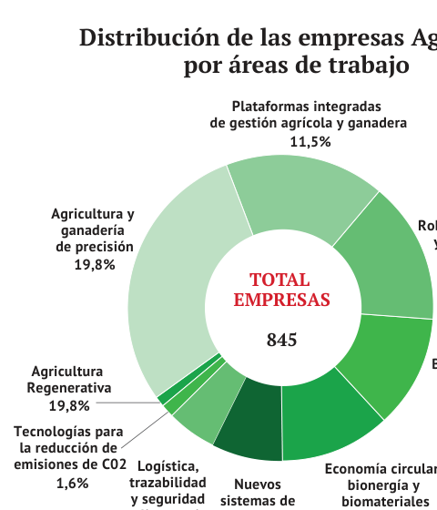
AGRITECH SNAPSHOT
Agritech in Spain: where companies are creating value
845 companies mapped
The ICEX agritech ecosystem mapping shows a large and diversified landscape.
Most visible areas
Precision agriculture and regenerative agriculture lead the map, followed by integrated management platforms and robotics.
What this tells us
Agritech is not only software. The ecosystem combines digital, hardware, biological and circular solutions.
Implication for the cohort
Different project types will need different validation partners, channels and scaling paths.
A strong ecosystem lens starts by recognising the diversity of solutions already operating in the sector.
Source: Alimarket (2025), Informe ecosistema Agritech, based on Mapeo del ecosistema Agrotech ICEX.
Impuls AgriTech 2026 · Technology at the service of systemic transformation · Session 2
Session 2
Notes:
Timing: 5 min.
The agricultural innovation systems approach is very useful for this sector. The World Bank defines an innovation system as a network of organisations, enterprises and individuals focused on bringing new products, processes and forms of organisation into economic use, together with the institutions and policies that affect their behaviour and performance.
OECD work on agricultural innovation systems also emphasises that these systems matter for economic, environmental and social performance in the agri-food sector. This is a key idea: agricultural innovation is not only research and development. It is the interaction between research, advisory services, farmers, companies, public policy, finance, education, standards and markets.
In Europe, you will often hear the term AKIS: Agricultural Knowledge and Innovation Systems. The point is similar: knowledge must circulate between those who produce knowledge, those who translate it, and those who use it in practice.
For startups, this has a direct implication. A technology that is not connected to knowledge flows will struggle. You need to know who translates your innovation into practice: an advisor, a cooperative, a processor, a distributor, a public programme, a living lab, or a lead farmer.

Slide 8
SECTOR SPECIFICS
Why agri-food ecosystems are harder than generic tech ecosystems
Living systems
Seasonal cycles
Risk + margins
biology, soil, water and climate
timing and crop windows
adoption risk is real
Mediated trust
Regulation + standards
Fragmented data
advisors and cooperatives matter
claims, safety and compliance
assets, platforms and contexts
In agri-food, the ecosystem is part of the business model.
Impuls AgriTech 2026 · Technology at the service of systemic transformation · Session 2
Session 2
Notes:
Timing: 5 min.
Agri-food innovation has sector-specific frictions. First, it deals with living systems. Soil, plants, animals, water and climate have biological rhythms. You cannot always validate impact in a two-week sprint.
Second, many decisions are seasonal. If you miss the right moment in a crop cycle, the next opportunity may be months away. Third, margins can be tight and risk aversion is rational. A farmer may not adopt a promising innovation if failure threatens yield, cash flow or reputation.
Fourth, trust is mediated. Farmers often rely on advisors, cooperatives, neighbours, input suppliers, processors or technical references. Fifth, regulation and standards matter, especially for bioinputs, food safety, claims, traceability and data. Sixth, data and infrastructure are fragmented across farms, machines, platforms, cooperatives and value chains.
This is why the ecosystem perspective is not optional in agri-food. It is not a nice add-on. It is part of the business model. Adoption depends on the alignment of biology, economics, trust, policy and infrastructure.

Slide 9
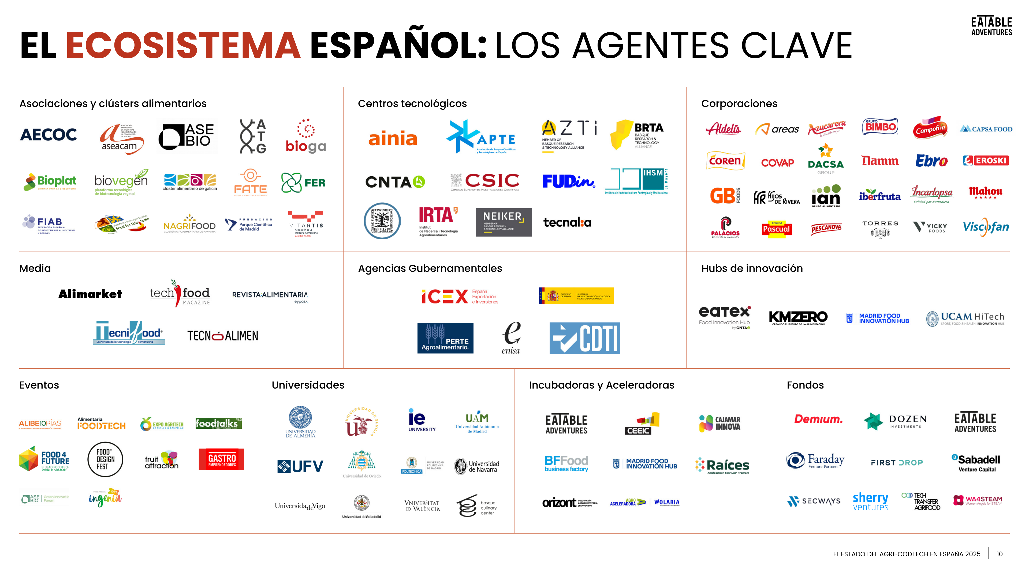
SPANISH ECOSYSTEM
Who makes the Spanish AgrifoodTech ecosystem move?
Production and market actors
farmers, cooperatives, food companies, processors, retailers and distributors create real adoption contexts and demand signals.
Knowledge and validation actors
universities, research centres and technology centres provide evidence, credibility and test capacity.
Public and financial actors
ministries, agencies, ENISA, CDTI, ICEX and investors reduce risk and finance the next milestone.
Intermediaries and infrastructures
clusters, hubs, accelerators, associations, pilot plants and living labs connect actors and structure collaboration.
Do not map logos for the sake of it. Map which actor can unlock access, evidence, legitimacy or a first customer.
Source: Eatable Adventures (2025), El estado del AgrifoodTech en España 2025.
Impuls AgriTech 2026 · Technology at the service of systemic transformation · Session 2
Session 2

Slide 10
STAKEHOLDER MAP
All ecosystem stakeholders at a glance
This view shows the breadth of the Spanish AgrifoodTech ecosystem: from technology centres and corporates to public agencies, hubs, universities, investors and flagship events.
Use this map as orientation, not as a contact list: identify which stakeholder type can unlock access, evidence, legitimacy or a first customer.
Source: Eatable Adventures (2025), El estado del AgrifoodTech en España 2025.
Impuls AgriTech 2026 · Technology at the service of systemic transformation · Session 2
Session 2

Slide 11
ACTOR FUNCTIONS
Different actors play different ecosystem functions
Problem owners
experience the problem and define whether it is relevant
Users and adopters
must change a routine, decision or process
Customers and buyers
pay for the solution or create the demand signal
Validators
generate technical, agronomic, industrial or scientific evidence
Intermediaries
connect actors, translate needs and structure collaboration
Risk reducers
provide grants, regulation, test environments or shared infrastructure
Channels and scalers
provide access to users, procurement, distribution and international markets
Legitimacy builders
provide credibility through standards, recognised evidence or institutional endorsement
The critical actor is not always the customer; it is the actor that makes adoption credible.
Impuls AgriTech 2026 · Technology at the service of systemic transformation · Session 2
Session 2

Slide 12
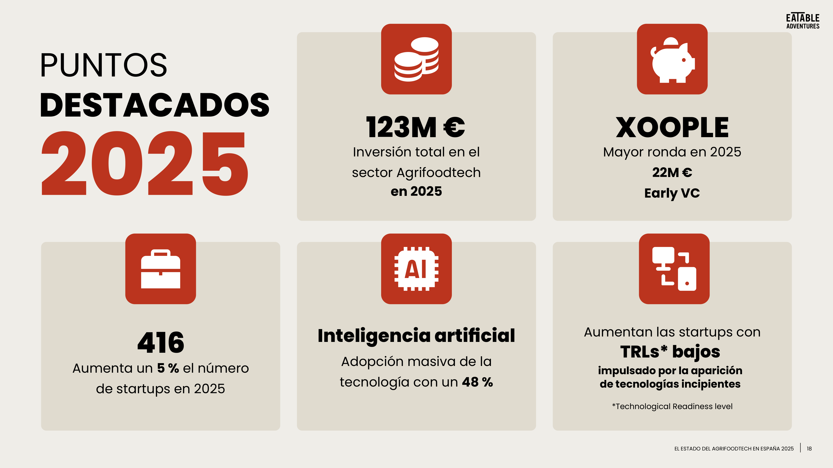
SPANISH CONTEXT
Spain: ecosystem scale, startup needs and adoption gaps
15% limited startup connection with universities or technology centres
38% startups perceiving adequate support from the food industry
90% startups asking for more industry-led pilots and co-development
93% startups asking for simpler access to public funding
Catalonia is the 2nd autonomous region by number of agritech companies (126), after Andalusia (181).
The challenge is not visibility alone — it is turning contacts into validation, procurement and scale.
Sources: Eatable Adventures (2025), El estado del AgrifoodTech en España 2025; Alimarket (2025), Informe ecosistema Agritech.
Impuls AgriTech 2026 · Technology at the service of systemic transformation · Session 2
Session 2

Slide 13
OPEN INNOVATION
Open innovation: how ecosystems actually move
Outside-in
Inside-out
Coupled
Bring in knowledge, data, users, infrastructure or validation from partners.
Let external actors use your technology through licensing, integration or channels.
Co-develop, test and scale with farmers, research, corporates and public actors.
Open innovation is not networking. It is structured exchange of knowledge, resources, risk and evidence.
Impuls AgriTech 2026 · Technology at the service of systemic transformation · Session 2
Session 2
Notes:
Timing: 5 min.
Open innovation is one of the mechanisms through which ecosystems move. In a closed innovation model, the organisation tries to invent, develop and commercialise mostly internally. In open innovation, knowledge, technology, data, users, infrastructure and capabilities can move across organisational boundaries.
For startups, open innovation can be outside-in: you bring in knowledge, infrastructure, data, users or validation from partners. It can be inside-out: your technology is used by others through licensing, integration, channel partnerships or spin-offs. And it can be coupled: several actors co-develop, test and scale something together.
In agri-food, the coupled mode is especially relevant. A startup may need a farmer group to test, a research centre to validate, a cooperative to recruit users, a food company to create demand, and a public actor to align incentives or regulation.
So open innovation is not networking for its own sake. It is structured interdependence: who contributes what, who learns what, who takes which risk, and what evidence is created for the next decision.

Slide 14
OPEN INNOVATION FORMATS
Living labs, testbeds, sandboxes and Operational Groups
Living labs
User-centred open innovation ecosystems in real-life settings; useful for co-creation and testing.
Testbeds / sandboxes
Controlled enough to learn, real enough to reveal adoption barriers; useful for technical, industrial or regulatory uncertainty.
EIP-AGRI Operational Groups
Complementary practical, scientific, technical and organisational knowledge around a need from practice.
Source lens: ENoLL; EU CAP Network EIP-AGRI Operational Groups.
Impuls AgriTech 2026 · Technology at the service of systemic transformation · Session 2
Session 2
Notes:
Timing: 5 min.
Living labs and testbeds are useful because they create spaces where innovation can be tested in real-life contexts with users and multiple actors. The European Network of Living Labs defines living labs as user-centred open innovation ecosystems based on systematic user co-creation, integrating research and innovation in real-life communities and settings.
For agri-food, this is important because many innovations cannot be validated only in the lab or in a slide deck. They need field conditions, farm routines, real data, real weather, real decision-making and real trade-offs.
EIP-AGRI Operational Groups are also a good European reference. They bring together people with complementary practical, scientific, technical and organisational knowledge to co-create solutions for agriculture, forestry and rural areas. The EU CAP Network stresses that these solutions should respond to needs from practice and be ready for practical application.
For your projects, the lesson is clear: the right test environment is not only a place. It is a coalition designed to produce credible learning.

Slide 15
STARTUP NAVIGATION
Where should a startup go next?
Field validation
farmers · cooperatives · advisors · research centres
Ask for a seasonal pilot with users, context and agreed metrics.
Industrial validation
food companies · pilot plants · processors · technology centres
Ask for a production trial covering safety, process, cost and scalability.
Regulatory uncertainty
public administrations · sandboxes · standards organisations
Ask for a classification, claims pathway or compliance roadmap.
First customer
corporates · processors · retailers · procurement teams
Ask for a paid proof of concept with a decision point.
Financing the next milestone
ENISA · CDTI · regional agencies · specialist investors · CVC
Ask for funding linked to a concrete validation or commercial milestone.
Internationalisation
ICEX · clusters · trade fairs · international partners
Ask for access to a specific market, segment or validation environment.
Choose partners by the adoption function they unlock — not by visibility or logo value.
Impuls AgriTech 2026 · Technology at the service of systemic transformation · Session 2
Session 2

Slide 16
ADOPTION ASSETS
Evidence, trust and legitimacy are ecosystem assets
Evidence
Trust
Legitimacy
Does it work in this context?
Do users believe the change is safe and useful?
Is it acceptable under rules, standards and norms?
research centres · field data · metrics
farmers · advisors · cooperatives
public actors · buyers · standards bodies
A pilot should produce the asset that unlocks the next adoption step.
Impuls AgriTech 2026 · Technology at the service of systemic transformation · Session 2
Session 2
Notes:
Timing: 4 min.
In many sectors, a startup can show a demo and move quickly to adoption. In agri-food, that is often not enough. Evidence, trust and legitimacy are ecosystem assets.
Evidence answers the question: does it work in this context? Trust answers the question: do I believe the actor who is asking me to change? Legitimacy answers the question: is this acceptable according to rules, standards, buyers, public expectations and professional norms?
These three assets are produced by different actors. Researchers can help with evidence. Farmers and advisors can help with trust. Public actors, standards bodies, buyers or recognised institutions can help with legitimacy. A strong ecosystem strategy understands which asset is missing.
This is why a pilot should not only test technology. It should produce the type of evidence, trust or legitimacy that unlocks the next adoption step.

Slide 17
ECOSYSTEM FAILURES
Where ecosystem strategies fail
Missing complements
Weak incentives
Low trust
data · standards · finance · channel
the changer does not capture value
credible actors are absent
Regulatory ambiguity
Pilot theatre
No orchestrator
unclear claims or classification
demo without decision
interdependencies remain unmanaged
When a project feels stuck, diagnose the ecosystem failure — not only the product feature.
Impuls AgriTech 2026 · Technology at the service of systemic transformation · Session 2
Session 2
Notes:
Timing: 5 min.
Ecosystem strategies fail in predictable ways. One failure is missing complements: the product works, but the data, standards, services, maintenance, finance or channels are not in place. Another failure is weak incentives: the actor who must change behaviour does not capture enough value.
A third failure is lack of trust. The technology may be credible to the startup but not to the farmer, cooperative, buyer or regulator. A fourth failure is regulatory ambiguity: no one knows exactly how to classify the innovation, what claims are acceptable, or which pathway is required.
A fifth failure is pilot theatre: many conversations, mentoring sessions or demos, but no clear decision, no success evidence, no buyer and no next step. A sixth failure is absence of an orchestrator: no actor takes responsibility for coordinating the interdependencies.
When your project feels stuck, the useful question is not only what feature is missing. Ask which ecosystem failure is blocking adoption.

Slide 18
ECOSYSTEM COORDINATION
Intermediaries and orchestrators reduce friction
Connect
actors that do not naturally meet
Translate
science, practice, policy and market language
Broker
trust, access and credibility
Structure
pilots, evidence and next decisions
Aggregate
demand, users or complementary assets
The right intermediary can reduce time-to-trust and reveal the real adoption barrier.
Source lens: World Bank AIS sourcebook; innovation brokering and co-design.
Impuls AgriTech 2026 · Technology at the service of systemic transformation · Session 2
Session 2
Notes:
Timing: 4 min.
Ecosystems do not coordinate themselves automatically. Intermediaries and orchestrators reduce friction. They connect actors, translate languages, create trust, structure pilots, broker knowledge, aggregate demand and sometimes provide neutral credibility.
In agri-food, intermediaries can be cooperatives, clusters, accelerators, incubators, research and technology centres, advisory services, public agencies, sector associations, living labs or innovation brokers. The World Bank agricultural innovation systems material highlights that imperfect interaction between farmers, researchers, extension, service providers, local government and agribusiness often reflects a lack of capacities, structures and incentives to interact effectively.
For a startup, this means that choosing an intermediary can be as strategic as choosing a customer. The right intermediary can reduce time to trust. It can also help identify the real adoption barrier before you spend months building the wrong pilot.
So do not ask only: who could buy this? Ask also: who can broker the relationship that makes adoption credible?

Slide 19
LOCAL CONTEXT
Use Impuls AgriTech as a broker
1 · Diagnose
Name the adoption bottleneck: evidence, trust, users, data, rules, channel, capital or legitimacy.
2 · Ask for one function
Do not ask for “contacts”. Ask for access, validation, a test site, a buyer conversation or regulatory clarity.
3 · Structure the test
Define a small collaboration with scope, metrics, timeline and roles.
4 · Close the loop
Agree what evidence will trigger the next decision: continue, pay, invest, regulate or scale.
Move from visibility → access → collaboration → evidence → next decision.
Source lens: Spanish AgrifoodTech ecosystem gaps and startup needs, Eatable Adventures (2025).
Impuls AgriTech 2026 · Technology at the service of systemic transformation · Session 2
Session 2
Notes:
Timing: 4 min.
Let us connect this to the Spanish and Catalan context. Spain has a strong entrepreneurial landscape with events, communities, clusters, incubators, public agencies and investors. OECD analysis of Spain's entrepreneurial ecosystem highlights that these actors provide important networking and matchmaking functions.
But the same analysis also points to a challenge that is very relevant for startups: connections need to become substantive collaborations, not only introductions. In particular, Spain would benefit from more open innovation with large corporates acting as first customers and providing opportunities to pilot and commercialise innovative products and services.
For your projects, this is important. The objective is not to meet everyone. The objective is to move from contact to structured collaboration: a partner, a context, a hypothesis, evidence and a next decision.
That is why programmes like this should not only give you visibility. They should help you identify which ecosystem actor can unlock the next learning step.

Slide 20
TASK CONNECTION
Phase 2 · Ecosystem Lens
1
Actors
2
Main bottleneck
Which 3 actors need to be involved for adoption to happen?
What ecosystem condition is missing: trust, evidence, users, data, rules, capital, channel, legitimacy or integration?
3
Critical partner
4
Evidence / pilot
Which actor could unlock the bottleneck, and what function would they provide?
What evidence or small 60-90 day experiment would make the next step credible?
You complete this after Session 2. Today we explain the logic behind each question.
Impuls AgriTech 2026 · Technology at the service of systemic transformation · Session 2
Session 2
Notes:
Timing: 4 min.
This slide connects the theory of today with Phase 2 of the student task. We are not going to complete the task during the session. The objective here is simply to make sure that the exercise makes sense.
Phase 1, which connects to the first session, asks you to describe the transition your project supports using Three Horizons: H1, H3, H2 and the risk of capture. Phase 2 adds the ecosystem lens. It asks: which actors need to be involved for adoption to happen? What is the main ecosystem bottleneck? Which actor could unlock it? And what evidence or small pilot could make the next step credible?
The most important idea is that adoption is not only a customer decision. It depends on the ecosystem around the project: trust, evidence, data, access to users, regulation, capital, channels, legitimacy and integration.
So when you complete this phase after the session, do not write a generic stakeholder list. Identify the few actors that actually make adoption possible, and the bottleneck that is most important right now.

Slide 21
PARTNERSHIP LOGIC
Turn the bottleneck into a partnership hypothesis
We need [actor] because they provide [ecosystem function], to test [adoption barrier], and generate [evidence] for [next decision].
Example: digital irrigation
Example: bio-input
We need a cooperative advisor because they provide trusted grower access, to test whether recommendations change irrigation decisions, and generate evidence for a paid pilot.
We need a research centre because it provides credible validation, to test agronomic performance across two soil contexts, and generate evidence for distributors.
This formula is useful for emails, pilot proposals, mentor meetings and pitch refinement.
Impuls AgriTech 2026 · Technology at the service of systemic transformation · Session 2
Session 2
Notes:
Timing: 4 min.
This formula helps translate the ecosystem lens into a concrete partnership hypothesis. It is useful when completing Phase 2 of the task, but also for emails, pilot proposals, mentor conversations and pitch refinement.
A useful sentence is: we need this actor because they provide this ecosystem function, to test this adoption barrier, and generate this evidence for this next decision.
This is more precise than saying: we need partners. Everyone needs partners. The strategic question is which partner, why now, and what learning they make possible.
For example: we need a cooperative because it provides trusted access to growers, to test whether our dashboard changes irrigation decisions, and to generate evidence for a first paid pilot. Or: we need a research centre because it provides credible validation, to test agronomic performance across two soil conditions, and to generate evidence for distributors.
This is the bridge between ecosystem theory and project action.

Slide 22
CLOSING
Key takeaways
1
An ecosystem is the interdependence around adoption, not a stakeholder list.
2
Entrepreneurial ecosystems help ventures emerge; innovation ecosystems help solutions become adopted.
3
Agri-food adoption depends on evidence, trust, regulation, timing, intermediaries and context.
4
Open innovation is how actors share knowledge, resources, risk and legitimacy.
5
The final task connects your Three Horizons transition with the ecosystem conditions needed for adoption.
Technology becomes transformative when the ecosystem around it moves in the right direction.
Impuls AgriTech 2026 · Technology at the service of systemic transformation · Session 2
Session 2
Notes:
Timing: 3 min.
Let me close the content with five takeaways. First, an ecosystem is not a buzzword. It is the structure of interdependence around a value proposition and adoption pathway.
Second, entrepreneurial ecosystems help ventures emerge, but innovation ecosystems help specific solutions become adopted. Third, agri-food innovation is ecosystem-dependent because it involves living systems, seasonal cycles, trust, evidence, regulation, margins and fragmented infrastructure.
Fourth, open innovation is the mechanism that allows actors to share knowledge, access, evidence, risk and legitimacy. Fifth, the final task is designed to connect both sessions: Session 1 helps you describe the transition your project supports, and Session 2 helps you identify the ecosystem conditions needed for adoption.
If you remember one sentence, remember this: technology becomes transformative when the ecosystem around it moves in the right direction.

Slide 23

Thank you!
Subvencionat pel Departament d'Empresa (Programa Primer) i amb el cofinançament del Fons Social Europeu Plus
impuls.agritech@gbsb.global
+34 930 086 588

