Slide 1

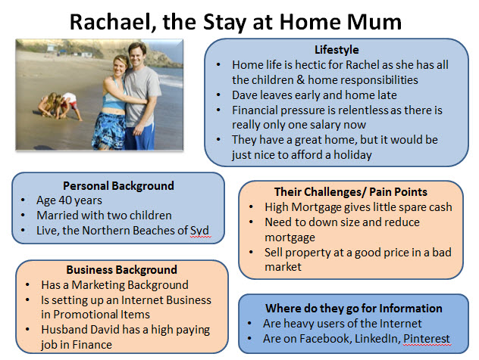
Opportunity Analysis
Let’s go to
the BUYER PERSONA description….
B2C Example

Slide 2
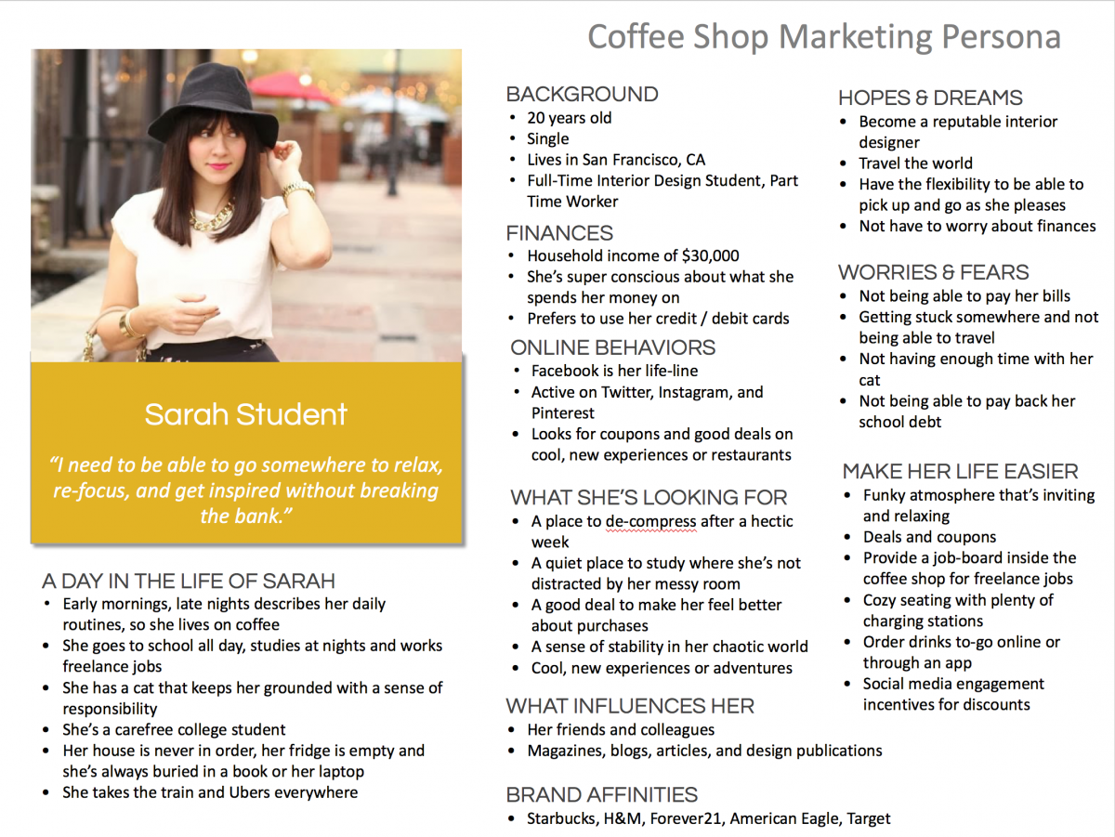
Opportunity
Analysis
B2C Example

Slide 3

Opportunity
Analysis
G-Accelerator Buyer Persona
B2C Example
BACKGROUND:
Linda 27 years old
French
Currently living in BCN
Full time Student at GBSB Global Business School’s Master in Business Innovation
She speaks English and French and is taking Spanish classes
FINANCE:
Doesn't have a direct income, her parents are paying her studies and living in BCN
She would like to start a part time job to get her living cost abroad covered to stay here after her studies
LIFESTYLE:
She likes hanging out with her friends and discover new places in Catalonia
She is passionate about travel and cultural activities
She is actively part of Meet ups group for expath in BCN to meet new people in town
WHAT SHE IS LOOKING FOR:
She would like to find the opportunity to stay in BCN after her studies
During her studies, she has been working on a business idea that she believe have a good potential
She needs support to develop it in the right way
Recently, she discovered about the G-Accelerator program offered by her Business School and would like to give it a try

Slide 4
Opportunity
Analysis
G-Accelerator Buyer Persona
B2C Example
HOPES AND DREAMS:
To work full time on her Tourism and Hospitality business idea and make it a reality
Open up the first branch of her business in Barcelona
That her business will be very successful and expand worldwide
To make a high revenue
Start to travel in here favorites spots she found in IG
WORRRIES AND FEARS:
Do not find the right support to develop the business
Legal impediment to set up a business as a foreign in Spain
Lack of finance to develop the business
Be alone in the project
Loosing Motivation
Have to return to France after her studies

Slide 5
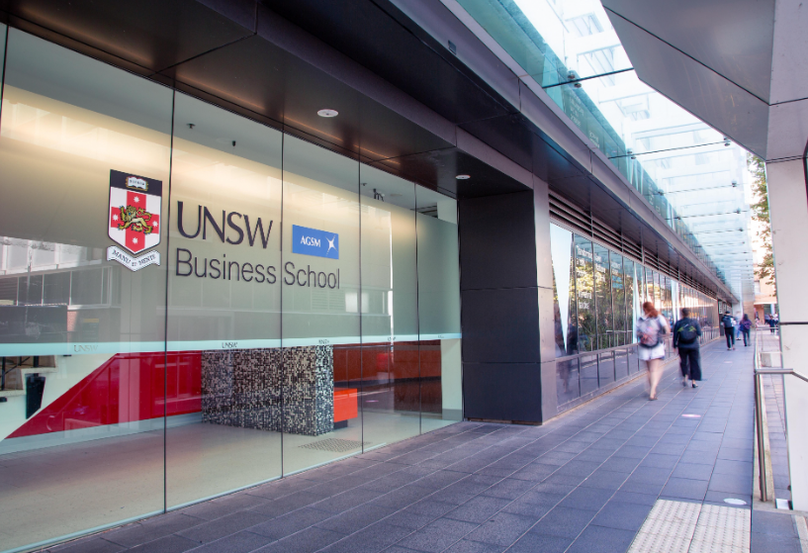

Opportunity
Analysis
G-Accelerator Buyer Persona
B2B Example
BACKGROUND:
James Scott
Managing Director at UNSW Business School in BCN
45 years old from Manchester
Currently living in BCN with his family
BUSINESS PROFILE:
MBA in Business Operations
Working in the Business Education industry from 5 years
Previous experience as a Managing Director in Business Development strategy
Decision maker, Member of the Board, Sales driven
BUSINESS GOALS:
To expand the presence of the Business School in Spain within an international student community
Increase annual revenue
Be more competitive towards other business schools and achieve better international ranking
Provide new range of services to Students related to Entrepreneurship and Business Innovation
Create an in-house accelerator program
CHALLENGES:
Lack of internal resources to develop new range of services
Lack of previous experience developing accelerator programs
Have a proper program running for the upcoming term
Lack of network within the field

Slide 6

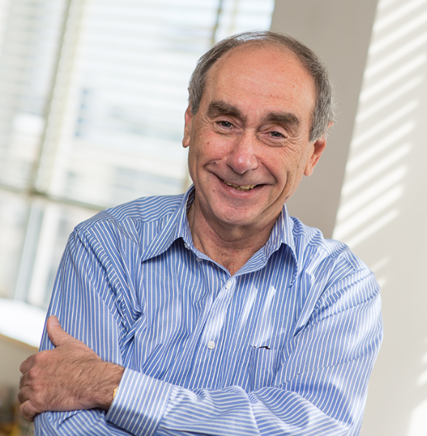
Opportunity
Analysis
G-Accelerator Buyer Persona
B2B Example
BACKGROUND:
Agustí Fonts
Project Manager at IRTA
65 years old from Manresa
Currently living in BCN with his family
BUSINESS PROFILE:
25 years of experience working for the public sector
More than 10 years working at IRTA in the Technology Transfer Department
Middle Management, not final decision maker
He likes well-structured procedures and project management
People Oriented
BUSINESS GOALS:
To help small-medium businesses from the local agriculture sector to be more competitive and sustainable by using technology and business strategy
Increase number of local technological projects supported
Expand opportunities in the territory by making more business interactions
CHALLENGES:
Difficulties in supporting projects with no business background
Lack of interest by researcher in learning business strategy
Lack of previous experience developing accelerator programs
Lack of internal resources and time to create ad hoc business support services

Slide 7
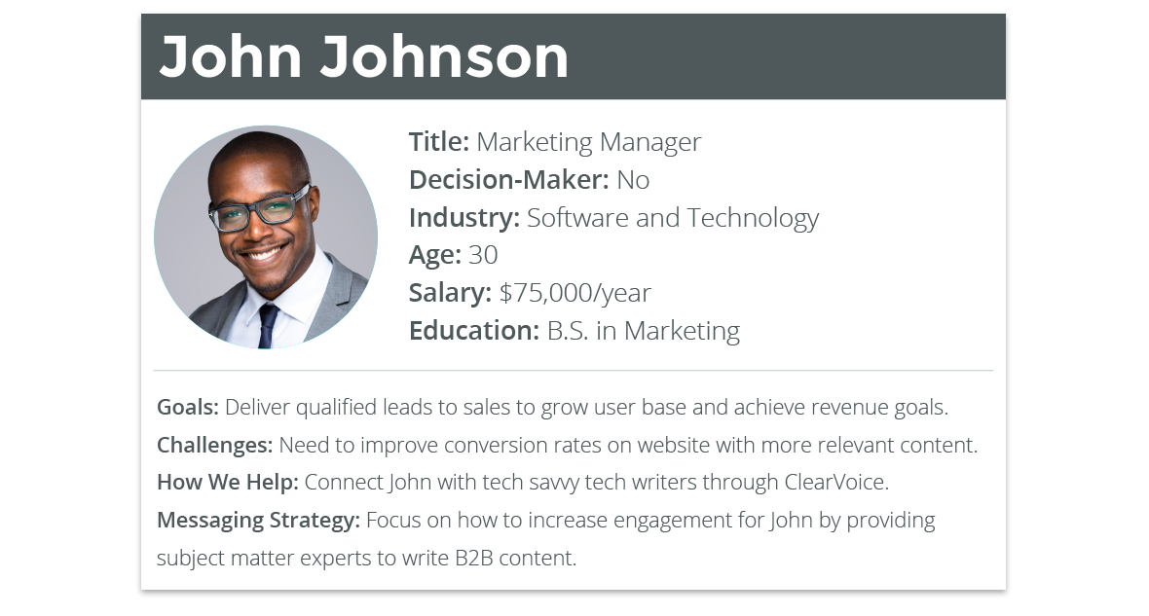
Opportunity Analysis
B2B Example

Slide 8
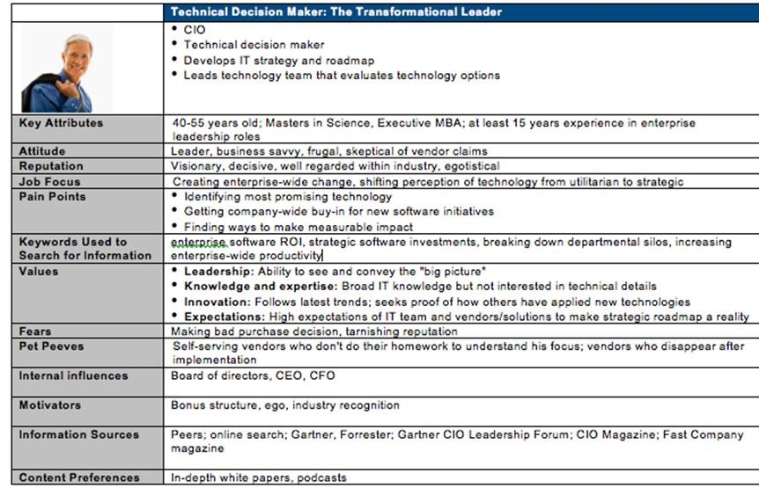
Opportunity
Analysis
B2B Example

