Slide 1



Impuls AgriTech 2025
Economic & Financial Plan
Xavier Arola
Subvencionat pel Departament d'Empresa (Programa
Primer) i amb el cofinançament del Fons Social Europeu Plus

Slide 2

Introduction to Economic &Financial Plan
To execute the economic-financial plan, we will use the calculation sheet and start introducing the economic information that comes from the…..
THE WHY? MISION AND VISION
THE CANVAS. BUSINESS MODEL GENERATION. THE IDEA
THE BUSINESS PLAN
THE IDEATION PROCESS- BLOCK 1
g-accelerator@global-business-school.org
+34 930 086 588

Slide 3
Accountancy, the basics of the Economic & Financial Plan
In the Financial Plan Chapter of the Business Plan, the first step is to define, without exaggerating on the numbers, the main financial aspects of the project:
Initial investment required.
Available financing sources.
Sales forecasts for the 3-5 initial years.
Treasury plan for the first 3-5 years.
It is important not to be excessively optimistic and above all reasonably justify and explain each number and forecast.
g-accelerator@global-business-school.org
+34 930 086 588

Slide 4
What are the Financial Statements
g-accelerator@global-business-school.org
+34 930 086 588

Slide 5
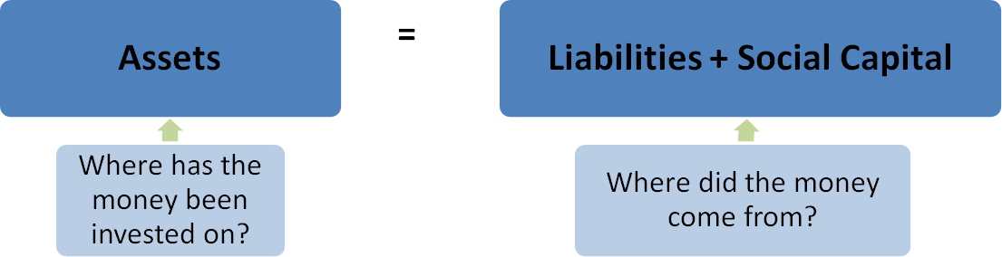
The Investment and Financing Plan
Business accounting is based on the two-sided nature of the accounting equation:
Assets: Rights and goods; property of the company.
Liabilities: Credit extended to the business.
Social Capital: Capital invested by owners in the business.
g-accelerator@global-business-school.org
+34 930 086 588

Slide 6
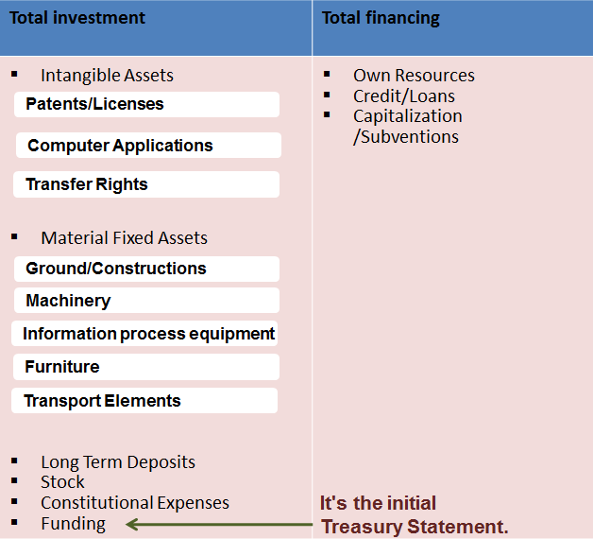
The Investment and Financing Plan
g-accelerator@global-business-school.org
+34 930 086 588

Slide 7
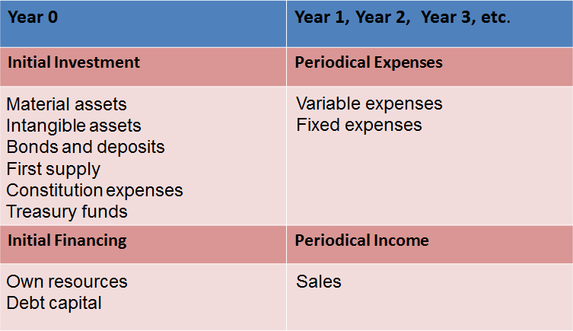
The Investment and Financing Plan
g-accelerator@global-business-school.org
+34 930 086 588

Slide 8
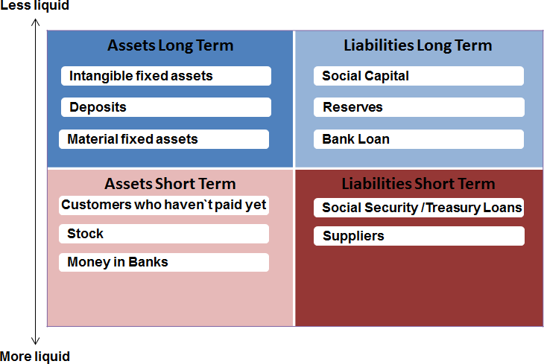
Balance Sheet
g-accelerator@global-business-school.org
+34 930 086 588

Slide 9
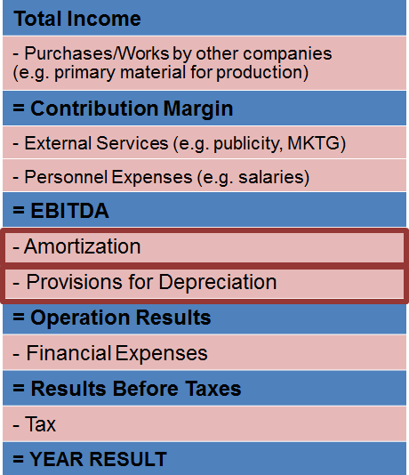
Profit & Loss Account
It compares Incomes Vs. Expenses
It's an indication of the company’s profitability
A company which permanently has greater expenses than incomes is not liable, it cannot remain in time
g-accelerator@global-business-school.org
+34 930 086 588

Slide 10
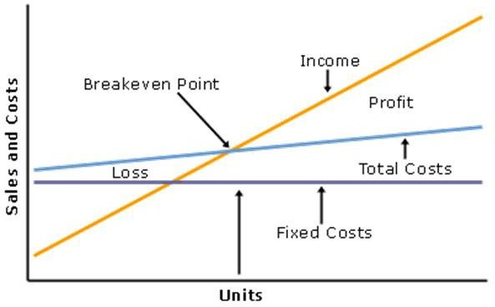
Business Analysis: Breakeven Point
It shows how much the company has to invoice at least to cover all its expenses (both fixed and variable).
g-accelerator@global-business-school.org
+34 930 086 588

Slide 11
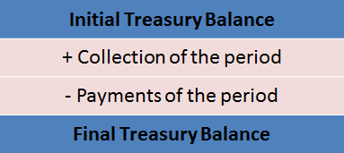
Treasury Account
It gathers the collections and payments of the company.
It is formed by Cash money, Money in bank accounts and temporary financial investment.
Payment Terms are a key element to build this statement.
Incomes/Payments are linked to Collection/Payments, but they not necessarily coincide.
What happens if the Final Treasury Balance is Negative?
Liquidity Problems
We must analyse where it comes from: if it is punctual or due to a lack of solvency (results account negative: expenses permanently higher than incomes).
g-accelerator@global-business-school.org
+34 930 086 588

Slide 12
Business Analysis: Breakeven Point
How many Units shall we sell in order to reach the BEP?
Selling Price of a specific product (SP): 100€
Variable Cost (VC): 50€
Fixed Cost (FC): 200.000€
g-accelerator@global-business-school.org
+34 930 086 588

Slide 13
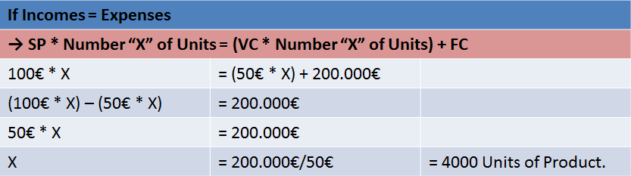
Business Analysis: Breakeven Point
g-accelerator@global-business-school.org
+34 930 086 588

Slide 14
Business Analysis
SOLVENCY & LIQUIDITY:
Debt Ratio: Relation between the Debts of the business and the Equity and Liabilities. The lower, the better!!!
Funds’ Performance: Relation between the Debts of the business and the Equity. The lower, the better!!!
Working Capital: Show our capacity to face to short time debts. The higher, the better!!!
Inventory turnover: is a ratio showing how many times a company has sold and replaced inventory during a given period.
g-accelerator@global-business-school.org
+34 930 086 588

Slide 15
Business Analysis
ECONOMIC BUSINESS GENERATION
Breakeven Point: If you reach this amount, you won’t gain or lose money.
EBITDA (Earnings Before Interests, Taxes, Depreciation and Amortization): Gross benefit of the business. The higher, the better!!!
Profitability Income: Measures the profitability of the benefits in relation with the sales.
g-accelerator@global-business-school.org
+34 930 086 588

Slide 16
Business Analysis
PROFITABILITY OF THE INVESTMENTS
Return On Investments (ROI): Shows the profitability of the Investments in relations with the Benefit before Taxes. The higher, the better!!!
IRR (Internal Rate of Return): it measures the opportunity cost of the benefit
IRR > Interest rate of the market → Engage the business
IRR < Interest rate of the market → Leave the money in the bank
Payback : it’s the time taken to recoup the investment. The sooner, the better!!!
NPV (Net Present Value): it measures the future cash flows (benefit) in the present time.
g-accelerator@global-business-school.org
+34 930 086 588

Slide 17
Business Analysis: SENSITIVINESS ANALYSIS
It measures the different scenarios we could meet if the initial conditions fixed vary.
If my incomes forecast came down to 5%, would my company still be profitable?
If my incomes forecast came down to 10%, would my company still be profitable?
If my purchase expenses increased 5%, would my company still be liable?
If my structure expenses increased 10%, would my project still be liable?
The sensitivity analysis shows us which external disruptions or deviations of the forecast we can be more sensitive to.
g-accelerator@global-business-school.org
+34 930 086 588

Slide 18
Accountancy: The Basics of the Economic & Financial Plan
We are going to use a template a tool to create a complete financial simulation of the three first years of the life of the company.
You can use the proposed template or another as far it includes:
Investment and funding plan
Profit and Losses
Treasury Plan
Let’s now review the Financial template in order you to start to build your Economic - Financial Plan…
g-accelerator@global-business-school.org
+34 930 086 588

Slide 19
P/L
g-accelerator@global-business-school.org
+34 930 086 588

Slide 20
Treasury Plan
g-accelerator@global-business-school.org
+34 930 086 588

Slide 21
Cost Structure
All the most important costs to run the business need to be reported.
It is also better to briefly explain their characteristics.
INITIAL COSTS TO OPERATE
INVESTMENT PLAN
OPERATIONAL PLAN
WHICH COSTS AM I GOING TO INCURR IN?
ARE THESE COSTS FIXED OR VARIABLE?
g-accelerator@global-business-school.org
+34 930 086 588

Slide 22
Cost Structure
To define you Cost Structure I want you review again the main sections of your Business Plan and review also your Business Model Canvas and guess associated costs..
Your Business model canvas and its building blocks should describe the most important costs incurred while operating under a particular business model. Creating and delivering value, maintaining Customer Relationships, and generating revenue all incur costs. Such costs can be calculated relatively easily after defining Key Resources, Key Activities, and Key Partnerships. Some business models, though, are more cost-driven than others. So-called “no frills” airlines, for instance, have built business models entirely around low-Cost Structures.
g-accelerator@global-business-school.org
+34 930 086 588

Slide 23
Cost Structure
A Cost Structures can have the following attributes:
Fixed cost
Costs that remain the same despite the volume of goods or services produced. Examples include salaries, rents, and physical manufacturing facilities. Some businesses, such as manufacturing companies, are characterized by a high proportion of fixed costs.
Variable cost
Costs that vary proportionally with the volume of goods or services produced. Some businesses, such as music festivals, are characterized by a high proportion of variable costs.
g-accelerator@global-business-school.org
+34 930 086 588

Slide 24
Cost Structure
First of all, you should determine which is your venture cost structure.
There are two main categories of cost structure:
Value-driven: The focus of value-driven cost structures is to create more value in the product itself, not necessarily producing the product at the lowest possible cost. Examples of this would be Prada, Rolex, or Ritz-Carlton.
Cost-driven cost structures focus on minimizing the costs of the product or service as much as possible. Examples would be Walmart and Southwest Airlines.
g-accelerator@global-business-school.org
+34 930 086 588

Slide 25
Cost Structure
Be realistic an do a proper benchmarking with the market of your costs and expenses.
Marketing cost are especially important from ones of you based on a digital business with many barriers of entrance. You must communicate you value proposition and to try to differentiate from the existing competitors.
Your costs will have to be less than your revenue, which you determined in the Revenue Streams block of the canvas. If this is not the case, you will have to pivot and make adjustments.
g-accelerator@global-business-school.org
+34 930 086 588

Slide 26
Let’s start with the Hypothesis
Investment Plan
Fixed costs
People costs
Variable Costs
g-accelerator@global-business-school.org
+34 930 086 588

Slide 27
Revenue Streams
Every company can only exist because flow in. Therefore, this section is so important.
In this section the entrepreneur has the possibility to think on how much he will be able to sell and the revenues the company will have.
WHICH PRODUCTS AND CHANNELS WILL BRING REVENUE IN?
WHAT IS THE PRICE OF THE PRODUCT-SERVICE GOING TO BE?
HOW MUCH CAN WE SELL EACH MONTH?
g-accelerator@global-business-school.org
+34 930 086 588

Slide 28
Incomes/Revenue Streams
Defining PRODUCTS &:
Types of Revenue Streams
Transaction revenues resulting from one-time customer payments
Recurring revenues resulting from ongoing payments to either deliver a Value Proposition to customers or provide post-purchase customer support
Pricing mechanisms, such as fixed list prices, bargaining, auctioning, market dependent, volume dependent, or yield management.
Payment Conditions, cash, 30-60-90 days
Discounts / offers policy / membership conditions
g-accelerator@global-business-school.org
+34 930 086 588

Slide 29
R$ Revenue Streams
There are several ways to generate Revenue Streams:
Asset Sale: selling ownership rights to a physical product, i.e., AMAZON
Usage Fee: generated using a particular service, i.e., Hotels/telecos
Subscription Fee: generated by selling continuous access to a service, i.e., gyms
Lending/Renting/Leasing: created by temporarily granting someone the exclusive right to use a particular asset for a fixed period in return for a fee, i.e., Avant car
Licensing: generated by giving customers permission to use protected intellectual property in exchange for licensing fee, i.e., Publishing company
Brokerage Fees: derives from intermediation services performed on behalf of two or more parties, i.e. Brokers and real state
Advertising: results from fees for advertising, i.e., Facebook
g-accelerator@global-business-school.org
+34 930 086 588

Slide 30
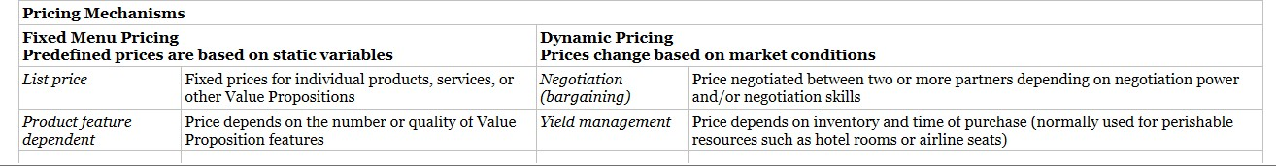
R$ Revenue Streams
Types of Pricing mechanism: fixes and dynamic pricing.
g-accelerator@global-business-school.org
+34 930 086 588

Slide 31
Competitor’s Analysis
In order to perform a competitor analysis, you need to identity at least three competitors in your market. For instance, if you are planning to open a restaurant, you need to focus on other 2/3 restaurants around you. It is better if they are in the same niche as you are, but other types of restaurants are competitors as well.
Give then yourself a grade for each category displayed in the following slide; try to do it in an honest way.
After that, try to research more about your competitors and give them a grade too.
In the end, the average of all the strengths and weaknesses will be displayed so that you can compare your results with your competitors. Try to identify parts of the project in which you are weak compared to others and see if you can improve them in some ways.
g-accelerator@global-business-school.org
+34 930 086 588

Slide 32
Competitor’s Analysis
g-accelerator@global-business-school.org
+34 930 086 588

Slide 33
EXERCISE
Do the competitors analysis and define your pricing strategy according to the analysis.
*Use Excel in Moodle Ocean Blue or Competitors Analysis
g-accelerator@global-business-school.org
+34 930 086 588

Slide 34
Incomes/Revenue Streams
STARTING WITH:
WHICH ONE IS YOUR MARKET?
TRY TO QUANTIFY YOUR CUSTOMER SEGMENTS:
In order to research what is the size of a specific market and its evolution overtime, as well as obtain other important figures regarding the demographics of your customers, some of the most important Statistic websites are listed here:
STATISTA https://www.statista.com/
EUROSTAT https://ec.europa.eu/eurostat/home
WTO WTO Stats
IMF https://www.imf.org/en/Data
OECD https://stats.oecd.org/
g-accelerator@global-business-school.org
+34 930 086 588

Slide 35
Incomes/Revenue Streams
USE GBSB / GBSB GLOBAL LIBRARY
g-accelerator@global-business-school.org
+34 930 086 588

Slide 36
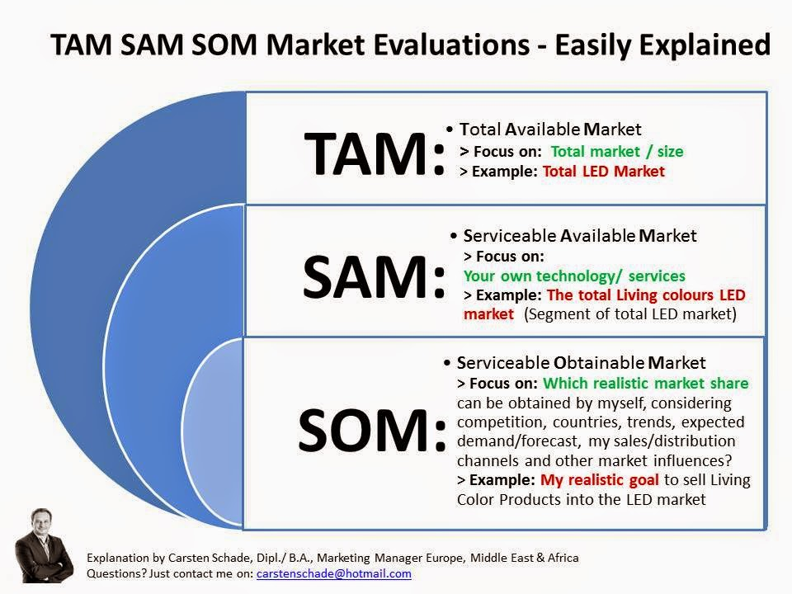
Calculate your TAM, SAM, SOM
g-accelerator@global-business-school.org
+34 930 086 588

Slide 37
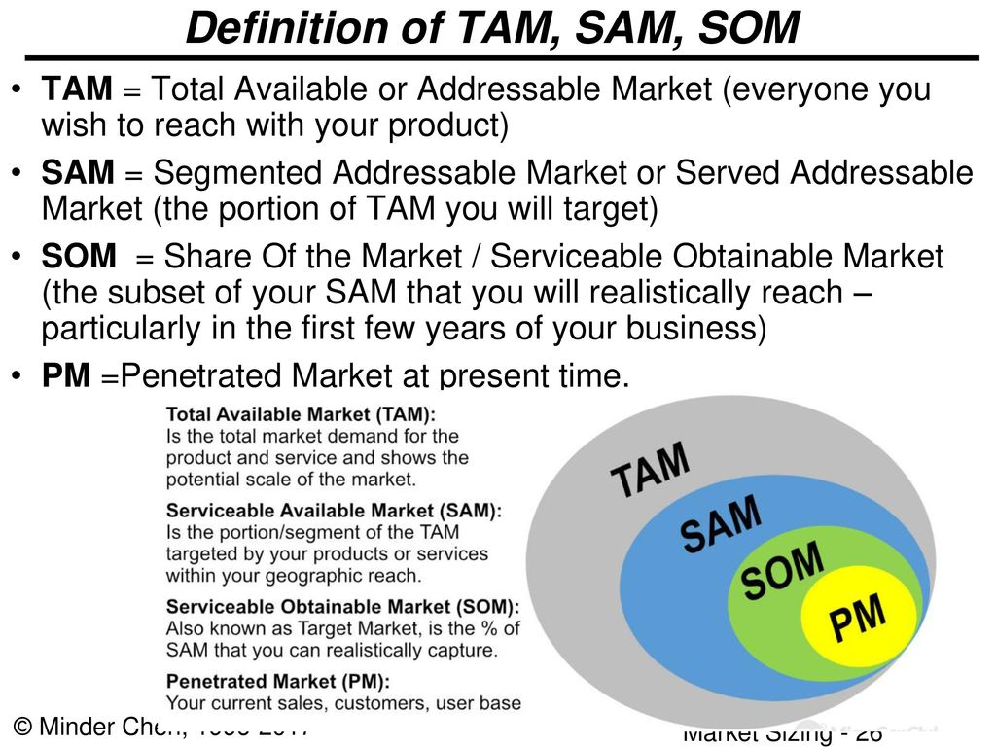
Calculate your TAM, SAM, SOM
g-accelerator@global-business-school.org
+34 930 086 588

Slide 38
Incomes/Revenue Streams
And then:
WHICH ONE IS YOUR MARKET SHARE?
The market share is the percentage of a market covered by a specific company at a specific time.
For instance, if the European car market has a size of 15 million cars sold in 2018 and the group XYZ sells 5 million cars in 2018 in that market, it has a market share of 5/15 = 0.33 = 33% in that specific year.
g-accelerator@global-business-school.org
+34 930 086 588

Slide 39
Revenue Streams in Digital Marketplaces
In MARKET PLACE business ideas, consider the traffic and conversion rates from your competitors:
Traffic: compare with other platforms / on-line stores
Conversion Ratio: 1-3%
Average ticket: 20$ – 50$?
g-accelerator@global-business-school.org
+34 930 086 588

Slide 40
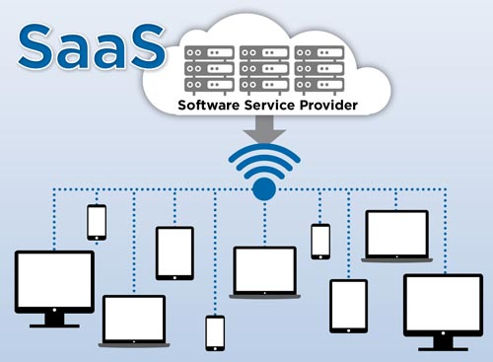
Revenues Indicators for SaaS Company
SaaS company is a company that hosts an application and makes it available to customers over the internet.
This infers that the software sits on a SaaS company's server while the user accesses it remotely.
g-accelerator@global-business-school.org
+34 930 086 588

Slide 41
Indicator – CLTV (Customer Lifetime Value)
Basic revenue metrics for SaaS:
CLTV is the positive cash flow the customer will generate while using the service of the Company minus the expenses to offer him the service.
For instance, the average customer of a company X uses the product for 3 years and over the period will provide 300 euro of revenues.
In order to offer the product, the Company will spend 200 euro during the period (depreciation, R&D, administrative costs…).
The CLTV is therefore 100 euro.
As long as the CLTV is higher than CAC the Company will make money.
g-accelerator@global-business-school.org
+34 930 086 588

Slide 42
Indicator – CLTV (Customer Lifetime Value)
In order to understand what is the CAC of the company, divide the marketing expenses of a given year for the number of new customers attracted during the period.
As long as the CLTV is higher than CAC the Company will make money.
Even though this metric isn’t exclusive to SaaS companies, it is widely used by SaaS because of its importance.
This ratio shows how much does it cost for the company to acquire a new customer.
It provides important insights on whether or not the company should further push to acquire new customers or if the cost is too high.
g-accelerator@global-business-school.org
+34 930 086 588

Slide 43
Indicator – Churn Rate
Churn rate the annual percentage rate at which customers stop subscribing to a service or employees leave a job..
For instance, a churn rate of 90% means that 90% of the customers stops using the Service even the year after they started using it.
This indicator is important as it indirectly shows how strong the service offered is and it is also a good indicator of the amount of competition that is present in that industry.
This indicator is also used to forecast the financial results the company will have and has also a big impact on the pricing and marketing strategy of the company.
g-accelerator@global-business-school.org
+34 930 086 588

Slide 44
NEXT SESSION
Each Group E&F Plan Presentation one to one sessions
g-accelerator@global-business-school.org
+34 930 086 588

Slide 45
Thank you!
Subvencionat pel Departament d'Empresa (Programa
Primer) i amb el cofinançament del Fons Social Europeu Plus
g-accelerator@global-business-school.org
+34 930 086 588

