Slide 1
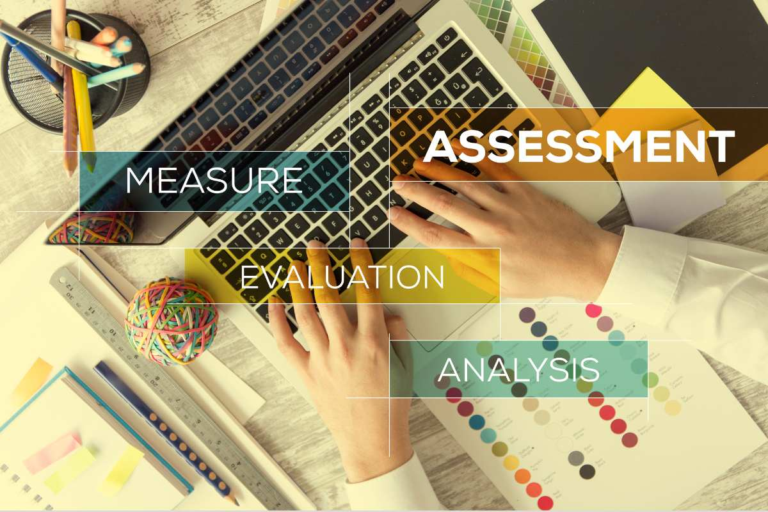



How to Measure the Impact of Technologies in the Agri-Food Sector
Bouali Guesmi
21-23/07/2026

Slide 2





Introductions
What are your goals for this course?

Slide 3
Index
Introduction to impact
Defining Impact Dimensions
Data Collection for Agritech Impact Assessment
Engaging and working with users of research
Demonstrating impact

Slide 4
I-Introduction to impact
An explanatory section covering what impact is (and what it isn’t), how to identify it, and general content on planning, user engagement, evidence and narratives.
Learning outcomes
To establish a basic understanding of impact, address myths and set a firm basis for more advanced topics.
Notes:
Emphasise that many projects report activities (e.g., workshops, sensors installed) but fail to demonstrate whether these activities led to meaningful changes.

Slide 5
Why Measure Impact?
We do not innovate for technology's sake—we innovate to create value.
Technology alone does not solve problems.
Impact tells us whether innovations:
Improve farmers' livelihoods
Protect natural resources
Strengthen food systems
Create economic value
Contribute to sustainability
"If you cannot demonstrate impact, you cannot demonstrate value."
Notes:
Discussion Question
Why do funding agencies increasingly require impact assessment?
all of which increasingly require evidence of societal and environmental impact.

Slide 6



WHAT IS IMPACT?

Slide 7

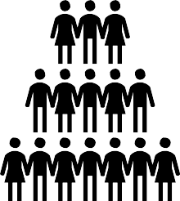
Impact =
Provable effects (benefits) of research/innovation in the ‘real world’
Effects felt here (outside academia)
Research
Academia
Society, environment, economy etc.

Slide 8
Impact is change
Reduced, less, lower…
Efficiency Effectiveness Wellbeing Engagement Access
Profit Skills
(etc.)
Mortality Waste Risk Cost
Staff turnover Stress Crime
(etc.)
Includes STOPPING or PREVENTING
something
Improved, more, faster, increased….
Not dissemination, academic interest or reputation, citations, attention

Slide 9

Types of impact
Capacity building
Change in the ability to do something
Conceptual
Change in the way something is thought about
Instrumental
Change in a thing

Slide 10
What is Impact?
Activities → Outputs → Outcomes → Impact
Example:
Technology
Install irigation sensors
↓
Output
100 sensors installed
↓
Outcome
Farmers irrigate differently
↓
Impact
20% reduction in water consumption
Higher profitability
Improved drought resilience
Notes:
Key Message: Impact is long-term change, not simply project delivery.

Slide 11
Outputs vs Outcomes vs Impact
Outputs | Outcomes | Impact
Sensors installed | Farmers use sensor data | Water savings across the region
Training delivered | Improved decision-making | Increased climate resilience
Mobile app developed | Farmers adopt the app | More sustainable farming systems
Notes:
Activity (5 minutes):Ask participants to classify several examples as outputs, outcomes, or impacts.

Slide 12
In Agri-Food Sector, for example…
New strategy
New jobs
New markets
Market share
Leveraged funding
Market position
Profits
Sales
Diversification
Improved equality
Upskilled staff
New partnerships
New structure
Staff wellbeing
Improved decision making

Slide 13
Why Impact Assessment Matters
Different stakeholders ask different questions.
Stakeholder | Main Question
Farmer | Does it improve my farm?
Investor | Is it worth investing?
Policymaker | Does it support public goals?
Researcher | Does it generate evidence?
Society | Does it improve sustainability?
Notes:
Stress that impact evaluation serves multiple audiences and purposes, from accountability to learning and scaling.

Slide 14
Agritech Is Transforming Food Systems?
🌾 Precision agriculture
🤖 Robotics
🛰 Satellite monitoring
💧 Smart irrigation
🌱 Biostimulants
📱 Farm management apps
🧬 Genomics
♻ Circular bioeconomy
Notes:
Encourage participants to share local examples from vineyards, fruit orchards, greenhouse horticulture, livestock, or olive production.

Slide 15
Example1: Precision Agriculture
Technology:Variable-rate fertiliser application
Possible impacts
Economic
✔ Reduced input costs
Environmental
✔ Reduced nitrogen losses
Social
✔ Better decision-making
Systemic
✔ Greater adoption of digital agriculture
Notes:
Question: Which impacts are easy to measure?/ Which are more difficult?

Slide 16
Example2: AI Decision Support
Technology : AI predicts disease outbreaks.
Possible indicators
fewer pesticide applications
lower costs
better crop quality
improved farmer confidence
better advisory services
Notes:
Discussion: Can improved confidence be measured?
How?
Introduce the idea that impact evaluation combines quantitative data with qualitative evidence.

Slide 17
Types of Impact
Economic productivity profitability Efficiency | Environmental water biodiversity carbon soil
Social jobs wellbeing inclusion | Governance transparency traceability collaboration
Notes:
Key Message: Most agritech projects create multiple types of impact simultaneously.

Slide 18
Key Concepts
Innovation
Creating new solutions
↓
Adoption
People actually use them
↓
Productivity
Doing more with fewer resources
↓
Sustainability
Meeting present needs without compromising future generations
↓
Resilience
Ability to cope with shocks
↓
Scalability
Can the innovation benefit many users?
Notes:
Discuss how these concepts reinforce one another and why adoption is often the bridge between innovation and impact.

Slide 19
Case Study: Smart Irrigation in Vineyards
Problem: Increasing drought
Technology: IoT irrigation sensors
Expected impacts
Economic: Higher grape quality
Environmental: Lower water consumption
Social: Reduced farmer uncertainty
Governance: Improved water management
Notes:
Discussion: What evidence would convince you this project succeeded?

Slide 20
Measuring Success
Participants brainstorm possible indicators
Impact | Possible Evidence
Water savings | Water meter records
Higher yield | Farm production data
Better soil | Laboratory analysis
Farmer satisfaction | Survey
Adoption | Number of active users
Collaboration | New partnerships
Notes:
Key Message: Evidence comes from multiple sources, not only numerical data.

Slide 21
Practical Exercise 1
Technology Impact: Each participant selects an Agritech innovation they know. Complete the following template.
Question | Response
Technology
Problem addressed
Who benefits?
What changes?
Expected impacts
How would you measure success?
What evidence would you collect?
Notes:
Participants work individually (15 minutes) and then discuss in small groups (15 minutes).

Slide 22
Wrap-Up and Key Takeaways
Impact is about change, not activity
✔ Outputs are not impacts
✔ Different stakeholders value different outcomes
✔ Agritech innovations affect economic, environmental, social, and governance dimensions
Evidence should combine quantitative and qualitative data
✔ Good impact assessment starts by asking:
Who benefits?
How will we know?
What changes?

Slide 23
Wrap-Up and Key Takeaways
Interactive Questions
What is the first indicator you think of when evaluating an agritech project?
Which impact dimension is most difficult to measure: economic, environmental, social, or governance?
What is the biggest barrier to measuring impact in your organisation?

Slide 24
II- Defining Impact Dimensions
Measuring the Economic, Environmental, Social and Governance Impacts of Agritech Innovations
Measuring What Really Matters in Agritech Projects
Learning objectives
By the end of this section participants will be able to:
distinguish between different dimensions of impact
select appropriate indicators
understand relationships between indicators
build a multidimensional impact framework

Slide 25
II- Defining Impact Dimensions
Why Do We Need Different Impact Dimensions?
Technology rarely creates only one type of impact.
Example
Precision irrigation
Economic
↓
Higher profits
Environmental
↓
Less water use
Social
↓
Less stress for farmers
Governance
↓
Better reporting and compliance
Notes:
Key message: A good evaluation considers all four dimensions.

Slide 26
The Four Dimensions of Impact
Economic | Environmental
Profit | Water
Productivity | Carbon
Market | Biodiversity
Social | Governance
People | Institutions
Communities | Policies
Wellbeing | Transparency
Notes:
Explain that these dimensions are interconnected and often reinforce one another.

Slide 27
Economic Impact
Does the technology improve economic performance?
Possible impacts
✔ Higher production
✔ Reduced costs
✔ Higher income
✔ Better competitiveness
✔ Better market opportunities

Slide 28
Economic Indicators
Indicator | Unit
Yield | tonnes/ha
Production costs | €/ha
Gross margin | €/farm
Net income | €/farm
ROI | %
Payback period | years
Market share | %
New customers | Number
Notes:
Discussion
Which indicators would be most important for a startup?
Which for farmers?

Slide 29
Economic Example
Technology:AI irrigation management
Results after two years
Yield: +12%
Water costs: −18%
Profit: +15%
ROI: 145%
Payback: 2.3 years
Would these results convince an investor?

Slide 30
Environmental Impact
Does the technology improve environmental sustainability?
Possible impacts
✔ Lower emissions
✔ Better soil
✔ Water conservation
✔ Biodiversity protection
✔ Circular resource use

Slide 31
Environmental Indicators
Indicator | Unit
Water consumption | m³/ha
Carbon footprint | kg CO₂e/kg
Greenhouse gas emissions | tCO₂e/year
Soil organic matter | %
Biodiversity index | Index
Nitrogen efficiency | kg yield/kg N
Energy use | kWh/ha

Slide 32
Example
Technology: Precision fertilization
Observed impacts:
Nitrogen use: −20%
Nitrate leaching: −30%
Fuel use: −12%
Carbon emissions: −18%
Soil health: Improved
Which indicators are easiest to measure?

Slide 33
Social Impact
Does the technology improve people's lives?
Social impacts include
jobs
income stability
wellbeing
inclusion
safety
education

Slide 34
Social Indicators
Indicator | Unit
Employment | Number
Farmer satisfaction | Survey
Working hours | Hours/week
Occupational accidents | Number
Gender participation | %
Youth participation | %
Training received | Hours

Slide 35
Example
Technology: Robotic harvesting
Positive impacts
Reduced physical strain
Improved worker safety
Higher productivity
Potential negative impacts
Reduced seasonal employment
Need for digital skills
Can one technology create both positive and negative impacts?

Slide 36
Governance Impact
Does the innovation improve how the food system is managed?
Governance includes
transparency
traceability
collaboration
regulation
digital inclusion

Slide 37
Governance Indicators
Indicator | Unit
Traceability | % products tracked
Data transparency | Score
Regulatory compliance | Yes/No
Data sharing | Number of partners
Digital inclusion | % users
Stakeholder participation | Number

Slide 38
Example
Technology: Blockchain traceability
Possible impacts
Consumers trust products
Food recalls become faster
Export opportunities increase
Regulatory compliance improves

Slide 39
Relationships Between Dimensions
Impact dimensions are interconnected
Economic
↓
Investment
↓
Environmental improvement
↓
Social acceptance
↓
Policy support
↓
Greater adoption

Slide 40
Choosing Indicators
Good indicators should be SMART
Specific
Measurable
Achievable
Relevant
Time-bound
Questions
Can you collect the data?
Who will collect it?
How often?

Slide 41
Example Dashboard
Dimension | Indicator | Current
Economic | ROI | 140%
Economic | Yield | +12%
Environmental | Water | −18%
Environmental | Carbon | −22%
Social | Satisfaction | 4.6/5
Governance | Traceability | 98%

Slide 42
Case Study
Technology: Smart irrigation in Lleida fruit orchards
Economic: Higher production
Environmental: Lower water use
Social: Better working conditions
Governance: Improved irrigation reporting
What additional indicators would you collect?

Slide 43
Practical Exercise 2
Each participant need top complete this table for one Agritech innovation:
Which indicators did you choose?
Why?
Which are easiest to measure?
Which type of data require?
Objective | Indicator | Unit | Baseline data | Frequency
Reduce water | Irrigation water | m³/ha |  | Monthly
Improve yield | Production | t/ha |  | Season
Reduce emissions | CO₂e | kg CO₂e |  | Annual
Improve income | Net profit | €/farm |  | Annual

Slide 44
Common Mistakes
Avoid
❌ Measuring only economic performance
❌ Too many indicators
❌ Indicators without baseline data
❌ Ignoring unintended impacts
❌ Measuring activities instead of outcomes

Slide 45
Key Takeaways
Successful impact assessment requires
✔ Multiple dimensions
✔ Good indicators
✔ Reliable evidence
✔ Stakeholder perspectives
✔ Long-term monitoring

Slide 46
III-Data Collection for Agritech Impact Assessment
From Data to Evidence
Learning Outcomes
By the end of this chapter participants will be able to:
Identify appropriate data sources
Select suitable data collection methods
Assess data quality
Choose an appropriate sampling strategy
Design a data collection plan for an agritech project

Slide 47
Why Data Collection Matters
"Good decisions require good data."
Impact assessment is only as good as the evidence collected
Poor data leads to:
❌ Incorrect conclusions
❌ Poor investment decisions
❌ Weak policy recommendations
❌ Inability to demonstrate project impact
Notes:
Introduce the concept that poor-quality data undermines the credibility of impact evaluations, regardless of how sophisticated the analysis is.

Slide 48
The Data Collection Process
Research Question
↓
Indicators
↓
Data Sources
↓
Collection Methods
↓
Quality Control
↓
Analysis
↓
Impact Assessment
Notes:
Key Message
Data collection should always be driven by the evaluation questions—not by what data happens to be available.

Slide 49
What Data Do We Need?
Explain the difference between quantitative and qualitative data
Quantitative | Qualitative
Yield (t/ha) | Farmer perceptions
Water use (m³) | Adoption barriers
Costs (€) | Lessons learned
CO₂ emissions | Stakeholder opinions
Notes:
Discussion: Why are both types of data important?

Slide 50
Data Sources
Introduce the main sources that could be used in Agritech projects
Primary Data
Field measurements
Surveys
Interviews
Sensors
Drone observations
Secondary Data
Government statistics
Weather databases
Scientific publications
Enterprise databases
Satellite products
Notes:
Key Message
Most impact evaluations combine several data sources to improve robustness.

Slide 51
Field Measurements
Examples:
Crop yield
Soil moisture
Water consumption
Fertilizer application
Biomass
Disease incidence
Advantages
✔ High accuracy
✔ Direct measurement
Limitations
❌ Time-consuming
❌ Labour intensive
❌ Expensive
Example
Measuring soil moisture weekly in irrigated vineyards in Catalonia.

Slide 52
IoT Sensors
Examples
Soil moisture sensors
Weather stations
Livestock collars
Greenhouse sensors
Flow meters
Smart irrigation systems
Notes:
Discussion
What are the benefits and limitations of continuous monitoring?

Slide 53
Farmer Surveys
When should surveys be used?
To collect information on:
Technology adoption
Satisfaction
Decision-making
Training needs
Perceived impacts
Best Practices
✔ Keep surveys concise
✔ Use clear language
✔ Pilot test the questionnaire

Slide 54
Administrative and Government Data
Useful sources include
Agricultural census
Farm Accountancy Data Network (FADN/FSDN)
Meteorological agencies
Water authorities
National statistics institutes
What public datasets are available in your region?

Slide 55
Data Quality
Introduce the five pillars of quality
Criterion | Question
Accuracy | Is the value correct?
Completeness | Are any data missing?
Consistency | Are measurements comparable?
Representativeness | Does the sample reflect the population?
Reliability | Would repeated measurements produce similar results?

Slide 56
Longitudinal Studies
Compare changes over several years
Benefits:
Measure long-term impacts
Detect delayed effects
Evaluate resilience
Example: Tracking soil health over five growing seasons

Slide 57
Common Data Quality Problems
Examples:
❌ Missing values
❌ Duplicate records
❌ Inconsistent units
❌ Incorrect dates
❌ Interview bias
Identify which issues you have experienced?

Slide 58
Case Study: Smart Irrigation
Technology: IoT irrigation sensors
Indicators:
Water use
Yield
Energy consumption
Farmer satisfaction
Possible data sources:
Water meters
Sensor data
Farmer interviews
Farm financial records
Which source is best for each indicator?

Slide 59
Practical Exercise 3
Design a Data Collection Plan
Each participant designs a data collection plan for an Agritech project (e.g., precision irrigation, AI disease detection, robotic harvesting).
Indicator | Data Source | Method | Frequency | Responsible
Water use | Sensor | Automatic | Daily | Technician
Yield | Field measurements | Harvest | Annual | Farmer
Satisfaction | Survey | Questionnaire | Annual | Evaluator

Slide 60
Common Mistakes
Avoid:
❌ Collecting unnecessary data
❌ No baseline
❌ Poor documentation
❌ Inconsistent measurement protocols
❌ No data backup

Slide 61
Key Takeaways
✔ Good impact assessments begin with good data.
✔ Use multiple data sources where possible (triangulation).
✔ Match the data collection method to the indicator.
✔ Prioritize data quality over quantity.
✔ Plan data collection before project implementation

Slide 62
IV-Engaging and working with users of innovation
A section focused on identifying stakeholders, considering how to engage them, and developing appropriate and effective ways to work together.
Learning outcomes
To understand the importance of stakeholder engagement
To understand the opportunities and challenges for stakeholder engagement
To be able to identify appropriate and effective ways to engage with stakeholders

Slide 63





Engagement
Why
the purpose
How
the methods
Who
the ‘audience’
What
can be mobilised
Remember: Engagement for impact

Slide 64
Engagement and fundamental research
‘Longer road’ to impact
Engagement may not be with ultimate beneficiaries; may be with (eg) companies, regulators, applied counterparts etc
Support a pathway to use.

Slide 65


Why engage?

Slide 66
Question
Why should we engage stakeholders in innovation?

Slide 67
Why engage?
To understand
what’s needed
the opportunity
To identify
‘market readiness’
(and embed) values
To find
a research partner
a translation partner
To explain
To set up an implementation path
As a duty
Practical
  Ethical
To fuel
Onwards innovation use
Societal use
To build trust

Slide 68
Who?

Slide 69
WHO includes…..
Businesses (Global to small enterprise)
Regulators
Voluntary organisations
Community organisations
Policy makers
Patients, carers
Public(s)
Commercial/production partners
Professional Bodies
Audiences
Commissioners
Funders
Discipline
Anyone / group / organisation who can support trajectory towards use
Question: Who do you engage with?

Slide 70
What?

Slide 71
What can be mobilized?
New knowledge, insights or evidence (‘we now know’)
New concepts, ideas or perspectives (‘we have rethought’)
Insights into ways things are understood (‘we know how we know’)
New or modified research methods (‘we know how to’)
Experiences of what doesn’t work (‘we know not to’)
A materially usable ‘thing’ such as a process, tool or intervention (‘we now have a thing for’)
A new practice or way of performing (‘we have a new way to’)
Newly heard voices, especially through coproduction (‘we’ve now heard from’)
A new definition or set of parameters (‘we can now specify’)

Slide 72
How?

Slide 73
Question
What makes it difficult to engage stakeholders in research?

Slide 74
Barriers include…..
Time
Jargon
Engagement incompletely reported; unclear exactly ‘what works’ Ambivalence or seen as unnecessary
Nervous about getting it right
Concerned about negative effects on research

Slide 75
Question
What makes it easier to engage stakeholders in research?

Slide 76
Facilitators include….
Strategic commitment Institutional engagement Guidance
Skills development Showing what works
Clarity on roles and expectations Practical support

Slide 77
Some mechanisms for ‘how’
Dissemination and communication, websites, blogs, seminars, outreach, engagement (etc
Mobilizing research
Eg. outward secondments, knowledge transfer partnerships, ‘in residence’
Mobilizing researchers
Mobilizing non- academics
Eg. inward secondments, ‘artist in residence’, use of University labs

Slide 78
To conclude
Engagement is the act of building connections and relationships with people / groups / organizations throughout the research process
Who you need to engage with will always depend on the nature of the research, the extent it is ‘ready-to-apply’, and other contextual factors
There is no one size fits all; engagement is about understanding how the research contributes to real world change, how it can be used, and how it can be used most effectively.

Slide 79
V-Demonstrating impact
This section focuses on impact indicators, the ways in which impact can be corroborated, quantitative and qualitative methods which can be used to demonstrate effects, and the types of evidence commonly used
Learning outcomes
To understand the need for evidence
To understand different ways in which impact evidence can be generated
To be able to identify appropriate forms of evidence

Slide 80
Demonstrating impact
Why do we need to demonstrate impact?
What are you looking for?
How can you find it and prove it?

Slide 81

Question
Why do we need to demonstrate impact?

Slide 82
Why do we need to demonstrate impact? Includes….
To understand what changes
To avoid assuming (or unrealistically claiming) contribution
To be accountable (particularly for public funds)
to ensure we’re reflecting effects felt outside academia
To showcase the contribution of research to society
To comply with regulations and requirements

Slide 83
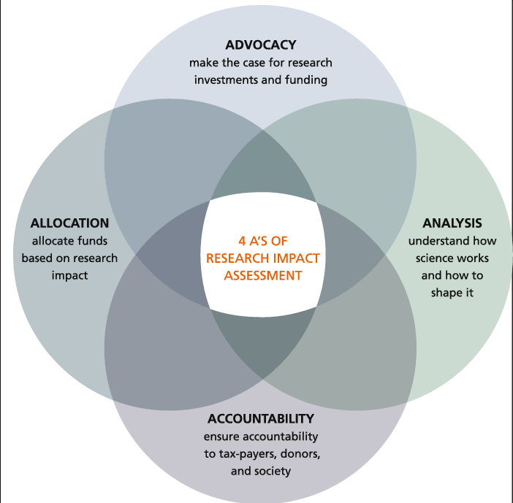
Why do we need to demonstrate impact? Includes….

Slide 84
What are you looking for?

Slide 85
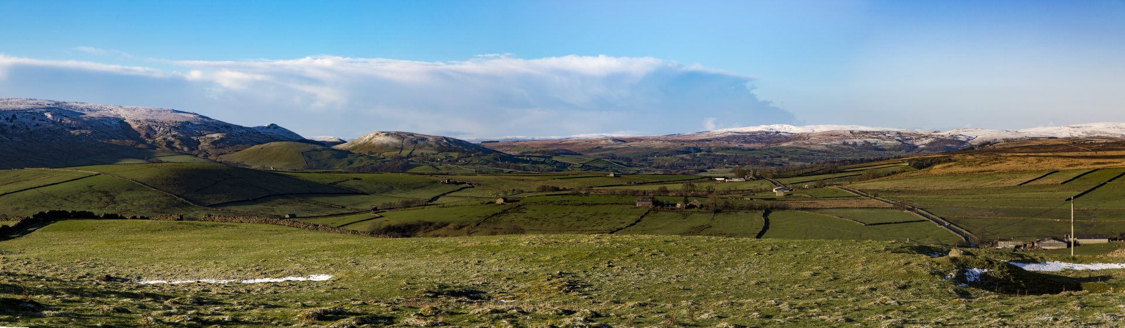

Impact across the landscape
‘All impact’
What are all the impacts our innovation achieves?
Focused areas
‘Targeted measurement’
What impact has our research had on specific SDGs / health / the environment / regional economy etc.

Slide 86
How can you find and prove it?

Slide 87
Question
What kinds of evidence could you gather?

Slide 88
Evidence of impact
Evidence is used to ensure impact claims are accurate, corroborated and verifiable.
Evidence can be qualitative or quantitative
Evidence usually consists of several pieces which collectively corroborate the claim(s)
Often needs ‘eyes’ in the sector

Slide 89
Example types of evidence
Testimonials from third parties
Organisational reports
‘Data’ (eg. sales figures, visitors, service access, change in audience…)
Policy citation
Practitioner guidance change
New standards
Surveys (eg. after engagement events)
‘Swift exit’ methods, such as dropping a token or voting card in a box
Other people’s / researchers’ evaluations
ie. something that corroborates the real-world change

Slide 90
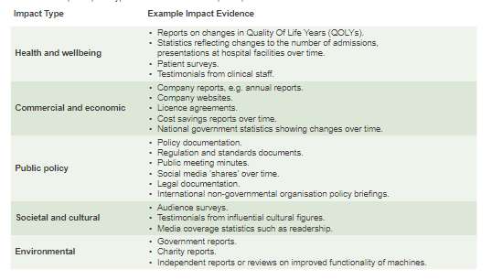
Example types of evidence

Slide 91
Levels of proof
Hard proof: There is no doubt
Softer proof: Provable when combined
Proxy measures: It indicates but doesn’t prove
Logic: Proof by elimination

Slide 92
Hard proof: There is no doubt
Where possible this should be the first point of call for any evidence claim.
Categorical link between your innovation and the impact.
Examples include:
  Citation in a new or changed policy (showing your research somehow materially contributed to the thing that now exists)
  Sales figures for the widget you designed (showing the company profited by selling the thing that didn’t exist before your research)
  Practitioner feedback saying ‘because of this research we were able to change our service….’

Slide 93
Softer proof: Provable when combined
Where there is no hard evidence / claim can’t be substantiated by single piece of evidence, add together:
Proof of connection
Proof of effect (impact)
What shows there is a link between our research and the impact claimed?
Eg. workshops, performances, policy engagement (etc)
What impacts arise from these connections?
Ie. the change(s)

Slide 94
Proxy measures
It indicates but doesn’t prove
Insight into what the impact could be, but stop short of legitimating the actual claim. Examples include:
Engagement figures, eg. audience numbers giving a sense of the size/location/nature of audience
Gatekeeper accounts: Those in a position to offer comment on the ‘beneficiaries’ behalf, such as carers, teachers, venue managers, employers….
  “My students are looking into STEM as a career choice now….”
  “Our visitors are telling us….”
  “My staff are much more confident now…”

Slide 95
Logic (elimination)
If you really can’t get evidence, then you may need to rely on elimination logic ie:
  “The impact could not have been possible without our research”
Relies on discounting other explanations for the impact, so can be risky

Slide 96

Hunt for impact
Ask researchers how the research has, or is likely to be used.
Ask external partners how the research has been used.
Follow citation paths; although citations aren’t impact, they can show you the onward path towards application. A useful tool is Connected Papers | Find and explore academic papers
Check if the work is cited in policies.
Check if there are any patents, or related intellectual property records which your research has influenced
Check mentions on media/social media

Slide 97
To conclude
Demonstrating impact is about articulating and corroborating real world changes
Quantitative or qualitative measures
Single evidence, or several pieces in combination
Helpful to have a frame of reference to focus your evidence gathering
Lots of resources and precedents within the sector

Slide 98
Centre de Recerca en Economia i Desenvolupament Agroalimentari (CREDA)
Thank you!
Tel + 34 935 521 124 | E-mail: creda@creda.es

