Slide 1



G-ACCELERATOR Impact Call 2026
Product Design
& AI Workflows
Lakshay Suri
Subvencionat pel Departament d'Empresa i Treball (Programa Primer) i amb el cofinançament del Fons Social Europeu Plus

Slide 2

G-ACCELERATOR MASTERCLASS
SESSION 2
Product Design
& AI Workflows
From idea to functional prototype: Building web and mobile applications in the era of AI.
Lakshay Suri | Senior Product Manager @ Inditex

Slide 3
G-ACCELERATOR MASTERCLASS
Session Objectives & Agenda
1. Mobile-First Mindset
Differences between desktop & mobile constraints.
2. UX Deconstructions
Teardowns of LinkedIn, Vinted, Mango, and Wise.
3. Hands-On Workshop
Build an interactive prototype in 30 minutes.

Slide 4
G-ACCELERATOR MASTERCLASS
Mobile UX vs. Web UX: Essential Differences
Design Question | Mobile UX | Web UX
How should navigation work? | Keep it simple and easy to reach | Can have more menus and navigation options
What should the design prioritize? | Speed, simplicity and easy access | Information, productivity and flexibility

Slide 5
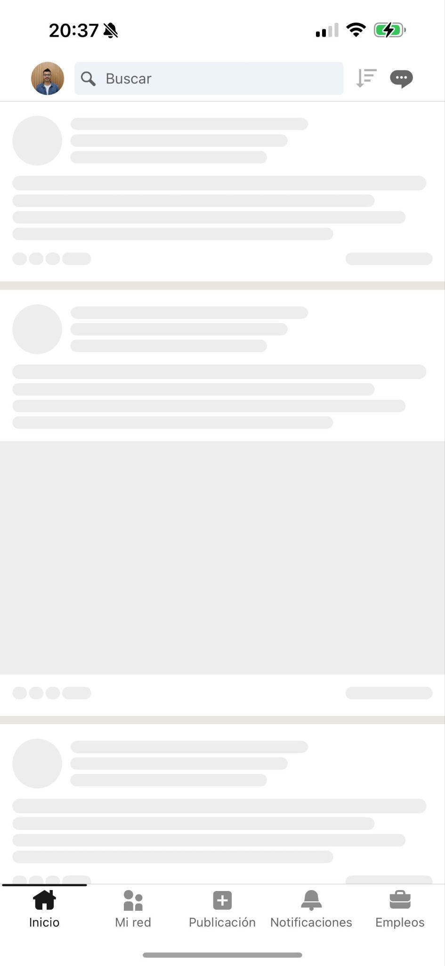
G-ACCELERATOR MASTERCLASS
Mobile Best Practice #1
KEY TAKEAWAY
Skeleton loading screens reduce perceived waiting time compared to generic spinners, keeping users engaged during data loading.
DESIGN RULE
Limit bottom navigation bars to 3–5 core, high-priority actions located strictly within natural thumb reach.

Slide 6
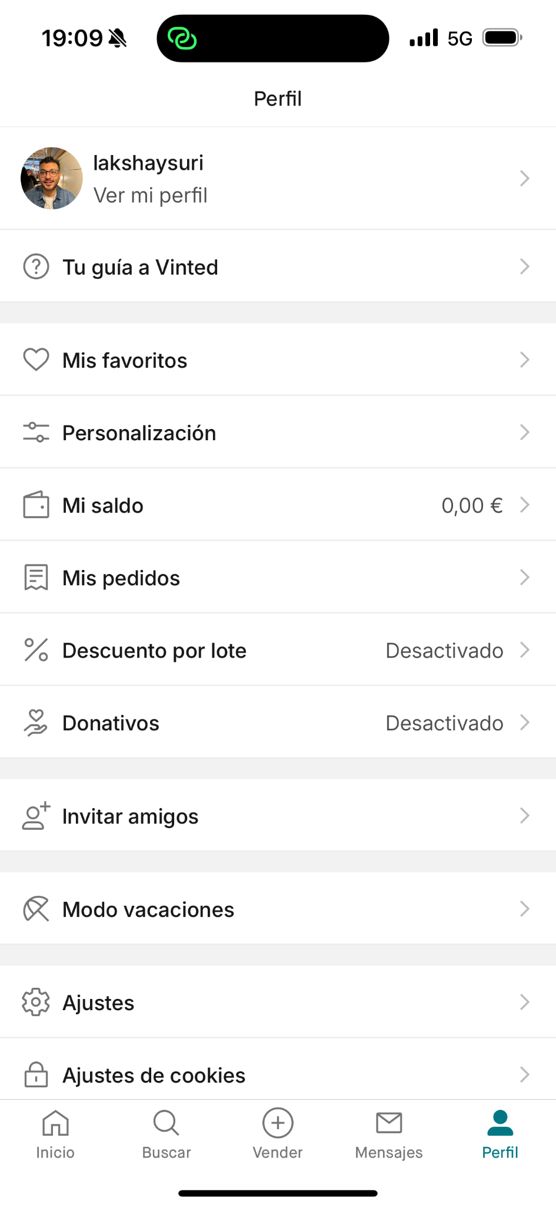
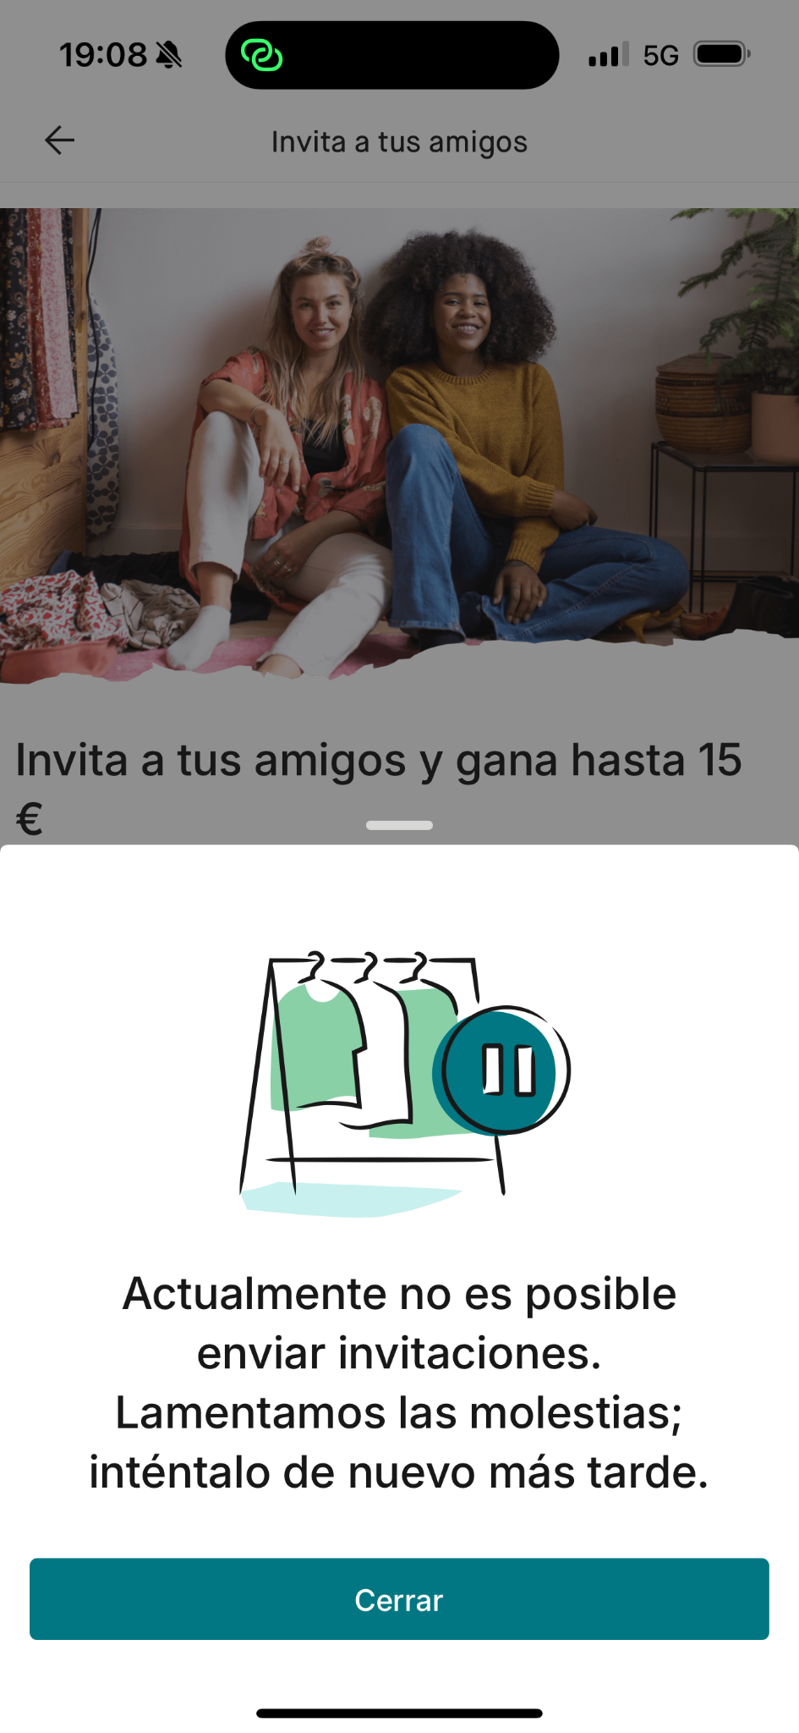
G-ACCELERATOR MASTERCLASS
Mobile Best Practice #2
KEY TAKEAWAY
Functionality to measure the usage without actually spending money developing the functionality

Slide 7
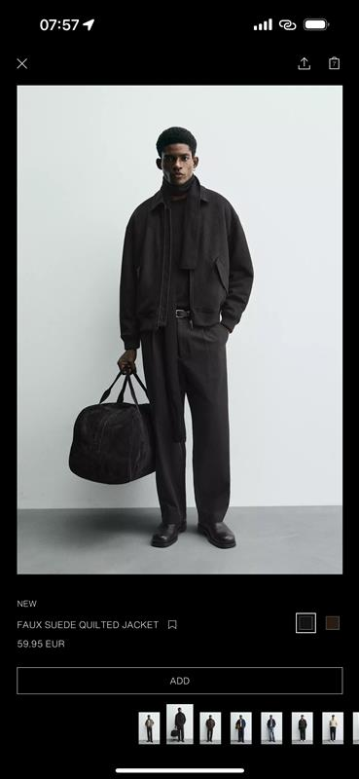
G-ACCELERATOR MASTERCLASS
Mobile Best Practice #3
KEY TAKEAWAY
Seamless tap accessibility for navigation

Slide 8
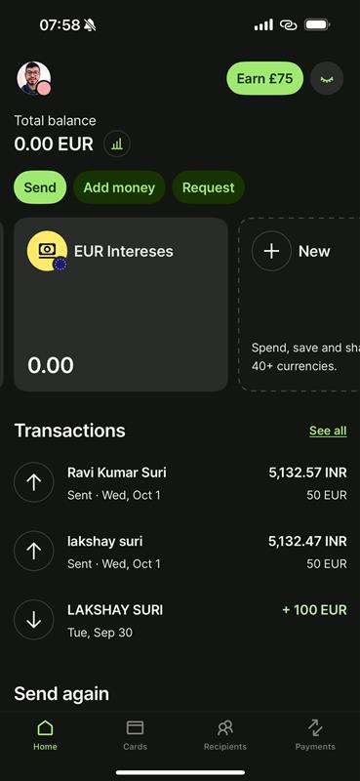
G-ACCELERATOR MASTERCLASS
Mobile Best Practice #4
KEY TAKEAWAY
size, contrast, and spacing to guide user attention toward the primary Call to Action (CTA).

Slide 9
G-ACCELERATOR MASTERCLASS
Checklist: The 5 Mobile App Commandments
1. Speed — Optimize the application so that each screen responds in less than 3 seconds!
2. Accessibility — Ensure contrast ratios and dynamic text sizing support.
3. Predictability — Adhere strictly to standard Design patterns.
4. Feedback — Provide immediate visual feedback for every user interaction.
5. Device Testing — Always test flows on real physical devices, not just desktop previews.

Slide 10
G-ACCELERATOR MASTERCLASS
Interactive Tooling for App Prototypes
Tool | Best Used For | Learning Curve | Key Advantage
Figma | High-Fidelity UI & Components | Moderate | Industry standard, robust vector styling & interactive components.
Uizard | AI-Assisted Wireframing | Low | Generates interactive screens rapidly from sketches or text prompts.
Canva | Pitch Deck & Visual Mockups | Low | Extensive template library for rapid visual polish and presentation.

Slide 11
G-ACCELERATOR MASTERCLASS
Workshop: Build Your Mobile Prototype (30 Mins)
Step 1: Setup
Select your tool (Figma, Uizard, or Canva)
Step 2: Core Screens
Draft 3 essential screens: Onboarding/Home, Main and Profile/Settings.
Step 3: Interactions
Map out basic touch triggers (e.g., Tap button -> Navigate to Screen 2).

Slide 12
Questions?
Thank you for your attention!

