Slide 1
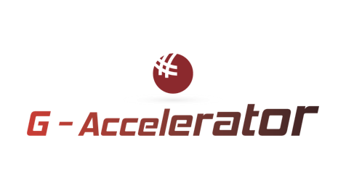


G-ACCELERATOR Impact Call 2026
Product Design
& AI Workflows
Lakshay Suri
Subvencionat pel Departament d'Empresa i Treball (Programa Primer) i amb el cofinançament del Fons Social Europeu Plus

Slide 2

G-ACCELERATOR MASTERCLASS
SESSION 1
Product Design
& AI Workflows
From idea to functional prototype: Building web and mobile applications in the era of AI.
Lakshay Suri | Senior Product Manager @ Inditex

Slide 3


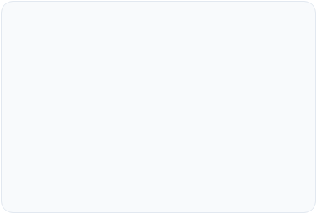
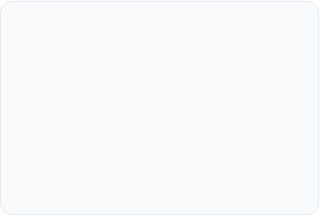



Session Objectives
1. Product Fundamentals
2. AI-Driven UX/UI
3. Prompt-to-App & Deploy
Understand what defines a modern web or mobile app and how to strategically build an MVP.
Apply AI tools for ideation, accelerated prototyping, and user-centered design.
Convert requirements into functional code and publish your digital product in minutes.

Slide 4

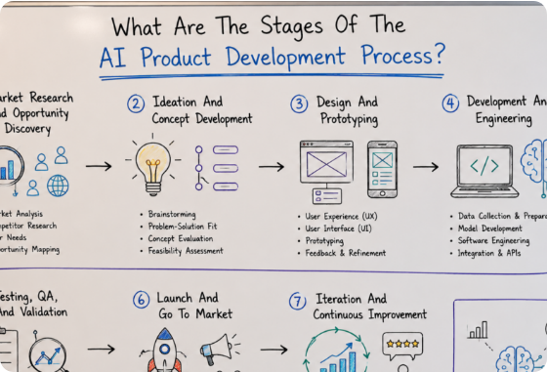
Anatomy of a Digital Product
Real Problem Solving:
A software product is not just code; it is a solution that eliminates a key market problem.
User Interface (UI/UX):
The touchpoint where the user interacts. It must be intuitive, clear, and accessible.
Intelligent Infrastructure:
Frontend + Backend + Database + APIs that deliver personalized value in real time.

Slide 5



MVP Evolution: Traditional vs AI
Traditional MVP
AI-Powered MVP
• Weeks of manual wireframe design.
• Instant generation of user flows.
• Slow development of static HTML/CSS templates.
• Rapid prototyping using natural language (Prompting)
• High cost of iteration and initial validation.
• Validation in hours using AI tools.

Slide 6
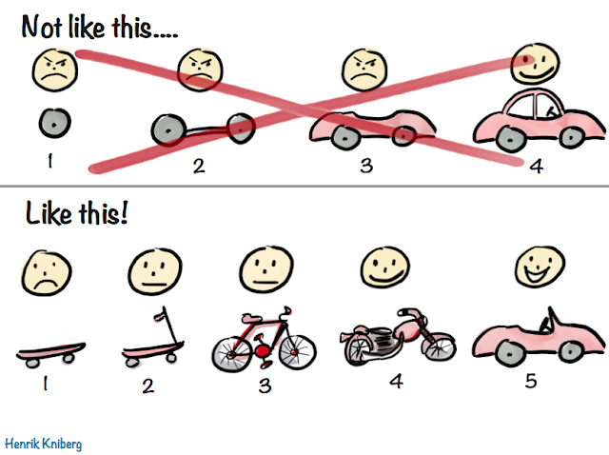
Digital Product MVP

Slide 7
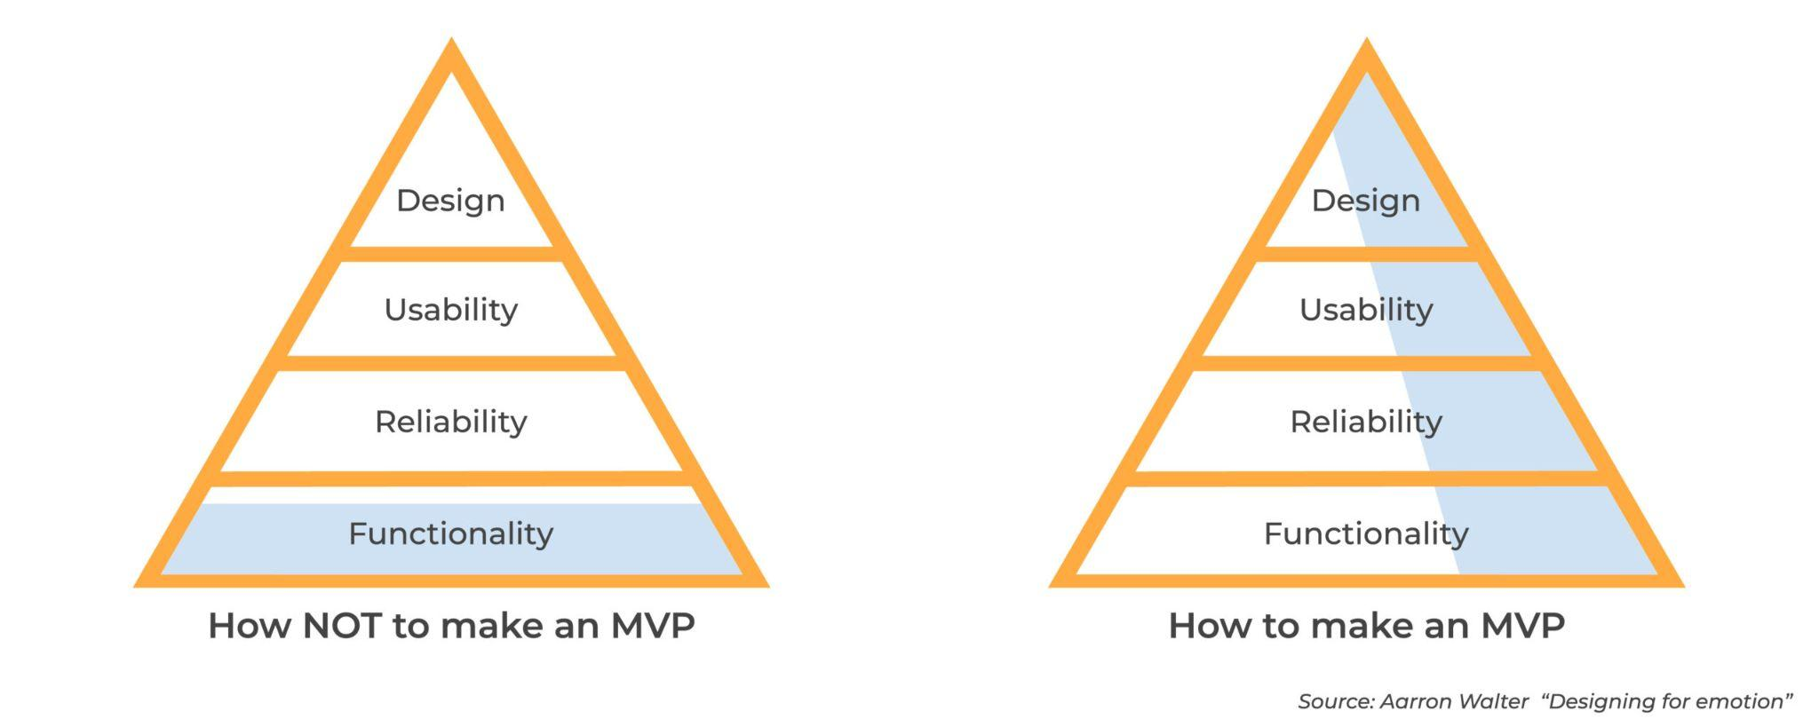
Digital Product MVP

Slide 8
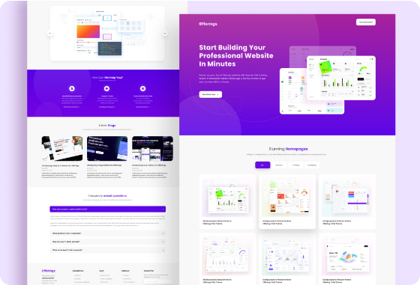
Golden Rules of UI/UX Web based Design
Clear Visual Hierarchy:
Use size, contrast, and whitespace to guide user attention toward the primary Call to Action (CTA).
Simplicity & Speed:
Eliminate distractions. Each screen should have a single main objective.
Mobile-First & Responsive:
Over 60% of global traffic occurs on mobile devices. Always take into account mobile

Slide 9



AI-Assisted Design Phases
1. Ideation
2. Prototyping
3. Development
4. Publishing
Research (interviews, surveys, chatgpt)
Design & Prototyping with Figma AI.
Coding and testing with OpenCode, Visual Studio etc.
Deployment on Vercel or Netlify.

Slide 10
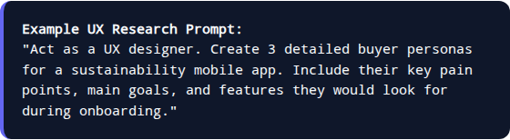
Phase 1: Research with AI
Instead of assumptions, leverage LLMs to simulate user interviews, analyze competitors, and structure value propositions quickly.
Synthetic Interviews: Model user reactions before launching real surveys.
Accelerated Benchmarking: Analyze competitor app reviews to identify UX flaws.

Slide 11
Phase 2: Intelligent Wireframing/Prototyping
Relume.io
Figma AI
Uizard
Generates complete website architecture and visual components from a simple product description.
Automates layout formatting, layer renaming, copy translation, and component variation generation.
Converts hand-drawn napkin sketches directly into interactive digital prototypes.

Slide 12

Phase 3: From Prompt to Live App
"Prompt-to-Code" Tools
Modern tools allow you to write what you want in natural language and generate beautifully styled, interactive apps
PROMPT EXAMPLE
"Create a clean dashboard for a personal finance mobile app in dark mode. Include a bar chart for monthly expenses, a recent transaction list, and a floating 'Add Expense' button."
open code
visual studio

Slide 13
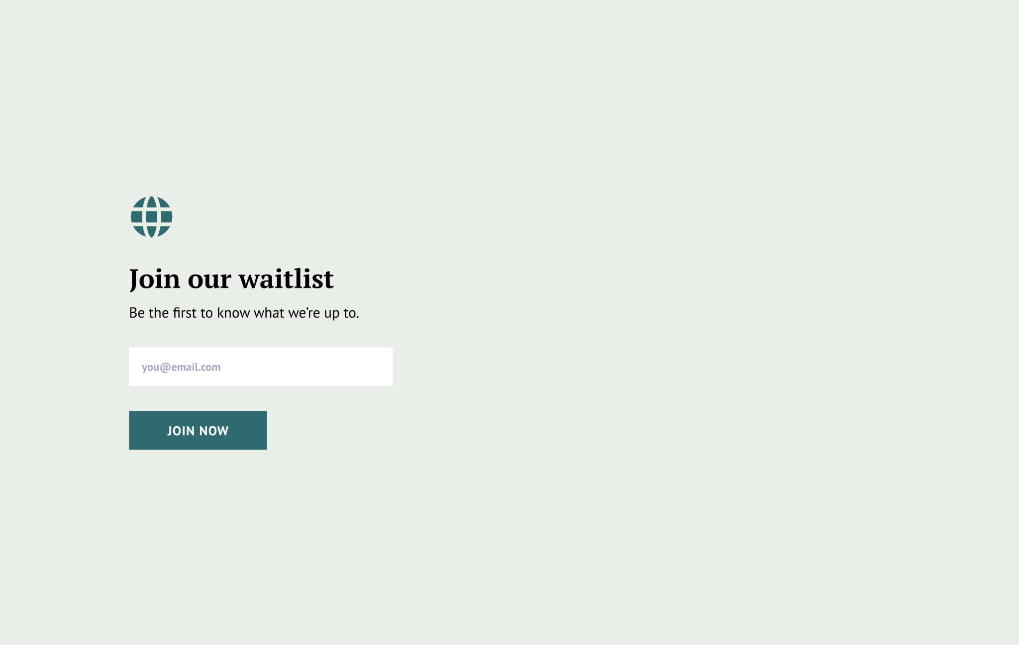
UI Tips
https://www.feathery.io/

Slide 14
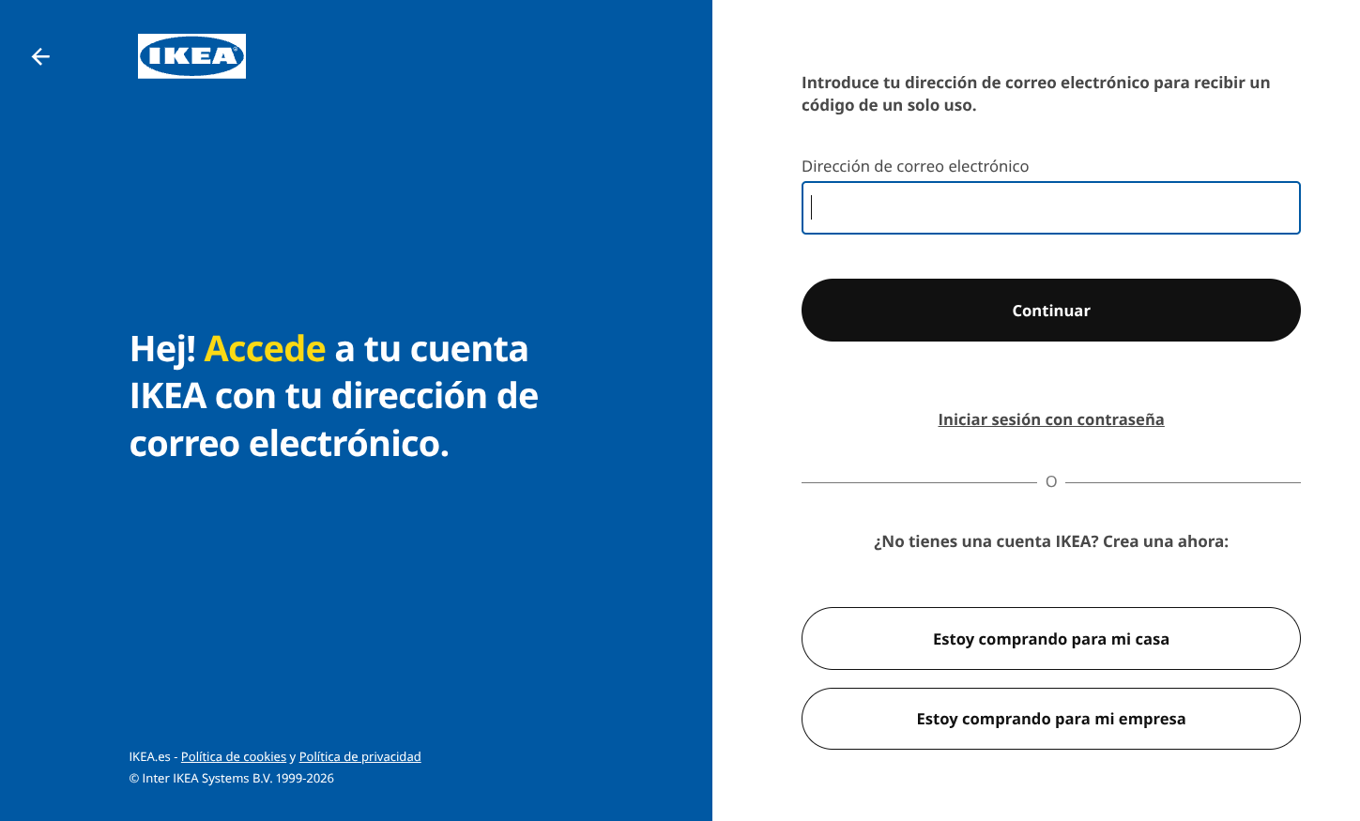
UI Tips
https://www.feathery.io/

Slide 15

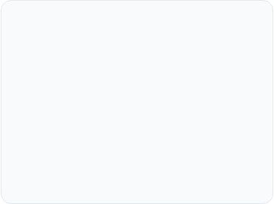
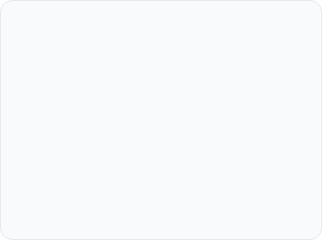



Basic Web/App Architecture
Frontend (UI)
Backend (Logic)
Database & APIs
What the user sees and interacts with.
Technologies: HTML, CSS, React, Tailwind.
The engine that processes business rules.
Technologies: Node.js, Python, Java.
Where data is stored and AI connects.
Technologies: SQL, MongoDB, Postgres, Firebase, OpenAI API.

Slide 16
Workshop: Build an App in 20 Mins
Step 1: Define the Initial Prompt (5 min)
Describe in 3 sentences your app's value proposition and the main screen you want to build.
Step 2: Build UI/app(10 min)
Enter your prompt, adjust design through chat iteration, and refine typography and colors.
Step 3: Deploy Publicly on Vercel / Netlify (5 min)
Connect with 1-click to get a public link and share your functional prototype.

Slide 17
Questions?
Thank you for your attention! Product design has evolved: it's no longer just about writing code, but knowing how to conceptualize, craft the right prompts, and iterate.

