Slide 1
WEEK 3
SESSION 2
Unit 6: Tools to
Activate Mobile Marketing (II)
Notes:
https://www.groundtruth.com/insight/location-based-marketing-101/
https://www.techtarget.com/whatis/definition/augmented-reality-AR
https://clevertap.com/blog/location-based-marketing-guide/

Slide 2
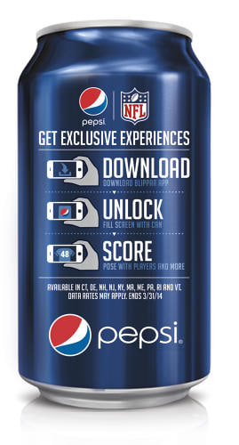
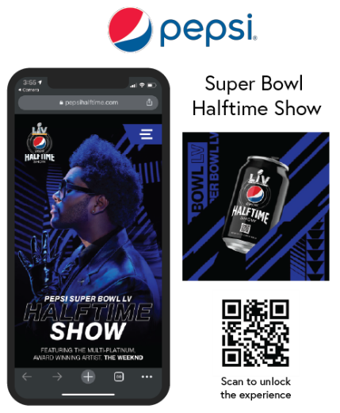
Tools to Activate Mobile Marketing (II):
Augmented Reality
Support you in apps that integrate this technology
Integrate technology into your own app
Notes:
Augmented reality is addressed by taking advantage of apps that already have that technology implemented or integrated into our own app. The key elements are: the camera, bookmarks, virtual information and AR software.
Augmented reality allows the user to see, through the mobile camera, a reality with superimposed information layers showing virtual content. This technology has been on the market for some time, although it experienced a boom with the arrival of Pokémon Go mobile.
In this sense, connecting with the mobile camera, recognize a series of points or physical elements and a virtual content is thrown in real time.
In this sense, there are two ways to approach augmented reality for a business:
• Support you in apps that integrate this technology, like Blippar. In this case you depend on the penetration of the app in the market and focus on additional communication to inform the user of what he or she can do with Blippar when scanning a product of yours, for example like Pepsi did for the Superbowl in their cans.
• Integrate technology into your own app, like Nintendo did with Pokémon Go or Ikea.
For its implementation, components must be taken into account:
Camera: The user should always be asked for permission to activate the mobile camera since it is the one that captures reality.
Markers: These are the elements that activate the content in augmented reality once recognized.
Virtual information: What we are going to show the user superimposed on the reality you are grasping.
AR software: A computer program that interprets the application and reproduces content on mobile.

Slide 3
Tools to Activate Mobile Marketing (II):
Second Screen
Interaction
Simultaneous apps
MasterChef
Automatic Content Recognition
VIDEO
Notes:
Television maintains a high penetration level worldwide; however, mobile devices are gaining increasing prominence as our attention shifts towards the small screen. Currently, technology is available to enhance TV content or assist advertisers in engaging audiences who engage in simultaneous or parallel consumption of TV.
This phenomenon occurs when the appeal of the TV at home diminishes, and more attention is directed towards mobile devices. The primary goal for brands is to maximize interactivity in television programs or series by connecting with viewers. It serves as a means to retain an audience that was once passive but has now become more active.
Several television channels have responded to this shift by offering their own apps to accompany users in consuming their content. TVE, for instance, exemplifies this trend with programs like Masterchef or El Ministerio del Tiempo, utilizing the app as an amplification tool for content. In the case of Masterchef, the app serves as an advertising element for brand sponsorships associated with TV broadcasts.
In this vein, Automatic Content Recognition (ACR) technology synchronizes the audio of TV content with events in the app. Shazam, leveraging its audio recognition technology, amplifies advertisements on mobile devices by linking them to TV spots from major advertisers. While this technology initially connected with television, it has expanded to other channels such as outdoor advertising, magazines, and even radio. An illustrative example is Coca Cola's "The Drinkable Ad," showcasing how Shazam's technology can be maximized.

Slide 4
Proximity Marketing
Notes:
With the number of available apps for download from the world’s leading app stores totaling over four million, enterprises know all too well that a meticulous marketing strategy is the only way to stand out in today’s app market. While focusing on mobile app development and building an app that functions properly is a central factor for success, if users’ don’t know the product exists, your hard work is worthless.
Mobile app marketing covers every user interaction from the moment they first learn about the product to when they become a loyal user. Marketing a mobile app effectively involves defining a target audience, learning how to reach them, how to communicate with them, and analyzing their in-app behavior to make continuous improvements as users move through the acquisition funnel. Ultimately, the goal of a mobile app marketing strategy should be to acquire users that will not only drive repeat engagement but will also become loyal advocates for the product.

Slide 5
Tools to Activate Mobile Marketing (II):
Geolocation
Geolocation on the Internet is a communication tool between the offer (the issuer or brand) and demand (the receiver/consumer) in a SoLoMo world (social, local and mobile).
Geolocation
GPS
GSM
Wi-Fi
Notes:
Location-based marketing, also known as location marketing, geo-targeting marketing, geolocation marketing, proximity-based marketing, and hyperlocal marketing, involves using data from mobile device users' current or past locations to display relevant content. This can be achieved through methods such as geofencing or geotargeting.
The importance of location-based marketing lies in its effectiveness in generating higher sales and improving customer relationships. According to a Factual report, 9 out of 10 marketers have found that location-based advertising contributes to increased sales. By incorporating location-based advertising into their strategies, marketers gain a better understanding of customer needs, allowing them to deliver personalized content and enhance customer engagement.
Several factors contribute to the rationale for using location-based marketing:
1. Proliferation of Smartphones: Over 94% of US millennials are expected to own smartphones in 2022.
2. Increased Mobile Device Usage: Daily mobile device usage reached 3 hours and 54 minutes in 2021, surpassing TV usage, which reached 3 hours and 22 minutes. This indicates a growing gap between TV and mobile time.
3. Effective Audience Targeting: To capture customers' attention, marketers need to focus on platforms with substantial reach. Location-based advertising allows them to target mobile device users effectively.
Geolocation is the foundational technology for determining the geographical position or location of an object. Three elements contribute to geolocation information:
1. GPS (Global Positioning System): Mobile devices incorporate GPS receivers connected to a network of at least 30 satellites orbiting the Earth. By receiving signals from multiple satellites, devices can calculate latitude, longitude, height, and time, providing accurate location information.
2. GSM (Global System for Mobile Communications): This system uses the telephone network, relying on towers or antennas installed throughout the geography. By considering the proximity to these towers, signal travel time, and signal strength, the device's location can be calculated. GSM is less accurate, with a margin of error of up to 200 meters.
3. Wi-Fi: Wi-Fi emits an identification signal, and by knowing which Wi-Fi connection a device is connected to, its location can be determined. Similar to GSM, Wi-Fi-based geolocation has a margin of error depending on factors like GPS signal strength and building interference.

Slide 6
Tools to Activate Mobile Marketing (II):
Types of Location Based Marketing
IP Address Marketing
GPS Marketing
Geofencing Marketing
Beacon Advertising
Blueprints Location-Based Marketing
Notes:
IP Address Marketing:
- Description: IP address marketing leverages the location information associated with every computer or device connected to the Internet through an IP (Internet Protocol) address. This information is used to target marketing efforts.
- Application: Targeting marketing based on the location associated with a device's IP address.
GPS Marketing:
- Description: GPS marketing utilizes GPS (Global Positioning System) location technology found in modern mobile devices. It determines location by measuring the distance from a network of global positioning satellites, allowing for precise targeting based on geographical location.
- Application: Targeting promotions and marketing efforts based on the GPS location information of mobile devices.
Geofencing Marketing:
- Description: Geofencing marketing involves setting up virtual boundaries or radii to target marketing to individuals within a defined area. Proximity marketing, related to geofencing, allows for targeting consumers within the range of a previously established geofence for an advertising campaign.
- Application: Targeting marketing efforts to individuals within a specific geographic area or proximity to a location.
Beacon Advertising:
- Description: Beacon marketing, also known as beacon advertising, utilizes physical devices called "beacons" placed on the premises of a business. These beacons communicate marketing messages to individuals within their range.
- Application: Using physical beacons to deliver targeted marketing messages to people in proximity to the beacon's location.
Blueprints Location-Based Marketing:
- Description: Blueprints location-based marketing is a sophisticated form of geolocation marketing. It involves creating geographical boundaries around points of interest and locations. When combined with location and behavior data, this technology allows for precise audience targeting.
- Application: Fine-tuning audience targeting by creating detailed geographical boundaries around specific points of interest and leveraging location and behavior data for optimal marketing results.
These location-based marketing strategies utilize various technologies to target audiences based on their geographical location, providing marketers with tools to deliver more relevant and timely content to their target audience.

Slide 7
Tools to Activate Mobile Marketing (II):
Geolocation
Geofencing: A location-based service that creates a virtual perimeter or geofence with smartphone data, Wi-Fi, or GPS to trigger a desired marketing action.
Example: You walk past a Best Buy and receive a push notification with the message: ‘Sale ends today! Buy 1 phone cover, get 1 free’
Geotargeting: A location-based service that delivers content to users who meet specific criteria inside a defined perimeter.
Example: You own a pizza food truck and recently launched a veggie pizza option. You target users within the community who are interested in health, a vegetarian lifestyle, and local produce.

Slide 8
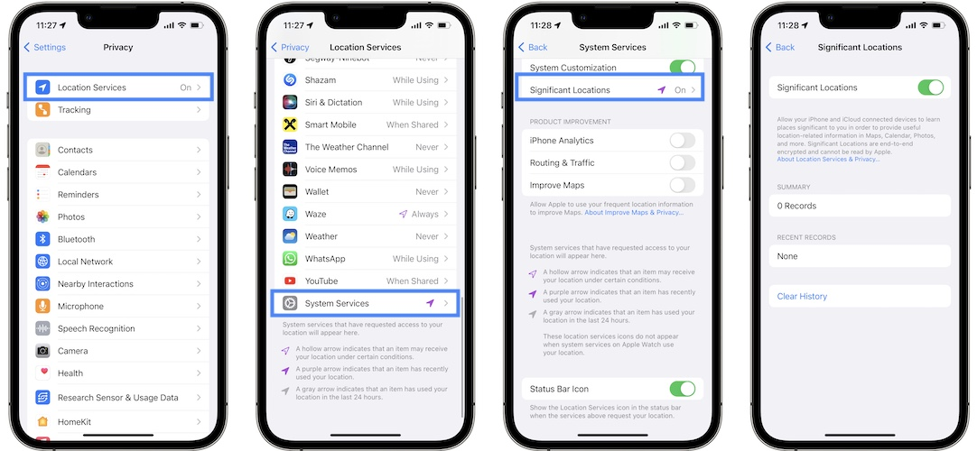
Tools to Activate Mobile Marketing (II):
Geolocation
Notes:
The data collected through mobile devices, particularly through geolocation, empowers professionals to craft communication strategies based on geo-profiles. Mobile devices have become an integral part of our daily lives, accompanying us 24/7 and storing a wealth of information about our habits, preferences, and routines. As humans are creatures of habit, the mobile device becomes a valuable tool for understanding and predicting user behavior.
The mobile device, being a constant companion, witnesses our daily activities, travels with us, and serves as a gateway to our preferences and interests. It accumulates information, potentially reaching a level of understanding about us that rivals our self-awareness.
Considering the routine of an average day, from morning commutes to work, school drop-offs, work hours, meal breaks, and evening activities, individuals tend to frequent the same locations regularly. This routine not only shapes our daily lives but also generates a trove of actionable information for advertising campaigns. Leveraging technology, advertisers can process this data to target audiences more effectively and precisely.
For instance, platforms like Apple Maps, Calendars, and Photos compile a history of visited places, providing insights into the frequency, specific dates, and times of these visits. This example illustrates the potential of data collection from mobile devices to impact target audiences with greater effectiveness and accuracy.
Moreover, the vast amount of information gathered by third-party applications downloaded on mobile devices opens up new possibilities for advertising use and exploitation. The implications of such data collection highlight the evolving landscape of targeted advertising and the role of mobile devices in shaping personalized and context-aware marketing strategies.

Slide 9
Tools to Activate Mobile Marketing (II):
Pros and Cons
Pros
Cons

Slide 10
Tools to Activate Mobile Marketing (II):
Pros and Cons
Pros
Location Targeting
Data Offerings
Enhanced Targeting
Cost Per Visit Performance Model
Cons
Opt-In Requirements
Non-Smartphone Users
Inappropriate Targeting
Ineffective Location Data
Notes:
Location-Based Marketing Advantages:
1. Location Targeting:
- Benefit: Increase in-store visits by targeting ads to customers when they are within range of a selected organization.
2. Data Offerings:
- Benefit: Marketers gain deep insights into customers' shopping behavior using visitation, audience, and trade area data. This helps in enhancing customer personas for future advertising efforts.
3. Enhanced Targeting:
- Benefit: Fine-tune and segment ads based on various factors such as location, time of day, shopping patterns, weather, etc. This enhanced targeting allows for more personalized ads, increasing the likelihood of boosting conversion rates and improving return on investment.
4. Cost Per Visit Performance Model:
- Benefit: Location-based advertising introduces new performance models like cost per visit (CPV), where advertisers only pay when customers make an in-store visit. This improves the return on ad spend.
Location-Based Marketing Disadvantages:
1. Opt-In Requirements:
- Disadvantage: Users must use location technology on their phones and provide verified apps access to that data. Many users may opt-out due to privacy concerns, limiting the reach of location-based marketing.
2. Non-Smartphone Users:
- Disadvantage: People without smartphones lack built-in location technology, making it impossible to target them with location-based marketing. However, the decreasing cost of smartphones is reducing this issue.
3. Inappropriate Targeting:
- Disadvantage: Location-based marketing requires proper segmentation to achieve meaningful conversions. Inappropriate targeting can lead to ineffective campaigns, even with a potentially large audience in a specific geographical area.
4. Ineffective Location Data:
- Disadvantage: The effectiveness of location-based marketing relies on accurate location data. Factors like VPN usage or inaccurate reporting can impact location data accuracy, leading to inappropriate targeting and ineffective campaign results.

Slide 11
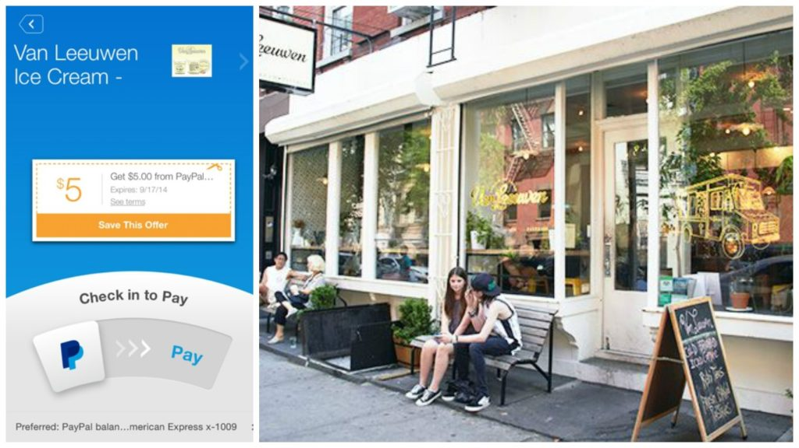
Tools to Activate Mobile Marketing (II):
Geolocation
Notes:
Case Study: Van Leeuwen Ice Cream
Objective:
- Increase customer engagement and sales by leveraging mobile payments and tracking user locations.
Implementation:
- Van Leeuwen, a New York ice cream store, integrated mobile payment options through the PayPal app.
- Customers were required to install the PayPal app, link it to their PayPal account, and enable location tracking.
- Geolocation was used to detect when a user was near a Van Leeuwen store, triggering special offers and deals within the app.
- Users could place orders and make payments for their treats through the mobile app.
Results:
- Enhanced customer experience: Users received personalized offers based on their proximity to Van Leeuwen stores.
- Increased sales: The combination of location-based offers and convenient mobile payments likely contributed to higher sales.
- Improved customer loyalty: Seamless mobile payments and tailored promotions could have fostered loyalty among customers.
Takeaway:
- Capitalizing on the growing trend of mobile payments with location tracking can significantly impact customer decisions at the moment-of-truth.
- Utilizing location data enhances the contextual relevance of offers, increasing the likelihood of influencing customer behavior positively.
Note:
- Proximity mobile payments were on the rise, and this case study highlights the successful integration of mobile payments with location-based incentives to drive customer engagement and sales.

Slide 12
Tools to Activate Mobile Marketing (II):
Geolocation
Notes:
When is a user most likely to offer useful feedback? When an interaction with a brand comes to a close. The customer is reflecting on how they feel about their recent experience. One tech brand that leverages this well is Google Maps.
As you can see in the below example, Google Maps has sent the customer a proactive prompt to rate their visit to a local establishment once they’ve detected the user has completed their interaction there, based on device location. Rather than include a form to fill out, or boxes to fill in, the star option is quick and effective. This is the time to engage with a captive audience.
Key takeaway: Offer customers the opportunity to share how they feel at a critical moment, i.e., after they experience what your brand has to offer. Even if it’s a negative review, real-time feedback is an opportunity to understand your customers and improve their experience.

Slide 13
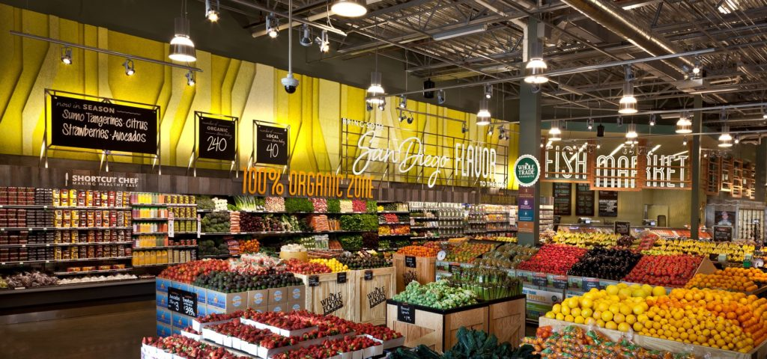
Tools to Activate Mobile Marketing (II):
Geolocation
Notes:
Whole Foods and Thinknear Partnership
Objective:
- Improve post-click conversion rates for mobile ads.
- Attract potential customers to Whole Foods by leveraging location-based marketing.
Implementation:
- Whole Foods collaborated with Thinknear, a location-based marketing firm.
- Geofences were placed around several Whole Foods store locations to target nearby mobile users.
- Ads and special offers were delivered to mobile users passing by Whole Foods stores, enhancing local engagement.
- Geo-conquesting tools were employed to place geofences near competitors' stores, targeting shoppers in those areas.
Results:
- Significant post-click conversion rate: Whole Foods achieved a 4.69% post-click conversion rate.
- Outperformed the national average: The conversion rate was more than three times the national average of 1.43%.
- Effective geo-conquesting: Targeting competitors' stores incentivized nearby shoppers to choose Whole Foods for better deals.
Takeaway
- Geo-conquesting, especially when targeting competitors' offline stores, can strongly influence consumer purchase decisions.
- Leveraging location-based marketing to provide targeted ads and offers to users in proximity can yield higher conversion rates.
Note:
- This case study highlights the successful collaboration between Whole Foods and Thinknear, showcasing the effectiveness of geofencing and geo-conquesting in driving post-click conversions and gaining a competitive edge in the grocery market.

Slide 14
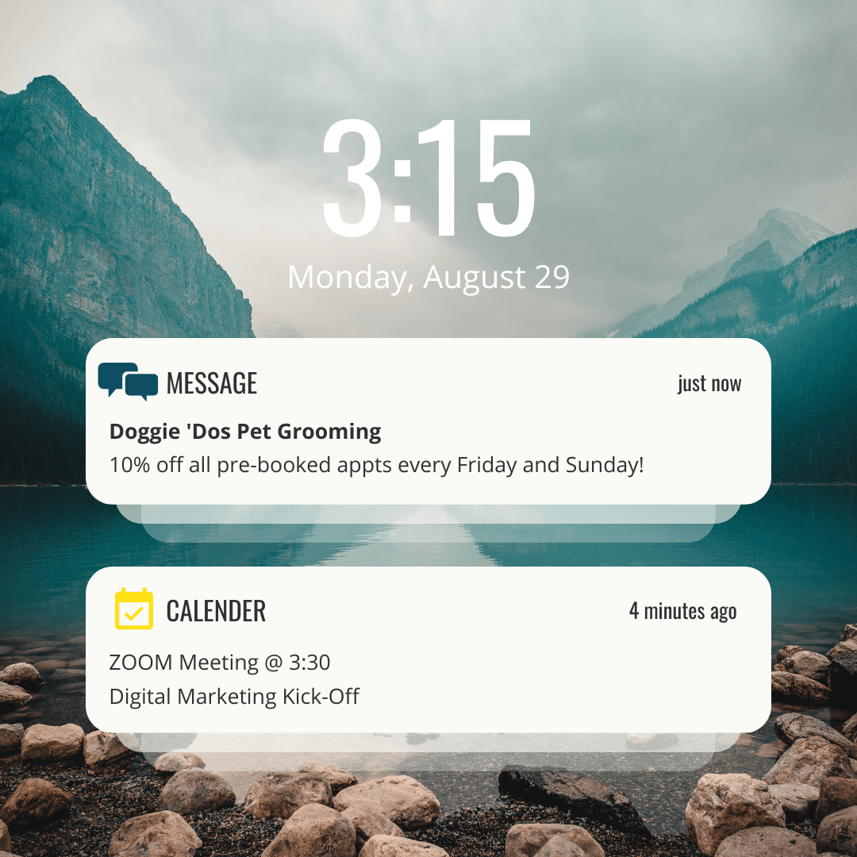
Tools to Activate Mobile Marketing (II):
Geolocation
Notes:
After assessing six months of visitor data, Doggie ‘Dos Pet Salon notices that they are most likely to get walk-ins on Saturday afternoons, which often puts the groomers behind schedule. To encourage customers to book appointments on Fridays or Sundays instead, the business offers a 10% discount to a targeted list of those who show a history of being at the shop’s specific location on Saturdays.

Slide 15
Tools to Activate Mobile Marketing (II):
Bluetooth and Beacons
What are beacons?
How do beacons work?
Notes:
Unlike the use of Bluetooth years ago, launching indiscriminate communications to whoever passed through a radius of action, now we link the marketing campaigns to the usage of beacons. These little beacons of low frequency chips emit to smartphones through Bluetooth.
Basically, they fulfill a function of micro-geolocation since the communication is based on exactly where you are in the establishment or venue. This is a great advantage for retailers who can, for example, generate shopper engagement with unique offers throughout the visit. In this way they can highlight products, including based on the profile or registered purchasing behavior.

Slide 16
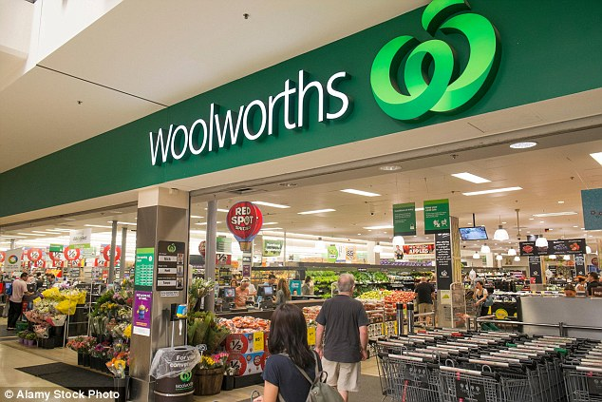
Tools to Activate Mobile Marketing (II):
Bluetooth and Beacons
Notes:
Supermarket giant Woolworths successfully completed a beacon trial with one store using iBeacon technology to improve customer service around click-and-collect. Thereafter, the chain announced that they are looking to roll out beacons across all 254 click-and-collect stores with the aim of allowing consumers to place their order online and pick them up in-store. For instance, when a click-and-collect consumer comes within a certain radius of the store, a notification is sent to Woolworths’ picking systems. This notification prompts the staff to start assembling the order. Certain triggers at different stages of the fulfilment process then prompt a push notification via the app to the consumer, notifying them that their order is ready.

Slide 17
Tools to Activate Mobile Marketing (II):
Bluetooth and Beacons
Notes:
Japan’s massive Nagoya University Hospital uses beacons to monitor patients’ vital signs and track patient and employee locations. When a patient’s vital signs – such as heart rate, movement and stress level – exceed or dip below specific levels, beacons alert the staff immediately. In addition to improving response time and reducing negative patient outcomes, beacons can be used to calculate the amount of time medical staff spends with patients to improve efficiency and care.
Nursing homes can use a similar system to monitor residents’ health and movement. For example, if a patient with dementia wanders off, beacons can alert staff immediately, allowing them to respond and keep the patient safe. Doctors’ offices can use beacons for contactless check-in, prompting the system to pull up patient records, which reduces wait times.

Slide 18
Tools to Activate Mobile Marketing (II):
Bluetooth and Beacons
Notes:
Check-Ins and Check-Outs No more queuing at the front desk to check-in and check-out. Once you walk into the beacon-enabled hotel lobby, a check-in push notification will be sent to the hotel app on your smartphone, which automatically displays the reservation so that you can check in digitally without delay. On the last day of your stay, you will receive push-notifications – allowing you to either extend your stay or check out digitally. Anyone who has activated Bluetooth through their smartphone can enjoy this self-service.

Slide 19
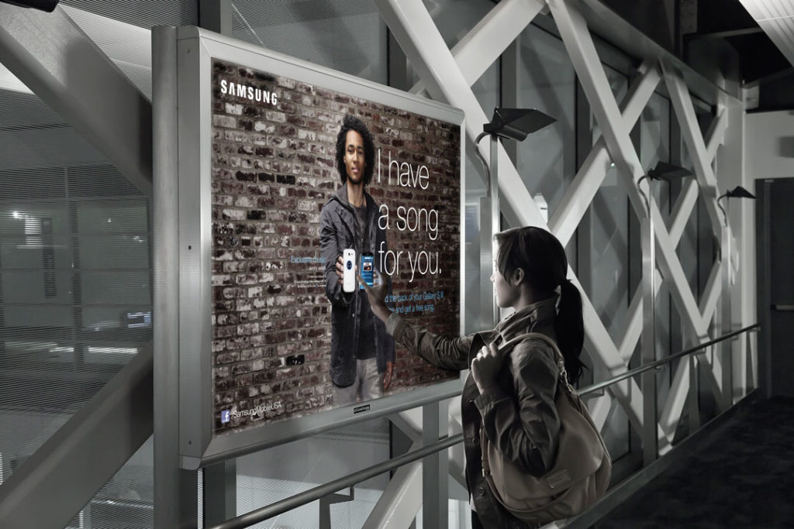
Tools to Activate Mobile Marketing (II):
NFC-Enabled Tags
What are NFC tags?
Notes:
Clear Channel also recently included chip tags, NFC, and thus allow customers to configure advertising campaigns that enlarge the ad that is already showing. This is the great step towards the digitization of the external environment. These NFC-enabled chips or “NFC-enabled tags” can be placed on diverse objects or places. Unlike the beacon, this technology does not require an app. The user only needs to connect the Bluetooth and put their mobile device close to the NFC label. Instantly a web or an app will activate the action that we have configured.
Although it is a technology that is closely linked to mobile payments, it also has great potential in the marketing territory. Whether including it in the product or exploiting it for advertising. For example, at the 2018 World Cup in Russia, the organizers had included in all the official FIFA balls an NFC chip with all the information of the competition. In Berlin, the city transport company (BVG) collaborated with Adidas to use a model of sneakers as a ticket for the subway, including the NFC chip in the product.
NFC “Scan Me” labels on billboards can engage offline consumers with online content. They have the added benefit of being able to provide some measurable analytics data for modern performance marketers.
NFC Tags
Near Field Communication (NFC) is slightly younger than QR Code technology and was introduced in 2002. The connection technology is based on RFID. NFC tags are designed, similar to the QR Code, to transmit short pieces of information (usually a URL) to an interacting phone. No special application is needed, nor is it necessary to open the phone's camera. When smartphones are in the range of the tags (up to 20cm), they automatically receive a notification that allows the user to perform the desired action. NFC tags are usually used in the shape of stickers and do not require their own power supply. The strength of NFCs lies in their simplicity, as they can be used where other technologies cannot. Due to the rapid adaptation of the smartphone industry, nearly all devices with Apple iOS, Android, Microsoft, and Blackberry operating systems are now NFC-compatible.
Advantages of NFC Tags
NFC tags are mostly embedded in consumer goods, rather than fast-moving consumer goods, compared to QR codes, and are therefore not discarded after the use up of the product. NFC tags are an extremely effective way to engage the customer throughout the entire customer journey. Thus, as with QR codes, brands can engage their customers with valuable content even very long after the purchase and gather customer feedback to make better product decisions. NFC thus also extends the value chain for a product.
Disadvantages Of NFC Tags
Despite the rapid adaptation of the market to NFC, there are certain disadvantages, especially compared to QR codes. Whereas QR codes can be easily printed on products, labels and other items, NFC tags are subject to production costs. Although these are in the low double-digit cent range, they add up depending on the size of the campaign. Another disadvantage of NFCs is when we look at how they are embedded in the products. For example, they have to be sewn into clothes or built into bottle caps. This has a major impact on the manufacturing process of the goods and is therefore associated with additional costs. Finally, NFCs are not counterfeit-proof - they can be manipulated by hackers, and, there is also the danger of counterfeiting by scammers.
In Which Cases do NFC Tags Work Best?
As the list of pros and cons in the previous section shows, this technology is most effective when integrated into consumer products. This authentic connection can be used throughout the customer journey, from pre-purchase to post-purchase. Post-purchase, brands can offer value-added content to their customers to get the most out of their purchases. Finally, brands can use this new stream of customer information to inform future product decisions. A great example of NFC campaigns are those where NFC tags are sewn into consumer goods like clothes. Consumers can use the tags to confirm that the product is original and not fake, as well as to get outfit guides and directly order more products.

Slide 20
Tools to Activate Mobile Marketing (II):
NFC-Enabled Tags
Notes:
Timberland, one of the world’s leading outdoor lifestyle brands, recently introduced tablets and digital installations that help customers learn more about its products at it’s Herald Square store in New York City. Through the use of customer-facing tablets powered by Near Field Communication (NFC) and beacon technology, Timberland customers will be able to digitally and socially engage with every product in the store, without being required to sign-up, download an app or initiate registration.
Shoppers will receive a guided Timberland experience, with rich digital product information, styling options and recommendations, as they build their online collection of Timberland® footwear, apparel and accessories. When finished, shoppers can choose to opt-in via email and receive personalized content related to their store visit.
Timberland’s Connected Store will also include interactive “tap walls” featuring an assortment of exclusive merchandise via a creative digital installation. Nimbus, CloudTags’ in-store recommendation engine, allows customers to shop from an extended range of styles, colors and sizing, based on their location and interests, that otherwise would only be available through timberland.com.
“Consumers use technology to shop where and when they want, and with a partner like CloudTags we can help them discover, shop and socialize, while getting immersed in the Timberland® brand,” said Kate Kibler, vice president of direct to consumer at Timberland. “CloudTags can help us better understand our customers’ preferences in-store, online and post-visit. These invaluable insights can enrich the shopping experience by allowing customers to interact with our products in exciting, innovative ways.”
Using CloudTags’ Connected Commissions, all related online sales that occur following the store visit will be attributed back to the store and associate. In this way staff are incentivized and credited for educating and helping customers who may purchase later online, while the store receives credit for its value in the customer journey.

Slide 21
Thank You

