Slide 1
WEEK 3
SESSION 1
Unit 5: Tools to
Activate Mobile Marketing

Slide 2
Tools to Activate Mobile Marketing
SMS, MMS, RCS (Rich Communication Services)
Notes:
Text messages remain the trailblazers of mobile messaging, evolving from a technology of the past into a potent marketing tool with considerable potential when wielded effectively. SMS (Short Messaging Service) and MMS campaigns (Multimedia Messaging Service, which includes photos, videos, or voice messages) prove instrumental in driving sales, fortifying brand identity, and nurturing customer relationships, thanks to their unparalleled proximity and immediacy.
The key to their efficacy lies in their exceptionally high open rates. However, caution is advised to avoid falling into the realm of spam or targeting the wrong audience due to the use of unqualified data in databases. Currently, these messaging strategies are predominantly employed by telecommunications companies or businesses boasting robust loyalty programs.

Slide 3
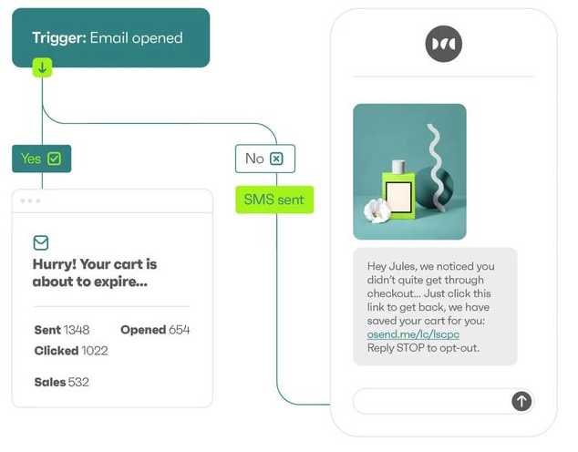
Tools to Activate Mobile Marketing
SMS, MMS, RCS (Rich Communication Services)
Higher engagement
Trackability
Immediate delivery
Notes:
Statistical studies about SMS marketing have shown that 83% of millennials look at SMS messages within 90 seconds from receipt. For 75% of millennials, SMS texts are the preferred method of communication to receive notifications from businesses. Marketing surveys are responded to by 31% of the recipients. When the same study was done on mobile marketing, it came to light that 46% of the emails are opened on mobiles. Customers spend 85% of their device time on mobiles. It was surprising to know that 50% of the product searches are done on mobiles.

Slide 4
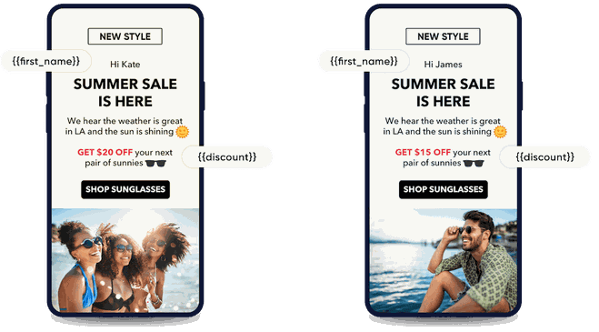
Tools to Activate Mobile Marketing
SMS, MMS, RCS (Rich Communication Services)
Personalization
Relevance
Clear CTA
Timing
Frequency
Chatbots
Notes:
When implementing an SMS or MMS campaign, it is crucial to determine the type of activation—whether 'push' or 'pull'—and utilize a reliable database, client, or Fully Qualified Provider. 'Push' campaigns involve sending an SMS to a volume of recipients to promote a product or service, ideal for communicating promotions or discounts, as exemplified by Zara's SMS notifications during sales. On the other hand, 'pull' campaigns encourage users to SMS a message or code, enabling them to send information, grant permissions, or subscribe to a service. This approach is commonly seen in television programs inviting viewers to participate in contests by sending an SMS.
Before incorporating the SMS channel into the marketing mix, it is crucial to design a robust SMS strategy aligned with the company's needs and objectives. To ensure success, attention should be paid to the following:
1. Relevance: SMS messages are personal, and users expect content that suits their profile, tailored to their gender, specific characteristics, or interests.
2. Clear and Attractive Call to Action (CTA): Include a tracked URL to measure the SMS's performance beyond the opening rate.
3. Timings and Frequency: Consider the timing of SMS delivery, avoiding early mornings, and be mindful of communication frequency to prevent user frustration. Regularly clean up your SMS list to prevent being perceived as spam.

Slide 5
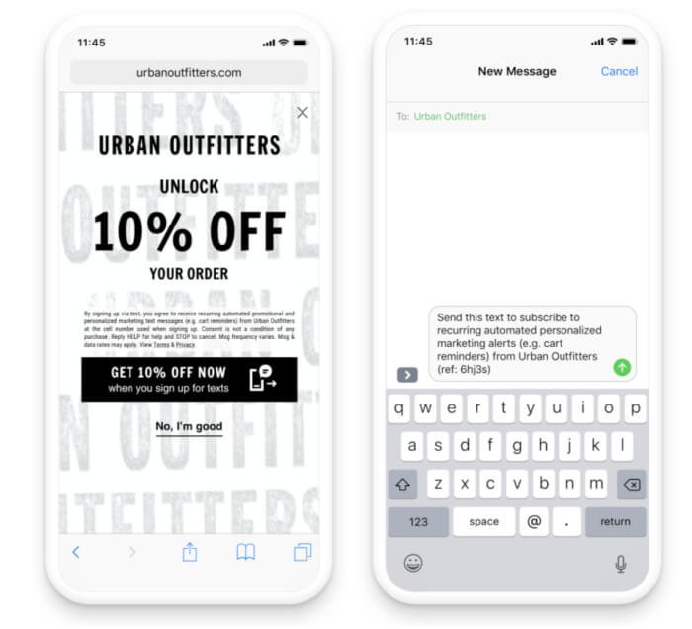
Tools to Activate Mobile Marketing
SMS, MMS, RCS: Examples
Sending coupons
Notes:
Sending coupons
Studies show that around 90% of consumers used coupons in 2020 and over 50% prefer to get them on their mobile devices. Coupons are a great way to make your customers feel special and create a positive first impression in their customer journey.

Slide 6
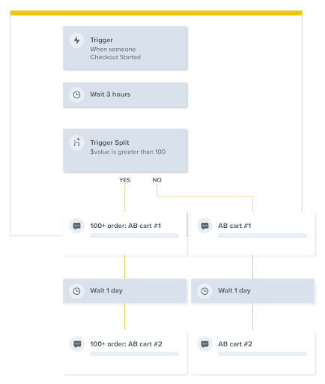
Tools to Activate Mobile Marketing
SMS, MMS, RCS: Examples
Sending coupons
Setting up cart abandonment flows
Notes:
Setting up cart abandonment flows
Mobile phones have an average cart abandonment rate of 81% so you definitely need to create a cart abandonment flow and send between 1 to 3 text messages to each customer.

Slide 7
Tools to Activate Mobile Marketing
SMS, MMS, RCS: Examples
Sending coupons
Setting up cart abandonment flows
Sending shipping and delivery notifications
Notes:
Sending shipping and delivery notifications
Not everything is about promoting your product, transactional messages are equally important. Send shipping updates and delivery notifications to help customers track their purchases. These are super important customer touchpoints and it’s really easy to set them up and send them automatically through your email and SMS tool.

Slide 8
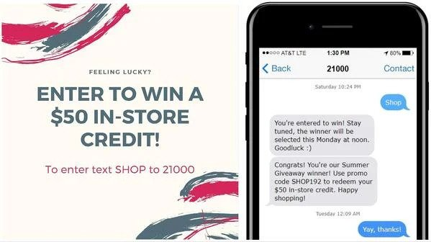
Tools to Activate Mobile Marketing
SMS, MMS, RCS: Examples
Sending coupons
Setting up cart abandonment flows
Sending shipping and delivery notifications
Running a giveaway
Notes:
Running a giveaway
Another thing you can do with SMS is run a giveaway. Giveaways help increase customer engagement and boost loyalty. You could offer your products, services, or cash to winners of a campaign to promote your brand. You could also run a contest for the best user-generated photo or video of your product.

Slide 9
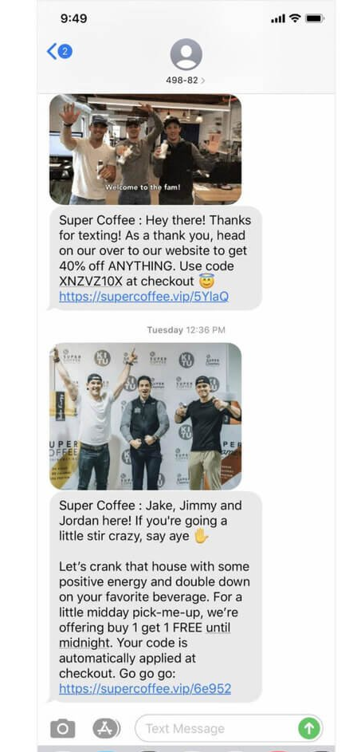
Tools to Activate Mobile Marketing
SMS, MMS, RCS: Examples
Sending coupons
Setting up cart abandonment flows
Sending shipping and delivery notifications
Running a giveaway
Using photos or videos
Notes:
Make it personal
Use GIFs, memes, and cool videos to make your SMS campaign stand out. Don’t be too formal or aloof. You can even send out a picture of your team like SuperCoffee did here.

Slide 10
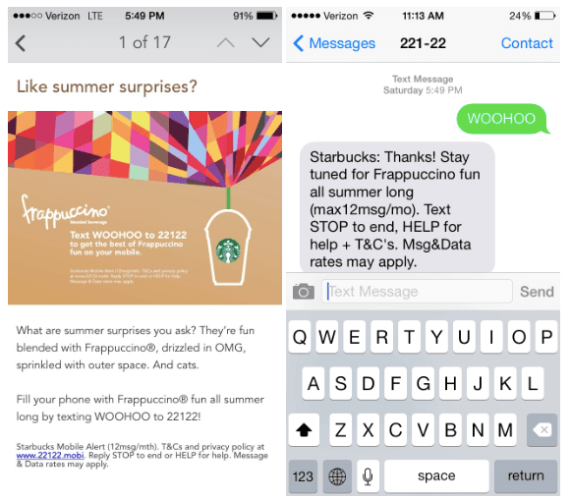
Tools to Activate Mobile Marketing
SMS, MMS, RCS: Examples
Notes:
Rewards campaign by Starbucks
Starbucks has one of the most famous rewards and loyalty programs on the planet which generates over 53% of its total revenue. The company has over 25 million users and regularly uses SMS marketing for its loyalty and rewards campaigns. They first send an SMS message to their subscribers informing them of a contest and offering a prize reward for signing up for summer alerts. Then, they follow up with a video about an in-store special offer.
Amazon launched its famous Treasure Truck in 2016, which is an SMS campaign that offered customers exclusive daily items and monthly deals. By subscribing via text, customers gained access to these deals and could pick them up at different locations around the city. The program was so successful that Amazon expanded it to 100 trucks in 25 major cities, and was able to gain millions of text subscribers.

Slide 11
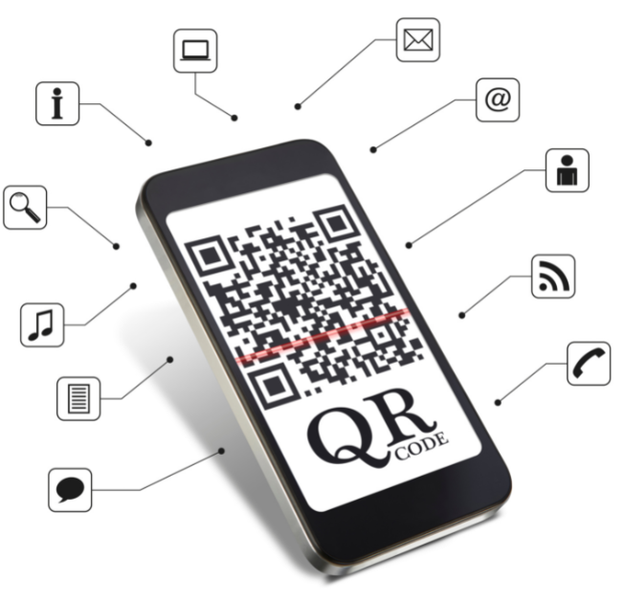
Tools to Activate Mobile Marketing
QR Codes
• The color and contrast of the code for a correct reading
• The location of the code, always at user scope
• The CTA that is motivating
Notes:
So, how did QR Codes come into existence?
QR Code or Quick Response Code is the trademark name for 2-dimensional barcodes. The Denso Corporation of Japan invented QR Codes in 1994 as a way of overcoming the limitations of barcodes. QR Codes gained importance after the Japanese automobile manufacturer Toyota incorporated the technology in their manufacturing process for the identification and tracking of automotive parts.
Although QR Codes were created as a technology to keep track of product inventory, it has become so much more today. The usage of QR codes varies significantly between countries. In Spain studies indicate that 64% of mobile users know what a QR code (quick response) however the user does not usually scan them. Nevertheless, in countries like China or Japan both recognition and use are very high, becoming present in the payment process of even food stalls.

Slide 12
Tools to Activate Mobile Marketing:
Benefits of QR codes for a Marketing Campaign
Directing customers to your website
A platform for customer feedback
App download
Advertising
Directing customers to your social media pages
Delivering freebies and offers
Scavenger hunts
Augmented reality
Gathering big data
Notes:
So, now we’ve covered what QR codes are, let’s consider the advantages of plugging them into your marketing strategy. There is a long list of possibilities when it comes to how your company can use QR codes, but in this post we will highlight the 8 genius ways we think they will help your marketing campaign thrive:
Directing customers to your website
A platform for customer feedback
App download
Advertising
Directing customers to your social media pages
Delivering freebies and offers
Scavenger hunts
Augmented reality
As an extra added bonus to the list above, when consumers scan QR codes they leave trackable data which you can use to your advantage to enhance your marketing campaign. This allows you to better understand consumer behaviour through interests, time and location, and other demographics, meaning you can alter your campaign making it more personalised to your target audience. Therefore, this should give you enough reason to use QR codes already, as every scan gives you more consumer information to keep building on and improving your campaign!
QR codes are known for spreading information faster, and to a wider community of consumers, as they are accessible and easy to scan on the go. This not only gets customers engaged and intrigued about what is on offer, but also encourages interaction as there is more than one use for a QR code. QR codes can trigger a range of actions such as taking customers to the company website, or sending a discount coupon to their mobile wallet. This means you can use them in a way that suits your company, or more specifically, your marketing campaign.
Ultimately, the data from these codes is easy to analyze and review, so you can use web analytics or tools to measure how many consumers are actually scanning your code, and spending time browsing your site. So, with that in mind, let’s get into the several ways you can maximize these codes to help monitor engagement and boost your campaign!

Slide 13
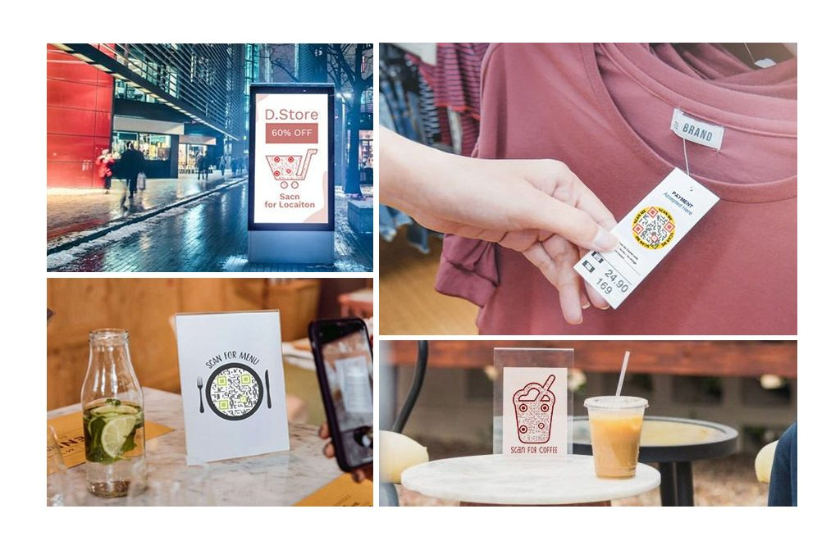
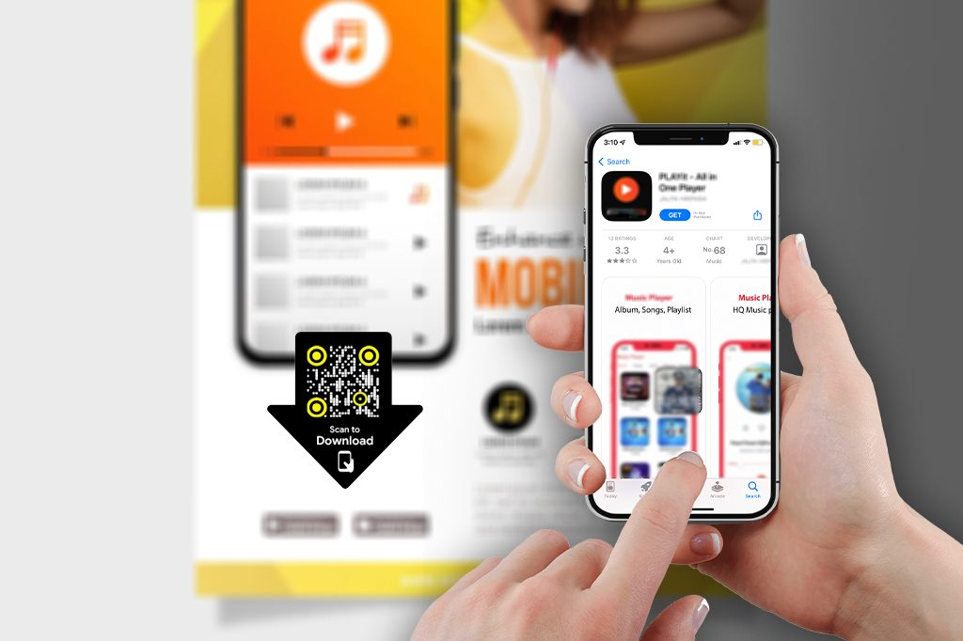
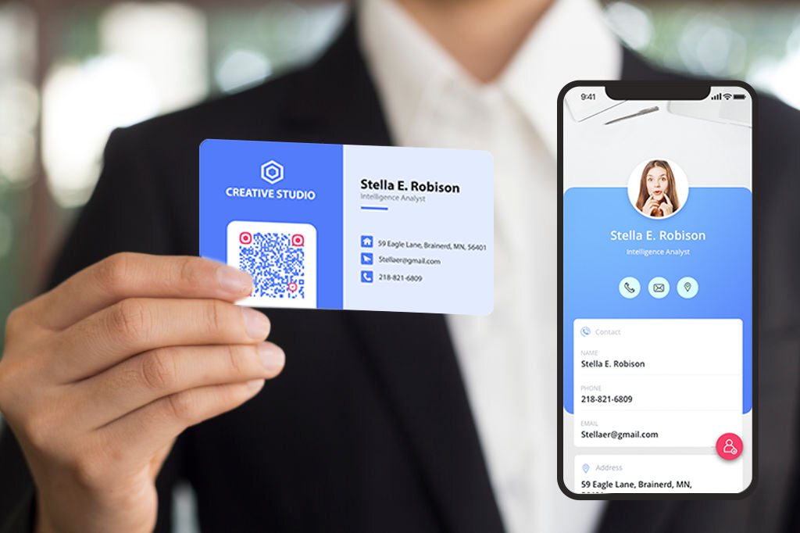
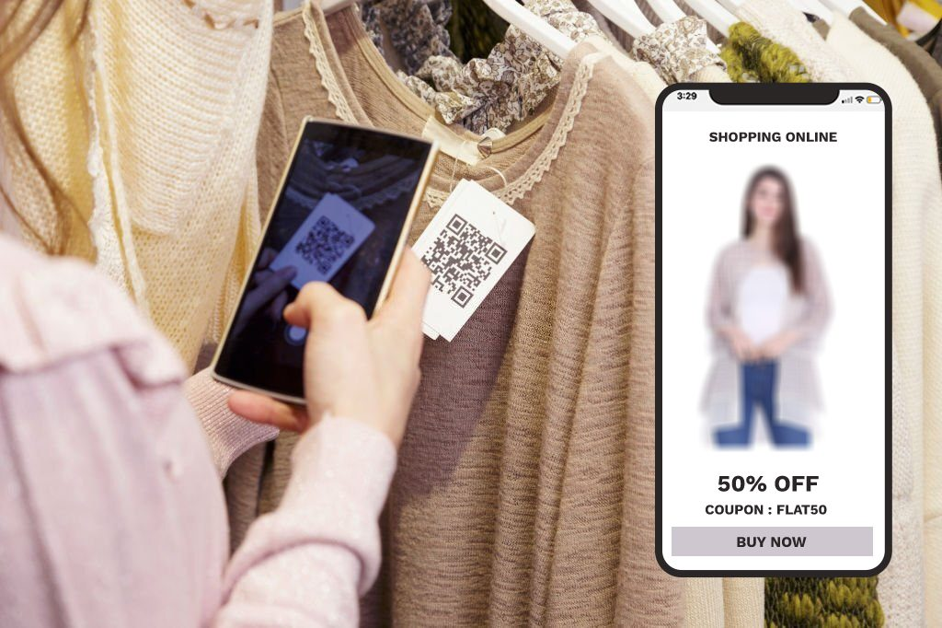
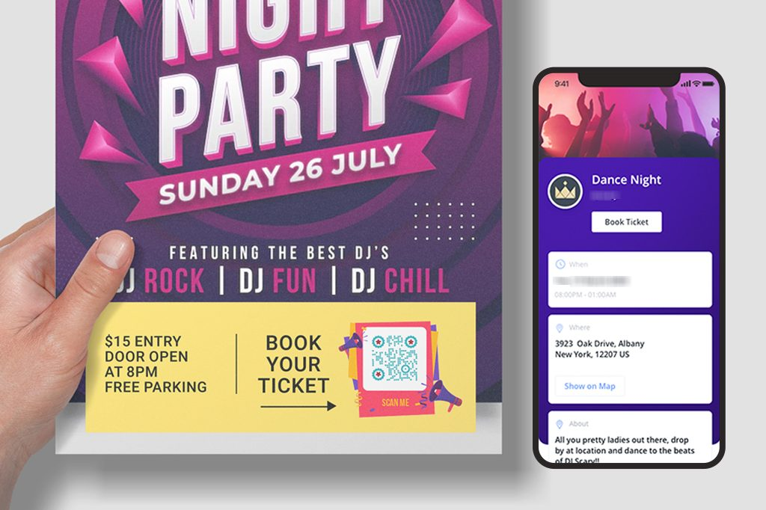
Tools to Activate Mobile Marketing
Creative Usage
Notes:
Increase Website Traffic and Generate Leads with a Marketing QR Code
The most widespread application of QR codes in marketing is to direct users to a website or landing page. In the digital age, with over 12 million eCommerce stores and a dramatic increase during the pandemic, businesses with physical products and services also maintain websites and landing pages to raise awareness and collect leads. Guiding an online audience to a website is relatively straightforward by sharing the website link. However, engaging an offline audience and directing them to a website or landing page becomes challenging. QR codes, specifically URL QR codes, allow marketers to address this challenge. Users can scan the QR code using their smartphones, eliminating the need for manual typing of the URL and providing greater accessibility and a better user experience.
Create Digital Business Cards for Your Clients
Business cards are crucial for service providers like consultants, realtors, and insurance agents. While physical business cards remain relevant, they require manual data entry into smartphones, which is tedious and error-prone. Adding a vCard QR code to a business card introduces digital capabilities. Users can scan the code to download and save contact information without manual entry, saving time, increasing accuracy, and facilitating rapid network growth.
Pro tip: Use QRCodeChimp to create a vCard Plus QR code, acting as a virtual contact card for a seamless contact-sharing experience.
Boost Mobile App Downloads
The mobile app economy is thriving, with apps expected to generate over $935 billion in revenue by 2023. QR codes provide an effective means to promote mobile apps on traditional advertising channels like billboards and newspapers, driving more downloads. An app download QR code allows users to scan and select the platform (iOS or Android) to reach the app store and download the app.
Attract Feedback and Reviews
Reviews significantly influence purchasing decisions, but obtaining positive reviews can be challenging due to the lengthy feedback process. A feedback QR code simplifies the process, making it quick and straightforward. Users can scan the QR code to access the feedback page, aiding marketers in generating more reviews.
Enable Event Registration to Increase Participation
Event marketing aims to boost enrollments, and event QR codes streamline the registration process. Placing event QR codes on billboards and print ads facilitates seamless registration, allowing users to scan the code, enter details, and register for the event.
Share Helpful Information to Educate Your Audience
QR codes facilitate the effortless sharing of information and multimedia. Marketers focused on educating consumers can use QR codes to share a diverse range of content, including images, GIFs, videos, and PDFs.
Seamless Offline to Online (O2O) Marketing
QR codes play a pivotal role in integrating online and offline marketing efforts. Placing QR codes on traditional advertising channels and linking them to websites or landing pages allows users to engage with offline advertisements by scanning the codes.
High Versatility
QR codes can be printed in various sizes as PDF or PNG files for diverse applications. Marketers can leverage them for promoting websites and social media, sharing contact details, growing email lists, sharing information, and more.

Slide 14
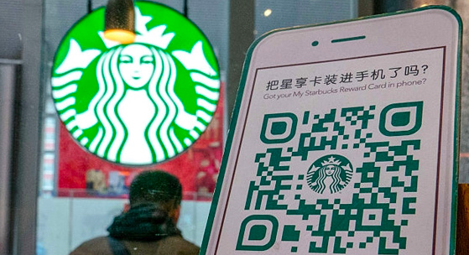
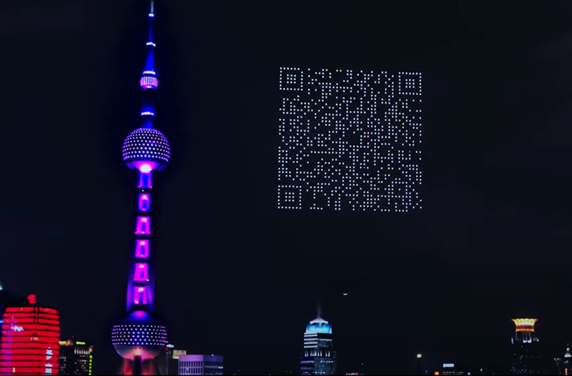
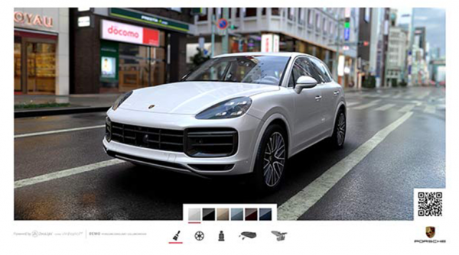
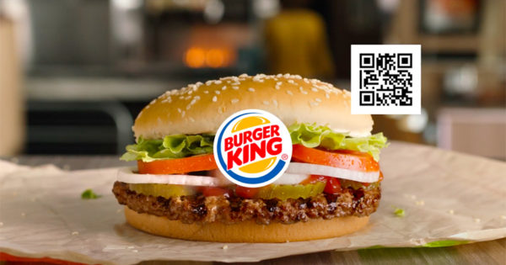
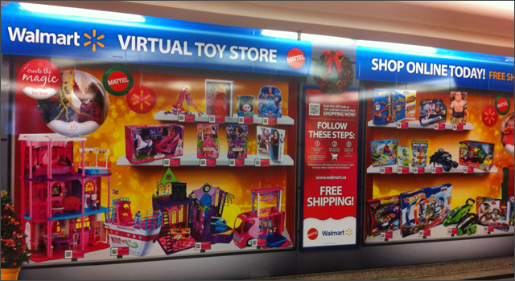
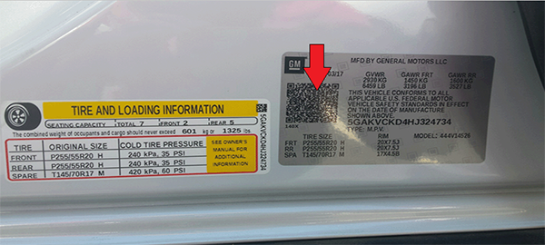
Tools to Activate Mobile Marketing
Brands Putting QR codes to Use
Notes:
The use of QR codes in marketing and customer engagement has experienced significant growth in recent years. Here are some notable examples of brands effectively incorporating QR codes into their strategies:
General Motors
- General Motors utilized QR codes to share critical vehicle information, enhancing customer engagement.
Walmart
- Walmart created a virtual toy store by displaying physical toys with accompanying QR codes. Users could scan the codes to access the online toy store and make purchases.
Porsche
- During the 2018 Digital Signage Expo, Porsche implemented QR codes, allowing users to scan and design their custom Porsche Cayenne Turbo 2019.
Burger King
- Burger King featured a QR code in its TV commercial during the pandemic. Viewers could scan the code on the screen to visit the Burger King website and receive free discount coupons.
Starbucks
- Starbucks incorporated app download QR codes in its stores to encourage customers to download their mobile app.
IKEA
- IKEA promoted its mobile app by placing app download QR codes in its stores.
Cygames
- Cygames took QR codes to another level by displaying a giant QR code in the sky composed of 1,500 QR codes. Users could scan the code to download Princess Connect, a game by Cygames.
The marketing landscape is evolving, and QR codes have become a pivotal element in post-pandemic marketing strategies. Brands are increasingly adopting omnichannel marketing and prioritizing offline-to-online (O2O) integration, where QR codes play a crucial role. The versatility of QR codes in marketing and customer engagement continues to grow, with new use cases constantly emerging.
However, as QR code marketing is still a relatively new concept, many marketers may not fully grasp its true potential and the optimal methods of implementation.
QRCodeChimp:
QRCodeChimp stands out as a global leader in QR code management solutions. Their platform empowers users to create, edit, manage, and track QR codes, offering comprehensive support for effective QR code integration into marketing strategies.

Slide 15
Tools to Activate Mobile Marketing:
Mobile Display Advertising
Banners
Interstitials
Videos
In-game
Notes:
Although the advertising formats for mobile devices have inherited elements from display advertising on PCs, they continue to evolve and adapt to the unique characteristics of mobile platforms. Notable advancements, such as the transition from Flash to HTML5, have enhanced the compatibility of ads with mobile devices. Here are some prevalent mobile display formats:
1. Banners:
- Description: A banner is an image that, when tapped, directs the user to a promotional page or the advertiser's website. It aims to drive traffic to a specific site.
- Variation: Depending on the support, it can take on a dropdown format.
2. Interstitials:
- Description: Interstitials are full-screen images that can appear when a new page loads or intermittently during scrolling while browsing the site.
3. Videos:
- Description: Videos are visual pieces, typically recommended to be no longer than 20 seconds, that engage users upon impact. Users may experience them in a 3G or 4G connection.
- Variations: Depending on the support, videos can be full-screen video banners or in-banner videos integrated into a graphic banner. They may also auto play.
4. In-game:
- Description: In-game ads have evolved within the realm of mobile gaming applications. These ads are integrated into video games and are often associated with in-game rewards (in-game advertising). For instance, users might earn extra lives by using a product sponsored by a particular brand within the game.
These categories provide a broad classification of mobile advertising formats. However, the mobile advertising landscape is dynamic, with new options emerging regularly. Staying informed about standardized formats in the market and keeping up with the latest developments is crucial. Technological advancements aim to make formats less intrusive and more user-friendly, preventing frustration and ensuring a positive user experience.

Slide 16
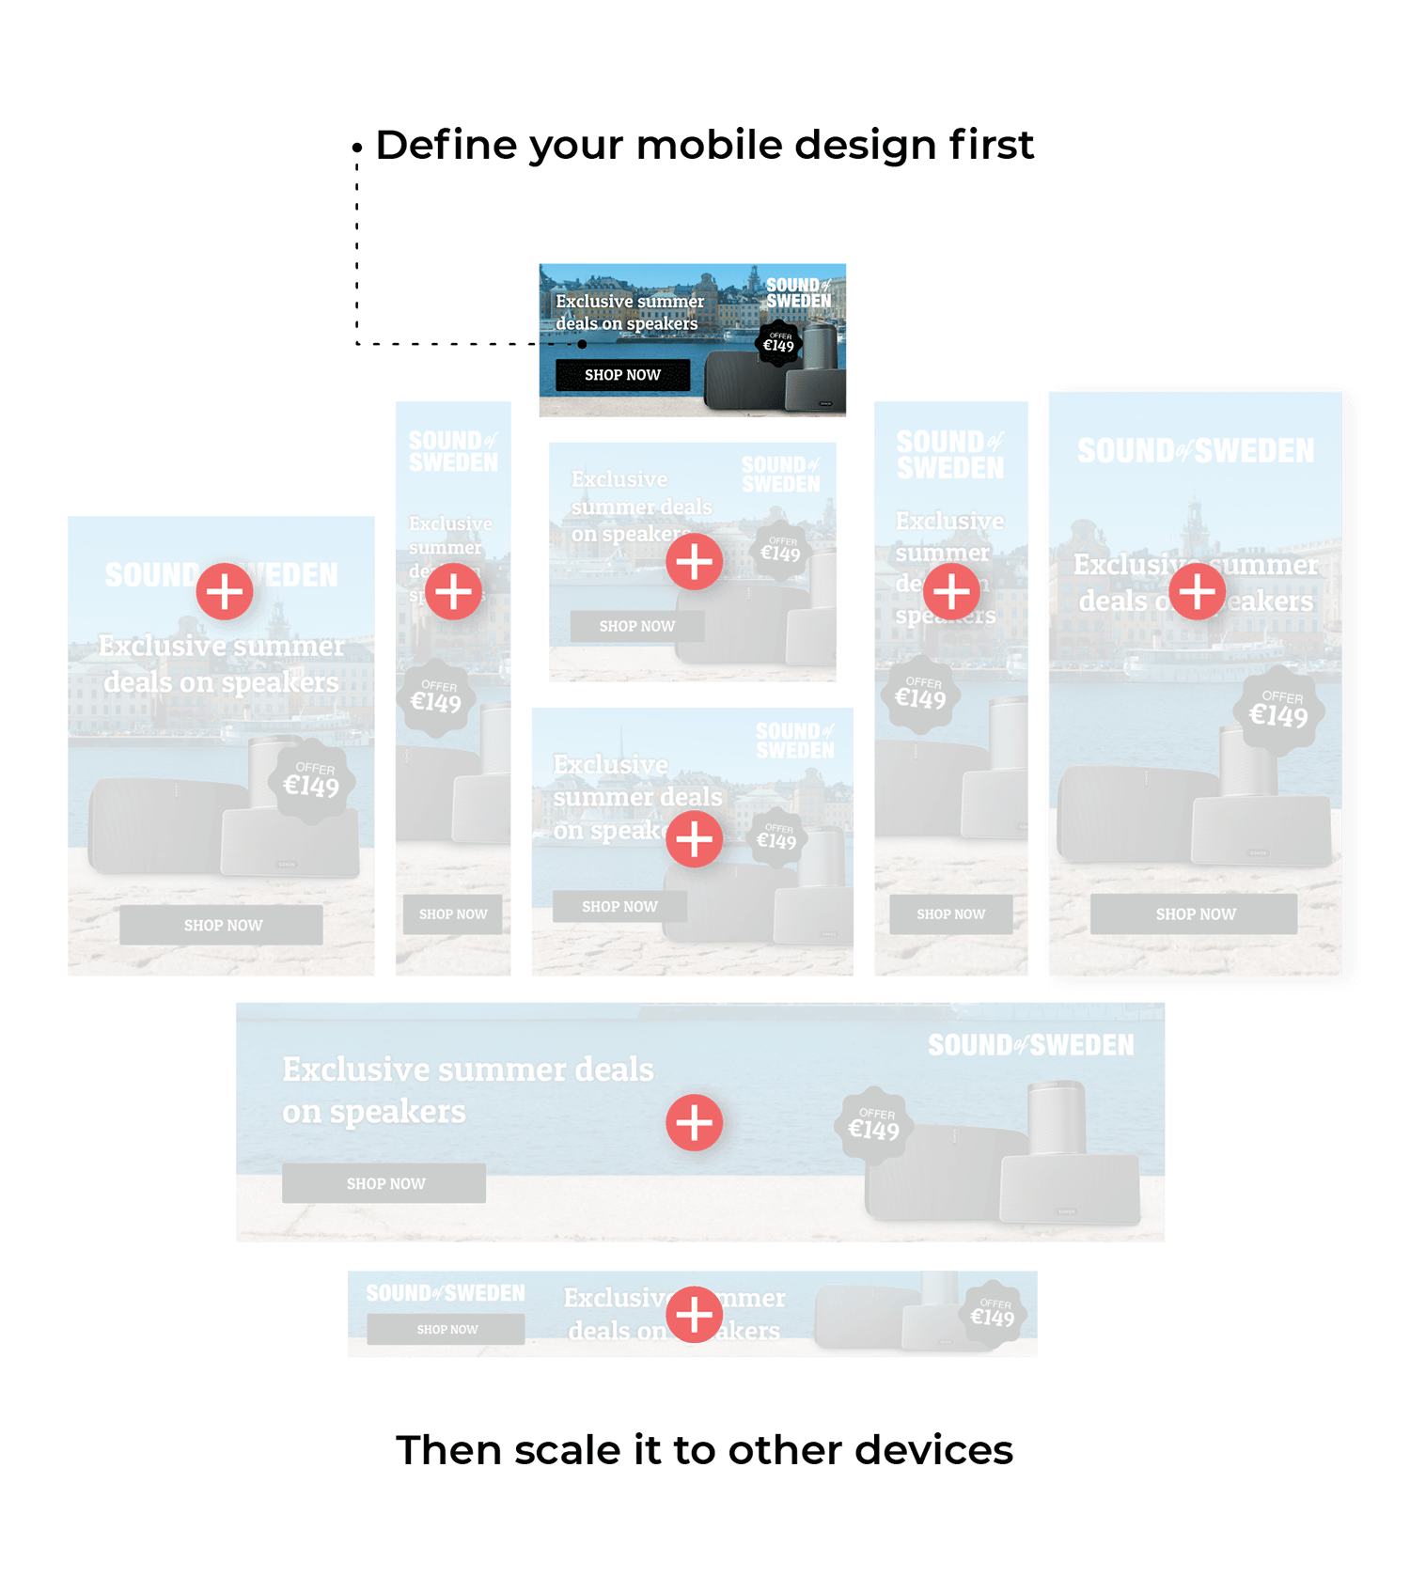
Tools to Activate Mobile Marketing:
Mobile Display Advertising: Banners
Design them mobile first
Notes:
Design your campaigns for mobile first. Building your mobile banner campaigns today requires a new way of thinking. Now is the time to design everything mobile-first! A display ad is far more likely to be viewed on mobile. Indeed, display advertising has long gone mobile and designers must think as such. Reject the old way of thinking: designing a campaign desktop first and then scaling down. Scaling-up from mobile enables better answering of countless mobile design questions.

Slide 17
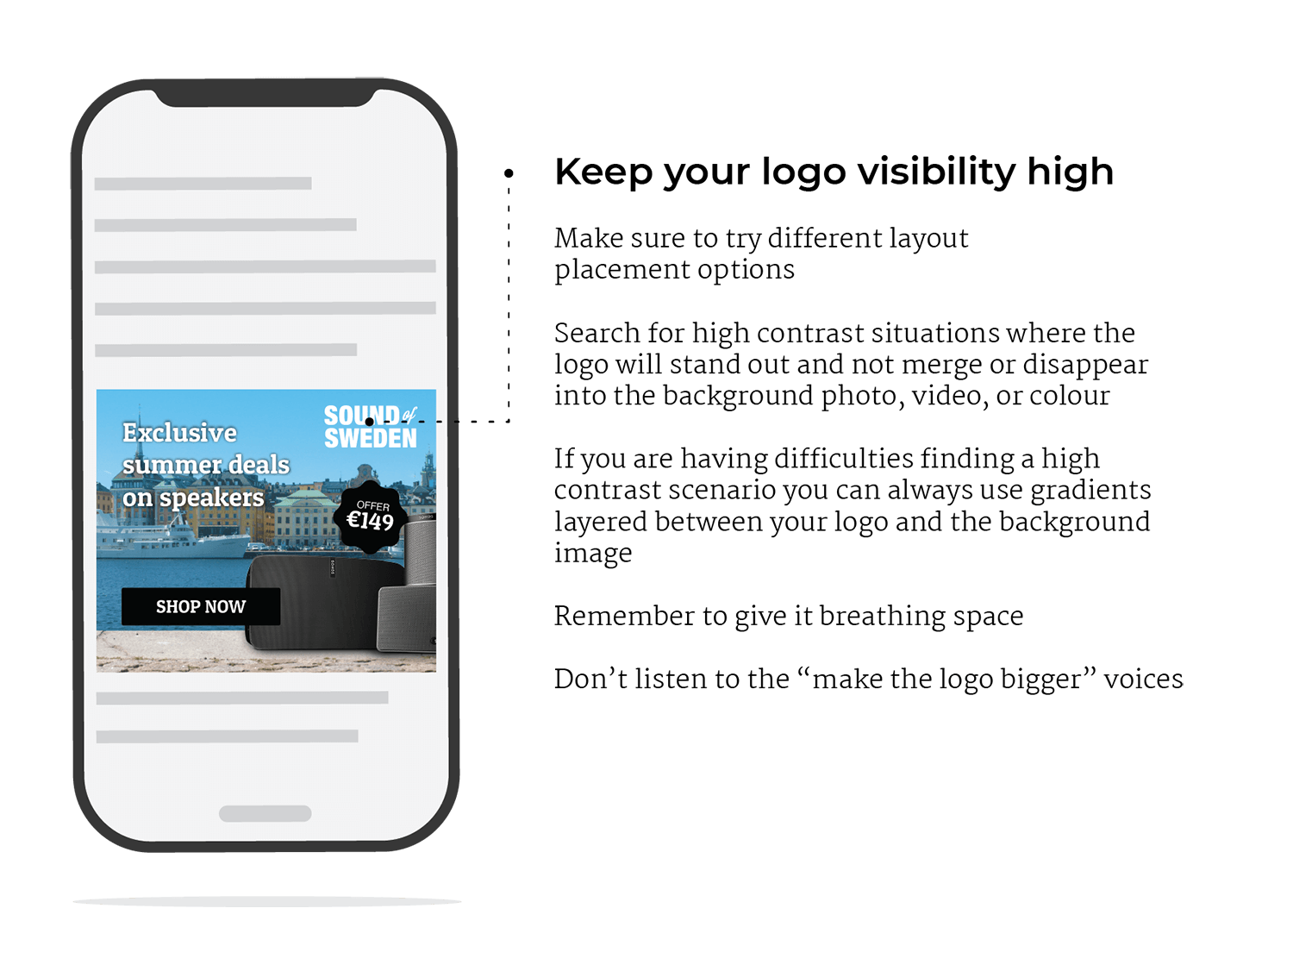
Tools to Activate Mobile Marketing:
Mobile Display Advertising: Banners
Source: https://www.bannerflow.com/blog/mobile-banner-ads/
Notes:
Design your campaigns for mobile first. Building your mobile banner campaigns today requires a new way of thinking. Now is the time to design everything mobile-first! A display ad is far more likely to be viewed on mobile. Indeed, display advertising has long gone mobile and designers must think as such. Reject the old way of thinking: designing a campaign desktop first and then scaling down. Scaling-up from mobile enables better answering of countless mobile design questions.

Slide 18
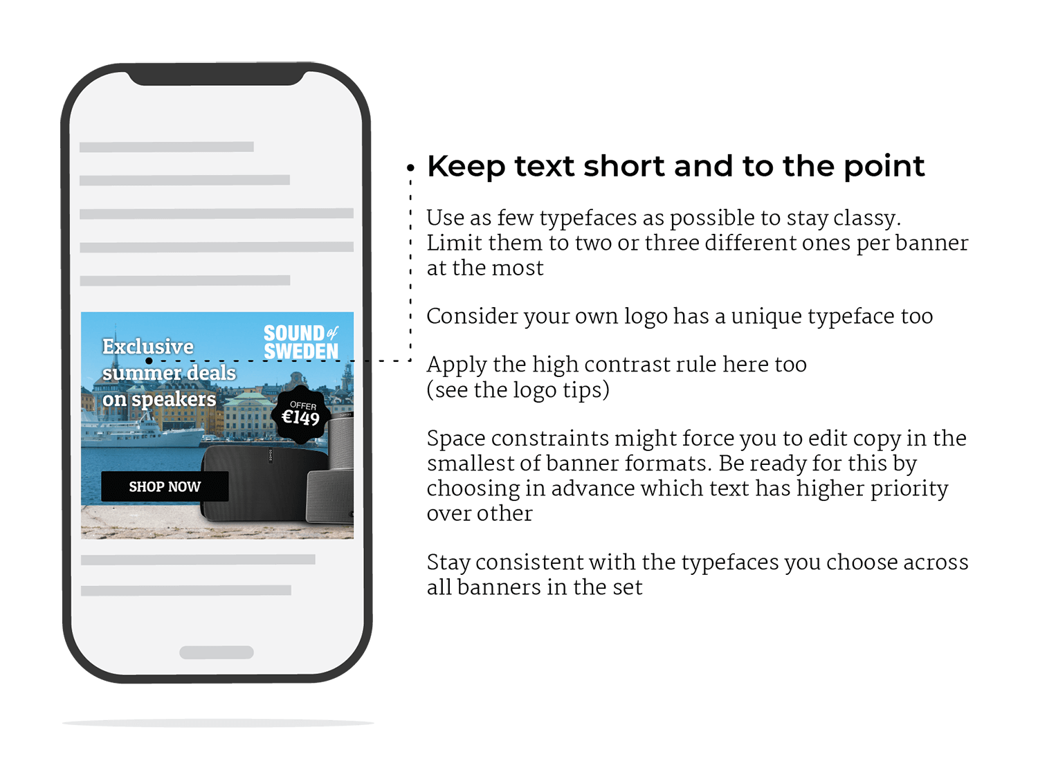
Tools to Activate Mobile Marketing:
Mobile Display Advertising: Banners
Source: https://www.bannerflow.com/blog/mobile-banner-ads/
Notes:
Investing time in refining your copy is crucial for the effectiveness of mobile banner ads. Many advertisers, especially those adapting desktop-sized banners, may be tempted to fill their mobile banners with excessive text. However, this approach is often counterproductive for mobile advertising.
Here's why:
Mobile users have limited attention spans, and you only have a few seconds to capture their attention. If your banner is loaded with lines of text, users are likely to skip over it. Mobile browsing is often quick, and users are less likely to engage with ads that require extensive reading.
Excessive text can clutter the design and diminish visual appeal. Mobile devices come in various screen sizes, making it challenging to predict how lengthy text will appear on each screen. Opting for concise copy minimizes the need for repetitive design work and ensures a cleaner, more visually appealing presentation.
Mobile banners should deliver a clear and concise message. A short and snappy copy is more likely to convey the essential information quickly and effectively. Focus on a compelling message that piques the viewer's curiosity and encourages them to click through.
Prioritize brevity in your copy. Craft a clear and compelling message that aligns with the viewing habits of mobile users, making it easier to capture attention and drive engagement.

Slide 19
Tools to Activate Mobile Marketing:
Mobile Display Advertising: Banners
Source: https://www.bannerflow.com/blog/mobile-banner-ads/
Notes:
Consider the location and size of your call to action (CTA) carefully when designing mobile banner ads. The CTA is a critical element of any banner ad, and for mobile banners, specific considerations are essential:
Craft short, catchy, and to-the-point copy for your CTA. Clearly communicate the desired action, aligning it with your message or offering. Mobile users appreciate simplicity and directness, so avoid lengthy or complex text.
Use a strong and eye-catching CTA image, preferably in the form of a button. Buttons are effective in encouraging viewers to click through. Ensure the visual elements stand out by using contrasting colors that draw attention. The goal is to make the CTA visually compelling.
Choose contrasting colors for your CTA to make it stand out against the background. This helps in grabbing the viewer's attention and directing them to take the desired action. The color contrast should be visually appealing and align with your overall design.
Consider a mobile-first approach when determining the location of your CTA. Place the CTA on the right side of the ad, considering how users typically hold and interact with their mobile devices. Since many users hold their phones with their right hand, placing the CTA on the right side increases the likelihood of engagement.
Ensure that the CTA button is large enough to be easily tapped on a mobile screen. Mobile users may have smaller touch targets, so make the CTA button sufficiently sized for convenient interaction.
By focusing on these factors, you can enhance the effectiveness of your mobile banner ad's CTA, increasing the chances of user engagement and click-throughs.

Slide 20
Tools to Activate Mobile Marketing:
Mobile Display Advertising: Banners
Source: https://www.bannerflow.com/blog/mobile-banner-ads/
Notes:
Think about the location and size of your CTA.
The call to action (CTA) is a fundamental part of any banner ad. However, on a mobile banner there are certain things to be aware of. First of all, make the copy short, catchy, and top the point. Have a clear action for the viewer to act on that suits your message or offering.
Make the CTA image strong and eye-catching. The best way to achieve this is by using a button – like you do in desktop banners – to encourage a viewer to click-through. Use contrasting colors that draw the eye’s attention too. And finally, think mobile-first and move the location of the banner to the right of the ad. If viewed on a phone, it is far more likely that your intended audience will click-through via the right side of your ad due to how most people hold mobile devices.

Slide 21
Thank You
Notes:
https://www.creatopy.com/blog/what-is-display-advertising/

