Slide 1
WEEK 4
SESSION 2
Unit 8:
Landing Pages
Notes:
Performance Marketing is a result driven digital marketing strategy in which brands only pay marketing service providers if the business goals have been met or when specific business actions have been taken, such as clicks, sales, leads. It might also be called performance-based advertising or pay-for-performance advertising
Typically, a company will contact an agency or a publisher to outsource the service and leave the experts to design and place ads on previously studied and analyzed channels, including social media, search engines, videos, etc. Once published, the supplier gets paid based on how well their ads perform, by measuring different pre-established KPIs, which can include (but are not limited to) website visits, clicks, impression, shares, sales, etc.
This win-win marketing opportunity for a retailer (or “merchant”) and affiliate (or “publisher”) allows both parties to target campaigns in a strategic, high ROI way, all based on performance. By paying the affiliate when a specific action is completed, a merchant can feel confident that their money is being well spent, since they are already converting their target audience before they pay for the transaction.

Slide 2
Landing Pages:
What is a mobile optimized website for?
Provide online visibility
It's a great complement to social media
It's 100% yours and it's always online
More advertising options for less $$
You can use SEO strategies
Notes:
Provide online visibility - There is a huge pool of customers available on the Internet that you could miss out on if you rely only on local clientele or word-of-mouth referrals. The web allows you to transcend local boundaries and expand your business nationally or even internationally. This visibility has another great benefit, which is to gain market breadth.
It's a great complement to social media - Creating social media profiles and having your own website are two good decisions that complement each other. Social media is great for showcasing your product or service and communicating with your customers, while the web can offer them the option to make purchases or gain more awareness of your brand. Moreover, it is estimated that by 2022 the global e-commerce turnover will exceed 5,000 billion euros and will pass 7,000 billion euros by 2025. There is no doubt that this is a market of opportunity that is better reached sooner rather than later.
It's 100% yours and it's always online - While in social media your account is not 100% yours (you are subject to the rules and decisions of a company) and the network can go down for hours (we have already experienced this), in the case of a website, it is in your name and you are the total owner of everything on it. You dictate the rules.
More advertising options for less $$. Online advertising is still much cheaper than traditional advertising. You can use it to drive more traffic to your website and make your brand more popular. It is very effective and has a huge reach (remember that the Internet has billions of daily users). Even if you don't want to pay for ads, your website already works as a 24/7 advertisement.
You can use SEO strategies - In line with the above, having a website will give you incredible results if you manage to appear in good positions in Google search results. Fortunately, this is possible if you apply Search Engine Optimization (SEO) techniques, which help you to position and -in the best case- appear on the first page of Google. Identify the keywords for which you want to appear and learn how to do SEO on your website.

Slide 3
Landing Pages:
What is a mobile optimized website for?
You can sell online
Create a blog
Inviting users to subscribe to a newsletter
Offer discounts and promotions
Generate leads and create potential customer databases
Analyze user behavior metrics
Offer 24/7 customer support
You can get leads
Newsletter subscription
Event registration
Downloadable documents (templates, studies, ebooks, reports)
Obtain a trial version
Etc.
Notes:
You can sell online
Websites are not what they were a few decades ago. Today you can integrate more and more functionalities and you have many customization options. Therefore, far from being just a space to showcase your brand, with your website you can achieve much more. Of course, one of the best options is to create your own e-commerce or online store but, in addition to that, you can implement a lot of digital marketing techniques such as:
Create a blog
Inviting users to subscribe to a newsletter
Offer discounts and promotions
Generate leads and create potential customer databases
Analyze user behavior metrics
Offer 24/7 customer support
You can get leads
A lead is a user who has left their data in exchange for some benefit on your website. This allows you to convert an unknown visitor into an identified person that you can classify in a database and contact in the future. How to get leads? Through what is known as lead magnet. Some lead magnet options are:
Newsletter subscription
Event registration
Downloadable documents (templates, studies, ebooks, reports)
Obtain a trial version
Etc.
Once you get the leads, you can classify them in databases according to their situation: if they just know your brand, if they were ever customers, if they are in a trial period of your service, etc.
This allows you to contact them via email in a personalized way. It is enough to use a good email marketing platform to send segmented and sequential messages that motivate the purchase decision (promotions, discounts, launches, information of interest, etc.) and build customer loyalty.

Slide 4
LANDING PAGES

Slide 5
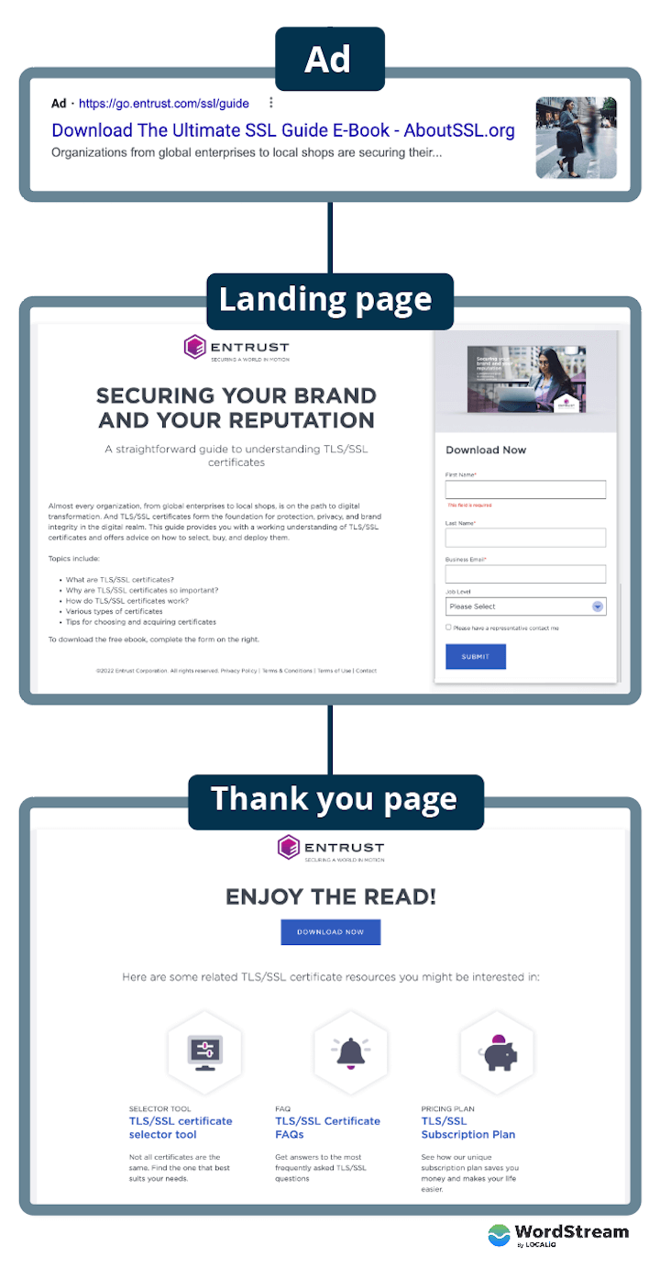
Notes:
In digital marketing, a landing page is a standalone web page, created specifically for a marketing or advertising campaign. It’s where a visitor “lands” after they click on a link in an email, or ads from Google, Bing, YouTube, Facebook, Instagram, Twitter, or similar places on the web.
Unlike web pages, which typically have many goals and encourage exploration, landing pages are designed with a single focus or goal, known as a call to action (or CTA, for short).
It’s this focus that makes landing pages the best option for increasing the conversion rates of your marketing campaigns and lowering your cost of acquiring a lead or sale.

Slide 6
Notes:
https://www.youtube.com/watch?v=nQ2f79bi_QE&t=13s

Slide 7
Landing Pages:
Lead Generation Pages or Landing Pages
What is the home page?
A home page usually houses the following information:
Contains the Web Site's Root Domain (ex. www.mybusiness.com).
Gives an understanding of the company's products or services
Equips the user with ways to contact the company
Consists of links that lead to other important internal pages of your Web Site.
What is a landing page?
Landing pages are designed to promote a single action, or a main action. This could be:
Create an account
Signing up for newsletters or promotions
Making a purchase, redeeming a promotional code
Requesting a product demo
Obtain more information about a specific service or product
Notes:
Landing Pages are an essential component of any marketing campaign. They serve as the primary resource for generating interest from potential customers and converting them into customers. A company is more likely to convert leads if it creates a Landing Page for a specific campaign, either a specific page within the company's Web site or a page created outside the main Web site. Often, new Internet business owners get a little confused between what a landing page and what a home page is.

Slide 8
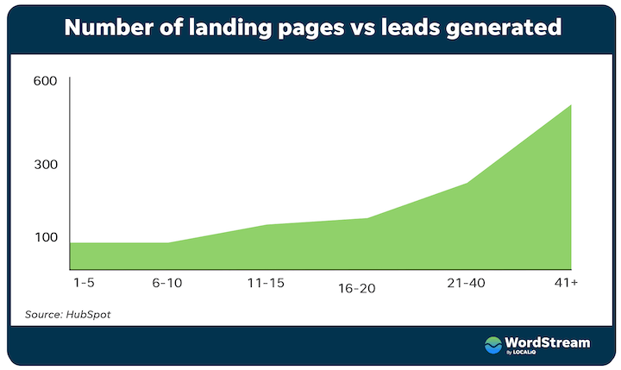
Landing Pages:
Why are lead pages important
Improve conversion
More leads and sales.
Higher ROI.
Notes:
Landing pages aren’t just important—they’re essential. They’re designed to improve conversion, which is ultimately one of your most important metrics. How so? Well, if someone clicks on an ad for your product and lands on your homepage, they’ll have too much information and too many choices for actions.
But if they are brought to an effective landing page describing the features and benefits of that product only, with a button or form to obtain that offer right there, think about how much more likely they are to convert. This means that landing pages lead to:
More leads and sales: Higher conversion rates mean more purchases, sign-ups, free trials, you name it. In fact, businesses with more than 30 landing pages generate 7x more leads than those with fewer than five.
Higher ROI: Whether you’re spending on ads, your website, email service, or something else, you’re getting more results for the same price— just by changing the URL the visitor goes to.
But it doesn’t just stop there. When you optimize your landing pages using the tips in this guide, you:
Increase brand credibility: Whether it’s influencer endorsements, partnership badges, reviews, or stats, the trust signals you use on your landing pages build your credibility, regardless of whether the user actually converts.
Create a memorable experience: Because landing pages are specific to an offer and even the user, the copy, imagery, and messaging are highly customized, making for a personalized and memorable experience.

Slide 9
Landing Pages:
Types of Landing Pages
Source: https://unbounce.com/landing-page-articles/what-is-a-landing-page/
Notes:
Lead Generation Landing Pages: Also called “lead gen” or “lead capture” pages, these use a form as their call to action. This form almost always collects lead data, like the names and email addresses of visitors. (You can read some expert-certified lead gen strategies here.) B2B marketers and companies selling high-ticket items use this type of landing page to build a list of prospective customers. They sometimes offering something free, like an ebook or webinar, in exchange for contact info. Ecommerce brands can also use these pages for list-building, or offering free shipping or special deals, too.
Clickthrough Landing Pages: Frequently used by ecommerce and SaaS (software-as-a-service) marketers, clickthrough pages go straight for sales or subscription. Usually, they have a simple button as the call to action that sends the visitor into the checkout flow (like the app store) or completes a transaction.

Slide 10
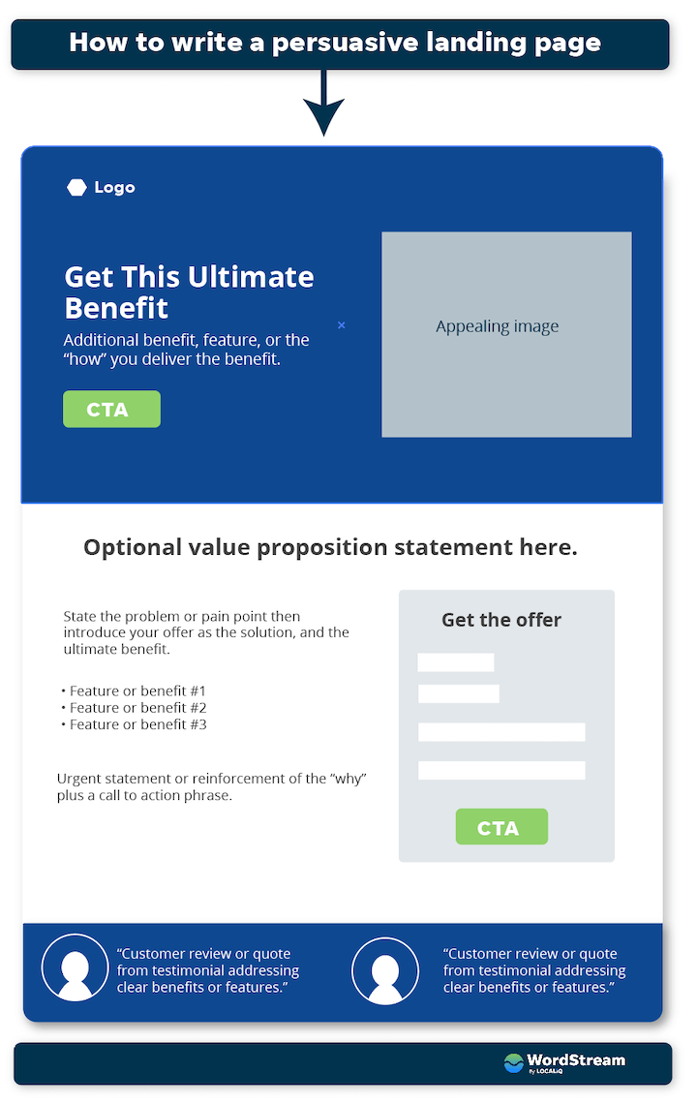
Landing Pages:
Landing Page Structure
Appealing offer
Strong headline
Write concise and engaging copy
Add a form
Follow up with a thank you page
Notes:
Once you’ve answered the fundamental pre-landing page questions, it’s time to write your awesome, persuasive landing pages. Landing pages should have a snappy headline, scannable body copy, a clear call to action, and a strategic thank-you page. Here’s how to write them:
1. Start with an appealing offer Your product or service, of course, is your highest value offer. But you’re looking to capture leads, you need to make sure you have a lead magnet: something your audience feels is worth giving up their contact information for. This could be a high-quality guide, informative webinar, or even a discount on their first order.
2. Create a strong headline A strong landing headline takes different forms, depending on the landing page, the offer, and the CTA that preceded it. In some cases, it’s the same as the ad headline so as to make the experience as seamless as possible and ensure message match. This is especially important for Quality Score in Google Ads. In other cases, it’s something more creative or evocative to capture attention and express your brand voice. These emotional words and phrases can help you out with that. Regardless, your headline needs to answer the one question your users have: What’s in it for me? When in doubt, a benefit-focused headline is a good first step. You can always A/B test and iterate.
3. Write concise and engaging copy
Copy that sells is clear, concise, credible, and compelling. Clear copy means it uses plain, conversational language that your customers use. It should be easy to read and organized with a proper information hierarchy. You have about eight seconds to convince users to stay on your page, so it’s absolutely vital that visitors can capture the essence of your offer with a quick glance. Concise means it gets to the point quickly. It provides the essential information to inform and interest your audience and nothing more. You can always add more information at the bottom in the form of accordion-style FAQs.
Credible copy uses facts rather than opinions and contains trust signals, which we’ll get to in a bit.
Compelling copy means it has the right mix of features and benefits but also uses powerful words.
4. Add a form
If you’re creating a lead-generation landing page, you’ll need to add a lead capture form. Your form should capture enough information so that you can follow up in a customized manner, but not so much information that it takes extra time or thought to fill out. A good rule of thumb is to have seven fields or less. Name and email are a safe bet. Ask for a phone number only if it’s necessary. Then you may need to get additional details to qualify or score your leads.
5. Follow up with a thank you page
The thank you page is essential. For one, it confirms for the visitor that they have completed all necessary steps. It also contains the instructions for obtaining the offer, such as checking your inbox or even clicking on a button right on that page to download the piece of media. And finally, you can use your thank you pages to introduce visitors to other resources or even a lower-funnel offer.

Slide 11
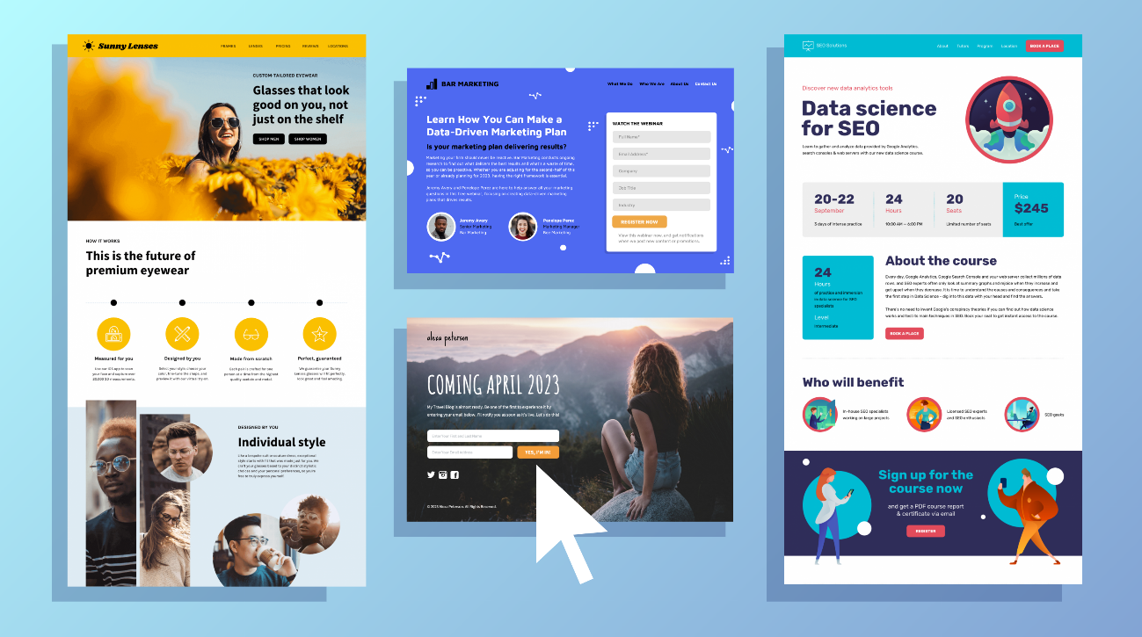
Landing Pages:
What is Landing Page Optimization?
Conduct research and look at what can be refined.
Generate hypotheses and create different variations of landing pages.
Run different experiments and see which page version works best.
Notes:
Landing page optimization (or LPO - Landing Page Optimization) is an online marketing technique also known as conversion rate optimization or conversion optimization. The goal of landing page optimization is to increase the overall conversion of visitors into customers.
LPO is about improving the elements of the landing page to increase its conversion. It accomplishes the following objectives:
• Conduct research and look at what can be refined.
• Generate hypotheses and create different variations of landing pages.
• Run different experiments and see which page version works best.
Once you have this data, you can continue to refine your current landing page for different marketing campaigns. You don't have to rebuild your landing page from scratch every time you have a new marketing campaign.

Slide 12
Landing Pages:
How to optimize the landing page for conversion
One goal, one CTA
Keep it clean and organized
Use trust signals
Customer quotes
Influencer endorsements
Data
Awards and recognition
QA your landing pages
Optimize for mobile
Run A/B tests
Notes:
. One goal, one CTA
Generally speaking, each landing page should have one goal and one CTA. Additional links on the page—like navigation links, footer links, or social share buttons—all serve as secondary CTAs that reduce the chances of the user taking the action you want them to take. Remove these or keep them to a minimum.
If your landing page is long, you can have multiple CTAs placed throughout that all point to the same form or destination, as with the example below. Also notice how the main navigation is removed from the page, giving the user just one option.
how to write a landing page - example of a landing page with one conversion goal
📣 Free guide >> The 36 Best Call to Action Phrases (Ever)
2. Keep it clean and organized
As mentioned above, the information on your landing page should be prioritized so that the most important elements are visible above the fold (or before the user has to scroll), like the CTA, key benefit(s), and value proposition. The rest of the information should be presented in an organized, skimmable manner, with plenty of visual elements to balance it out (F and Z patterns are your friend). If you’re optimizing for SEO, consider using tab, drop-down, or accordion-style functionality to include additional copy without cluttering up the page.
3. Use trust signals
These are crucial for landing page conversion, and there are lots of different types.
Customer quotes: Pull quotes from testimonials and case studies, or include customer reviews.
Influencer endorsements: If confidentiality is not an issue, include logos of well-known brands who use your product or service, or quotes from influencers.
Data: There are lots of options here, like “over X five-star Google reviews,” “trusted by X customers,” or “over x leads generated/money saved.”
Awards and recognition: Do you have any partnership or certification badges? Any form of recognition or award from a third party helps build trust, including just being featured in a publication or being a finalist, even if you didn’t win.
example of landing page with trust signals by loomly
4. QA your landing pages
Before you make your landing page live, go through the process as if you’re a user. Read the page in full, fill out the form, and make sure the correct thank you page loads and the offer is delivered. If you have tracking set up, make sure the information makes its way into your CRM or database. Repeat this process on mobile devices.
5. Optimize for mobile
Speaking of which, make sure your landing pages look and function just as well on desktop as they do on mobile. You may need to make adjustments on the back end of the page so that things appear differently on mobile.
6. Run A/B tests
There are several components to a landing page that influence your users’ behaviors. The headline, the image used, the button colors, even the button copy all have an impact. Test your landing pages regularly to find out what works and what doesn’t.

Slide 13
Landing Pages:
Driving traffic to landing pages
Paid Search Traffic
Paid Social Traffic
Email Campaigns
Organic Search Traffic
Notes:
You’re going to need to fill that funnel full of visitors for your landing page to work. Fortunately, you’ve got a lot of options. Let’s explore some of the more common sources of traffic to landing pages.
Paid Search Traffic
Most search engines include paid advertising. When someone looks something up (say, “cheese of the month club”) these ads appear clearly marked—but not too clearly marked—in the search results. Here’s a typical example from Google:
Screenshot of a typical Google Ad
Unlike the other results on the page, pay-per-click ads are prepared and paid for by marketers. Someone who clicks will be primed by your charming copy (and, sometimes, your visuals). And you’ve likely targeted them based on their search term, demographic data, or interests revealed by their browsing history.
Crucially, when you create an ad, you get to choose where the link takes your visitor. Yes, you could choose to send them to your homepage. But, as we’ll explore below, it’s much better to create a standalone landing page that matches your ad copy and offers a clear call to action.
Paid Social Traffic
Running ads on social media sites like Facebook, Instagram, Twitter, or LinkedIn is a kickass way to target people and communities who’ll be particularly interested in your brand, regardless of whether they’re in the market yet.
Instead of people searching for “cheese of the month club,” you might advertise to people who’ve added “cheese appreciation” to their list of interests in their Facebook profile. The beauty of it is that you can connect with customers before they start to look for your product—or before they want it!
Aside from offering advanced targeting features, each social channel has its own characteristics. Instagram, for example, works well for products and lifestyle brands with a strong visual appeal. On the other hand, B2B advertisers prefer to use LinkedIn to reach professionals working in specific industries.
Email Campaigns
Email is often touted as the most effective marketing channel out there because of its enormous reach (and low costs) compared to other platforms. A 2018 study by the Radicati Group projects that there’ll be 4.2 billion email users by 2022. That’s more than half the planet!
A powerful combo of emails and landing pages can be used both to nurture existing relationships with customers and to acquire new ones. After building a list of contacts, your carefully crafted email lets you entice readers with your offer, while the landing page fills in the details and directs visitors toward a call to action.
Organic Search Traffic
The term “organic traffic” refers to any visitors who come from an unpaid source—like the bottom half of Google or Bing search results (SERPs). By creating compelling, legitimately useful content on your website or landing pages, you can ensure that your business appears more frequently in related searches. The higher your content ranks, the better.
Calling it “unpaid” is a little bit misleading, however. It doesn’t mean there isn’t time and money invested in ranking. (If only!) There’s an entire field of professionals dedicated to squeezing as much organic traffic from Google as possible through a balance of careful strategy, technical know-how, and brilliant content creation. That’s search engine optimization (SEO) in a nutshell. (Read more about SEO for landing pages here.)

Slide 14
SOME EXAMPLES

Slide 15
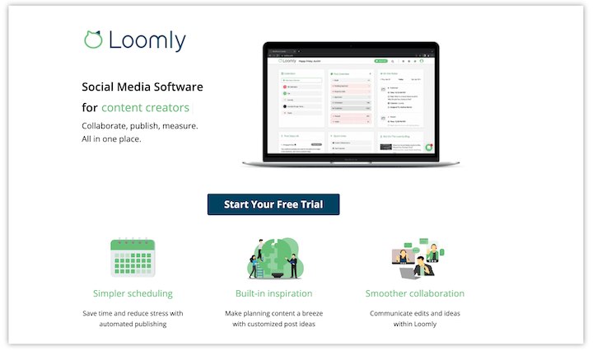
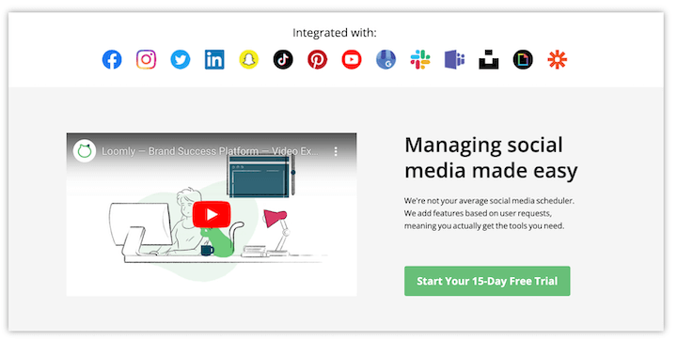
Landing Pages:
Notes:
Targeted messaging: The headline may not be the most compelling, but it reads “Social Media Software,” a direct connection to the query that triggered the ad to appear. Note that Loomly refers to itself as a brand management platform, so this is a great example of tailoring its messaging.
Clean design: Like CallRail, this landing page has just one action, to start a free trial, with multiple buttons that all lead to the free trial signup form.
Video: An embedded explainer video on the page is used to outline the features and benefits. Studies have shown that adding video to landing pages can increase conversions by 86%.
Trust badges: Testimonial quotes from customers, plus badges for awards from G2, Capterra, and Source Forge

Slide 16
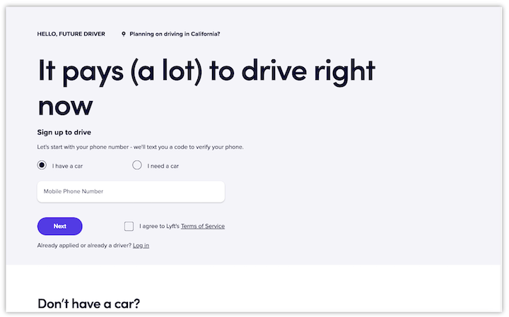
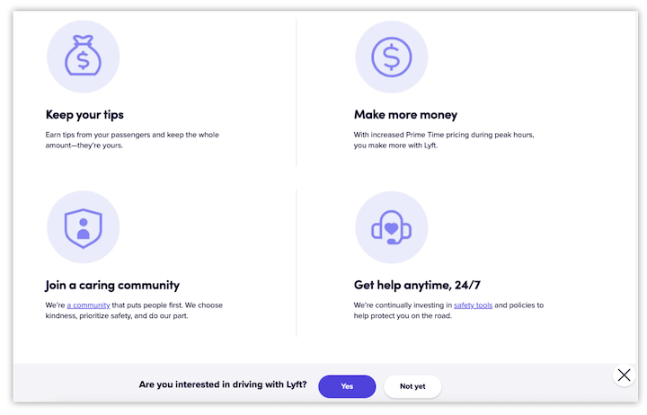
Landing Pages:
Notes:
Prominent form: The form on this landing page is right at the top, and it only has one field, the user’s mobile number. There are more steps to the form, but this is a great way to reduce friction and barriers to entry.
(Really) big headline: There is no image above the fold, but the headline serves as the focal point: “It pays (a lot) to drive right now.” Benefit focused, conversational, and compelling copy.
Information hierarchy: “Don’t have a car?” is above the fold, likely strategically placed to prevent drop-off from visitors who exit thinking they can’t drive without a car. Later on, you learn how it works, the insurance protection, and then FAQs. This is all necessary information, but it is presented in a way that is not cluttering up the page.
Scroll-triggered floating bar: There is a lot of content on this page, but rather than having multiple buttons placed on the page, there is a floating bar that appears after a certain point of scrolling.

Slide 17
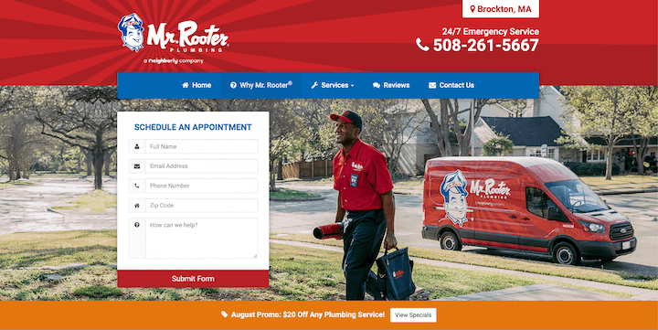
Landing Pages:
Notes:
Our final landing page example is from Mr. Rooter, a multi-location plumbing company. Here’s what makes it great:
Large, vibrant image: The full-width image of a smiling man (perhaps Mr. Rooter himself) heading into a job on a sunny day gives this brand a friendly, inviting feel.
Information hierarchy: I landed on this page after clicking an ad for “plumber near Brockton, MA.” The location in the upper right-hand corner of the page reassures me immediately that I’m in the right place, and the contact number is extra large.
Simple form: This form is five fields and visible above the fold, making it super easy to book an appointment.

Slide 18
Thank you

