Slide 1
Sports Business Management and Strategy
Sports Media and OTT
Aarthi Rajaraman

Slide 2
Sports Media
The television industry utilizes two primary formats for delivering programming to viewers:
1. Free-to-Air Broadcast:
In the past, this was the exclusive method of receiving TV content, where households could pick up broadcast signals. Consequently, broadcast networks evolved to provide nationwide coverage of sports to a broad audience. The revenue model for free-to-air broadcasting relies on 30-second advertising commercials. Notably, sports programs have consistently ranked among the highest-rated shows on free-to-air TV.
2. Cable: The cable segment of TV comprises two main components:
a) Cable Content Channels: These channels cater to diverse target audiences by delivering specialized content.
b) Sports Channels: Among the top-rated cable channels, sports channels have gained prominence. A recent trend involves the introduction of "special sport packages," offering season-long access to out-of-town games that may not be included in local broadcast or cable offerings.

Slide 3
Sports Media
The primary revenue streams for most cable content channels originate from two main sources:
1. Carriage Payments from Cable Distribution Platform Companies:
Cable content channels receive carriage payments from cable distribution platform companies such as Directv and Comcast. These payments can vary significantly, and most contracts between cable content channels and their distribution platform partners are structured on a monthly per-subscriber basis. Securing a position in high-volume subscriber packages is generally preferable for cable content channels, as it leads to higher revenues.
2. Advertising Revenues:
Another major source of income for cable content channels is advertising revenue. Advertisers pay for slots during programming, contributing to the overall financial health of the channel.
Distribution platform companies play a crucial role in the delivery of cable content channels to viewers. These companies package multiple individual "cable" channels and use one of two technologies to transmit them to viewers:
a) Below-the-Ground Cable: Channels are delivered through cables installed underground.
b) Satellites: Signals are conveyed to dishes attached to houses or apartment complexes via satellites. This technology enables the distribution platform companies to reach a broad audience with their bundled channel packages.

Slide 4
Sports Media
TV Ratings are central to determining what broadcasters and cable companies are willing to bid for sports media rights and the contracts they are willing to sign.
Different Contracting Models
Media company pays a fixed, up-front fee – most commonly used model for major sporting properties. Using the national TV contracts for the NBA, NFL, MLB as examples, the guaranteed fixed fee aspect of this model provides “revenue certainty” to the sporting league.
Revenue Sharing Model
A component of the sports rights fee (or sometimes even all of the fee) is a function of revenues associated with the broadcast of the event. This model works best with a broadcast free-to-air partner where the advertising revenues stream can be identified with the sports broadcast.

Slide 5
Sports Television
Different Contracting Models
Sports Rights holder buys time on the media outlet and keep all advertising revenue it sells - this provides revenue certainty to the media outlet. The risk of a downturn in ratings or advertising revenues falls on the sports rights holder.
These three models have many variants in practice. In some leagues a media partner may look beyond the advertising revenues or increased cable subscribers as the value drivers in a sports right fee contract.

Slide 6
Sports Television
Sports Rights Fees (from the rights holder perspective)
Several factors to consider when choosing a media partner for a rights holder,
include:
Size of rights fees bid – The highest bidder is typically the most attractive.
Financial solvency of the potential high bidder. Several leagues have awarded sports rights to the highest bidder and subsequently been stranded when the bidder cannot pay the committed fees because of bankruptcy.
Broadness of coverage – The ability to provide coverage to as broad a base of viewers as possible (typically higher on broadcast than cable).
Capability of bidders to broadcast the event – Technical capacity and ability for innovation in coverage.
Capability of bidders to market and cross –Promote the sporting league.
Long-term relationships – Takes time to develop trust and confidence in a broadcasting partner.

Slide 7
Sports Television
Cable Sports Networks and Regional Sports Networks
ESPN launches as the first cable content sports channel in 1979.
1. Local Sports Networks – Fan interest in club sports is typically strongly Regionally focused. Sufficient sports products are available in many areas to support local cable sports content channels.
2. National/Regional Hybrid Sports Networks – While individual region-focused cable content channels have the benefit of a local focus, viewers are also interested in what is happening at the national level. (Ex: Fox Sports and local league programming).
3. Sporting Club “Controlled” RSNs – Traditionally, the regional sports network isn’t involved with individual sporting clubs but that has changed with growing interest in the creation of RSNs where a sporting club is an equity investor. (ex:Yankees network, New England Patriots).

Slide 8
Sports Television
Single Sport-Related Networks – Avid fans of particular sports can find a
dedicated channel worth their time b/c they are guaranteed regular and detailed
coverage of their favorite sport. Specialized channels like the Tennis Channel and
Golf Channel illustrate these points.
League-Owned and Operated Cable Content Channels – Leagues are looking
to own and operate cable content channels that are dedicated to their respective
sports. NBA TV, NFL Channel are some examples. It is similar to the single-sport
related networks, but for a league the benefits include brand management and a
the ability to benefit from negotiating for higher sports rights fees with
independent networks and cable companies.

Slide 10
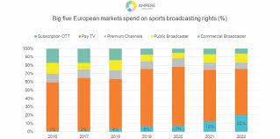
Sports Television - The Benefits
Broadcasts instantaneous sporting action to a large audience.
Cheap to film compared with dramas etc.
Hence features heavily on TV schedules particularly on weekends.
Has brought minority sports to the fore.
Helps participants reach superstar status.
Raised performers earnings.
Provides role models.
Developed academic qualifications, sports science, books, journals and videos.

Slide 11
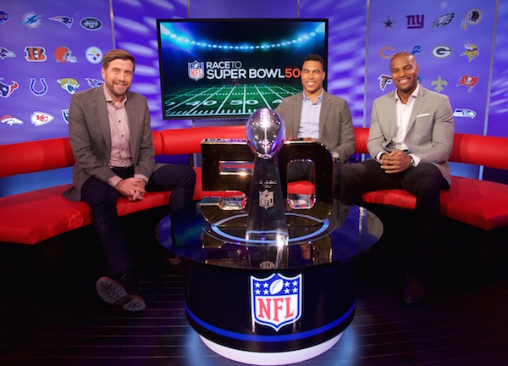
Sports Television - The Disadvantages
Places athletes under pressure to perform more regularly than is good for them.
Players become public figures where their every move is scrutinized.
Over-dramatizes problems in sports world. Sensationalism sells papers.
Focus is often on the critical element of sport e.g. a violent incident or a challenge to the ref.
Deals between sporting bodies and the media can favor certain sports e.g. Adidas and FIFA.

Slide 12
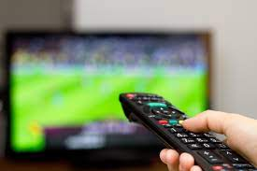
Sports Television - How does it Change Sport?
Some sports have had to change to be more amenable to media coverage.
Television coverage can influence participation in certain sports.
Example: 23 million people in the US watched the Women’s World Cup final in 2014 (higher than men’s world cup) and girls’ club soccer participation is up 37% while participation in high school soccer programs also has seen a boost of 45%.

Slide 13
Sports Television
Sports Rights Fees (from the rights holder perspective)
Several factors to consider when choosing a media partner for a rights holder:
Size of rights fees bid – The highest bidder is typically the most attractive.
Financial solvency of the potential high bidder. Several leagues have awarded sports rights to the highest bidder and subsequently been stranded when the bidder cannot pay the committed fees because of bankruptcy.
Broadness of coverage – The ability to provide coverage to as broad a base of viewers as possible (typically higher on broadcast than cable).
Capability of bidders to broadcast the event – Technical capacity and ability for innovation in coverage.
Capability of bidders to market and cross-promote the sporting league.
Long-term relationships – Takes time to develop trust and confidence in a broadcasting partner.

Slide 14
Sports Television - The Rights Game

Slide 15
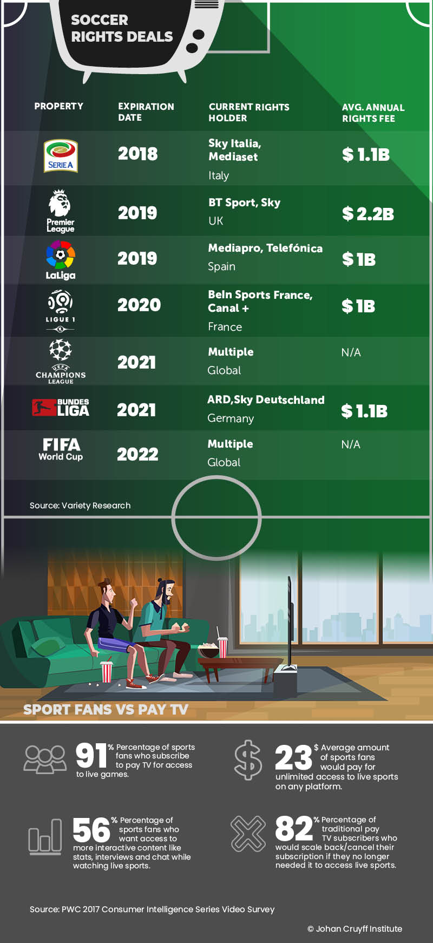
Sports Television - The Benefits
When national teams do well in a sport at the Olympics there is often and increase in grassroots participation.
Spectatorism is on the decline because it is more comfortable to watch the game from home.
This is why football clubs charge large fees to TV companies wanting to televise the match.

Slide 16
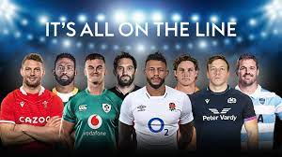
Sports Television - The Effect(s)
American networks own the Olympics and can alter the timing of main events to suit live broadcasting times.
Sky TV has changed football from a Saturday game to an everyday event. Having bought exclusive TV rights to Rugby league, Sky changed the winter sport to a summer one, restructured the leagues to create a Super League and manufactured clubs in under represented areas. All clubs had to devise a non-geographical nickname in order to merchandise themselves.

Slide 17
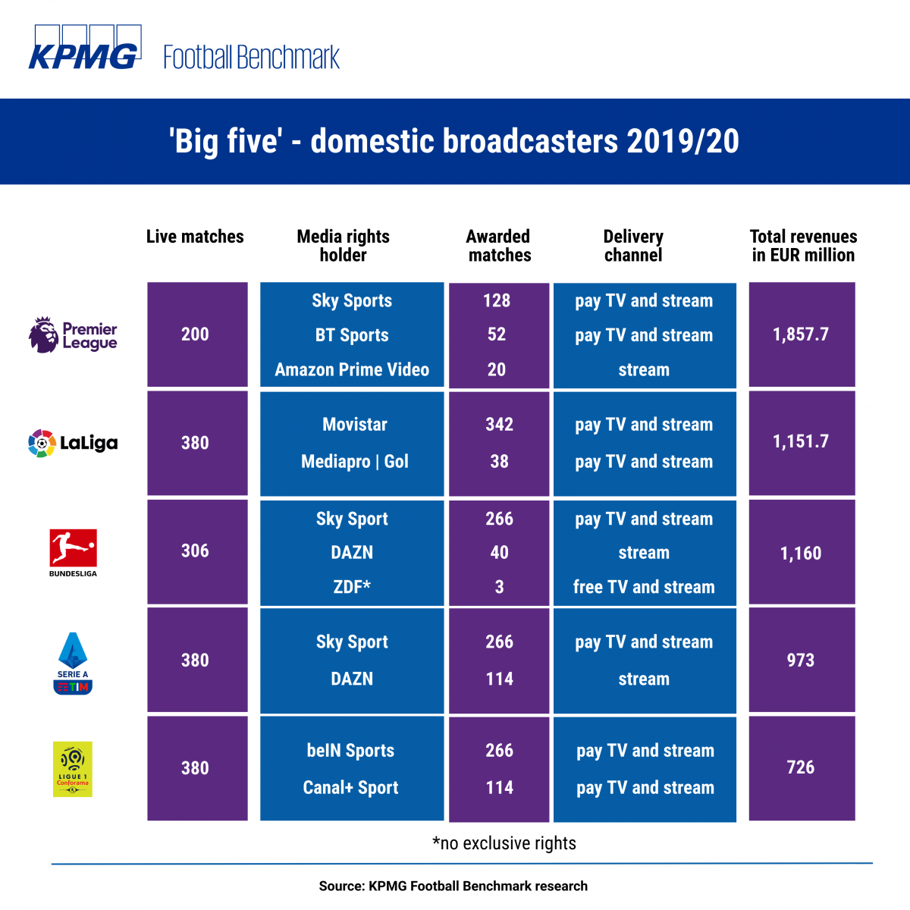
Sports Television - The Costs

Slide 18
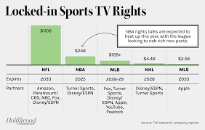
Sports Television - The Costs
With cameras being placed in goals, underwater and in racing cars, the viewer at home gets a more detailed coverage than a live spectator.
Action replays and freeze frames mean a detailed analysis can take place minutes after the goal.
Satellite communication means international events can be screened live to all homes.
The Broadcasting Act of 1990 declared all rights to broadcast sport could be sold to the highest bidder.

Slide 19
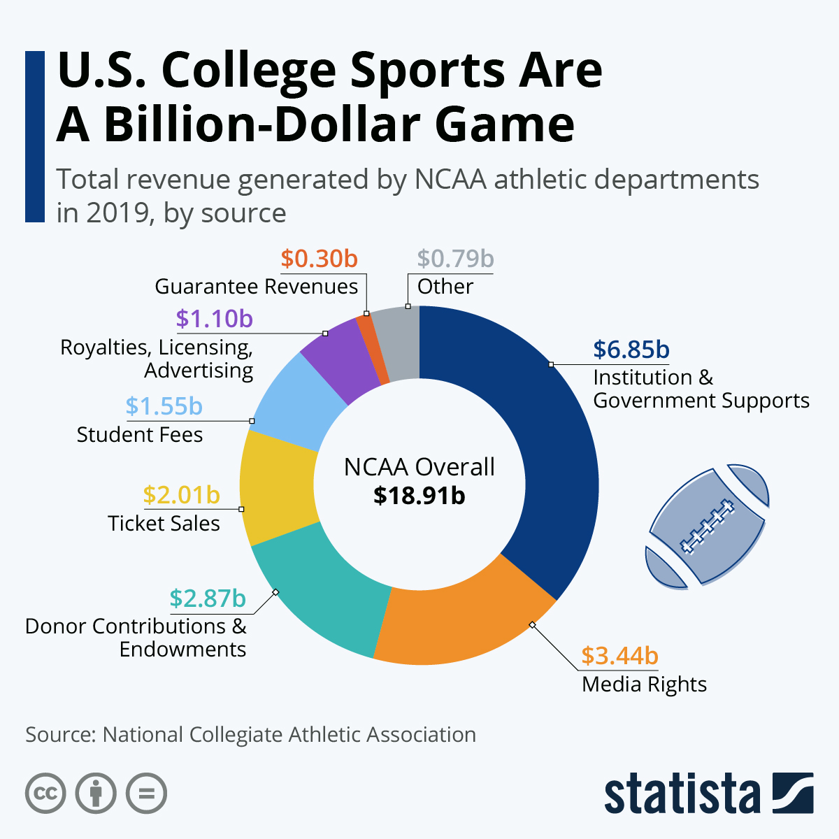
Sports Television
TV companies pay huge sums to cover sports and the advertisers and sponsors back the sport because of the exposure they will get in the media.
Individuals train for sport because the media gives them the stage on which to demonstrate their talents.
Media coverage brings in the sponsors and advertising to sports (essential for sports to be viable).
Sponsorship of sports is a cheap form of advertising.
Sponsorship funds the sport.
Sport attracts paying customers to the media’s presentation.

Slide 20
Thank You

