Slide 1
Sports Business Management and Strategy
An Overview of the Olympics
Aarthi Rajaraman

Slide 2
The Olympics

Slide 3
Olympics: What Makes up the Olympic Brand?

Slide 4
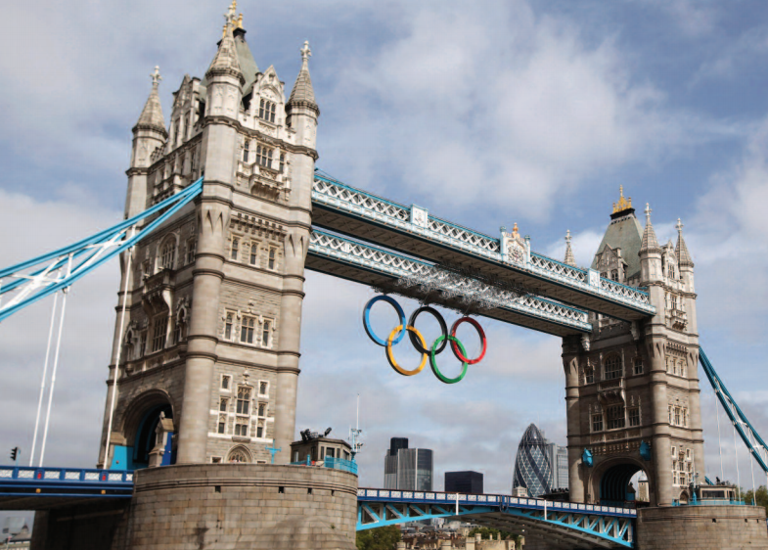
Olympics - Brand Values

Slide 5
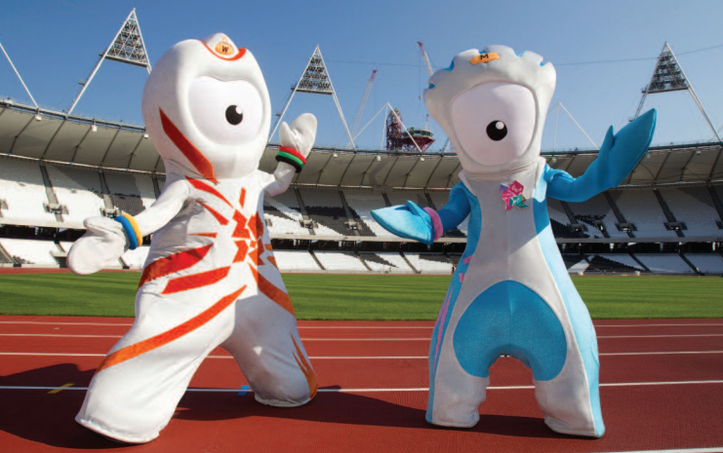
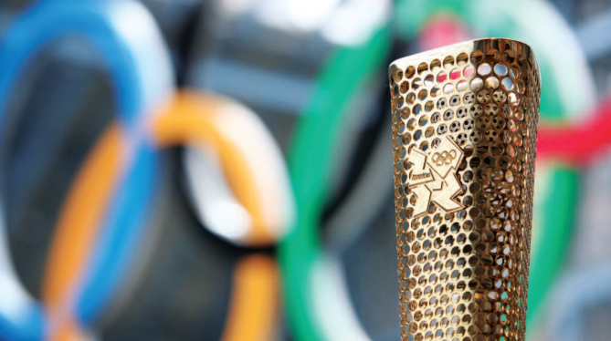
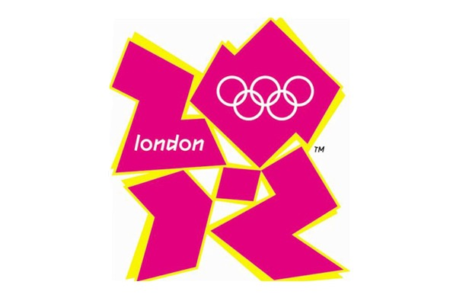
Olympics
The Olympics
BRAND ELEMENTS
MASCOTS
PICTOGRAMS
TORCH
MEDALS

Slide 6
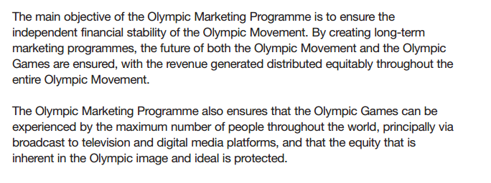
Olympics
The Olympics
MARKETING OBJECTIVE
How does the IOC generate revenues?

Slide 7
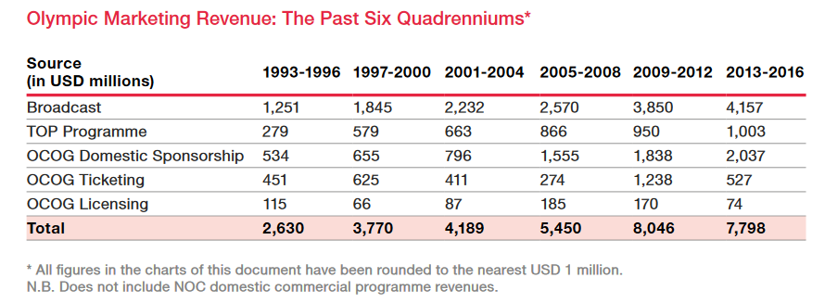
Olympics
The Olympics
MARKETING REVENUES

Slide 8
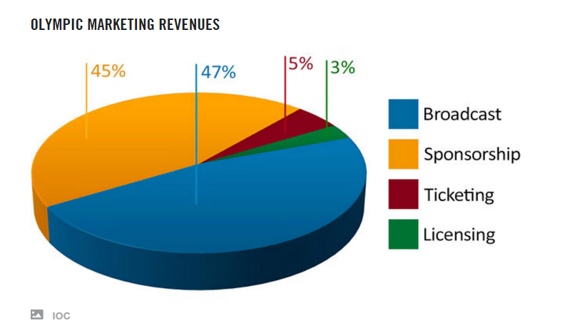
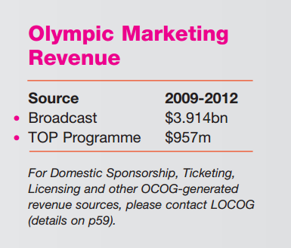
Olympics
The Olympics
MARKETING REVENUES

Slide 9
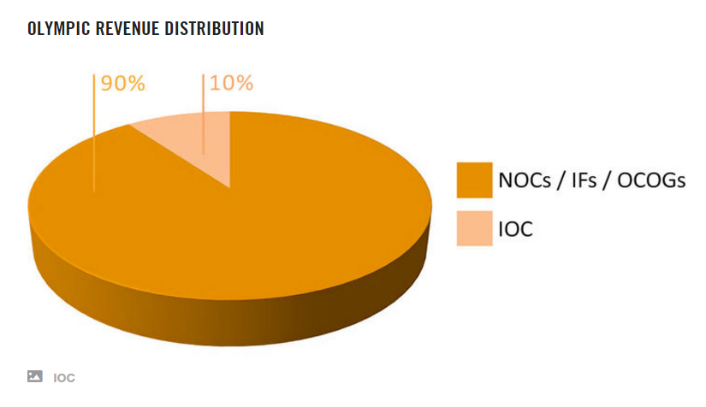
Olympics
REVENUE REDISTRIBUTION
But where exactly does this go?

Slide 10
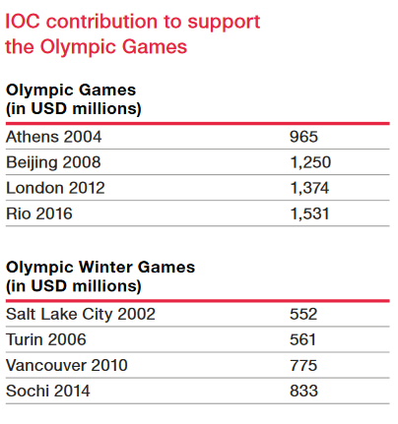
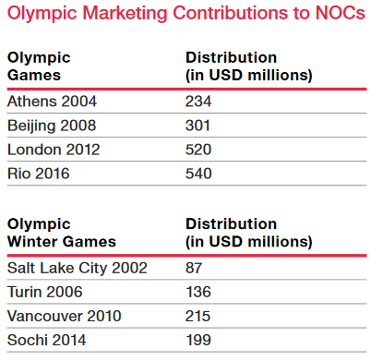
Olympics

Slide 11
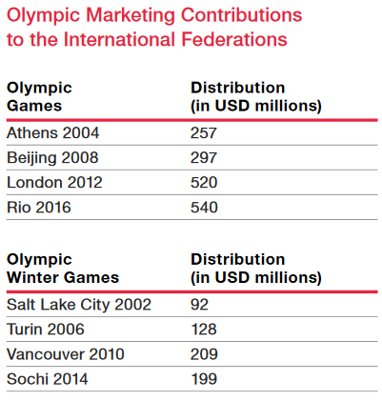
Olympics

Slide 12
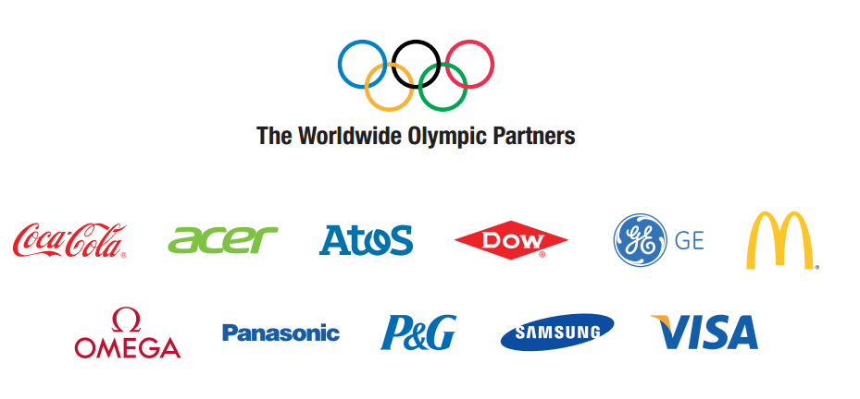
Olympics
SPONSORS
What value is exchanged between the IOC and TOP?
Important changes have happened between 2013-16
and 2017-20…

Slide 13
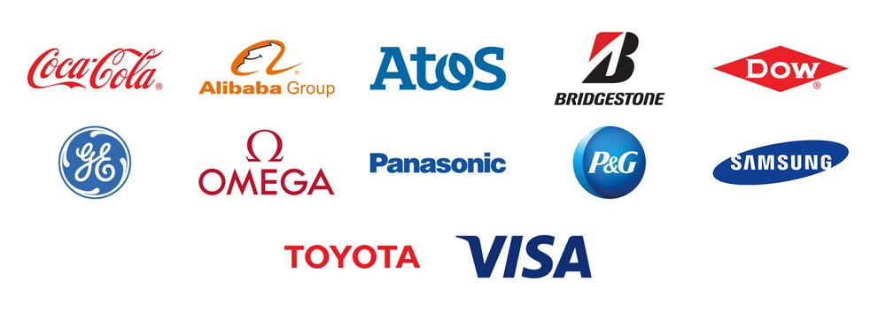
Olympics
SPONSORS
2017-20

Slide 14
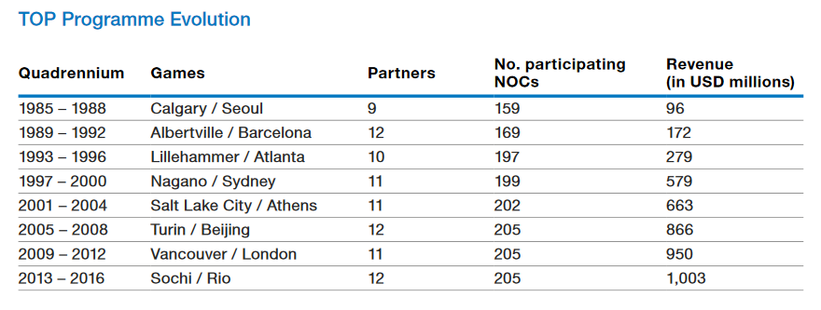
Olympics
TOP evolution How did the TOP program begin?

Slide 15
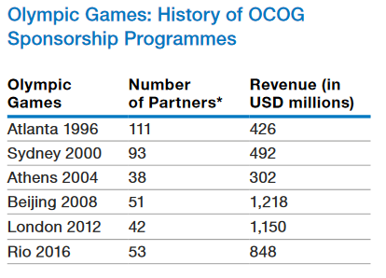
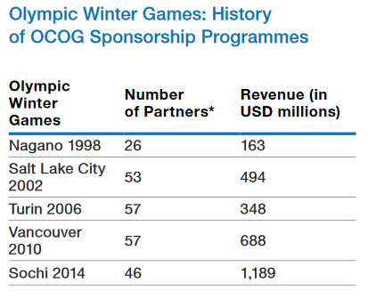
Olympics
SPONSORS
Domestic sponsors for OCOGs

Slide 16
Olympics
OLYMPIC SPONSORS

Slide 17
Olympics
OLYMPICS AND SPONSORSHIP
Charitable donations - No commercial return is expected although a company may use donations to be seen as a good corporate citizen.
Corporate patronage - A halfway house between donations and sponsorship, patronage generally provides only some recognition of a company’s activity among a relatively small, though influential, group. It is more common in the arts than sport.
Corporate hospitality
Public/community relations - Sponsorship of sport can be used to meet objectives on a company’s social or political agenda.

Slide 18
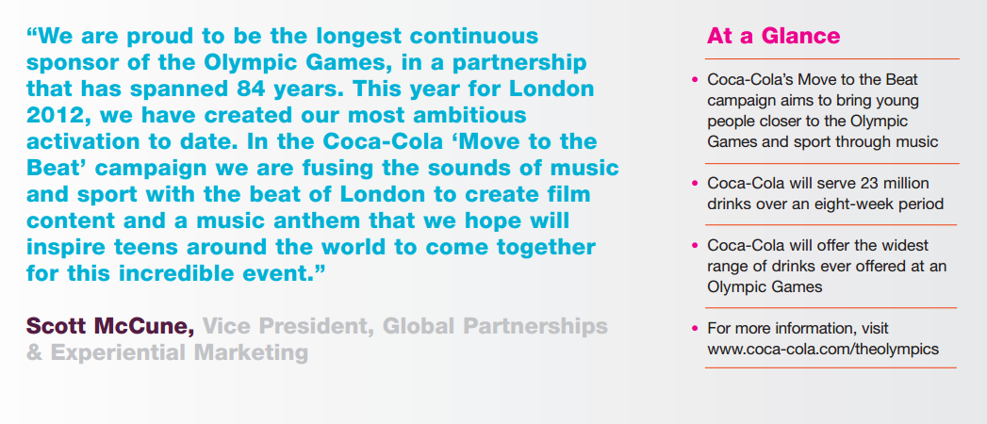
Olympics
SPONSORS

Slide 19
Olympics
SPONSORS

Slide 20
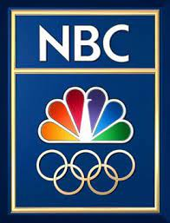
Olympic - TV Rights
1980 Olympics in Moscow were a turning point for the rights process; prices escalated 2.5 times to what they were prior.
No regulation to bidding process – 3 networks used multiple rounds of bidding and eventually went to NBC, which had highest bid of $106 million USD.

Slide 21
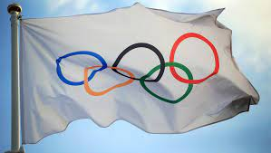
Olympic - TV Rights
Why pay so much?
Networks hope to make the money back in advertising – not always a perfect science.
Several unpredictable elements – stability of economy, interest in games, athletes representing their nation, boycott of Olympics, costs of production.
Benefits can include: increased viewers for other shows/programming on the network.

Slide 22
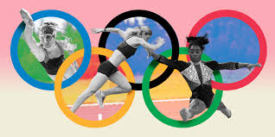
Olympic - TV Rights
The IOC obviously carries a great deal of influence.
TV helps drive the growth of Olympics.
Prior to Moscow there was no competition for bidding, ABC was awarded rights and made a killing in advertising revenues.
Today IOC uses various strategies for bidding process.

Slide 23
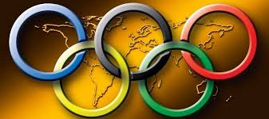
Olympic - TV Rights
Setting Minimum Bids – network has to bid a minimum amount to be considered.
Multiple Rounds of Bidding – an open-ended, sealed bid process for multiple rounds over a set period of time.
Single Round of Bidding – all competitors submit a sealed bid and highest bidder wins (IOC has a minimum number set).
Revenue sharing – network will share revenue based on advertising revenues.

Slide 24
Olympic - TV Rights
Networks’ Strategies:
Using inside information – inside sources on the organizing committee.
Avoid a bidding war – networks threaten not to participate in outbidding each other.
Spreading disinformation – passing along rumors or bad information to influence bidding process.
Striking pre-emptively – bidding for future Olympic games in package deal to avoid competition.

Slide 25
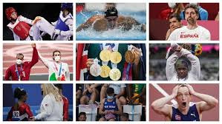
Olympic - TV Rights
TOP Olympic Sponsors are official sponsors of games.
They are currently spending $100 million dollars each on the Olympics. Rio earned over a $1 billion in sponsorships.

Slide 26
Olympic - TV Rights
In terms of audiences worldwide, the summer Olympics tend to be higher than the Winter Games.
The London Olympics had a draw of approximately 900 million viewers for opening ceremonies.
212 million viewers in US.
52 million viewers in the UK.
Overall 4 billion people worldwide tuned in at some point.

Slide 27
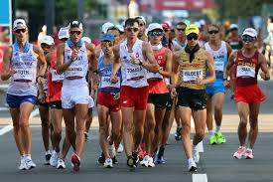
Olympic - TV Rights
NBC paid $4.4 billion for Olympics between 2012-2020. Breakdown is:
$1.18 billion London (2012)
$775 million Sochi (2014)
$1.23 billion for Rio (2016)
$963 million for Peoyong (2018)
$1.45 billion for Tokyo (2020)

Slide 28
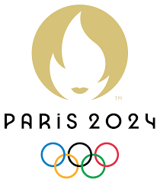
Olympic - TV Rights
NBC announced that they have secured the Olympics through 2032. How much?
They have thrown in a $100million signing bonus to the IOC.
The deal covers six Olympics, from 2021 to 2032, and gives NBC rights to all media platforms including TV, Internet and mobile. NBC's previous agreement, negotiated in 2011, included four Olympics through 2020 and cost the network $4.4 billion.
2022 Olympics will be held in Beijing.
2024 Paris.
2026 TBD.
2028 Los Angeles.

Slide 29
Thank You

