Slide 1
Sports Business Management and Strategy
International Expansion of the NFL and the NBA in China

Slide 2
Football vs. Futbol - A look at the NFL
TV Rights Deals
$4 billion in radio, TV and digital earnings across its 32 teams -- $125 million a piece, plus an equal share for the league -- and that number shows no sign of declining. The 19 highest-rated fall TV programs (and 28 of the top 30) were NFL games, and this year's Super Bowl was the most-watched program ever.
ESPN pays $1 billion per season (18 games).
DirecTV pays $1 billion per season (8 games plus NFL Sunday Ticket).
Fox pays $712.5 million per season (102 games).
NBC pays $650 million per season (18 games).
CBS pays $622.5 million per season (102 games).
Stadium Sponsorships
Teams can collect as much as $25 million to $30 million for stadium naming rights, usually on 10-year deals. In LA: Sofi paid $625 million over 20 years for naming rights to the $5billion stadium. Reliant Energy pays $10 million per year for stadium naming rights with the Texans.

Slide 3
Football vs. Futbol - A Look at the NFL
Corporate Sponsorships
From credit cards to cameras, from auto makers to pizza, companies pour money into the league's coffers for the right to associate their brands with the NFL. Among those pouring are Pepsi ($560 million over eight years, starting in 2004) and Gatorade ($45 million a year, plus marketing costs and free Gatorade for teams). Nike paid $1.1 billion to land the NFL's apparel sponsorship. Previous partner Reebok had been moving $350 million annually in NFL gear. Verizon paid $720 million over four years to be the NFL's wireless provider. The league will see $700 million in cash from its $1.2 billion, six-year deal with beer sponsor Anheuser-Busch--but teams still cut their own deals when it comes to pouring rights at individual stadiums.

Slide 4
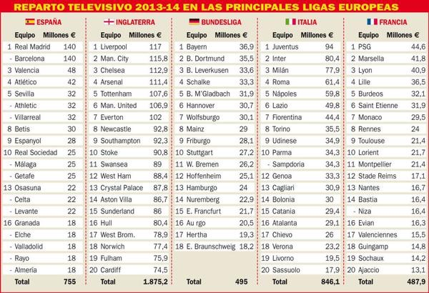

Slide 5
Football vs. Futbol
Worldwide audience for last El Clasico was between 500-600 million viewers.
Barca was valued at 2.6 billion Euros last year by Forbes, and Real Madrid at 3.7 billion (based on operating income, debt, marketing, merchandise).
Both clubs are owned by their members and had slight increases in revenue over the season.

Slide 6
NFL International
The NFL played 3 games in London for the 2018 season. They took place in October, with 1 game held in the Tottenham stadium and the other two at Wembley. Tickets started at 42 pounds and went up to 280 pounds.
Tottenham Hotspur of the Premier League opened its new 64,000-seat stadium in August 2019, at an estimated cost of 400 million pounds. Ten million pounds (about $13.3 million U.S.) is coming directly from the NFL. In turn, the place will have locker rooms built for a football team, facilities for coaches and cheerleaders, and a sunk FieldTurf football field under a retractable grass surface for soccer that will allow for a conventional fan experience for both, without having to tarp seats for football.
Tottenham could be the home of an NFL Intl expansion franchise, given the investment and new stadium.

Slide 7
Football vs. Futbol - A Look at the NFL
Tickets and Concessions
In 2010 more than 17 million fans passed through NFL turnstiles, paying anywhere from $54.51 (Browns) to $117.84 (Patriots) for the average game ticket. Though the league won't open its books, numbers for the publicly-held Packers offer some insight into what teams reap at the ticket office and concession stands. The Packers reaped $13 million from concessions, parking and local media in 2010, which figures to about $416 million NFL-wide. Green Bay also cleared $60 million from home and away game tickets plus private boxes. Projected over 32 teams, that's close to $2 billion.

Slide 8
Expansion of NFL
The NFL’s next five years internationally will be very important. During that time, a new labor deal will be struck, new broadcast deals will be negotiated, and a plan for the future abroad will become clear. Whether or not the NFL hits its goal of getting a team in London at the International Series 15-year anniversary, 2022.
The game in Mexico City went off better than last year, when playing the Monday night before Thanksgiving and flying out of a private airport over an hour away proved a logistical nightmare for the Raiders and Texans. Playing on Sunday afternoon and flying out of the international airport certainly helped.
The league’s new deal to play games in Mexico stipulates that there will be one game a year through 2021, and all of them will be at Mexico City’s Estadio Azteca (recent renovations there made it an ideal site). Waller said, for now, he doesn’t see the league looking to play multiple games per season there, largely because they aren’t testing the market and its logistics the way they are with London.

Slide 9
NFL International Expansion
The way Mark Waller (current President of NFL Intl) sees it, London represents a pivotal step on the way to a truly global NFL—serving both as a proof of concept and a kind of franchise beachhead for further expansion into countries like Germany, Mexico, and Brazil.
It helps to look at the league’s current international growth strategy. The first part of this three-step approach, according to Waller, is choosing the right city. That means finding a place that not only has an existing NFL fan base, but one that also has the potential to grow large enough to support a full-time team. Can you grow a fanbase like you would grow a business? It’s hard to say. But that isn’t stopping the NFL from trying.
Next comes infrastructure. If you’re wondering why the NFL isn’t aiming its expansion efforts a little closer to home, like in Mexico for instance, the answer is basically stadiums. By some estimates, Mexico City has an American football fanbase three times the size of London’s. What it doesn’t have are very many modern stadium options.
From the NFL’s perspective, the issue of fans and modern stadium access in London are less problematic. But that still leaves the third, and arguably most difficult step in the internationalizing process: figuring out how to make everything work logistically.

Slide 10
NFL International Expansion
In August 2017, the NFL and Tencent announced a three-year partnership. The Chinese Internet giant gained the rights to digital distribution, inside China, of live and on-demand pre-season and post-season games; Thursday, Sunday and Monday Night Football; and non-game content, such as pre-game talk shows, post-game analysis and TV programs NFL Hard Knocks and A Football Life.
China is home to about 19 million people interested in the NFL, according to Kantar-CSM China research, and its own indoor football league. The China Arena Football League began play in 2016 after it was first established in 2012. Today, six teams compete 8-on-8 in a four-game group play season that culminates in a "Super Bowl" championship. Each team fields a squad with four Chinese and four foreign players.
But it's also home to the world's most expansive online mobile content distribution, an ecosystem of networks that blend content, payment, sharing and social. There are more than 1.4 billion mobile phone subscribers in China. In 2017, more than 95% of China's internet users used their phones to access the Internet.

Slide 11
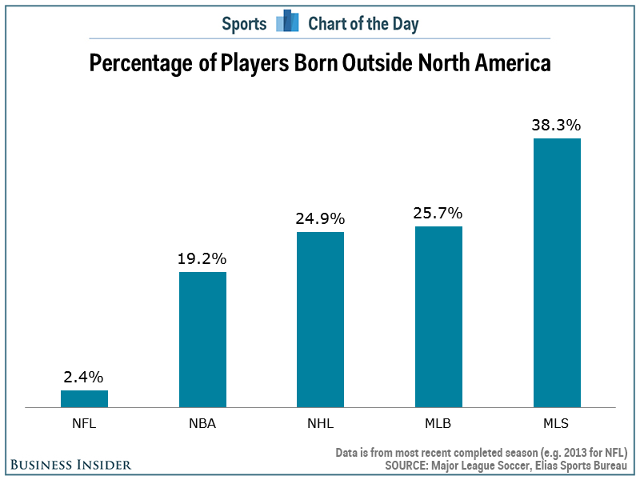
NFL International

Slide 12
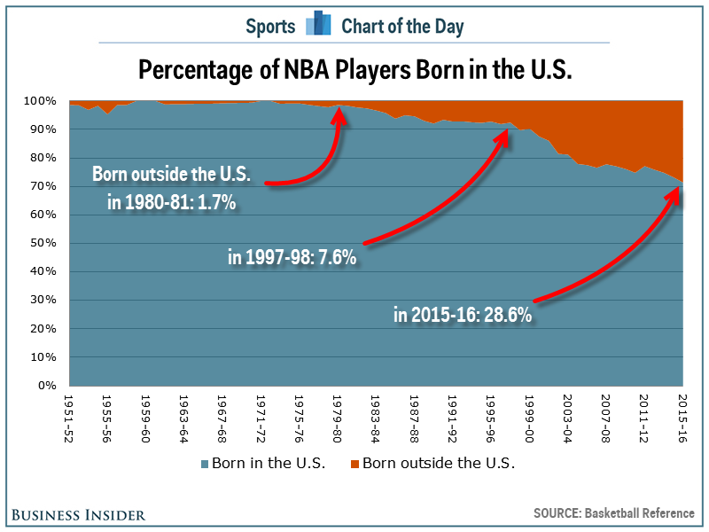
NBA Foreign-Born Players

Slide 13
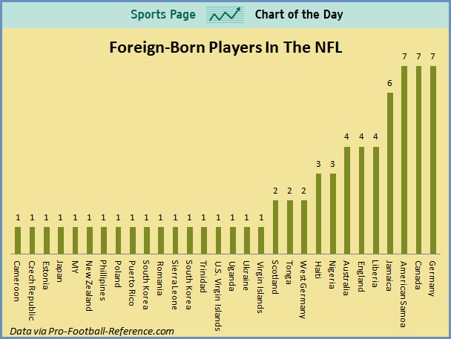
Foreign-Born NFL Players

Slide 14
NBA China
NBA China, formed in 2008, is now a 15-year-old entity that conducts all of the Chinese Basketball Association’s business throughout greater China.
Started as an idea to have an exhibition game between the CBA’s Champion and NBA Champion 20 years ago.
Now a 100-employee enterprise with 4 offices.
Transitioned CBA from FIBA rules to NBA Rules.
Now an official NBA affiliated league.

Slide 15
NBA China - Marketing Power
Estimated NBA Fans
83% of people between 15-24
1.2 Billion
People in China
450 Million
Less Than 20 Yrs Old
300 Million
NBA in China
Estimated Chinese Basketball Players
310 Million
US Population

Slide 16
Shaq In China
Baron Davis & Jose Calderon on Li Ning Tour
NBA Jam Van Touring China
NBA Partners with Tsingtao Beer
Take-Two's NBA Online Game In China
NBA Reality TV Show in China
Completed a tour throughout several major cities in China
Met fans and played ping pong in busy shopping area
NBA reality show in China called “Mengniu Basketball Disciple”.
Allows fans to show off their skills on 7’, 8’, 9’ and 10’ rims
Multi-year sponsorship with China’s Largest Beer Brewer
Take Two Interactice and Tencent enter online gaming
The Shaolin Temple in Henan - birth place of Kung-Fu
Davis reveals his plan to make a documentary
NBA implemented an interactive tour for fans to get closer to the game
45 min show showing Chinese Amateur Basketballers
Will fund Sport & Dance Competitions for NBA CHINA
Launched Top Rated NBA 2K sports franchise in China
Animated attempt to learn the art of Kung Fu
Shows Sino-US basketball culture & basketball bridge between China & US
1 MVP Choses; Gets tryout with NBDL Team
Chinese online gaming market grew by 61% last year ; now $2.75 billion in revenue.

Slide 17
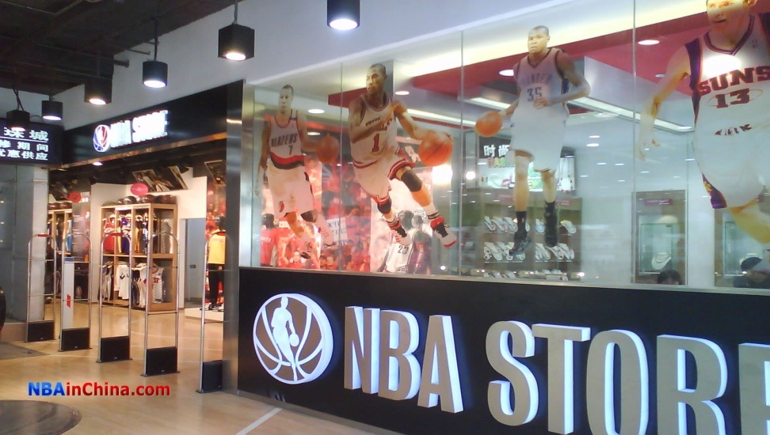
NBA China - SWOT Analysis - Strengths
Young, innovative league
NBA China has backing
"Basketball Diplomacy"
NBA China has several stores
The NBA brand recognition
NBA on TV
China has taken a lead role in the development in NBA CHINA
17 Teams already in place
Chinese stimulus package
League revenue sharing
Central location in Asia

Slide 18
NBA China - SWOT Analysis - Weaknesses
Unfamiliarity
Skewed playing roster
Revenue sharing
Lack of experience and reputation
Superior talent of regular NBA
International basketball previously operated under FIBA rules
Lack of history of the sport within the country
Lack of current “star” power

Slide 19
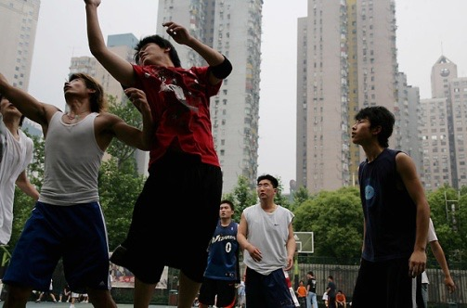
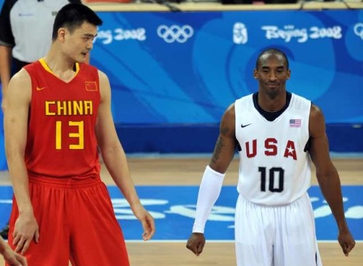
NBA China - SWOT Analysis - Opportunities
Population
450 million people interested in basketball
300 million play basketball
Merchandise sales = $$$
New international market
Ticket sales
TV ratings
Growth of Chinese talent, coaches, and
management positions.
Uniting of Chinese and American cultures

Slide 20
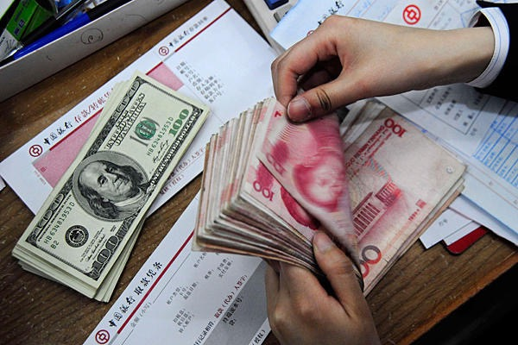
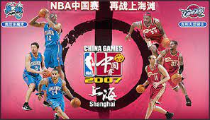
NBA China - SWOT Analysis - Threats
European Basketball
Westernization of China
CBA already in existence
Minor League basketball feel
Different currency rate
American players willingness to play overseas

Slide 21
NBA China - Salary Cap
820,000 U.S. dollars per team
Allows a capitalist system for its local players to compete and the most successful being rewarded heavily
Monthly salary of foreign players was not allowed to go above $60,000 (limit 2 players per team)
League is protecting the domestic industry from foreign domination
Chinese club players will not exceed 300,000 yuan ($44,000)
Foreign player influence is down and an incentive to make the national team pushes competitive level of play from Chinese players
The total salary for players and coaches must be below 55 percent of a club's revenue
The motivation to play good is making the Chinese National Team where players can make up to $146,000 for making the team

Slide 22
NBA China - Typical Season
No competition with other leagues since it is the only pro basketball league in China. Due to the fact that you can only have 2 Non-Chinese Players, the aim is to stick to the domestic fanbase!
Season Ends March 14th
Playoffs Begin March 24th
Playoffs End April 25
32 Game Season
Season Begins Dec 20
Season is Approx 4 months

Slide 23
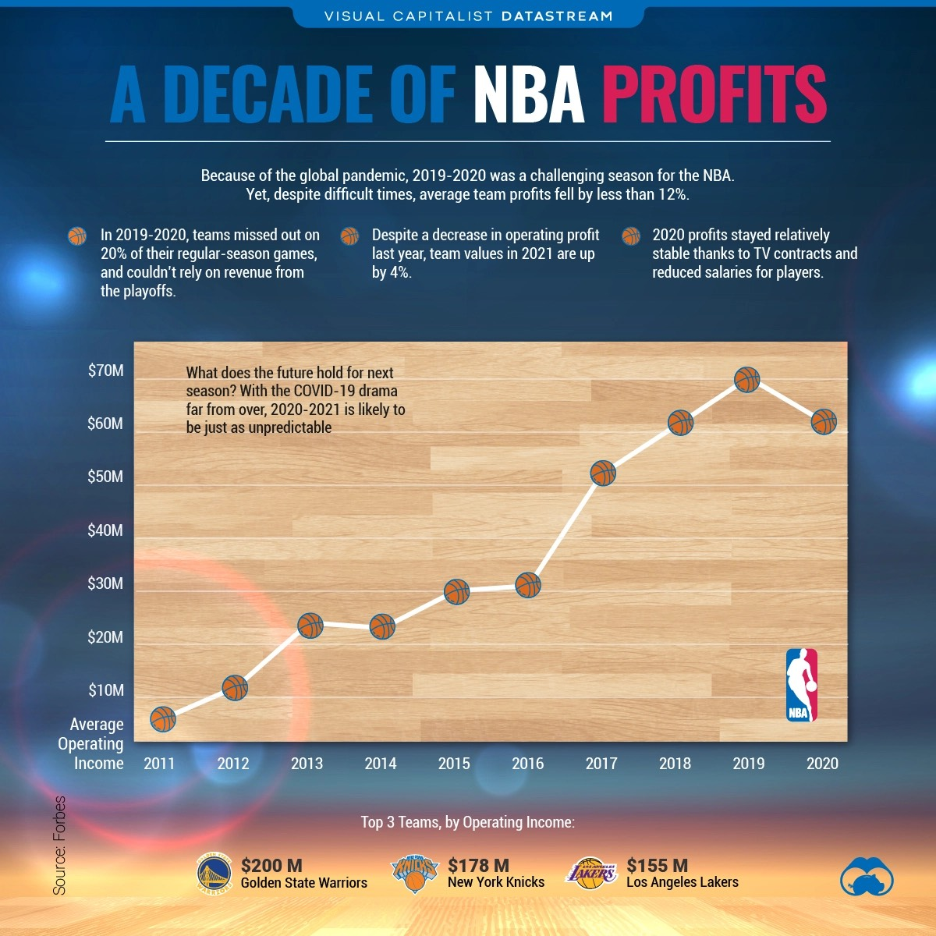
NBA Revenues

Slide 24
Thank You

