Slide 1
Sports Business Management and Strategy
Football Ownership Structures
Aarthi Rajaraman

Slide 2
Ownership and Management Structures
Two views from the EPL (WSJE, 7 Feb 2011)
“It’s (football) an incredible industry, but I wouldn’t describe it as a business… in business you can make money, you can lose money or you can break even. In football clubs they’ve take out the bit where you can make money. There’s just no way you can justify it economically.” (David Gold, Chairman West Ham United)
“I’m very doubtful that a football club would ever provide me with significant profit or revenue… I simply love football. My interest is – how high can I go?” (Valeri Belokon, part owner of Blackpool FC)

Slide 3
Ownership and Management Structures
Members
Domestic Owner
Club Ownership
International Owner
Shareholders – either Public or Private

Slide 4
Ownership and Management Structures
1: Associative/Members Model:
Non-profit entities, in which the members are the legitimate owners, are involved in strategy decisions, and elect the president and board of directors.
In La Liga, there are four football clubs that subscribe to this model: Real Madrid, FC Barcelona, Osasuna and Athletic Bilbao. Turkish giants, Galatasaray’s ownership is also structured on this model.
In the associative model, entities are managed on the basis of objectives such as achieving sporting success or developing initiatives and services to achieve member satisfaction.

Slide 5
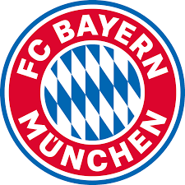
Ownership and Management Structures
In Germany, there is the "50 + 1" rule, where the association or club has to have a controlling stake, commercial interests can't gain control. In Bayern Munich, for example, Audi and Adidas each own 9% but the rest is controlled by the members via the club.
There are two exceptions: Wolfsburg is owned by Volkswagen and Bayer Leverkusen is owned by the chemical company, Bayer. Both clubs originated as works sporting clubs. But generally a club in Germany is a true club for the members.

Slide 6
Ownership and Management Structures
Exceptions to the 50 plus 1 rule are possible, albeit sometimes controversial
The regulations permit an exception where an investor can show that it has "supported the sport of football within the parent club substantially and continuously for more than 20 years".
Exceptions were granted for the so-called "works clubs" Bayer 04 Leverkusen (started by workers of the Leverkusen-headquartered pharmaceutical company Bayer in 1904) and VfL Wolfsburg (started by workers of the car manufacturer Volkswagen in 1945).
The only other exception granted to-date is for TSG 1899 Hoffenheim and its now majority owner Dietmar Hopp, founder of software company SAP. Hopp has invested over £300million into his local "village" team since the late 1980s and helped propel the club from local village leagues into the Bundesliga. Hopp was granted an exception on the basis of the 20 year rule in 2015 when he became majority shareholder.

Slide 7
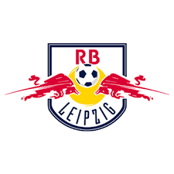
Ownership and Management Structures
In the case of RB Leipzig, an exemption has not been granted. Nonetheless, RB Leipzig is 99% owned by the energy drinks company Red Bull, with the remaining 1% held by the e.V. The e.V. retains 100% of the voting rights but it has a closed membership of only 19 voting members, all of whom are either directly or indirectly employed by Red Bull.
Furthermore, despite league restrictions on the use of company logos and names, the club and Red Bull have been careful to stay within the regulations: for example, the RB in the club's full name stands for "RasenBallsport" – nevertheless, the club remains synonymous with Red Bull.

Slide 8
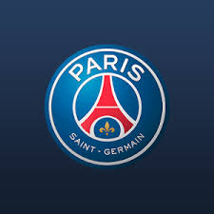
Ownership and Management Structures
2. Single Ownership Model:
All or vast majority of club shares are in the hands of a single person or company that has injected
considerable amount of money that will be hard to recoup through the natural workings of the club. In
Europe, we have the examples of Roman Abramovich at Chelsea, Sheikh Mansour at Manchester City
FC, the Glazers at Manchester United FC, Silvio Berlusconi formerly at AC Milan and the Qatari
investors at PSG in France.
In all these cases the owners have made big financial investment that they hope to capitalize on, obtaining added benefits such as:
● Public recognition, presence and PR purposes. ● Synergies with other companies they own and advertising returns for these companies. ● Sporting successes.

Slide 9
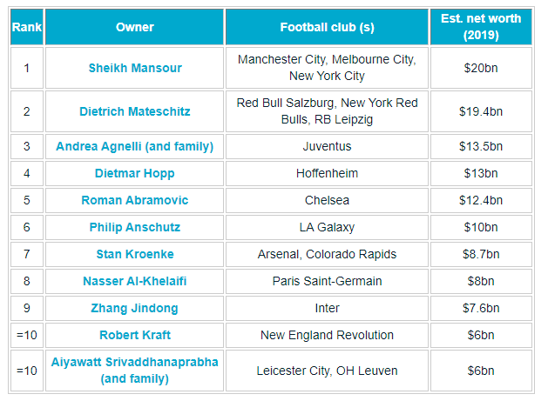
Ownership and Management Structures
Richest Owners in Football

Slide 10
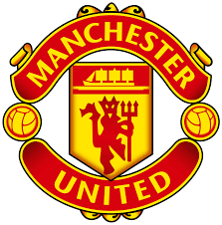
Ownership and Management Structures
3. Share Ownership Model
This model is a similar to the single ownership but with the added factor that some of the shares are listed on the stock exchange where they are freely transferred between buyers and sellers.
This model is clearly in decline because of the pressure that the sporting activities put on the price of the shares. It can lead to value swings that are unjustifiable from the point oft view of the actual financial value of the club’s assets.
In Europe, there are currently about 15 clubs or so listed on the stock exchange, a far cry from the over 50 there used to be in the 1980s and 1990s.

Slide 11
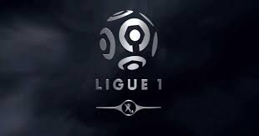
Ownership and Management Structures
In France, a sporting entity is first and foremost an association: a non-profit entity formed primarily for non-commercial purposes.
However, the French sport code requires, under certain circumstances, that the associations incorporate a dedicated commercial company to operate professional football activities.
To protect against conflicts of interest, the code includes a prohibition on the same legal person controlling, via its shareholding or otherwise, more than one club, irrespective of the competitions those clubs participate in (with an exemption for interests in different men and women's clubs).

Slide 12
Ownership and Management Structures
The flexibility of the French rules has seen multiple investors flow into the top division of French football in recent years.
Most famously, in 2011, Qatar Sports Investments, a sovereign investment fund of Qatar, acquired Paris St Germain FC.
Recently 100% of FC Girondins de Bordeaux was acquired by a US investment fund, King Street Capital Management and 80% of OGC Nice was acquired by the British Petro Company Ineos.
An alternative approach is that of Olympique Lyonnais, which is the first and (for the time being) the only publicly listed French football club.
For now, however, Lyon’s model remains the exception.

Slide 13
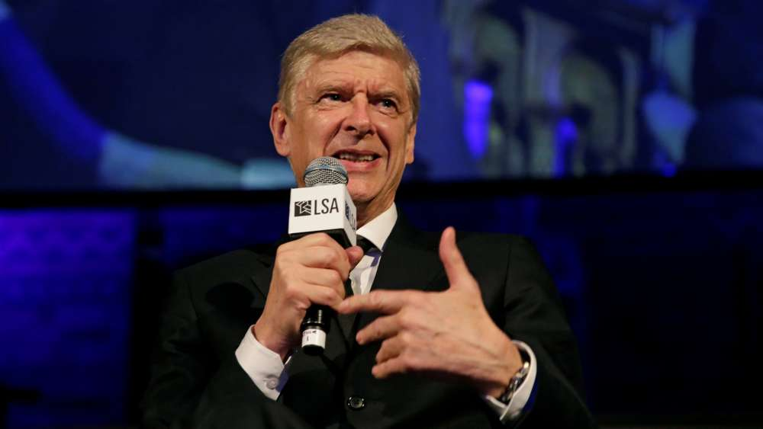
Ownership and Management Structures
'Some are just coming to make quick money’ - Wenger warns Ligue 1 clubs against foreign investors

Slide 14
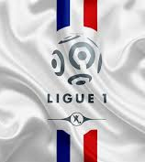
Ownership and Management Structures
Speaking to BEIn Sports, Wenger backed up the viewpoint that selling clubs to rich foreigners will not necessarily guarantee success and may even be against the best interests of Ligue 1 teams.
“Unfortunately, I think we’re witnessing a reverse phenomenon today,” he said. “For example, take French clubs. They are gradually falling into hands of people who are not real builders for the future of the club, but rather investors who are seeking to earn money very quickly. And we can see in France today that there are a lot of problems at this level because the clubs are dissatisfied. Supporters feel that the primary goal is not to build a good team but to achieve financial gain.”
Wenger, who is now FIFA’s director of football development, has argued that measures must be taken in France in a bid to prevent unscrupulous individuals or conglomerates from taking charge.

Slide 15
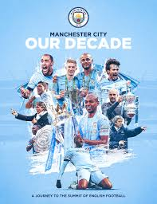
Ownership and Management Structures
Manchester City Football Club is wholly owned by City Football Group Limited (CFG).
CFG is a holding company in which Abu Dhabi United Group owns an 87% stake with the remaining 13% held by the China Media Capital consortium (CMC).
The City Football Group (CFG) is the holding company established to oversee the creation and administration of a network of linked clubs and other footballing operations.
The company's aim is to own a team on each continent, each with the identifier "City" in its name.

Slide 16
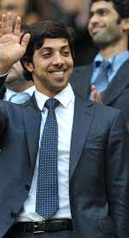
Ownership and Management Structures
Sheikh Mansour spent £210million from his personal account on buying the 90% Manchester City stake.
City’s takeover happened as the club was heading into financial crisis under the ownership of the ousted Thailand prime minister, Thaksin Shinawatra, who was wanted on corruption charges at home.
Mansour is said to be a football fan, like many people in the UAE which was a British protectorate until 1971, and he owned a club in Abu Dhabi, Al-Jazira. With Premier League clubs becoming serially bought by overseas investors, Mansour saw that City met his criteria: a big, well-supported club with a new stadium (built by the local council for the 2002 Commonwealth Games).

Slide 17
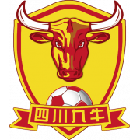
Ownership and Management Structures
City Football Group bought a majority stake in Chinese third division team Sichuan Jiuniu F.C in 2019.
Tencent-backed robotics company UBTECH and China Sports Capital have jointly purchased the remaining 13% in Sichuan Jiuniu FC. UBTECH has been a partner of Manchester City since 2016.
Soriano said Sichuan Jiuniu FC will be at the core of improving soccer in China. “We believe strongly in the future of football in China. We are making a long-term, sustainable commitment to grow and develop Sichuan Jiuniu FC and to nurture Chinese footballing talent. These objectives are equally important.”

Slide 18
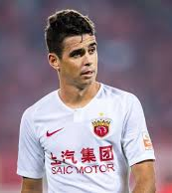
Ownership and Management Structures
President Xi Jinping has set the goal for China to be among the world leaders in football by 2050 at the latest and to have hosted a World Cup. Billions will be invested in the development of soccer.
At least 70,000 football pitches are to be built and talent scouts for young footballers will be developed.
The interest of the population has also been growing by leaps and bounds since clubs from the Chinese professional league signed international football stars such as former Bayern-striker Sandro Wagner, former Bremen striker Marko Arnautovic and former Chelsea midfielder Oscar.
More than 300 million Chinese watch football at least once a week, and 250 million now describe football as their favorite sport.

Slide 19
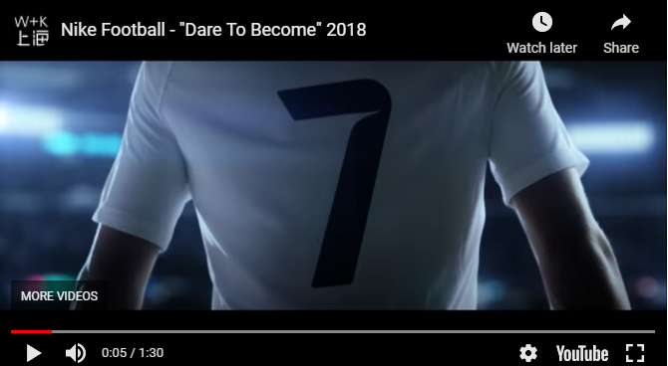
How Sports Companies Can Conquer the Chinese Market
https://youtu.be/xpxl7CKJsNU

Slide 20
Ownership and Management Structures
Manchester United History
Corporate pvt
Local philanthropists
1892 Independence from railway company then bankrupt
1902
5 local businessmen invested 2000 GBP to form
MUFC
1878 Railway company club formed
Corporate public
1990 Club floats on stock exchange and raises 6.7m GBP
1960s Edwards family take control for 40,000 GBP and club is successful in 1960s
1927-1950s James Gibson takes control of club for 2000 GBP but club struggles
Corporate pvt
1998 attempted buy-out by BSkyB (blocked)
2003 Glazer family start buy-out
2005 Glazer buyout complete with a valuation of $1.4bn

Slide 21
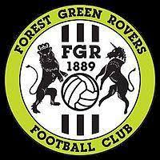
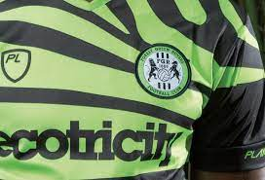
A New Take on Ownership
Forest Green Rovers
https://youtu.be/3Lt0p9Y7IAA
https://www.fgr.co.uk/another-way

Slide 22
Ownership and Management Structures
The tycoon model is unsustainable – it does not provide competitive balance and creates dependency.
Ownership models that disenfranchise the fans are high-risk – pure profit maximization can threaten your business model.
Limited accountability can result in corruption.
Fan-owned (FCB) are becoming more popular among fans and are being promoted by some governments.
http://www.guardian.co.uk/commentisfree/video/2011/aug/30/fan-owned-football-clubs-chester-fc-video
Ownership exposes a central dichotomy related to the identity of pro clubs: are we a business or not?

Slide 23
Thank You

