Slide 1
Sports Business Management and Strategy
Sponsorship in Sports

Slide 2
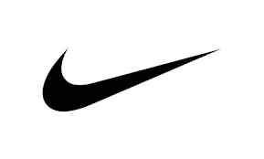
Sponsorship and Sport What is Sponsorship? Its Role in Sport?
According to IEG, Sponsorship can be defined “a cash and/or in-kind fee paid to a property in return for access to the exploitable commercial potential associated with that property.”
Sponsorship is an exchange:
Sponsor provides cash and/or in-kind services
Sponsored cedes commercial rights and communication opportunities
This exchange can become a ‘relationship’ or ‘partnership’

Slide 3
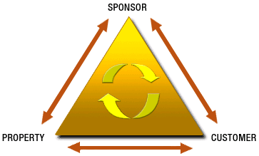
Sponsorship and Sport What is Sponsorship? Its Role in Sport?
Sponsorship is a dynamic three-way relationship. It harnesses the emotional connection between a property and its audience and converts this emotional connection into a desired response for a sponsor.
Marketing partners such as advertisers, sponsors and endorsers are a key pillar of most successful sporting leagues, events and clubs.

Slide 4
Sponsorship and Sport What is Sponsorship? Its role in Sport?
Marketing partners such as advertisers, sponsors and endorsers are a key pillar of most successful sporting leagues, events and clubs.
Companies that compromise the “TOP” (The Olympic Partner) are currently paying around $200 million in paying the IOC every 4-year cycle to be an Olympic sponsor (does not include activation costs).

Slide 5
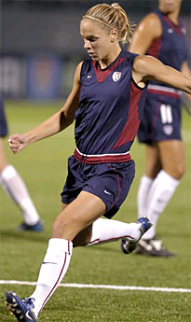
Sponsorship and Sport What is Sponsorship? Its role in Sport?
Sponsorship money can make the difference in terms of success or failure for some sporting leagues. Ex: WUSA – Women’s professional soccer league (in US). It began in 2001 and ended in 2003 after incurring losses of around $100 million USD.

Slide 6
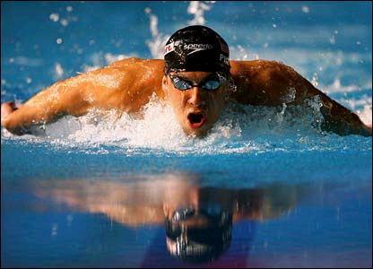
Sponsorship and Sport Deliverables to Official Sporting-Related Sponsorship
Association Type Deliverables
Name association recognition – “official sponsor”
Sports association recognition
Athlete association recognition
Event Day and Related Deliverables
Tickets/tickets in preferred zones
Hospitality suites/facilities
Access to off-limit areas – ex: courtside/bench side, pits in F1 and NASCAR, etc

Slide 7
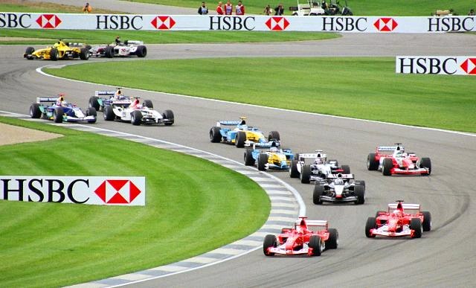
Deliverables to Official Sporting-Related Sponsorship
Visual Image Deliverables
At event site
At event surroundings
On direct transmission of event
On replays of events
Use in advertisements/promotions

Slide 8
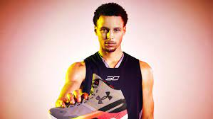
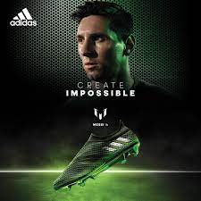
Sponsorship and Sport
Deliverables to Official Sporting-Related Sponsorship
Athlete/Team/Facility Deliverables
Athlete appearance deliverables
Athlete endorsement deliverables
Athlete image deliverables
Use of facilities for corporate events

Slide 9
What is Sponsorship Activation?
Sponsorship is more than just posting your logo on an event, athlete or team – it’s more than just brand exposure.
The activation process is where the sponsor “extracts value” from the sponsorship. This means that the sponsorship investment is capitalized on, by being leveraged effectively.
Brand activation engages consumers and enhances an event experience – it’s often very powerful in spreading positive word of mouth for brands with a very specific audience.
Activation ratios are important! Sponsor pays a sponsor fee of X for an event and an additional Y to for every sponsor dollar to extract value from the sponsor status. For example – in 2003, Nike paid $50 million for Olympic rights, and then paid an activation ratio of 1.3 dollars for maximizing their sponsorship. This means they paid an additional $65 million dollars in activation (1.3 x $50 million).

Slide 10
What is Sponsorship Activation?
The Snickers Street Olympics in China that was “activated” in the lead-up to the Beijing Olympics 2008.
Snickers ran a series of street events in conjunction with an integrated marketing campaign.
The results were extremely successful - Snickers is now the number 2 chocolate brand in China and sales rose 75% from the first sales quarter of 2007 to the end of the first quarter in 2008.
https://www.youtube.com/watch?v=W9p_uKJJYAs
Other successful sponsorship activation examples: Sony Ericsson Night Tennis campaign (launched in Madrid 2006), Red Bull Air Race Competition.
https://www.youtube.com/watch?v=bWUALmRI5_w

Slide 11
Measuring Objectives and Evaluation in Sponsorship
There are multiple objectives for companies investing in sponsorship relationships. These include:
Stimulate Sales – Generate increased purchases from existing customers or attract new customers.
Brand Awareness – Increase a consumer’s favorable recognition of a product by exposure to the name.
Brand Personality/Image – Promote a product having distinctive and memorable attributes by association with a sporting league, event, club or player.
Customer Reach – Access a desired customer base in a targeted way.
Exclusivity – Provide a platform where the products of potential competitors are precluded from obtaining customer mind share.
Employee Motivation – Promote greater loyalty and commitment from employees.
Community Citizenship – Promote company as supporting events and clubs to which many members of the community are emotionally attached.

Slide 12
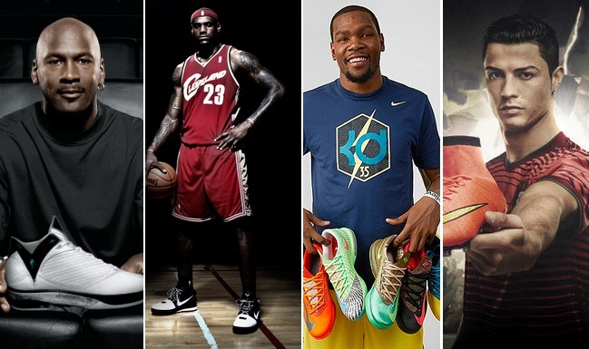
A Look at Some of the Most Lucrative Athlete Sponsor Deals in Sports

Slide 13
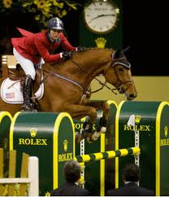
Sponsorship and Corporate Communication
Sponsorship is not philanthropy.
The sponsored is expected to play an active role in the sponsor’s communication strategy.
Sponsors generally expect a return on their investment.
It is also more than a marketing tool.
Both entities are involved in co-image protection and development.
https://www.youtube.com/watch?v=zJ_LXsPFens

Slide 14
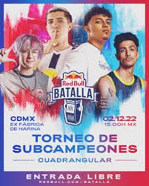
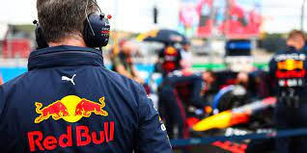
Sponsorship and Corporate Communication
What kind of product is Red Bull?
What customer segments consume Red Bull?
What kind of sports do Red Bull sponsor?
What is Red Bull trying to communicate?
http://energydrink-uk.redbull.com/

Slide 15
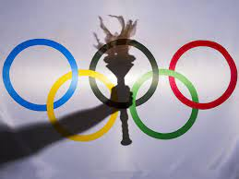
Sponsorship and Corporate Communication
A widely used sponsorship model has emerged in Europe:
Increasing numbers of sponsors = decreasing value of sponsorship deals (dilution).
Small number of high value sponsorship deals.
Product category exclusivity.
Often tiered (from title sponsor to official supplier).
Medium-long term deals (relationship-based).
This model began in the mid-1980s in the Olympic Games.
www.olympic.org/sponsorship

Slide 16
Sponsorship and the Olympics
What Makes the Olympic Brand?

Slide 17
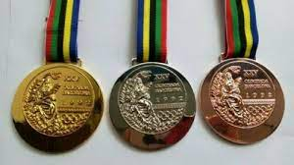
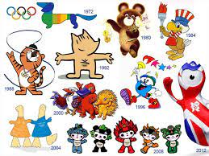
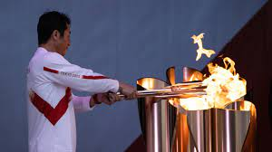
Sponsorship and Corporate Communication
The Olympic Brand Elements consist of:
Mascots
Pictograms
Torch
Medals

Slide 18
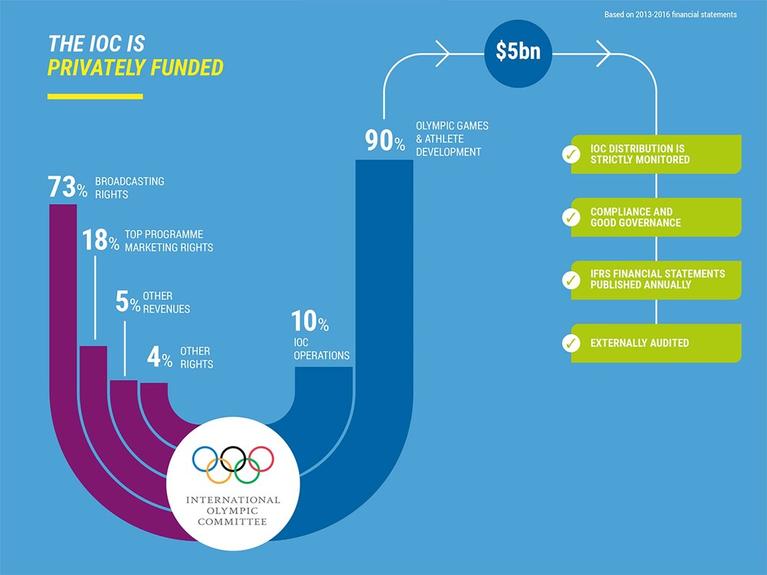
Sponsorship and Corporate Communication

Slide 19
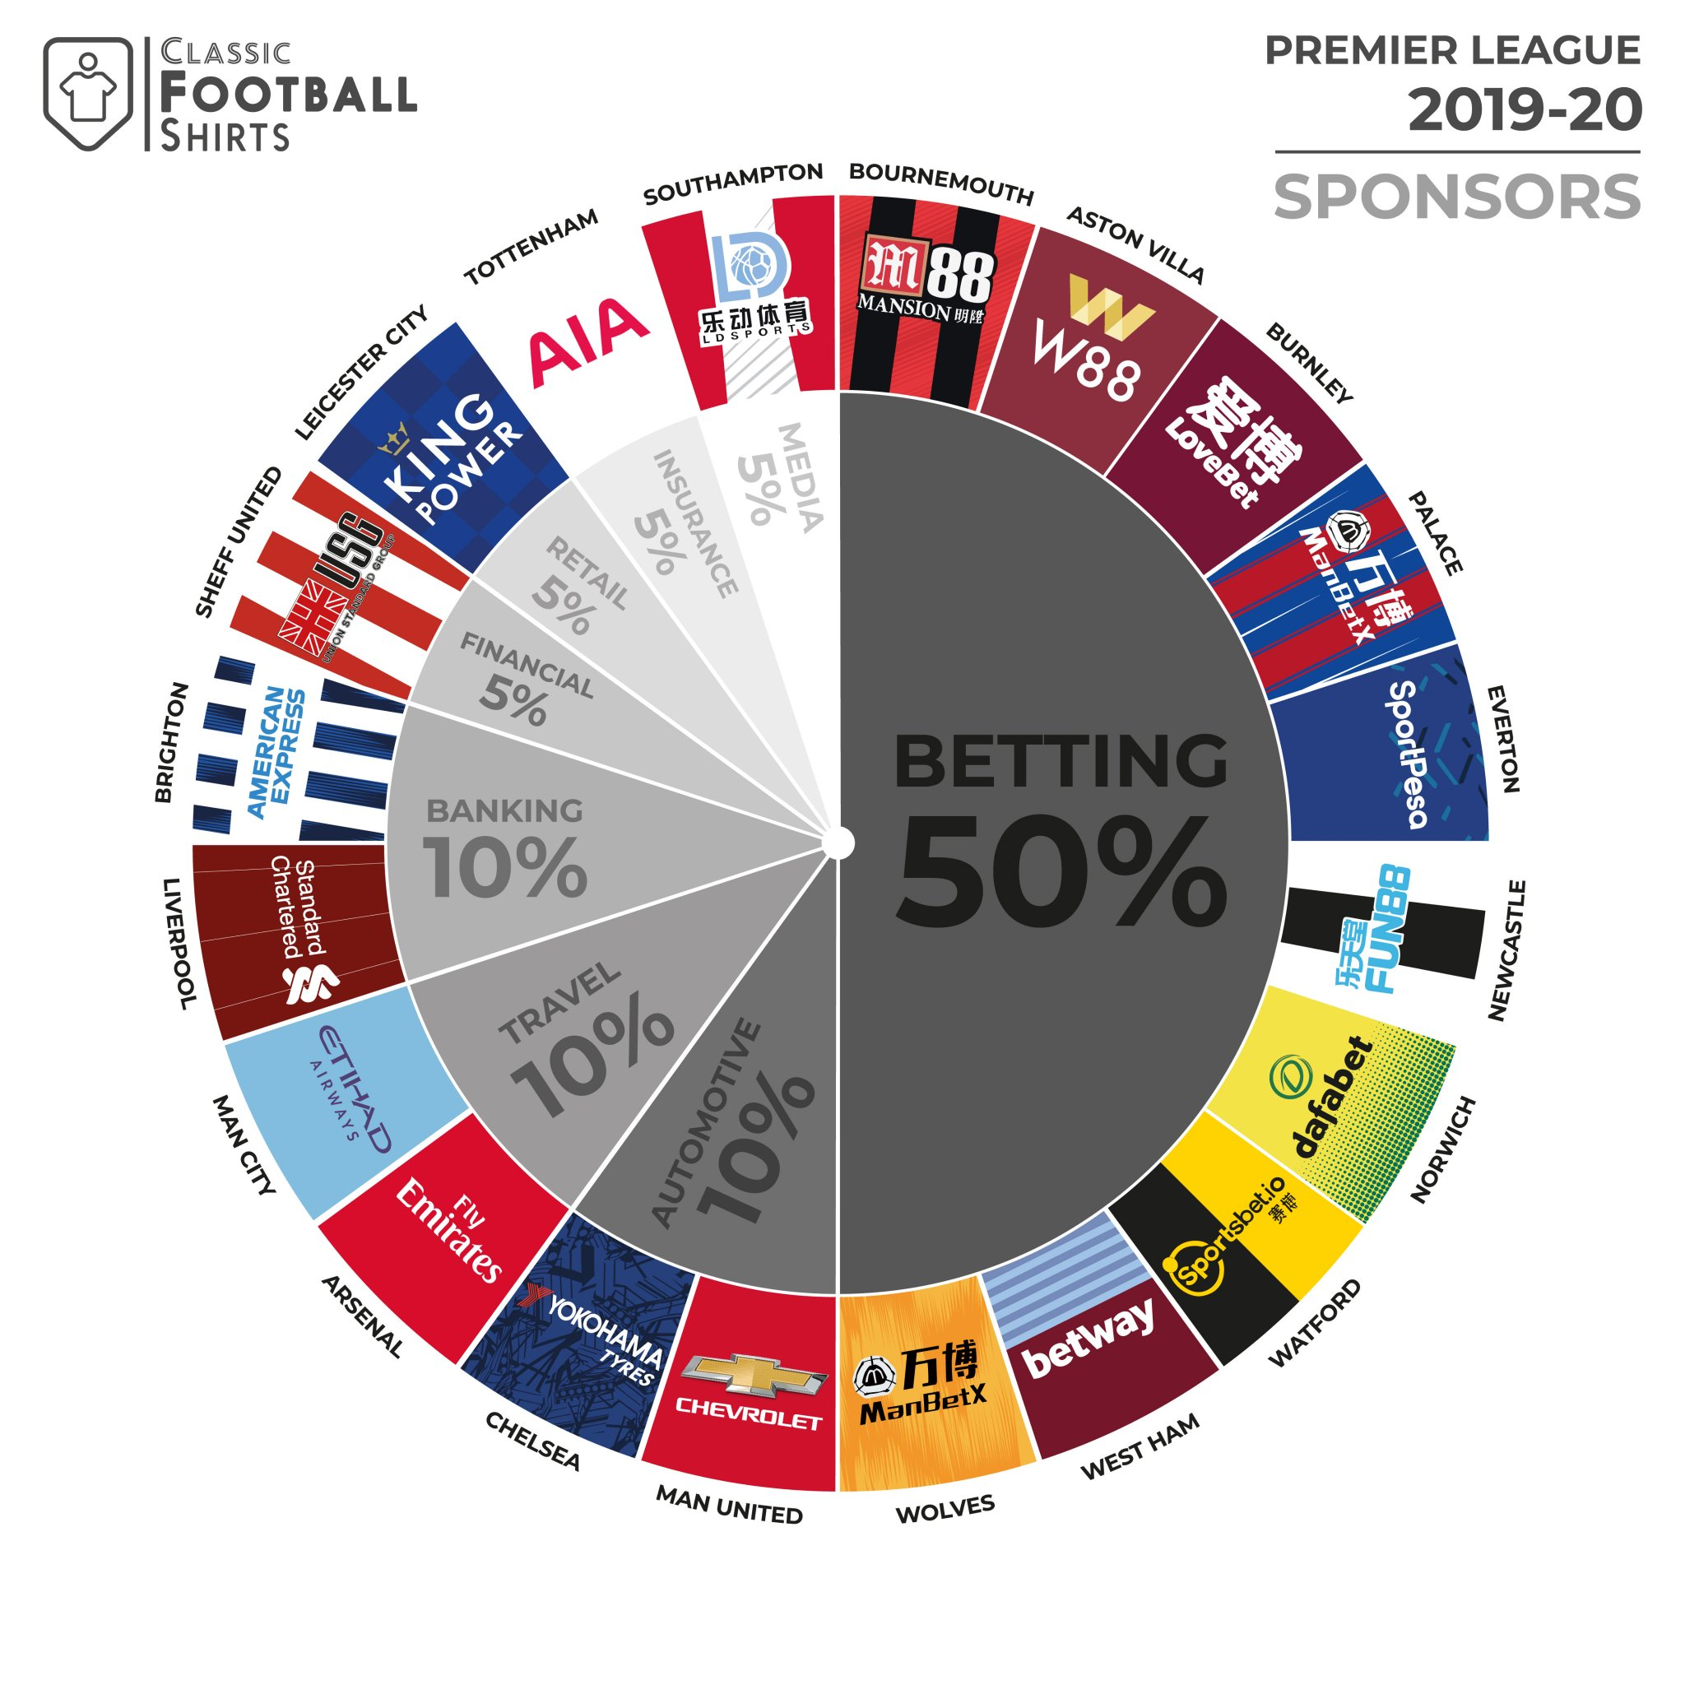
Sponsorship and Premier League Football

Slide 20
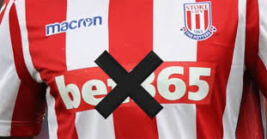
Sponsorship and Premier League Football
Gambling firms have become more prominent in the EPL than ever before. Only 3 teams – Chelsea, Liverpool, and Sheffield United – began the 2020/21 Premier League season without any betting brand partnership.
Nine of those clubs – Brentford, Burnley, Crystal Palace, Leeds, Newcastle, Southampton, Watford, West Ham and Wolves – display a betting brand on the front of their shirts. A further two clubs – Aston Villa and West Bromwich Albion – also feature betting brands on their kits, but on their sleeves instead.

Slide 21
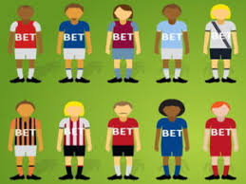
Sponsorship and Premier League Football
It’s notable to see that none of the traditional top six have a betting logo on their official kits, though Manchester United, Manchester City, Tottenham and Arsenal have all partnered up with gambling companies in one way or another. Leicester City have the highest number of betting partnerships with five, having ties to Yabo Sports, Parimatch, bet365, Betway and W88.
A total of 17 different betting companies appear on the list, with the most heavily featured being bet365 (5), followed by Betway (3), Sportsbet.io (2) and Parimatch (2). West Ham are the highest earners, as a result of their £10m deal with Betway.

Slide 22
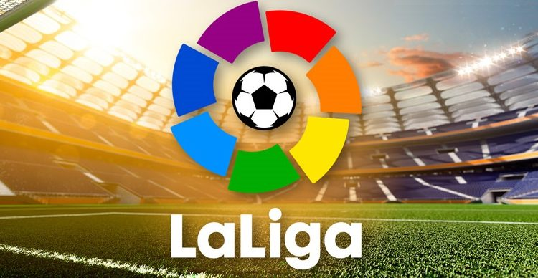
Sponsorship and La Liga Futbol
In the fall of 2020, the Spanish state initiated its reform to ban betting sponsorships and gave clubs only one season to make appropriate adjustments.
However, partly due to the short time frame, and partly due to the pandemic-affected economy, many clubs were unable to find replacement sponsors –as several teams started the 2021-22 La Liga season without shirt sponsors, including Granada and Real Sociedad.

Slide 23
Sponsorship and Football Jerseys
Football shirts are attractive billboards, allowing gambling companies to reach hundreds of millions of fans around the world.
Sponsorship of English teams also helps to target fans in Asia, where Premier League football shirts pushes company logos to fans without falling foul of local laws, such as in China where online gambling is banned, or Australia, where there is a ban on betting groups advertising on television during sports matches.
These big six clubs, among the 10 richest clubs in the world, can command lucrative commercial tie-ups with global brands willing to pay big to reach an enormous international fan base.
Instead, it is smaller clubs, which do not command such large support but still regularly appear on television screens in the UK and worldwide, targeted by gambling sponsors with smaller marketing budgets. For Championship clubs with gambling shirt sponsors, commercial income accounts for about 14% of revenues.

Slide 24
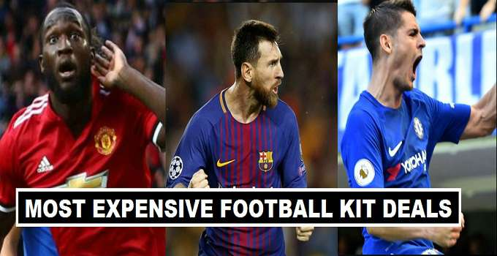
Most Lucrative Football Jersey Sponsorship Deals
Nike, Adidas or Puma? https://www.sportingfree.com/football/biggest-sponsorship-deals/

Slide 25
Sponsorship and Football Jerseys
It’s notable to see that none of the traditional top six have a betting logo on their official kits, though Manchester United, Manchester City, Tottenham and Arsenal have all partnered up with gambling companies in one way or another. Leicester City have the highest number of betting partnerships with five, having ties to Yabo Sports, Parimatch, bet365, Betway and W88.
A total of 17 different betting companies appear on the list, with the most heavily featured being bet365 (5), followed by Betway (3), Sportsbet.io (2) and Parimatch (2). West Ham are the highest earners, as a result of their £10m deal with Betway.

Slide 26
Sporting Sponsorship Tendencies: Bottom Line
Increasing focus on bottom line and measurement of ROI.
Incentive sponsorship – performance related deals (results-based bonuses).
Shorter-term deals to reduce risk.
Generation of principal (sponsor) and agent (sponsored) relationship – control problem.
Increased potential for conflicts of interest.
These tendencies are more rational, but the best way to ensure return is to develop a relationship and build trust – be part of the ‘family’.

Slide 27
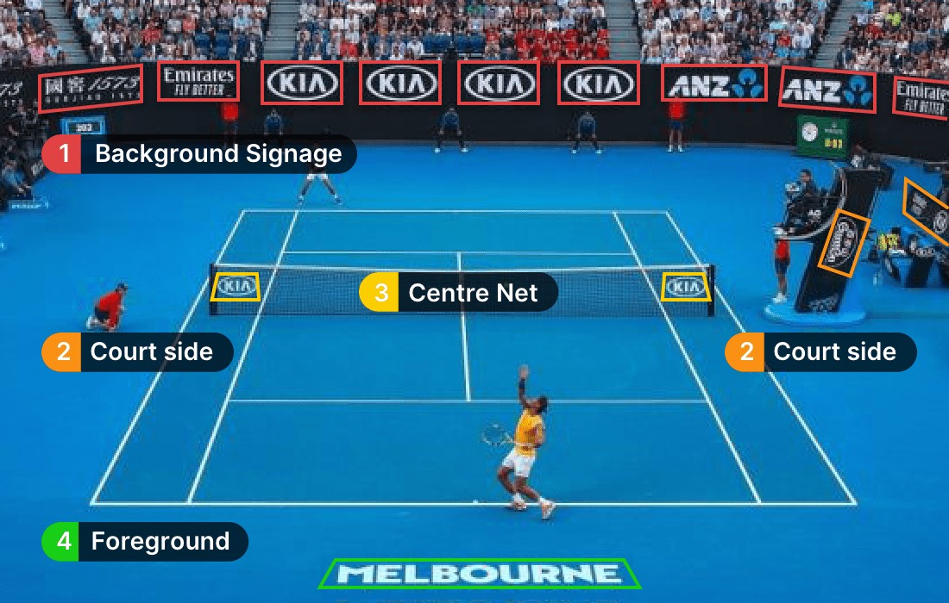
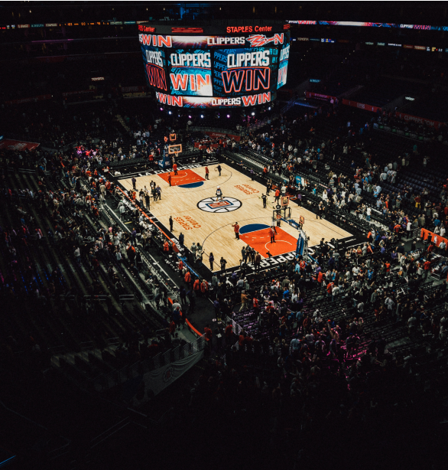
Sporting Sponsorship Tendencies: Experiential
Increasing fan proximity
Enabling the fan to experience a brand
Physical engagement
Shared experiences
Not product-focused

Slide 28
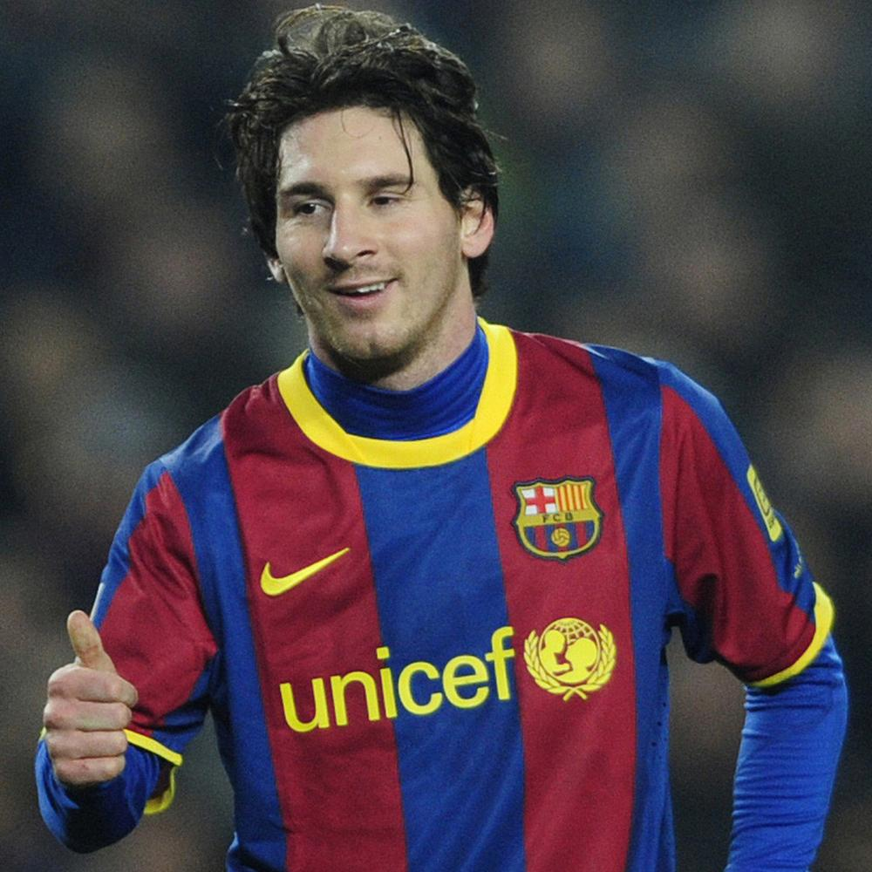
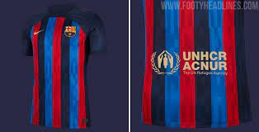
Sporting Sponsorship Tendencies: An Exception?
FCB + UNICEF €1.5m annual donation, joint health and education ventures in Africa and Latin America, joint promotional actions.
What are the advantages of this deal from both sides?
https://www.youtube.com/watch?v=DOW8m7uH0rg

Slide 29
Thank You

