Slide 1
Sports Business Management and Strategy
Athlete Endorsements
Aarthi Rajaraman

Slide 2
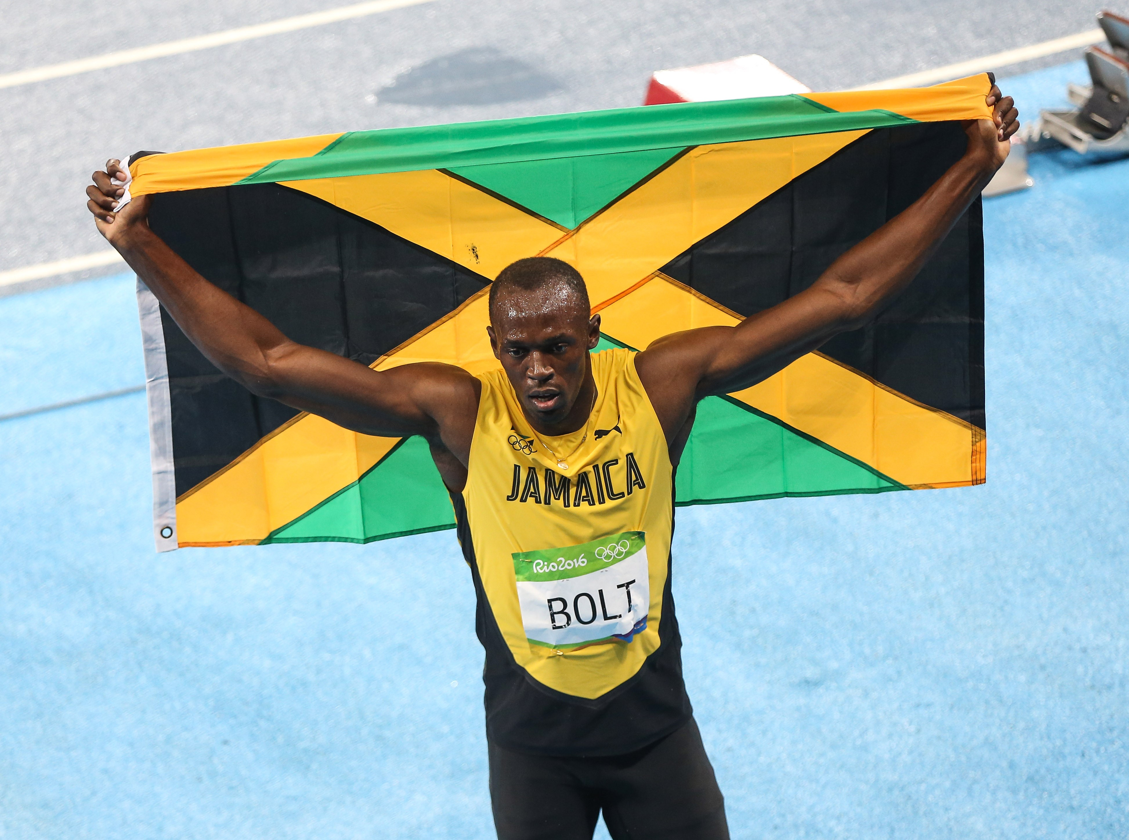
Athlete Endorsements
Why do companies invest big money in athletes?
There’s an emotional connection that fans make when they see their sport heroes endorsing a line of shoes or clothing.
It’s something that they both physically and emotionally identify with. Maybe they even think in their heart of hearts that the equipment will help them play a bit better.

Slide 3
Athlete Endorsements
Why do companies invest big money in athletes?
While the strategy is inherently risky -- endorsers are people, after all – look at Tiger Woods, the payoff is solid.
Endorsers often create tremendous value for the companies that rely on their services -- that is why the best endorsers are so richly compensated, and why most top athletes in America make more money from sponsorships than from salary or winnings.
Marketers of brands that employ the services of celebrities will know that few promotional strategies can impact the bottom line as much as -- and as quickly as -- forming an alliance with a celebrity.

Slide 4
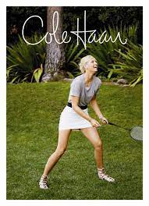
Athlete Endorsements
Why do companies invest big money in athletes?
Why do celebrity endorsements work as well as they do? One obvious explanation is that celebrities help firms to tap into their fan base. They open new markets. Consider tennis star Maria Sharapova, one of today's most sought-after -- and, as our research shows, most effective -- endorsers: The mere fact that Sharapova promotes fashion label Cole Haan may encourage her most devoted fans to visit its shops, allowing Cole Haan to perhaps attract a younger and more diverse demographic.
A second, more subtle, explanation is that endorsements trigger sales by reassuring consumers of the quality of the endorsed brand. Consumers often cannot easily assess the true quality of products, at least not before they consume them. But seeing a celebrity attaching his or her name and good reputation to a product may help alleviate some of their uncertainty.

Slide 5
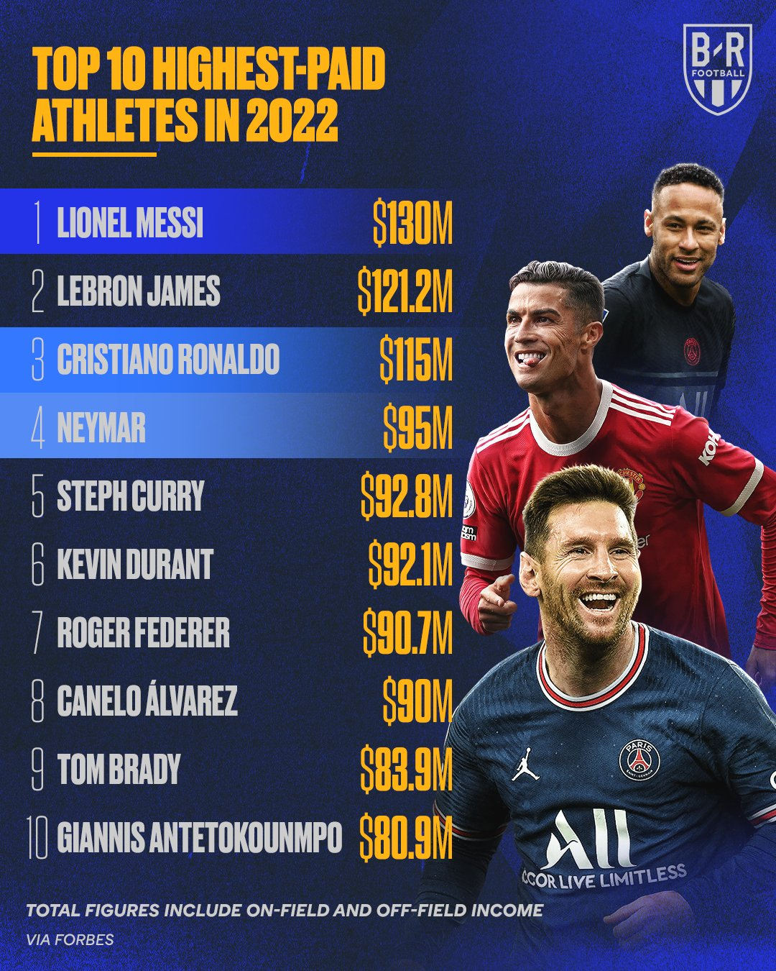
Athlete Endorsements

Slide 6
Athlete Endorsements
Why do companies invest big money in athletes?
A third possibility is that an alliance with an endorser can convey important information about an attribute that helps differentiate a brand from its competitors. This is particularly helpful for attributes that are hard to explain, demonstrate, or measure.
Canon's reason for turning to Maria Sharapova was her reputation as someone who plays aggressively but with precision, and who has a sense of style -- exactly the kinds of attributes it hoped to emphasize in marketing its line of PowerShot cameras.

Slide 7
Athlete Endorsements
Why do companies invest big money in athletes?
Marketers who rely on athlete endorsers know they can be in for a rocky road -- their allied partners can suffer from injuries, a loss of form, scandals, rumors, and a range of other woes -- and they need to adapt accordingly. But don't expect firms to cut back on the strategy altogether, as endorsers on the whole generate considerable value.

Slide 8
Athlete Endorsements
They say with fame comes fortune, but it’s not always as straightforward as that. It might be more fitting to say that “With fame comes offers.” And for athletes that means sponsorship opportunities.
Naturally, most of the companies that end up sponsoring athletes and receiving their endorsement are businesses specializing in products that appeal to the athlete in all of us—shoe designers, sports drink companies and athletic merchandisers.
But that’s not always the case.
Sometimes athletes end up putting their stamp of approval on some random or seemingly nonsensical stuff, products with no correlation to the player pushing them. Which is precisely what this list is about: occasions when athletes have loaned their brand to products or services that have little to no natural correlation with their public persona.

Slide 9
Athlete Endorsements
The Endorsers Of The Future
Endorsers can create incredible value for the companies that rely on their services.
This is why the best endorsers are compensated so well, and why most top athletes in America make more money from sponsorships than from salary or winnings.
Not only that, but it holds true that stock prices for these companies may rise as well. Marketers of brands that employ the services of celebrities will know that few promotional strategies can impact the bottom line as much as and as quickly as forming an alliance with a celebrity.
Even though, these brands who rely on athlete endorsers know they can be taking a huge risk as their partners can suffer from injuries, a loss of form, scandals, rumors, and a range of other downfalls, don't expect these brands to cut back on the strategy altogether, as endorsers generate considerable value for these brands overall.
Athletes are the endorsers of the future and don't expect that to change anytime soon.

Slide 10
Athlete Endorsements

Slide 11
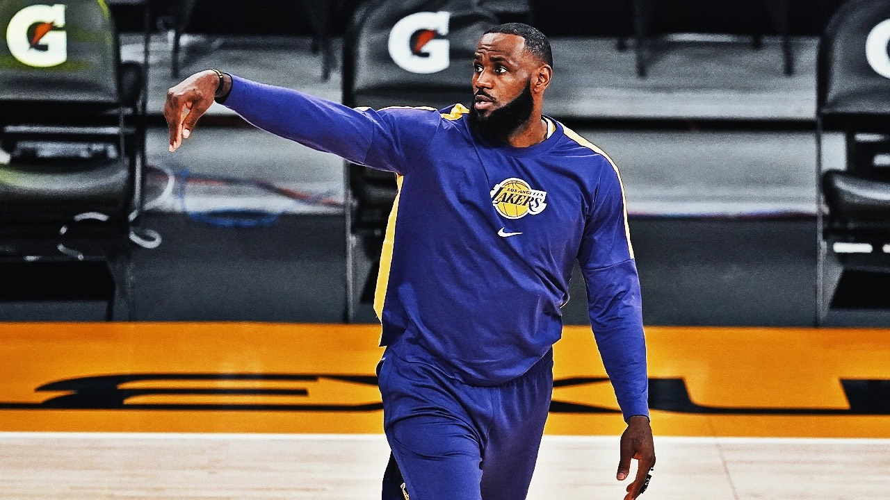
Athlete Endorsements
An example of a setback
Nike came out with their new $200+ LeBron-11 basketball shoes in October 2013, calling them “one of the most innovative Nike basketball shoes to date..."
And while fans have been thrilled, one wonders about Mr. James. Apparently in 18 games played since the season opener, Mr. James has only worn the new LeBron-11’s for only two complete games. A few times Mr. James started the game with the 11’s but then switched back to last season’s X model. So, what are fans to think when the guy with his name on the shoe, isn’t wearing the shoe?

Slide 12
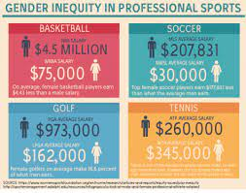
Athlete Endorsements
Women are making great sporting achievements, yet the media attention to back it up unlike male sporting achievements is very minimal. This lack of media coverage is a major issue for the sports industry and not just the female athletes involved in sport. Not to mention they are usually objectified and sexualized. This lack of media attention on Women’s sporting achievements, means that there are significantly fewer sportswomen idols out there who young women can aspire to be like. More funding in Women’s sporting leagues would be vital in their growth and create more media coverage which would then lead to more interest in sports and more participants. This lack of media coverage, unbalanced salaries and poor attitude towards sportswomen and women’s sports are creating a significant in-equality between genders and sport which can be fixed if change is made.

Slide 13
Athlete Endorsements
There are more women playing collegiate sports—about 200,000—than ever before. The number of female athletes at NCAA schools has increased from less than 30,000 to over 193,000 since 1972, but women still have over 60,000 fewer participation opportunities than their male counterparts. Women now make up more than half of all college undergraduates, but they still don't get an equal portion of athletic opportunities—and schools spend proportionally less money on them.
For example, in 2010 at NCAA Division I schools, women comprised almost 53% of the aggregate student body but were under 46% of the schools' student athletes. Women's teams received just 41.4% of the money spent on head coach salaries, just 36.4% of the recruiting dollars, and just 39.6% of overall athletic expenses—a figure that's remained virtually unchanged for several years. (Most of the spending gaps can be explained by the schools' money-hogging and revenue-generating men's football programs.)

Slide 14
Athlete Endorsements

Slide 15
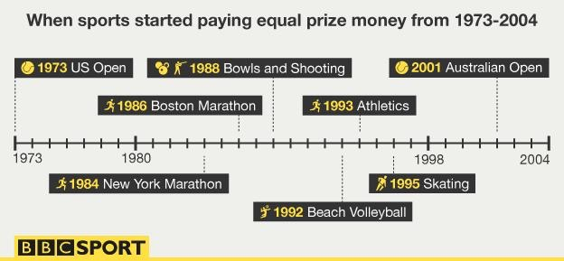
Athlete Endorsements

Slide 16
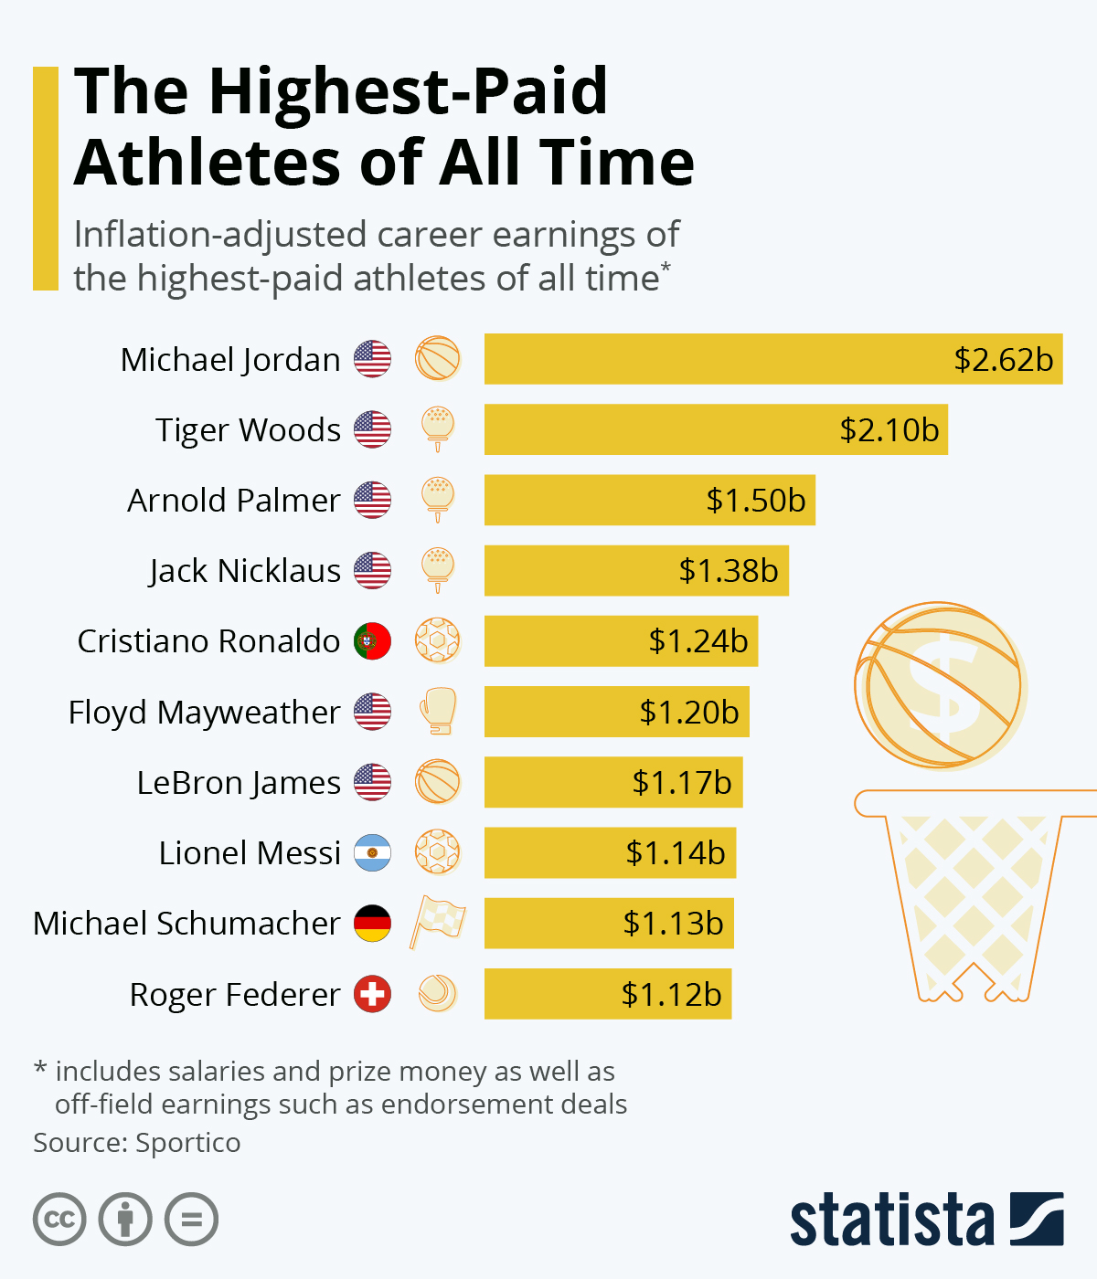

Slide 17
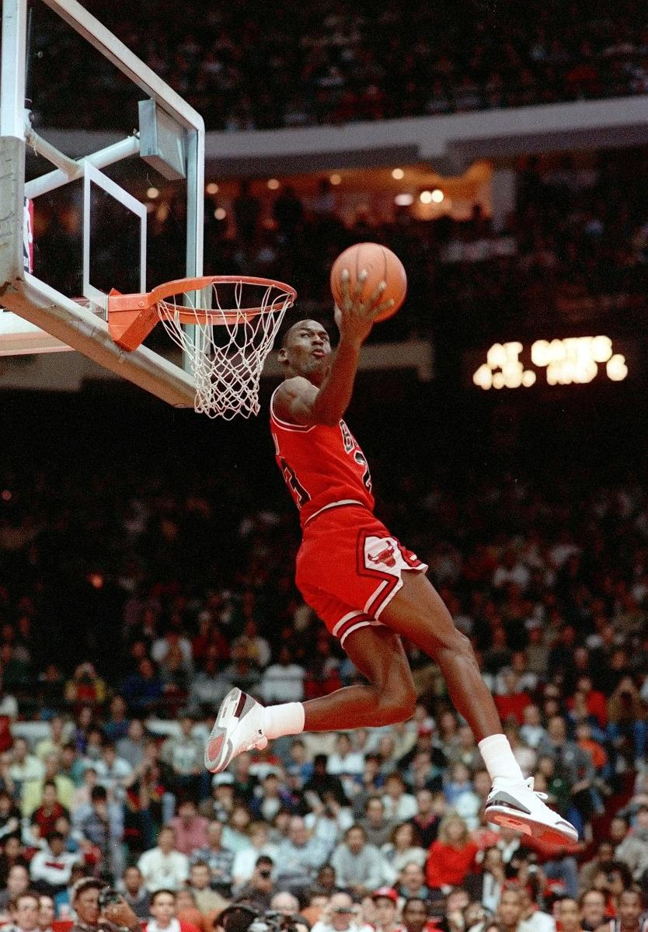
Athlete Endorsements
Retirement and Earning Potential
#1 Michael Jordan
Earnings: $90 million
Retired: 2003
Age: 52
Jordan’s hefty earnings are mostly attributable to the incredible
success of Nike’s Jordan Brand, which is now roughly a $2 billion
business for the Beaverton, Ore. sports giant. The five-time MVP gets a
cut of every Jordan shoe, hoodie and pair of shorts sold by Nike under
the Jordan Brand. Long-time partners Gatorade, Hanes, Upper Deck
and Five Star Fragrances are still cutting MJ a check, as are newer
additions like 2K Sports and Novant Health. Jordan owns 80% of
the Charlotte Bobcats, which turned a profit last season after five years of
heavy losses.

Slide 18
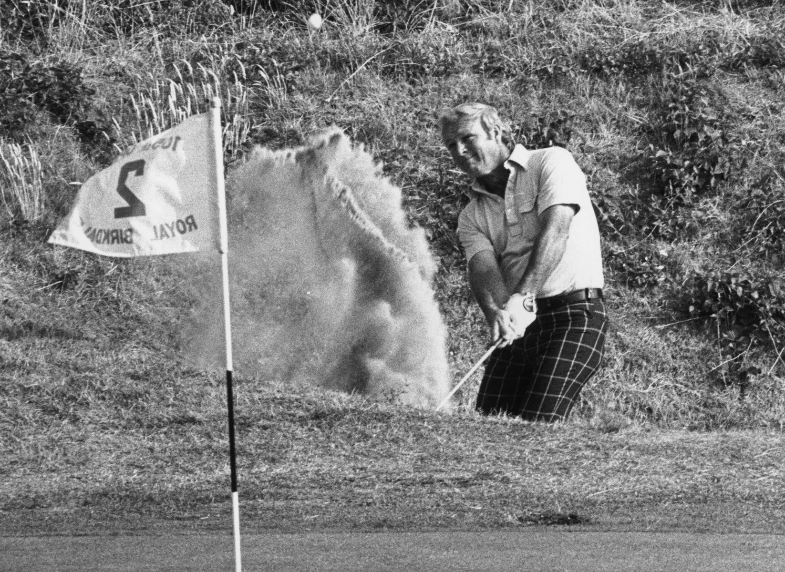
Athlete Endorsements
Retirement and Earning Potential
#2 Arnold Palmer
Retired: 2006
Age: 84
Palmer won the last of his 62 PGA Tour victories in 1973, but 2013 was
his most successful year ever from an earnings standpoint. The Arnold
Palmer line of drinks is a $200 million business and represents roughly
25% of the revenues for AriZona Beverages. The Palmer name is
licensed all over Asia. He has 400 freestanding stores in Asia that bear
his name and sell apparel and leather goods.

Slide 19
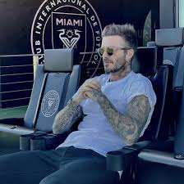
Athlete Endorsements
Retirement and Earning Potential
#3 David Beckham
Earnings: $37 million
Retired: 2013
Age: 38
Becks hung up his boots last year, but he has been plotting his next
career for the past decade. Beckham wants a piece of the action in his
deals and that is his arrangement with his Coty cologne deal and H&M
bodywear pact. He's added deals over the past year in Asia with Sands,
China Auto Rental and the Chinese Super League. Beckham's latest
venture is bringing an MLS club to Miami. He exercised his $25 million
option for an expansion franchise this month, but is looking for investors
at a grossed-up value of $75 million.

Slide 20
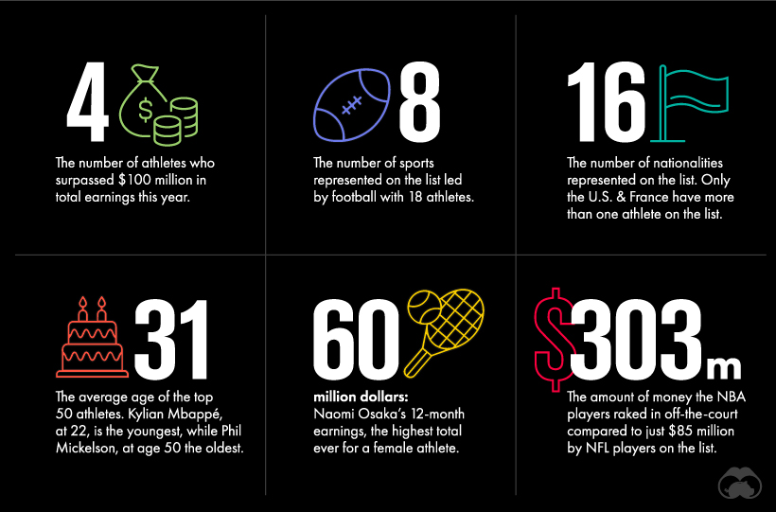
Athlete Endorsements

Slide 21
Thank You

