Slide 1
Sports Business Management and Strategy
Athletes and Agents
An Overview of Representation
Aarthi Rajaraman

Slide 2
Athlete Salaries
Athlete Salaries have increased dramatically over the last 20 years:
NFL (National Football League)
- The average salary for a place in 1992 was $496,000 USD
- In 2022 the average salary was $7million USD
NBA (National Basketball Association)
- The average salary in 1994 was $1 million USD
- In 2022 the average salary was $9 million USD
MLB (Major League Baseball)
- The average salary in 1994 was $590,000 USD
- The average salary in 2022 was $4.4 million USD
English Premier League (EPL)
- The average salary in 1990 was 1,500 pounds a week
- The average salary in 2022 was £515,000 pounds a week

Slide 3
Salary Structures
Free Market versus Agreed Salary Structure
There are fundamental differences across sporting leagues in how athlete compensation is determined.
Approaches:
Allow free-market to operate on an individual player-by-player basis – this means there is no constraint on salaries at either the top or bottom of the roster. Examples: English Premier League, Spanish Liga.
Allowed to have an “agreed salary structure” that places constraints on salary payments.

Slide 4
Salary Structures
Agreed Salary Structure
League Level: This constraint is typically a formula that sets total player salary payments as a percentage of designated total league-related revenues. For example, in the NBA, player salaries are linked to a percentage of BRI (basketball-related income), and in the NFL, they are set as a percentage of the DGR (designated gross revenues). All of these terms are outlined between the leagues and their players' associations.
Club Level: Constraints on player salaries at the club level in some leagues are related to constraints agreed upon at the league level. These can include salary caps, where each club is given a set dollar salary cap for the coming season, which they cannot exceed without incurring severe penalties.
Player Level: Player associations often negotiate with the leagues to secure a minimum salary for their members. These minimums are unrelated to market forces for any specific player. For example, minimum salaries in the NBA are a function of the years played in the league.

Slide 5
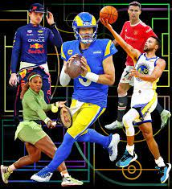
Motivations for Player Salary Constraints
Promote Competitive Balance – Attempts to prevent one or several clubs from having payrolls much larger than those of other clubs. Ex: New York Yankees.
Economic Viability of League – Restricting player salaries to a level that ensures club profitability is needed for the league. Ex: the NFL combines the player salary/DGR revenue with the largest league central revenue pool, that is then equally shared.
Promote a Broad Sharing by Players of the Total Revenues in a Sport: Allowing max and min salary levels for each team increases the chance for the creation of a set of players who will receive good salaries in relation to the free market system.

Slide 6
Labor Issues - Strikes versus Lockouts
Strikes and Lockouts
Players and owners don’t always enjoy harmonious relationships. Strikes and lockouts can take
place during labor negotiations. A strike can occur when a player refuses to play under
the conditions offered.
A lockout occurs when the owners shut down the operations on knowledge that the players will
not agree to certain conditions the owners have offered them.

Slide 7
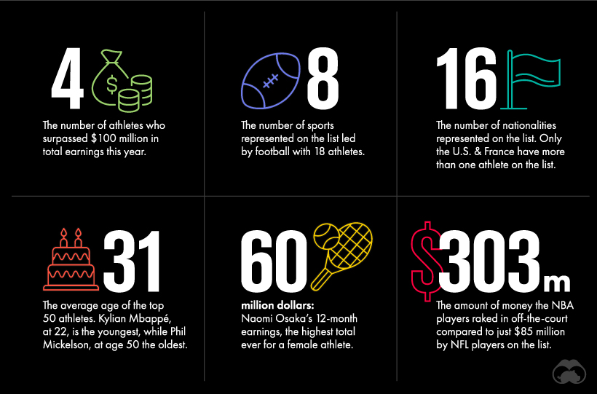

Slide 8
Sports Marketing
Player Representation
Many players/athletes are represented by agents in negotiations
with clubs, tournaments and endorsement-related dealings. Agents
have become necessary for athletes as the financial stakes are large
and astute contracting can contribute to a player’s welfare.
Options for agents include:
1. A well-known agency such as: IMG, Octagon, CAA. They have worldwide operations and own events, too
2. Small agent groups – ex: Wasserman Group in Hollywood.
3. Individual agent – an agent that works exclusively with one or more clients.

Slide 9
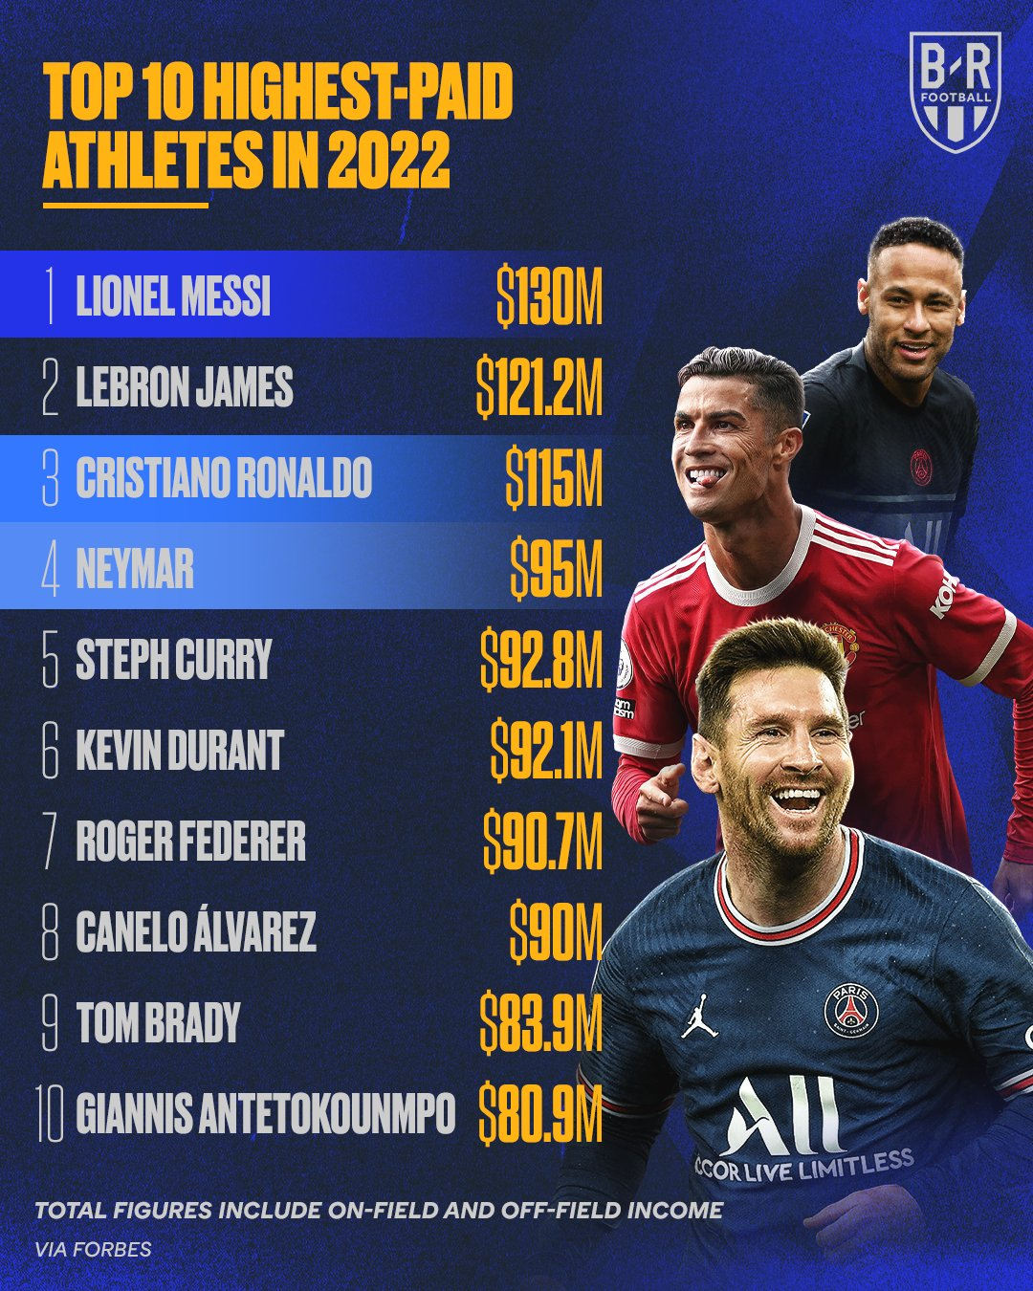

Slide 10
Player Representation
Large multi-service firms have grown to include sports marketing and event management.
A highly competitive business:
Many agents either have a limited number of clients or are doing agency work only part of the time.
Law of agency imposes fiduciary duties on the sports agent.
Fiduciary duties inherent in principal-agent relationship include:
To comply with a contract if one exists
To compensate the agent for his or her service
To reimburse the agent for any expenses incurred while acting on the principal’s behalf
Agent’s fiduciary duties include:
To obey wishes of principal (client)
To remain loyal
To exercise reasonable care
To account for information and finances on a reasonable basis

Slide 11
Athlete Contracts
Agents represent athletes and entertainers in negotiations.
Agents understand the legal concepts behind contracts.
Agents are paid a percentage of earnings and understand the legalities of contracts.
Handlers are used to deal with difficult clients.
Free agency allows players to explore options of moving to another team with little or no financial penalty.
Higher player/personnel costs result from bidding wars for certain players.
Salary caps limit the amount a team may spend on contracts.
Less profitable teams are protected from continual losses.
A luxury tax is paid by teams that exceed the salary cap in the NBA and is split between less profitable teams.

Slide 12
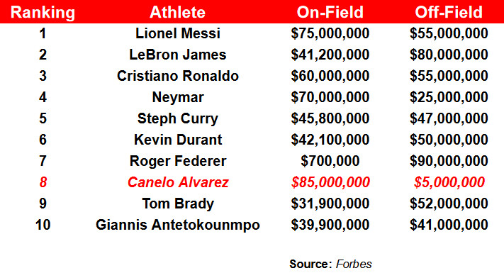

Slide 13
Agencies and Codes of Conduct
Organizations must be above reproach and hold themselves to high standards.
Corporations adopt Codes of conduct: regulations regarding worker conduct.
Codes of conduct improve:
public perception
business operations
Certain products are protected from reproduction or use unless permission is granted by the owner.

Slide 14
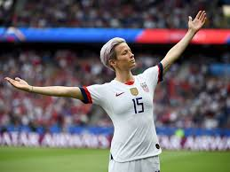
Agencies and Codes of Conduct
Certain products are protected from reproduction or use unless permission is granted by the owner. Intellectual property is a person’s thoughts or creations. Protecting intellectual property is important because:
Substantial profit is a reflection of a good idea.
Businesses who originate an idea and protect it usually maximize profits.
Exclusivity - A right purchased by a sponsor to be the sole provider of a particular type of good or service for a sport/event.
You may use an athlete’s identity in a book, TV news show, newspaper, or magazine, but marketers must learn where to draw the line between freedom of expression and violations of rights of privacy or publicity.
You may not use their identity on your advertisements without their consent!

Slide 15
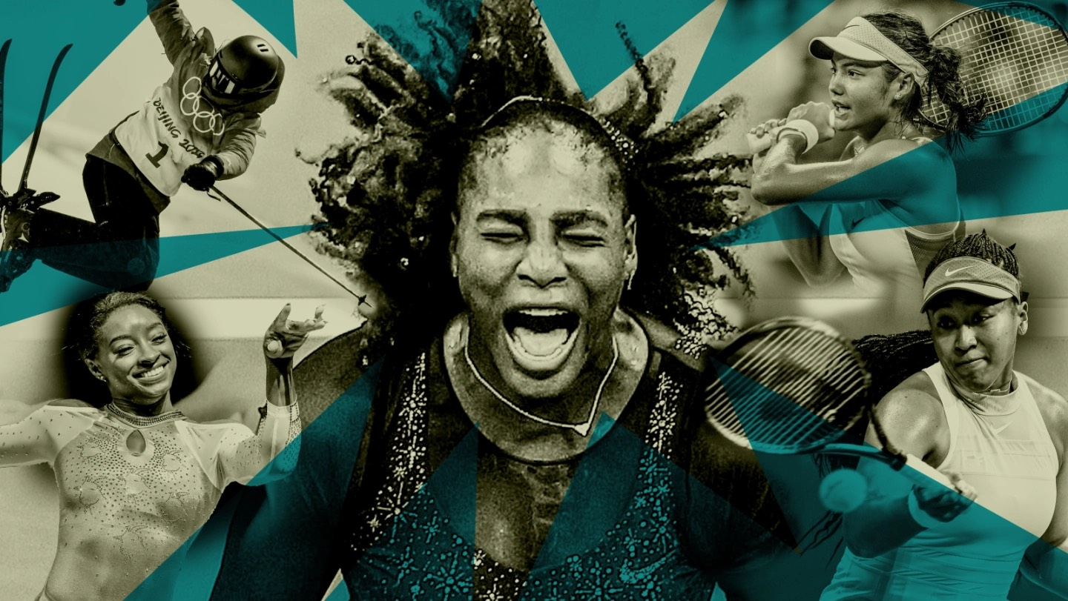
Athlete Contracts
Collective bargaining can be used in most sports with the exception of Major League Baseball.
Excludes MLB because of the Sherman Antitrust Act ruling.
Gives players the right to organize, use the agent of choice and protect themselves.
Collective bargaining agreements are agreements between players’ associations (or unions) and team ownership/management.

Slide 16
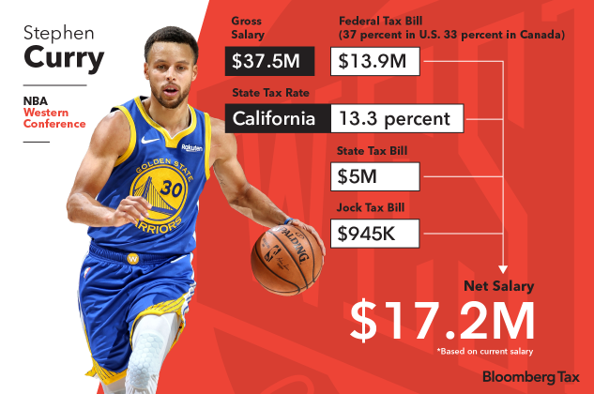

Slide 17
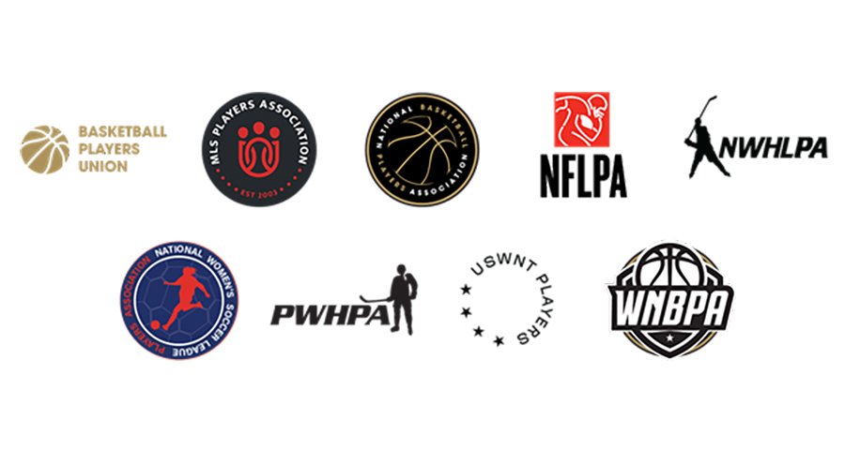
Athlete Contracts
Collective bargaining gives players the right to organize, use the agent of choice and protect themselves. Also includes:
A minimum salary
Player’s rights
Medical disability insurance
Labor rules
Length of contract
Restrictions of certain activities or behaviors
Rules for agents
Player and team travel

Slide 21
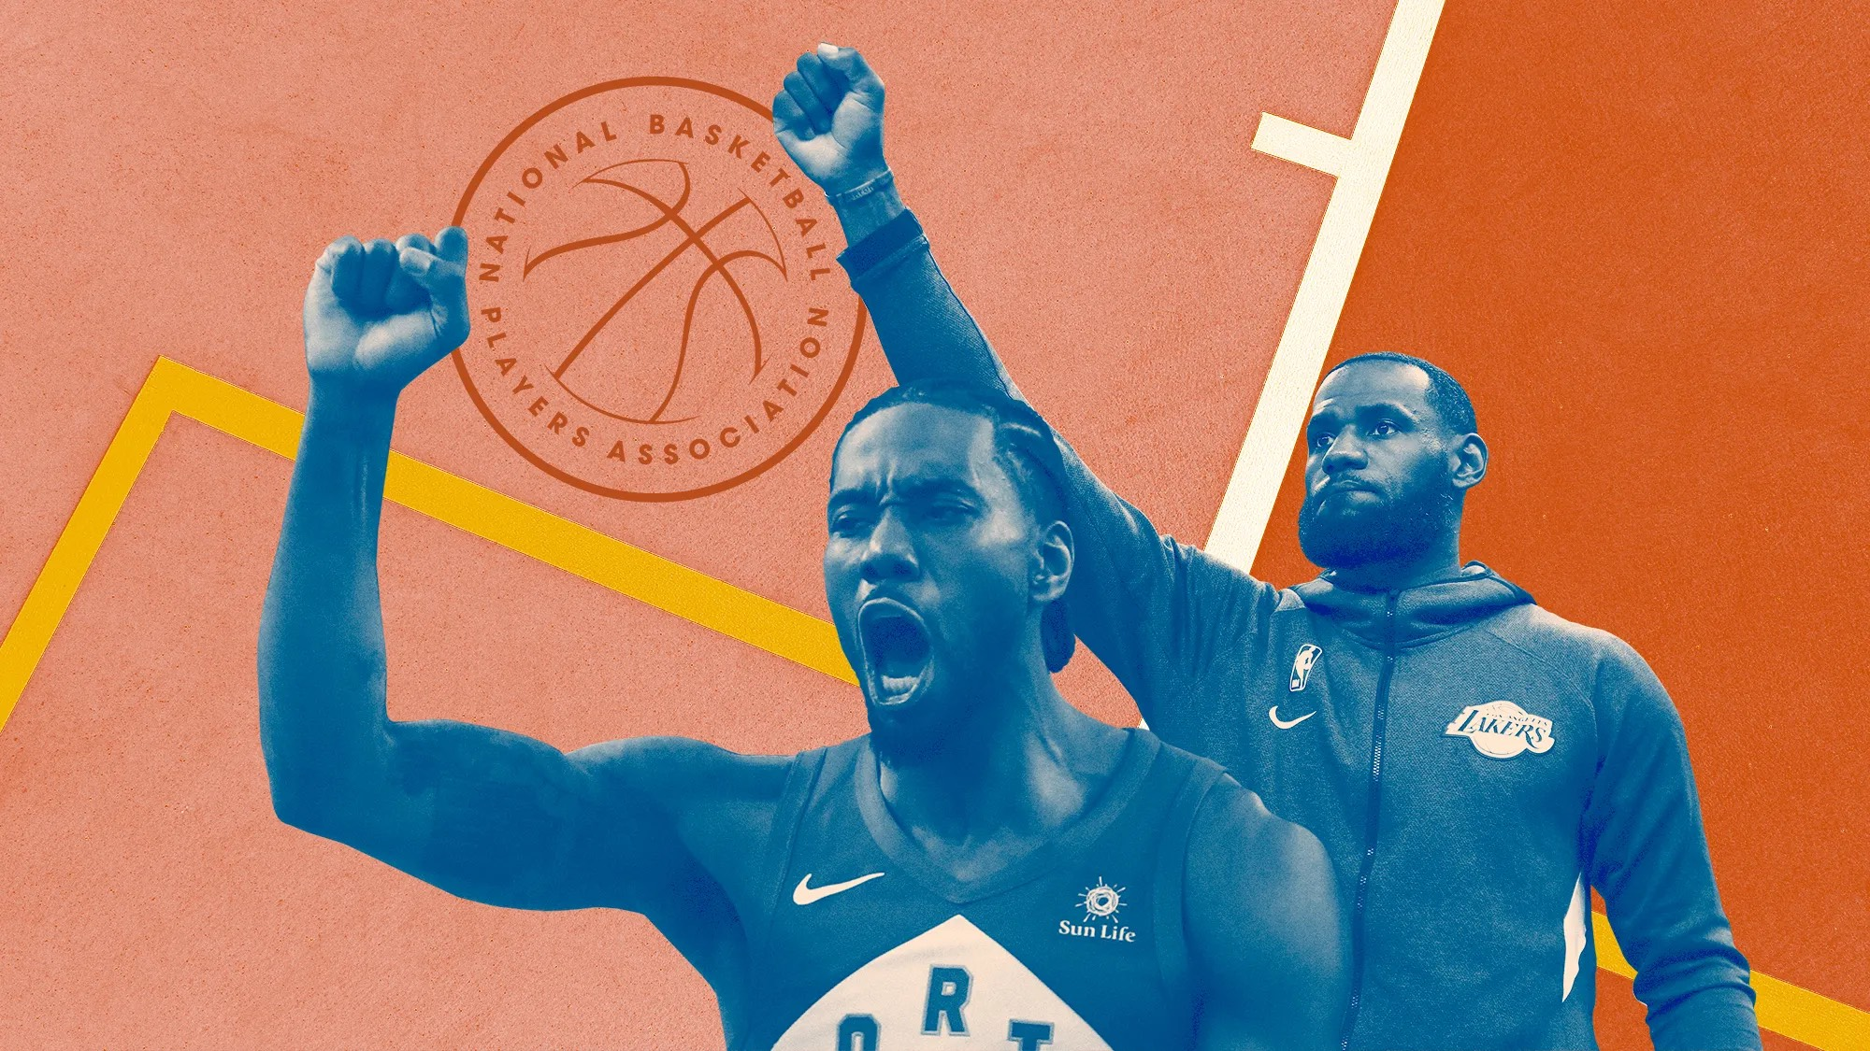
Player Associations
The labor unions that represent athletes and function the same as unions in other industries.
They help aid athletes in issues such as salaries, contracts, and profit sharing.
The sports’ leagues represent the owners and managers and their goals = control costs.

Slide 22
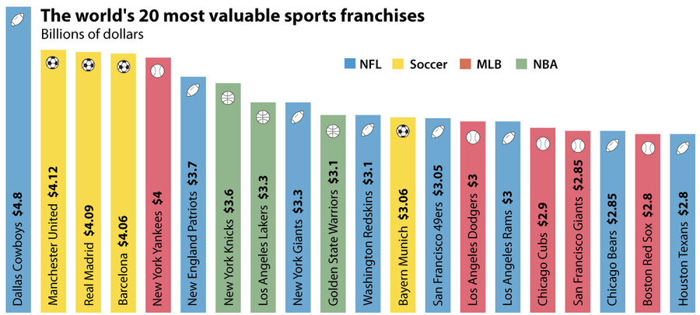

Slide 23
Player Unions
Over the past 60 years, the NBPA collectively bargained professional basketball players into an average salary of $7 million, making them the highest-paid union employees in the world (the NFL and MLB also have unions, but they earn their members less take-home pay). Yet, over the very same period, millions of American workers saw paychecks flatline, jobs automate, and factories offshore. Today, as economic inequality drives debates both presidential and pedestrian, some economists argue that the decline of labor unions explains why workers receive a shrinking sliver of national income. Offering a blueprint to reverse this trend, the NBA players’ union shows how collective bargaining can help spread prosperity to workers in sectors beyond basketball.
"Prior to the union, the players had nothing," the NBPA proclaims. On their official website, a short video reel recounts how, in the early 1960s, the players had no pension, no health-care benefits, and a per diem of $7 a day. Boston Celtics Hall of Famer Bob Cousy portrayed the 1950s pre-union NBA as a sports oligarchy where “players had no voice" and "team owners took advantage of them." Even after unionizing in 1954, the Celtics' Gene Conley scoffed that owners were so stingy, they only conceded to give players "more soap in the shower room, and two towels instead of one."

Slide 24
Thank You

