Slide 1
Sports Business Management and Strategy
An Overview of Sports Stadiums
Aarthi Rajaraman

Slide 2
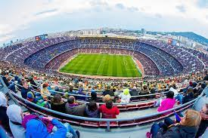
Stadiums
Stadiums and arenas are a pivotal component of the business of sports. They are a major revenue source for many clubs, and the difference between the highest and lowest revenue earning clubs in many leagues is often associated with the either:
Differences in their stadium revenue-generating capabilities
2) Differences in contracts with which those stadium revenues are shared
Stadiums and arenas also play an important role in the economic revival of cities and in attracting major events to those cities (e.g.: Superbowl to Houston with the new Reliant Stadium).

Slide 3
Stadiums
Three factors influencing decisions related to the business side of stadium management are:
Who owns the stadium?
Who operates and manages the stadium?
How many sporting clubs are tenants of the stadium?
For stadiums with a single major tenant, it gets complicated when the stadium is either owner or operated by a third party. Contracts over decision rights, revenue sharing and cost responsibilities have to be negotiated between the sporting club, the stadium owner and the stadium operator.

Slide 4
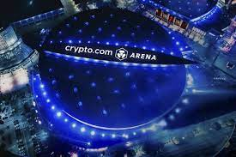
Stadiums
For stadiums with multiple anchor tenants, it gets even more complicated. This setup often occurs in indoor arenas and the best example is when the owner of the multiple anchor tenants also owns and operates the arena.
The most complex case is where there are multiple tenants, and a different group/entity owns and operates the arena. For example, the Staples Center (now known as the crypto.com area) in Los Angeles is owned and operated by the Anshutz family. It is operated by AEG and has 4 anchor teams – Lakers, Clippers, Kings, Sparks and home to several concerts, events and conferences. They don’t all have the same ownership group!

Slide 5
Stadiums
Managers in all areas of sports need to expand their revenue base and a state-of-the-art stadium or arena can help in multiple ways:
Capacity Decisions – Costs of adding extra capacity versus the likely demand for seats (including playoff and peak events). Too much capacity needs to be factored into construction and operating costs and bad for televised games to have empty seats.
Personal Seat Licenses – A PSL is a one-time purchase of the underlying rights to a particular seat (typically in premium location) in the stadium. PSLs offer fans control over their tickets and seat locations as well as future ownership of the seat. The stadium owner receives a front-end payment from the sale of the PSL as well as the annual season-tickets revenue for the seat. In most cases, the PSL owner has the right to resell the PSL and personally gain from any increase in its market value.

Slide 6
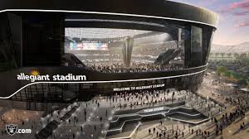
Stadiums
Naming Rights– Attractive naming rights deals offer a stadium a long-term sequence of cash inflows and can be very lucrative for the team/club.
Suites – They offer occupants viewing of a game in an upscale setting with more space, ready access to catered food and drink and privacy. Suites are typically sold on a multi-year basis.
Season-ticket holders – This source of revenue is highly attractive in the annual financial planning for a sporting club. It is paid in full at the start of the season.

Slide 7
Stadiums
Financing of a Stadium or Arena – costs of new sports stadiums continue to escalate. (NFL - $400 million).
Public funding for a stadium/arena – can take the forms of hotel-motel tax, car-rental tax, parking tax, airport travelers' tax, alcohol and cigarette taxes.
Those in favor of public funding for stadiums and arenas say:
Additional revenues from the new stadium will add to the city’s revenues because of visiting supporters of teams (hotels, rental car, restaurants, etc.).
Job creation in both the construction and operation of the stadium.
Additional mega-events at the new stadium like concerts, super sports events like a Super Bowl, global events like a World Cup, etc.
Enhanced city status residing in a general increase in tourism, conventions, etc.
Community building benefit of having a professional sports team.

Slide 8
Stadiums
Those against the public funding for stadiums and arenas say:
Owners of sporting clubs (typically already wealthy) will receive an excessively high percentage of the value increase associated with the new stadium revenues.
Total city revenue increases are overestimated – some increased stadium revenues come at the expense of decreased city revenues elsewhere.
Sporting stadiums rank low in terms of community priorities – some prefer an increased sales tax which can mean better schools, hospitals or police force.

Slide 9
Stadiums
Decision-making by sporting clubs – things that must be considered when seeking public financing:
Is 100% private funding feasible? It has happened in very rare cases, as with the Staples Arena and Pacific Bell Bark in San Francisco.
What are the constraints and other costs of public financing? Cities can place constraints on the naming rights, for example… costs of public financing can include sharing of revenue streams from a new stadium.
What is the voter tendency for different levels of public financing? New taxes must normally pass voter approval, and in some cases, voters may have little desire for public financing.
Upside from building strong community ties? A combo of the private-sector and public-sector financing can lead to both working productively together and increasing stronger ties between the sporting club, city officials and community.
Competitive situation in a league. If most clubs make heavy use of public funding, those few relying on private funding may have higher interest on debt payments that other clubs don’t.

Slide 10
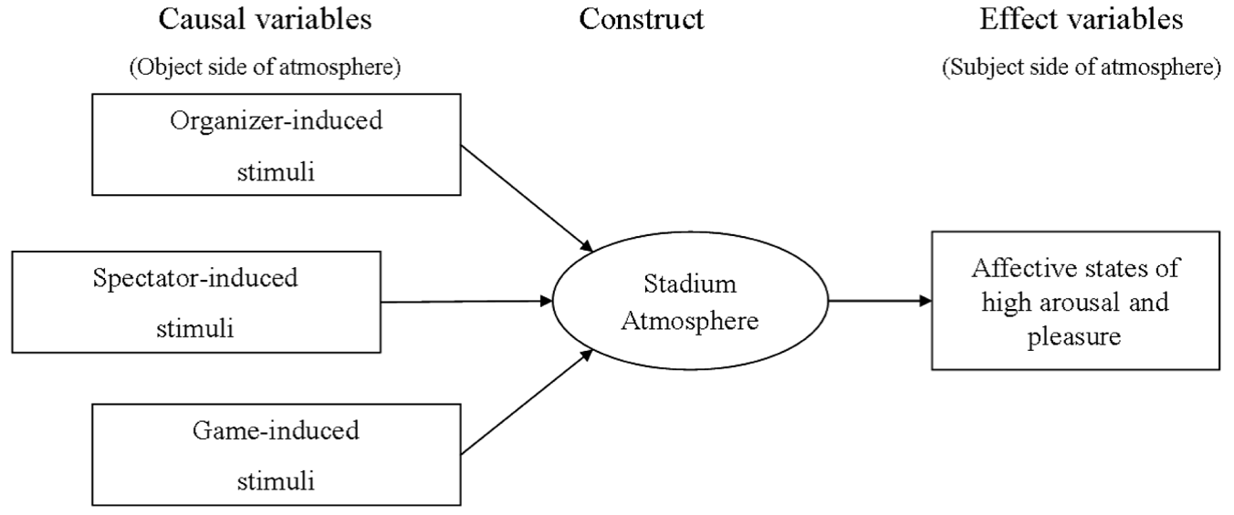
Stadium Atmosphere

Slide 11
World’s Largest Capacity Stadiums

Slide 12
Stadiums
The NFL franchise LA Rams spent over $5 billion on their new stadium deal in Inglewood.
Key to the decision was team owner Stan Kroenke’s proposal to build an 80,000-seat stadium in Inglewood, California, just east of Los Angeles International Airport.
Designed by the Dallas firm HKS Architects, the 70,000-seat stadium is part of a larger 298-acre redevelopment of the former Hollywood Park racetrack. This redevelopment will include new facilities for the league and its NFL Network cable-TV channel, as well as a mix of entertainment, commercial, and residential buildings.
The most noticeable design feature of the stadium is its expansive, transparent ETFE (ethylene tetrafluoroethylene) roof. This roof will cover not only the entire playing field and seating bowl but also an adjacent pedestrian plaza and a proposed 6,000-seat theater capable of hosting high-profile events like the Academy Awards. While several NFL stadiums built in the past decade incorporate retractable roofs to protect against weather and to host events on non-game days, HKS principal Mark Williams, AIA, says the Rams’ fixed, clear roof will actually be more versatile. “You’ve got beautiful weather 350 or so days out of the year, and you want to take advantage of that,” he says. “But if you’re spending billions of dollars, you want to have events 365 days a year no matter what the conditions are outside.”

Slide 13
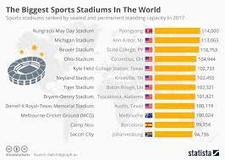
Stadium Operations
Today sports facilities are relied upon to host more and more varied events.
To do so, more space is being allocated for the event programming to house, support and stage the event.

Slide 14
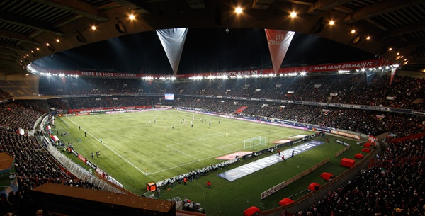
Trends in Stadium Design
Site and surroundings – capture senses from outside in.

Slide 15
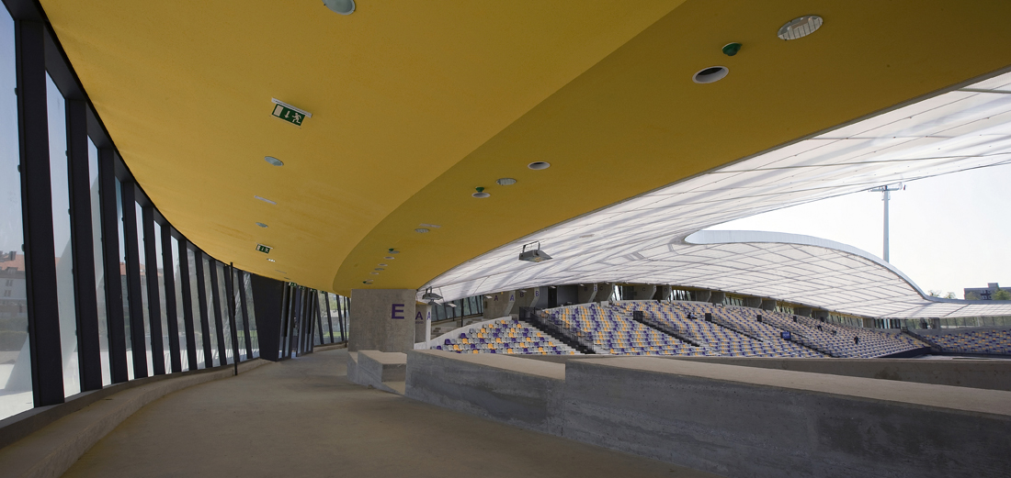
Trends in Stadium Design
Horizontal Circulation - wider concourses, lobby and entry space.

Slide 16
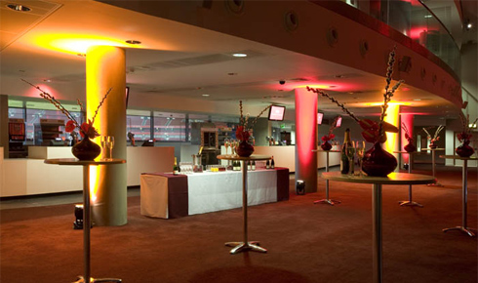
Trends in Stadium Design
Vertical Circulation – stairs, elevators focused on public/private users.

Slide 17
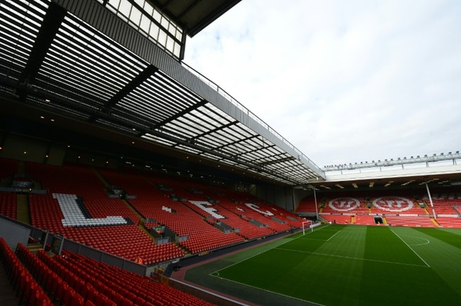
Trends in Stadium Design
POS Distribution and access to pitch/field.

Slide 18
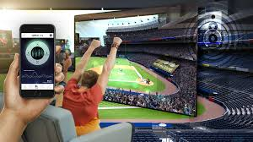
Trends in Stadium Design
In-game experience – fan sense of “being at the game”.

Slide 19
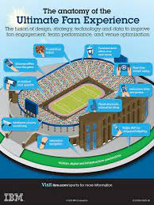

Slide 20
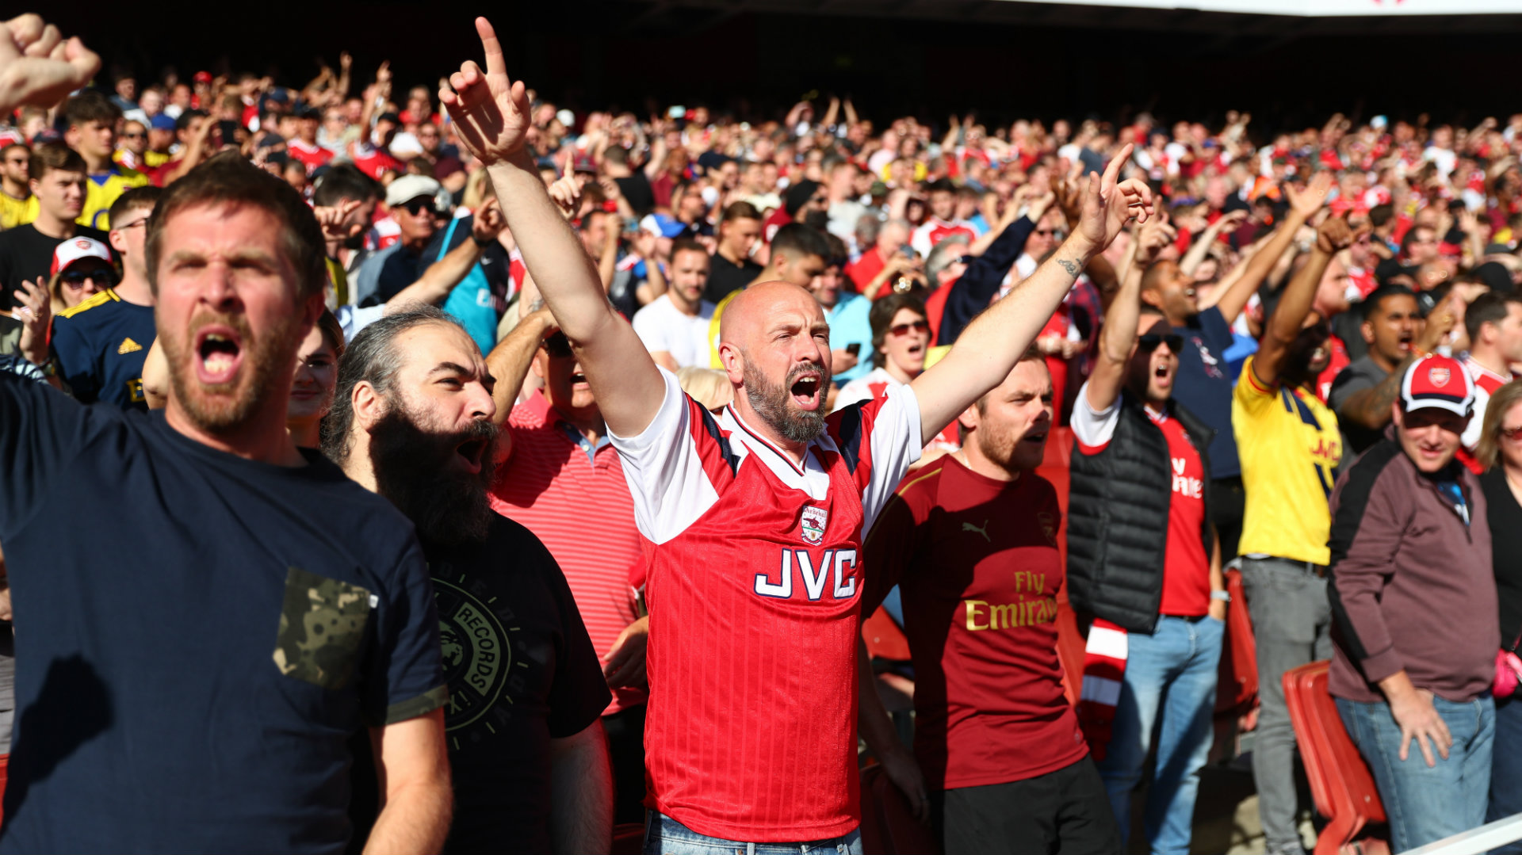
Trends in Stadium Design
Seating Environments – seats, suites and amenities.

Slide 21
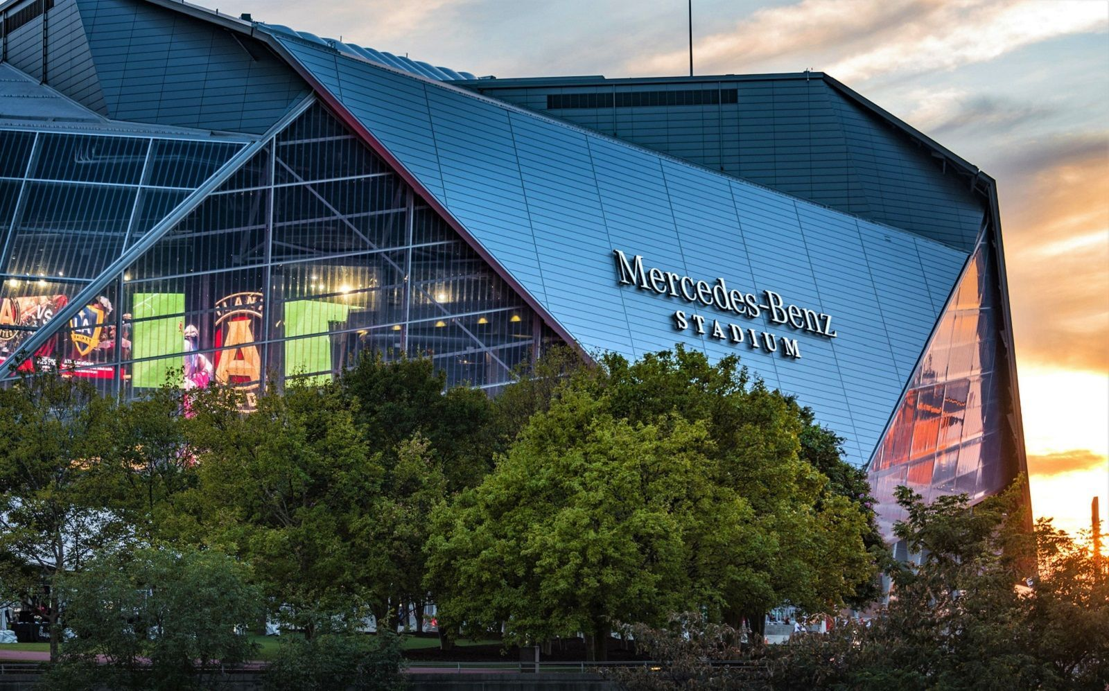
Trends in Stadium Design
Efficient Buildings - Design Construction/Eco Friendly.

Slide 22
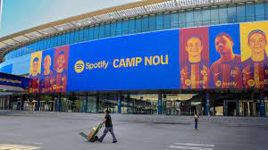
Spotify Camp Nou
The new Camp Nou will increase the seating from 99,350 to 105,000.
The stadium name sponsorship is expected to bring in €300+ million for the club which will cover a third of the cost of the renovation.

Slide 23
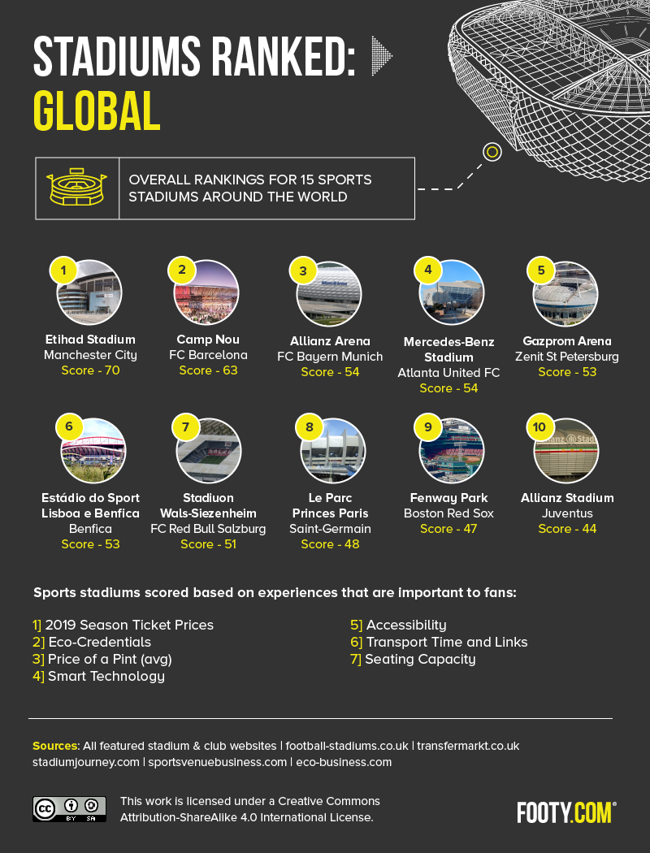

Slide 24
Thank You

