Slide 1
Sports Business Management and Strategy
Crisis Management
Aarthi Rajaraman

Slide 2
Crisis Management
Once upon a time, a professional athlete could play their chosen sport, collect a paycheck, and
retire happily to the family home without intrusions into their private lives.
Sports Stars are now…
Part of celebrity culture
Public property like the stars of movies and music
Considered entertainers as much as sportsmen

Slide 3
Crisis Management

Slide 4
Crisis Management
What Makes Sports Stars Different?
Sports-based talent
Highly valued media constructed sports
Part of a media narrative that tells us how important they are
Athletes are reality stars
On-field performance supports ongoing celebrity

Slide 5
Crisis Management
Sports Star Narratives That We See Repeatedly:
1. Emergence of striking talent – “hello world”
2. Extraordinary accomplishments
3. Public celebration
4. Displays of ignorance
5. Erratic behavior
6. Public scandal
7. Failure
8. Hero redeemed by extraordinary performance
9. Forgiveness
10. Weakening power

Slide 6
Crisis Management
The saying "Any publicity is good publicity" suggests that even negative publicity can be worthwhile for the heightened awareness and recognition it brings. While this can be true in certain situations, it can also be very false.
Professional sports organizations and their athletes face intense media attention, which can be invaluable on one side and devastating on the other. Effective management processes play a crucial role in maximizing the positive impact and minimizing the damage caused by crises and scandals.

Slide 7
Crisis Management
Difference between a Crisis and a Scandal
Crisis – Derived from the Greek word "krisis" meaning a difficult decision. It represents a critical choice, a decisive moment, or a turning point. The day-to-day life of organizations is usually stable and continuous, but crisis situations bring instability and chaos. Crises typically occur outside the control of the organization.
Scandal – Instances of personal or professional impropriety that can involve a violation of social or moral norms. Scandals are attractive to the media and can be damaging to a sports organization. The term is often used synonymously with crisis, though there are distinctions between the two.

Slide 8
Crisis Management
Anticipating a crisis is one thing, but predicting when, where, or how significant it will be is impossible. However, you can rest easier knowing your crisis management plan is effective.
Building confidence in your plan involves implementing a program of effective, multidimensional simulations. These simulations test not only your board, your C-Suite but also the entire organization that supports them.
The true test of a crisis management plan is whether it feels "for real" during simulations. Experiencing a crisis scenario should be a genuine evaluation. Even more critical is the question of whether you genuinely learn something from the experience. After all, a plan is only a plan until you put it to the test.

Slide 9
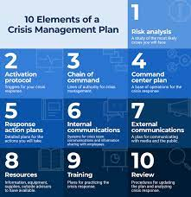
Crisis Management

Slide 10
Crisis Management
Assessing the Damage
The degree to which actions and values that are compromised compared to social values and norms. If a player hits another player in practice, it would be looked at as an internal sports related transgression. “He is just not acting like a team player”.
If a player has an incident of sexual misconduct, then a violation of social, moral and legal norms creates a larger breach that must be bridged by crisis management personnel.

Slide 11
Crisis Management

Slide 12
Crisis Management
Step One: Signal Detection
Crises inevitably leave a trail behind, manifesting in various situations. This step involves activating institutional scrutiny and communication channels, allowing the organization to become proactive in identifying and addressing potential crises.

Slide 13
Crisis Management
Step Two: Preparation and Prevention
This step involves planning for a crisis by rehearsing potential scenarios. The organization explores and ranks the probabilities of various crises. Standard operating procedures and emergency response teams are formed, collectively constituting the Crisis Management Plan. Additionally, preventative measures are studied and implemented to minimize the impact of potential crises.

Slide 14
Crisis Management
Step Three: Containment and Damage Limitation
The actions an organization takes in the minutes, hours, and days following a crisis are crucial. It is imperative to:
Not ignore the problem
Not attempt to cover the problem up
Gather all the facts quickly (before making any comments)
Appoint a spokesperson to act as a media liaison
Establish a consistent message and talking points
Explain the steps that the organization or individual is taking
Be accessible throughout the crisis
Be as truthful and forthcoming as possible

Slide 15
Crisis Management
Step 4
Recovery
Assess what damage was done
Reach out to stakeholders from the inside out
Allow time to heal all wounds

Slide 16
Crisis Management
Step 5
Phase 5 – Learning
Develop and evolve as an organization
Make needed changes
Revisit all preventative policies
Rehabilitate broken relationships
Do something positive

Slide 17
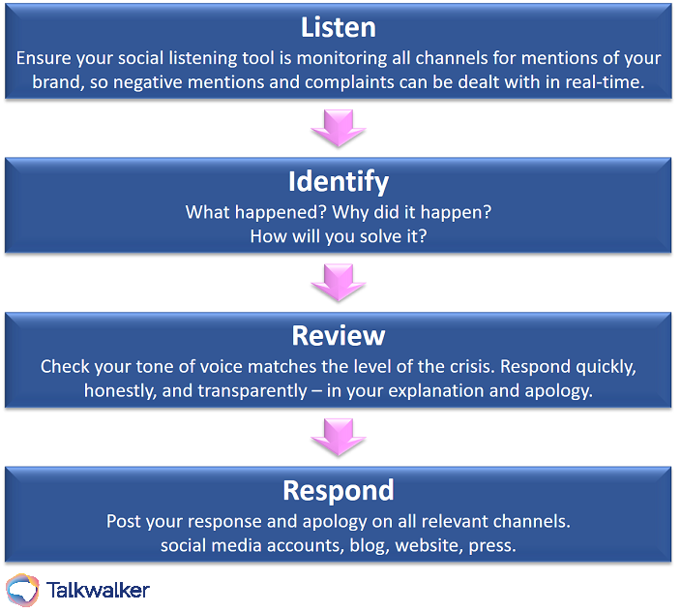
Crisis Management

Slide 18
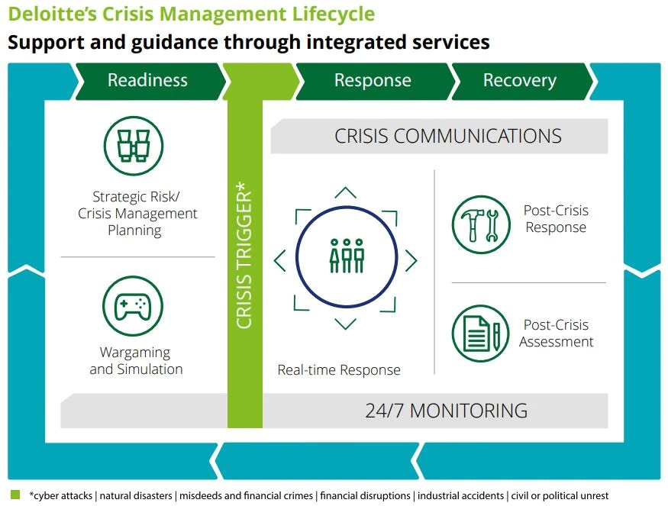
Crisis Management

Slide 19
Thank You

