Slide 1
Sports Business Management and Strategy
Sport and Social Media
Aarthi Rajaraman

Slide 2
Sport and Social Media
During the past two decades social media has evolved drastically both in how we utilize it and how prominent it is within our culture.
If you are not minding your Social Media presence than you are not fully branding yourself.
Social media can be the catalyst for success by empowering people and fueling ideas.
We have all seen the good and the bad that can come from social media.
The way that social media has impacted the Sports Industry has been profound. Over a third (37%) of Twitter users will buy from a brand they follow.
Almost every team, league and sports association has a social media profile on Twitter. From the pros to the minors and from the high school athlete to the retired athlete, social media has been a force in the sports industry landscape.

Slide 3
Sport and Social Media
According to Navigate Research, sports fans are 67% more likely to use Twitter to enhance their viewing experience compared to non-sports fans. Essentially, Twitter serves as the virtual sports bar that fans flock to before, during, and after games. Consequently, the behavior of a team or athlete on social media can directly influence a fan's perception of that team or athlete.
Almost every sports-related show or event has a hashtag associated with it, displayed on screen during the event or show. This practice not only drives engagement but also creates a relationship with the audience that was not possible several years ago.
Social media is a powerful vehicle that propels sports talk today, shaping the way fans interact with teams, players, personalities, and fellow fans. It serves as a potent source for obtaining news, engaging in topical discussions, and empowering brands.

Slide 4
Sport and Social Media
According to Forbes, Cristiano Ronaldo stands out as one of the most valuable and impactful social media influencers.
Take Ronaldo's collaboration with Tag Heuer, for instance. He posted six times on Facebook over two days last year regarding the watch brand's "Don't Crack Under Pressure" ad campaign. These posts garnered an impressive 35 million views and received 2.4 million "likes" within that short span. Research firm Repucom estimates that these posts generated an impressive value of $380,000 for Tag. Ronaldo boasts a total of 158 million followers across Facebook, Twitter, and Instagram, a figure surpassing Lionel Messi and Neymar by 65 million, who have the next biggest followings.
Ronaldo holds the distinction of being the first athlete to accumulate 100 million Facebook fans, and his current total of 103 million exceeds that of any other person on the planet. Notably, he continues to amass fans at a rate of nearly one per second. His most popular Facebook post to date features a photo of him celebrating Children's Day with his son, amassing 4.3 million likes.

Slide 5
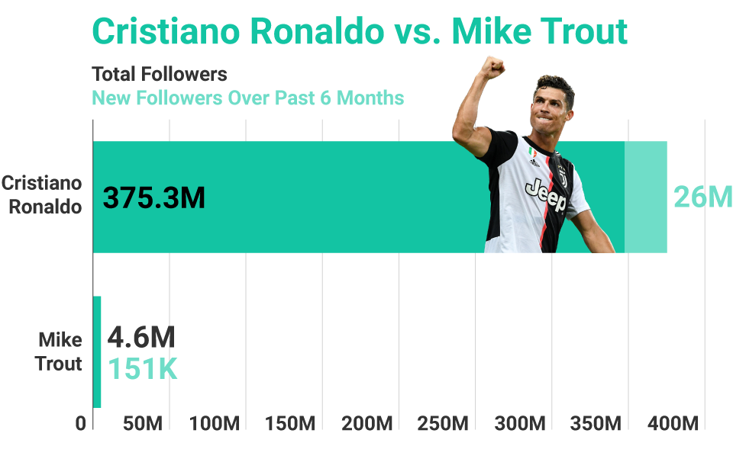
Sport and Social Media

Slide 6
Sport and Social Media
LeBron James, with his impressive 138 million followers, is the sole athlete preventing soccer players from dominating the top of the list. Other NBA stars boasting substantial social media followings include Steph Curry (64 million followers), Kevin Durant (35 million), and the late Kobe Bryant (36 million).
While Major League Baseball and the National Football League both harbor global aspirations, they fall short compared to soccer and, to a lesser extent, basketball in terms of the social media presence of their stars. The global appeal of soccer and basketball gives rise to international icons among their premier players.

Slide 7
Sport and Social Media

Slide 8
Sport and Social Media
Despite its reputation as one of the world’s most traditional sports properties, Wimbledon has achieved success in engaging consumers via social media while steadfastly maintaining its core values and traditions.
The primary role of social media, for Wimbledon, is to articulate its purpose and core values. As a brand, Wimbledon benefits from its iconic attributes: grass, strawberries, whites, royalty, and the hill.
The All-England Club adopts a strategy wherein social media serves as the next best experience to being physically present at Wimbledon. They utilize these platforms to convey the unique atmosphere of walking through the gates for the first time and being greeted by the magnificent structure covered in ivory.

Slide 9
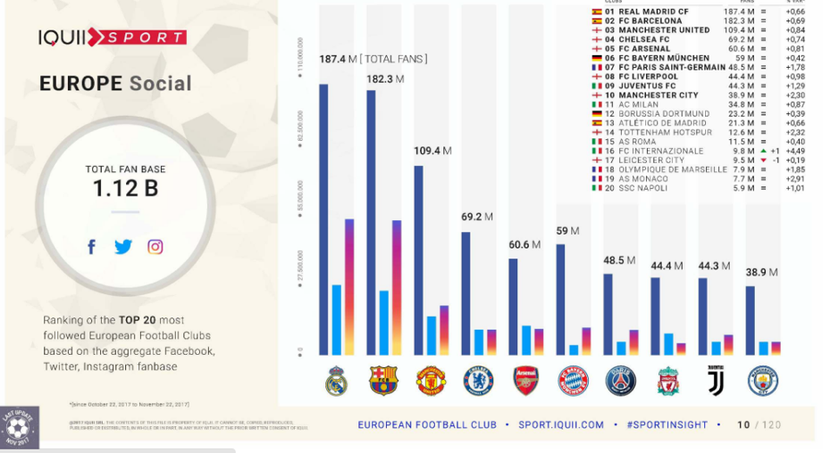
Sport and Social Media

Slide 10
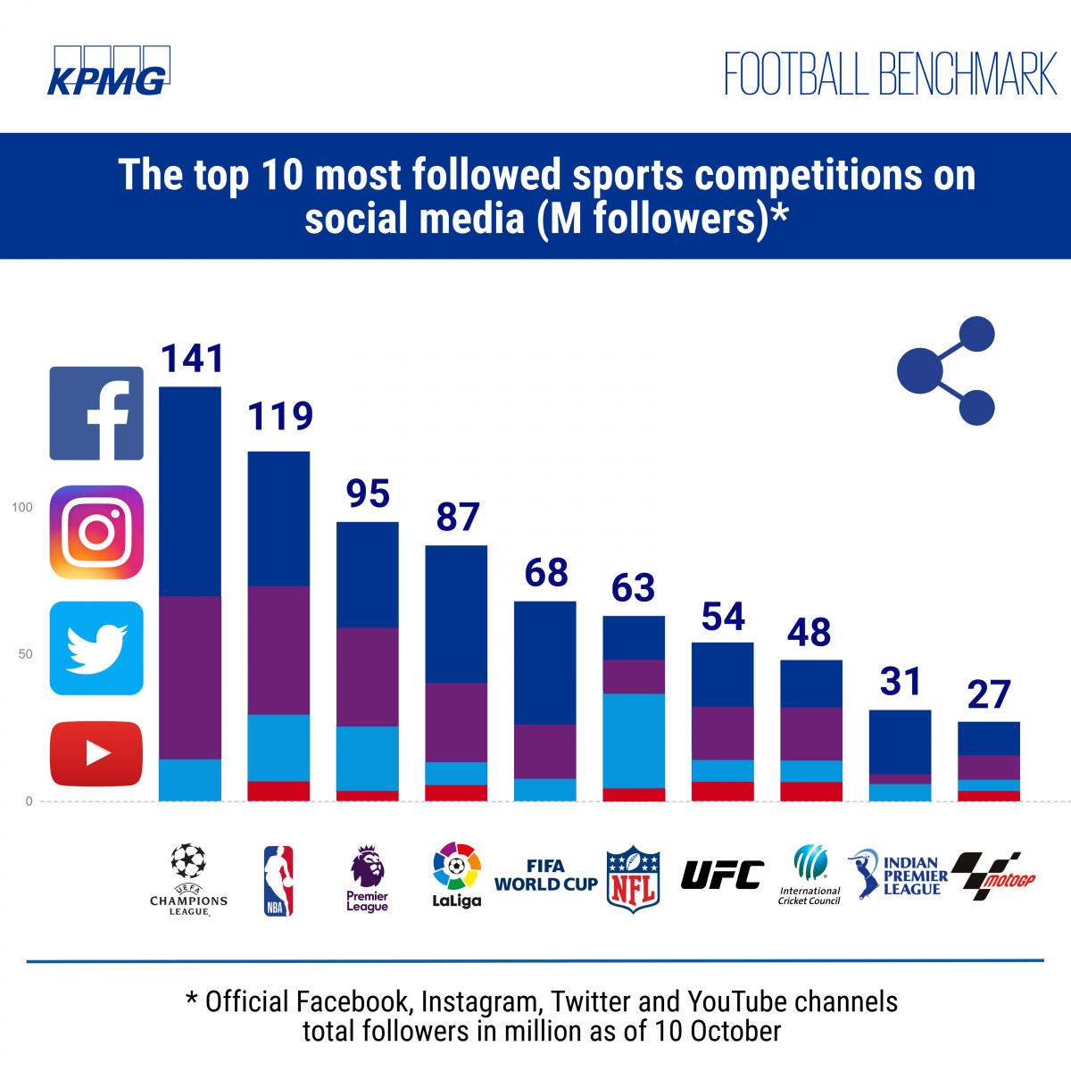
Sport and Social Media

Slide 11
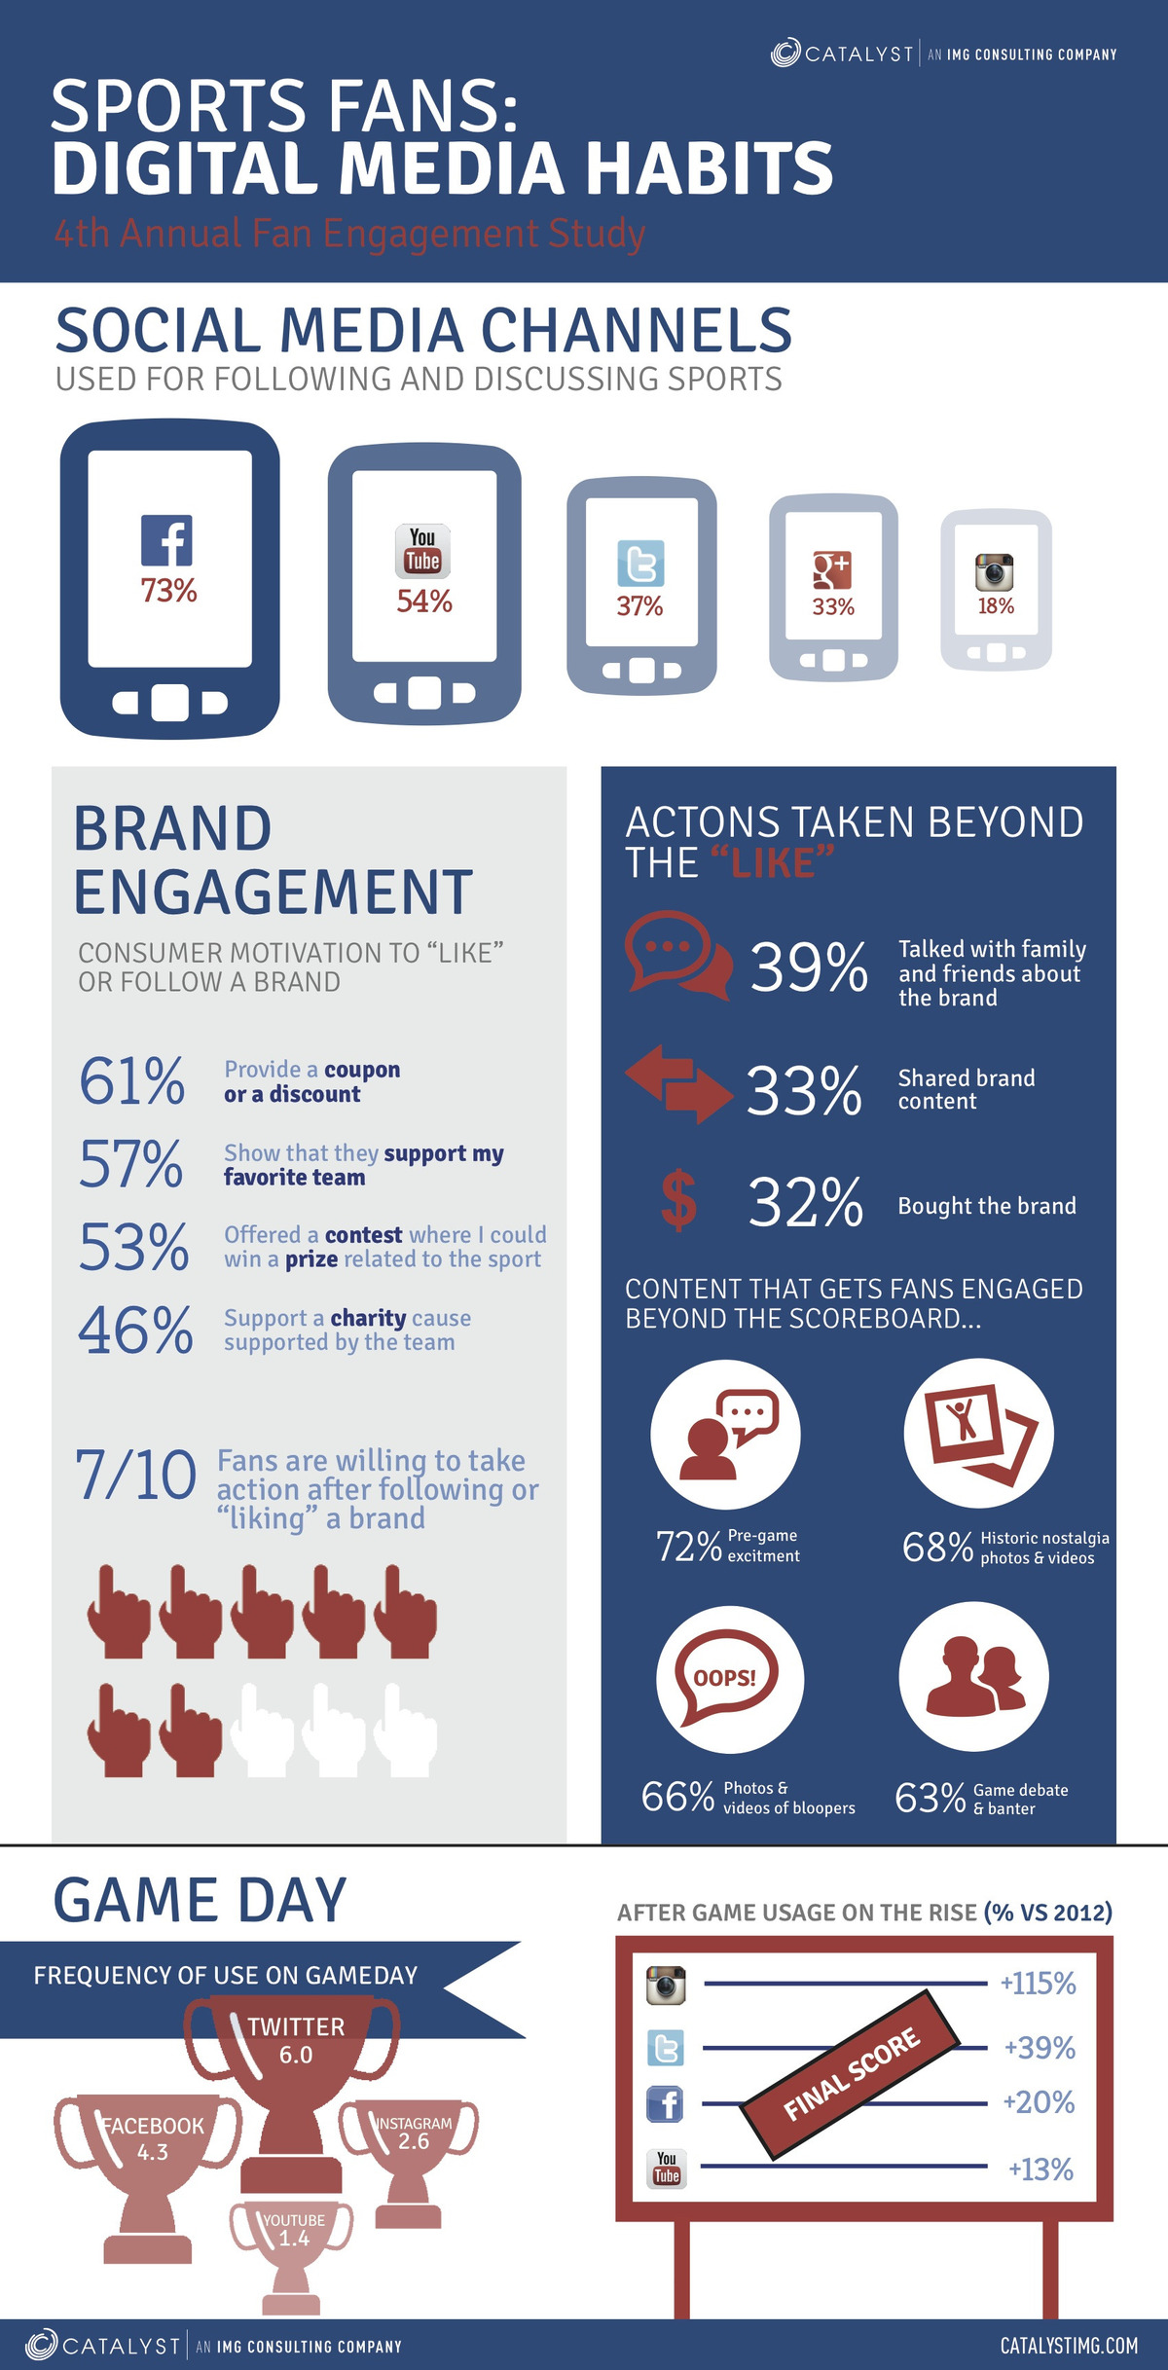
Sport and Social Media

Slide 12
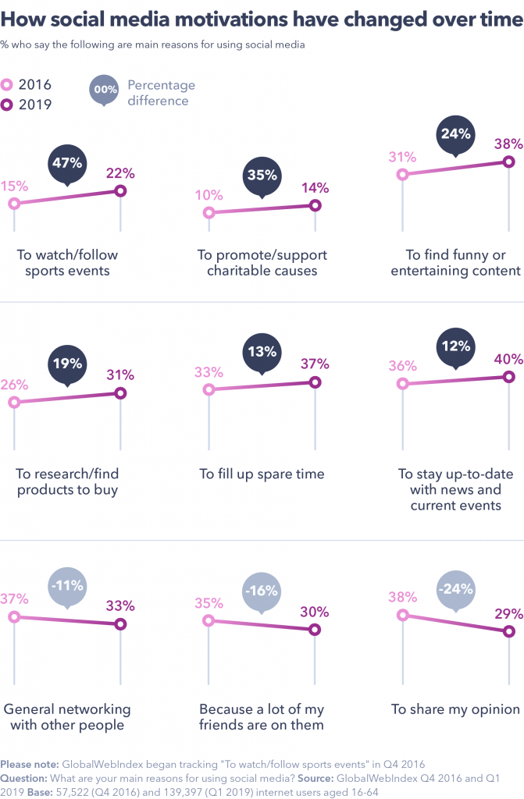
Sport and Social Media

Slide 13
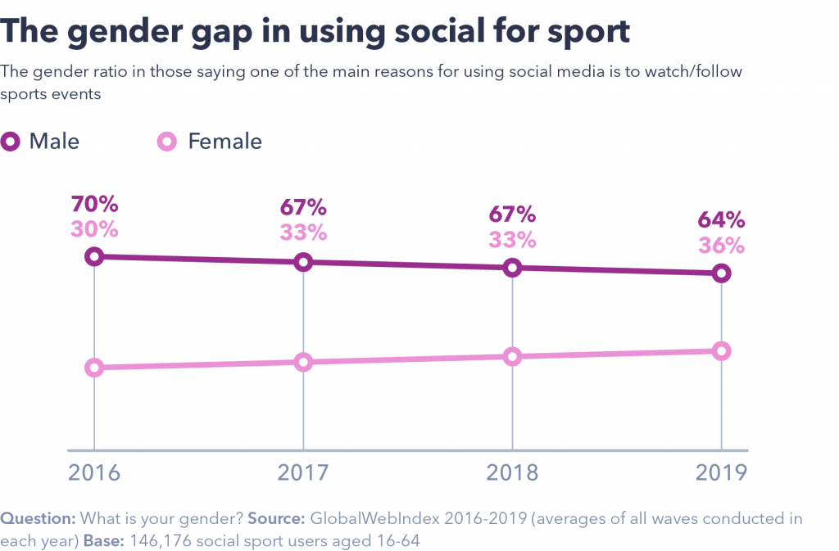
Sport and Social Media

Slide 14
Sport and Social Media
Social media is a double-edged sword in sports, offering fans unprecedented access while providing athletes with real-time communication opportunities, often sparking issues. The media's attention on professional athletes and organizations has surged through platforms like Instagram and Twitter, with a particular emphasis on the latter.
Twitter has swiftly emerged as one of the most powerful social media outlets for athletes and their fans. It facilitates direct communication between fans and the stars they follow, support, or even dislike. On Twitter, users can ask questions, comment on each other’s tweets, or express their thoughts on the latest games.
Beyond this interactive aspect, Twitter's widespread success among sports fans can be attributed to its practicality. Modern sports enthusiasts crave constant and up-to-date access to sports information, including scores and stats, and Twitter effectively meets these needs.
However, this increased connectivity comes with significant risks to reputations. While Twitter serves as a valuable tool for modern sports fans, some professional athletes have faced challenges in using it in a practical and beneficial manner. Notably, Twitter played a crucial role in the three cases discussed above, not as a cause of the issues but as an instrumental tool for athletes to issue apologies and statements quickly, far outpacing traditional media.

Slide 15
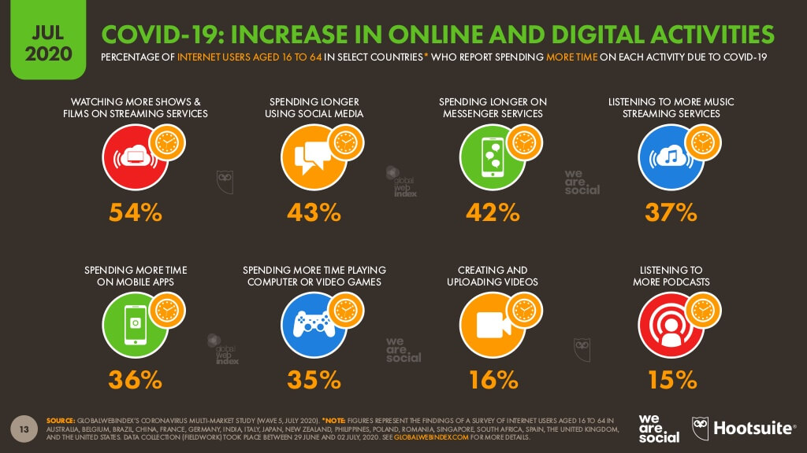
Sport and Social Media

Slide 16
Sport and Social Media
Almost every team in any sports league, not just the NBA, maintains a presence on Twitter, Instagram, and Facebook, along with an official app to share news with its fans. Two essential datasets that brand managers can leverage for impactful results are team and player performances, as well as insights into upcoming matchups. Given that sports-related news is inherently more engaging through visual content such as pictures, clips, and graphics, it's beneficial to make full use of the visual-sharing capabilities offered by each social platform.
Significant plays unfold during various points in the season—against rival teams in the regular season, in playoff games, and ultimately in championship clashes. For instance, videos capturing someone like LeBron James scoring 20 points not only garner clicks and elevate his profile but, if it occurs during a regular-season game, showcasing crowd reactions can be utilized for marketing to highlight the excitement of live games. On the other hand, if it's a playoff game, these videos can serve to rally fan support on social media, creating a buzz and fostering heightened enthusiasm.

Slide 17
Sport and Social Media
Moving on to the topic of rivalries, every sports league has at least two teams engaged in a heated rivalry. While the reasons behind these feuds may be clear or somewhat hazy, sharing data about the rivalry leading up to the game can be compelling. For instance, consider the longstanding rivalry between the Boston Celtics and the Los Angeles Lakers, one of the longest-running rivalries in NBA history. Providing statistics based on previous victories and defeats adds to the pregame interest, including specific player statistics.
Transitioning to the actual game itself, in addition to highlighting ongoing results, historical comparisons can add a fascinating dimension and bring the story full circle, all while keeping fans informed about the current roster’s prowess. This information can be presented through eye-catching graphic designs or quick videos.
Now, what about smaller-market teams? While this is a common occurrence in any league, it's not an insurmountable challenge. Every team, regardless of market size, has a star player, even if they don't appear on ESPN every day. Elevating a player's profile on social media can lead to growing interest from casual fans. This can involve showcasing not only their on-court/field achievements but also their interactions with local fans, providing a more personalized and engaging narrative.

Slide 18
Sport and Social Media
While traditional media platforms continue to experience a negative dip in revenue growth, the sponsorship of live sports content is flourishing. According to a recent survey, 98% of sports marketers identified social media as the number one way to fully leverage sponsorships. In 2017, sports sponsorships increased by 4.3%, representing $16.37 billion of the total North American sponsorship spend.
The way fans consume sports is rapidly evolving, from watching games on demand to engaging with shorter, snackable content on platforms like Snapchat. This season, Facebook is set to live stream college sports, and it will also feature NFL game recaps and highlights through a deal with the NFL. Additionally, Amazon is streaming Thursday Night NFL games for Prime members, and Twitter has expanded its coverage to broadcast college sports 24/7, along with MLB games on Friday nights.

Slide 19
Sport and Social Media
Trends like augmented reality and virtual reality are reshaping the way fans interact, offering VR experiences at the stadium and new apps enabling VR group viewings akin to multiplayer video games. Wendy’s recently partnered with Fox Sports to create a VR experience, allowing fans not only to watch games together but also to explore the action on the field from multiple angles with user-controlled instant replays.
Forward-thinking sports marketers are swiftly adapting to sponsor on-demand and VR content, while also delving into live content and storytelling on a larger scale. During this year’s finals, the NBA exclusively produced content for Snapchat, and the NHL introduced a playoff beard filter to enhance fan engagement with the Stanley Cup.
The ascendancy of live streaming will continue to redefine how we consume sports. With platforms and content strategies evolving rapidly, traditional media is diminishing in relevance. From individual athletes and teams to brands, everyone is embracing live content to bring fans closer to the game, fostering new experiences in collaboration with tech players.

Slide 20
Sport and Social Media
The entire sports industry is now exploring various opportunities to create content and engage with fans, and social media plays a crucial role in this endeavor. The sports industry can harness the popularity of social media in both favorable and challenging times through the following:
Boost Loyalty Through Real-Time Engagement
Professional athletes are celebrities in their own right, having achieved their status through rigorous training and hard work. Sports fans adore interacting with their favorite teams and players, a common occurrence on platforms like Twitter. Sports teams should continue to amplify the interest and passion of their fans by engaging with them in real-time. Especially with the pandemic keeping many people indoors, a bit of interesting real-time interaction with favorite sports superstars can go a long way. Sports teams can help maintain the enthusiasm of their fans by involving them in discussions or polls on social media.

Slide 21
Sport and Social Media
Increasing Sales Through Influencer Marketing
Sports fans are known for their passionate and emotional engagement. They follow their favorite athletes on social media and interact with fellow fans on these platforms. Take footballer Cristiano Ronaldo, for example, who boasts 234.5 million followers on Instagram and almost 128 million followers on Facebook as of this writing. It's no surprise that he is one of the highest-paid influencers on social media. Businesses related to sports, health, and fitness products and services recognize the potential to boost revenue by collaborating with athletes who have a substantial social media fan base.
Giving Back to the Community by Supporting Various Causes
How can organizations and companies cultivate loyal and passionate customers on social media? One effective way is to support charitable organizations and promote various causes online. Renowned athletes such as Serena Williams and Michael Phelps are recognized for their efforts in supporting and establishing charities that aid children in need, promote gender equality, alleviate poverty, and more. Sports organizations, advertisers, and brands can garner more interest and sales by collaborating with athletes and sports teams that use their influence to advocate for the less fortunate and speak up on important social causes today.

Slide 22
Thank You

