Slide 1
Sports Business Management and Strategy
An Introduction
Aarthi Rajaraman

Slide 2
The Sports Spectrum
Amateur sports and professional sports are best viewed as ends of a spectrum. One end makes no money, while the other brings in billions in revenues.
Professionals make enough money to play their sport as their job, while amateurs refer to participants that practice or play for fulfillment.
From a management perspective, they are managed differently and have different rules.
Up until the 1988 Olympic Games, the IOC banned professional athletes from competing in the Games.
The emergence of professional sports still creates tensions in the operation of amateur sports federations, as many of these organizations were created to manage and support amateur sports due to their values and social relevance, and they are often funded by governments around the world.

Slide 3
The Sports Ecosystem
The key stakeholders in the ecosystem
1. Leagues, Federations and Associations – Most sports either at the pro and amateur level have one or more bodies that govern major aspects of the game.
2. Clubs and Teams – Many sports have a club/team as well as an individual participant aspect. Teams in the leagues help engage fans.
3. Players, Coaches, Agents and Player Associations – These are the key players at the pro sports level.
4. Events – Sporting activities are associated with organized events.
5. Facilities, Arenas, Stadiums – At the pro level, events can attract mega crowds in housed in facilities.
6. Health and Sport Medicine Bodies – A key role of sports in society is promoting physical and mental health
7. Apparel and Equipment Providers – Varies sport to sport but has become a major growth area of the sports ecosystem thanks to companies like Nike.

Slide 4
The Sports Ecosystem and its Stakeholders
8. Media Content and Distribution – A major financial pillar of many sporting leagues and clubs – broadcast revenue.
9. Branding, Marketing and Sponsorship – Occurs at multiple areas of the ecosystem. Brand is an important aspect for every stakeholder in sport. Leagues, clubs and players in the pro area benefits from developing brands that create a positive image.
10. Ticketing – The ticketing companies are key to the ecosystem as they are the way in which the public transacts with the event/club.
11. Sports Advisory/Service Companies – Pro sports often use the services of third-party companies who have sizable expertise in areas of importance to decision making in the sports industry.
12. Government, NGOs, Sports Law – Govt has a vital interest in many areas of sports. In some countries, they are the primary funder of sports. Based on the role in the country, govt can make sporting related investments to promote health and events to its citizens.

Slide 5
Managing in the Sports Industry versus Other Industries
Areas of Commonality Areas of Differentiation
1. Leadership and Strategy Matters 1. Winning on the Field Central
2. Value Creation and Value Sharing 2. Diverse Owner Objectives
3. Search for Revenue Growth 3. Managing in the Fishbowl
4. Growth and Fluidity in Various Areas 4. Supporting the Weakest
5. New Product Innovation 5. Handicapping the Strongest
6. Astute and Creative Contracting 6. Revenue Pools &Allocation Rules
7. Quality of the Product Matters 7. Athletes as Business Assets
8. Branding Matters 8. Managing w/“Badly Behaving”
9. Fans and Customers as a Business Pillar 9. Limited Financial Disclosures
10. Globalization 10. Sports and Entertainment

Slide 6
1. Leadership and Strategy Matter – the sports industry, just like other industries, also places importance on top managers/management exhibiting strong leadership and executing well-developed strategies.
2. Value Creation and Value Sharing as a Major Focus - Business executives face the challenge of creating value and then sharing (distribution) that value. The sports industry is no different.
3. Relentless Search for Revenue Growth Opportunities – just as business executives are continually pursuing opportunities to grow revenue, the sports industry is pursuing the same objective at multiple levels, via league, club, player, and broadcasting.
4. Growth and Fluidity – can also be thought of as vertical integration – whereby clubs/teams/leagues seek to own or operate other aspects in the value chain. For example, owning the stadium, cable channels, internet. Managing in the sports industry is similar to managing in other industries.
5. New Product Innovation Fuels Revenue Growth – like other businesses, across the major players in the sports value chain, new product innovations are a central part of growth strategies. From new sporting competitions to new leagues, this is evident.
6. Astute and Creative Contracting – successful managers in many businesses combine innovative product strategies with contracts that enable them to capture a sizeable part of the gains as well as not being exposed to inordinate risks from those strategies. Many of the sporting industry’s contracts are multiyear, and costs can be offset, for example, through stadium naming rights.
7. Quality of the Product Matters – like other industries, delivering a quality product is a key business success determinant in the sports industry! For example, "competitive balance," fan experience, and quality coverage. Managing in the sports industry is similar to managing in other industries.

Slide 7
Managing in the Sports Industry versus Other Industries
8. Branding Matters – It is an important strategy for other businesses, but especially crucial in the sports industry. It takes place at multiple levels and can be demonstrated via global brands that have high merchandising rates.
9. Fans and Customers as a Business Pillar – Leading clubs, sporting leagues, and athletes have a deep emotional connection to their fans. Creating this emotional link is crucial to building a sustainable relationship over an extended period.
10. Globalization – Other industries are emphasizing globalization strategies, and the sporting industry is no different. Many leagues, clubs, and individual athletes are also adopting a global perspective/strategy in their outlook. Managing in the sports industry is similar to managing in other industries.

Slide 8
Sports Marketing
Areas of Differentiation
1. Winning on the Field Central – Very public “thumbs up or
thumbs down” after each game. This affects the business side
as well as the playing side. Senior management’s jobs often
depend on on-field success.
2. Diverse Owner Objectives – Companies in all industries often compete
for the similar objective of shareholder wealth maximization. This isn’t
necessarily the case with owner of sporting clubs and teams. They can
Also pursue winning on the field, financial gains, trophy status of owning a
club, protecting a community asset. The diversity of owner objectives can
create unstable equilibriums unless there are tight constraints on player
salaries and other outlays.
3. Managing in the Fishbowl – The media spotlight shines not only on the
players and the coaches, but the front office executives. Decisions they
make are subject to scrutiny by both informed and uninformed parties on a
regular basis.

Slide 9
Areas of Differentiation
4. Supporting the Weakest – In business, we rarely see attempts to help build up low-performing companies in a competitive marketplace, but revenue-sharing rules in some leagues aim to assist struggling clubs. This is done to bolster the overall health of the league.
5. Handicapping the Strongest – Successful companies often continue to grow and move upward. Sporting dynasties aren’t always viewed as a good thing. Take Formula 1, for example—Schumacher and Ferrari dominated for so long, which was seen as detrimental to the overall health of the competition.
6. Revenue Pools and Allocation Rules – Sports executives at multiple levels often deal with central and local revenue pools and allocations for distributing and redistributing those revenues.
7. Athletes as Business Assets – High-profile individual athletes attain an emotional attachment from fans that can provide many commercial opportunities. However, with business leaders, you might admire them, but that’s it—there is no emotional connection.
8. Managing with the Badly Behaving - Since many high-profile athletes often reach success at such a young age, they are exposed to bad temptations early on. The media coverage of these events can be debilitating to a team, club, industry, and therefore, resources need to be devoted to combating this problem.
9. Limited Financial Disclosures - While many industries have detailed audited financial statements available, it’s not always the case with sporting companies. Mainly because they are privately owned, and owners prefer to keep their business affairs private. Sometimes, clubs opportunistically release their financials when they are seeking extra revenues, but the validity of these statements is not always accurate.
10. Sports and Entertainment – The sports industry is an example of how aspects of the entertainment industry are being incorporated into another.

Slide 10
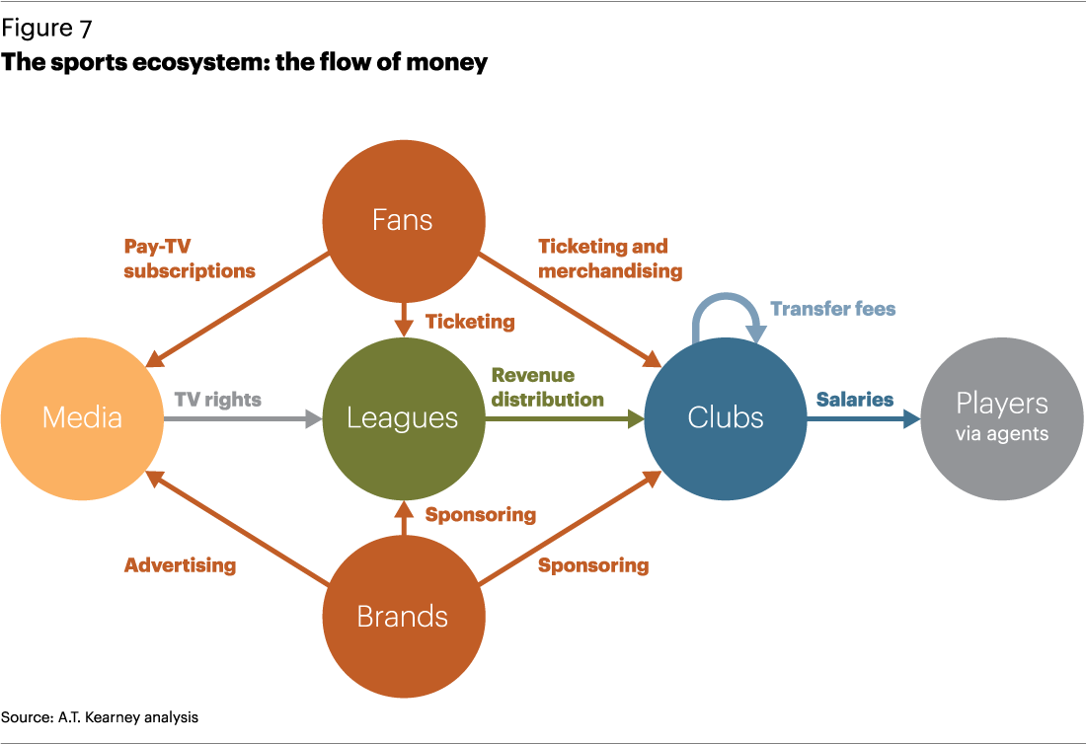

Slide 11
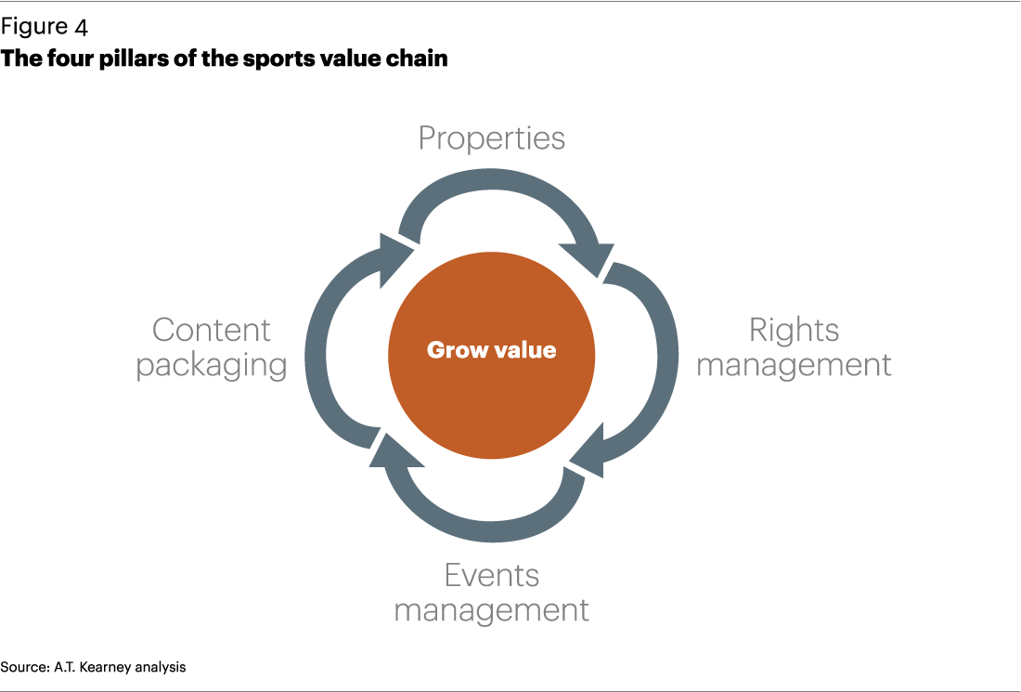
Why Has Sports Become Such a Big Business?
We need to understand how sports create value.
Rights owners define the structure of professional sports around the world. They set the rules, organize the events, and take responsibility for generating revenues from matches, media, and marketing rights.
The sports value chain is structured around four pillars:

Slide 12
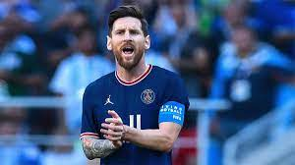
Key Areas of Professional Sport
Properties. The properties managed by rights owners are the intangible assets that draw fans and money. They include a wide range of parties, including leagues (such as the Premier League), pro tours (golf's PGA Tour), teams (Arsenal or Atletico Madrid) and athletes (Lebron James, Lionel Messi).

Slide 13
Key Areas of Professional Sport
Rights management has evolved over time. Historically, the monetization of properties was based on gate receipts, but in contemporary professional sports, media and marketing rights have become crucial revenue sources. Rights owners or sports agencies, acting on their behalf, not only structure the deals but also engage in the trading of media and marketing rights.
In the following, we will provide a general overview of branding and sponsorship and apply it specifically to European sports teams and individuals.

Slide 14
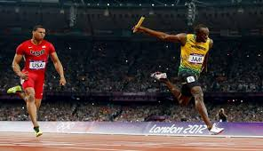
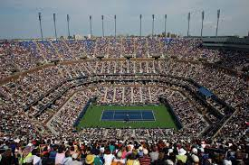
Key Areas of Professional Sport
Events. Effective rights management depends first on operating live events. An enjoyable experience for fans can create additional opportunities for revenue.
We will look at changing stadium design, how events are run and managed , the fan and fan development

Slide 15
Key Areas of Professional Sport
Content. The stadiums can only seat a certain number of fans, but packaging content for broadcasters' and sponsors' needs is a vital part of creating revenue in modern sports.
We will look at social media, technology and communication and fantasy sports league growth.

Slide 16
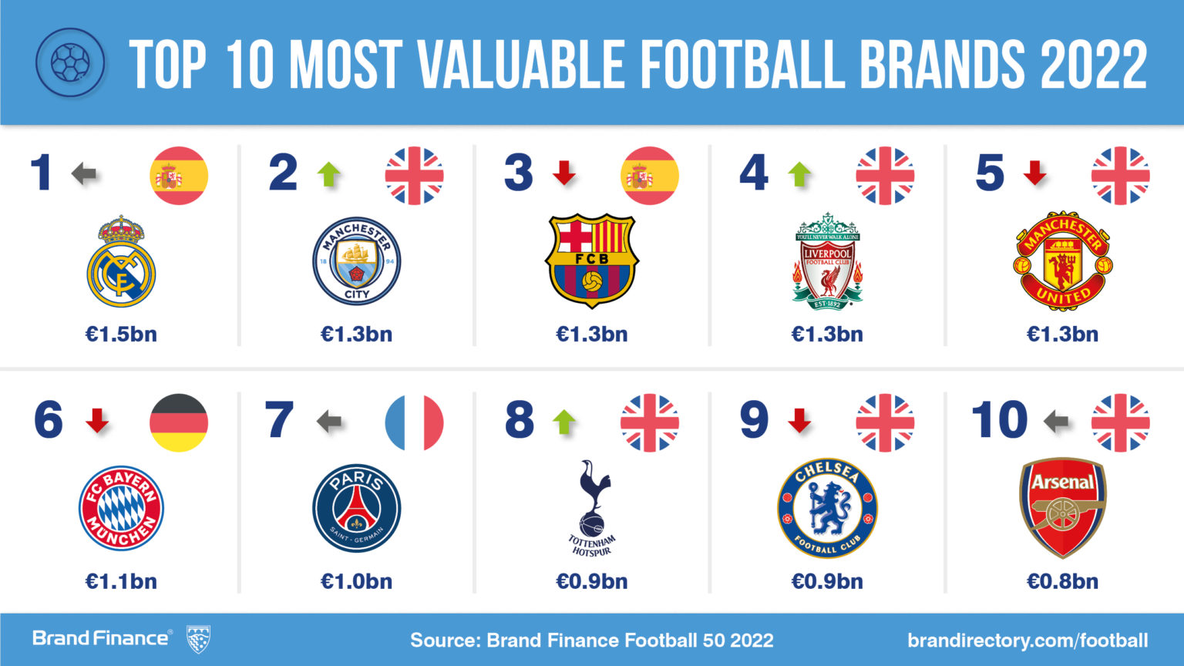
Key Areas of Professional Sport
The three most valuable sports teams in Europe play the non-American brand of football. Take a look below….

Slide 17
Most Followed Sports on the Globe

Slide 18
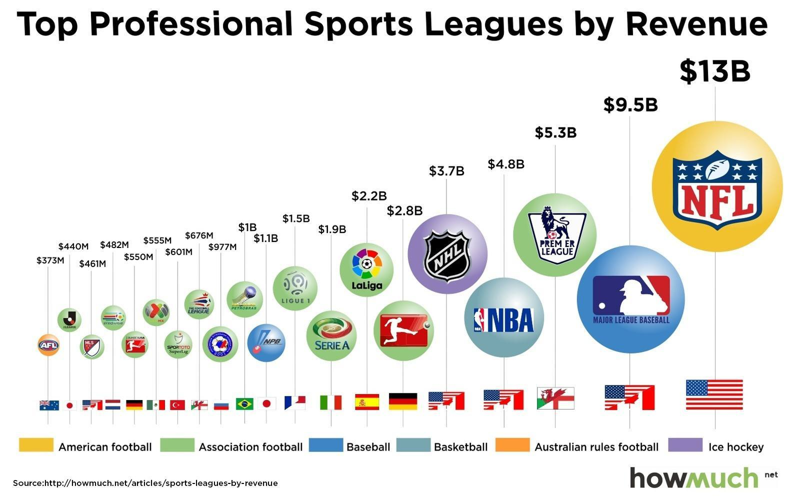
Richest Pro Sporting Leagues on the Planet

Slide 19
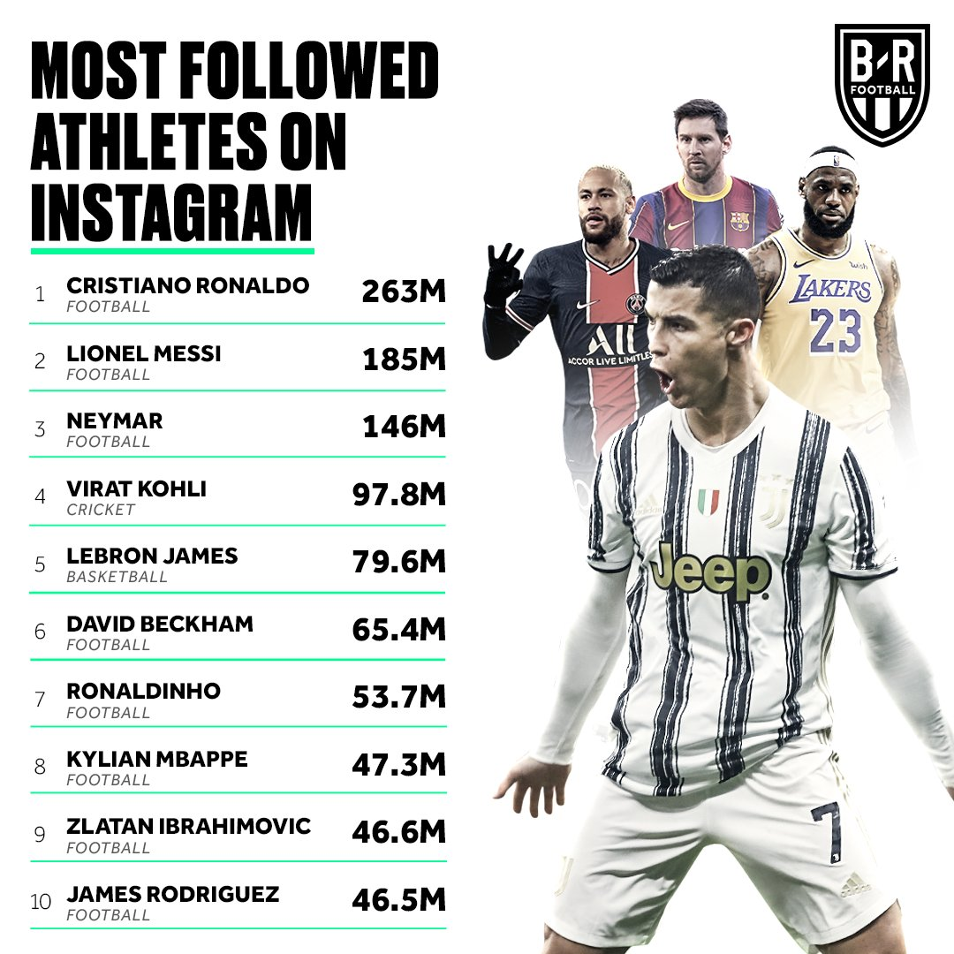
Most Followed Athletes on the Planet

Slide 20
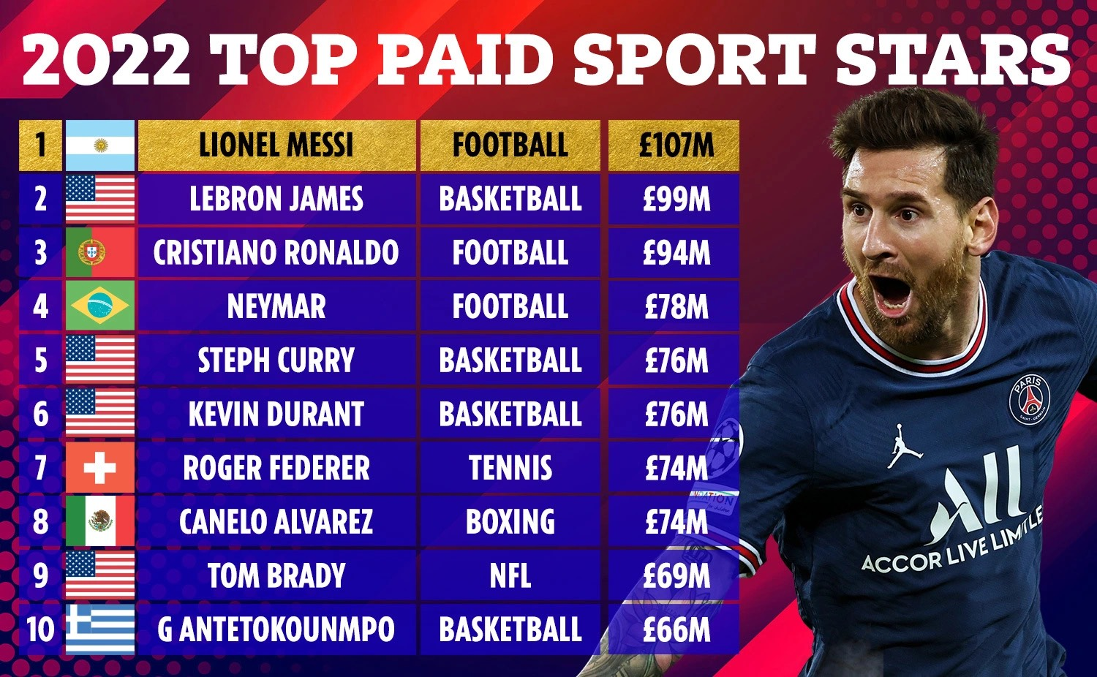
Highest Paid Athletes on the Planet

Slide 21
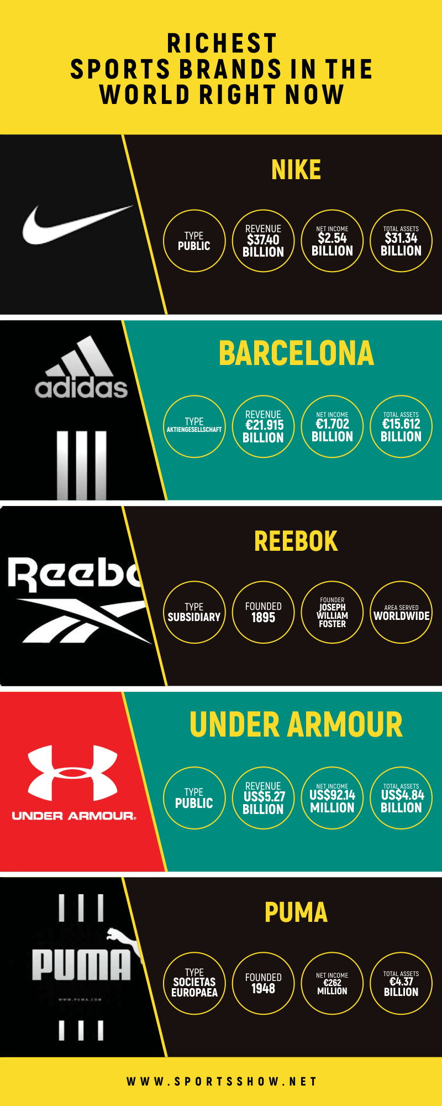
Most Followed Sporting Brands on the Planet

Slide 22
Most Watched Sporting Events on the Planet

Slide 23
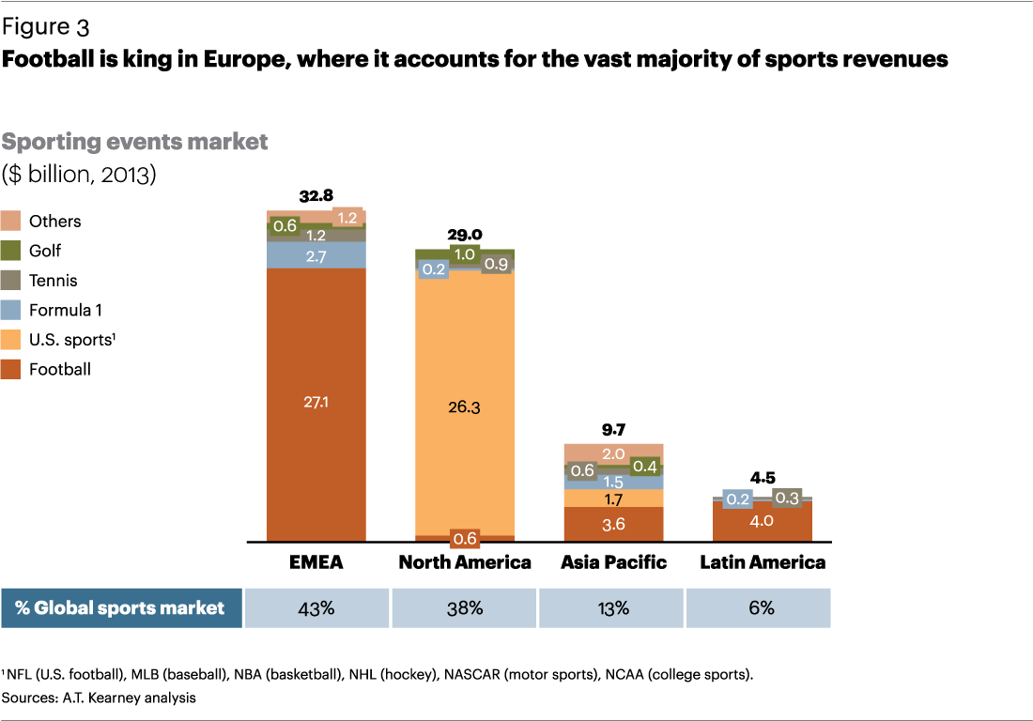

Slide 24
Growth of Sports Media and Coverage
ESPN, the original sports-only network launched in 1979, reaches some 76 million homes with its 4900 hours of sports programming and, ESPN2 reaches 65 million viewers.
$7.75 billion to secure the broadcast and cable rights for the Olympic Games in from 2014-2032.
Overall, for the week, NBC averaged 26.7 million viewers in primetime during the Olympic Games.
$2.64 billion paid by NBC and Turner Sports to televise NBA contests, $18 billion paid by the networks for the NFL, $2.5 billion for post season MLB.
New sports networks, such as the College Sports Television, Tennis Channel, Blackbelt TV, and the Women’s Sports Network.
Internet, satellite stations, and pay-per-view cable television are growing in popularity.
Rights for live games of Premier League football for 3 seasons starting this year sold for 5.1 billion pounds (Sky and BT).

Slide 25
Thank You

