Slide 1
MIM115 Global Sports Business and Industry

Slide 2
News Palco 23
BAY FC INVESTS 735,000 EUROS FOR Rachel Kundananji
https://www.palco23.com/competiciones/bay-fc-invierte-735000-euros-en-kundananji-el-traspaso-mas-caro-del-futbol-femenino
Jim Ratcliffe buys 25% of Man U
https://www.palco23.com/clubes/la-premier-league-autoriza-la-venta-del-25-de-manchester-united-fc-a-jim-ratcliffe

Slide 3
Class 10: Olympic Sports Business
History and Commercial Development of the Olympic and Paralympic Games
Staging the Olympic and Paralympic Games
Bidding Process and Costs of Hosting the Olympic and Paralympic Games
Challenges and Issues of Hosting the Olympic and Paralympic Games
Broadcasting and Media Coverage
Environmental Impact

Slide 4
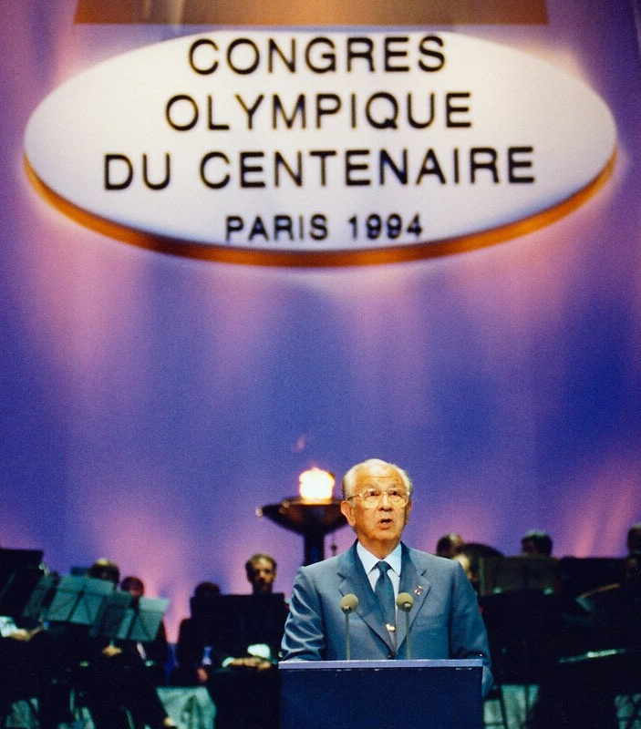
History and Commercial Development of the Olympic and Paralympic Games
Founded at the first Olympic Congress in Paris in 1894, the IOC is the leader of the Olympic Movement
The evolution into a global mega-event has introduced complex challenges, including the management of broadcasting rights, ensuring environmental sustainability, and addressing social and ethical issues such as gender equality and athlete welfare.

Slide 5
History and Commercial Development of the Olympic and Paralympic Games
Commercial development escalated after the 1984 Los Angeles Games, which famously turned a profit through corporate sponsorships and broadcasting rights. Similarly, the Paralympic Games, established in 1960.

Slide 6
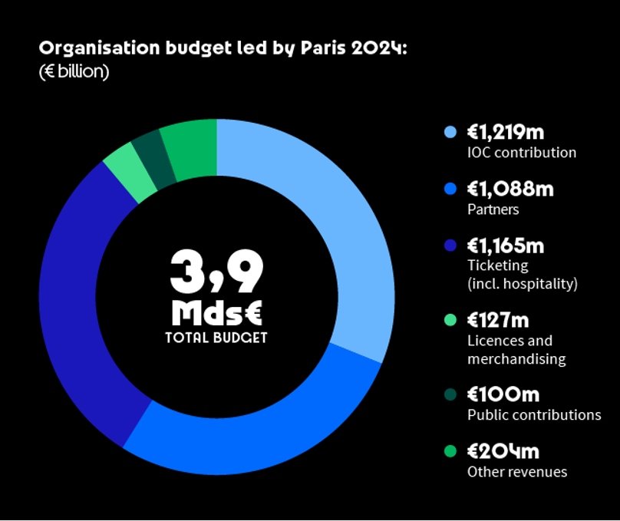
Key Steps to Bidding Process
Expressing interest: Cities or countries express their interest in hosting the Games
Submitting an application: covering plans for venues, infrastructure, environmental sustainability, finance
IOC makes the final decision.

Slide 7
Discussion
What are the ethical considerations when bidding for and hosting the Olympic Games?
Social Equity and Displacement
Environmental Sustainability
Economic Responsibility (public funds, public debt, divert resources from public service, job creation).

Slide 8
Activity (15 minutes)
Role-play exercise where groups represent different cities bidding for the Olympic Games, focusing on creating a sustainable and beneficial proposal for their city
Each group has to ask a question from the proposal presented
Each group will select a winner

Slide 9
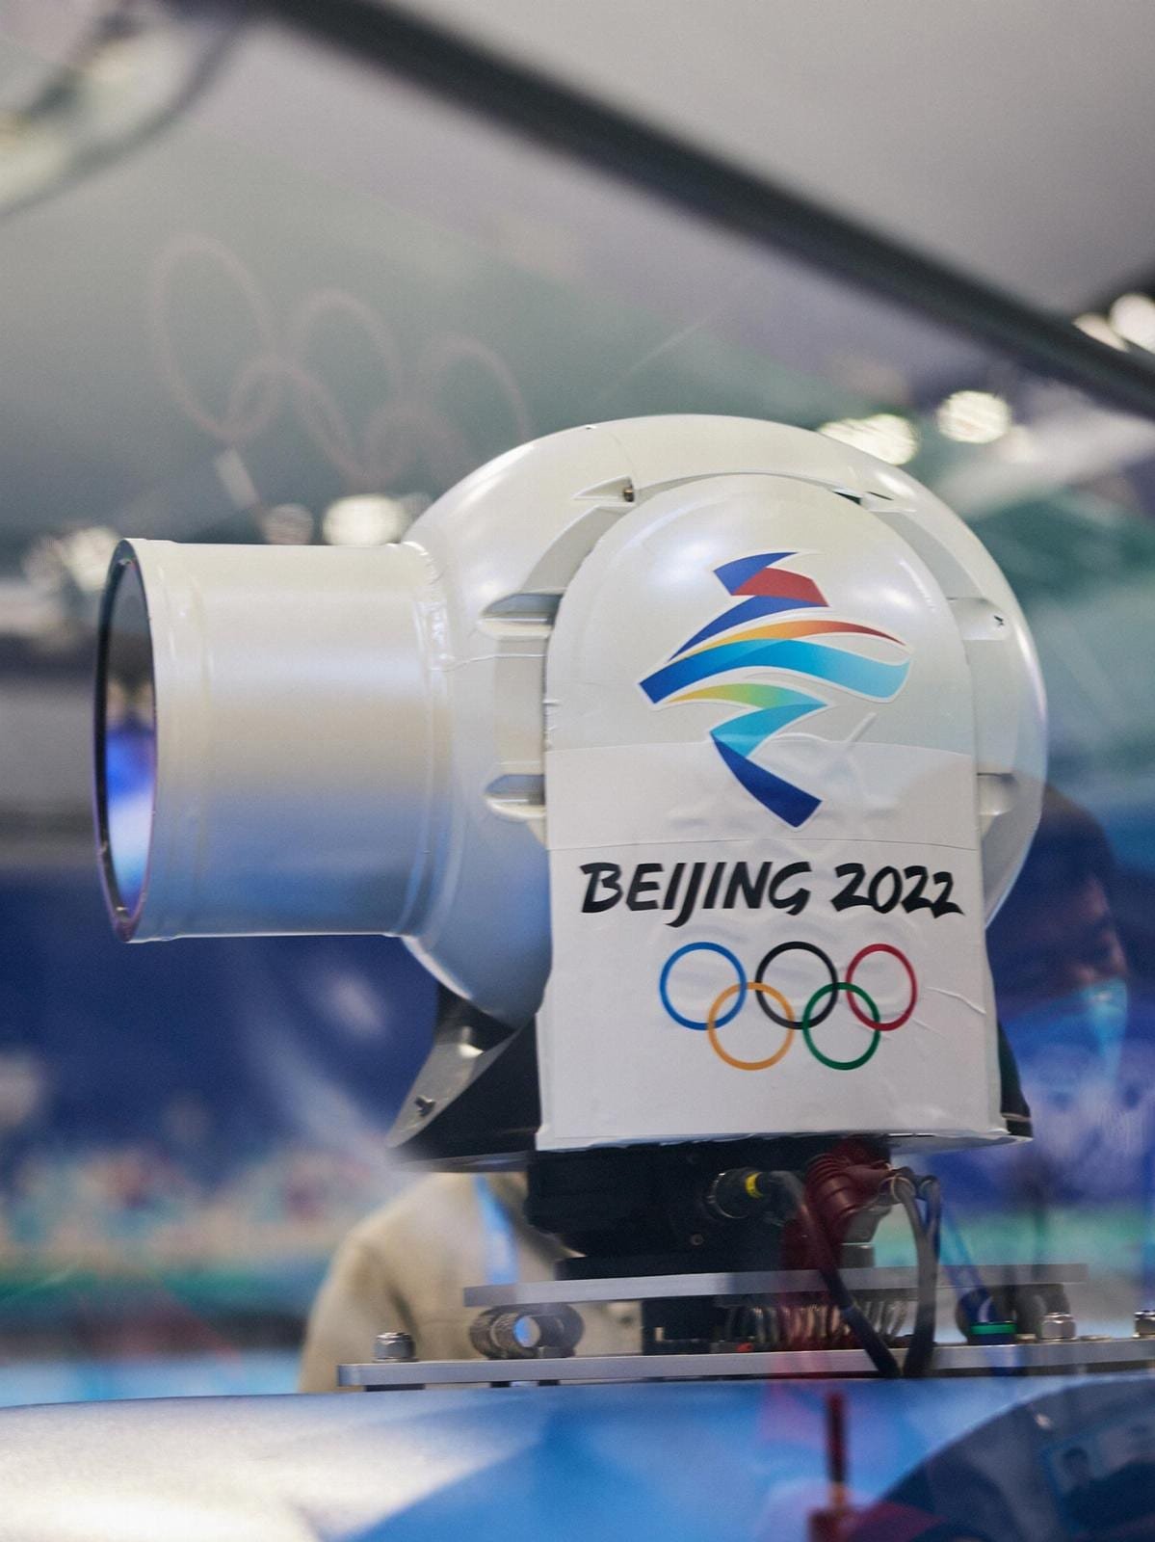
Broadcasting and Media Coverage
Broadcast and digital coverage are the principal means for people around the world to experience the magic of the Olympic Games.
The IOC is the owner of the global media rights for the Olympic Games – including broadcasts on television, radio and digital platforms
The IOC is responsible for allocating Olympic media rights to media companies throughout the world through the negotiation of media rights agreements.

Slide 10
Broadcasting and Media coverage
Distribution of Olympic Games coverage has been the principal driver of the:
Funding of the Olympic Movement and the Olympic Games.
Growth of the global popularity of the Olympic Games.
Global representation and promotion of the Olympic Games and the Olympic values.

Slide 11
Broadcasting and Media coverage

Slide 12
Broadcasting and Media coverage

Slide 13
Broadcasting, Media Coverage, and Environmental Impact
Key source of revenue for the olympic games
Global recognition of many sports
Visibility of host cities and countries, potentially boosting tourism and international goodwill.

Slide 14
Discussion
How can the Olympic Games balance the need for extensive media coverage with the responsibility towards environmental sustainability?
. Broadcasting technologies and remote production
. Encourage digital engagement and virtual attendance
.Renewable energy and recycling materials.

Slide 15
Environmental Impact For Paris 2024
Aiming to halve the carbon footprint compared to previous Games and power all competition venues with renewable electricity
Building less and using sustainable materials for new constructions
Promoting clean transport and soft mobility
Limiting food waste and reducing the use of single-use plastics

Slide 16
Group Activity (20 minutes)
Role-play exercise where groups represent different cities bidding for the Olympic Games, focusing on creating a sustainable and beneficial proposal for their city
Choose your own country
Create a proposal that best fit their sporting, economic, social and environmental-planning needs and the most convincing proposal wins
Groups will have to decide what proposal is the winner. A group cannot vote themselves

Slide 17
Thank You

