Slide 1
MIM115 Global Sports Business and Industry

Slide 2
News Palco 23
WWE names Dwayne Johnson as part of the board and shareholder
https://www.palco23.com/competiciones/la-wwe-nombra-al-ex-wrestler-dwayne-johnson-miembro-del-consejo-y-entra-en-su-accionariado
Football COmpetition Serie A Plans Matches In The USA & India (Not Saudi)
https://www.palco23.com/competiciones/la-serie-a-estudia-jugar-partidos-fuera-de-italia-y-pone-el-foco-en-estados-unidos-e-india

Slide 3
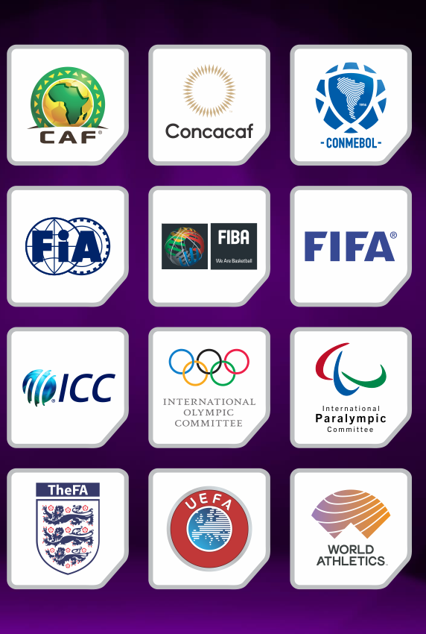
Emerging Sports and Markets
What is your favourite emerging sports and how are they expanding across other communities internationally and globally?

Slide 4
Group Activity (15 minutes)
How do different global markets impact sports business strategies for emerging sports?
What are the ethical considerations in sports business at a global scale for emerging sports?

Slide 5
Emerging Sports and Markets
The disruption of new technologies in the early 21st century paved the way for the development of new corporate strategies, novel forms of entertainment, and disintermediation. This evolution has resulted in:
- New forms of investments
- New platforms
- Emerging sports
- Opening new markets for traditional sports
All within the sports and entertainment environment.

Slide 6
Esports
Esports, or competitive video gaming, has experienced exponential growth over the past decade. Once a niche hobby, it has now become a billion-dollar industry with its own professional leagues, celebrity players, and a massive global audience.

Slide 7
Esports - Challenges & Solutions
Fan monetization
Teams focusing on the competitive side

Slide 8
Group Activity (15 minutes)
In groups analyze an emerging sport case study and outline one main challenge and develop three strategic solutions from a stakeholder point of view (athlete, media company and sponsor)
Present analysis and recommendations

Slide 9
Emerging Sports and Markets
What are recent developments and trends in the sports industry you have observed?

Slide 10
Capitalization on Emerging Markets in the Sport Industry

Slide 11
Capitalization on Emerging Markets in the Sport Industry

Slide 12
Commercial Trends in the Sport Industry

Slide 13
Commercial Trends in the Sport Industry
Nielsen Sports:
New sponsorship entrants, new measurement requirements
Athlete platforms: influential and measurable
A crowded media mix requires one consistent framework
More fan touchpoints
Sales impact as standard metric

Slide 14
Commercial Trends in the Sport Industry
PWC Sports
Non-fungible tokens (NFTs): The future of digital assets in sports.
Media rights: Content still rules as big tech weighs in.
Smart venues: Make it magical to build revenue.

Slide 15
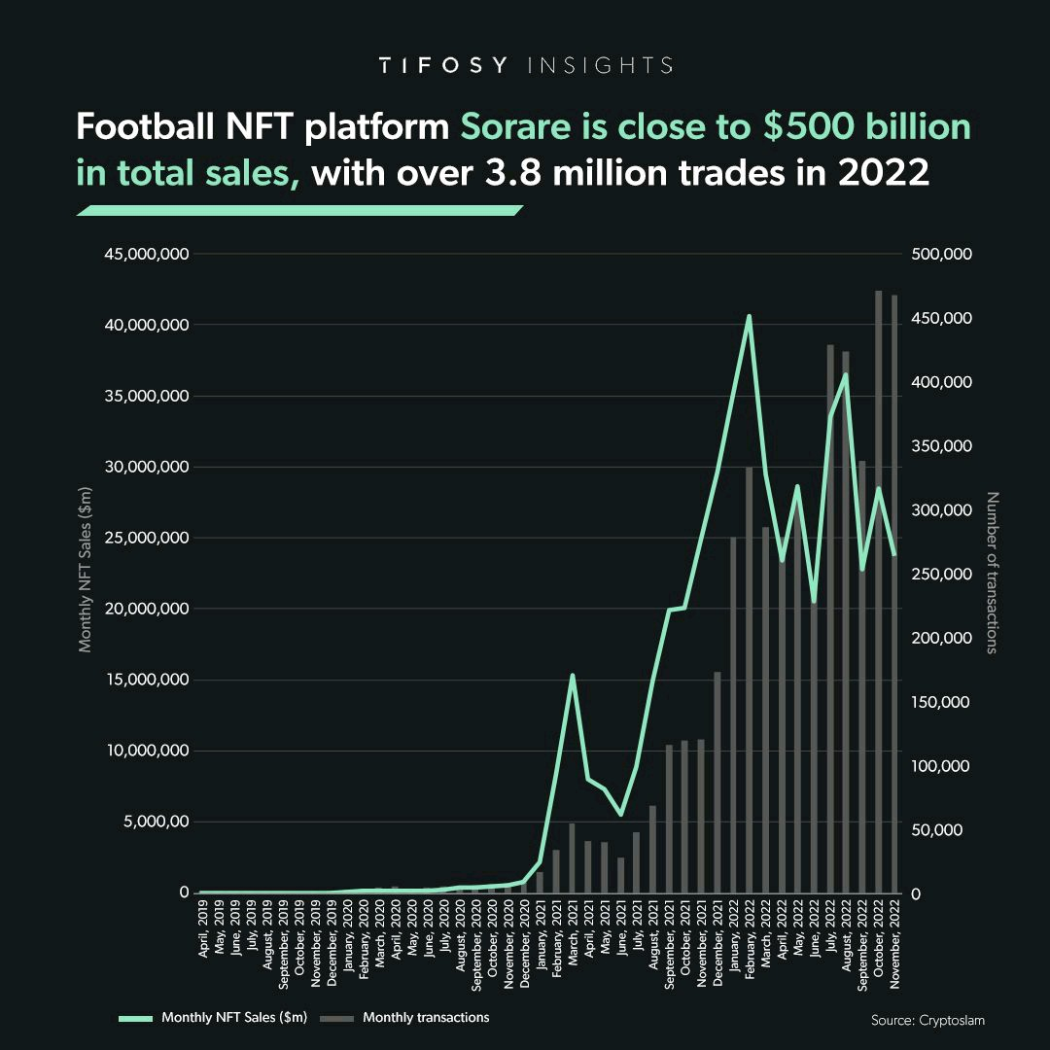
Commercial Trends in the Sport Industry

Slide 16
Sport and Sustainability
Sports have long been involved in Corporate Social Responsibility (CSR) activities to create positive impacts in their communities. This relationship has evolved, setting new standards for sports organizations' societal roles, with sustainability now fully integrated into their broader operations.

Slide 17
Sport and Sustainability
Investment in stadia and technology, the carbon footprint of major sports events, and the development or utilization of new technology that can mitigate environmental impact or expedite the protection and restoration of the environment are critical aspects within the realm of sports and sustainability.

Slide 18
Sport and Sustainability
Also, sports organizations can use the power of their platforms to become an advocacy hub for sustainability and generate a positive impact in society, achieving their objectives without jeopardizing the resources for future generations.

Slide 19
Potential For Growth of the Sports Industry in Emerging Markets
Emerging markets, defined as countries or regions with some characteristics of a developed market but not yet fully developed, are unexplored territories for most sports properties and that is not by chance.
Challenges like the complexity of the business environment, cultural and language barriers as well as political and social instability represent a few of the common hardships most companies and specially sports organizations will find in these markets.

Slide 20
Thank You

