Slide 1
MIM115 Global Sports Business and Industry

Slide 2
Class 5: International Sports Industry and Business Environment Introduction
Global, International and Regional Sports Business
Global Sporting Goods Industry
International Nature of Modern Sport
National and Regional Aspects of Sports Business

Slide 3
Global, International and Regional Sports Business
Sports Business has Global, International and Regional impact.
In some cases, the impact has global and local impact at the same time – to which we refer as “Glocal” impact.

Slide 4
Global, International and Regional Sports Business
Examples of Global Sports Business:
FIFA Football World Cup Broadcasting
Olympic Games (Summer and Winter) Broadcasting
Liberty Media’s Formula 1 Broadcasting
Boxing Broadcasting
Sporting Goods and Merchandise Industry
International Federations Competitions and Regulatory Attributions
Sports Law
Sports Content, Audiovisual Production and Movies

Slide 5
Global, International and Regional Sports Business
Examples of International Sports Business:
World Rugby Broadcasting
International Federations Competitions
Extreme Sports Competitions
Amateur Sports Competitions
MMA (UFC)
eSports
Sports Special Apparel Industry
Sports Marketing Industry (Consultancy)
Transfer of Athletes Business
Sports Finances Industry (Consultancy)
Sports Travel and Hospitality Industry
Sports Procurement and Construction Industry

Slide 6
Global, International and Regional Sports Business
Examples of Regional Sports Business
Gyms and Clubs
Special and Cultural Sports Events
Procurement and Construction
Sport Public Private Partnerships
Education and Sports Industry
Sports Marketing Industry (Consultancy)
Sports Business Law Industry (Consultancy)
Amateur local competitions (National or Regional Federations)

Slide 7
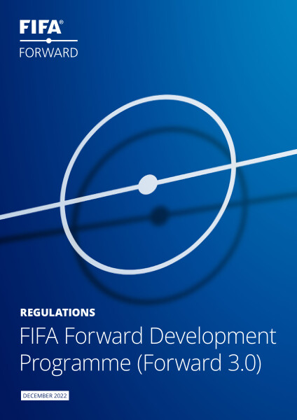
Global, International and Regional Sports Business
In some cases, sports can have a glocal impact. One example is the FIFA Forward Programme, developed with the aim of enhancing development and support for football worldwide. The goal is to enable football to realize its potential in every single country, ensuring that everyone who wishes to take part can do so without encountering barriers.

Slide 8
Global Sporting Goods Industry
Sporting Goods refers to fitness equipment and accessories, which presently involve treadmills, home gyms, aerobic exercises, trampolines, weights and benches and exercise accessories, but the content of such product lines may vary from time to time.

Slide 9
Global Sporting Goods Industry
The sporting goods industry is growing fast. According to Mckinsey & Company, growth is likely to continue, with the market expanding by an average of 8-10 percent from €295 billion in 2021 up to €395 billion in 2025.

Slide 10
Global Sporting Goods Industry

Slide 11
Global Sporting Goods Industry

Slide 12
Global Sporting Goods Industry
"More digital, less gym" encapsulates a dominant trend in recent times against a complex demographic landscape.
There have been notable shifts in how people engage in exercise, marked by significantly higher levels of digital participation, reduced gym attendance (attributed to the impact of lockdowns), and an increase in home-based activity.
The growth in online fitness, wellness, and digital exercise has exceeded 50% during the pandemic, with up to 80% expressing an intent to continue this trend even after the pandemic subsides.

Slide 13
Global Sporting Goods Industry

Slide 14
Global Sporting Goods Industry
Amidst growing user numbers and the relentless expansion of its capabilities, social media is establishing itself at the center of many brands' e-commerce strategies. As an increasing number of companies experiment with new approaches, leaders are elevating the art to a whole new level by creating powerful blends of social interaction and e-commerce.

Slide 15
Global Sporting Goods Industry

Slide 16
Global Sporting Goods Industry

Slide 17
Global Sporting Goods Industry
Climate change has steadily risen on consumer agendas in recent years, and the impact of the COVID-19 pandemic has accelerated its prominence.
People now, more than ever, understand the strong connection between their choices and the world they will leave for future generations. Sporting goods companies are naturally aligned with these values, but brands must do more to empower their customers to make sustainable choices.

Slide 18
Global Sporting Goods Industry

Slide 19
Global Sporting Goods Industry
Finally, the sporting goods industry is confronted with twin supply chain challenges.
Firstly, it must contend with the short- and medium-term impacts of the pandemic, including challenging imbalances between supply and demand, escalating shipping costs, and the effects of lockdowns on manufacturing hubs. The second challenge is longer-term and more structural, stemming from the industry's shift toward e-commerce. With these trends expected to persist through 2022, brands need to adopt a strategic mindset to ensure the continuous flow of stocks.

Slide 20
Global Sporting Goods Industry

Slide 21
Global Sporting Goods Industry

Slide 22
Global Sporting Goods Industry

Slide 23
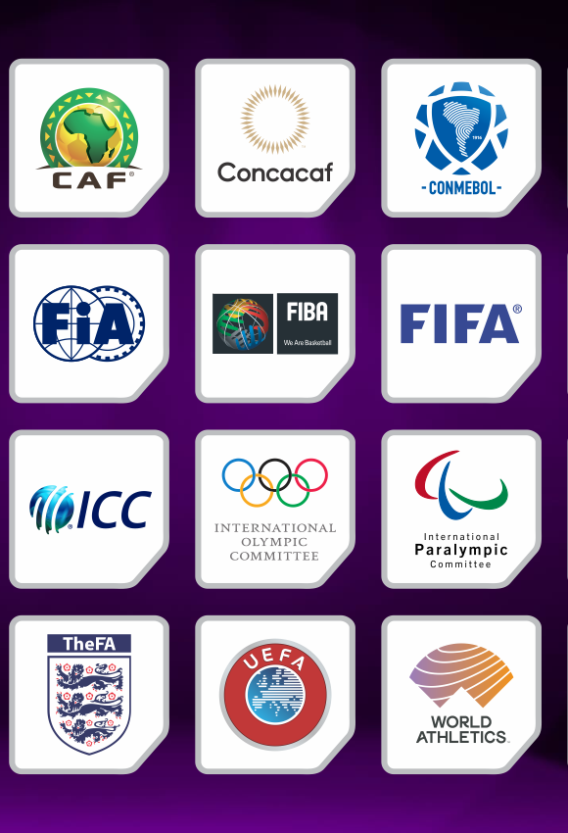
International Nature of Modern Sport
By understanding the origin of modern sport, structured as private associations, and the development of its industry, mostly derived from the evolution of broadcasting, marketing, and intellectual properties, it is possible to comprehend its international nature.
Also, by analyzing the evolution of the sports industry and its impact on various levels (global, international, and regional), we can understand how this "glocal" influence takes place. From governance to broadcasting or merchandising, sports are inherently international.

Slide 24
International Nature of Modern Sport
The governance of sports begins with International Federations, non-governmental organizations recognized as leaders in the sport, with regulatory, organizational, and commercial responsibilities. Some sports can be more international than others, either due to their nature, evolution, or participation, such as football (soccer) or running.
Other sports may have a more national or regional nature, for the same reasons or other factors such as weather or infrastructure, as seen in sports like ice hockey or even Pickleball.

Slide 25
National and Regional Aspects of Sports Business
Modern sport has an international nature, but national and regional aspects will influence the realm of sports business by a lot.
Aspects such as:
Infrastructure
Weather and Climate
Government and Public Spending
Macroeconomic Policies
Sectorial Regulations (Public and Private)
Industry Development
Production Capacity
Consumption Capacity
Sociocultural and Historical Characteristics
Sport Participation
International Agreements and Treaties

Slide 26
Thank You

