Slide 1
Unit 3 // Session 5
International Business & Global Business Challenges

Slide 2
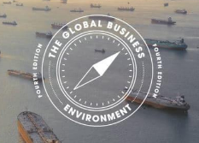
Session 5: Global Business Environment
Chapter INDEX
Business Environment
How Trade is measured
Definitions of allocation of resources, size of economy, GDP, GNP…
Impacts of International Business per region and continent on local businesses

Slide 3

International Business Environment Definition
What is International Business Environment?
The term “Business environment” represents the sum of all the individuals, institutions, competing organizations, government, courts, media, investors, and other factors outside the power of the business organizations but affects the business performance. Hence, changes in government economic policies, rapid changes in technology, changes in consumer tastes and preferences, increasing market competition, etc. are outside the business organizations' power but affect the business performance immensely.

Slide 4

International Business Environment
Business Environment
Environment by definition is something external outside an organization or an individual. Therefore, business environments are external factors that have a direct or indirect impact on the activities of the business. Some will pose threats to the business, some will positively influence its growth.
The business environment is the sum of all external factors that affect its growth.
The business environment includes both general and specific forces. Specific factors affect individual enterprises directly and immediately in their day-to-day working. General forces affect the business environment individually.
The business environment is dynamic.
The business environment is uncertain.
The business environment is a relative concept from country to country and even region to region.

Slide 5
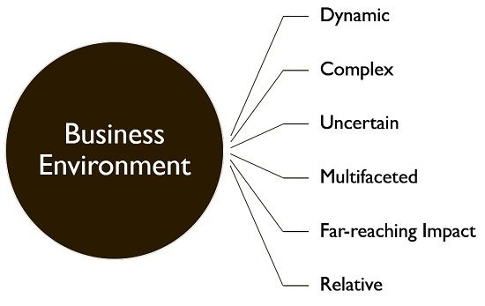
International Business Environment
Source: Businessjargons.com

Slide 6
International Business Environment
Components of Business Environment
Internal - combines factors that exist within the company:
Human resources
Value system
Vision and mission
Labor union
Corporate culture
External - outside factors that influence the business’s operations.
Macro - Sociocultural, political, legal, and global factors fall into this category.
Micro - This environment has a direct and immediate impact on a business. It consists of customers, investors, suppliers, etc.

Slide 7
International Business Environment
What Is Trade?
Trade is the voluntary exchange of goods or services between different economic actors. Since the parties are under no obligation to trade, a transaction will only occur if both parties consider it beneficial to their interests.
Trade can have more specific meanings in different contexts. In financial markets, trade refers to purchasing and selling securities, commodities, or derivatives. Free trade means international exchanges of products and services without obstruction by tariffs or other trade barriers.
The level of trade is measured by the percentage of exports out of GDP, or the size of the economy. The level of trade depends on a country’s history of trade, its geography, and the size of its economy. A country’s balance of trade is the dollar difference between its exports and imports.

Slide 8
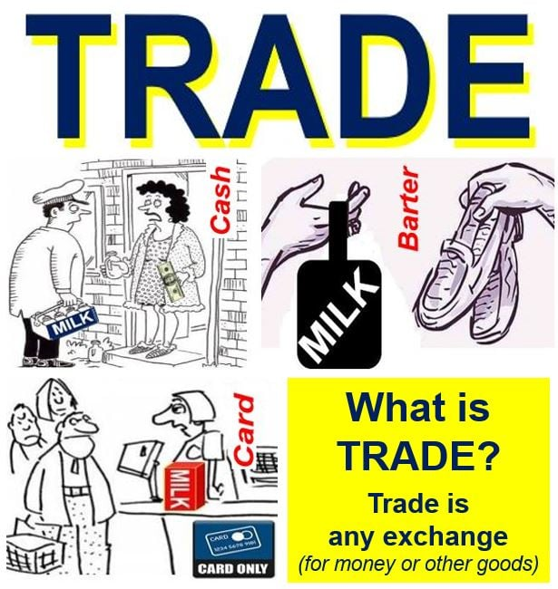
Session 5
International Business Environment
Source: Marketbusinessnews.com

Slide 9
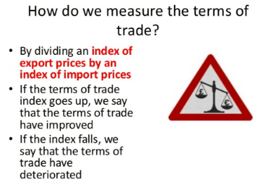
International Business Environment
International Trade
Trade refers to the voluntary exchange of goods or services between economic actors.
Since transactions are consensual, trade is generally considered to benefit both parties.
In finance, trading refers to purchasing and selling securities or other assets.
The comparative advantage theory states that trade benefits all parties.
Most classical economists advocate for free trade, but some development economists believe protectionism has some advantages.
Source: Momentumsclub.org

Slide 10
International Business Environment
International Trade - Deficits
In macroeconomics, trade usually refers to international trade, the system of exports and imports that connects the global economy. A product sold to the global market is an export, and a product bought from the global market is an import. Exports can account for a significant source of wealth for well-connected economies.
International trade results in increased efficiency and allows countries to benefit from foreign direct investment (FDI) by businesses in other countries. FDI can bring foreign currency and expertise into a country, raising local employment and skill levels. For investors, FDI offers company expansion and growth, eventually leading to higher revenues.
A trade deficit is a situation where a country spends more on aggregate imports from abroad than it earns from its aggregate exports. A trade deficit represents an outflow of domestic currency to foreign markets. This may also be referred to as a negative balance of trade (BOT).
Source: Momentumsclub.org

Slide 11
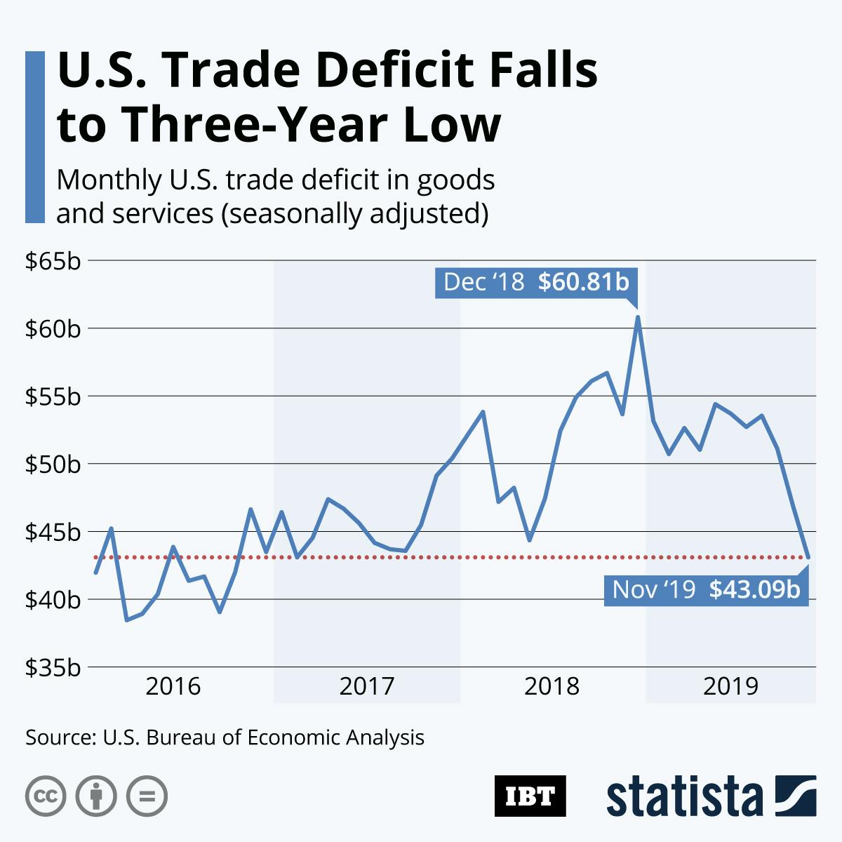
International Business Environment
International Trade – Balance of Trade
The main measuring tool of international trade is the Balance of Trade within the Country´s Balance of Payments, that register the overall flows of payments in an out of the country generally on annual basis.
The Balance of trade is a basic measure of the difference in value between a nation's exports and imports, including both goods and services. It could have positive or negative annual results, on a per country bilateral basis or on an overall consolidated view:
1. Trade surplus: Positive net flow that occurs when the total value of a nation's exports outcome is higher than the total value of its imports.
2. Trade deficit: Shortfall that occurs when the total value of a nation's imports is higher than the total value of its exports.

Slide 12
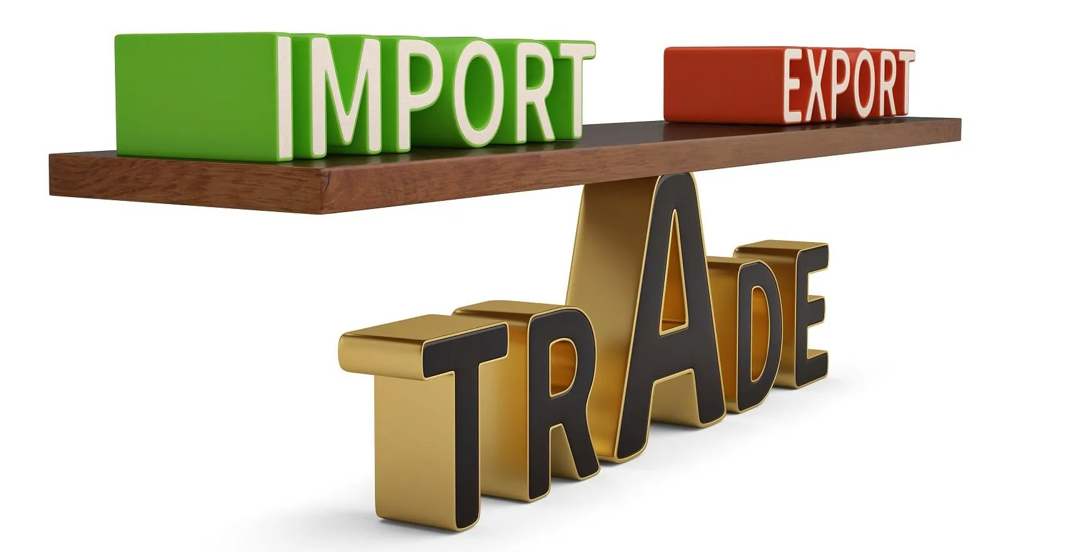
International Business Environment
International Trade
The balance of trade (BOT), also known as the trade balance, refers to the difference between the monetary value of a country’s imports and exports over a given time period. A positive trade balance indicates a trade surplus while a negative trade balance indicates a trade deficit. The BOT is an important component in determining a country’s current account.
The formula for calculating trade balance is as follows:
Balance of Trade Formula
Image Source: CFI

Slide 13
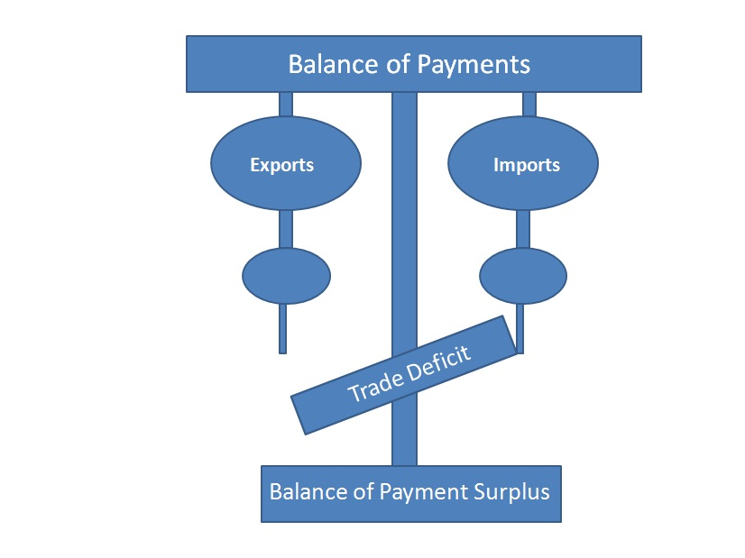
International Business Environment
International Trade
To the misconception of many, a positive or negative trade balance does not necessarily indicate a healthy or weak economy. Whether a positive or negative BOT is beneficial for an economy depends on the countries involved, the trade policy decisions, the duration of the positive or negative BOT, and the size of the trade imbalance, among other things.
In short, the BOT figure alone does not provide much of an indication regarding how well an economy is doing. Economists generally agree that neither trade surpluses or trade deficits are inherently “bad” or “good” for the economy.
A positive balance occurs when exports > imports, a trade surplus.
A negative trade balance occurs when exports < imports , a trade deficit.

Slide 14
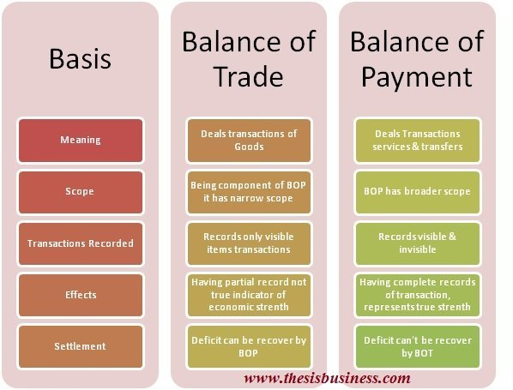
International Business
Relevant Trade Indicators

Slide 15
International Business
Relevant Trade Indicators
Gross Domestic Product (GDP)
The total value of the output of goods and services produced by an economy, by both residents and non-residents, regardless of the allocation to domestic and foreign claims. It is used to show the relative wealth of different countries and through yearly comparisons to show levels of economic growth.
Gross National Product (GNP)
The total domestic and foreign value added claimed by residents and therefore equals the GDP + net income from abroad (which is the income residents receive from abroad for services (labour and capital) less similar payments made to non-residents who contribute to the domestic economy).
Human Development Index (HDI)
A summary measure of human development. It measures a broader definition of wellbeing and provides a composite measure of three basic dimensions of human development: a long and healthy life, access to knowledge and a decent standard of living. Data availability determines HDI country coverage.
(Source: Human Development Report 2010. http://hdrstats.undp.org)

Slide 16
International Business
Relevant Trade Indicators
Inequality-adjusted Human Development Index (IHDI)
This measure adjusts the HDI for inequality in the distribution of each dimension across the population by 'discounting' each dimension's average value according to its level of inequality. The IHDI equals the HDI when there is no inequality across people but is less than the HDI as inequality rises. In this sense, the IHDI is the actual level of human development (accounting for this inequality), while the HDI can be viewed as an index of 'potential' human development (or the maximum level of HDI) that could be achieved if there was no inequality. The 'loss' in potential human development due to inequality is given by the difference between the HDI and the IHDI and can be expressed as a percentage. Adjusting HDI achievements to reflect disparities.
Human Poverty Index (HPI)
Introduced in the Human Development Report 1997, the HPI does not measure poverty by income. Instead, it uses indicators of the most basic dimensions of deprivation: a short life, lack of basic education, and lack of access to public and private resources. The HPI concentrates on the deprivation in the three essential elements of human life already reflected in the HDI: longevity, knowledge, and a decent standard of living.

Slide 17
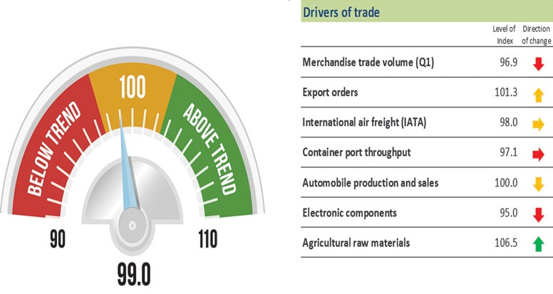
International Business
Relevant Trade Indicators - WTO
The WTO has launched a new World Trade Outlook Indicator (WTOI) designed to provide “real time” information on trends in global trade. Combining a variety of trade-related indices, the WTOI is designed to give an early signal of the current direction of world trade and where it is likely to go in the near future.
Image WTO
The WTOI should signal turning points in world merchandise trade volume. It complements existing tools as the WTO’s longer-term trade forecasts, and other statistical releases. The WTOI gives a headline figure to show performance against trend. A reading of 100 would indicate trade growth in line with recent trends, a reading greater than 100 would suggest above trend growth, while a reading below 100 indicates below trend growth. The WTOI will be updated on a quarterly basis.

Slide 18
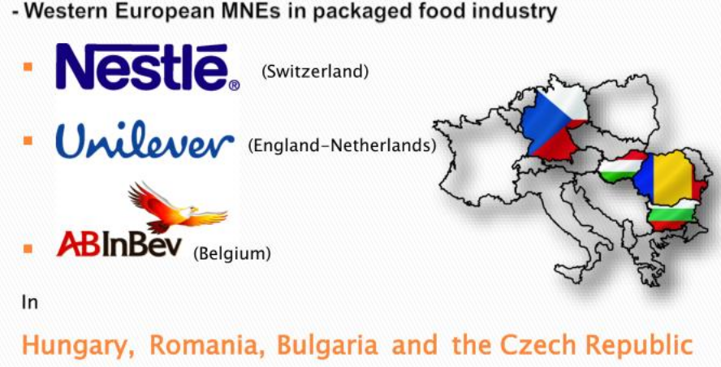
International Business
Impacts of International Business
Impacts of International Business Per Region and Continent on Local Businesses
Local industries and multinationals have always been competing for resources, supplies, labor, channel distributions, raw materials and customers, among many other factors. Modern industry reforms challenged local markets in many ways: technologies, soft skills, knowledge, etc. But local industries do have some advantages that they can exploit in this fight.
Companies in the raw material, food, manufacturing and cosmetic industries are facing maximum challenge due to customer preferences for globally traded brands. With the rising prices of energy and commodities, local industries always end up competing for basic local resources with multinationals.

Slide 19
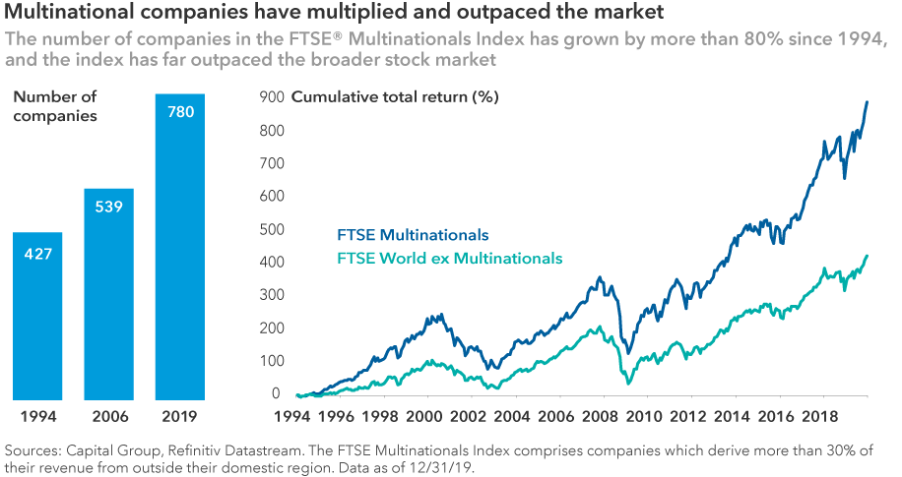
International Business
Impacts of International Business

Slide 20
International Business
Impacts of International Business
Better Economic Conditions
To encourage multinational companies to invest in their countries, governments sometimes offer incentives such as lower taxes and administrative support. They also might ease labor and environmental regulations. Local governments also develop infrastructure facilities such as transportation, roads, communication channels and utilities for the use of multinational companies, which results in the host country’s overall development. Local businesses often benefit from these easier regulations and advanced facilities.
Vertical Affiliation
To conduct operations more effectively, multinational companies partner with local companies for supplies. They also might use resident businesses to get their products to local consumers and employ local companies on contracts and rent out franchises, which results in growth for locals. Local businesses must develop advanced methods of conducting business. This might include using lean methods, providing better workplace conditions, hiring skilled staff and adopting marketing plans. Affiliation with international companies often put local companies in direct contact with better technology.

Slide 21
International Business
Impacts of International Business
Advanced Products
Multinational companies often bring better and more advanced products into local markets, and resident companies must match them to stay in business. This means that locals must adopt equivalent technologies and products. Because multinational companies have more resources at their disposal, they can explore new markets in the host country. These markets are usually untapped by local businesses, which often aim their operations at exporting their goods and services. Local businesses, therefore, can grow by entering the new markets that the multinational companies uncover.
Labor Force
Multinational companies often create more products and receive more revenues. Therefore, they can offer better wages and invest in highly skilled workers. This can be disadvantageous to local companies because they have to match the better wage scale to prevent employee turnover in their own operations. The flip side to this scenario is that multinational companies often train their employees and make better technical skills available to them. When these employees leave the multinational company, they might take their skills and experiences to local companies.

Slide 22
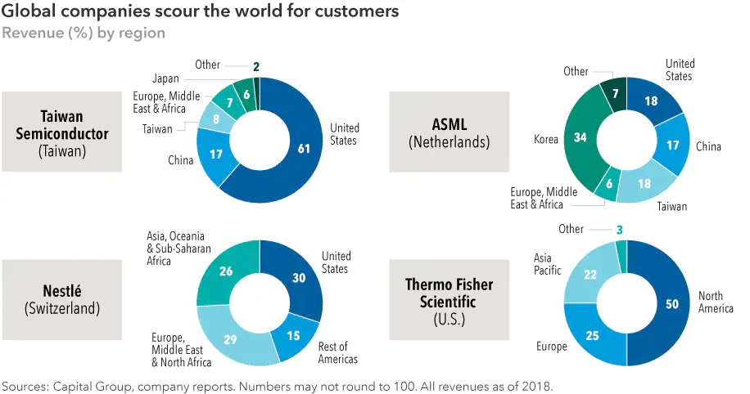
International Business
Impacts of International Business

Slide 23
International Business
Impacts of International Business
Downside
When governments create support systems for multinational companies, they don’t always extend the same privileges to local businesses. This gives the multinational companies an advantage. Also, multinational companies often edge local businesses out of the market because the multinationals frequently sell better products, and these products are often cheaper than those at local competitors.
Because of the direct investment they bring into the country, multinational companies exert influence on governments to adapt policies that are suitable to multinational companies. These policies aren't always advantageous to local businesses.

Slide 24
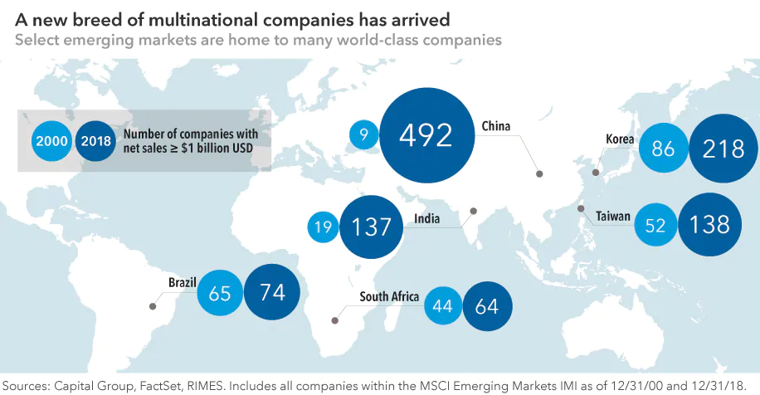
International Business
Impacts of International Business

Slide 25
Thank You

