Slide 1
Instagram for Business
Building a Successful Account

Slide 2
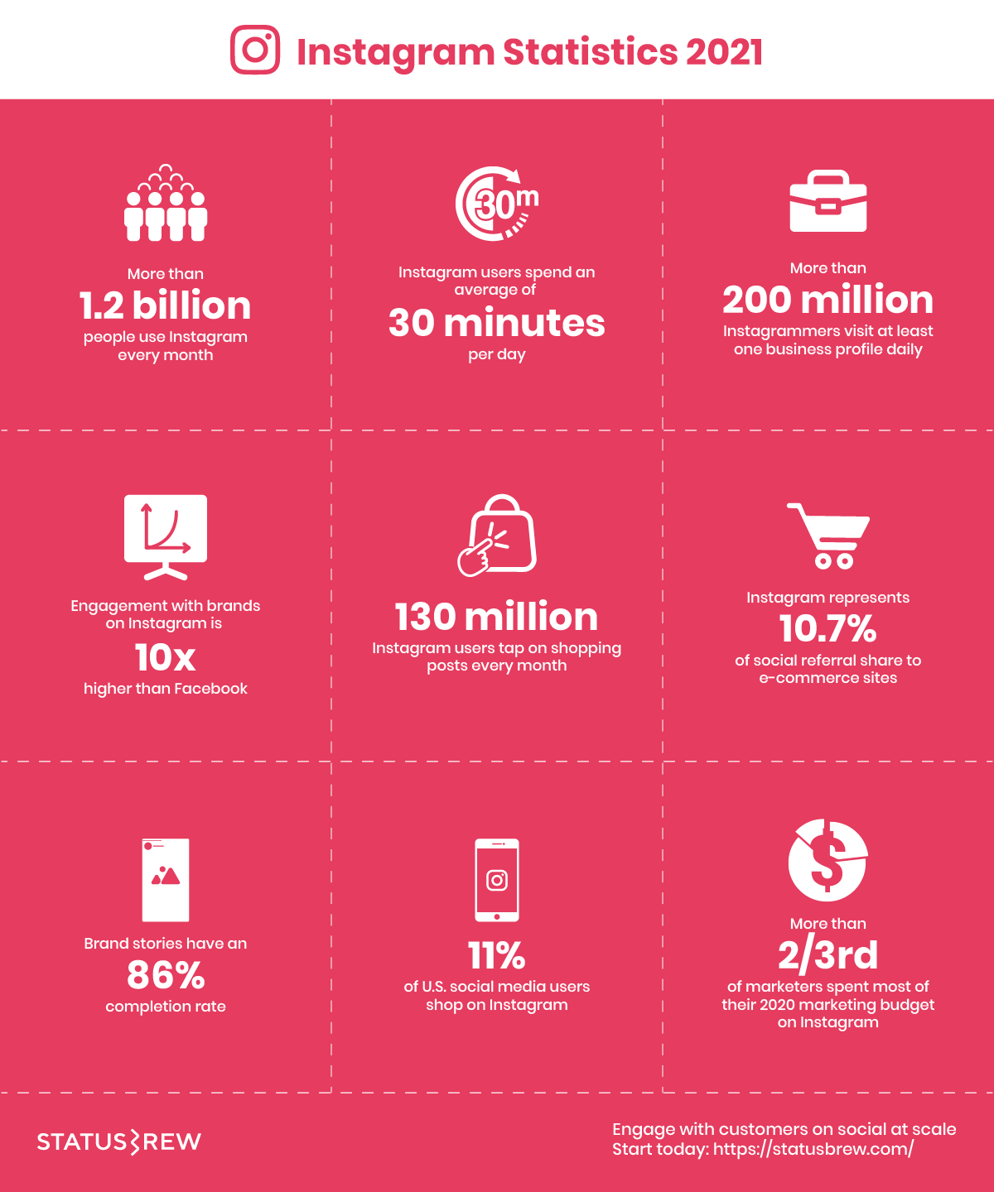

Slide 3
Why use Instagram?
As the popularity of photo and video sharing apps continues to rise, more and more businesses and marketers are using Instagram.
Define your Instagram Goals
To become known?
To get more engagement?
To drive more sales?
To become Influencers?
Or maybe just increasing the number of followers?

Slide 4
Accounts of all sizes are getting fewer likes, comments, and followers than they did in the past. And it all has to do with Instagram’s algorithm.

Slide 5
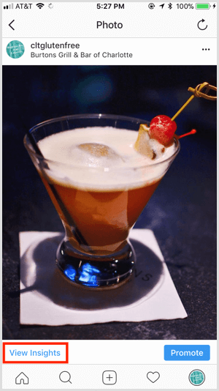
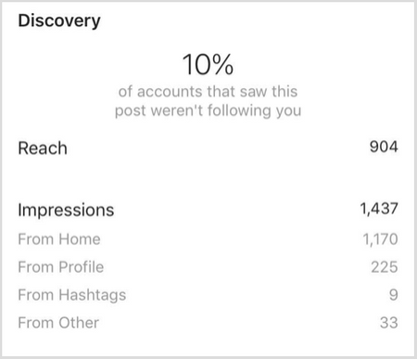
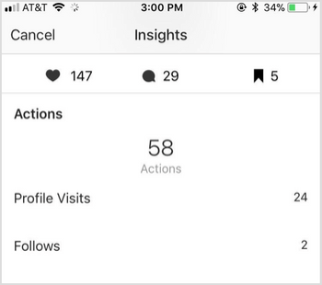
Instagram Insights - For Business Profiles
Post Insights

Slide 6
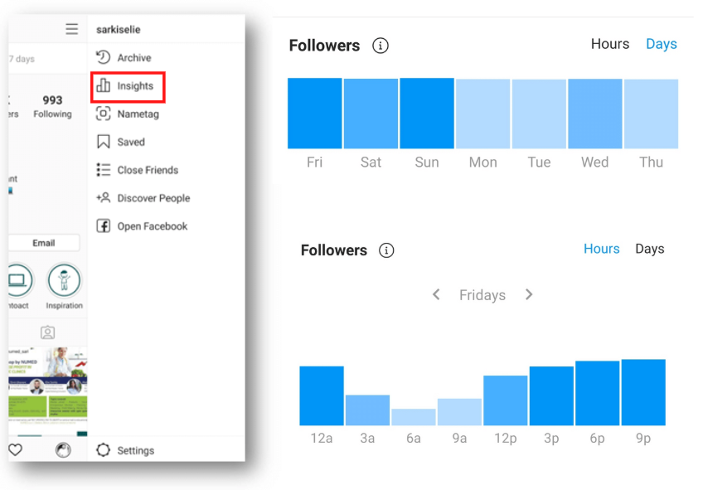
How does the Instagram Algorithm work?
Interests: Instagram predicts how much you will like a post based on your behavior on the platform.
Posting time: The latest update in Instagram algorithm prioritizes recent posts.

Slide 7
How does the Instagram Algorithm work?
Frequency of opening Instagram app:
The more you open the app, the more you will see recent posts in your feeds, listed in their chronological order, as Instagram will show you "the best posts since the time of your last visit".
The number of followers that you have:
If you follow a lot of people, then you will probably not see all the posts of the accounts that you follow, because Instagram has more options to choose from.

Slide 8
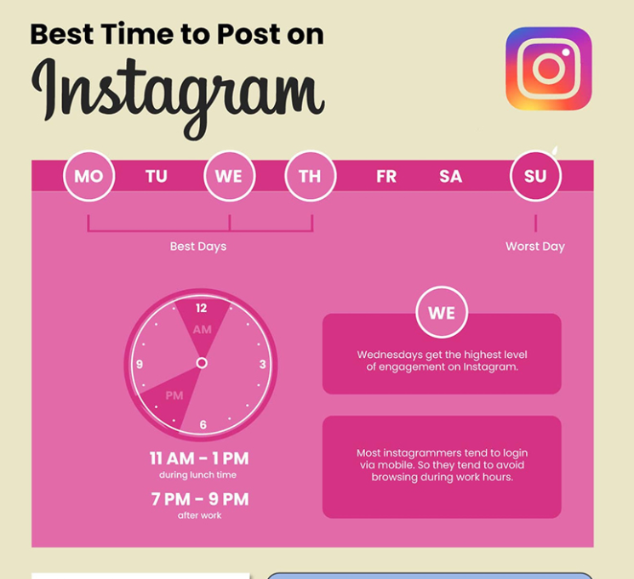
Best time to Post
on Instagram

Slide 9
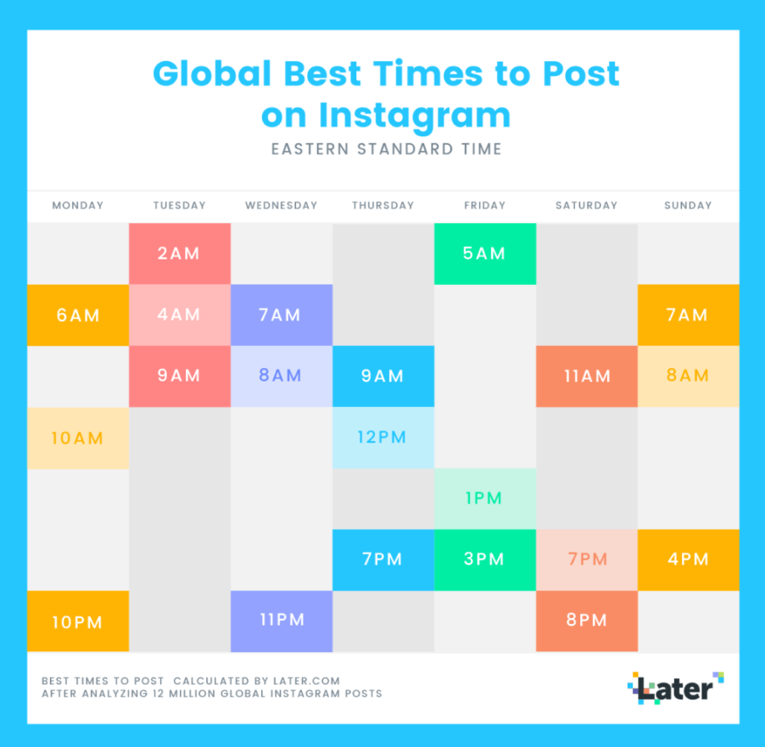
Best time to Post
on Instagram
Per Hour

Slide 10
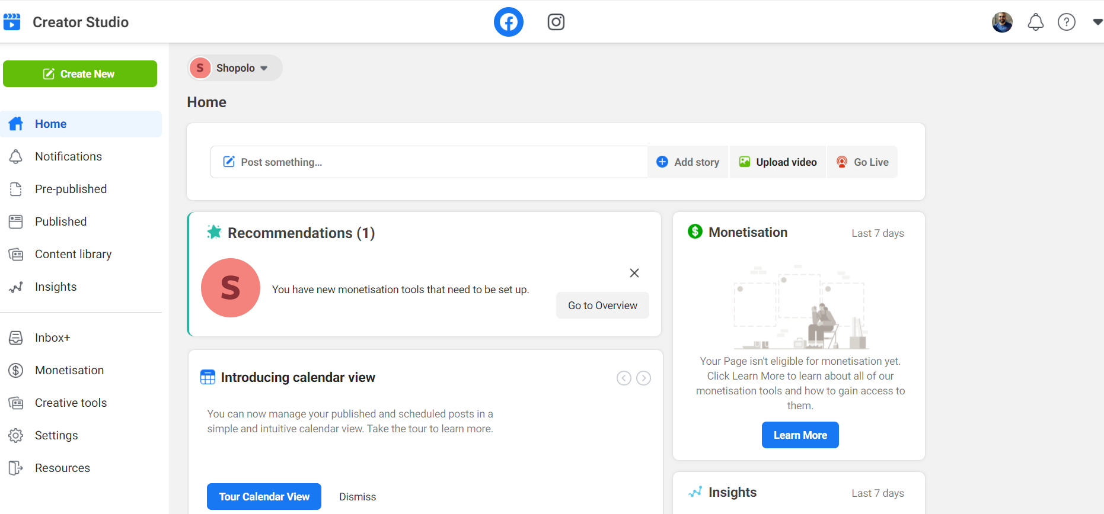
Schedule Content
Business Suite
You can schedule Stories and reels too.
Post from Desktop

Slide 11
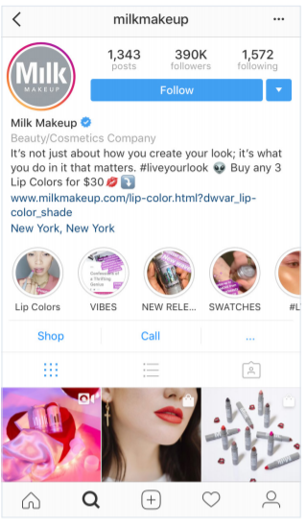
While personal profiles are all about the basics, Instagram business profile has many advanced features, like Instagram Insights, promoted posts, and a “Contact” button, which makes it much easier to connect with your followers.

Slide 12
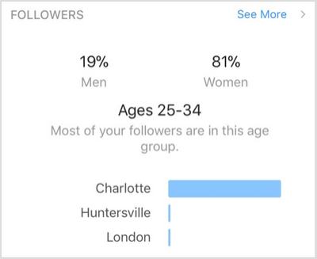
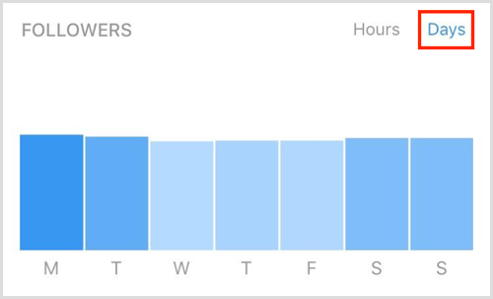
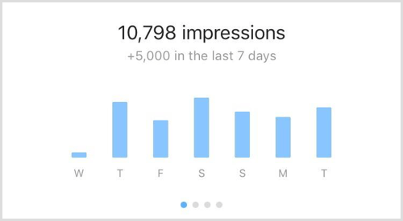
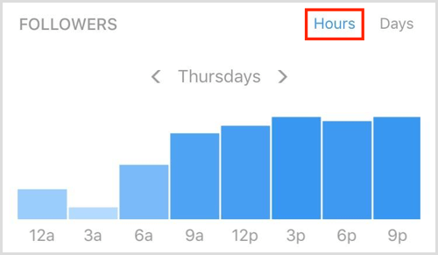
Instagram Insights - For Business Profiles
Profile Insights

Slide 13
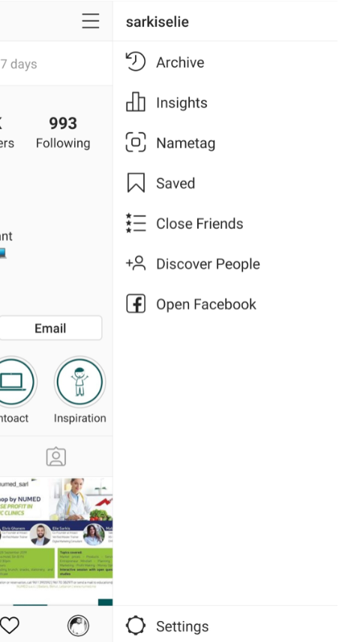
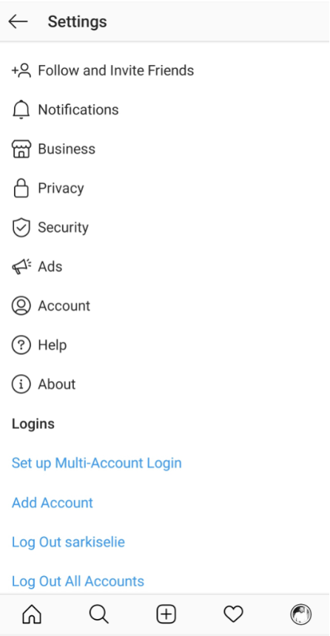
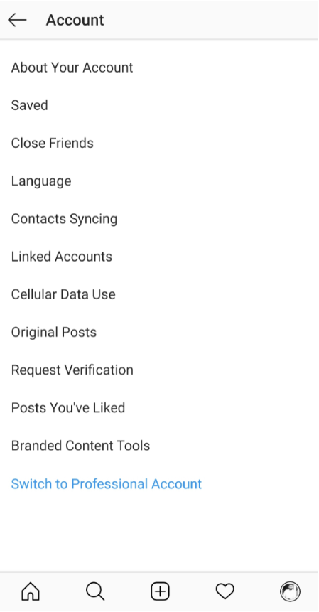
Switch to Business Account

Slide 14
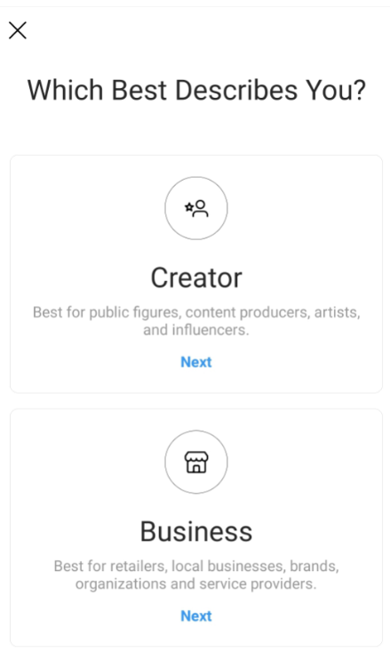
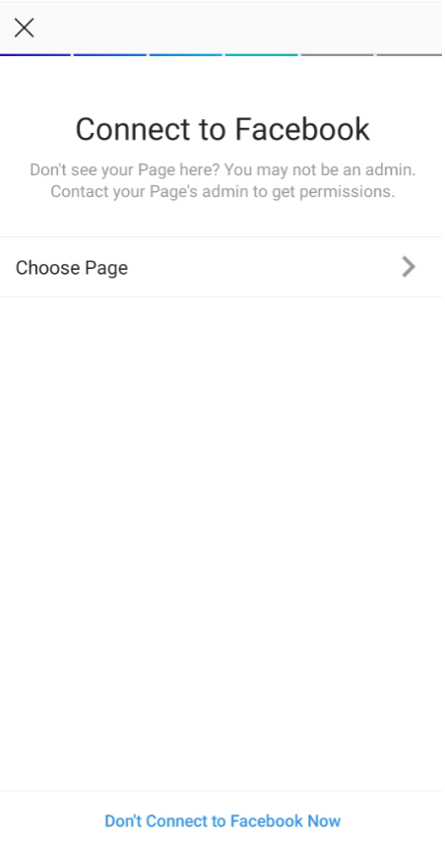
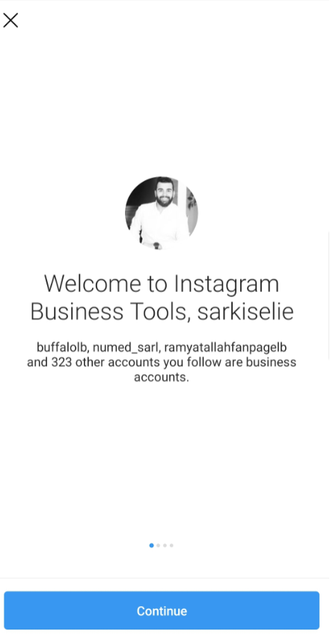

Slide 15
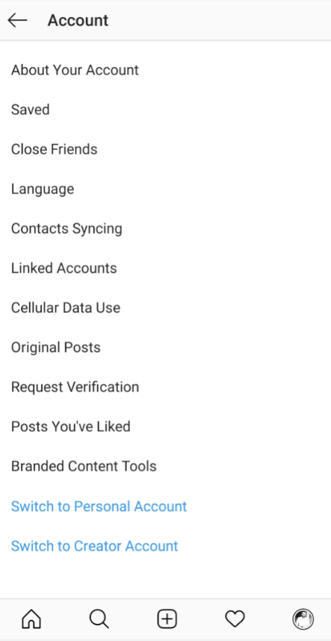
Switch Back to Personal Account

Slide 16
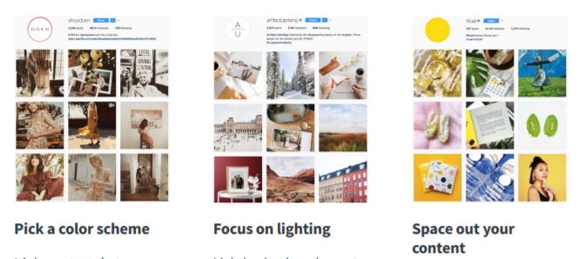
Optimize your Business Profile

Slide 17
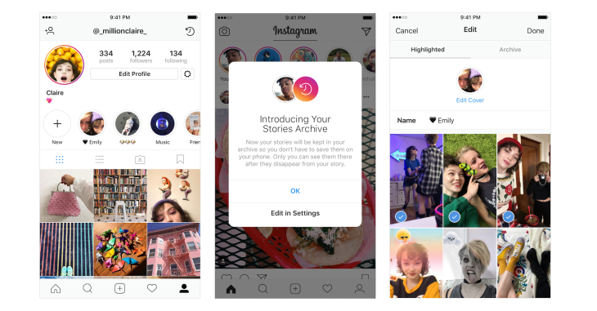
Instagram Stories Highlights
Select stories to be featured in the Highlights where they will be shown until removed manually.
You can use Highlights to:
Create trailers for your account. Show off your customers.
Showcase product features.
Directly address new followers with a pitch about your content and account.
Advertise a sale.

Slide 18
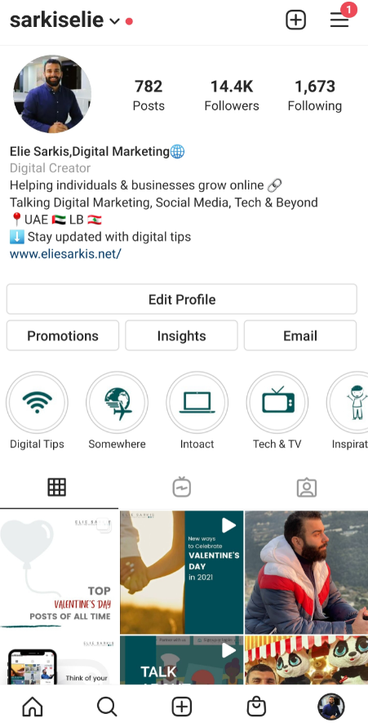
Instagram Stories Highlights – Design

Slide 19
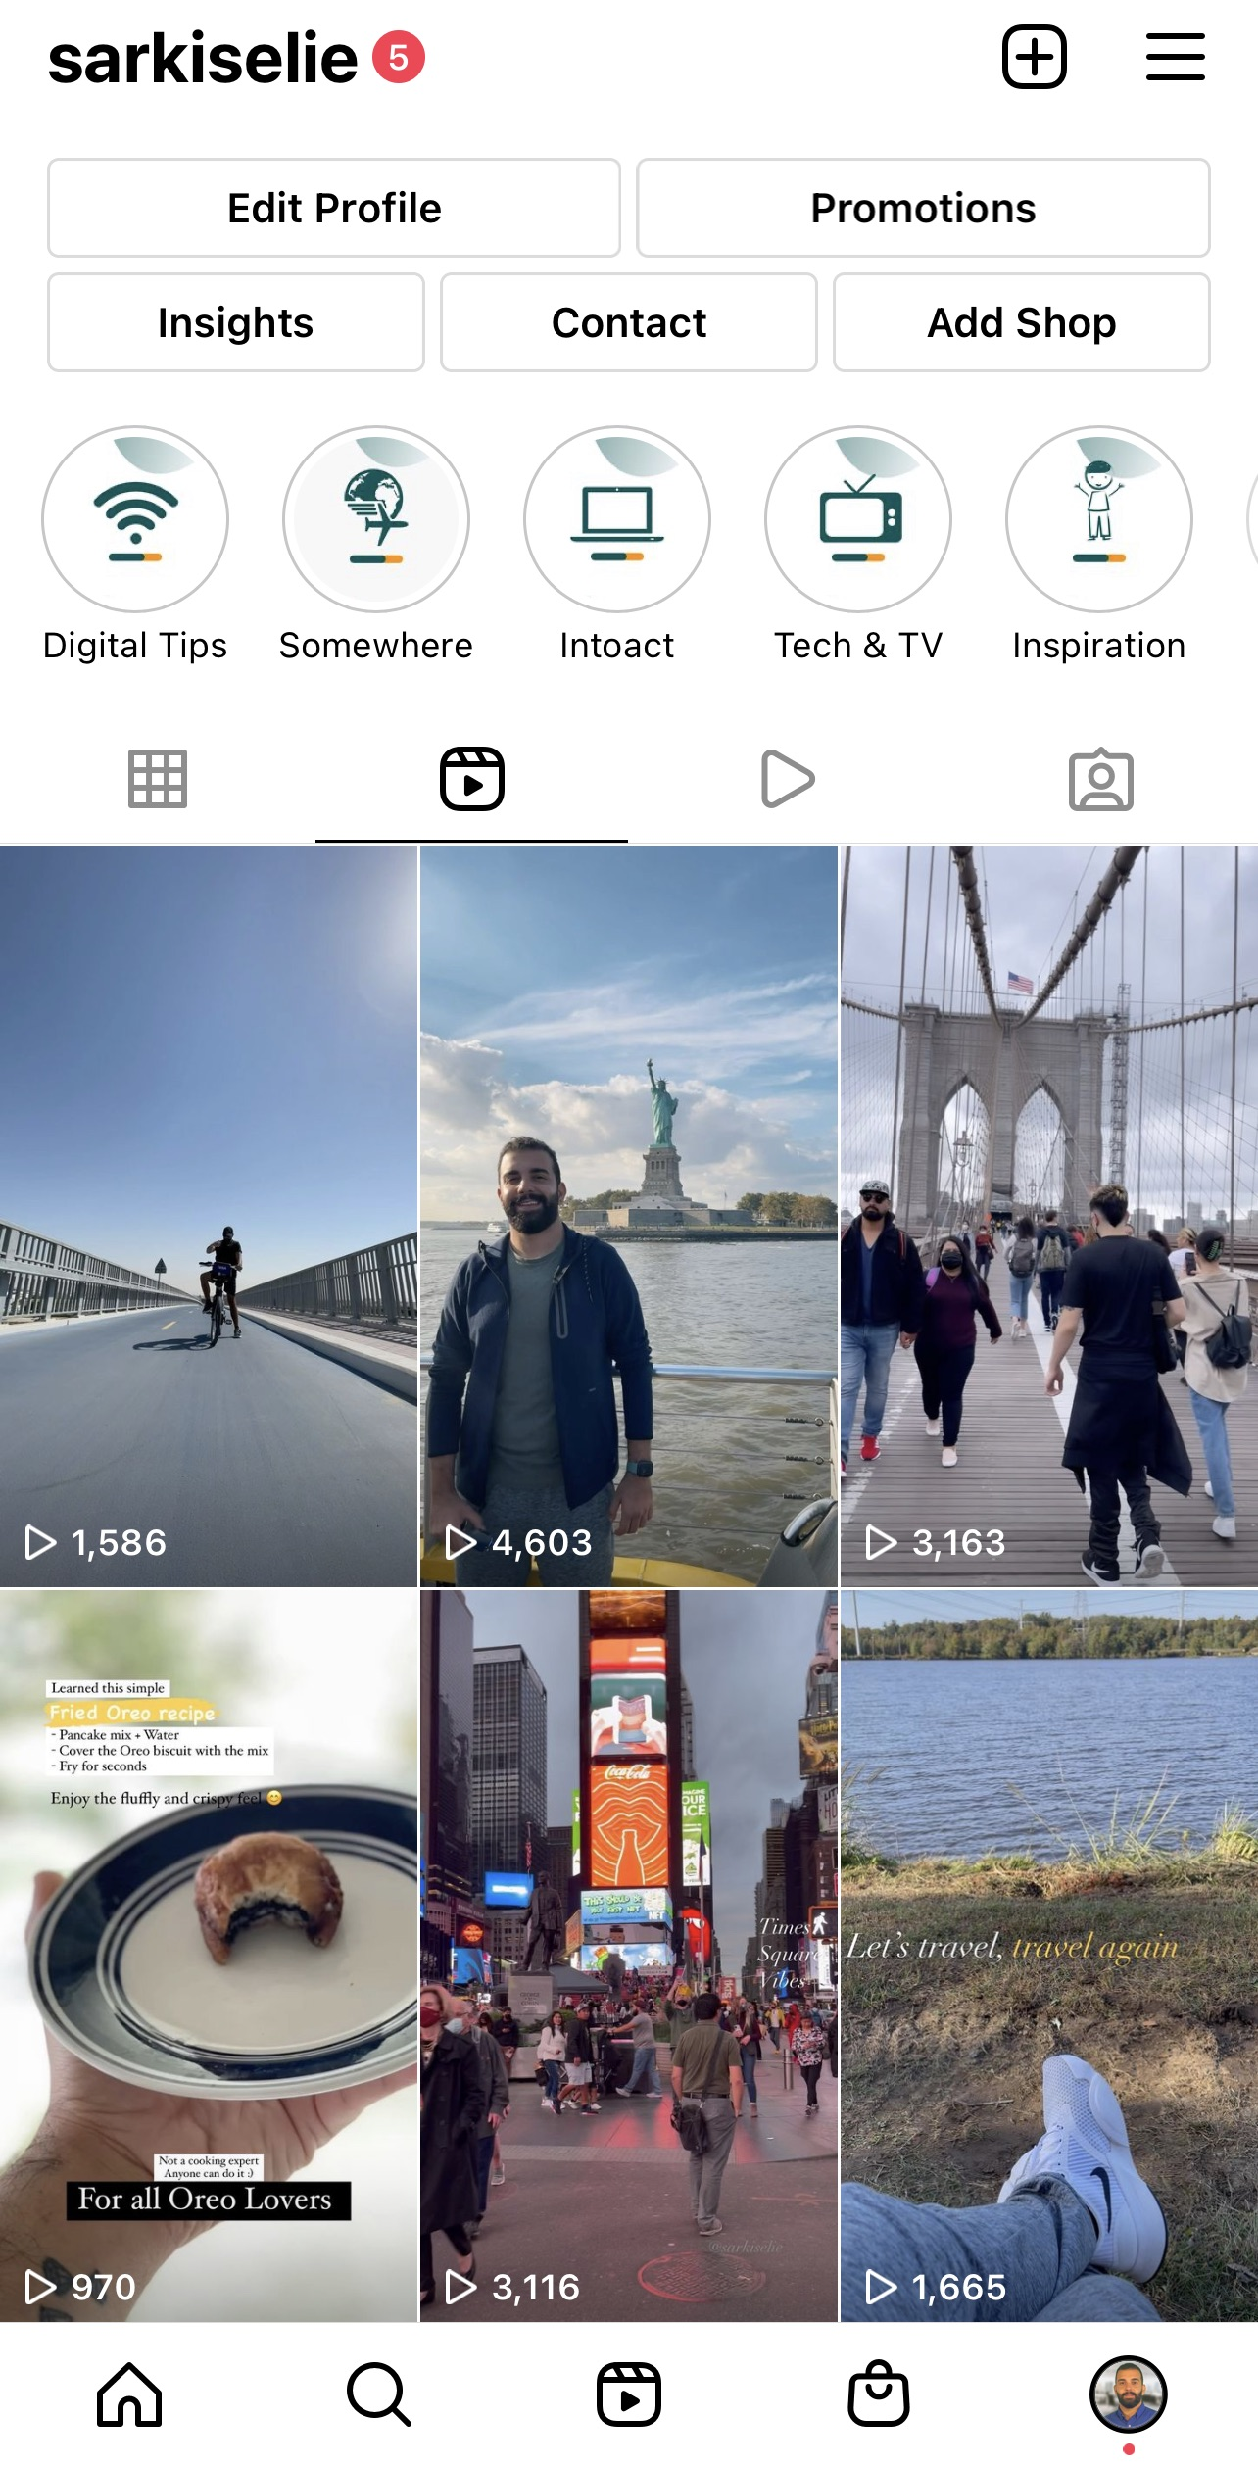
Instagram Reels
Showcase new products
Answer common questions
Provide helpful tips
Suggest use cases
Collaborate with influencers
Post behind-the-scenes videos
Share exclusive deals/sales
Tease upcoming events
Get into the trends

Slide 21
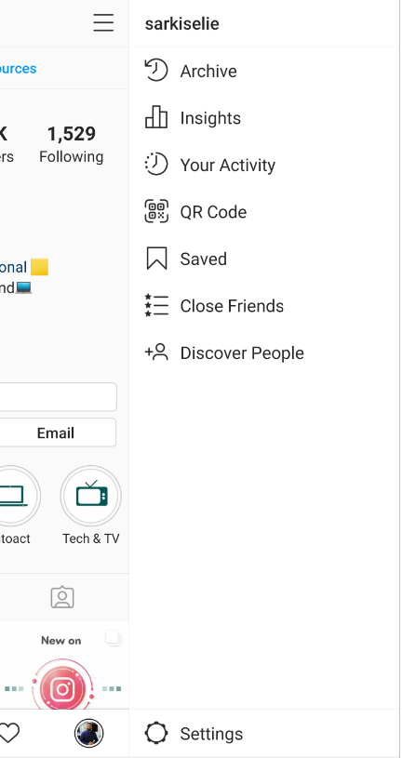
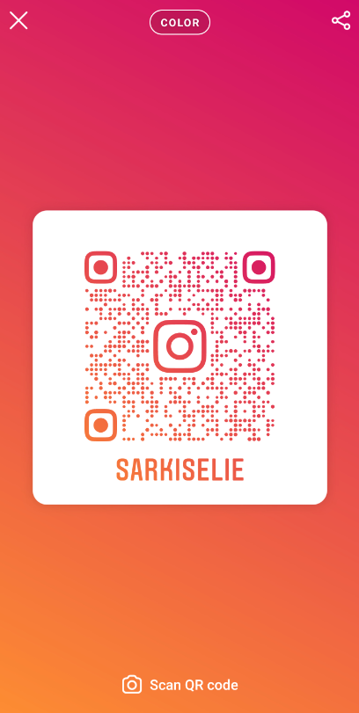
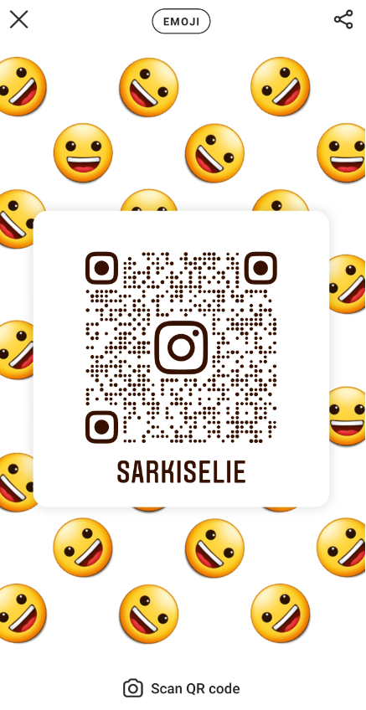
QR Code
People can scan it to instantly go to your Instagram page and follow you.

Slide 22
Where to Use it?
On your website:
Add the name tag on your About page
On your blog (like in the sidebar, or bottom of your blog page)
On your “Contact us” page
Outside of your website:
Email signature
Your PDF freebies
In your YouTube videos
Pin it on Pinterest
If you have a physical shop:
On your storefront window
On the tags of your products
Product delivery box
At your counter
On the dining tables (as a fun flyer that people can scan straight away)

Slide 23
Instagram Verification

Slide 24
Additional Criteria Considered for Instagram Verification
Authentic. Your account must be a real person, business, or entity.
Unique. Instagram typically doesn’t verify general interest or repost accounts. The content being created and posted must be your own.
Public and Complete. Instagram requires every verified account to be public and have a completely filled out bio. This includes having a profile picture and posts uploaded to your account.
No Cross-promotion. Your account cannot have “add me” links that tell users to follow you on other social platforms. Your link should only be used to direct traffic to your website, store, landing page, etc.
Notable. While verification was typically reserved for celebrities before, Instagram is now considering accounts that have been featured in multiple well-known news sources. (Paid or promotional content are deemed invalid).

Slide 25
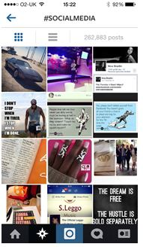
Use Relevant Hashtags
Hashtags make it easier for users to search for specific content on a variety of platforms. Another way to get your content noticed.
Readers tend to search trends, subjects and locations.
Hashtag Recommendations:
Local businesses: hashtag your city (#Spain, #Barcelona, #NewYork, #Dubai)
Products and services: hashtag your niche type (#Makeup, #Shoes, #Dentist, #Mobiles, #Smartphones)
Experts and websites: hashtag your industry (#Marketing, #Travel, #Fitness)

Slide 26
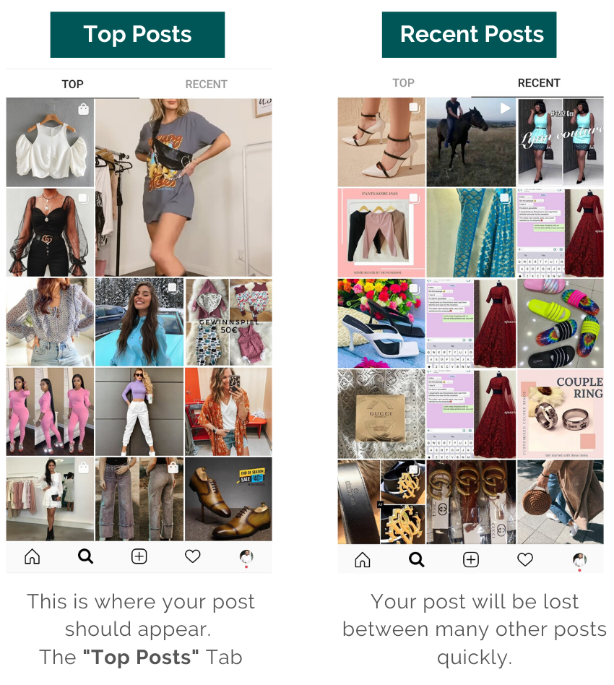

Slide 28
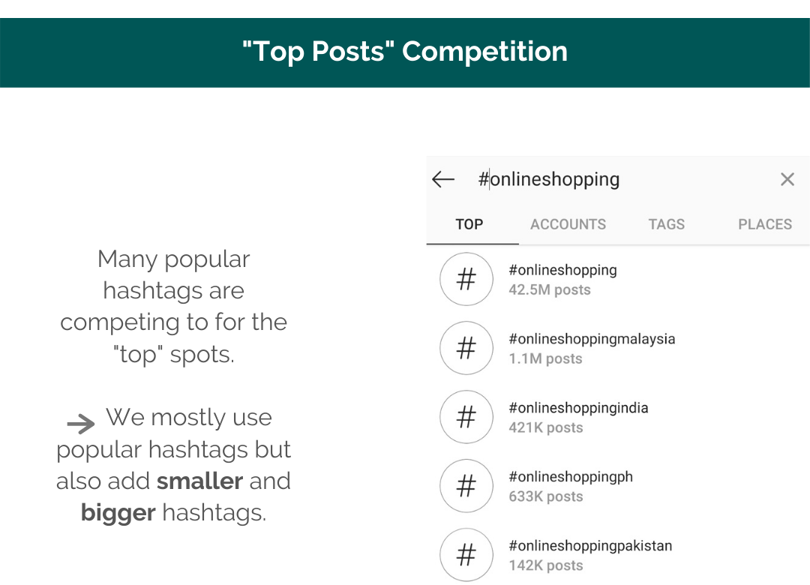

Slide 30
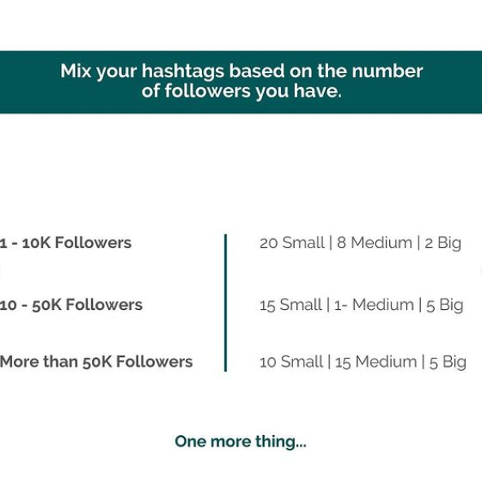

Slide 31
Thank You!

