Slide 1
Facebook
and Instagram Ads | Part 3
Remarketing

Slide 2
Remarketing
on Facebook and Instagram

Slide 3
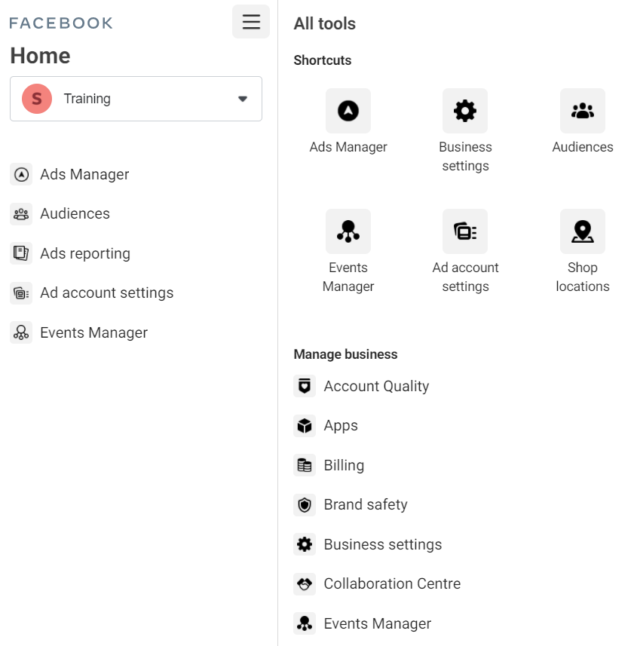
Create Custom Audiences and Lookalikes
From your Business Manager, go to Menu – Audiences
Click on Create Audience

Slide 4
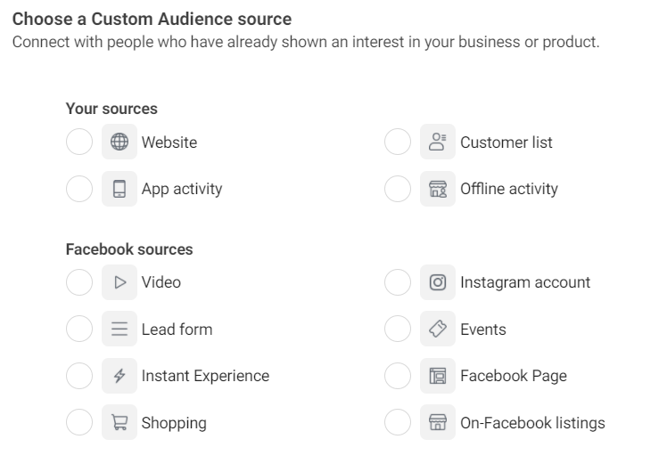
Types of Custom
Audiences

Slide 5
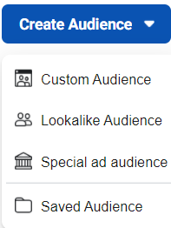
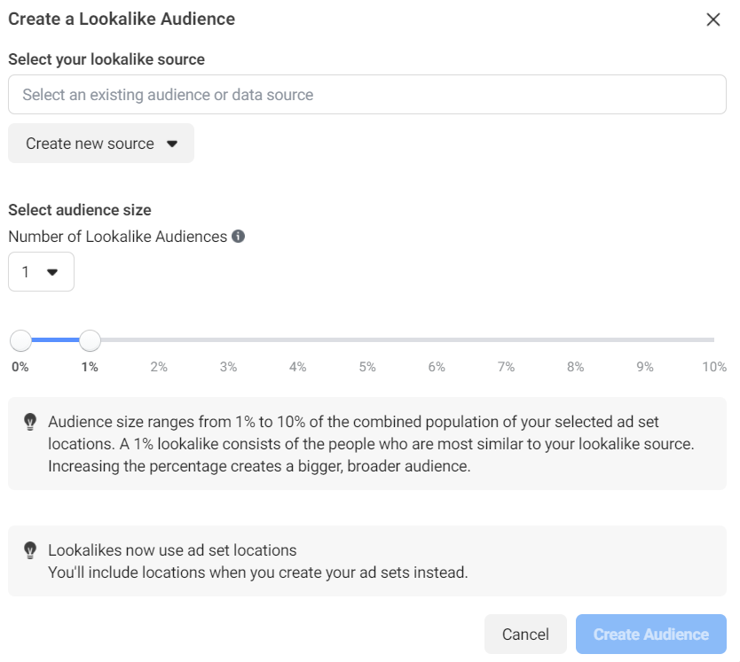
Lookalike Audiences
People similar to your Custom Audience

Slide 6
Ads Tips to Remember
Retarget people who put a product in their cart but never checked out.
Exclude from your targeting, users who are already your customers, whenever needed.
Create a Lookalike audience of users very similar to your customers.
Promote your mobile app to your website’s users and vice versa.

Slide 7
Additional Features and Tips

Slide 8
Frequency

Slide 9
Facebook Ad Fatigue Optimization

Slide 10
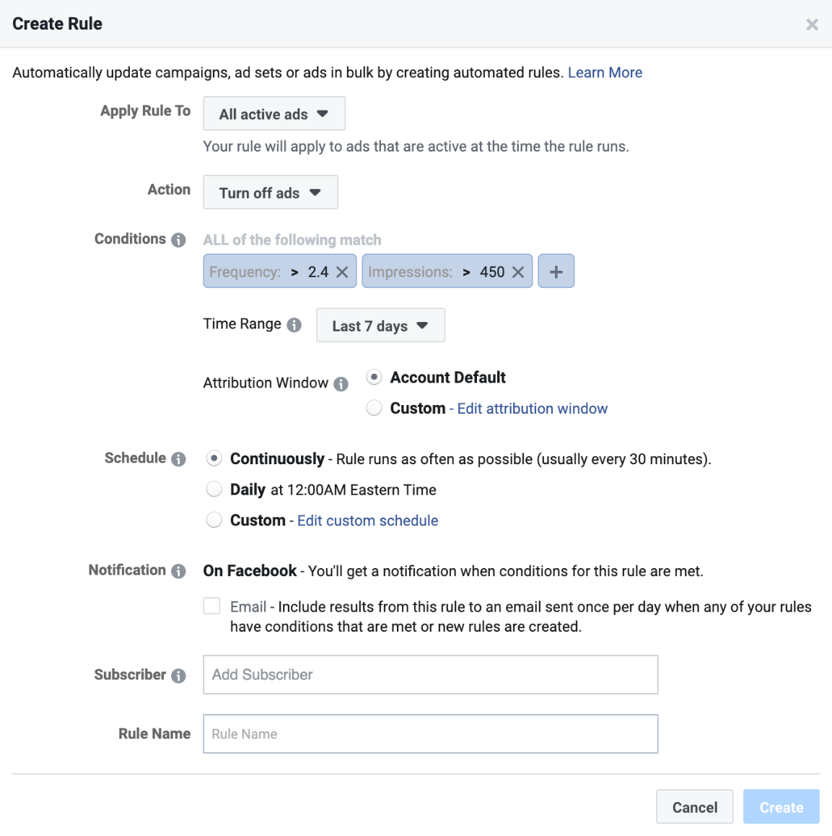
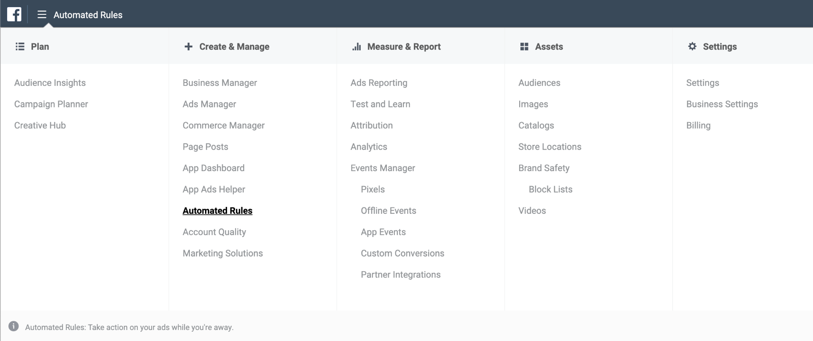
1. Automatically Pause Ads with High Frequency

Slide 11
2. Create New Audiences and Ads
Update ad creatives in a quick way
Change image background color
Change CTAs
Change text and/or headlines
Use new images/videos
Test new audiences
Create lookalikes based on your key conversion metrics (purchase, time spent, engagement, etc.)
Create audiences based on behavior
Create lookalikes from by uploading customers or syncing your CRM

Slide 12
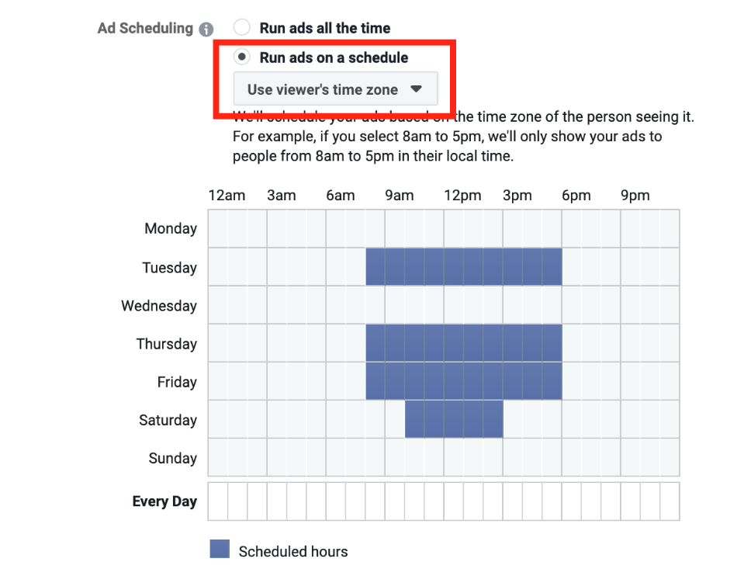
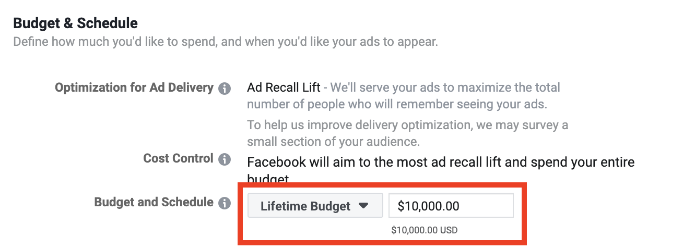
3. Limit Ad Deliverability by Running Ads on a Schedule (Dayparting)

Slide 13
Facebook Custom Conversions
Track conversion events inside Facebook ads.
Learn what campaigns, ad sets, and ads are generating conversions and how many.
Optionally exclude users who have already converted from your audiences.
Create lookalike audiences of similar users as those who have already converted.
To make custom conversions work, all you’ll need to have is a page where your customers end up after they convert, such as a thank you page or a confirmation page.

Slide 14
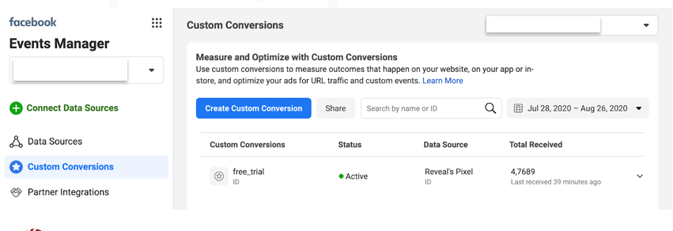
Conversions Setup
Once you set up your Facebook pixel, you can access the custom conversions by going to your Ad manager and selecting the Events Manager option from the main menu in the top-left.
Once you’ve installed the Pixel, click on Custom Conversions in the left sidebar.

Slide 15
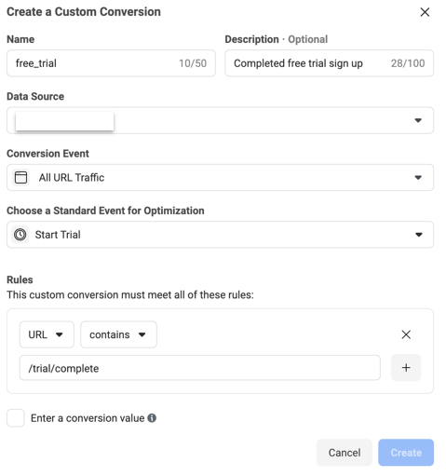
Conversions Setup
Inside the Custom Conversions section of the Events Manager, click on Custom Conversions in the left menu.
Next, click the blue Create Custom Conversion button.

Slide 16
Manage your Ads from Mobile

Slide 17
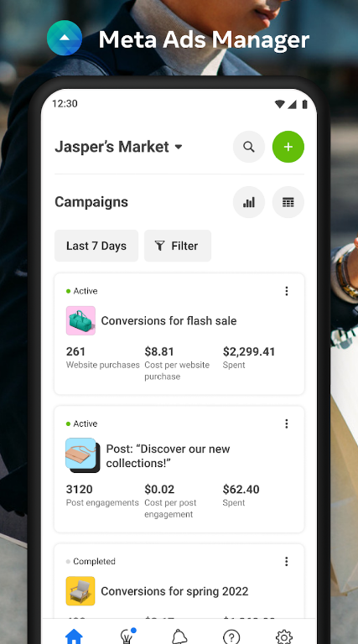
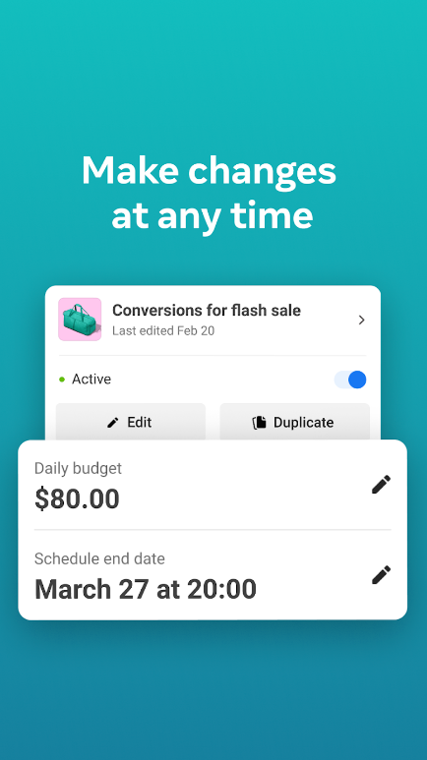
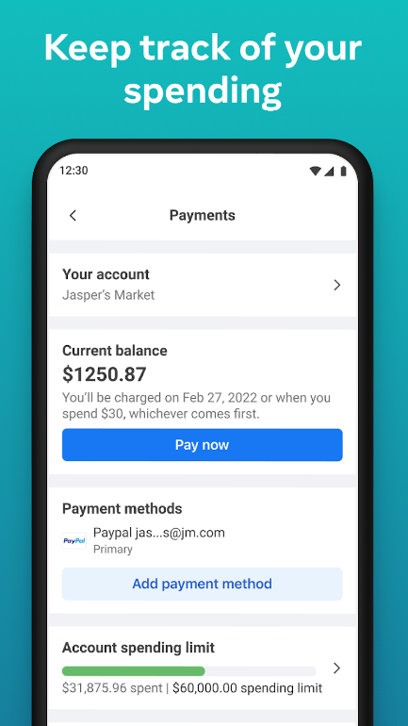

Slide 18
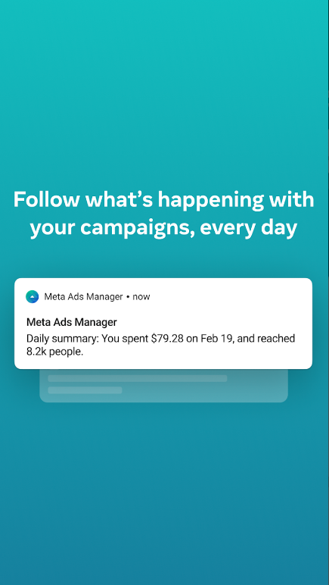
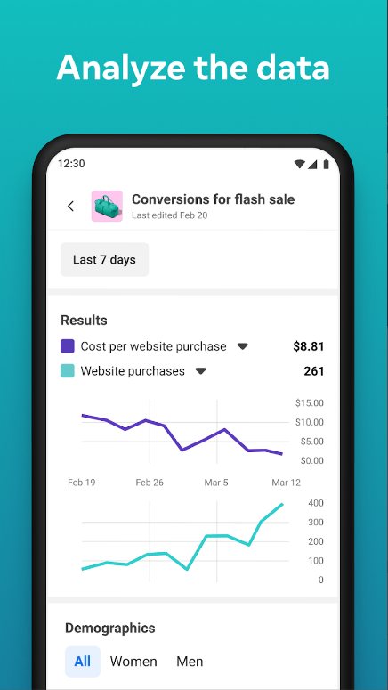
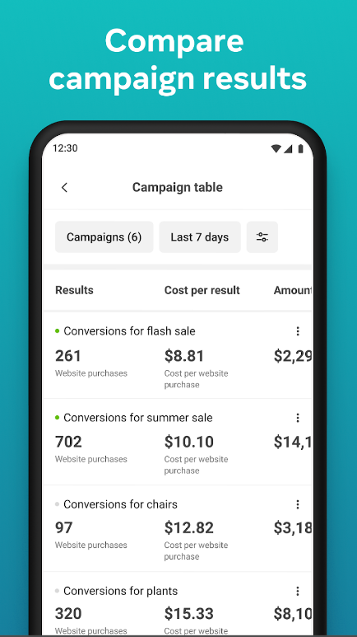

Slide 19
Thank You!

