Slide 1
Facebook
and Instagram Ads | Part 2

Slide 2
Creating and Optimizing the Ads
We continue with the Ad Sets and Ads

Slide 3
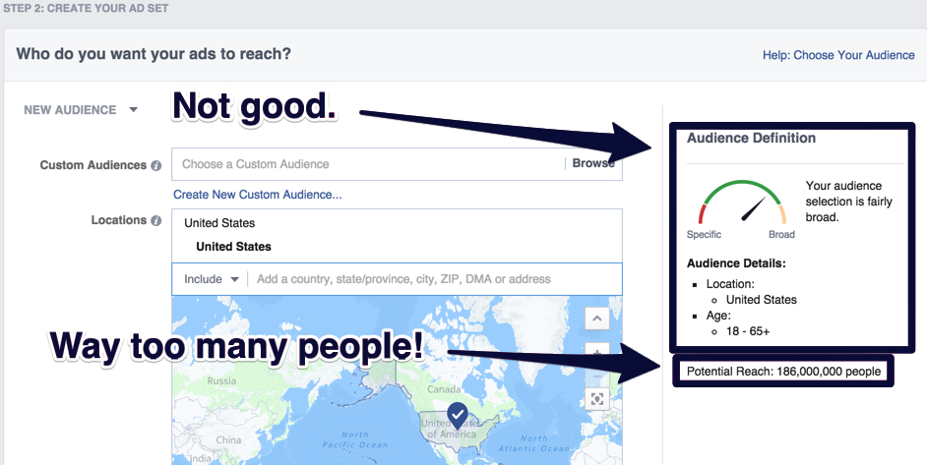
Create an Ad Set
The narrower your audience, the better.
Do not shoot for millions in the beginning. You can always expand later. Knowing your target audience demographics is key.

Slide 4
Country
Huge price and performance differences. Never mix in same Ad Set.
Custom Audiences
Best targeting right now. Require a database of emails or phone numbers. Great for B2B, startups or any business with a good database and wants to reach a defined audience.
Interests
Used to be the best option. Less effective due to spam and like-buying. Still relevant.

Slide 5
Gender
Depending on the market, targeting just men or women can make a huge difference.
Behaviors
Many interesting options. Purchase behaviors is remarkably useful for ecommerce.
Connections
Effective depending on the quality of your page’s fans. Good for generating likes and engagement.

Slide 6
Ad Bidding Types

Slide 7
This auction system is designed to balance the needs of advertisers with the needs of Facebook’s users by allowing advertisers to make money and serving relevant content to users.

Slide 8
3 Factors that Influence the
Ad Delivery

Slide 9
Your bid – This is the maximum amount that you will potentially pay to win a bid. Facebook’s system is designed to allow you to pay the lowest possible amount that still wins you the bid.
Relevance score – Your ad’s relevance score is determined by taking into account all the positive interactions that users have with your ad such as liking, commenting, or clicking on it versus all the negative interactions such as hiding the ad or ignoring it. Your ad’s relevance score is very important to Facebook. Having a high relevance score means that your ad will help people spend more time on Facebook.
Estimated action rates – A behind-the-scenes aspect of Facebook’s ad delivery algorithm. If the algorithm estimates that your ad will receive a high number of actions, it will give your ad priority against other ads.

Slide 10
Ad Delivery Optimization

Slide 11
Facebook also allows you to choose an objective for ad delivery optimization.
Conversions – This is the default option. When using the Conversions objective, Facebook will try to deliver your ads to users who are the most likely to convert.
Link clicks – This option will make Facebook optimize your ads to get as many clicks from users as possible.
Impressions – If you use the Impressions objective, Facebook will try to show your ad to as many users as possible.
Daily unique reach – This option allows you to deliver your ads to every member of your audience once per day. This is a great option if you’re offering a limited offer to a small remarketing audience.

Slide 12
Post engagement – The Post Engagement optimization delivers your ads to users who are most likely to interact with your ads by liking, sharing, or commenting.
Brand awareness – Designed to deliver ads to people who are most likely to pay attention to them.
Leads – Allows you to show your ads to people who are most likely to give out their information (e.g. their email address).
Landing page views – Designed to show you ads to people who are most likely to view your landing page.

Slide 13
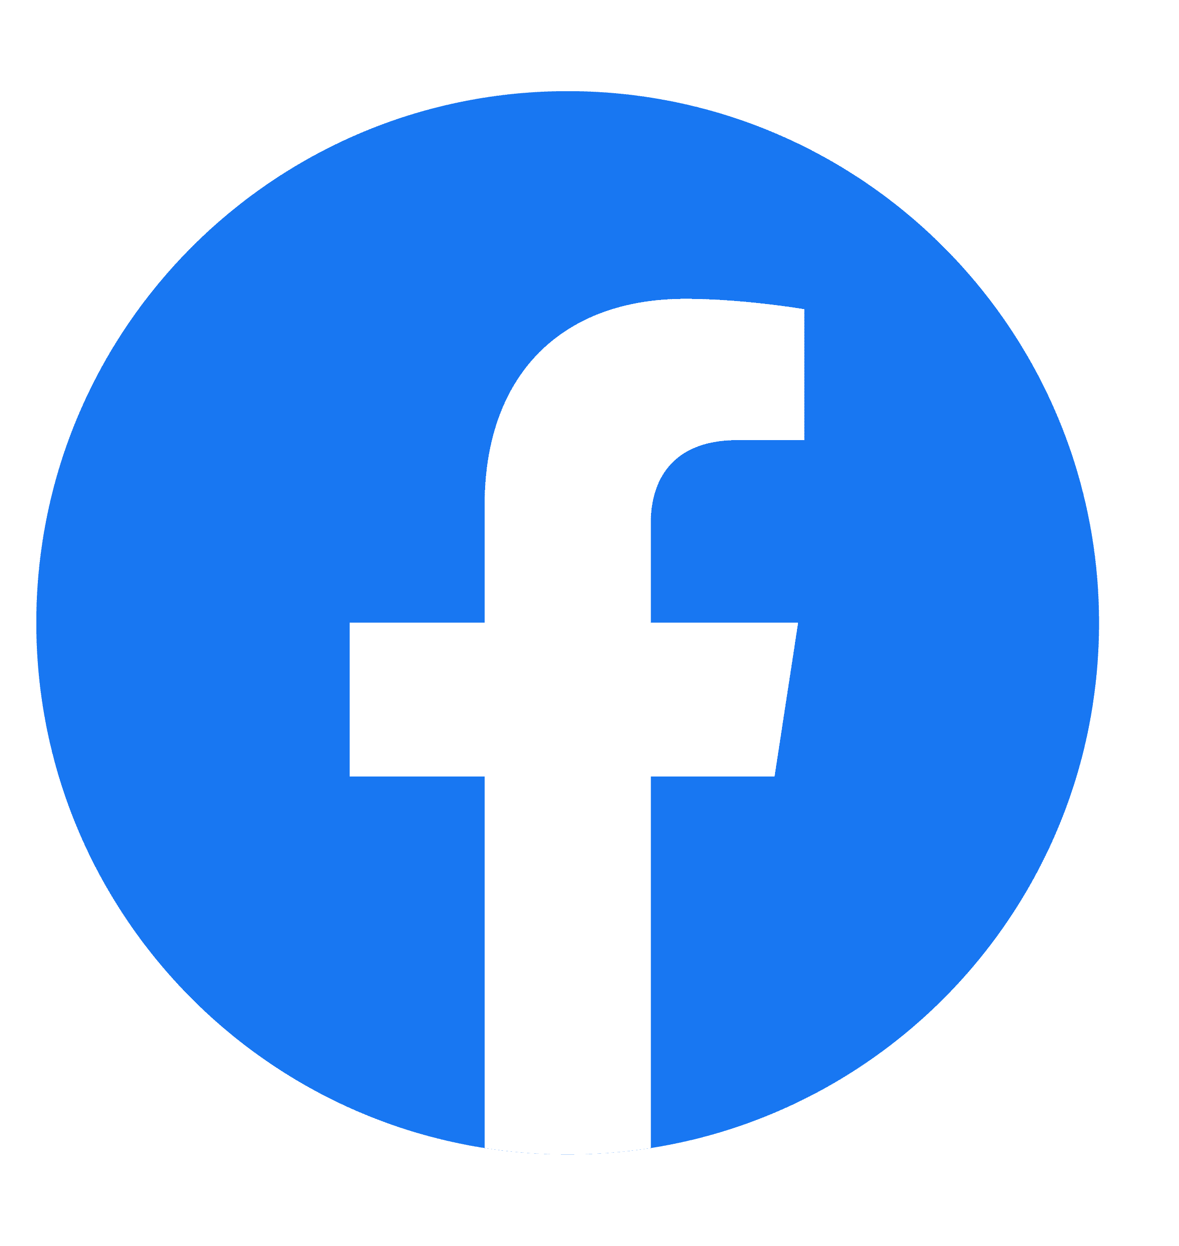
Additional Features and Tips

Slide 14
Frequency

Slide 15
Facebook Ad Fatigue Optimization

Slide 16
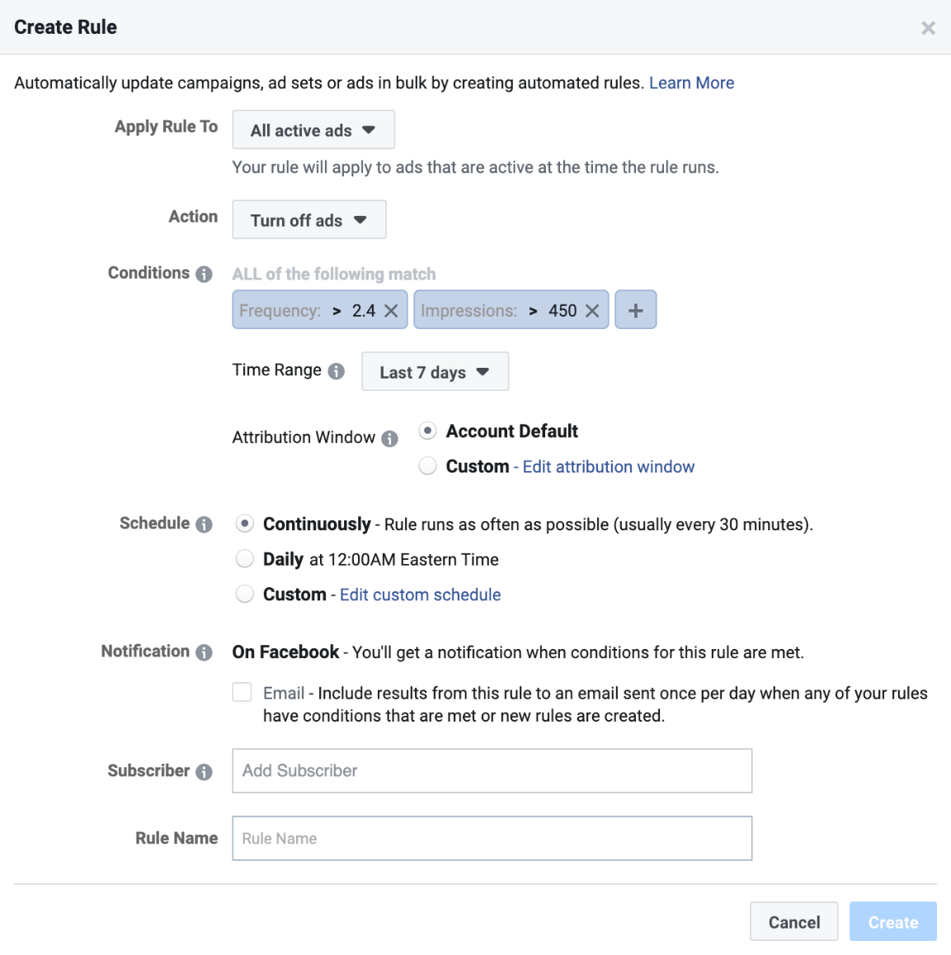
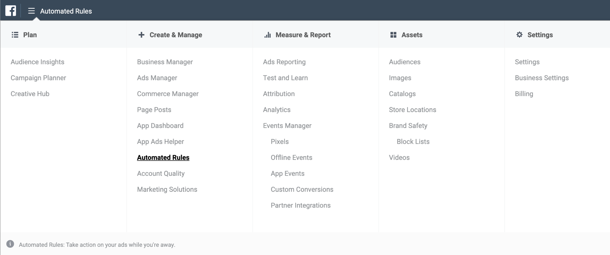
1. Automatically Pause Ads with High Frequency

Slide 17
2. Create New Audiences and Ads
Update ad creatives in a quick way
Change image background color
Change CTAs
Change text and/or headlines
Use new images/videos
Test new audiences
Create lookalikes based on your key conversion metrics (purchase, time spent, engagement, etc.)
Create audiences based on behavior
Create lookalikes from by uploading customers or syncing your CRM

Slide 18
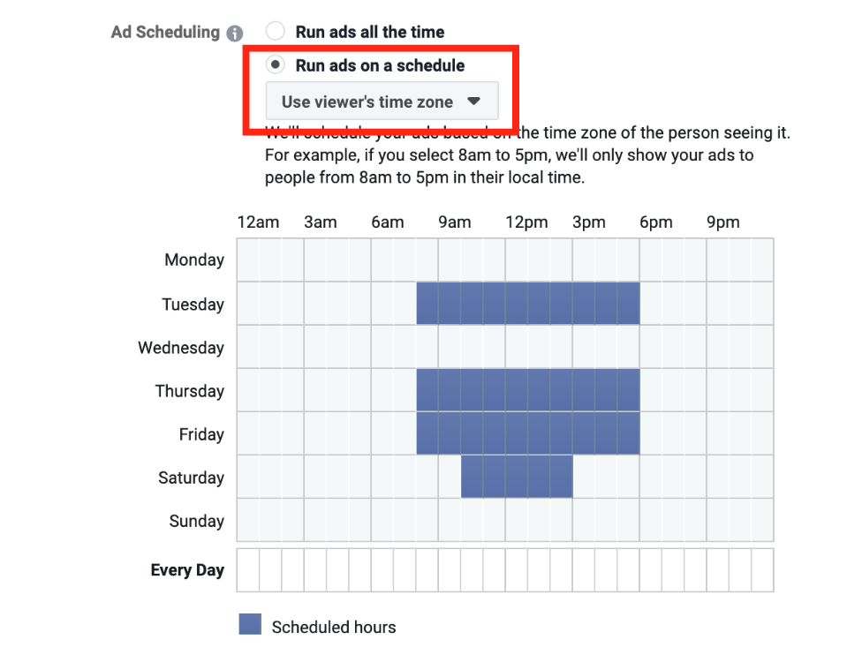
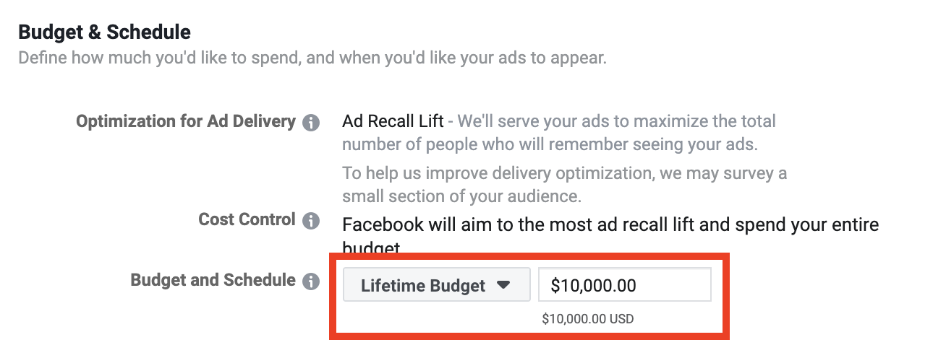
3. Limit Ad Deliverability by Running Ads on a Schedule (Dayparting)

Slide 19
Manage your Ads from Mobile

Slide 20
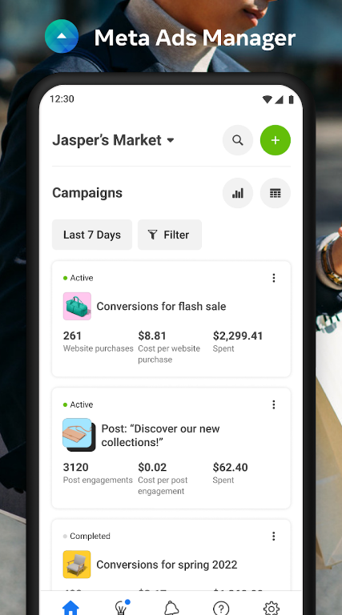
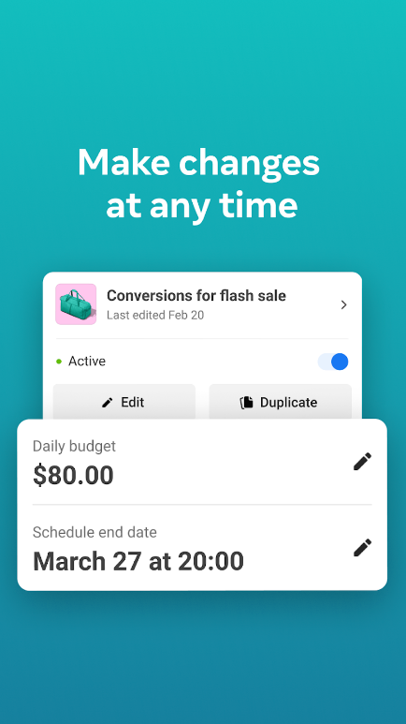
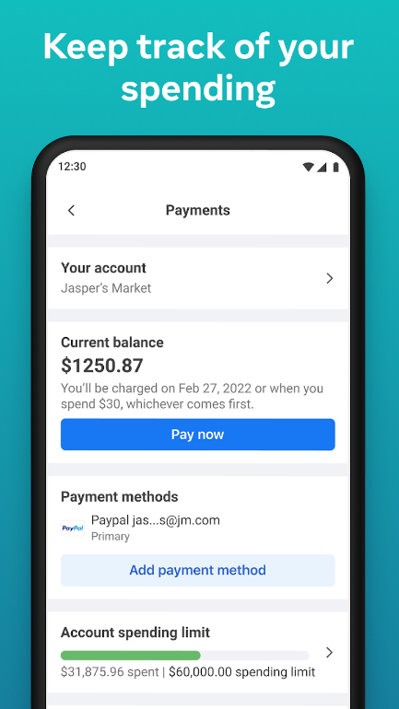

Slide 21
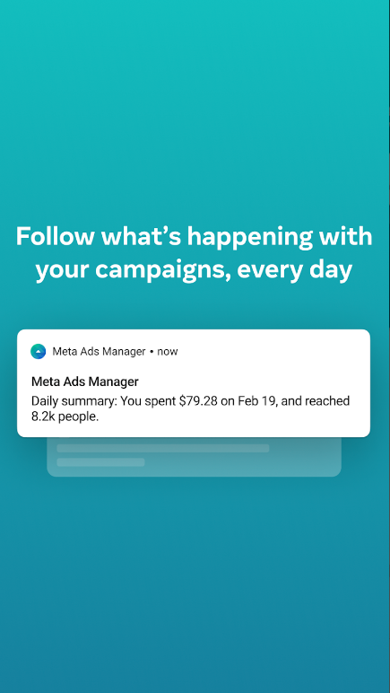
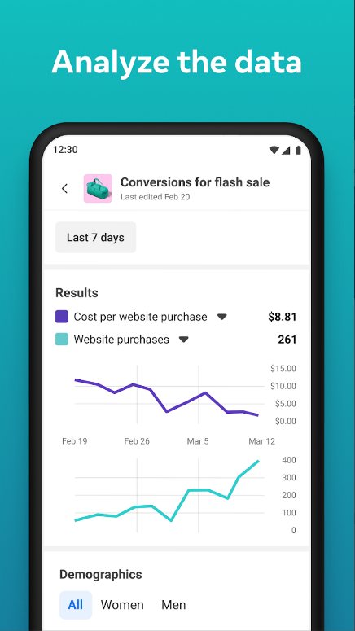
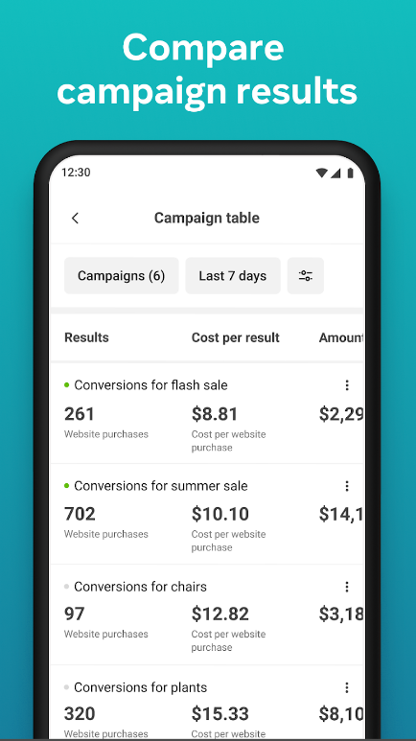

Slide 22
Thank You!

