Slide 1
Facebook
and Instagram Ads | Part 1

Slide 2
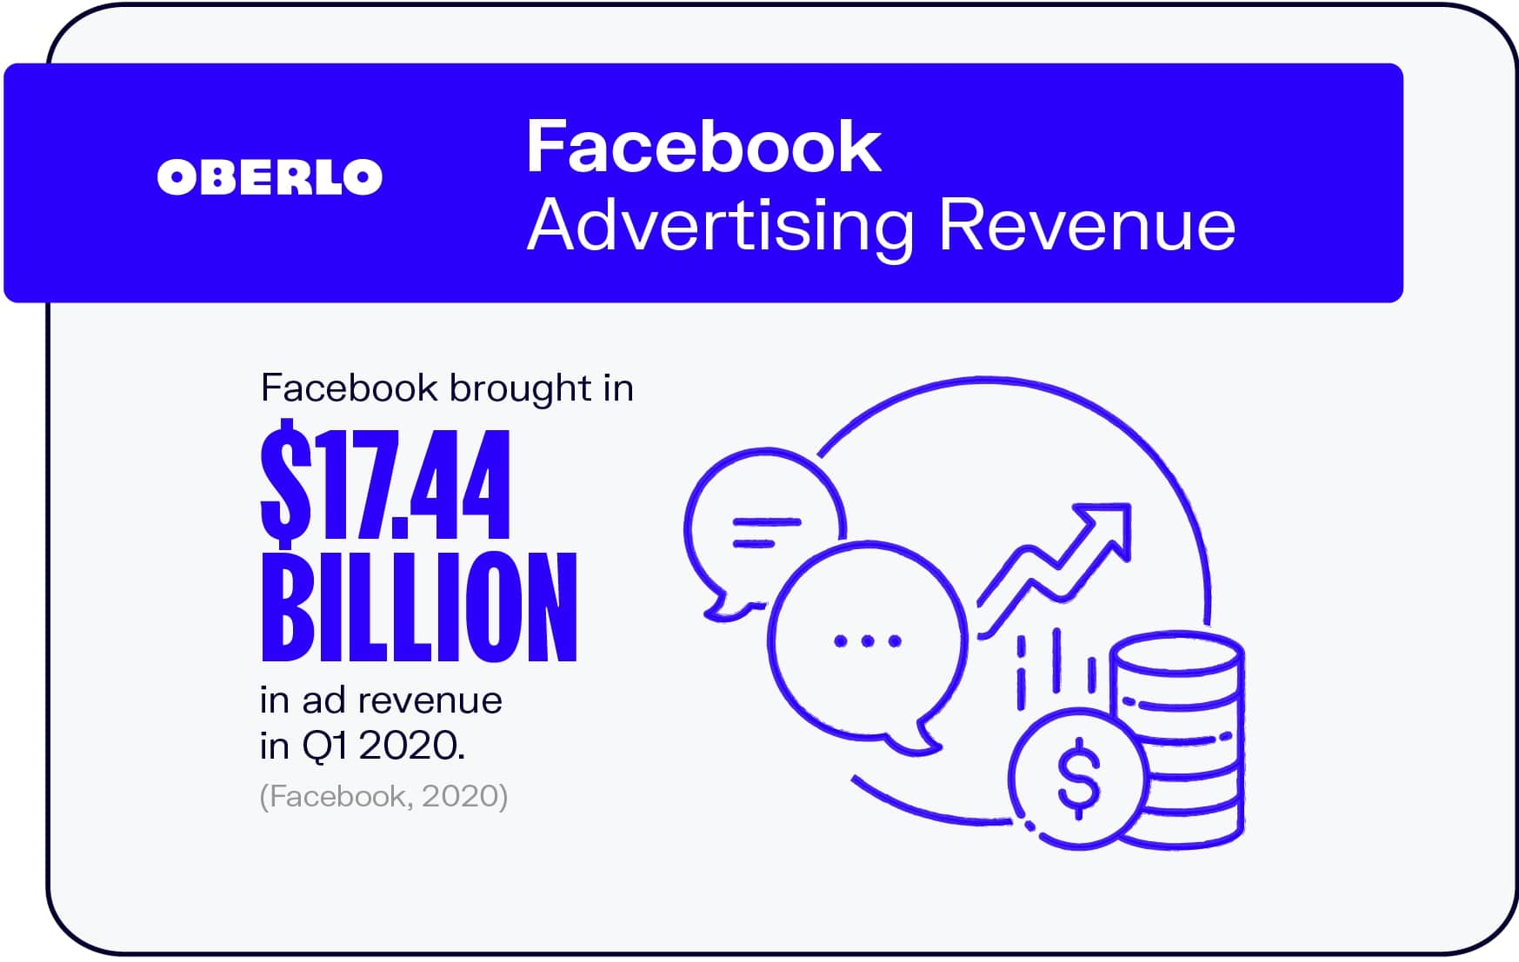
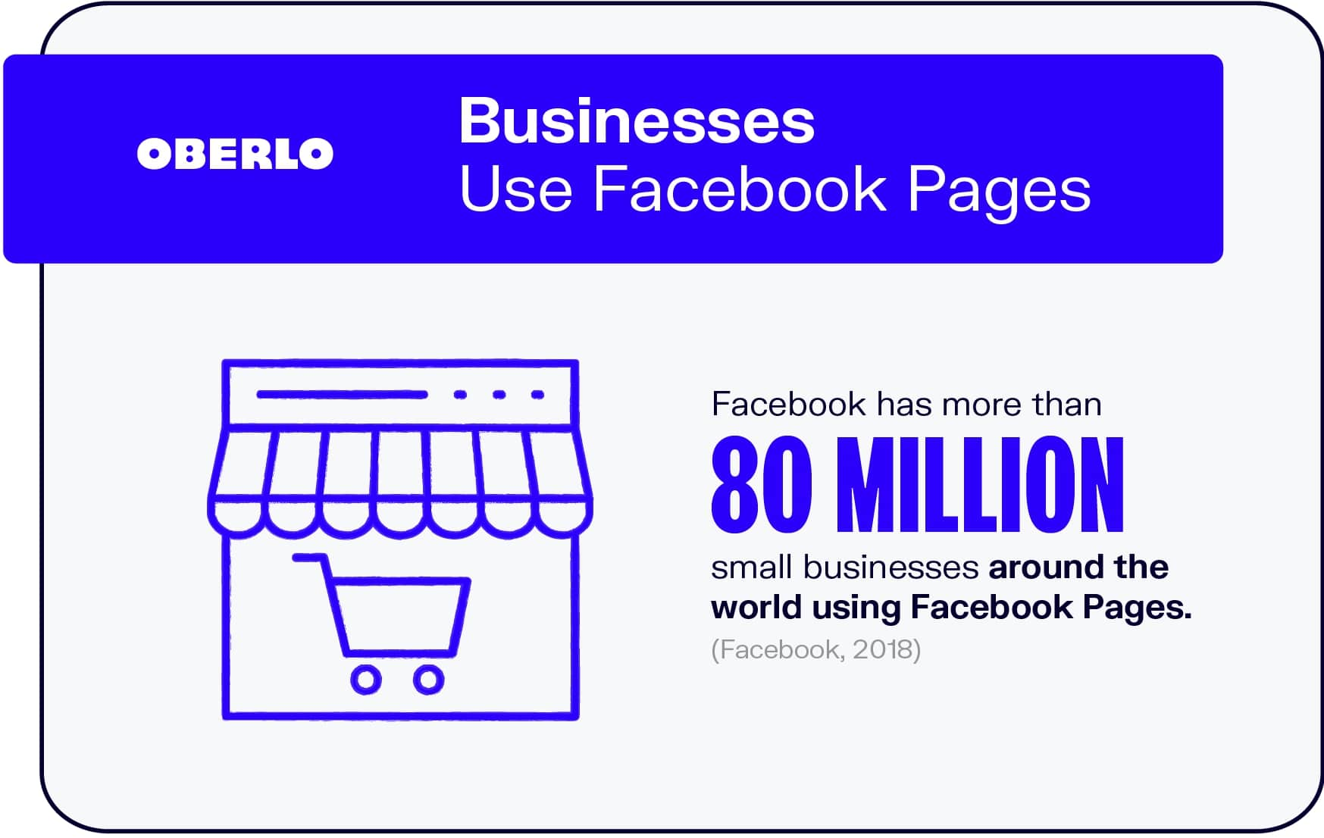

Slide 3
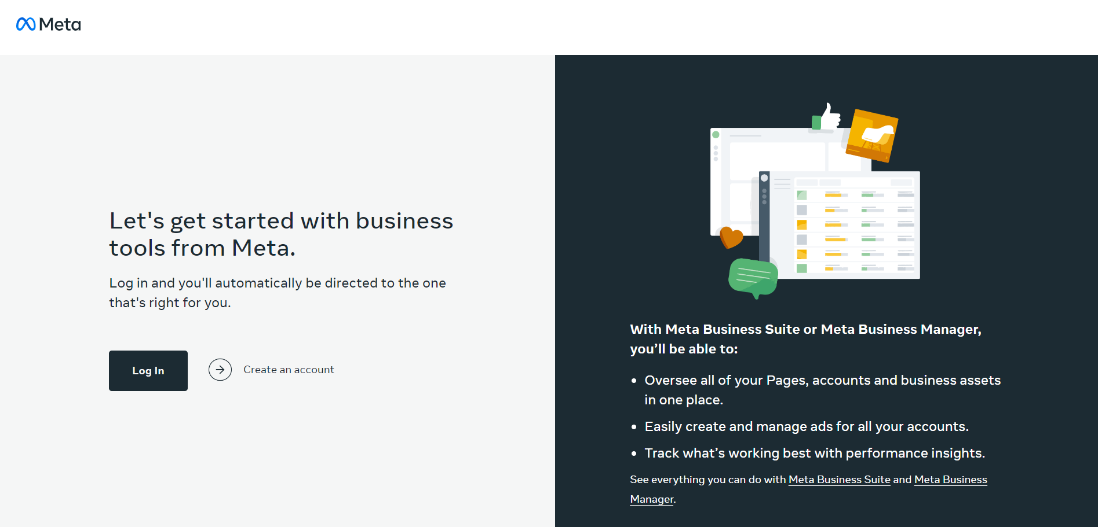
Setting up the Meta Business Manager

Slide 4
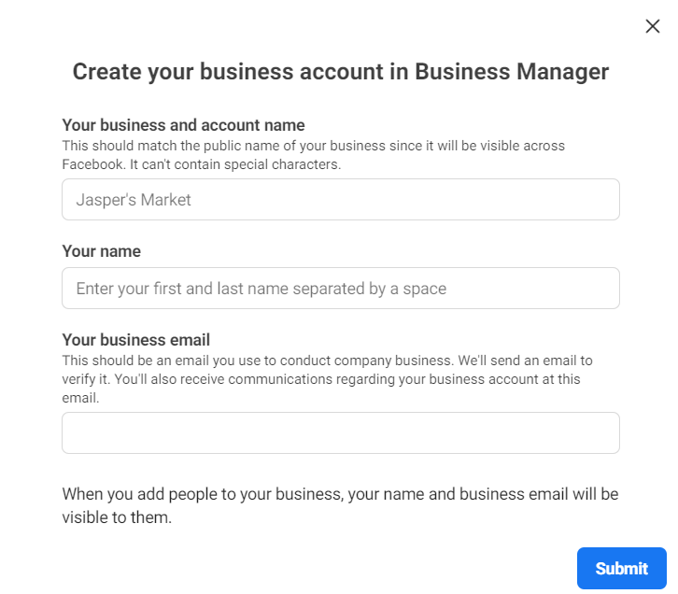

Slide 5
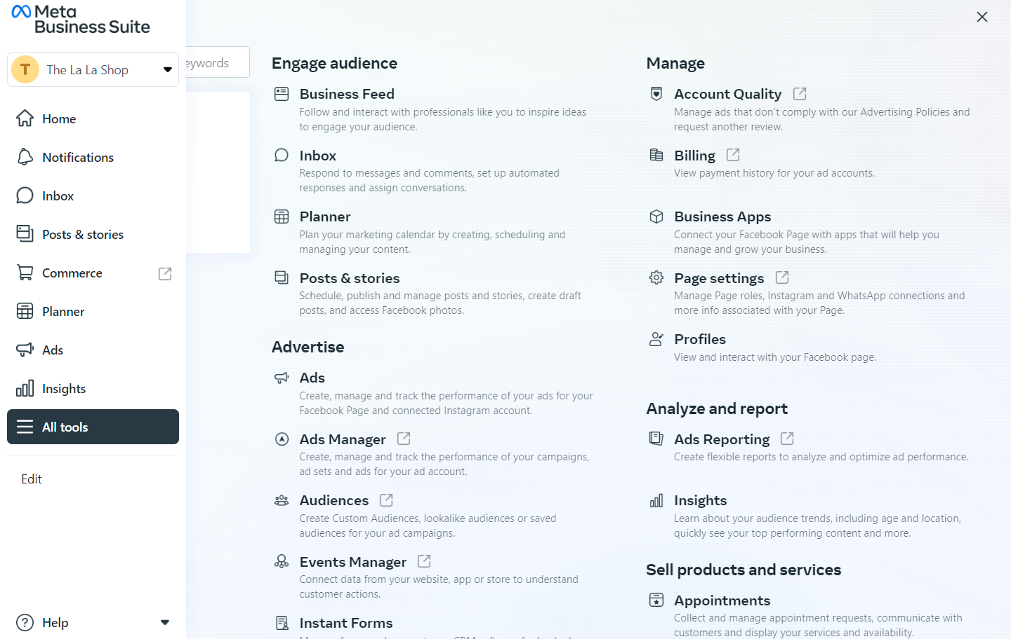
Understand the Meta Business Suite

Slide 6
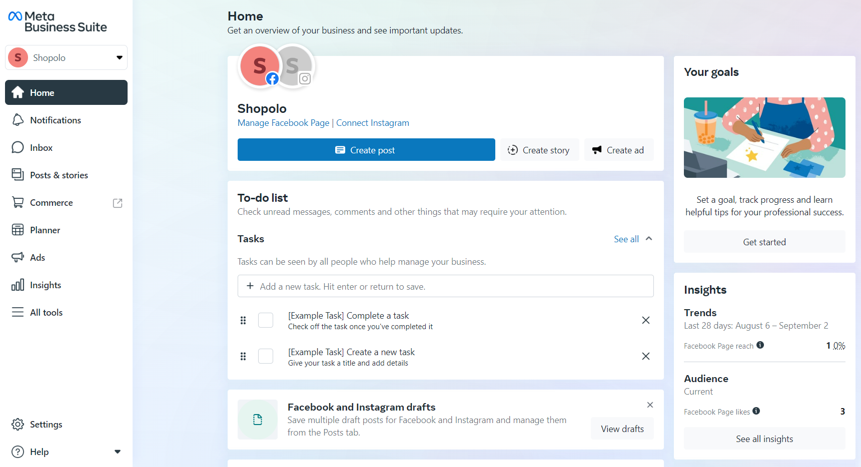
Meta Business Suite

Slide 7
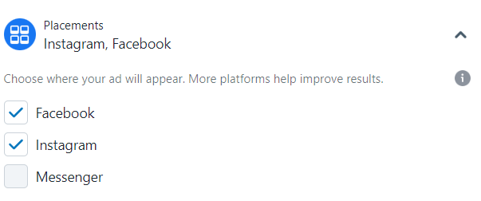
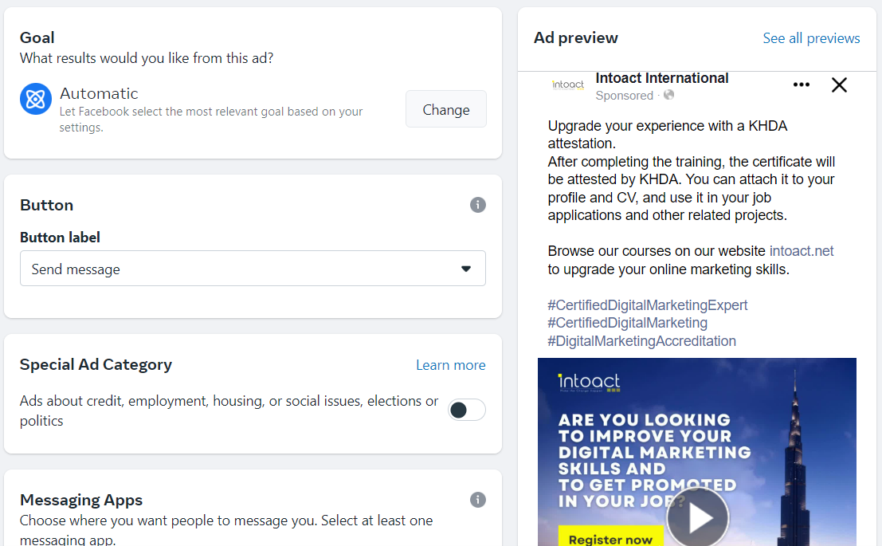
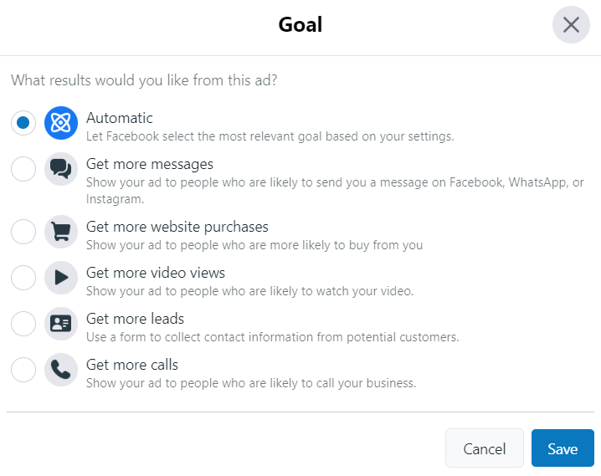
Facebook Ads – The Basic Way

Slide 8
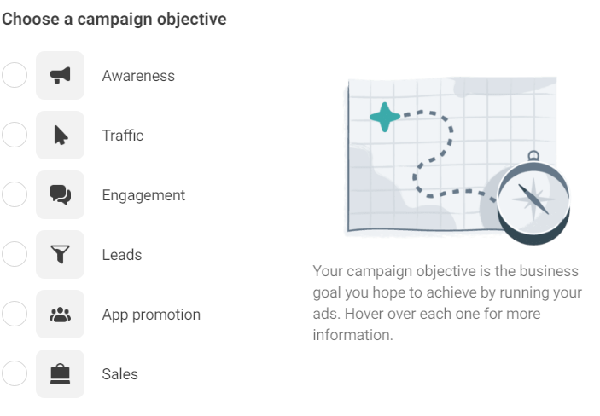
Advanced Targeting using Facebook Business Manager
Create campaigns with purpose

Slide 9
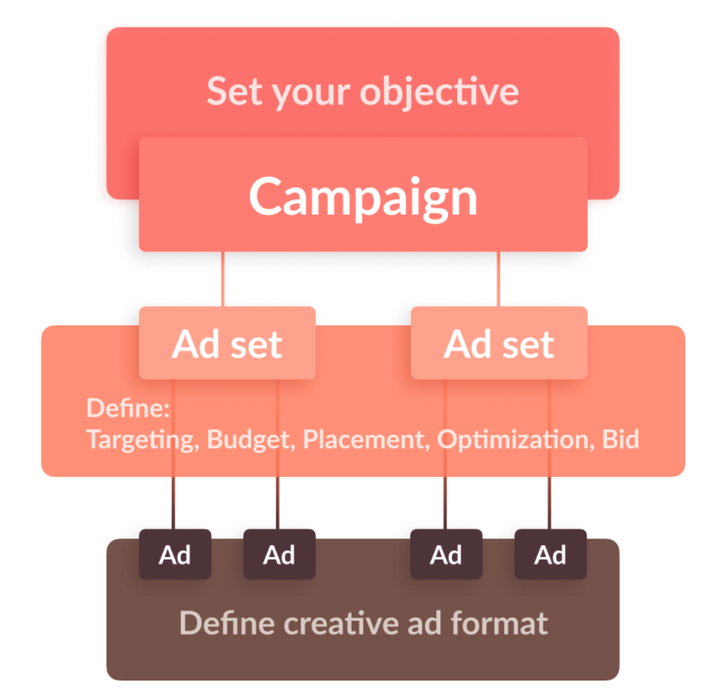
Ad Campaign Structure

Slide 10
Objectives vs. Metrics
Awareness → CPM
Reach → Reach
Fan Base → CPL | Followers
Traffic → CTR
Video Views → CPV
Sales & Leads → Conversions
Revenue → ROAS (Return on Ad Spend)

Slide 11
More about Measuring the
Campaign Performance
ROAS| Return on Ad Spend
If ROAS = 5 → With every Euro spent, 5 Euros are generated as Revenue.

Slide 12
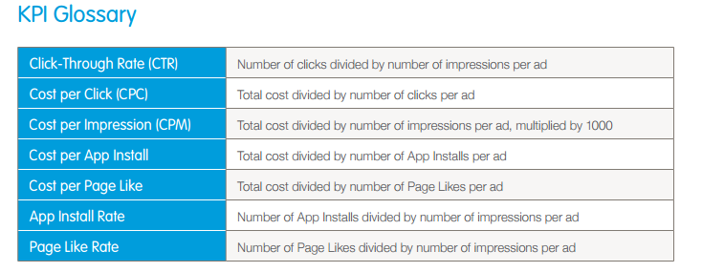

Slide 13
Thank You!

