Slide 1
Facebook for Business

Slide 2
Setting up a Facebook page

Slide 3
Why Facebook Marketing?
Most visited social media platform
Most active social media site that exists
Over a billion active users a month
Finding the perfect audience for your business is easier on Facebook

Slide 4
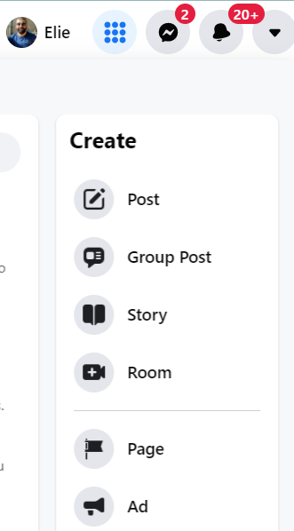
From your personal profile, click on Menu - Create - Page

Slide 5
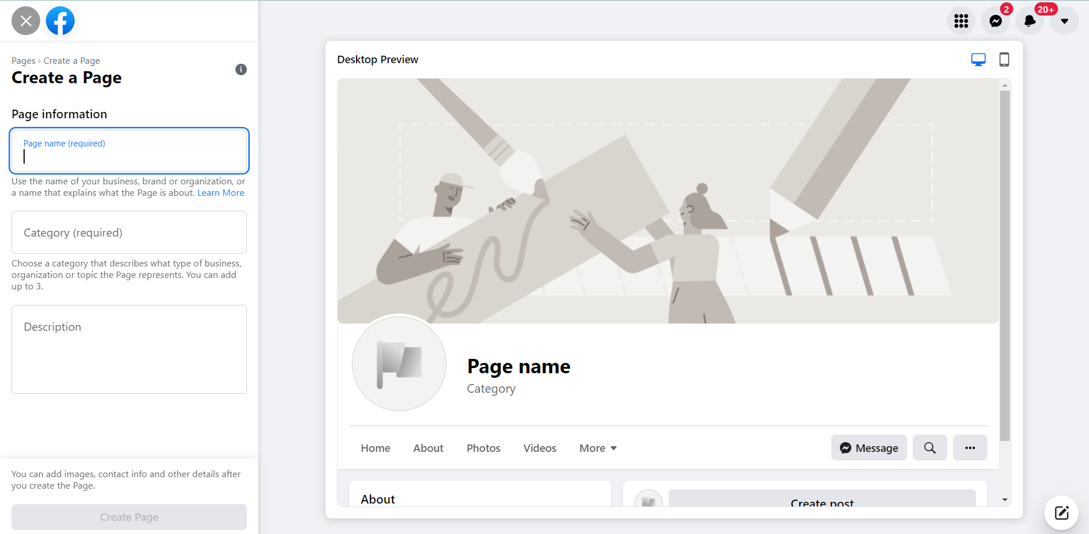
Complete the Initial Setup

Slide 6
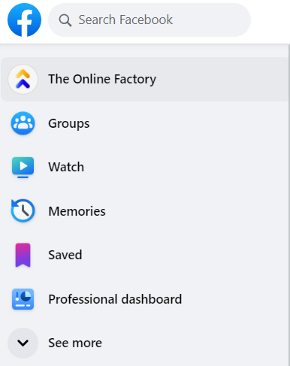
Professional Dashboard

Slide 7
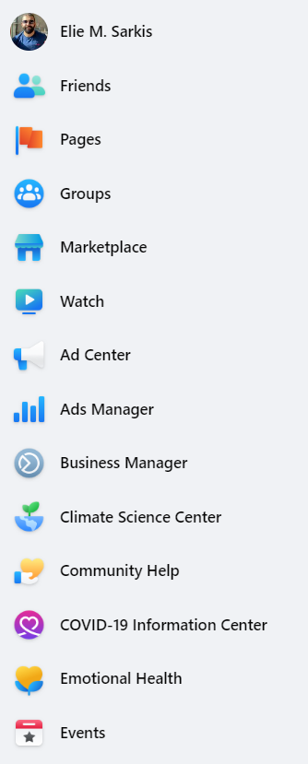
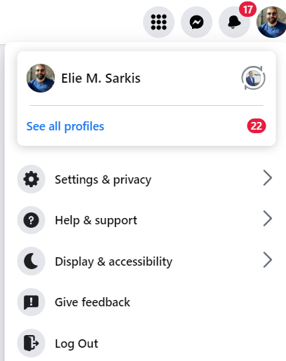

Slide 8
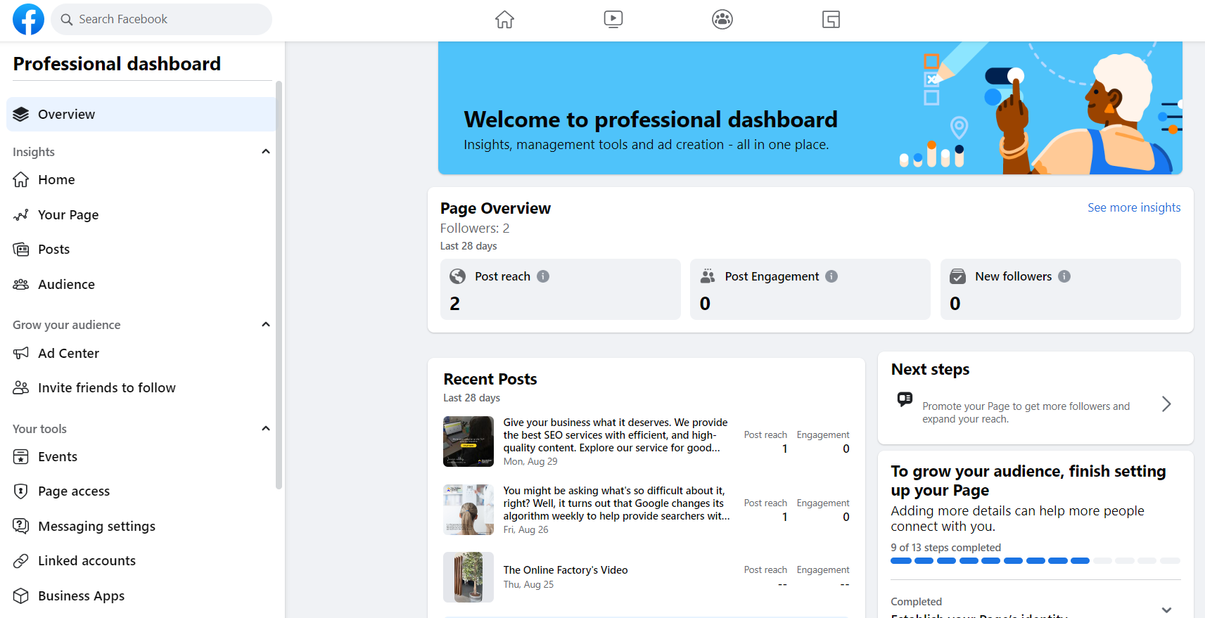
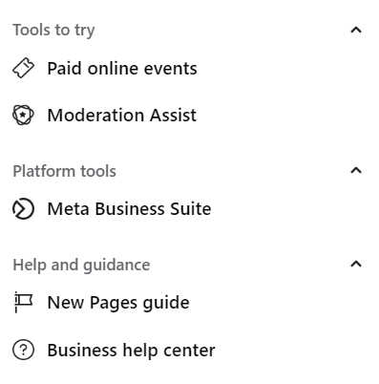

Slide 9
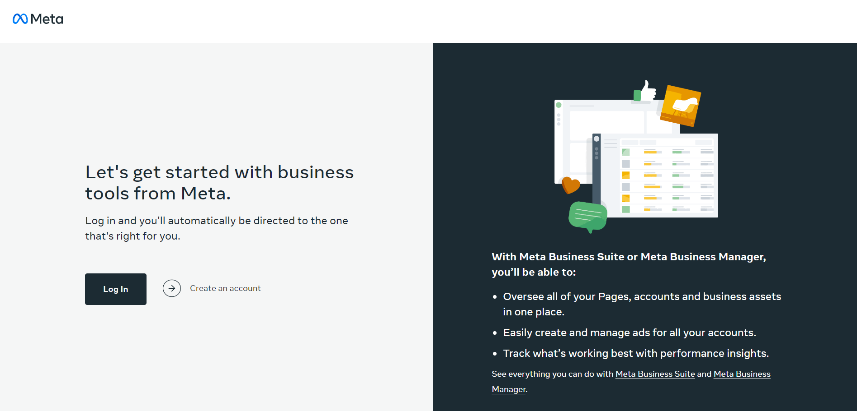
Understand the Meta Business Suite

Slide 10
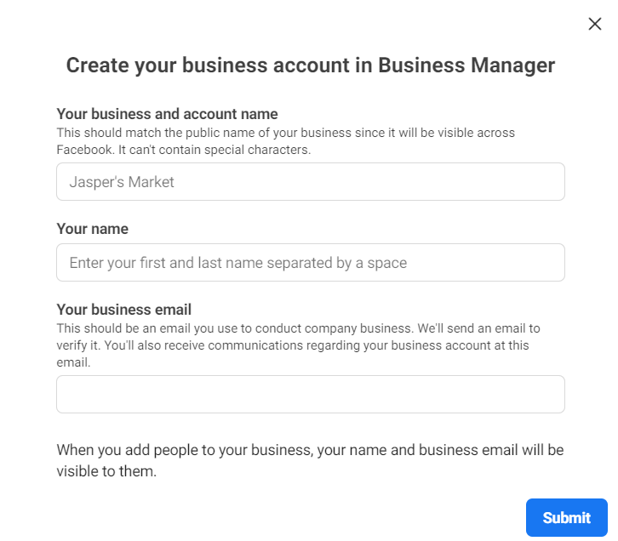

Slide 11
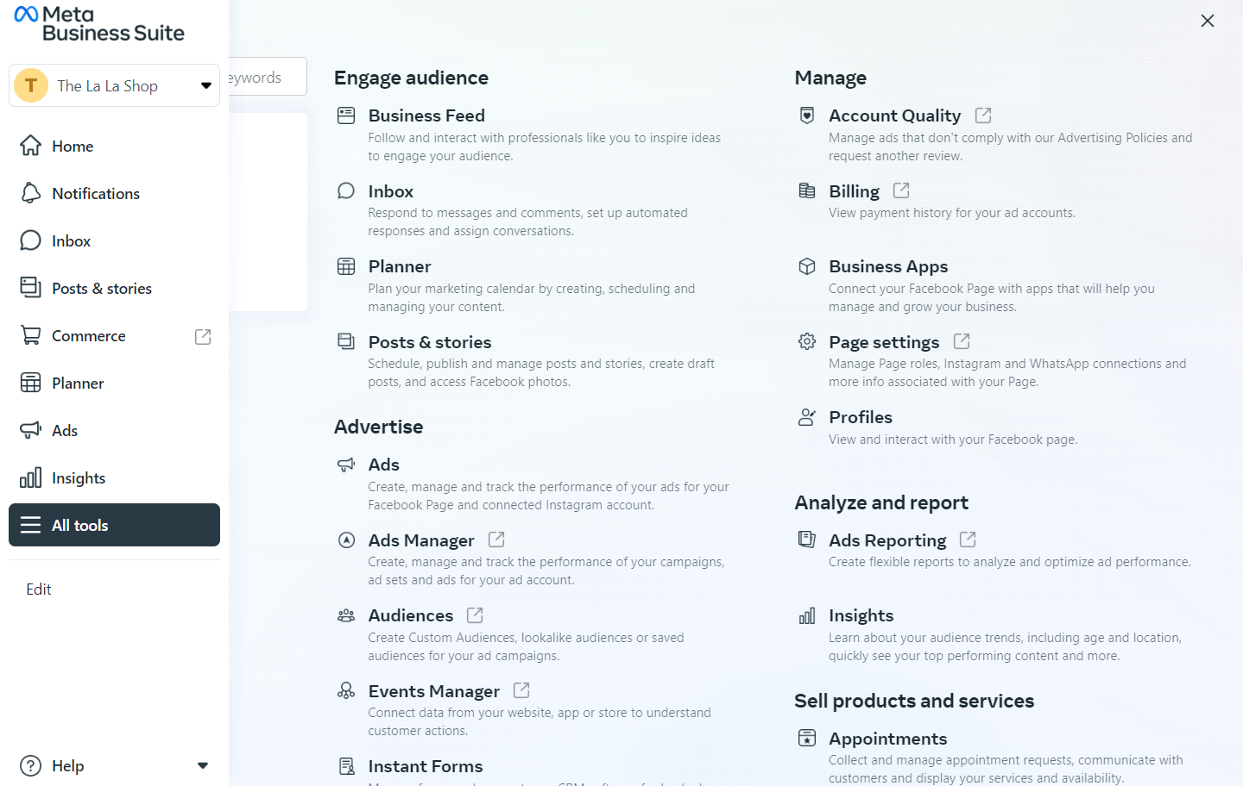
Understand the Meta Business Suite

Slide 12
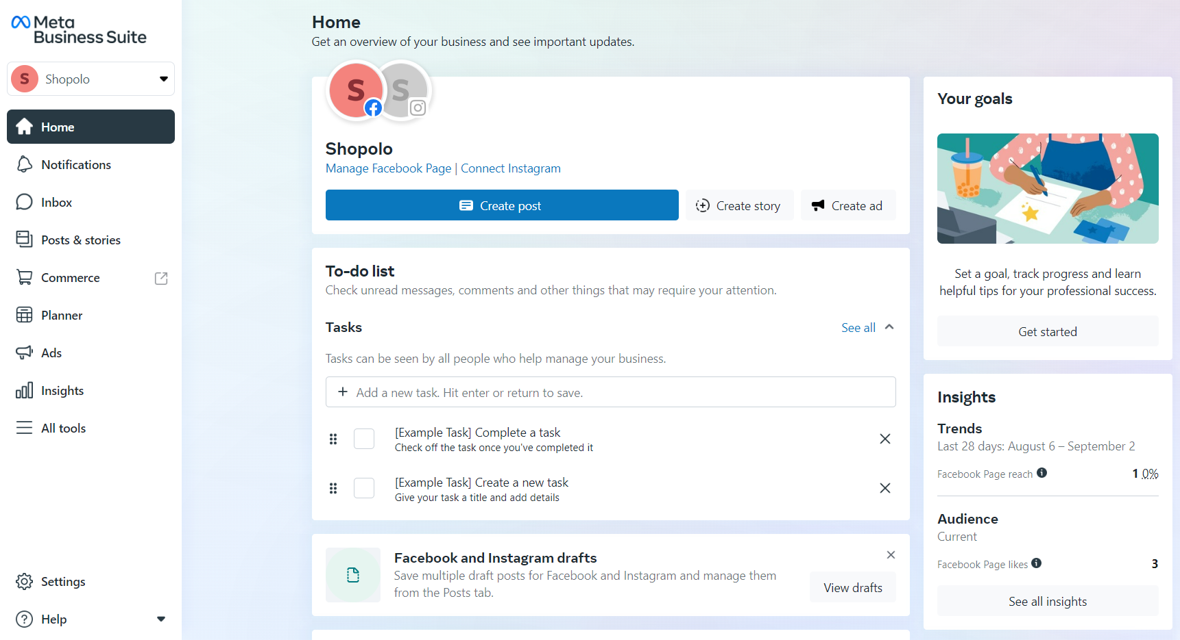
Meta Business Suite

Slide 13
Hashtags on Facebook
Hashtag your location
#Malta #Madrid #Spain
Hashtag your product or services
#Makeup, #Shoes, #Dentist, #Mobiles, #Smartphones
Hashtag your industry
#Marketing, #Travel, #Fitness #Insurance #RealEstate

Slide 14
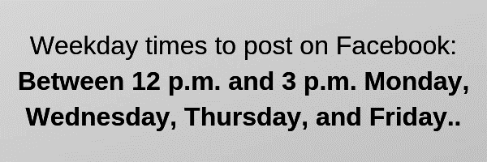
When is the best time to post
on Facebook?
Posting time is unique
per business
and industry
Source: hootsuite.com

Slide 15
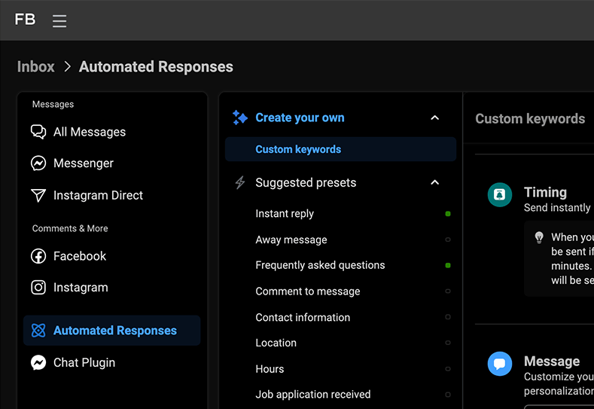
Automated Responses in Facebook Messenger

Slide 16
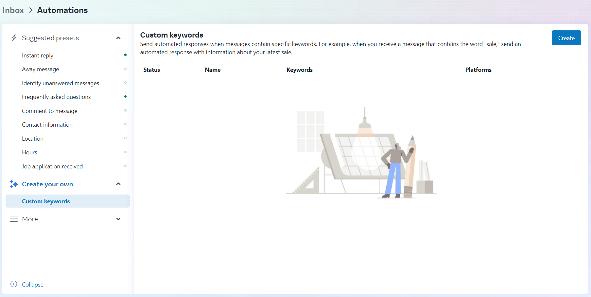
Add Custom Keywords and Messages

Slide 17
Posting/scheduling posts on Facebook and Instagram
Community management – replying to people’s comments and messages
Manage Instagram’s comments and messages
Page insights
Reply to people’s reviews

Slide 18
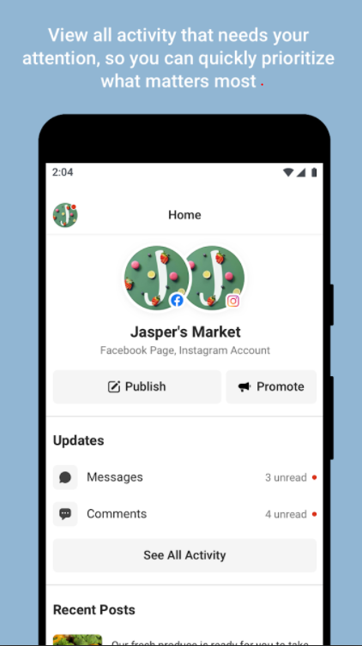
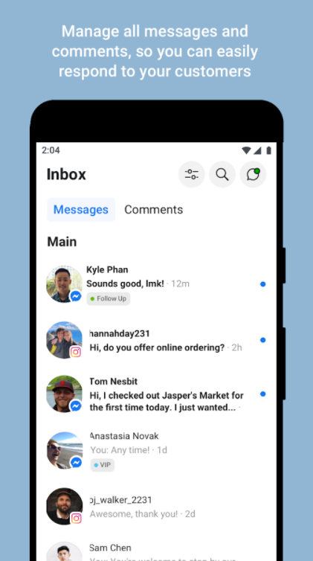
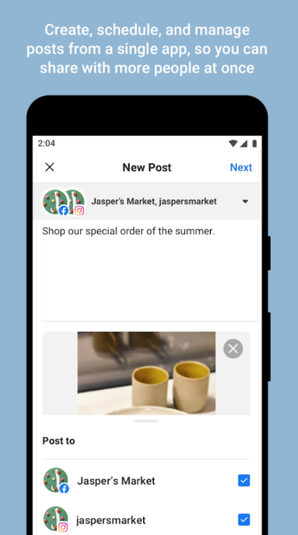

Slide 19
Thank You!

