Slide 1
Content Marketing
From Traditional to New Marketing

Slide 2
“Content Marketing is really like a first date. If all you do is talk about yourself, there won’t be a second date.”
David Beebe

Slide 3
Content Marketing Strategy

Slide 4
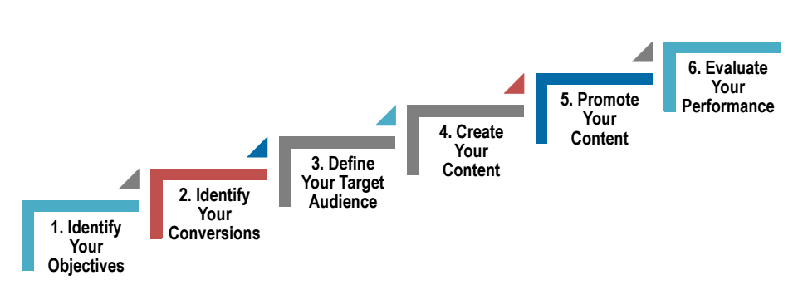
Content Strategy Funnel

Slide 5
Traditional Marketing
Content Marketing
Sales-driven approach.
Selling the product.
Holds attention for a short period.
Describes the product
and features.
Educating the audience
on their needs.
Selling ideas about the product.
Valuable and viral content.
Solves a problem.

Slide 6
Regular Post
Optimized Post
Caption:
Introducing our New #Watches Collection! Trendy yet elegant.
Place your order online via a secure online payment or Cash on Delivery.
Delivering to anywhere in #Spain.
Shop now on www.websitexyz.com #OnlineShopping #Spain
Caption:
Introducing our new watches collection! Shop now on www.websitexyz.com

Slide 7
Tone of Voice
Honest
Friendly
Helpful
Funny
Trendy

Slide 8
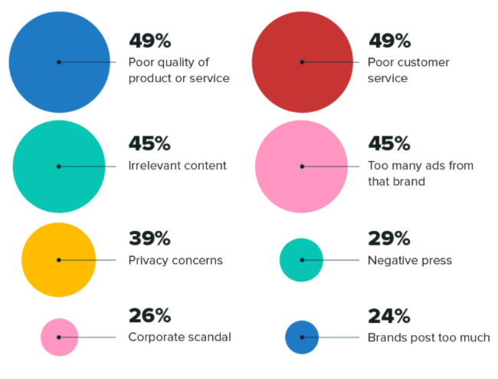
Why Do People Unfollow Brands on Social Media?
Source: Sproutsocial.com

Slide 9
Content Marketing Forms
Photos
Videos
Articles
Infographics
Stories
Case Studies

Slide 10
Posting Strategy

Slide 11
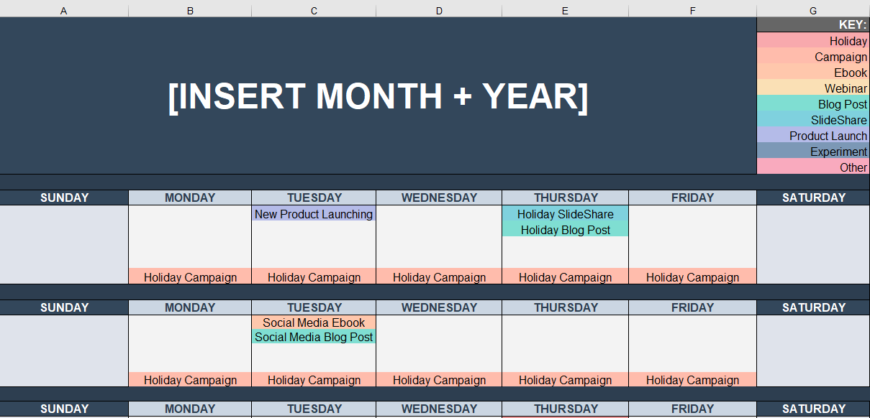
Monthly Content Calendar

Slide 12
Content Creation Tips and Tools

Slide 13
Getting Started with Content Creation
Create a consistent social media schedule.
Create a template/design feel to be applied on all the posts. → Build an identity by having a link between the content shared.
Use the right social media sizes. → Most used size: 1080x1080px
Save your social media posts in PNG format.

Slide 14
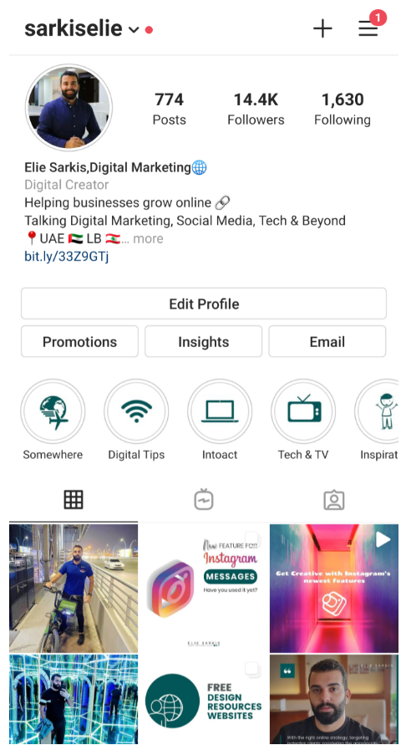
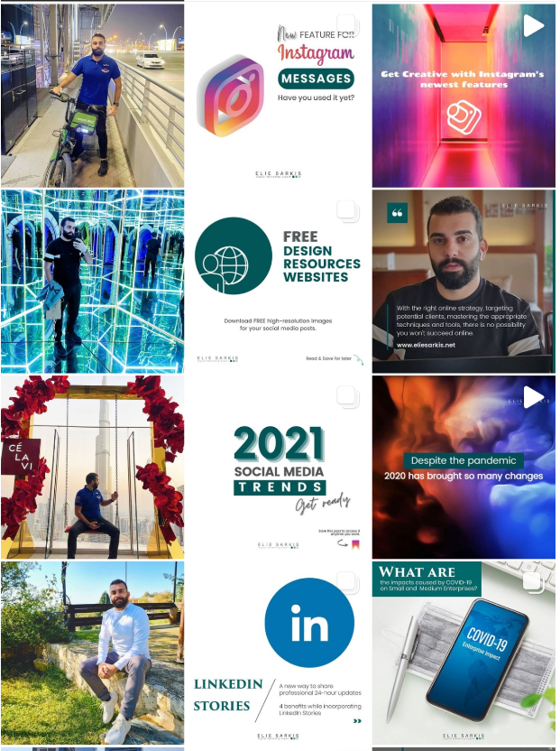
An example about the identity:
Link the posts with elements, colors or by applying a specific theme.

Slide 15
Content Marketing Example:
Coca-Cola
Emotional Marketing

Slide 16
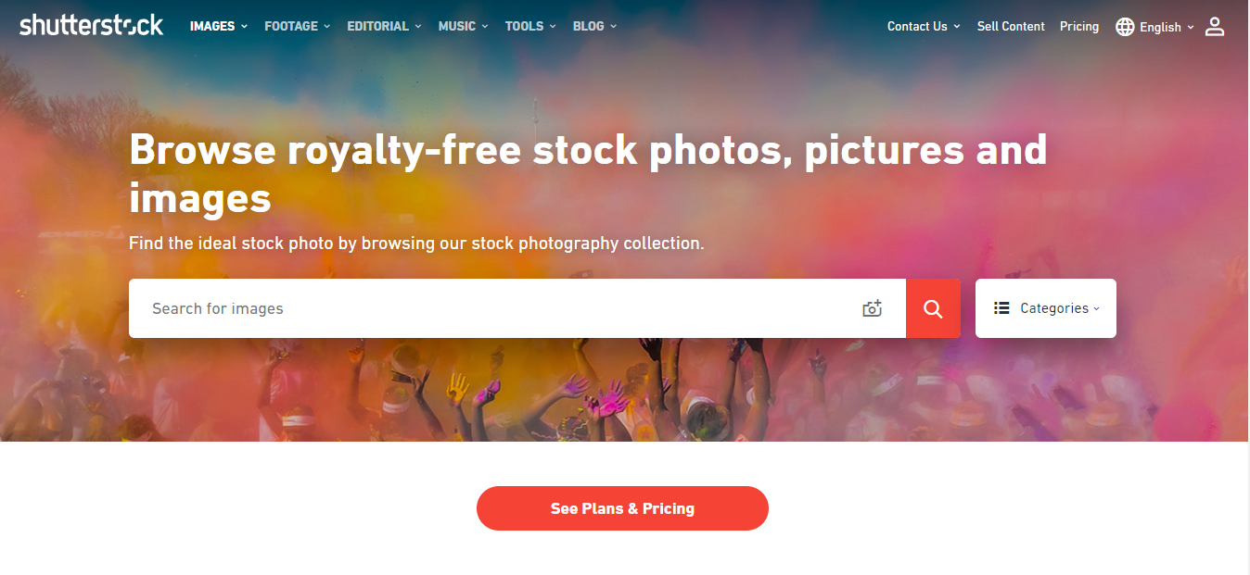
Use Copyright-free Photos
Shutterstock.com
Paid

Slide 17
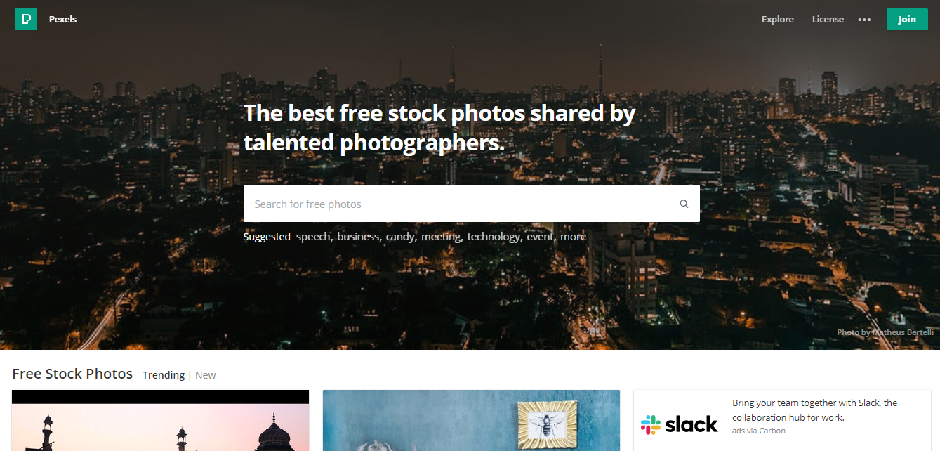
Use Copyright-free Photos
Pexels.com
Free

Slide 18
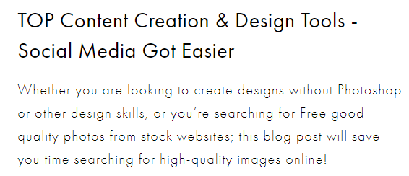
Use Copyright-free Photos
Top Content Creation and Design Tools
22 Places to Find FREE Stock Photos

Slide 19
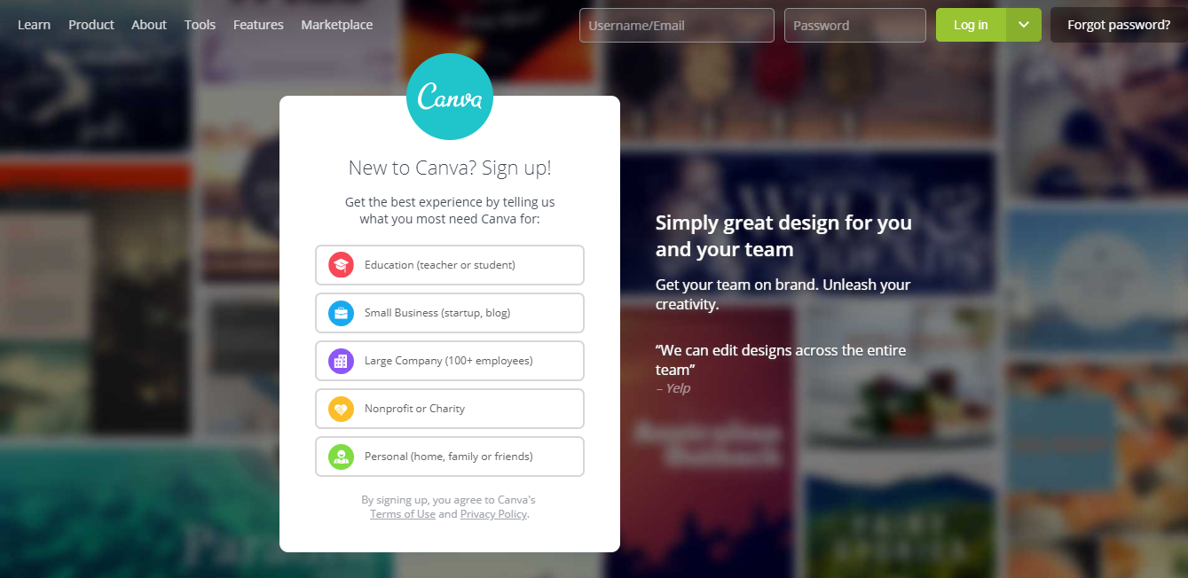
Create Stunning Images Yourself without Design Skills
Canva.com or Canva Mobile App

Slide 20
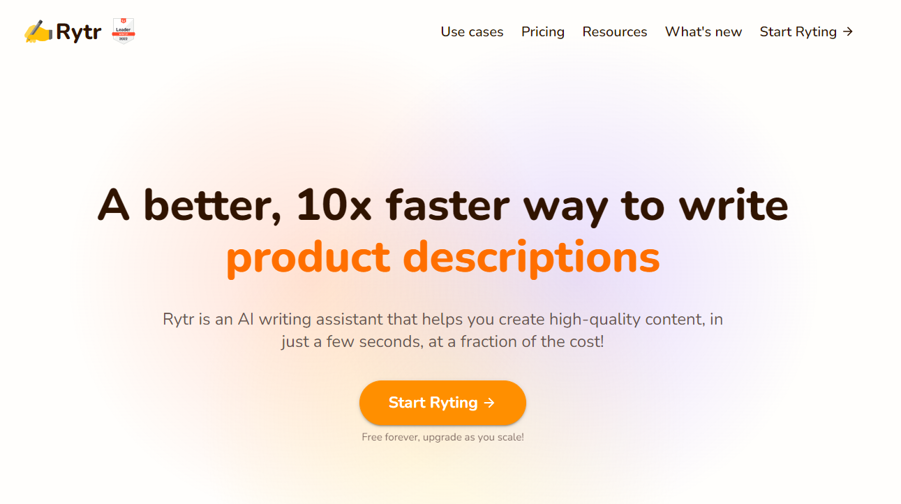
Content Writing: AI Writing Assistant
Rytr.me | A Tool that will write the text on your behalf using different tonalities

Slide 21
Video Editing Mobile Application
VideoShow – Video and Photo Editor

Slide 22
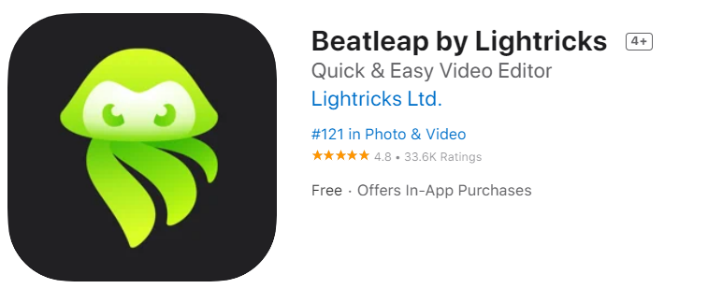
Easy, Quick and Video Editing on the Beat
Available on iOS

Slide 23
Shorten your Links
Bitly.com
Trach the clicks on your link – by traffic source/channel

Slide 24
You have now the strategy and the tools.
Are you ready to apply
and dive more into Content Marketing?

Slide 25
Thank You!

