Slide 1
Inbound Marketing
and Creating the Plan

Slide 2
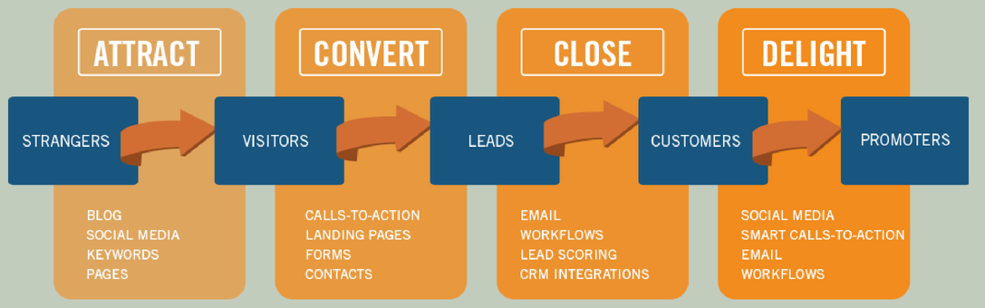
Inbound Marketing | New Marketing Approach

Slide 3
Understand the Funnel
Awareness
Consideration
Evaluation
Conversions

Slide 4
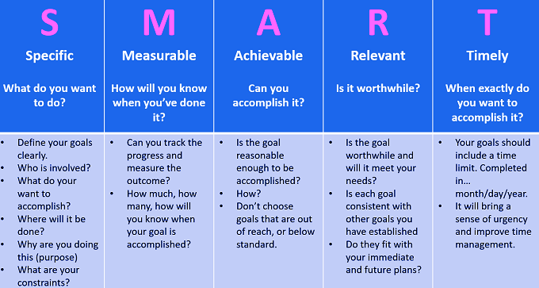
It all Starts with the SMART Goals

Slide 5
What to Include in the Plan
WHAT | WHY | WHEN | WHO | WHERE | HOW MUCH
Content
Purpose
Timeline
Target Audience
Channel
Budget
Short, medium and long-term business goals.
Investment and budget.
The strategies to achieve the goals at the digital level.
The online channels to use.
Action and development plans.
The timing and roadmap.

Slide 6
Set your Business Objectives for Social Media
Brand visibility
Engaging with
customers
Likes/Followers
Customer
support
Generating
leads
Increasing sales
Attracting
new customers

Slide 7
Social Media Strategy
Set your Goals.
Select your Social Media networks and the channels you would like to be present on.
Know your audience - Social Media Monitoring.
Create professional and valuable content.
Posting Strategy - Great content, perfect timings and ideal frequency.
Promote your content to the right target audience.
Engage the audience.
Measure Results - Analyze the campaigns’ performance and take a decision accordingly.

Slide 8
Writing the Plan

Slide 9
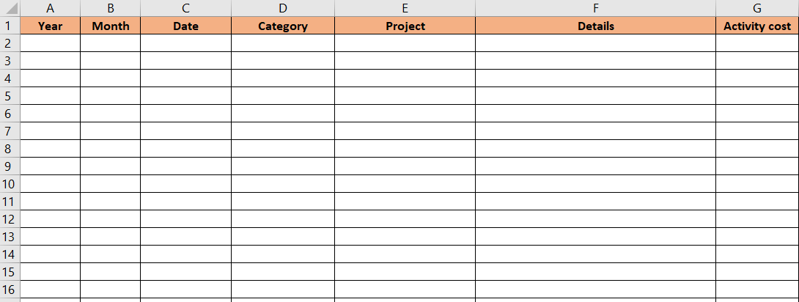
Budget Plan - Template

Slide 10
Budget Plan - Sample

Slide 11
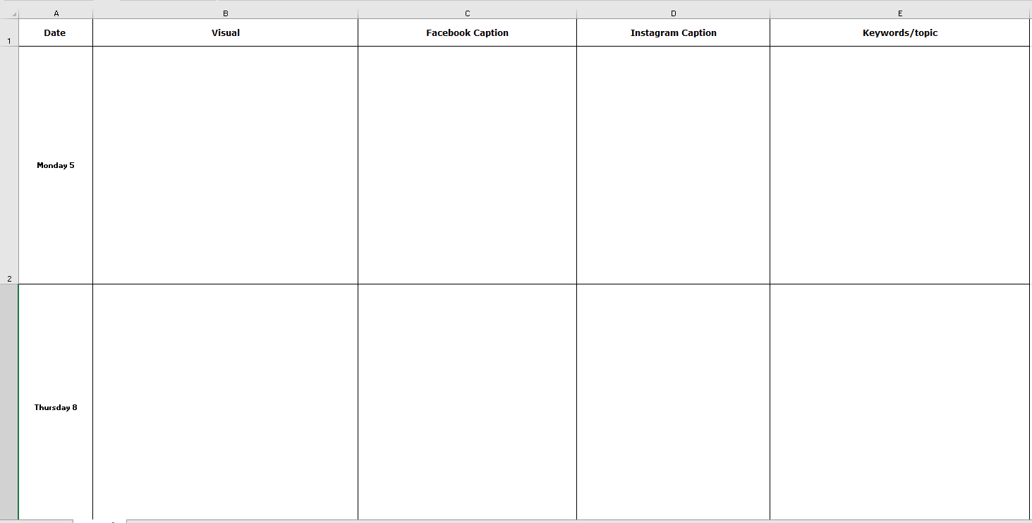
Monthly Social Media Calendar - Template

Slide 12
Monthly Social Media Calendar - Sample

Slide 13
Common Mistakes – Learn from These!
Not Understanding Your Audience’s Expectations
Not Speaking To Specific Pain Points And Needs
Focusing On Your Brand And Not Setting Up A Conversation
Failing To Keep Up With Current Trends
Sharing Static Content That Lacks Value
Focusing On Selling In Every Call To Action
Not Being Generous To Your Followers

Slide 14
Thank You!

