Slide 1
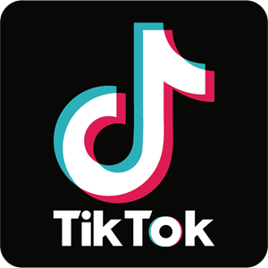
TikTok
Marketing

Slide 2
Why Market on Tiktok?
Increase brand awareness
Build engaged communities
Sell products and services
Get feedback from customers and audiences
Provide customer service
Advertise products and services to target audiences

Slide 3
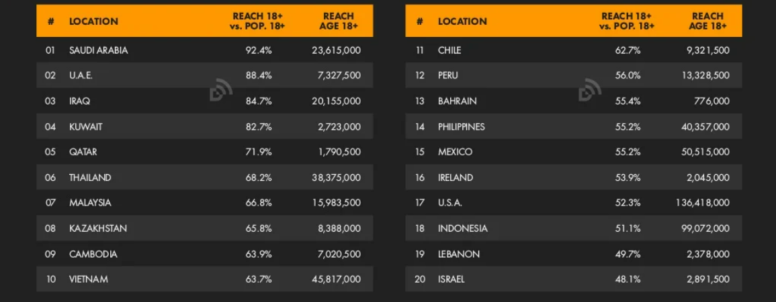
TikTok Ad Reach Rate Ranking

Slide 4
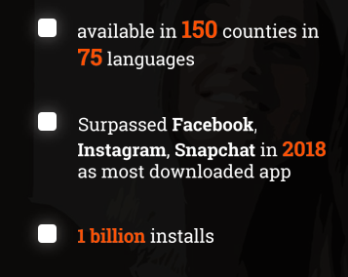
Facts
Over 50% of users under 24
Nearly 38% of TikTok’s users within the US are above 30.

Slide 5
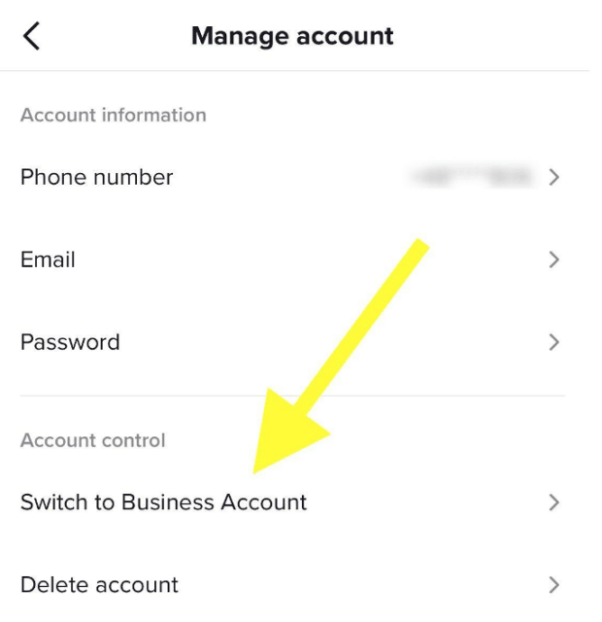
How to Create a TikTok
Business Account
Go to your profile page.
Open the Settings and Privacy tab in the top right corner.
Tap Manage account.
Under Account control, choose Switch to Business Account.
Choose the category that best describes your account - Tiktok offers categories from Art and Crafts to Personal Blog to Fitness and more.
From there, you can add a business website and email to your profile, and get started.

Slide 6
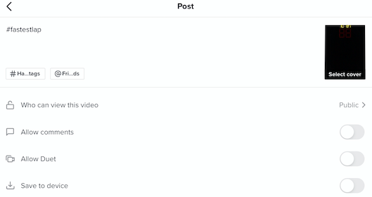
Hashtags, Cover
& Additional features.

Slide 7
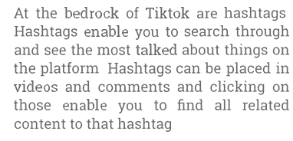

Slide 10
Top Content Types
Comedy
Inspirational Content
Tips and Tutorials
Travel

Slide 13
You don’t need a high-profile influencer for successful marketing, try to discover rising stars, or influencers in your niche.

Slide 16
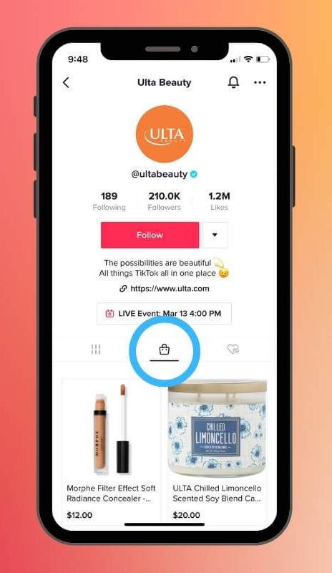
Tiktok Shopping
eCommerce feature
Allowing users to shop for products without leaving the app
A dedicated shopping tab on the profile marked by a small bag

Slide 17
How TikTok Algorithm Works
It shows a user content they are most interested in based on previous engagement.
Content you like, share, comment on, re-watch, and complete.
Hashtags and captions you engage with (or include in your own content).
Subject matter you search for.
Trending audio on videos you engage with.
Account settings like language preferences, device type, and posting location.

Slide 18
Tips to Succeed on TikTok

Slide 19
1. Share User-Generated Content (UGC)
Encourage customers to tag you in their social media posts.
If you’ve created a branded hashtag for your business, be sure to check it for tagged content from users as well.
Save content from users that you’d like to repost on your own profile. As you repost UGC, be sure to give credit to the original creator.
Beyond simply reposting already-made videos, you can also consider responding to UGC using Duets or Stitching. Duets let you respond by cutting the screen in half, so your response plays side-by-side with the original video.

Slide 20
2. Build Relationships with Influencers
Influencers are extremely popular on TikTok. About 25% of all content on TikTok features either a celebrity or influencer.
These content creators can generate a lot of buzz for your brand by sharing your products with their own audiences.
This helps expand the reach of your marketing efforts and can give you an algorithmic boost by placing your products and services in front of more eyes. Case Example: West Elm. The furniture store partnered with Sophia Bush and Plant Kween to create a video about plant propagation.

Slide 21
3. Use TikTok Ads
Advertising on TikTok may just change the way you think about digital marketing.
Research shows that UGC-focused ads on TikTok outperform other kinds of digital ad placements, including Facebook ads (by 32%) and more conventional digital ads like Google ads (by 46%).
https://ads.tiktok.com/

Slide 22
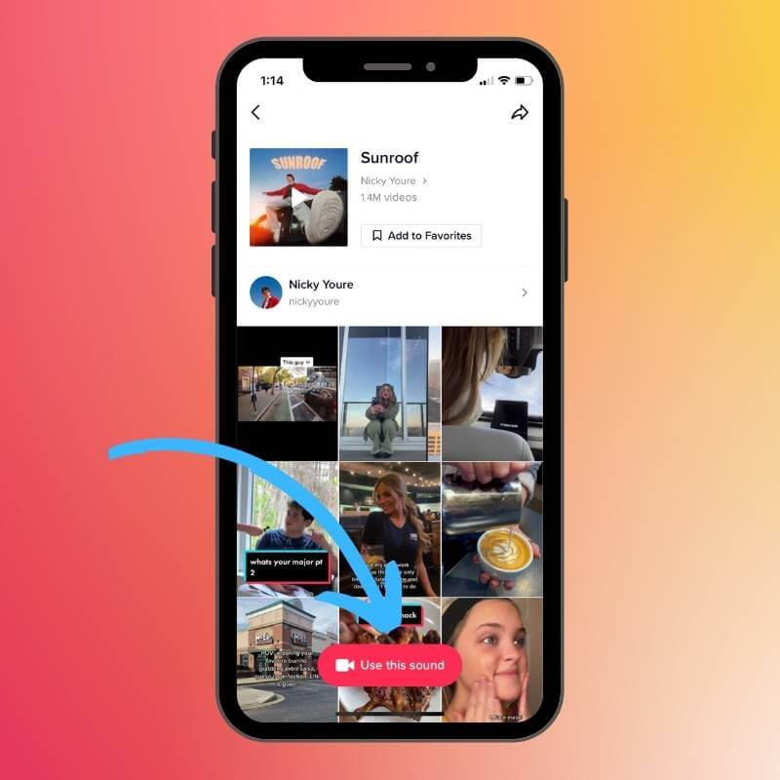
4. Use Trending Audio
Music and sounds have a tremendous impact on engagement and visibility.
67% of users want to see TikTok videos from brands that feature trending audio.
68% of users say trending audio helps them remember the brand better.
58% of users say they're more likely to share an ad that features trending sounds.
62% say they're curious to learn about the brand after watching a video with trending sounds.

Slide 23
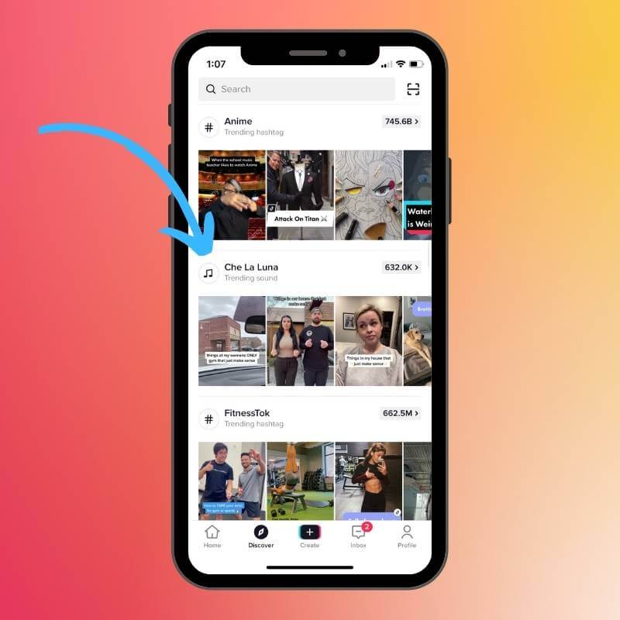
Here’s is an easy way to find trending audio:
Tap Discover on the bottom of your screen.
You’ll see a scrolling feed of all trending hashtags and sounds across the app.
Scroll until you see an icon on the left-hand side of a music note inside a circle. On the right-hand side, you’ll see a number that indicates how many videos on TikTok use that sound.

Slide 24
5. Track Engagement with Analytics
Gain insight into the things your target audience enjoys seeing, and use it to refine your content.
Overview: Tracks engagement and follower count
Content: Track your most popular videos
Followers: Break down audience growth as well as audience demographics
Live: Shows insights from Live videos

Slide 25
Thank You!

