Slide 1
Social Media Marketing

Slide 2
Digital Marketing Strategy

Slide 3
Introduction
Social Media Marketing
Promote any product or service on the social media channels.
Social Media Management
Manage social media accounts and pages in terms of setting the plan, content strategy, budget planning, implementing advertising campaigns, generating reports, and more.

Slide 4
Social Media Management
Create well-targeted campaigns across social media platforms and other online mediums.​
Reach and influence​
Increase potential traffic and sales
Improve reputation​
Grow more exposure
Retain customers

Slide 5
Your social media strategy must be consistent in voice and brand identity, positive, honest, transparent and human.
The social media platforms speak to consumers.

Slide 6
Some Digital Insights

Slide 7
Social Media Users vs. Population
Global Figures
Active social media users as a percentage of total population
Note: Users may not represent unique individuals

Slide 8
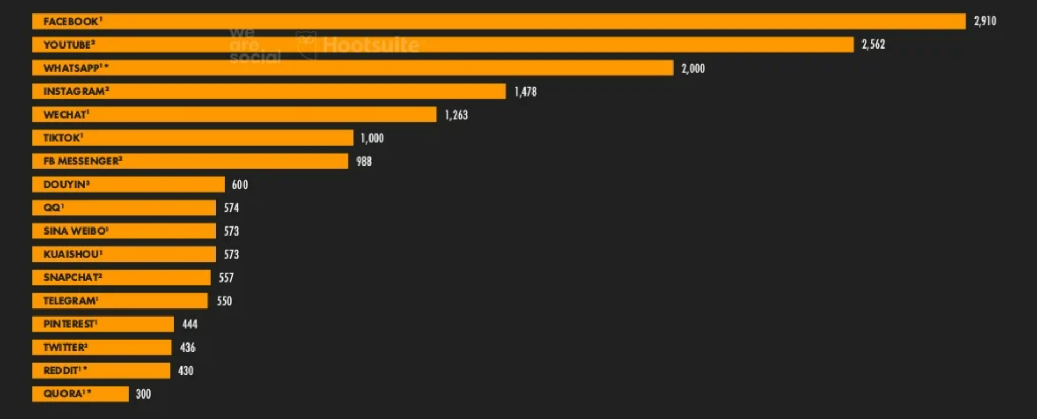
The World’s Most Used Social Platforms
Global Figures

Slide 9
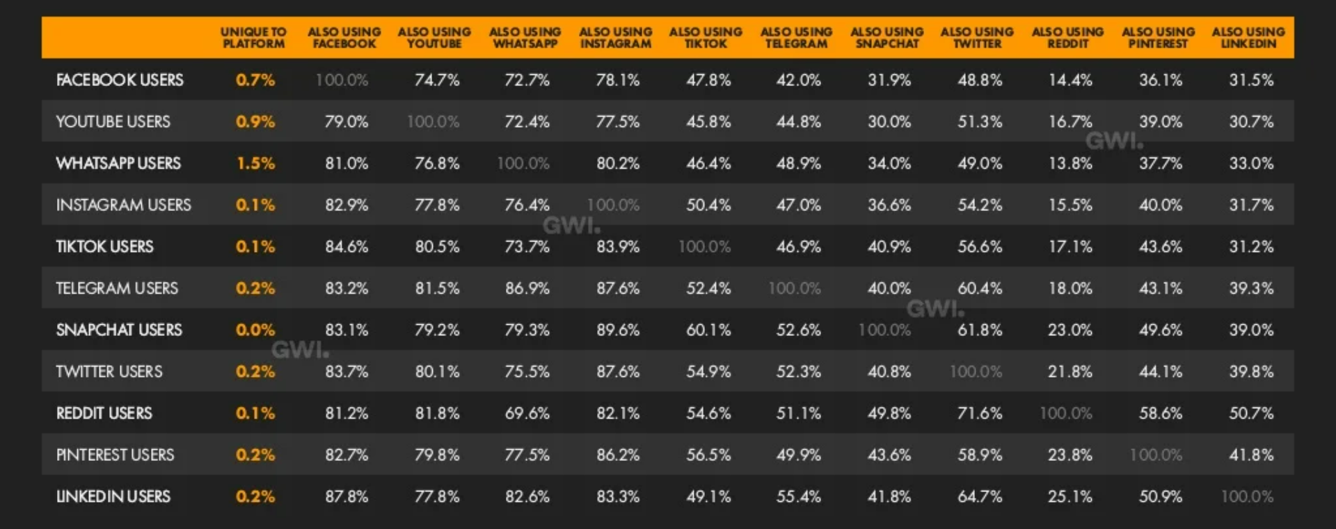
Social Media Platforms | User Overlaps
Percentage of users of each social media platform who use other platform.

Slide 10
Digital Marketing Strategy

Slide 11
Applied Digital Marketing
New Digital Marketing Concept

Slide 12
5Cs
Content
Channel
Campaign
Conversation
Conversion
Traditional
5Ps
Product
Price
Place
Position
promotion
Digital

Slide 13
Digital Marketing
Interactive communication
Internet channels the main medium of communication
Faster and adaptable communication
Publicly available and on-demand upon request
Global reach
Measurable
Traditional Marketing
One-sided communication
Mass communication media usually used
Time-intense communication
Publicly available but not on-demand
Local reach
Estimate-able
More expensive

Slide 14
Thank you!

