Slide 1
Lesson 20
Finance for Management

Slide 2
Lesson Topics and Content
Course Wrap-Up:
Review of Outstanding Material and Issues
Preparation for the Summative Reports
BARCELONA | MADRID | MALTA | ONLINE

Slide 3
Course Wrap Up - summary
The Role of Financial Information for Business Decision-Making
Reaching good decisions is vital for organizations, but the implementation of such decisions is equally crucial.
Decision-makers need to commit to the decisions taken to reach the goals of the organizations.
The most important financial information needed for business decision comes from accounting and financial statements.
Accounting is a service function to management - processes and studies “raw data” and converts them into suitable information in the process of decision-making.
Financial information has different end-users like investors, managements, creditors, suppliers or regulators and financial statement interpretation knowledge to “reading” those financial statements.
A well-established process of management based on the financial statements and financial in-formation is one of the most significant presumptions of the quality of business.

Slide 4
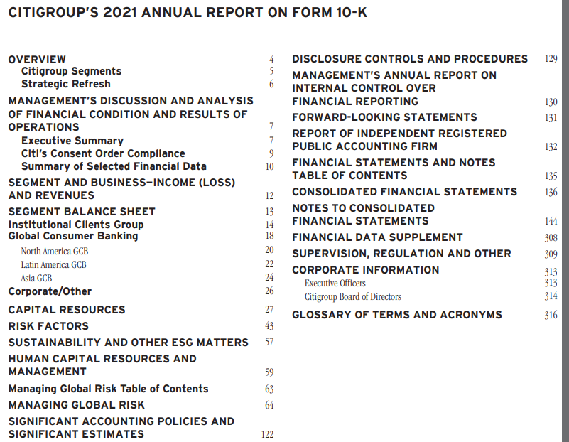
Course Wrap Up - summary
The Annual Report
Across global markets, Annual reports have different formats and components; this happens due to statutory requirements in different economies.
Some of the common components are:
Director’s message to shareholders
Information on corporate governance
Financial highlights
Management discussion and analysis
Shareholding pattern, management/board of directors’ information
Detailed and audited financial statements
Statement of financial position
Income statement
Statement of Cashflows
Statement of Changes in Equity
Notes to financial statements – to back up the FS data
Usage of accounting policies and changes
Other information or disclosure.
In the United States, Annual Reports
can also be presented in a 10-K format
Financial Statements
Source https://www.citigroup.com/citi/investor/quarterly/2022/ar21_en.pdf

Slide 5
Course Wrap Up - summary
The Four Financial Statements: Structure and Components
Financial statements are written records that convey the business activities and the financial performance of a company.
The corporate annual report contains four basic financial statements available from several sources like regulators SEC, CNMV, Financial Conduct Authority or their own websites.
Most businesses require those statements to be audited by external auditors, government agents, or other bodies ensure accuracy and for regulatory, tax, financing, or investing purposes.
Financial statements included:
The balance sheet
The income statement
Statement of changes in equity
Cash flow statement

Slide 6
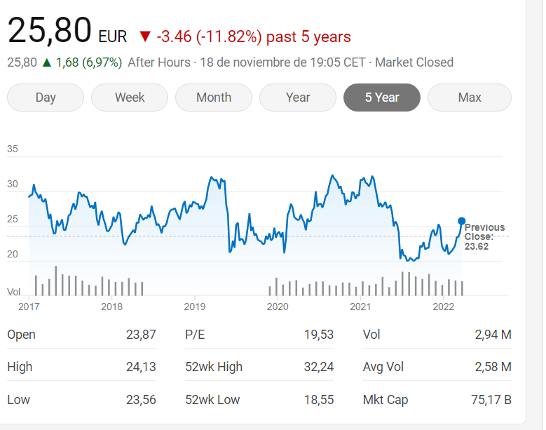
INDITEX: World’s largest fashion retailer with seven brands – Value for the Investors Nov 18, 2022
The news effect in the value of the stock
Relevant News:
Inditex falls sharply on the stock market due to its exposure to Russia CE Noticias Financieras (Latin America)
Inditex, Zara’s parent company, recorded losses of 5% in the Ibex 35 due to its high exposure in Russia and Ukraine. The Spanish textile company has 606 stores in both countries for all its brands, which represents 9.1% of its total business.

Slide 7
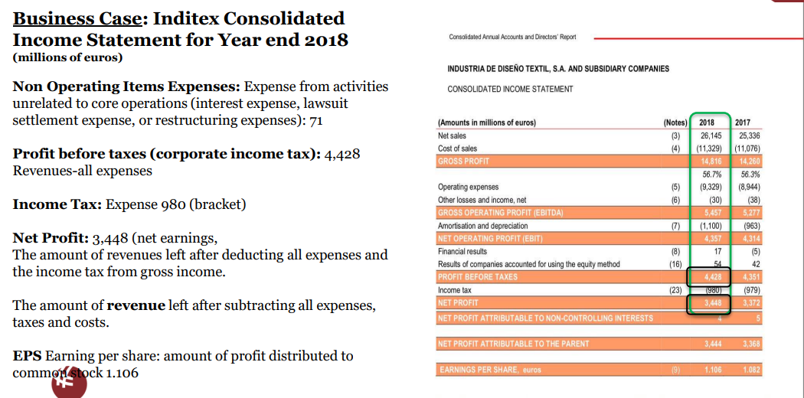
Course Wrap Up - summary
The Four Financial Statements: Structure and Components
Example - Income Statement

Slide 8
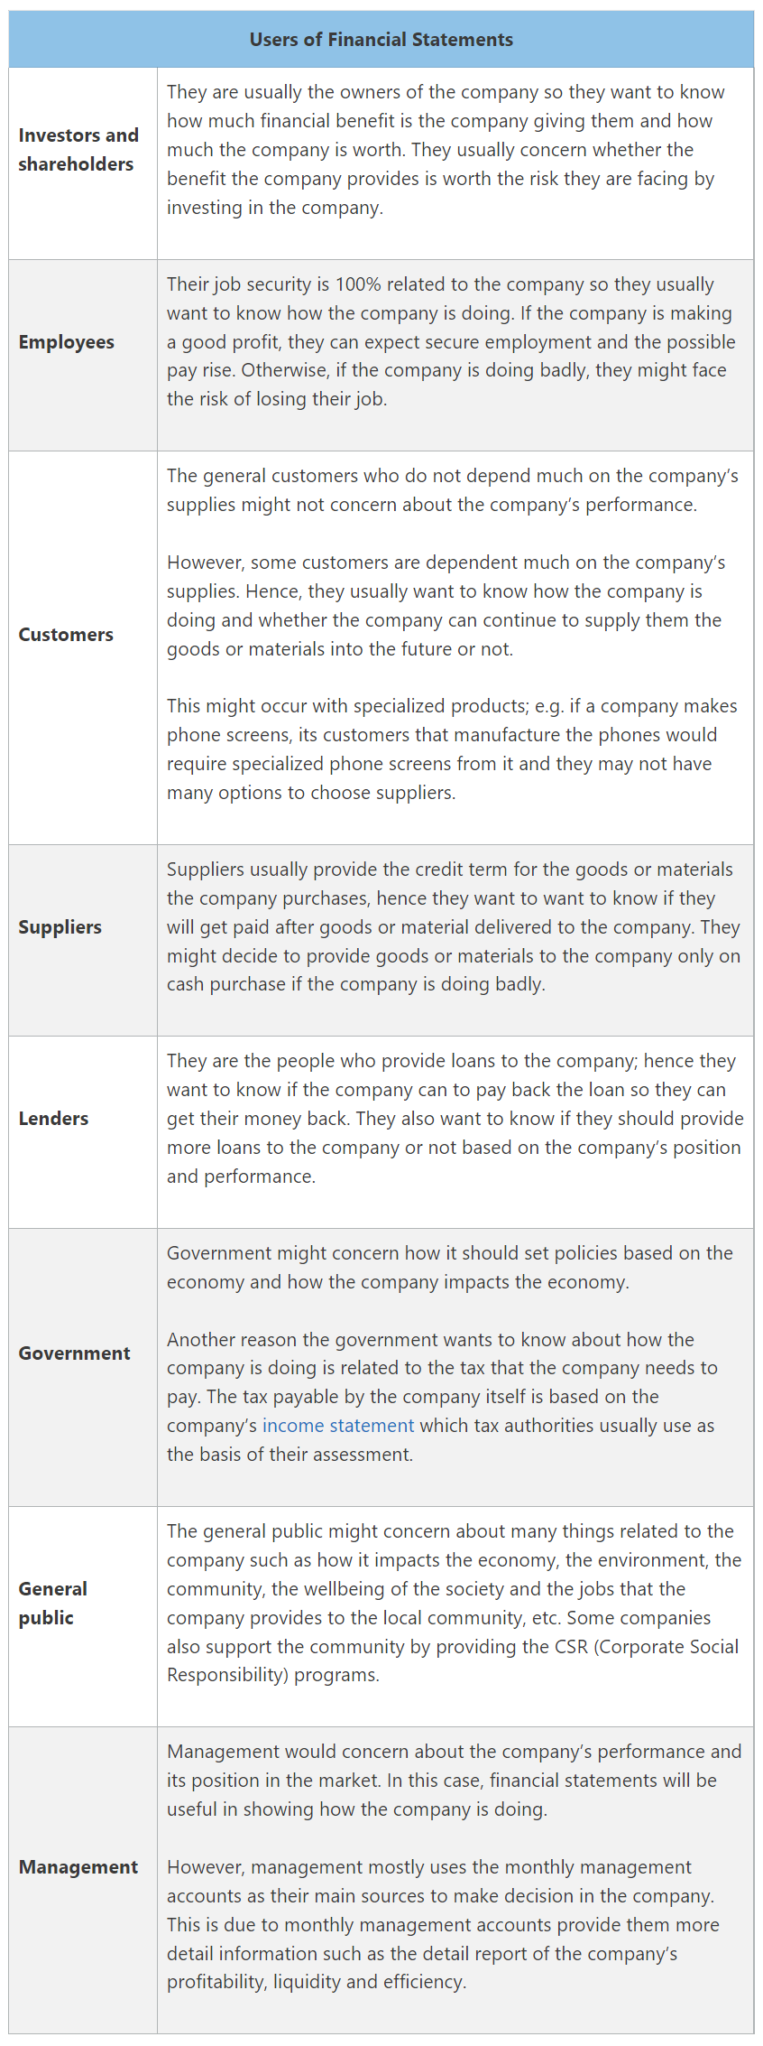
End Users
The Four Financial Statements: Structure and Components
Users of the Financial Statement Information – End Users
www.accountinguide.com

Slide 9
Course Wrap Up - summary
Comparative Financial Statement Analysis

Slide 10
Course Wrap Up - summary
Financial Ratios

Slide 11
Course Wrap Up - summary

Slide 12
Course Wrap Up - summary
Conflict of Interest and Ethics
Agency Relationship is the relationship between stockholders and management.
In corporate finance, the agency problem refers to a conflict of interest between a company's management and the company's stockholders.
Control of the Corporation:
Financial manager acts in the best interests of the stockholders by taking actions that increase the value of the stock.
Corporations have many stakeholders.
Management effectively controls the firm - will they necessarily act in the best interests of the stockholders? Or pursue its own goals at the stockholders' expense?
Reasons for Agency Problems: Conflict of interest and agents tend to have more information than principals.
Example of Principal - Agent Problem: Issuers (principal) and rating agencies (agency).
Agency theory: Explain the important relationships between principals and their relative agent.
The principal is someone who heavily relies on an agent to execute specific financial decisions and transactions that can result in fluctuating outcomes.

Slide 13
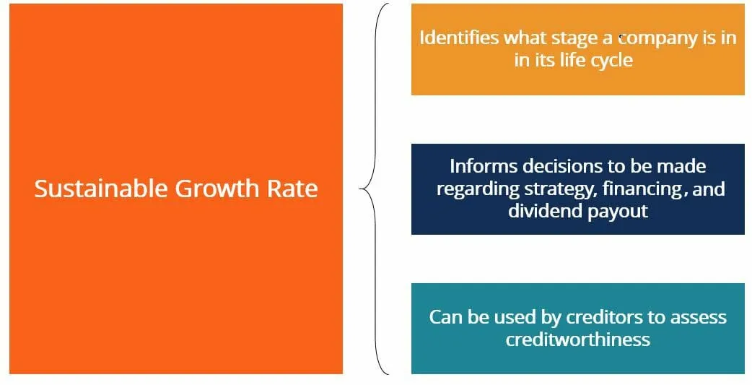
Course Wrap Up - summary
Long-Term Financial Planning and Sustainable growth rate:
The sustainable growth rate is the rate of growth that a company can expect to see in the long term.
The sustainable growth rate is an indicator of what stage a company is in, during its life cycle.
Understanding where a company is in its life cycle is important in determining the corporate finance objectives: sources of financing to use, dividend payout policies, and overall competitive strategy.
The growth ratio is used by creditors to determine the likelihood of a company defaulting on its loans: A high growth rate may indicate the company is focusing on investing in R&D and NPV-positive projects, which may delay the repayment of debt.
A high-growth-rate company is generally considered riskier, as it likely sees greater earnings volatility from period to period.
Retention Rate – [ (Net Income – Dividends) / Net Income) ]
the percentage of earnings that the company has not paid out in dividends
ROE – Return of Equity
https://corporatefinanceinstitute.com/

Slide 14
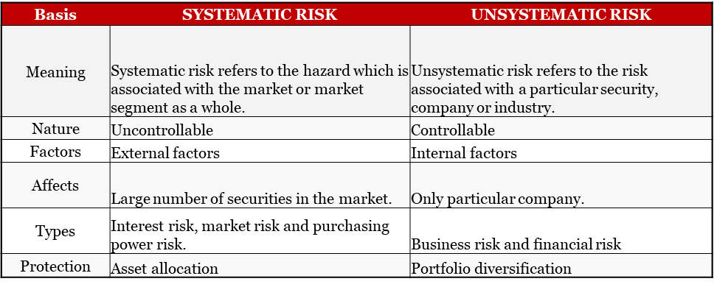
Course Wrap Up - summary
Risk and Return – the higher the required return the higher the risk involved.
Types of Risks: Systematic and Unsystematic Risk
Systematic risk relates to the probability of a loss that is associated with the entire market.
Unsystematic risk refers to the probability of a loss within a specific industry or security.
www.wallstreetmojo.com

Slide 15
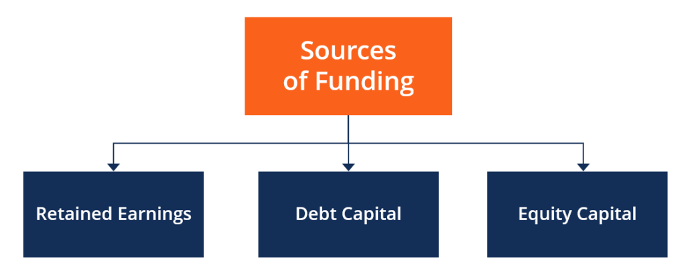
Course Wrap Up - summary
Sources of Capital
Businesses needs capital to grow their businesses and are always looking for the best sources of funding or financing their expansion.
Capital financing is the act of contributing resources to finance a program, project, or a need for the business to meet their short-term or long-term strategies.
An important task of the corporate financial manager is measurement of the company’s cost of capital.
The major sources of funding are:
Retained earnings
Debt capital
Equity capital
corporatefinanceinstitute.com

Slide 16
Course Wrap Up - summary
The Business ideal Debt to Equity Ratio Decisions
Efficient Mix
Debt ➝ Cost of Debt
Common Equity ➝ Cost of Equity
Preferred Stock ➝ Cost of Preferred Stock
Wallsteerprep.cp,

Slide 17
Course Wrap Up - summary
TVM – Time Value of Money for decision-making
Example – PV with Multiple Cash Flows

Slide 18
Course Wrap Up - summary
Tools and Types
Business sustainability depends upon management’s ability to conceive, analyze, and select investment opportunities that are profitable using formulas.
The firm must select such projects that maximize the returns of the business.
Capital budgeting is the allocation of available resources to various proposals.
It involves estimation of cost and benefits of a proposal, estimation of required rate of return and evolution of different proposals to select one.
The costs and benefits are expressed in terms of cash flows from the proposal.
It is a crucial part of an Investment Decision, and a company determines whether projects like R&D, opening a new branch, replacing a machine are worth pursuing.
Capital expenditures often involve large cash outlays with major implications on the future values of the company.
Once a business commit to making a capital expenditure it is sometimes difficult to backed out.
A project is worth pursuing if it increases the value of the company.

Slide 19
Course Wrap Up - summary
Dividends and Dividend Policy
Dividends are profits generated by businesses is accumulated retained earnings, those earnings can be either reinvested in the business, buy back shares outstanding or paid out to shareholders.
Profits are distributed to shareholders as dividends - is a share of profits and retained earnings that a company pays out to its shareholders.
A firm’s dividend policy refers to its choice of whether to pay out cash to shareholders, in what fashion, and in what amount.
A dividend’s value is determined on a per-share basis and is to be paid equally to all shareholders of the same class (common, preferred, etc.)
The payment must be approved by the Board of Directors, and when a dividend is declared, it will then be paid on a certain date- payable date.

Slide 20
Course Wrap Up - summary
Short-Term Financial Planning and Management
The issues of Short-Term Finance and Planning:
What is a reasonable level of cash to keep on hand (in a bank) to pay bills?
How much should the firm borrow in the short term?
How much credit should be extended to customers?
Components of Working Capital:
Current Assets: Inventories, or Marketable Securities
Current Liabilities: Accounts Payable or notes Payable
How much should the firm borrow in the short term?
How much credit should be extended to customers?

Slide 21
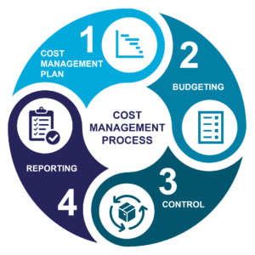
Course Wrap Up - summary
Cost / Price estimation techniques
Cost management is all about achieving value for money.
Cost management is all action necessary to understand why costs occur and the necessary responses so that decisions controlling costs are taken promptly – considering all relevant information.
Cost management involves the overall planning, coordination, control and reporting of all cost-related aspects from initiation to operation and maintenance.
It is the process of identifying all costs associated with the investment, making informed choices about the options that will deliver best value for money and managing those costs, including costs throughout the life of the project, where whole life costs are being considered.
www.googleimages.com

Slide 22
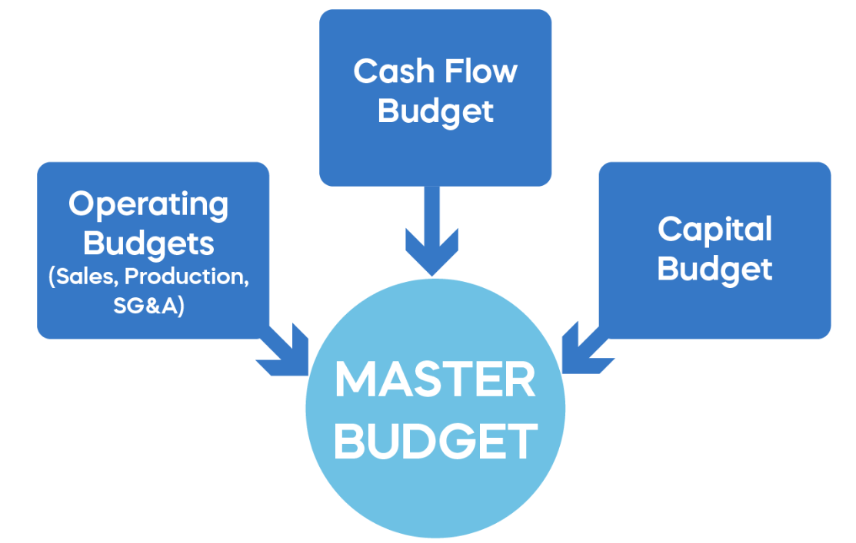
Course Wrap Up - summary
Master Budget and allocation of Overheads methods
Organization goals
Senior management of the companies establish broad objectives (macro) or organization goals that company employees work to achieve financial goals: such as income growth, as well as more general goals focusing on employee learning, innovation, and community involvement.
Those broad goals provide a philosophical statement that the company is expected to follow in its operations, and corporations include their goal statements in published codes of conduct, annual reports to stockholders, and websites.
www..365financialanalyst.com

Slide 23
Course Wrap Up - summary
International Capital Budgeting: Overseas Project Appraisal
Risks of operating internationally
The present value to the parent company of a multinational is a function of future cash flows accruing to it which are distributable to the parent company’s investors.
Analyzing capital investment decisions involves comparing cash inflows with cash outflows from a project.
Investment appraisal focuses upon expected incremental cash flows associated with a project.

Slide 24
Course Wrap Up
Summative Assessment 1
Task
You are requested to choose one publicly traded global business of the industry of your own interest and submit a comprehensive case study. Each student must have the instructor’s approval of the business before starting the assessment. Your case study should consist of about 2,000 words, excluding figures and tables, appendices and references, covering the following:
Executive summary of the case report and introduction to the company. (5 points)
Critically assess the business financial condition by using comparative financial statement analysis (5 points), financial ratio analysis (10), and industry analysis by using the last two years (5 points).
Analyze the selected business current capital structure (5 points), and the critically describe the real challenges they have or had (if any) for raising capital through debt or equity (10 points). Compare, and contrast the findings with a major industry competitor. (10 points).
Critically identify the business three capital budgeting decisions (5 points), explain how the business raised the capital to fund the projects and the challenges – if any(10 points) and identify the valuation technique used. (5 points).
Critically explain two of the business capital investment decisions (5 points), and critically analyze how they are related to their long-term business strategy (5 points), and the contribution to their economic sustainability by creating value. (5 points)
Case study findings and conclusions (10 points)
References and Bibliography (5 points)

Slide 25
Course Wrap Up
Summative Assessment 2
Task:
Individually prepare and submit a comprehensive 2000 report excluding figures and tables, appendices and references of a Large-Cap publicly traded Global Corporation of your interest covering the following:
Executive summary of the report and introduction to the company. (5 points)
Using the business annual report, critically assess the business financial performance the las two financial results (5 points), and analyze
effect of major global events in the business performance using the cash management policies (working capital), the short-term financial strategy implemented for business sustainability (5 points) and the inventory management policy. (5 points)
Analyze the selected corporation’s current capital structure, and discuss the repercussion of relevant news, corporate actions, and other general information available on the internet in the company’s stock price in the last 2 years. (10 points)
Select and discuss the business most relevant capital budgeting decisions (5 points). Critically explain the impact of their capital investment decisions and the long-term strategy for sustainability. (10 points)
Analyze and discuss the business dividend policy (5 points); include an analysis of their common stockholder dividend payment (EPS, Dividend Yield) for the last 3 years (10 points), and the impact of the COVID-19 outbreak and the Russia war on Ukraine in their last dividend payment. (10 points)
Critical thinking – hypothetical situation: You are the CFO of the corporation, and the business is considering entering or expanding its presence in Brazil. Explain the type’s risks inherent to the country and as a CFO provide specific recommendations as to how to mitigate those risks from operating in that market. (10 points). The business is considering building a facility that will serve as a headquarters for the Latam region. Critically analyze the factors the business must consider in international capital budgeting when the project is overseas. (5 points)
Report findings and conclusions – is the business in good financial standing: The corporate finance manager strategies and actions are adding value to the investor.
Based in the findings, and the information publicly available on the internet, will you recommend investing in the business buying stock? Explain your rationale. (10 points)
References and Bibliography (5 points)

Slide 26
Thank You

