Slide 1
Lesson 19
Finance for Management

Slide 2
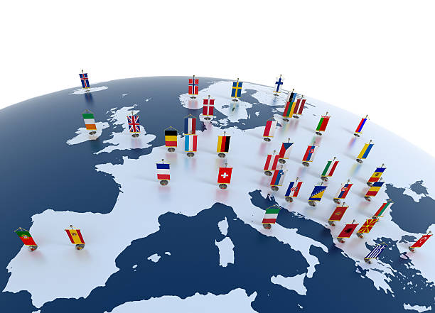
Lesson Topics and Content
Global Financial Operations
Country and Political Risk
The Foreign Exchange Market: FX Risk
Purchasing Power Parity PPP
Interest Rate Risk
International Capital Budgeting: Overseas Project Appraisal
istockphoto.
BARCELONA | MADRID | MALTA | ONLINE

Slide 3
Global Financial Operations
International Aspects Financial Management
  Corporations with foreign operations are often called international corporations or multinationals (MNC).
  MNCs must consider other international many financial factors like foreign exchange rates, differing interest rates from country to country, complex accounting methods for foreign operations, foreign tax rates, or foreign government intervention.
  NPV holds for both foreign and domestic operations: invest in projects that create more value for the shareholders than they cost and to arrange financing that raises cash at the lowest possible.

Slide 4
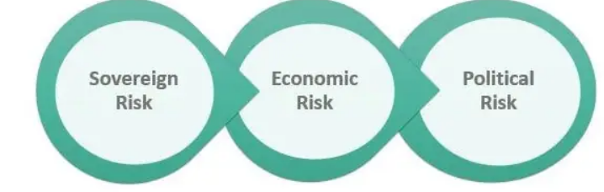
Global Financial Operations
  Country and Political Risk
    Country risk refers to the uncertainty inherent with investing within a given country.
    Governments intervene in their national economies, increasing the level of political risk that the multinational firm faces.
    Political risk is the exposure to a change in the value of an investment cash position resultant upon government actions ranges from exposure to changes in tax legislation like tariffs, FX exchange controls, restrictions affecting operations, or financing in a host currency.
    Multinationals are concerned with the measurement and management of political risk like deciding against investments in political uncertain countries or the use of insurance.
    Assets may be insured in politically risky areas against expropriation and other risks of a political kind - more expensive in high-risk countries.

Slide 5
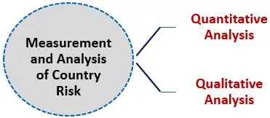
Global Financial Operations
  Country and Political Risk
#1 – Quantitative Analysis
Risk measures like beta coefficients and risk denoting ratios or the Morgan Stanley Capital Investment Index or the MSCI.
#2 – Qualitative Analysis
More subjective aspects of measurement - idea about the risk environment of a country.

Slide 6
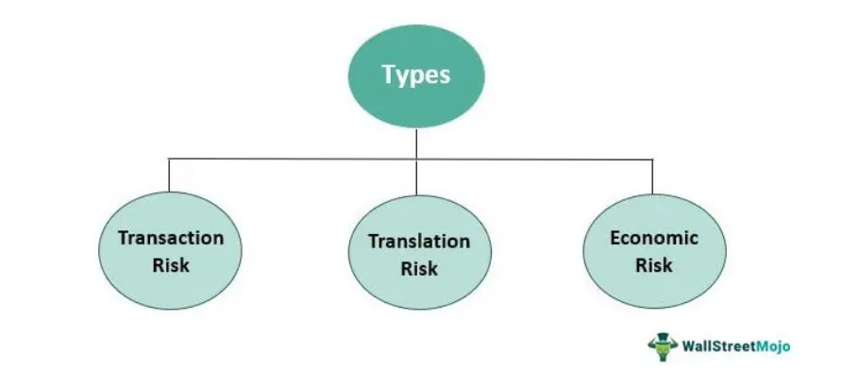
Global Financial Operations
The Foreign Exchange Market: FX Risk
Foreign exchange risk can be caused by appreciation/depreciation of the base currency, appreciation/depreciation of the foreign currency, or a combination of the two.
Foreign exchange risk refers to the risk that a business’ financial performance or financial position will be affected by changes in the exchange rates between currencies.
The three types of foreign exchange risk include transaction risk, economic risk, and translation risk all related to registering and invoicing transactions in a foreign currency.
Foreign exchange risk is a major risk to consider for exporters/importers and businesses that trade in international markets.

Slide 7
Global Financial Operations
The Foreign Exchange Market: FX Risk
The foreign exchange or forex market is the largest financial market in the world – larger even than the stock market, with a daily volume of $6.6 trillion, according to the 2019 Triennial Central Bank Survey of FX and OTC derivatives markets.
Most of the trading takes place in a few currencies: The U.S. dollar ($), the British pound sterling (£), the Japanese yen (¥), and the euro (€).
The foreign exchange market is an OTC : no single location where traders get together, but participants are in the major commercial and investment banks around the world communicating through computers, telephones, and other telecommunication devices.
Example if participants in the foreign exchange market are Importers who pay for goods using foreign currencies, Exporters who receive foreign currency and may want to convert to the domestic currency, Portfolio managers who buy or sell foreign stocks and bonds, Foreign exchange brokers who match buy and sell orders, Traders who “make a market” in foreign currencies, or Speculators who try to profit from changes in exchange rates.

Slide 8
Global Financial Operations
The Foreign Exchange Market: FX Risk
Exchange rate is the price of one country’s currency expressed in terms of another country’s currency
Example Quotation: Aug 19th, 2021 @ 22.45 CEST
USD EUR
1 USD 0.852895 EUR
Case Light Inc - US Dollars for Euros
Exchange rate is $1.3679 per €1
The business a US based business (US dollar) is interested in buying an office space for €100,000 in Spain (Euro currency) how many dollars the business needs to buy the asset?
The business needs US $136,790 to pay the €100,000 in order to buy the office space in Spain
(€ 100,000 * 1.3679 $ /€)
Foreign exchange risk or exchange rate risk, is the risk of financial impact due to exchange rate fluctuations between currencies.

Slide 9
Global Financial Operations
The Foreign Exchange Market: FX Risk
Foreign exchange risk types:
  Transaction risk:
  A change in the exchange rate before transaction settlement – time delay between the transaction and settlement.
    Transaction risk can be mitigated using forward contracts (a binding agreement to perform a trade in the future).
    Example of Foreign Exchange Risk and Mitigation Strategy:
    - A Canadian company with operations in China is looking to transfer CNY600 in earnings to its Canadian headquarters account @the exchange rate at the time of the transaction of 1 CAD for 6 CNY, and the rate falls to 1 CAD for 7 CNY before settlement, an expected receipt of CAD100 (CNY600/6) would instead of CAD86 (CNY600/7), a financial loss of CAD 14.
    - Example of Foreign Exchange Risk mitigation: The mitigation strategy involves a forward contract with a bank or investment bank to buy a forward contract of 100 CAD at a rate of 6 CNY per CAD by the time of the settlement

Slide 10
Global Financial Operations
The Foreign Exchange Market: FX Risk
Foreign exchange risk types:
  Economic risk or forecast risk, is the risk that a business value is impacted by unavoidable exposure to exchange rate fluctuations:
    The risk is created by macroeconomic conditions shift government policies or regulations.
    Mitigation strategies are more awareness than technical like stay grounded in the present, perform regular assessments, or be vigilant and respond fast, or prepare the business for a variety of scenarios.

Slide 11
Global Financial Operations
The Foreign Exchange Market: FX Risk
Foreign exchange risk types:
  Translation risk is the risk faced by a company headquartered domestically but conducting business in a foreign jurisdiction, and of which the company’s financial performance is denoted in its domestic currency.
    Translation risk is higher when a company holds a greater portion of its assets, liabilities, or equities in a foreign currency.
    Companies can attempt to minimize translation risk by purchasing currency swaps (forwards) or hedging through futures contracts or request clients to pay for goods and services in the currency of the company's country of domicile.

Slide 12
Global Financial Operations
The Foreign Exchange Market: FX Risk
The foreign exchange markets provide important information and opportunities for an international corporation when it undertakes capital budgeting and financing decisions.
International trade allows people to shop around for the best price. Given enough time, this comparison shopping allows everyone's purchasing power to reach "parity".
Choices between fixed and floating rate funding should be based upon a careful analysis of the firm’s interest rate exposure and a view of future rate movements given the level of risk aversion of the management.

Slide 13
Global Financial Operations
The Foreign Exchange Market: FX Risk
Advantages of Foreign Exchange Risks
Foreign exchange fluctuation provides an opportunity of gaining from favorable movement in the currency of open foreign exchange position.
Availability of numerous new and innovative products to hedge the risk.
Risk can be hedged by pairing the open positions in currencies with the same or precisely opposite foreign exchange movements.
The flexibility of hedging the risk in an exchange-traded or an Over-the-Counter OTC market as both the markets are very much liquid.
Foreign exchange markets operate round the clock in one or the other country; hence the hedging or speculation is possible anytime.
Disadvantages of Foreign Exchange Risks
It can result in huge losses even if there is a small movement in the rates where the open position is huge.
Hedging the risk involves an additional cost.
Hedging results in margin requirements along with a change in the foreign exchange rates.
Rate and spread determination is a complex process and is often opaque.

Slide 14
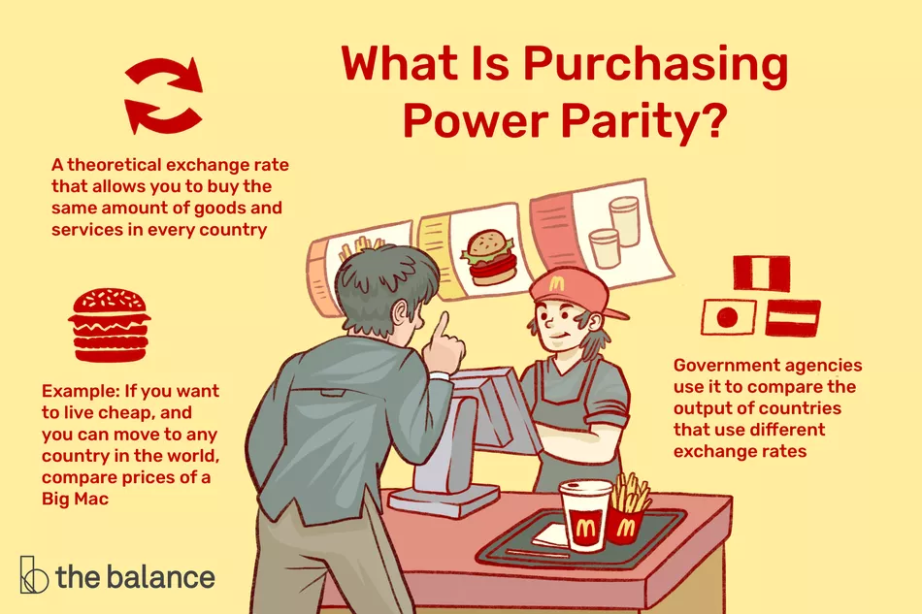
Global Financial Operations
The Purchasing Power Parity PPP
Purchase power parity (PPP) is a method of accounting for differences in the cost of living when comparing national economies base in similar basket of goods.
Tells how much things would cost if all countries used the same currency - the rate at which one currency would need to be exchanged to have the same purchasing power as another currency.
PPP says that the change in the exchange rate is determined by the difference in the inflation rates of the two countries.
1. | Switzerland | 4.48 $
102. | India | 0.45 $
Price Rankings by Country of Coke/Pepsi (0.33 liter bottle) (Restaurants)
www.usnews.com
Image by Miguel Co © The Balance 2019

Slide 15
Global Financial Operations
Interest Rate Risk
    Interest rate risk is concerned with the sensitivity of profit, cash flows or valuation of the firm due to changes in interest rates.
    Every MNC should analyze how its profits, cash outturns and value alter in response to movements in interest rate levels - If a firm’s profits and cash flows are likely to fall when interest rates rise, the business risk averse and will finance itself with fixed-rate funds, for example.
    Choices between fixed and floating rate funding should be based upon a careful analysis of the firm’s interest rate exposure and a view of future rate movements given the level of risk aversion of the management.
    Some mitigation actions are diversification or interest rate options - give the firm the right but not the obligation to fix a rate of interest on a notional loan or deposit, for an agreed amount, for a fixed term, on a specific forward date.

Slide 16
Global Financial Operations
  International Capital Budgeting: Overseas Project Appraisal
Two of the major distorting features of international investment appraisal, which are absent in the domestic counterpart, are exchange controls and international corporation tax.
One of the major differences between domestic and international capital budgeting is the distorting effect of exchange controls - regulations that forbid or restrict the holding of assets denominated in foreign currency and foreign exchange transactions of residents.
Currency is said to be convertible if the authorities of the country allow it to be exchanged without restriction or the need for permission into currencies of other countries.
The tax treatment of foreign exchange gains and losses varies from one country to another - local tax regulations are properly and comprehensively understood if optimal tax treatment is to be obtained for a multinational group.
Multinational companies have developed techniques to mitigate some the adverse impacts of currency exchange control like the use of royalty payments, reinvoicing centers, parallel loans and many others.

Slide 17
Global Financial Operations
  International Capital Budgeting: Overseas Project Appraisal
The present value to the parent company of a multinational is a function of future cash flows accruing to it which are distributable to the parent company’s investors.
Analyzing capital investment decisions involves comparing cash inflows with cash outflows from a project.
Investment appraisal focuses upon expected incremental cash flows associated with a project.

Slide 18
Global Financial Operations
  International Capital Budgeting: Overseas Project Appraisal
Overseas projects possess the usual difficulties found with respect to domestic capital projects.
International project analysis is much more complex, and multinational firms must consider factors peculiar to international operations like availability of technology.
Consider only incremental cash flows that can be remittable to the parent company and add value for its shareholders - a project may can produce considerable cash flows in a foreign territory but, because of exchange control restrictions, the bulk of these foreign cash flows may not be distributable to the parent company.
Multinational companies have developed techniques to mitigate some the adverse impacts of currency exchange control like currency invoicing.

Slide 19

Global Financial Operations
  International Capital Budgeting: Overseas Project Appraisal
There are two approaches to evaluate a foreign project:
  Home currency approach involves converting the foreign project cash flows to local currency based on expected forward exchange rates and discounting them based on home country cost of capital.
  Foreign currency approach requires calculating NPV based on foreign country cost of capital and then converting the foreign-currency NPV to local currency at the spot exchange rate.
  F_{i} the forward exchange rate at t years in future
  S₀ spot rate
  r_{d} is the nominal interest rate in domestic currency
  r_{f} is the nominal interest rate in foreign currency

Slide 20
Global Financial Operations
  International Capital Budgeting: Overseas Project Appraisal
Case Study: Mery’s Books
A U.S. based firm is considering a new project in Spain with expected free cash flows in euros of:
The spot exchange rate is $1.26 per euro, the risk-free interest rate in dollars is 5% and the risk-free interest rate on euros is 7%. The dollar WACC for these cash flows is 10%. What is the dollar present value of the project?

Slide 21
Global Financial Operations
  International Capital Budgeting: Overseas Project Appraisal
Home currency approach
Compute the forward rates:
F1 =($1.26/€) * (1.05/1.07) = $1.2364/€
F2 =($1.26/€) * (1.05٨2/1.07٨2) = $1.2133/€
F3 =($1.26/€) * (1.05٨3/1.07٨3) = $1.1907/€
2. Convert euro cash flows into dollars:
Year | Free Cash Flow (in millions) | Rate | Cash Flow in US $ (in millions)
0 | -100 | 1.2600 | -126
1 | 20 | 1.2364 | 24.728
2 | 70 | 1.2133 | 84.931
3 | 40 | 1.1907 | 47.628

Slide 22
Global Financial Operations
  International Capital Budgeting: Overseas Project Appraisal
Home currency approach
3. Compute the net present value of the project:
NPV= -$126 + ($24,728/(1.10) ٨1) + ($84,931/(1.10) ٨2) + ($47,628/(1.10) ٨3)
NPV=$2.45 million
Foreign currency approach
1. The euro cost of capital can be calculated using the International Fisher Effect
IFE states that the difference between the nominal interest rates in two countries is directly proportional to the changes in the exchange rate of their currencies at any given time
E = [(i₁-i₂) / (1+ i₂)] ͌ (i₁-i₂)
E = % change in the exchange rate
of the country’s currency
I₂ = Country’s B’s Interest rate I₁ = Country’s A’s Interest rate
R fc = (1+rfc) / (1+s) * (1+Rs) -1 = (1.07) / (1.05) * (1.10) = 12.1%
The Euro Cost of Capital 12.1%

Slide 23
Global Financial Operations
  International Capital Budgeting: Overseas Project Appraisal
Foreign currency approach
2. The NPV in the foreign currency is
NPV= - €100 + (€ 20/(1.121) ٨1) + (€ 70/(1.121) ٨2) + (€ 40/(1.121) ٨3)
NPV= € 1.94 million
3. Converted back to dollars at the spot rate
NPV= € 1.94 * ($1.26/ € ) = $2.44 million
CONCLUSIONS
Both methods have potential sources of estimation error
Both NPV are positive, and the forecasts suggest that it is a good deal for the business in equal weight since NPV’s are similar

Slide 24

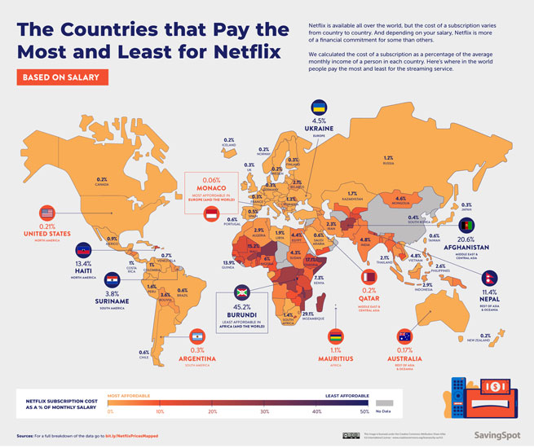
Global Financial Operations
International Case: Netflix strategic pricing worldwide
Best Cost-Effective Countries | Most Expensive Countries | Best Value for Money
Argentina – $3.28/month | Switzerland – $12.40/month | Argentina – $3.28/month for nearly 5000 Titles
Turkey – $3.68/month | Denmark – $11.63/month | Colombia – $4.95/month for Over 4500 Titles
Brazil – $4.13/month | Panama – $8.99/month | Australia – $5.93/month for approx. 5500 Titles
Colombia – $4.95/month | El Salvador -$8.99/month | Turkey – $3.68/month for approx. 4500 Titles
Mexico – $6.44/month | Costa Rica – $8.99/month | Brazil – $4.13/month for approx. 4500 Titles
https://netflixjunkie.com/

Slide 25
Global Financial Operations
  Terms
American depositary receipt (ADR) is a security issued in the United States that represents shares of a foreign stock, allowing that stock to be traded in the United States. Foreign companies use ADRs, which are issued in U.S. dollars, to expand the pool of potential U.S. investors.
The cross-rate is the implicit exchange rate between two currencies (usually non-U.S.) when both are quoted in some third currency, usually the U.S. dollar.
Eurocurrency is money deposited in a financial center outside of the country whose currency is involved. Eurodollars—the most widely used Eurocurrency—are U.S. dollars deposited in banks outside the U.S. banking system.
Gilts are British and Irish government securities, although the term also includes issues of local British authorities and some overseas public-sector offerings.
The London Interbank Offered Rate (LIBOR) is the rate that most international banks charge one another for overnight loans of Eurodollars in the London market. LIBOR is a cornerstone in the pricing of money market issues and other short-term debt issues by both government and corporate borrowers. Interest rates are frequently quoted as some spread over LIBOR, and they then float with the LIBOR rate.

Slide 26
Thank You

