Slide 1
Lesson 18
Finance for Management

Slide 2
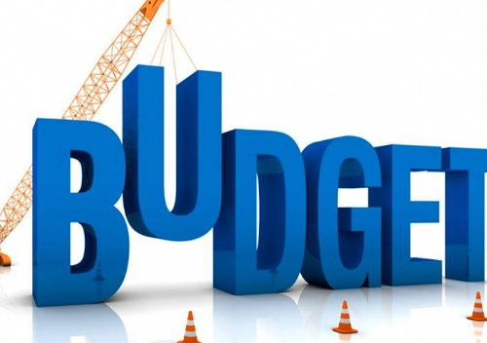
Lesson Topics and Content
Planning and Budgeting:
  Overall Plan
  Master Budget
  Quantitative Techniques
  Fundamentals of Variance Analysis:
    Total Cost, Price and Efficiency
  Variance Analysis for Decision-Making
www.googleimages.com
BARCELONA | MADRID | MALTA | ONLINE

Slide 3
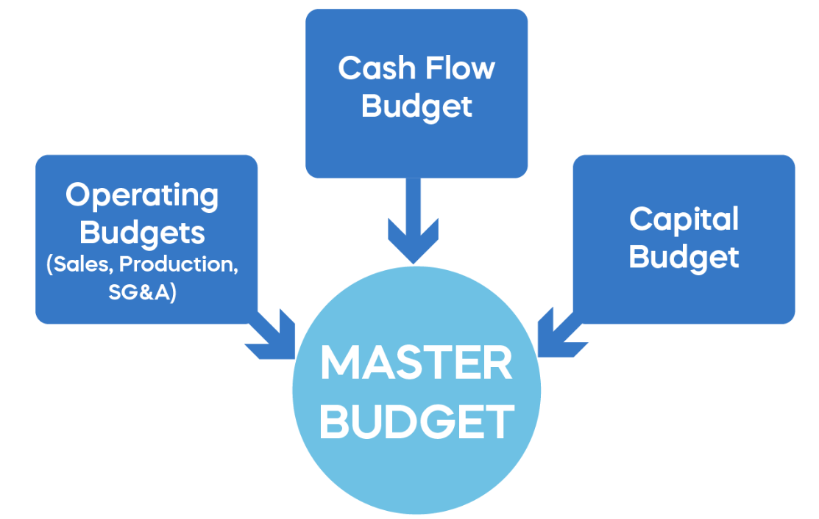
Planning and Budgeting
  Overall Plan
Organization goals
Senior management of the companies establish broad objectives (macro) or organization goals that company employees work to achieve financial goals: such as income growth, as well as more general goals focusing on employee learning, innovation, and community involvement.
Those broad goals provide a philosophical statement that the company is expected to follow in its operations. Corporations include their goal statements in published codes of conduct, annual reports to stockholders, and websites.
www..365financialanalyst.com

Slide 4
Planning and Budgeting
  Overall Plan
Budgeting - Financial plan of the resources needed to carry out activities and meet financial goals necessary for success.
Budget/the plan, in financial terms - How the organization expects to carry out the activities and meet the financial goals, how it fits into the overall business plan for achieving organization goals.
Strategic planning can increase competitiveness and affect global operations:
  Period where businesses identify critical success factors (strengths that are responsible for success) enable a company to outperform their market competitors.
  Identifying and incorporating these factors into the strategic plan, businesses can maintain competitive advantage over their competitors.
  Companies use a budget for forecasting, reporting, performance evaluation, manage cash flow.
Master budget is part of an overall organization plan for the next planning period (year (s)/ periods) and is made up of three components: Organization goals, Strategic long-range profit plan, and the tactical short-range profit plan.

Slide 5
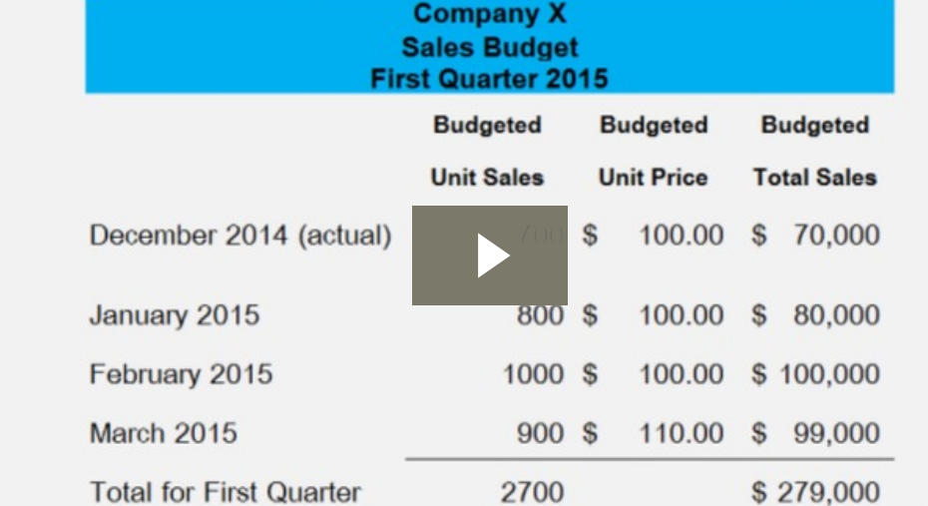
Planning and Budgeting
  Master Budget
Master Budget (Tactical Short - Range Profit) - Tying the Strategic Plan to the Operating Plan
The plan for the coming period - master budget / static budget / the budget plan / or the planning budget - The plan is more specific for shorter than longer terms.
Long-range plans are achieved in year-by-year steps.
Profit plans is the income statement portion of the master budget.
The master budget indicator includes: the level of sales, production, and cost as well as income and cash flows anticipated for the following periods and the data is used to build balance sheet.
A master budget is the consolidation of the department budgets, which are calculated by various functional areas of the business and is a strategy that documents the financial statements, cash flow forecast, financial plans, and capital investments.
www..wallstreetmojo.com

Slide 6
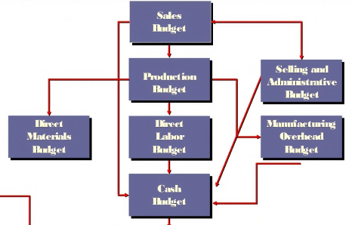
Planning and Budgeting
  Master Budget
MB - Budgets that are within a master budget:
  Direct labor budget, Direct material budget, Finished goods budget, Manufacturing expenses budget, production budget, sales budget, cash budget, capital asset acquiring budget and selling, and administrative budget.
Presented periodically: Monthly or quarterly form as per the requirement and covers the entire fiscal year.
MB- The planning tool used by the management to direct and judge the performance of the various cost centers that reside within an organization to have proper control.
  Undergoes multiple revisions and approvals before it is final approved by the senior management to allocate funds accordingly - Prepared under the guidance of the Budget director - Controller
The sum of all the individual budgets made within separate departments providing sales, production, and costs ensuring that all the departments work together to achieve the common objective of the overall business.
www..wallstreetmojo.com

Slide 7
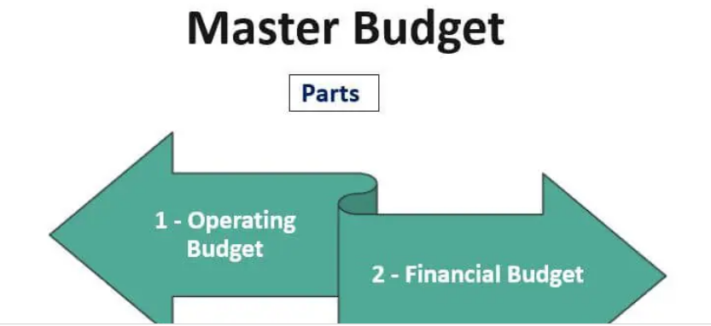
Planning and Budgeting
  Master Budget
Parts of the Master Budget
Operating Budget
  Operating activities and includes the revenues generated and expenses incurred.
  Presented in the form of the budgeted income statement representing the income-generating activities carried on within an organization.
2. Financial Budget
  Provides information about the financial position of the firm.
  Represents the cash budget - information about cash availability.
  The financial budget is prepared by making a budgeted balance sheet.
Benefits:
  Acts as a motivation tool to measure actual performance with the desired one and thereby know the areas of improvement.
  Serves as a summary budget for the owners as they know what the business is estimating to earn and what it would incur to reach the goals.
  Anticipate problems and the overall planning in advance.
www..wallstreetmojo.com

Slide 8
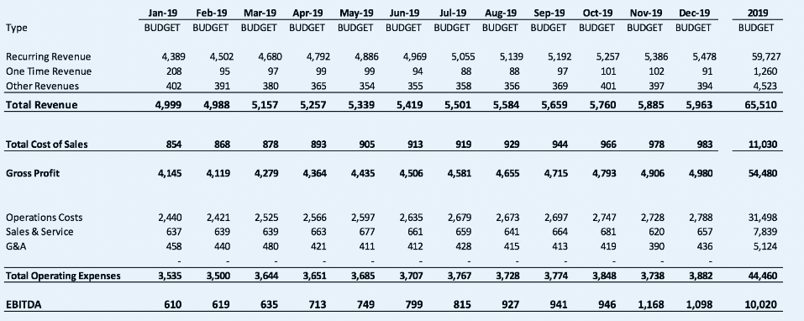
Planning and Budgeting
  Master Budget – Components
  Income: Major component of the master budget - generated from sales operations and other income like interest income, dividends, and capital gain earned by the company.
  Expenses: Major component of the master budget and are divided into fixed and variable expenses.
      Fixed expenses are incurred by the company irrespective of the production level like rent, insurance.
      Variable expenses are an expense that varies according to the level of production.
  Cost of Overhead and Production: To help the business decide the price for its product.
      Cost of production: Raw material, direct labor, machinery, and overhead costs include general and administrative expenses, selling expenses, etc.
  Net Profit or Loss: Net result of the company’s operations.
  Projected Annual performance: To forecast the company’s future performance if a company continues to operate at its current level.

Slide 9
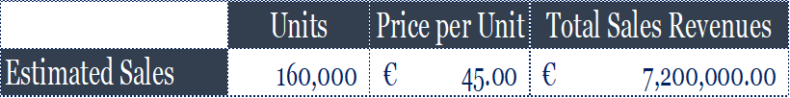
Planning and Budgeting
  Quantitative Technique - Case Study Mery’s Jackets
Step 1 Sales Budget - Production plan of resources needed to meet current sales demand and ensure that inventory levels are sufficient for next budget year, and the required inventories.
Step 2 Production Budget - How many units to be produced
Production level: Units in beginning inventory + Required Production (u) – Budgeted Sales (u) = Units in ending inventory
  Mery’s Jackets sales budget projects sales of 160,000 units
  Management estimates that 5,000 units will be in the beginning inventory of finished goods with an estimated cost of $120,000
  Based on management’s analysis, the required ending inventory is estimated to be 15,000 units.
  There is no beginning or ending work-in-process inventory
Required production (units) : 160,000 units (sales) + 15,000 units (ending inventory) - 5,000 units (beginning inventory) = 170,000 units
Production manager reviews that there is capacity

Slide 10
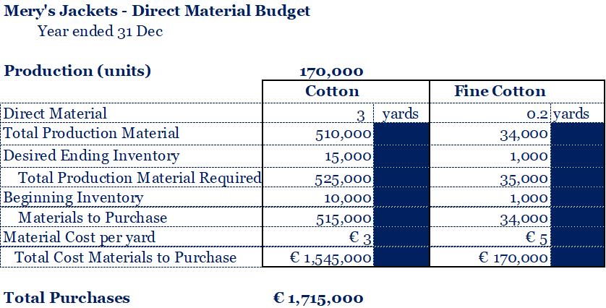
Planning and Budgeting
  Quantitative Technique - Case Study Mery’s Jackets
Step 2 Production Budget - How many units to be produced
Estimate the costs of direct materials, direct labor, and manufacturing overhead at budgeted levels of production
COGS
The cost per yard is expected to remain constant in budget period
Required production (from the production budget) is 170,000 units
The required materials purchases in units of each material:
  Cotton = (170,000 * 3.0) +15,000 -10,000 = 515,000 yds
  Fine Cotton = (170,000 * 0.2) + 1,000 -1,000 = 34,000 yds
  In Currency: € 1,545,000 for cotton (515,000 yards* € 3) &
  € 170,000 for fine cotton (34,000 yards * € 5)

Slide 11
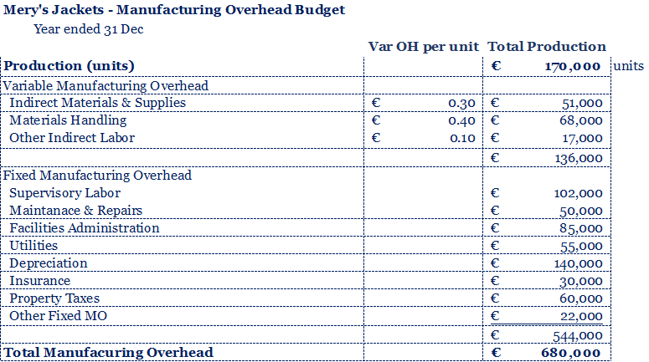
Planning and Budgeting
  Quantitative Technique - Case Study Mery’s Jackets
Step 2 Production Budget - How many units to be produced
Estimate the costs of direct materials, direct labor, and manufacturing overhead at budgeted levels of production.
Forecasting Direct Labor:
Forecasting Overhead Cost:
The direct labor costs are estimated at 0.50 hours per unit at €22 per hour - € 11 per output unit produced)
The budgeted direct labor cost of production of 170,000 units is € 1,870,000
For convenience, after consultation with department management, the budgeting team has divided all overhead into fixed and variable costs totaling €680,000

Slide 12
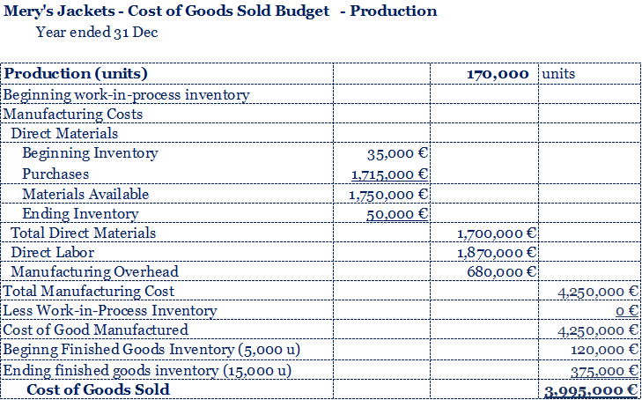
Planning and Budgeting
  Quantitative Technique - Case Study Mery’s Jackets
Step 2 Production Budget - How many units to be produced
Estimate the costs of direct materials, direct labor, and manufacturing overhead at budgeted levels of production.
Forecasting Inventory WIP and Finished Goods:
Forecasting adjustments COGS:
No WIP inventory
Estimated beginning inventory 5,000 at a cost € 120,000
Cost of Producing Jackets €25
Final Forecasting Entry

Slide 13
Planning and Budgeting
  Quantitative Technique - Case Study Mery’s Jackets
Step 2 Production Budget - How many units to be produced
Estimate the administrative and marketing costs at a projected level of sales.
Based on each manager's requirement

Slide 14
Planning and Budgeting
  Quantitative Technique - Case Study Mery’s Jackets
Step 2 Operating Budget P&L - How many units to be produced
Based on each managers requirement
Projected Operating Profits € 1,149,000
Taxes projected € 550,000

Slide 15
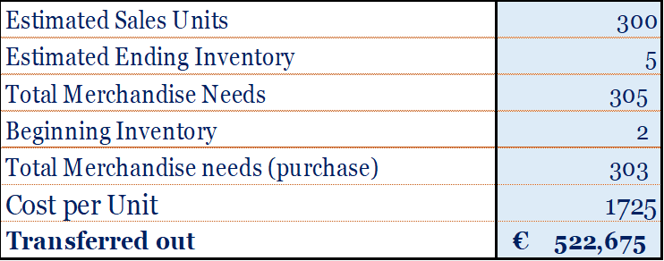
Planning and Budgeting
  Quantitative Technique - Case Study Carol’s Megabyte, Inc
Carol’s Megabyte is a PC Retail store. The manager, Carol prepared the following purchases budget for a particular office development. This budget requires extensive coordination between the managers responsible for sales and those in charge of buying. Timing is critical because the seasonality in merchandising.
Estimated sales . . . . . . . . . . . . . . . . . 300 units
Estimated ending inventory . . . . . . . . 5 units
Estimated beginning inventory. . . . . . . 2 units
Estimated cost. . . .. . . . . . . . . . .. . . . . $1,725

Slide 16
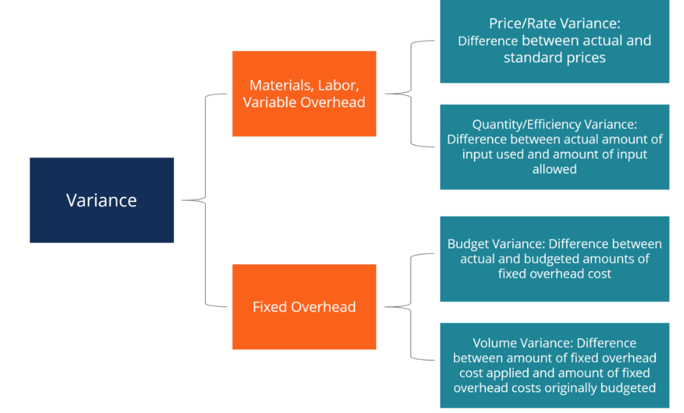
Planning and Budgeting
  Fundamentals of Variance Analysis - Total Cost, Price and Efficiency
Variance analysis is an analysis of the difference between planned and actual numbers.
The sum of all variances gives a picture of the overall over-performance or under-performance for a particular reporting period.
For each item, companies assess their favorability by comparing actual costs to standard costs in the industry.
Variances are computed for the price and quantity of materials, labor, and variable overhead and are reported to management.
It is used to:
  Evaluate the performance of individuals and business units
  Identify possible sources of deviations between budgeted and actual performance
  Attempt to explain the causes of the difference

Slide 17
Planning and Budgeting
  Fundamentals of Variance Analysis - Total Cost, Price and Efficiency
  Case Study - Piamonte Division, Dolcissimo Enterprise, LLC
For the second month in a row, profits at the Piamonte Division part of Dolcissimo Enterprise which is in the southern United States, are down and management do not how to explain. They budgeted a realistic € 190,000 in profit for August, but the actual result was only € 114,500. Sales are down some, but management is not sure it is the only problem. Management is concern on whether they should focus on improving the marketing of the division or review the manufacturing operations. Corporate offices do not have resources to hire an external, so I have the managing director of Piamonte Division to identify the primary cause of the shortfall—revenues or costs—and report back to the Senior Management Committee. They are even considering the full disposal of the division, of there is no improvement. The Piamonte Division makes a single product, a metal frame, which it sells regionally to other manufacturing firms. The division operates as a profit center.
Profit unfavorable variance: € 75,000, decrease in operating profits
Negative performance

Slide 18
Planning and Budgeting
  Fundamentals of Variance Analysis - Total Cost, Price and Efficiency
  Case Study - Piamonte Division, Dolcissimo Enterprise, LLC
Variance column:
Provides information useful for understanding the source of the difference between planned and realized profit performance.
Provides information on the impact on profit performance of each of the revenue and cost categories.
The information allows the manager to investigate more
efficiently the causes of off-budget performance, corrected and improved in the following period.
Allows the manager to evaluate subordinate managers responsible for various aspects of the firm’s operations (marketing and production).
Reasons - Actual and Budgeted Results Different differs:
The Business wants to know how it should change its marketing or production operations to improve results or why the individual line items differs.
Managers need to understand, first, what might cause a difference between actual and budgeted results and, second, what portion of the total profit variance is due to each cause.

Slide 19
Planning and Budgeting
  Fundamentals of Variance Analysis - Total Cost, Price and Efficiency
  Case Study - Piamonte Division, Dolcissimo Enterprise, LLC
Variance Analysis:
Total cost of producing and selling 100,000 frames at Piamonte is € 810,000 (€ 470,000 variable costs and € 340,000 in fixed costs.
In developing the budget, Piamonte used the following budgeting formula to determine costs at the master budget level:
Total cost = € 340,000 + (€ 4.70 × Units produced and sold)
According to the results, the division had done a good job of cost control because actual costs were € 84,500 lower than the budget plan (variable costs were $72,320 lower and fixed costs were € 12,180 lower).
Flexible Budget
Piamonte produced and sold only 80,000 units, and according to the flexible budget concept, the master budget must be adjusted for this change in activity:
€ 716,000 [= € 340,000 + (€ 4.70 × 80,000 units)] less than the actual costs
    Static budget: Budget for a single activity level or master budget
    Flexible budget: Budget that indicates revenues, costs, and profits for different levels of activity
    Flexible budget line: Expected monthly costs at different output levels

Slide 20
Planning and Budgeting
  Fundamentals of Variance Analysis - Total Cost, Price and Efficiency
  Case Study - Piamonte Division, Dolcissimo Enterprise, LLC
Variance Analysis:
A comparison of the master budget with the flexible budget and with actual results is the basis for
analyzing differences between plans and actual performance - flexible budget is based on actual activity.
Comparing Budgets and Results : Sales Activity Variance:
  Sales Activity Variance: The difference between operating profits in the master budget and operating profits in the flexible budget.
  The € 106,000 unfavorable variance is due to the activity that resulted in a 20,000-unit difference between actual sales and planned sales.
  The information is useful for management because it isolates the decrease in operating profit caused by the decrease in activity from the master budget.
  Variable costs are expected to decrease by € 94,000, giving an unfavorable contribution margin of € 106,000 - sales activity variance.
  20,000-unit decrease in sales creates an unfavorable sales activity variance.
    Poor performance? Economic conditions could have been worse than planned decreasing the demand.
    20,000-unit decrease in sales volume could have been greater.

Slide 21
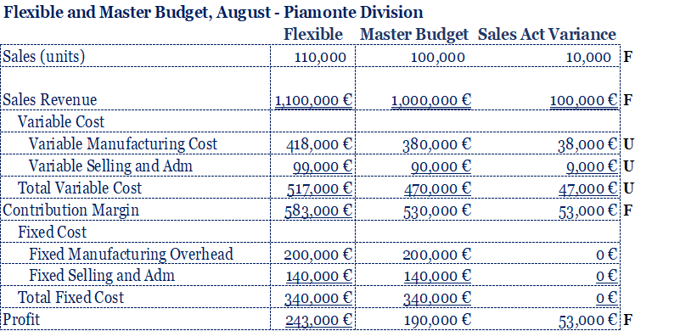
Planning and Budgeting
  Fundamentals of Variance Analysis - Total Cost, Price and Efficiency
  Case Study - Piamonte Division, Dolcissimo Enterprise, LLC
Variance Analysis:
Assuming a new result: flexible budget for Piamonte Division for August with the same master budget but 110,000 units were sold.
F

Slide 22
Planning and Budgeting
  Fundamentals of Variance Analysis - Total Cost, Price and Efficiency
  Case Study - Piamonte Division, Dolcissimo Enterprise, LLC
Variance Analysis - Direct Material
Piamonte determines the standard price of the materials it uses to make frames:
A single material (metal) is used, and each frame requires 4 pounds of this material
Piamonte’s purchasing manager estimates that the cost of metal with the correct specifications and quality should be €0.55 per pound
The €0.55 is the standard price for a unit of input, not output
The standard materials cost for a unit of output, a frame, is € 2.20 (= 4 pounds × € 0.55 per pound)
Actual= (AP * AQ)
Actual Input at Actual Prices ( SP * AQ)
Flexible Production Budget ( SP * SQ)
  Price Variance= 1 –3
  Efficiency Variance = 2 - 3
  Total variance = 1 - 3

Slide 23
Planning and Budgeting
  Total Cost, Price and Efficiency - Variance Analysis for Decision Making
  Case Study - Piamonte Division, Dolcissimo Enterprise, LLC
1 Actual Cost = (AP * AQ) = 328,000 pounds* 0.60 €/pound= €196,000
2 Standard Cost= ( SP * AQ) = 328,000 pounds*0.50 €/pound = €180,400
3 Flexible Production Budget ( SP * SQ)=4pounds*80,000units* 0.55 €/pound = €176,000
Price Variance= 1 –3 €196,000 - €176,000 = €16,400/u
Efficiency Variance = 2 – 3 €180,400 - €176,000 = €4,400 /u
Total variance = 1 – 3 €16,400 + €4,400 = €20,800 /u
Price Variance (€0.60-€0.55)*328,000units = €16,400/u
Efficiency Variance €0.55*(328,000-320,000)units = €4,400/u

Slide 24
Planning and Budgeting
  Total Cost, Price and Efficiency - Variance Analysis for Decision Making
  Case Study - Piamonte Division, Dolcissimo Enterprise, LLC
Analysis and Decisions:
The direct materials price variance shows that in August, the prices paid for direct materials exceeded the standards allowed, thus creating an unfavorable variance of €16,400, responsibility for this variance is usually assigned to the purchasing department.
Reports to management include an explanation of the variance, for example, failure to take purchase discounts, higher transportation costs than expected, different grade of direct materials purchased, or changes in the market price of direct materials.
The explanation for Piamonte’s variance was the closure of a nearby vendor’s plant, which required a change in suppliers and increased transportation costs that caused the price of materials to be higher than expected
Management has begun market research to determine whether Piamonte should attempt to increase sales prices for its frames.
Direct materials efficiency variances are typically the responsibility of production departments. At Piamonte, the unfavorable materials efficiency variance was attributed to an increase in the amount of scrap that results from the cutting process. One of the new employees hired in August required some time to learn to work efficiently with the material. The production supervisor claimed that this was a one-time occurrence and foresaw no similar problems in the future.

Slide 25
Thank You

