Slide 1
Lesson 17
Finance for Management

Slide 2
Lesson Topics and Content
Managerial Accounting Cost Method Approach and Techniques:
Fundamentals of Cost Management
Plantwide and Department Allocation
Activity Cost Method ABC
Target and Life Cycle Cost techniques
Overhead Allocations
Limiting Factor Analysis
BARCELONA | MADRID | MALTA | ONLINE

Slide 3
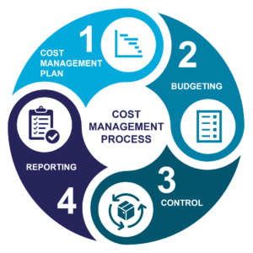
Managerial Accounting Cost Method Approach and Techniques
Fundamentals of Cost Management
Cost management is all about achieving value for money.
Cost management are all actions necessary to understand why costs occur and the necessary responses so that decisions controlling costs are taken promptly – considering all relevant information.
Cost management involves the overall planning, coordination, control and reporting of all cost-related aspects from initiation to operation and maintenance.
It is the process of identifying all costs associated with the investment, making informed choices about the options that will deliver best value for money and managing those costs, including costs throughout the life of the project, where whole life costs are being considered.
www.googleimages.com

Slide 4
Managerial Accounting Cost Method Approach and Techniques
Fundamentals of Cost Management
Value Creation in Organizations
The purpose of using cost accounting is to guide managers in achieving the maximum value for their organizations.
Cost accounting measures the effects of decisions on the value of the organization.
Value chain: Is the set of activities that transforms raw material into the goods and services end users. They comprises: R&D, production process, marketing or customer service.
The objective of cost accounting is to ensure that the entire value chain is as efficient as possible and coordinating with vendors and suppliers and with distributors and customers to achieve this objective.
How do managers use accounting information to create value in organizations?

Slide 5
Managerial Accounting Cost Method Approach and Techniques
Fundamentals of Cost Management
Focus on:
The design of cost accounting systems and the information provided to managers for decision-making.
Illustrate the use of cost accounting data in making pricing and product portfolio decisions.
The use of the information for managing costs.
www.googleimages.com

Slide 6
Managerial Accounting Cost Method Approach and Techniques
Fundamentals of Cost Management
Value Creation in Organizations
Cost Data for Managerial Decisions – Framework
Good decisions help businesses remain viable and achieve their goals.
Managers use accounting information to make decisions, decision determines the performance of an organization, and stakeholders or senior management measures management performance:
Managers identify and eliminate non-value-added activities, which often result from the current product or process design: poor plant layout and work-in-process inventory must be moved during the production process, reworking defective units (wages, equipment).
If activities that do not add value to the company can be eliminated, then costs associated with them will also be eliminated.
www.googleimages.com

Slide 7
Managerial Accounting Cost Method Approach and Techniques
Fundamentals of Cost Management
Value Creation in Organizations
Cost Data for Managerial Decisions – Framework
Identifying Strategic Opportunities
Value chain analysis and other information about the costs of activities - companies can identify strategic advantages in the marketplace: eliminating non-value-added activities, reduces costs without reducing the value of the product to customers.
Reducing costs provides benefits like lower pricing giving it competitive cost advantage over competitors.
Evaluation of management performance by stakeholders.
www.googleimages.com

Slide 8
Managerial Accounting Cost Method Approach and Techniques
Fundamentals of Cost Management
Cost: Use of a resource for price
Cost vs. expense: Expense is cost associated with the revenue for a given accounting period:
The statements are prepared for internal management use, not for external reporting.
Management focus on operating profit.
Information from the cost accounting system is just a means to an end, the final products are managerial decisions and actions, and the change in business value.
Accuracy is not relevant. We are not seeking the “most accurate” information; we are looking for the best information, understanding how the information is used in decision making, and recognizing the cost of preparing and using the information.
Service Companies: Billable hours, retail/wholesale cost of goods sold manufacture companies – manufacturing costs, manufacturing direct and indirect costs, allocations.
www.googleimages.com

Slide 9
Managerial Accounting Cost Method Approach and Techniques
Fundamentals of Cost Management
Presentation of Costs in Financial Statements:
Income Statement: Cost of goods manufactured, cost of goods sold, direct materials, finished goods inventory.
Cost Allocation: Result from several departments sharing facilities.
Cost Behavior: Fixed, Variable, Semi Fixed, Step
Understanding cost behavior is an important part of using cost accounting information wisely for decisions.
Components of Products costs
Full cost: Sum of all costs of manufacturing and selling a unit of product (includes both fixed and variable costs) - full absorption cost full cost of manufacturing the one unit.

Slide 10
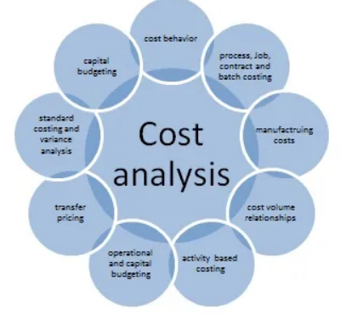
Managerial Accounting Cost Method Approach and Techniques
Fundamentals of Cost Management
Methods of costing:
Job Costing
Contract Costing
Cost Plus Costing
Batch Costing
Process Costing
Operation Costing
Unit Costing
Operating Costing
Departmental Costing
Multiple Costing
Techniques of costing:
Budgetary Control
Standard Costing
Marginal Costing
Lifestyle Costing
Target Costing
Activity Based Costing
www.googleimages.com

Slide 11
Managerial Accounting Cost Method Approach and Techniques
Overhead Allocations
Overhead allocation is the apportionment of indirect costs to produced goods.
In many businesses, the amount of overhead to be allocated is substantially greater than the direct cost of goods, so the overhead allocation method can be of some importance.
Formula, Cost pool ÷ Total activity measure = Overhead allocation per unit
Types of Overhead:
Administrative overhead includes those costs not involved in the development or production of goods or services, such as the costs of front office administration and sales - all overhead that is not included in manufacturing overhead.
Manufacturing overhead is all of the costs that a factory incurs, other than direct costs.
Depreciation of factory equipment | Quality control and inspection
Factory administration expenses | Rent, facility and equipment
Indirect labor and production supervisory wages | Repair expenses
Indirect materials and supplies | Rework labor, scrap and spoilage
Maintenance, factory and production equipment | Taxes related to production assets
Officer salaries related to production | Uncapitalized tools and equipment
Production employees’ benefits | Utilities
www.accountingtools.com
Case Study: Villanueva Investments has total indirect costs of $100,000 and it decides to use the cost of its direct labor as the allocation measure. The business incurs $50,000 of direct labor costs, the overhead rate is $100,000 Indirect costs ÷ $50,000 Direct labor or an overhead rate of 2.0.

Slide 12
Managerial Accounting Cost Method Approach and Techniques
Plantwide and Department Allocation
Managers analyze the most efficient and effective ways to compute the cost of their products.
Manager’s decision:
A manufacturing plant produces printers; the company has three possible methods that can be used to allocate overhead costs to product:
Plantwide allocation - A method of allocating costs that uses one cost pool, and therefore one predetermined overhead rate, to allocate overhead costs.
Department allocation - A method of allocating costs that uses a separate cost pool, and therefore a separate predetermined overhead rate, for each department.
Activity-Based allocation or activity-based costing refers to the allocation of costs (charges and expenses) to different heads or activities or divisions according to their actual use or on account of some basis for allocation.
The choice of an allocation method depends on how managers decide to group overhead costs and the desired accuracy of product cost information, the more cost pools used, the more accurate the allocation process.
www.googleimages.com

Slide 13
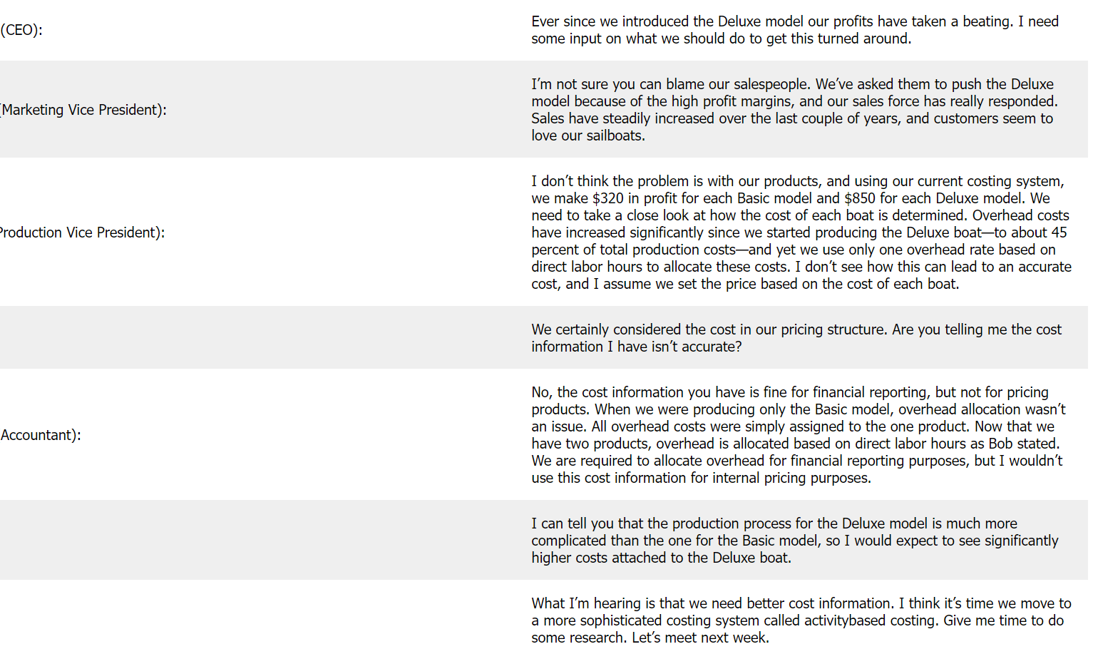
Managerial Accounting Cost Method Approach and Techniques
Plantwide and Department Allocation – Case Study Nautic, LLC
Carol is the owner and chief executive officer of Nautic, LLC. The business builds two models of sailboats that are sold at hundreds of retail boat showrooms throughout the world, the Basic model, which is 12 feet long and designed for two sailors. Very few options are available for this model, and the production process is relatively simple. Because many owners of the Basic model wanted to move to a bigger, more sophisticated boat, Nautic developed the Deluxe model two years ago. The Deluxe model is 14 feet long and designed for three sailors. Many additional features are available for this model, and the production process is more complex than for the Basic model. Last year the business sold 5,000 units of the Basic and 1,000 units of the Deluxe.
Although sales of both models increased last year over the year before, company profits have steadily declined. Carol is concerned about this trend and discusses her concerns with Bernard, the company’s accountant; Maria, the VP sales and marketing; and Bruno, the VP of production.
CEO
BRUNO
www.googleimages.com
MARIA

Slide 14
Managerial Accounting Cost Method Approach and Techniques
Plantwide and Department Allocation – Case Study Nautic, LLC
Direct Costs traced to products:
Labor: Employees building the boat
Materials: Fiberglass to build the hull, mast, sails, and rope
Indirect manufacturing costs – Overhead not easily traced to products:
Electricity to run the factory, rent for the factory building, and factory maintenance
Accounting for indirect manufacturing costs requires allocating overhead using predetermined overhead rates
Overhead costs are allocated to products to provide information for internal decision making, to promote the efficient use of resources.
Assumptions:
Annual overhead costs estimated for the business $8,000,000
Management estimates that a total of 250,000 direct labor hours are worked annually
Direct materials cost $1,000 for one unit of the Basic sailboat and $1,300 for the Deluxe
Direct labor costs are $600 for one unit of the Basic sailboat and $750 for the Deluxe
Pricing: The average sales price is $3,200 for the Basic model and $4,500 for the Deluxe
The cost pool in the Hull Fabrication department is estimated in $3,000,000 for the year, and in the Assembly department is estimated at $5,000,000 ($8,000,000)
Machine hours (estimated at 60,000 hours) will be used as the allocation base for Hull Fabrication, and direct labor hours (estimated at 217,000 hours) will be used as the allocation base for Assembly department

Slide 15
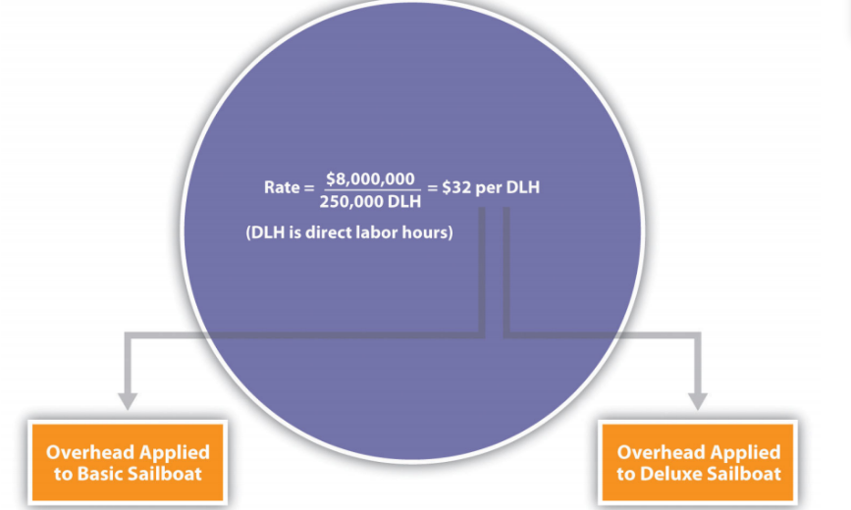
Managerial Accounting Cost Method Approach and Techniques
Plantwide and Department Allocation – Case Study Nautic, LLC
Plantwide Allocation method to allocate overhead to the two sailboat models produced by the business:
The simplest and least expensive approach, it also tends to be the least accurate.
Uses one predetermined overhead rate to allocate overhead cost for each cost pool.
Predetermined overhead rate is $32 per direct labor hour ($8,000,000 ÷ 250,000 direct labor hours) - products are charged $32 in overhead costs for each direct labor hour worked.
www.libretext.org

Slide 16
Managerial Accounting Cost Method Approach and Techniques
Plantwide and Department Allocation – Case Study Nautic, LLC
Nautic’s product cost per unit and resulting profit using the plantwide approach to allocate overhead is:
*$1,280 = 40 direct labor hours per unit × $32 rate.
**$1,600 = 50 direct labor hours per unit × $32 rate.
www.libretext.org
Profit per unit:
Basic Model is $320 ($3,200 price – $2,880 cost)
Deluxe Model is $850 ($4,500 price – $3,650 cost)
Organizations that use a plantwide allocation – Nautic, LLC have simple operations with a few similar products
Management may not want more accurate product cost information or may not have the resources to implement a more complex accounting system.

Slide 17
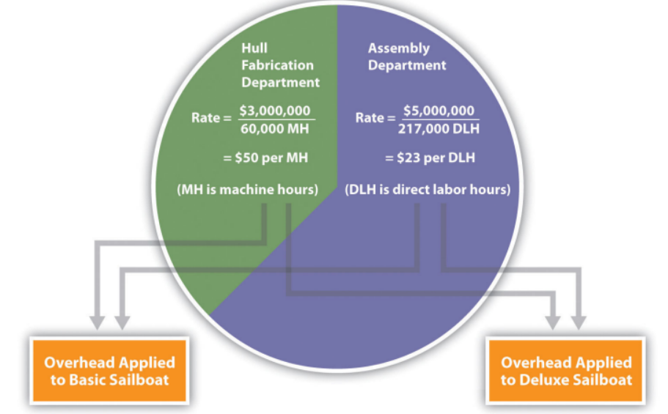
Managerial Accounting Cost Method Approach and Techniques
Plantwide and Department Allocation – Case Study Nautic, LLC
Department Allocation method to allocate overhead to the two sailboat models produced by the business:
Also, a traditional approach but more accurate – plantwide
Cost pools are formed for each department rather than for the entire plant, and a separate predetermined overhead rate is established for each department:
Hull Fabrication department rate is $50 per machine hour ($3,000,000 ÷ 60,000 hours): Products going through the Hull Fabrication department are charged $50 in overhead costs for each machine hour used
Assembly department rate is $23 per direct labor hour ($5,000,000 ÷ 217,000 hours): Products going through the Assembly department are charged $23 in overhead costs for each direct labor hour used
Department allocation approach allows cost pools to be formed for each department and provides for flexibility in the selection of an allocation base.
www.libretext.org

Slide 18
Managerial Accounting Cost Method Approach and Techniques
Activity Cost Method ABC
Activity-based costing (ABC costing) refers to the allocation of costs (charges and expenses) to different heads or activities or divisions according to their actual use or on account of some basis for allocation to arrive at a profit.
Activity-Based Costing Formula = Cost Pool in Total / Cost Driver
An activity is any process or procedure that consumes overhead resources.
Cost Pool: Item for which measurement of the cost would require, e.g., a product.
Cost Driver: It is a factor that will cause a change in the cost of that activity - two kinds of cost drivers:
Resource Cost Driver: It measures the number of resources that activity consumes. It will be used to assign the cost of a resource to an activity. E.g., Electricity, Staff wages, Advertising, etc.
Activity Cost Driver: This is the measure of the intensity of demand and the frequency placed on the activities by the cost pools. It will assign the activity costs to a product or a customer. E.g., Material ordering costs, Machine setup costs, Inspection and testing charges, Material handling and storing costs, etc.

Slide 19
Managerial Accounting Cost Method Approach and Techniques
Activity Cost Method ABC
Kings, Inc is considering shifting from the traditional costing method to the ABC-based costing method, and it has the following details. Using ABC costing formula, find out the new overhead rates for the company.
Activity Based Costing
We have two activities. The first one is a machine set-up activity, and the second one is inspecting the same. A cost driver is a unit that derives the expenses and sets a basis on which a particular cost is to be allocated between the different departments and based on that driver’s activity completed in that period the cost is allocated
These are the structural determinants of the activities on which cost is being incurred and determine the behavior of the costs on an activity.
Machine setup cost / Number of Machine setups =200,000 / 340 = 588.24
Inspection cost / Inspection hours = 1,40,000 / 7500 = 18.67

Slide 20
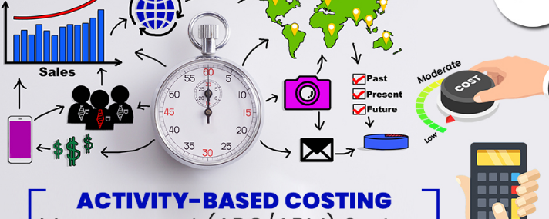
Managerial Accounting Cost Method Approach and Techniques
Activity Cost Method ABC– Case Study Nautic, LLC
ABC Five steps of activity-based method to allocate product cost of the two sailboat models produced by the business:
Uses several cost pools organized by activity to allocate overhead costs.
Activities are required to produce product like purchasing materials, setting up machinery, assembling products, and inspecting finished products - can be costly.
The cost of activities is allocated to products based on the products’ use of the activities.
The total overhead ($8,000,000) is broken out into different activities not departments, and an overhead rate is established for each activity.
The goal is to understand all the activities required to make the company’s products.
An activity is any process or procedure that consumes overhead resources.
www.googleimages.com

Slide 21
Managerial Accounting Cost Method Approach and Techniques
Activity Base Costing ABC – Case Study Nautic, LLC
Step 1 Identify costly activities required to complete products.
After meeting with personnel throughout the company, Nautic’s accountant identified the following activities as having the biggest impact on overhead costs:
Purchasing materials
Setting up machines
Running machines
Assembling products
Inspecting finished products
Step 2 Assign overhead costs to the activities identified in step 1
The accountant at Nautic developed the following allocations after careful review of all overhead costs
www.libretext.org

Slide 22
Managerial Accounting Cost Method Approach and Techniques
Activity Base Costing ABC– Case Study Nautic, LLC
Step 3 Identify the cost driver for each activity
A cost driver is the action that causes the costs associated with the activity by interviewing key personnel.
Identifying cost drivers requires gathering information and interviewing key personnel in various areas.
After scrutiny of the process required for each activity, Nautic LLC established the following cost drivers:
www.libretext.org

Slide 23
Managerial Accounting Cost Method Approach and Techniques
Activity Base Costing ABC– Case Study Nautic, LLC
Step 4 Calculate a predetermined overhead rate for each activity
Dividing the estimated overhead costs (step 2) by the estimated level of cost driver activity (step 3)
Predetermined Overhead rate for Nautic, LLC:
www.libretext.org
For each purchase requisition processed, products will be charged $120 in overhead costs, $800 for each machine setup, $30 for each machine hour used, $6 for each direct labor hour worked, and $50 for each hour of inspection time.

Slide 24
Managerial Accounting Cost Method Approach and Techniques
Activity Base Costing ABC– Case Study Nautic, LLC
Step 5 Allocate overhead costs to products
Overhead costs are allocated to products by multiplying the predetermined overhead rate for each activity (step 4) by the level of cost driver activity used by the product.
www.libretext.org

Slide 25
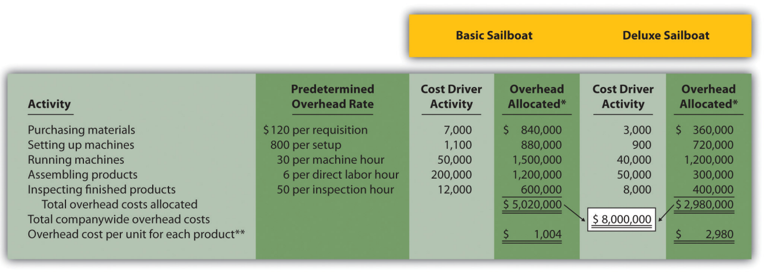
Managerial Accounting Cost Method Approach and Techniques
Activity Base Costing ABC– Case Study Nautic, LLC
Step 5 Allocate overhead costs to products
www.libretext.org
Overhead cost per unit for each product assuming Nautic produces 5,000 units of the Basic sailboat and 1,000 units of the Deluxe sailboat

Slide 26
Managerial Accounting Cost Method Approach and Techniques
Activity Base Costing ABC– Case Study Nautic, LLC
Product Cost using ABC
A product’s cost involves three components—direct materials, direct labor, and manufacturing overhead.
Using the product cost information:
Basic model has a profit of $596 ($3,200 price – $2,604 cost) per unit
Deluxe model produces a loss of $530 ($4,500 price – $5,030 cost) per unit
www.libretext.org

Slide 27
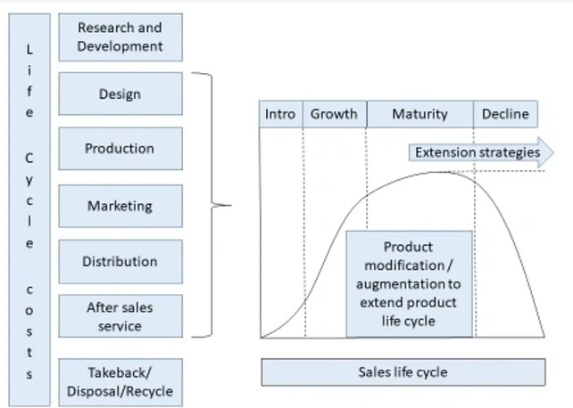
Managerial Accounting Cost Method Approach and Techniques
Target and Lifecycle Cost techniques
The lifecycle cost primary purpose is to help management decide whether to go ahead with a project or acquire an asset. Management usually analyzes the cost of ownership and operating cost and then eventually chooses the asset with the minimum overall cost.
www.libretext.org
Lifecycle Costing Formula = Initial Cost + PV of All Recurring Costs – PV of Residual Value

Slide 28
Managerial Accounting Cost Method Approach and Techniques
Life Cycle Cost techniques – Case Study: Lago, Inc
The business wants to buy in a new towing truck at cost $12,000 and estimates to sell the car in five years at a residual value of $3,000. Some of the estimated annual expenses are:
Maintenance & repair $1,000
Gas consumption $3,500
Using the Life Cycle cost technique, compute truck’s life cycle cost considering the interest rate to be 8%.
Initial cost = $12,000
Recurring cost = Maintenance & repair + Gas consumption = $1,000 + $3,500 = $4,500
Residual value = $3,000
No. of years = 5
Interest rate = 8%
Life Cycle Costing Formula = Initial Cost + PV of All Recurring Costs – PV of Residual Value
$12,000 + $4,500 * [1 – (1 + 8%)⁻⁵] / 8% – $3,000 / (1 + 8%)⁵ ⁼ $27,925

Slide 29
Managerial Accounting Cost Method Approach and Techniques
Life Cycle Cost techniques
Benefits
It provides a precise estimate of the expected cost to be incurred over the asset’s life span.
It makes sure that the best decision is made based on an accurate and realistic estimate of costs.
It ensures that the management takes early actions to lower recurring and non-recurring costs.
Effects
The life cycle costing estimates help decision-making where a mutually exclusive option is available.
Management can plan to reduce the item’s overall cost through the extension of useful life, efficient utilization, or other similar cost rationalization measures.

Slide 30
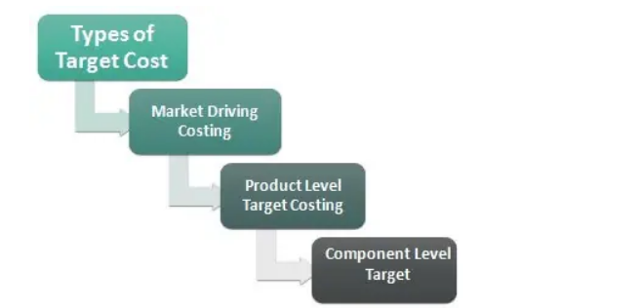
Managerial Accounting Cost Method Approach and Techniques
Target and Life Cycle Cost techniques
Target costing is an approach to determine a product's life-cycle cost which should be sufficient to develop specified functionality and quality, while ensuring its desired profit.
It involves setting a target cost by subtracting a desired profit margin from a competitive market price.
target cost = selling price - expected profit margin.
It is the early stages of the new product development process where the technique is said to be the most useful.
Target costing consists of cost planning in the design phase of production as well as cost control throughout the resulting product life cycle.
Market Driving Costing: Based upon the market conditions and the expected selling price of the product.
Product Level Costing: Targets are set to individual products rather than the entire portfolio.
Component Level Target: It refers to the company’s functional and supplier level targets.
Target Cost Formula = Projected Selling Price – Desired Profit
www.libretext.org

Slide 31
Managerial Accounting Cost Method Approach and Techniques
Target Cost techniques – Case Study Pronaca, Ltd
No 1 The business is powerful player within the supermarket industry its groceries at $1000 per piece. Their profits are 20%, and the cost works out to be $800. The company recently received a government subsidy, which it needs to pass on to its customers. The subsidy amount is $200 per piece. The company sells 10,000 units annually.
Work out the target cost?
The company has received a subsidy of $200 - new selling price $1000 – $200 = $ 800. The Company will keep the profit 20% = $160, and the new target cost for the company would be $800-$160 = $ 640; however, to earn the same revenue as before, the company will have to sell more units than the current.
Earlier revenue = $1000*10,000 = $10,000,000
The company now needs to sell 15,625 units to achieve the same revenue
If the company fails to achieve this sales target, it will be at a loss, and the entire exercise will go on a toss
No 2 Sells food to the public at $100 per packet. The company desires to achieve a 20% profit on its sales. Compute the target cost of the product.
Total profit margin of the product would be $100*20% = $20, to achieve $20 on the sale of one product, the company needs to sell the products at $80 ( $100- $20), which is the target cost of the product year.
Target Cost Formula = Projected Selling Price – Desired Profit

Slide 32
Managerial Accounting Cost Method Approach and Techniques
Limiting Factor Analysis
In management accounting, limiting factors refer to the constraints in availability of production resources for example shortages in labor, machine hours or materials that prevent a business from maximizing its sales.
Limiting factor is the scare resource within our operation that prevents us from the archive the highest output or profit. This factor will create the bottleneck in our production process.
The production input includes the following: Labor, Raw material or Machine capacity
Six Step Approach:
Step 1: Determine the maximum sales.
Step 2: Determine the limiting factor establish which factor is responsible for limiting the production of its various products.
Step 3: Calculate contribution per unit of output of each product - selling price minus variable costs.
Step 4: Calculate contribution per unit of limiting factor for each product.
Step 5: Rank products in order of priority.
Step 6: Calculate production quantities.

Slide 33
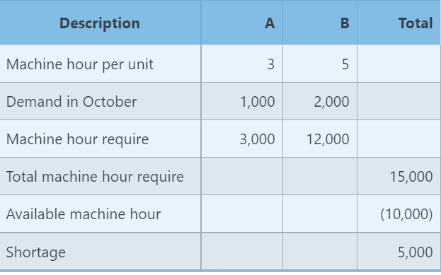
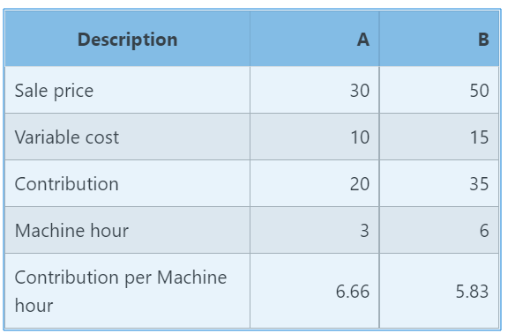
Managerial Accounting Cost Method Approach and Techniques
Limiting Factor Analysis
Example:
Company Z produces two types of product A & B with the standard costing as following:
Description | A | B
Direct Material | 5 | 8
Direct Labor | 6 | 10
Machine hour | 3 | 6
Demand in October | 1,000 | 2,000
Selling price | 30 | 50
Due to machine breakdown in October, the Machine can only operate 10,000 hours. There are enough material and direct labor to cover the order of both products. Calculate the production plan, which will maximize the profit.
Step 1. Define the limiting factor
Step 2. Identify the contribution per unit of the limiting factor
accountinguide.com
It is more profitable to produce product A which has a higher contribution per machine hour.

Slide 34
Managerial Accounting Cost Method Approach and Techniques
Limiting Factor Analysis
Example:
Company Z produces two types of product A & B with the standard costing as following:
Step 3. Prepare the production plan
The business have 7,000 machine hours for product B after spent 3,000 machine hours for product A. It will equivalent to 1,166 units (7,000h /6h per unit) of product B
accountinguide.com

Slide 35
Thank You

