Slide 1
Lesson 16
Finance for Management

Slide 2
Lesson Topics and Content
Short-Term Financial Planning and Management:
Short-Term Finance and Planning
Cash and Liquidity Management
Credit and Inventory Management
BARCELONA | MADRID | MALTA | ONLINE

Slide 3
Short-Term Financial Planning and Management
Short-Term Financial Planning and Management
A financial plan outlining investment and other financial goals for the coming fiscal year, for example ordering raw materials or cash payments.
The most important difference between short-term and long-term finance is in the timing of cash flows - cash inflows and outflows that occur within a year.
Short-term finance is concerned with the analysis of decisions that affect current assets and current liabilities or working capital, and involves less uncertainty, and are more adjustable than long-term financial plans.
Short-term financial strategies aims goals that would benefit the firm’s long-term strategies.
The cash budget is a primary tool of short-term financial planning.

Slide 4
Short-Term Financial Planning and Management
Short-Term Financial Planning and Management
Managing short-term cash flows involves the minimization of costs.
The two major costs are carrying costs (the interest and related costs incurred by overinvesting in short-term assets such as cash) and shortage costs (the cost of running out of short-term assets).
The objective of managing short-term finance and short-term financial planning is to find the optimal trade-off between these costs.

Slide 5
Short-Term Financial Planning and Management
Short-Term Financial Planning and Management
The Issues with Short-Term Finance and Planning:
What is a reasonable level of cash to keep on hand (in a bank) to pay bills?
How much should the firm borrow in the short term?
How much credit should be extended to customers?
Components of Working Capital:
Current Assets: Inventories or Marketable Securities
Current Liabilities: Accounts Payable or notes Payable
How much should the firm borrow in the short term?
How much credit should be extended to customers?

Slide 6
Short-Term Financial Planning and Management
Cash and Liquidity Management
The objective in cash management is to keep the investment in cash as low as possible while keeping the firm operating efficiently and effectively.
Managing short-term cash flows involves the minimizing of costs.
The two major costs are carrying costs - the return forgone by keeping too much invested in short-term assets such as cash, and shortage costs - the cost of running out of short-term assets.
The objective of managing short-term finance and doing short-term financial planning is to find the optimal trade-off between these two costs.
The financial manager seeks the optimal level of each of the current assets and can use the cash budget to identify short-term financial needs.
The cash budget tells the manager what borrowing is required or what lending will be possible in the short run.
The firm has available to it several possible ways of acquiring funds to meet short-term shortfalls, including unsecured and secured loans.

Slide 7
Short-Term Financial Planning and Management
Cash and Liquidity Management
Sources of Cash:
Increasing long-term debt (borrowing over the long term)
Increasing equity (selling some stock)
Increasing current liabilities (getting a 90-day loan)
Decreasing current assets other than cash (selling some inventory for cash)
Decreasing fixed assets (selling some property)
Uses of Cash:
Decreasing long-term debt (paying off a long-term debt)
Decreasing equity (repurchasing some stock)
Decreasing current liabilities (paying off a 90-day loan)
Increasing current assets other than cash (buying some inventory for cash)
Increasing fixed assets (buying some property)

Slide 8
Short-Term Financial Planning and Management
Short-Term Financial Planning and Management:
Short-Term Finance and Planning
The financial manager can use the cash budget to identify short-term financial needs. The cash budget tells the manager what borrowing is required or what lending will be possible in the short term. The firm has a few possible ways of acquiring funds to meet short-term shortfalls:
(1) Unsecured bank borrowing from a bank
(2) Secured borrowing compromising assets like inventories or account receivables
(3) Other sources like commercial papers

Slide 9
Short-Term Financial Planning and Management
Cash and Liquidity Management
Liquidity issues and Financing Options:
Cash reserves
Maturity hedging: Most firms finance inventories with short-term bank loans and fixed assets with long-term financing
Term structure: Short-term interest rates are normally lower than long-term interest rates - is more costly to rely on long-term borrowing than on short-term borrowing

Slide 10
Short-Term Financial Planning and Management
Cash and Liquidity Management
Inventories represent a significant investment for many firms – around 15 to 25 percent of assets therefore an efficient management is required to provide value to the stockholder.
Credit policy and inventory policy are used to drive sales, and the two must be coordinated to ensure that the process of acquiring inventory, selling it, and collecting on the sale proceeds smoothly. For example, changes in credit policy designed to stimulate sales must be accompanied by planning for adequate inventory.
The are three types of inventory depending on the stage with different costs associates: Raw Material, Working Progress, and Finished Good.
Inventory has a cost associated like storage and insurance costs, loses due to loss of obsolete, and the opportunity cost of investment in another asset, and they could range from 20 to 40 percent of the inventory value per year.
Businesses can use one of the inventory management tools like ABC approach or Economic Order Quantity to calculate the efficient inventory and the restocking periods and needs.

Slide 11
Short-Term Financial Planning and Management
Credit and Inventory Management
Credit Management
A firm sells goods and services demanding cash on or before the delivery date or extending credit to customers and allow some delay in payment.
The credit policy enclosed the business criteria to grant credit to its customers.
Granting credit is making an investment in a customer—an investment tied to the sale of a product or service.
The credit policy decision involves a trade-off between the benefits of increased sales and the costs of granting credit.
From an accounting perspective, when credit is granted, an account receivable is created.

Slide 12
Short-Term Financial Planning and Management
Credit and Inventory Management
Credit Policy Components
Terms of sale or how the firm proposes to sell its goods and services.
Credit analysis: Procedures and tools to determine between customers who will pay and customers who will not pay.
Collection policy: After credit has been granted, the firm has the potential problem of collecting the cash, for which it must establish a collection policy.
The optimal amount of credit is determined by the point at which the incremental cash flows from increased sales are exactly equal to the incremental costs of carrying the increase in investment in accounts receivable.

Slide 13
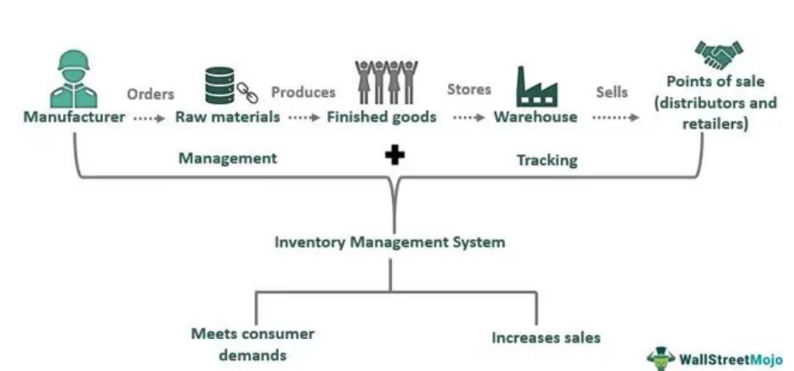
Short-Term Financial Planning and Management
Credit and Inventory Management
Inventory management means a business strategy, which deals with managing order processing, manufacturing, storing, and selling raw materials and finished goods.
Ensures product availability at warehouses, retailers, and distributors.
Businesses of all sizes, and industries use it to meet consumer demands and grow sales.
There are several stock management techniques like stock review, just-in-time, and ABC analysis.

Slide 14
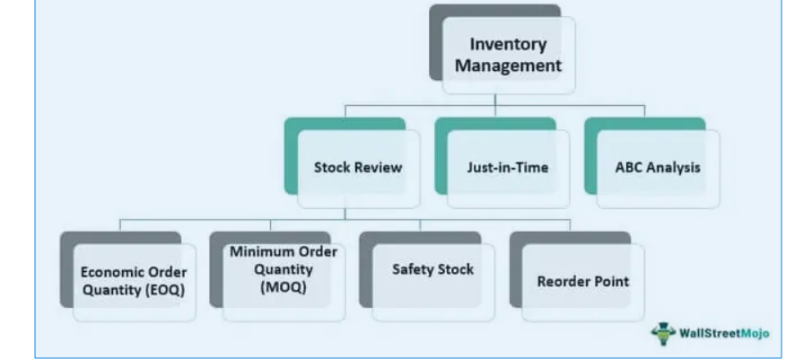
Short-Term Financial Planning and Management
Credit and Inventory Management
Shortages of inventory might be problematic; having too much can lead to damage and waste due to demand fluctuations.
Addressing complex business decisions, such as reordering, restocking, pricing, and distributing products in response to market demand.
All this is made possible by tracking inventory (inputs/ingredients and outputs/products) at every level, including warehousing and distribution.
The idea is risk mitigation of scarcity or excess inventory at any given point in time; in addition, the timely availability of products reflects in customer satisfaction and increased sales.
Techniques

Slide 15
Thank You

