Slide 1
Lesson 15
Finance for Management

Slide 2
Lesson Topics and Content
Long-Term Financial Policies: Dividend Policy
The Concept and the relevance of the dividends
Types of Dividends
Optimum payout Policy for a Business
Stock Splits, and the strategy in Stock Buyback
Factors Affecting Dividend Decisions
BARCELONA | MADRID | MALTA | ONLINE

Slide 3
Long-Term Financial Policies: Dividend Policy
The Concept and the relevance of the dividends
Dividends and Dividend Policy
Dividends are profits generated by businesses is accumulated retained earnings, those earnings can be either reinvested in the business, buy back shares outstanding or paid out to shareholders.
Profits are distributed to shareholders as dividends - is a share of profits and retained earnings that a company pays out to its shareholders.
A firm’s dividend policy refers to its choice of whether to payout cash to shareholders, in what fashion, and in what amount.
A dividend’s value is determined on a per-share basis and is to be paid equally to all shareholders of the same class (common, preferred, etc.)
The payment must be approved by the Board of Directors, and when a dividend is declared, it will then be paid on a certain date - payable date.

Slide 4
Long-Term Financial Policies: Dividend Policy
The Concept and the relevance of the dividends
Dividends are an important consideration when investing in the share market as they provide a reliable source of return, and an incentive for investors to keep investing in the firm.
Dividend payments are reliant on the company’s profitability, so they are not always directly correlated to the share price/profits, for example ARAMCO.
https://www.spglobal.com/platts/en/market-insights/latest-news/oil/040121-aramco-may-slash-dividend-payment-to-boost-saudi-economic-growth-plan
The frequency of dividend payments is often aligned with the announcement of company profits: quarterly, semi-annually, or annually.
Paying dividends allows companies to share their profits with shareholders, which helps to thank shareholders for their ongoing support via higher returns and to incentivize them to continue holding the stocks.
Consistent dividends are often viewed by investors as a sign of a company’s strength and that the company’s management has positive expectations around future earnings growth.
Become and alternative for income objective (retirees or pension funds) investors by choosing companies that have a track record of attractive dividends.

Slide 5
Long-Term Financial Policies: Dividend Policy
The Concept and the relevance of the dividends
As a rule, large, well-established companies are more likely to pay dividends than startups or smaller firms.
Businesses that have paid attractive dividends historically may not do so in future if they’re planning an acquisition or other investment that requires large amounts of cash.
The issue can take many different forms, including cash, stocks, property, and scrip, among others.
Tax impact: In most countries, it is a taxable income for the shareholders, and the tax amount on the same is deducted at source, i.e., by the company at the time of distribution.
More often in Large-cap stocks and well-established public companies - companies which list their shares on the public stock exchange allowing the trading of shares to the common public.

Slide 6
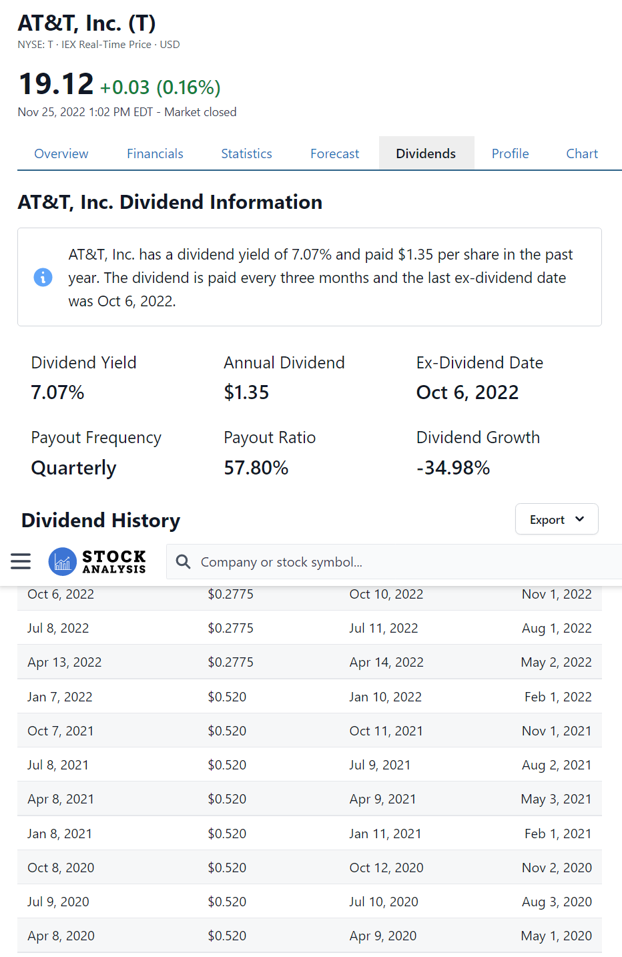
Long-Term Financial Policies: Dividend Policy
The Concept and the relevance of the dividends
Case: AT&T
Has over 30 years of history of providing stable dividends
In 2022 dividend yield 7.12% @ $1.35 / share
AT&T stocks attracts investors for offering a relatively steady income over and above the earnings that can come through their sales.
Chronology:
Declaration Date: Management announces the upcoming dividend distribution, payment amount, and the payment issue
Ex-Dividend Date: Cut-off date
Record Date: The company decides on the list of shareholders who will receive the payment
Payment Date: Date when the payment is executed
Source – NASDAQ
yahoo.finance.com

Slide 7
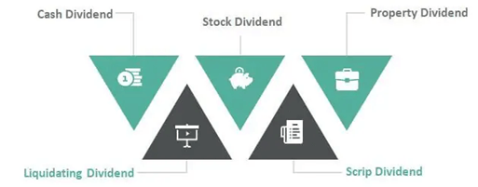
Long-Term Financial Policies: Dividend Policy
Types of Dividends
Case: Midterm international Ltd, on January 1, 2021, held the meeting, and declare:
Cash Dividend: Cash payment of $1 / share was declared on the company’s outstanding shares; the total outstanding shares of the company are 3,000,000 – Cash Dividend Paid $3,000,000
Stock Dividend - A payment of additional shares instead of cash to shareholders as a form of return on their investment in the company – paid out pro-rata - based on the number of shares. The business declares a 15% stock dividend-every shareholder receives an additional 15 shares for every 100 shares of ownership
Assets - payout other assets: investment securities, physical assets, or real estate (not a common practice)
CFA Institute for educational purposes only

Slide 8
Priceline.com (NASDAQ:BKNG) is the biggest winner. It went through a 1-for-6 reverse split in 2003 when the online travel portal was flopping around after the dot-com bubble burst
source: www.nasdaq.com
Long-Term Financial Policies: Dividend Policy
Types of Dividends
Stock Splits is similar to a stock dividend, except that a split is expressed as a ratio instead of a percentage.
When a split is declared, each share is split up to create additional shares.
For example, 3:1 stock split, each old share is split into three new shares.
Case Apple:
Apple's stock has split five times since the company went public. The stock split on a 4-for-1 basis on August 28, 2020, a 7-for-1 basis on June 9, 2014, and split on a 2-for-1 basis on February 28, 2005, June 21, 2000, and June 16, 1987.
source: www.nasdaq.com
CFA Institute for educational purposes only

Slide 9
Long-Term Financial Policies: Dividend Policy
Types of Dividends
Corporate Action: Stock Reverse Split
To decrease the number of shares.
For example: 1:10 reverse stock split each investor exchanges 10 old shares for 1 new share to reduce the number of its shares outstanding, and the prices is adjusted proportionally.
Case Priceline.com (NASDAQ:BKNG)
Priceline.com is the biggest winner. It went through a 1-for-6 reverse split in 2003 when the online travel portal was flopping around after the dot-com bubble burst source: www.nasdaq.com
CFA Institute for educational purposes only

Slide 10
Long-Term Financial Policies: Dividend Policy
Types of Dividends
Dividends and the Impact in the Business Value
The total market value of a company does not change if the business pays cash dividends or issue more shares.
In the case of cash dividends, the price of the stock has implicit the value of the dividend.
In the case of stock dividends, the market value is spread over more shares by reducing the value of the shares to compensate for the increased in the number of shares.
Example: A business has a total market value of $10 million and it has 1 million shares outstanding, then each share should sell on the open market for $10/share. If the company then issues a 15% stock dividend, there are now 1,150,000 shares outstanding, but the market value of the entire firm has not changed. Thus, the market value per share after the stock dividend is now $10,000,000 / 1,150,000, or $8.70.
YES.Fundamentals%20of%20Corporate%20Finance

Slide 11
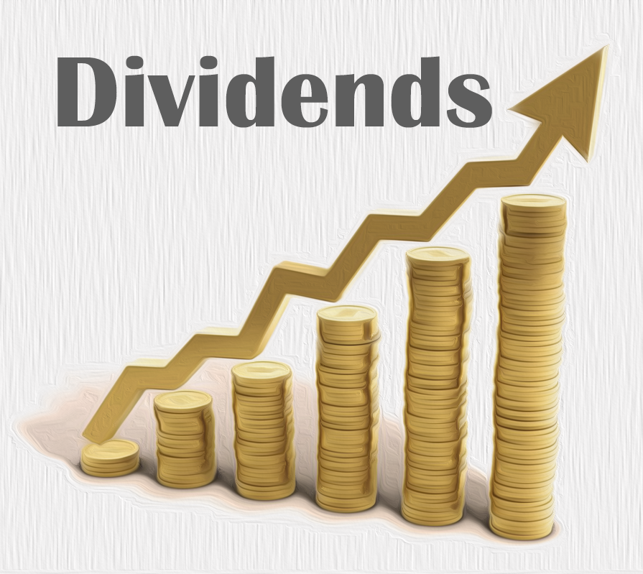
Long-Term Financial Policies: Dividend Policy
Optimum Payout Policy for a Business
Factors affecting payout ratios
Reasons for Low Dividend
Taxes
High Issuing Costs
Reasons for High Dividend
Desire for Current Income
Information Asymmetry
Dividends as a signal about firm’s future performance
Lower Agency Costs
Capital market as a monitoring device
Reduce free cash flow, and hence wasteful spending
Bird-in-the-hand: Theory or Fallacy?
Uncertainty resolution
YES.Fundamentals%20of%20Corporate%20Finance

Slide 12
Long-Term Financial Policies: Dividend Policy
Optimum Payout Policy for a Business
Industries that pay high dividend payout ratios
Utilities, transportation companies, financial institution and companies involved in heavy manufacturing firms tend to have high leverage and high dividend payouts in all countries.
Regulated companies and firms with stable cash flows and stable asset bases tend to have high leverage and high payouts.
Service firms, high-technology companies and firms with highly variable earnings (e.g., mining) have low dividend payout ratios.
Companies operating in a volatile industry, or which must make ongoing and high-risk discretionary investments in new technologies have low dividend payouts.
YES.Fundamentals%20of%20Corporate%20Finance

Slide 13
Long-Term Financial Policies: Dividend Policy
Optimum Payout Policy for a Business
There is no optimal payout ratio but rather the industry benchmark.
A firm should not reject positive NPV projects to pay a dividend.
Personal taxes and issue costs are real-world considerations that favor low dividend payouts.
Many firms appear to have a long-run target dividend-payout policy.
There appears to be some value to dividend stability and smoothing.

Slide 14
Long-Term Financial Policies: Dividend Policy
Stock Splits and the strategy in Stock Buyback
Stock Splits:
When a split is declared, each share is split up to create additional shares.
For example, 3:1 stock split, each old share is split into three new shares.
The strategy behind a stock split is to make de security accessible to investors.
Case: NVR Stock price: $4,035, at that price it limits the number of investors - Just like Berkshire Hathaway, NVR hasn't split its stock.

Slide 15
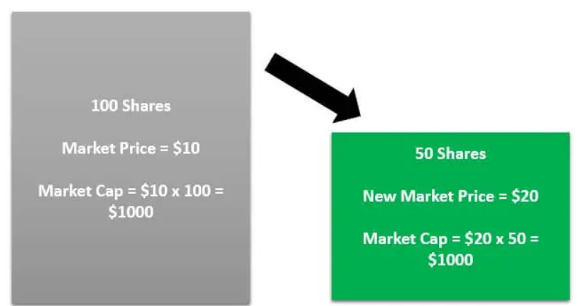
Long-Term Financial Policies: Dividend Policy
Stock Splits and the strategy in Stock Buyback
Stock Reverse Split:
To decrease the number of shares.
For example: 1:10 reverse stock split each investor exchanges 10 old shares for 1 new share to reduce the number of its shares outstanding, and the prices is adjusted proportionally.
The strategy behind that corporate action is raising their value.
Priceline.com (NASDAQ:BKNG) is the biggest winner. It went through a 1-for-6 reverse split in 2003 when the online travel portal was flopping around after the dot-com bubble burst
source: www.nasdaq.com
CFA Institute for educational purposes only

Slide 16
Long-Term Financial Policies: Dividend Policy
Stock Splits and the strategy in Stock Buyback
When a firm declares a stock split, it increases the number of shares outstanding and decreases the price - each is entitled to a smaller percentage of the firm’s cash flow.
Example
If the managers of a firm whose stock is selling at $90 declare a 3:1 stock split, the price of a share of stock should fall to $30.
A stock split strongly resembles a stock dividend.
An alternative form of cash payout is a stock repurchase - use cash to buy back shares of its stock - the shares are held by the corporation and accounted for as treasury stock.
CFA Institute for educational purposes only

Slide 17
Long-Term Financial Policies: Dividend Policy
Stock Splits and the strategy in Stock Buyback
Pros and Cons of Stock Splits
Pros
Improves liquidity
Often increases share price
Cons
Could increase volatility
Not all stock splits increase share price
CFA Institute for educational purposes only

Slide 18
Long-Term Financial Policies: Dividend Policy
Stock Splits and the strategy in Stock Buyback
Repurchase of Stock
Apple was the largest individual stock repurchase in the first quarter of 2021 followed by Alphabet ($11.4 billion); Microsoft ($6.9 billion.); and Berkshire Hathaway ($6.6 billion).
Instead of paying dividends, a firm may use cash to repurchase shares of its own stock.
Share repurchases have taken on increased importance in recent years.
Share repurchases is accomplished in the form of one of the three actions:
Purchase their own stock in the open market purchases
Tender offer - the firm announces to all its stockholders that it is willing to buy a fixed number of shares at a specific price
Repurchase shares from specific individual stockholders - targeted repurchase
Apple has spent $319.2 billion on share buybacks over the past five years, a period in which its stock price has almost quintupled in value.
source: forbes.com

Slide 19
Long-Term Financial Policies: Dividend Policy
Factors Affecting Dividend Decisions
Dividend decision relates to how much of the company’s net profit is to be distributed to the shareholders and how much of it should be retained in the business for meeting the investment requirements while keeping in view the overall objective of maximizing shareholders’ wealth.
Factors affecting dividend decision :
Amount of Earnings: Dividends are paid out of current and past earnings.
Stability in Earnings: A company having higher and stable earnings can declare higher dividends than a company with lower and unstable earnings.
Stability of Dividends: Generally, companies try to stabilize dividends per share. A steady dividend is given each year like Coca Cola Company.
Growth Opportunities: Companies having good growth opportunities retain more money out of their earnings to finance the required investment. Dividends declared in growth companies is, therefore, smaller than that in the non-growth companies.
YES.Fundamentals%20of%20Corporate%20Finance

Slide 20
Long-Term Financial Policies: Dividend Policy
Factors Affecting Dividend Decisions
- Long-Term Financial Policies: Dividend Policy – Other Considerations
Dividend vs. Repurchase
Assuming the company has a certain amount of cash they wish to return to shareholders, the two ways they can do it are through dividends and share repurchases.
Share repurchases is the best option when the share price is undervalued, and not-so-great when the share price is overvalued,
Share Repurchases -Better tax treatment than dividends for investors. -Share repurchases are more flexible than regular dividends for the company.
Regular Dividends -Important for those seeking current income. -Dividends are more flexible than share repurchases for the shareholder. -Provides a psychological edge and discipline to both shareholders and company management.

Slide 21
Long-Term Financial Policies: Dividend Policy
Other Considerations - Dividend Decisions
Advantages:
Cash dividends help in establishing the prices of equity.
It attracts investors, particularly those who wants returns in the form of dividends.
Increase or higher cash dividend increases equity share price.
It can help reduce agency cost that might arise from management and shareholders' conflict due to “excess cash.
Disadvantages:
It can decrease internal sources of financing and management might rely on costly external financing.
Shareholders will pay tax for dividends received.
Once declared, dividends cannot be reduced without affecting the equity share price.

Slide 22
Long-Term Financial Policies: Dividend Policy
Factors Affecting Dividend Decisions
Cash Flow Position: Availability of enough cash is necessary for payment or declaration of dividends.
Shareholders’ Preference: The companies should consider the preferences of all shareholders.
Taxation Policy: If the tax on dividends is higher, it is better to pay less by way of dividends.
Stock Market Reaction: An increase in dividends has a positive impact on stock market.
Access to Capital Market: Large and reputed companies generally have easy access to the capital market and, therefore, may depend less on retained earnings to finance their growth-tend to pay higher dividends than the smaller companies.
Legal Constraints that place restrictions on payouts as dividends.
Contractual Constraints for example when granting loans to a company, the lender may impose restrictions on the payment of dividends in future.
YES.Fundamentals%20of%20Corporate%20Finance

Slide 23
Long-Term Financial Policies: Dividend Policy
Factors Affecting Dividend Decisions
Corporations take many various factors into account when deciding about the character of their dividend policy.
Country legal rules
Business liquidity position
The CF priorities - need to pay off debt
Restrictions in debt contract
Rate of expansion of assets
Profit rate
Stability of earnings
Access to capital markets
Control, and
Tax position of shareholders - the clientele effect on dividend policy
Financial analyst combine these factors into dividend theories about the way in which dividend policy affects less the company's value.

Slide 24
Long-Term Financial Policies: Dividend Policy
Dividend Decisions
In a highly competitive environment, the financial objective of a firm should be set within the framework of corporate objective of sustainable competitive edge. As such, Wealth maximization objective has come to be widely recognized criterion with which the performance of a business enterprise is evaluated.
Dividend Payout is measured by the Dividend Yield: Stock's annual dividend payments to shareholders expressed as a percentage of the stock's current price.
Dividend policy is irrelevant as it has no effect on the equity share price and the even on the cost of capital - Modigliani and Miller.
The dividend payment policy of the company is the reflection of the financial performance of the company. Thus, the company should choose the dividend policy that it will be following correctly as it is critical to the company’s financial growth and success.

Slide 25
Thank You

