Slide 1
Lesson 11
Finance for Management

Slide 2
Lesson Topics and Content
Long-Term Decisions: Capital Structure
  The Business Debt to Equity Ratio Decisions
  Factors Affecting Target Capital Structure
  Capital Structure and Corporate Taxes Considerations
BARCELONA | MADRID | MALTA | ONLINE

Slide 3
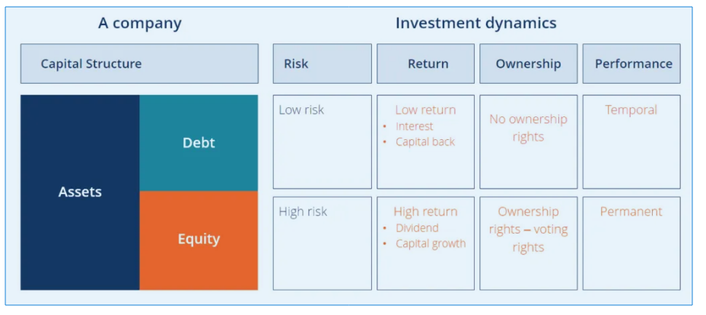
Long-term Decisions: Capital Structure
The Investor Debt to Equity Ratio Decisions
corporatefinanceinstitute.com

Slide 4
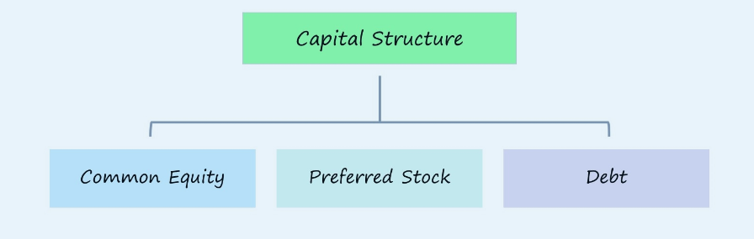
Long-term Decisions: Capital Structure
The Business Debt to Equity Ratio Decisions
Efficient Mix
Debt ➝ Cost of Debt
Common Equity ➝ Cost of Equity
Preferred Stock ➝ Cost of Preferred Stock
Wallsteerprep.cp,

Slide 5
Long-term Decisions: Capital Structure
The Business Debt to Equity Ratio Decisions
Business Cases:
GlaxoSmithKline PLC and satellite television provider DirecTV announced bond issues. While part of GlaxoSmithKline’s $9 billion bond offering was for general corporate purposes, much of it was to be used to buy back the company’s stock. In DirecTV’s case, all of the proceeds from its $2.5 billion issue were to be used to buy back stock. Target announced planned to issue new debt to buy back about $10 billion of its stock.
Why would companies like GlaxoSmithKline and DirecTV even consider borrowing money to repurchase their own stock? And why would Target do so at the expense of a credit rating downgrade?
Optimal debt policies

Slide 6
Long-term Decisions: Capital Structure
The Business Debt to Equity Ratio Decisions
  Capital structure describes a firm's finances in terms of the balance between its debt and equity.
  The senior business's management team and other stakeholders will consider the proper mix of debt and equity for their ideal capital structure.
  The optimal capital structure is the right mix of debt and equity that minimizes the weighted average cost of capital (WACC) of a company while maximizing its market value.
  The lower the cost of capital, the greater the present value of the firm's future cash flows, discounted by the WACC.
Maximizing the wealth and worth of the company and minimizing its cost of capital.

Slide 7
Long-term Decisions: Capital Structure
The Business Debt to Equity Ratio Decisions
  Business leaders need to independently come up with a capital structure that works best for their operation by deciding on the right debt–equity ratio.
    The value of the firm:
    V = B + S
    B is the market value of the debt
    S is the market value of the equity
  The firm should pick the debt–equity ratio that makes the total V as valuable as possible.

Slide 8
Long-term Decisions: Capital Structure
The Business Debt to Equity Ratio Decisions
  Maximizing Firm Value versus Maximizing Stockholder Interests
    Debt and Firm Value – Case Study:
    The market value of the Yud LLC is $1,000 (100 shares of common stock @$10/share) and has no debt outstanding – unlevered. The business will borrow $500 and pay the proceeds to shareholders as an extra cash dividend of $5/share – levered. Management consulted with investment bankers, an agreed that operation will not change firm value more than $250.
    The possible outcomes are:
    Greater than the original firm value of $1,000 or $1,250
    Equal to $1,000 or the same
    Less than $1,000 or $750

Slide 9
Long-term Decisions: Capital Structure
The Business Debt to Equity Ratio Decisions
        The original capital structure and the new three possibilities for the stockholder and the firm under the new capital structure:
Outcome 1:
Yud, LLC should restructure the firm because the stockholders would gain $250
The price of the stock declines by $250 to $750, but holder’s will receive $500 in dividends
The value of the firm increases to $1,250
Outcome 2:
Restructuring would not affect the stockholders’ interest because the net gain to stockholders in this case is zero
The value of the firm is unchanged
Outcome 3
Yud, LLC should not restructure the firm because the stockholders would expect a $250 loss
The stock price falls by $750 to $250 and they receive $500 in dividends
Stockholder’s net loss is $250, and the value of the firm would change by -$200
Capital structure producing the highest firm value is the one that maximizes shareholder wealth
Yud, LLC should borrow $500 if Outcome I is expected, and debt should be added to the capital structure.

Slide 10
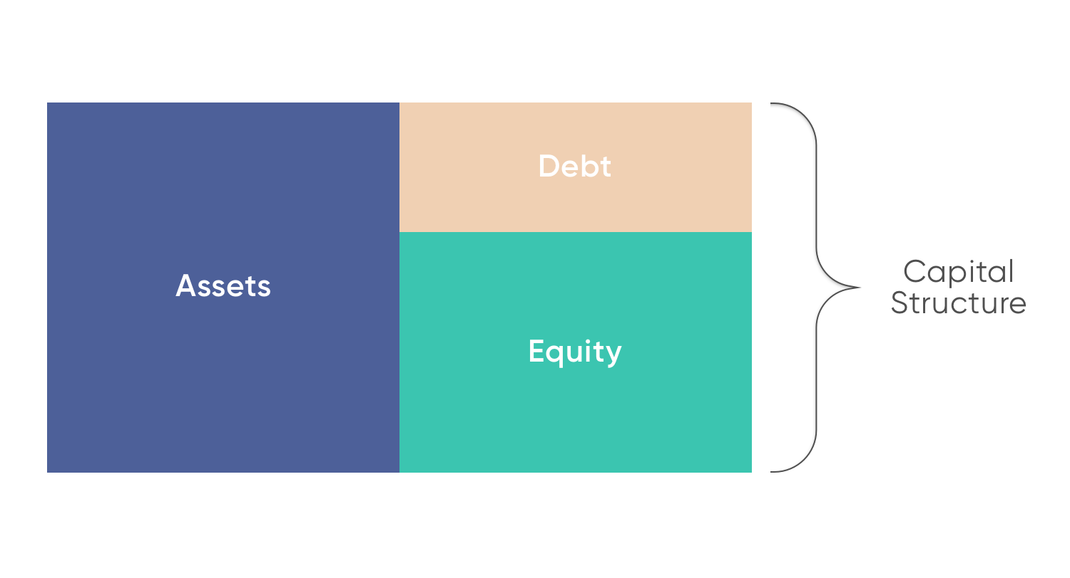
Long-term Decisions: Capital Structure
Factors Affecting Target Capital Structure
  Optimal Capital Structure
    Companies use equity and debt capital for making acquisitions, other investments and conducting business operations. Managers usually balance debt and equity to find out the perfect capital structure.
    Debt financing offers the lowest cost of capital due to its tax deductibility, but too much debt poses a financial risk to shareholders and return on equity they require.
    Companies should define the optimal structure, where the marginal benefit of debt will be equal to the marginal cost.
    To find the best capital structure for a particular business, the company can either issue more equity or debt, and the new acquired capital can be used for investing in other assets or repurchasing outstanding equity/debt as a form of recapitalization.
    Capital structure can differ in different industries - the mining industry has highly volatile cash flows therefore is not very suitable for debt, and insurance sector use great amounts of leverage and their structure presupposes huge amounts of debt.
https://capital.com/

Slide 11
Long-term Decisions: Capital Structure
Factors Affecting Target Capital Structure
  Case 1 Optimal Capital Structure – All Equity
    Scenario III equity shareholders get maximum return.
    More debt brings more income for owners in the capital structure until Rate of Earning of Capital (ROI) > Rate of Interest charged on Debt.
Scenario III has the highest ROI.

Slide 12
Long-term Decisions: Capital Structure
Factors Affecting Target Capital Structure
Cash Flow Position: The decision related to composition of capital structure also depends upon the ability of business to generate enough cash flow (bondholder’s, dividends, or interests).
Cover some financial ratio requirements like Interest Coverage Ratio (ICR) or Debt Ratios.
Return on Investment requirements: If ROI > Rate of Interest paid.
Cost of Debt: If firm can arrange borrowed fund at low rate of interest, then it will prefer more of debt as compared to equity.
Tax Rate: High tax rate makes debt financing beneficial.
Cost of Equity
Floatation Costs: Cost involved in the issue of shares or debentures.
Risks Consideration
Flexibility: Excess of debt may restrict the firm’s capacity to borrow further.
Control of the business: The higher use of equity financing gives away company control.
Regulatory Framework
The General Stock Market Condition
Capital Structure of similar Companies

Slide 13
Long-term Decisions: Capital Structure
Capital Structure and Corporate Taxes
Taxes affect the use of interest-paying debt. Increases in corporate tax rates lead to increases in leverage; increases in personal taxes on interest income decrease leverage; and increases in personal taxes on dividend income increase leverage. Leverage changes are stronger among corporate taxpayers, dividend-paying companies, and companies that have a low proportion of institutional investors.
Taxes affect the use of interest-paying debt.
Increases in corporate tax rates lead to increases in leverage; increases in personal taxes on interest income decrease leverage; and increases in personal taxes on dividend income increase leverage.
Leverage changes are stronger among corporate taxpayers, dividend-paying companies, and companies that have a low proportion of institutional investors.

Slide 14
Long-term Decisions: Capital Structure
Capital Structure and Corporate Taxes
Managers should choose the capital structure that they believe will have the highest firm value because this capital structure will be most beneficial to the firm’s stockholders.

Slide 15
Thank You
BARCELONA | MADRID | MALTA | ONLINE

