Slide 1
Lesson 10
Finance for Management

Slide 2
Lesson Topics and Content
Funding the Business Operations - Capital Structure:
Debt: Introduction and types of Debt (Loans and Bonds)
Equity: Introduction and types of Equity
Sources of Capital:
Retained Earnings
Equity and equity valuation: The Capital Asset Pricing Model CAPM and Security Markey Line (SML)
Bonds and bonds valuation: Interest Rates and taxes
Deciding among sources: The impact of the Cost of Capital decision for Business Financial Success
Weight Average Cost of Capital (WACC)
BARCELONA | MADRID | MALTA | ONLINE

Slide 3
Capital Structure: Funding the Business Operations and Growth
Debt Financing: Introduction and Types of Debt
Debt financing - Companies borrows funds in order to operate, rather than raising money from investors.
Debt financing occurs when a company raises money by selling debt instruments, most commonly in the form of bank loans or bonds - financial leverage.
Bank Loan:
The advance of a specified sum of money to a business (borrower) by for example commercial or savings banks (lender).
A bank loan is a form of credit that is often extended for a specified period of time, usually on fixed interest terms with the principal being repaid either on a regular instalment basis or in full on the redemption date.
The cost of debt for commercial loans from banks or financial institutions is the borrowing rate on the prospective loan.

Slide 4
Capital Structure: Funding the Business Operations and Growth
Debt Financing: Introduction and Types of Debts
Debt (bonds) financing:
A bond is a fixed obligation to pay that is issued by a corporation or government entity to investors. Bonds are used to raise cash for operational or infrastructure projects. Bonds usually include a periodic coupon payment and are paid off as of a specific maturity date.
Companies are borrowers (issuers) because they exchange securities for cash needed to execute projects.
Quote - Bond’s price agreed by buyer and seller during a determined timeframe, generally at the time of trading. The value is presented on a scale of 0 to 100, representing a percentage of $1,000 or $100, the usual face value for a single bond, and pays periodically a coupon like 6% to the investor until maturity like 2026.
The issuer will be repaying the debt (capital and interest) according to the specified schedule.
The drawback of borrowing money through debt is that borrowers need to make interest payments, as well as principal repayments, on time - failure to do so may lead the borrower to default or bankruptcy.

Slide 5
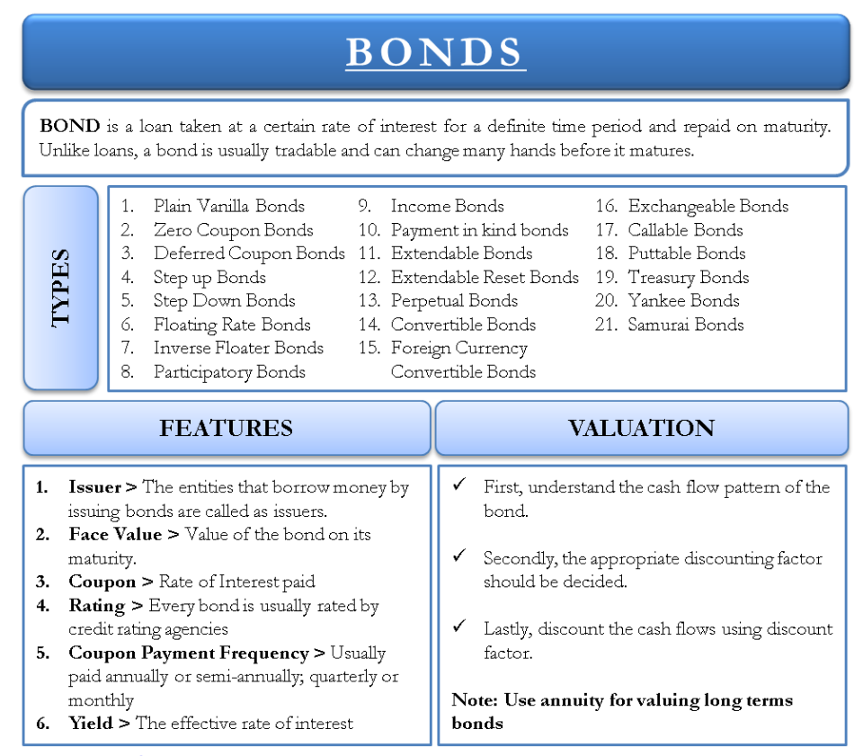
Capital Structure: Funding the Business Operations and Growth
Debt Financing: Introduction and Types of Debt

Slide 6
Capital Structure: Funding the Business Operations and Growth
Debt Financing: Introduction and Types of Debt
Bonds and Interest Rates and Yield (YTM)
Yield is a figure that represents the return from a bond, if the price change due to changes interest rates, yields will change.
Example: An investor buys a bond at its ¥1,000 par value with a 10% coupon, if it is held to maturity, the issuer (corporation) pays the investor ¥ 100 a year for 10 years, and in year 10, pays back the ¥1,000 on the scheduled date.
Yield = coupon amount/price
Yield = 10% (¥ 100/ ¥ 1000)*100%
Interest rates change in the marketplace while cash flows from a bond stay the same (coupon); therefore, the value of the bond fluctuates.
If interest rates rise, the present value of the bond’s remaining cash flows declines, and the bond is worth less.
If interest rates fall, the bond is worth more.

Slide 7
Capital Structure: Funding the Business Operations and Growth
Debt Financing: Introduction and Types of Debt
Bond: Valuation
YIELDS - Interest rates change in the marketplace while cash flows from a bond stay the same (coupon); therefore, the value of the bond fluctuates.
If interest rates rise, the present value of the bond’s remaining cash flows declines, and the bond is worth less.
If interest rates fall, the bond is worth more.
Yield is a figure that represents the return from a bond, if the price change due to changes interest rates, yields will change.
Example: An investor buys a bond at its ¥1,000 par value with a 10% coupon, if it is held to maturity, the issuer (corporation) pays the investor ¥ 100 a year for 10 years, and in year 10, pays back the ¥1,000 on the scheduled date.
Yield = coupon amount/price
Yield = 10% (¥ 100/ ¥ 1000)*100%

Slide 8
Capital Structure: Funding the Business Operations and Growth
Debt Financing: Introduction and Types of Debt
For example, Beck Corporation wants to raise $1,000 for 30 years to fund the plant expansion, the interest rate on similar debt issued by similar corporations is 12%. Beck will pay $120 (0.12 × $1,000) in interest every year for 30 years to the bondholders, and at the end of 30 years, Beck will repay the $1,000.
Bond Market: The bond market is a financial market where participants can issue new debt, known as the primary market, or buy and sell debt securities, known as the secondary market. This is usually in the form of bonds, but it may include notes, bills, and so for public and private expenditures.

Slide 9
Capital Structure: Funding the Business Operations and Growth
Equity Financing: Introduction and Types of Equity
Equity: Introduction
In finance and accounting, equity is the value attributable to the owners of a business
It can be computed by:
The business book value of equity or the difference between assets and liabilities on the company’s balance sheet – net worth or shareholder’s equity.
The market value of equity (public) is based on the current share price or a value that is determined by investors or valuation professionals.
https://corporatefinanceinstitute.com/

Slide 10
Capital Structure: Funding the Business Operations and Growth
Debt Financing: Introduction and Types of Debt
2. Equity Financing:
Businesses can raise funds from the public in exchange for a proportionate ownership stake in the company in the form of shares issued to investors who become shareholders after purchasing the shares.
Compared to debt capital funding, equity funding does not require making interest payments to a borrower.
Equity capital funding shares profits among all shareholders in the long term, and dilutes the company’s ownership control as long as it sells more shares.

Slide 11
Capital Structure: Funding the Business Operations and Growth
Equity Financing: Introduction and Types of Equity
Common Stock or Equity
Is a security that represents equity ownership in a corporation.
Provides voting rights, and entitles the holder to a share of the company's success in the form of dividends and any capital appreciation in the value of the security.
Common stockholders are residual owners of the firm - they earn a return only after all other security holder claims (debt and preferred equity) have been satisfied in full.
Dividends on common stocks are neither fixed nor guaranteed. A company can choose to reinvest all profits and pay no dividends.
Preferred Stock
Preferred stock is also referred to as a hybrid security as it has features of both common stock and bonds.
Preferred stock is similar to common stocks in that it has no fixed maturity date, the non-payment of dividends does not result in bankruptcy of the firm, the dividends are not deductible for tax purposes.
Preferred stock is similar to corporate bonds in that the dividends are typically a fixed amount, and there are no voting rights.
Is an equity security that has preference with regard to:
Dividends: They are paid before the common stockholders.
Claim on assets: They are paid before common stockholders if the firm goes bankrupt and sells or liquidates its assets.

Slide 12
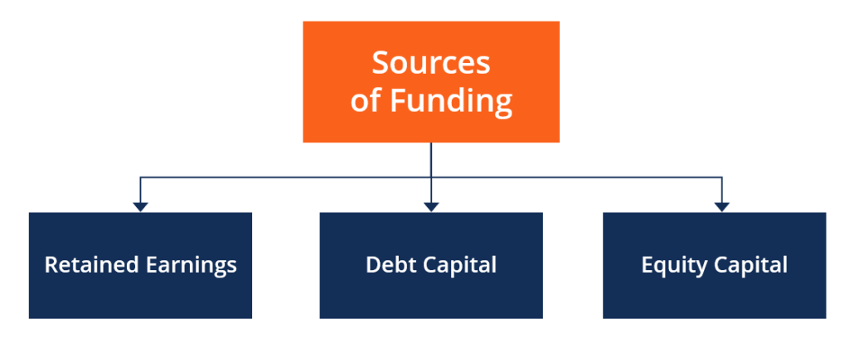
Capital Structure: Funding the Business Operations and Growth
Sources of Capital
Businesses needs capital to grow, and are always looking for the best sources of funding or financing their expansion.
Capital financing is the act of contributing resources to finance a program, project, or a need for the business to meet their short-term or long-term strategies.
An important task of the corporate financial manager is measurement of the company’s cost of capital.
The major sources of funding are:
Retained earnings
Debt capital
Equity capital
corporatefinanceinstitute.com

Slide 13
Capital Structure: Funding the Business Operations and Growth
Sources of Capital
The major sources of funding are:
Retained earnings: The business’s net income
Considerations
Age of the company: The older the company the more retained earnings balance.
Dividend policy: A business that periodically pays dividends will have fewer retained earnings balance.
Profitability: A high profit percentage eventually yields a large amount of retained earnings.
Cyclical industry (revenues tied to economic cycles): Business in a high cyclical industry tends to reserve more retained earnings during the profitable part of the cycle in order to protect it during downturns.
The cost of retained earnings is equal the return shareholders expects on their investment.
It is an opportunity cost because the shareholders sacrifice an opportunity to invest that money for a return elsewhere and instead allow the firm to build more capital.

Slide 14
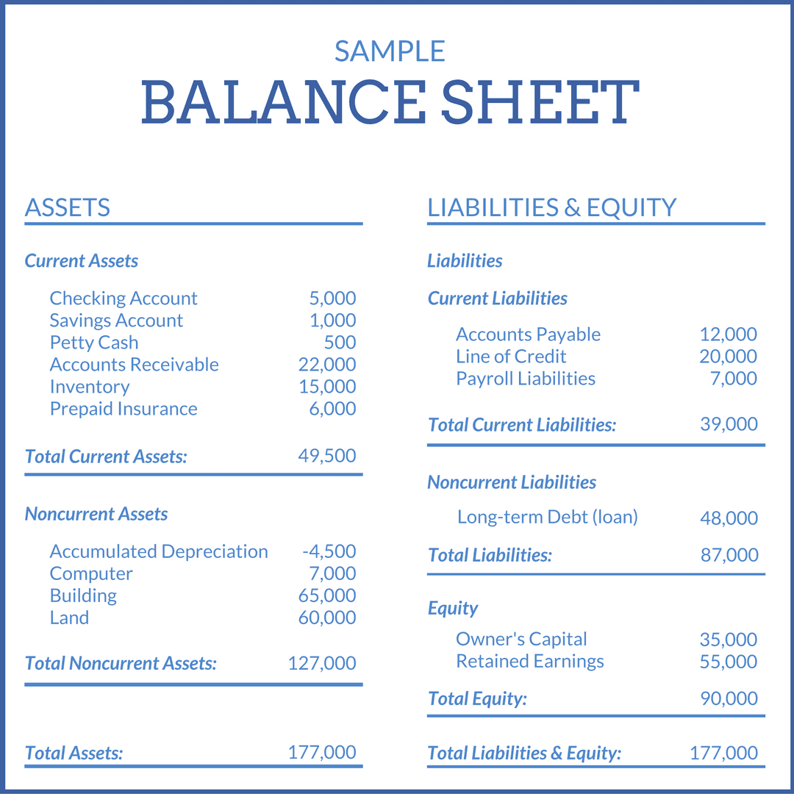
Capital Structure: Funding the Business Operations and Growth
Sources of Capital
Retained earnings are the profits that a company earned to specific date, less any dividends or other distributions paid to investors.
The account is adjusted whenever there is an entry to the accounting records that impacts a revenue or expense account of the business.
A large retained earnings balance usually implies a financially healthy organization, and a negative retained earnings balance account is called accumulated deficit balance.
The balance is reported in the Stockholder’s Equity section of the Balance Sheet of the business, and formula for ending retained earnings is:
Beginning retained earnings + Profits/losses - Dividends = Ending retained earnings
www.patriotsoftware.com

Slide 15
Capital Structure: Funding the Business Operations and Growth
Sources of Capital
2. Equity and Equity Valuation CAPM and SML:
Businesses can raise funds from the public in exchange for a proportionate ownership stake in the company in the form of shares issued to investors who become shareholders after purchasing the shares.
Compared to debt capital funding, equity funding does not require making interest payments to a borrower.
Equity capital funding shares profits among all shareholders in the long term, and dilutes the company’s ownership control as long as it sells more shares.

Slide 16
Capital Structure: Funding the Business Operations and Growth
Sources of Capital
2. Equity and Equity Valuation CAPM and SML:
Common stock valuation is a method of determining the intrinsic value (or theoretical value) of a stock.
The importance of valuing stocks is the fact that the intrinsic value of a stock is not attached to its current price, and by knowing a stock’s intrinsic value, an investor may determine whether the stock is over- or under-valued at its current market price.
The holder of one share in a company that has one million shares outstanding is the owner of one-millionth of the company.
The value of that share should represent that percentage of the company's worth.
Stock valuation methods can be are two types: absolute and relative methods.
Absolute and Relative methods relies on the company’s fundamental information:
The analysis of financial information found in the business financial statements.
The method techniques involves the company’s cash flows, dividends, and growth rates like:
Dividend discount model (DDM): based that the intrinsic value of the company’s stock price equals the present value of the company’s future dividends.

Slide 17
Capital Structure: Funding the Business Operations and Growth
Sources of Capital
2. Equity and Equity Valuation CAPM and SML:
Absolute and relative method relies on the company’s fundamental information:
Dividend discount model (DDM): based that the intrinsic value of the company’s stock price equals the present value of the company’s future dividends.
The formula to calculate DDM is: Present value of stock or P = D1/(Re ­– G)
D1 = Next year’s estimated dividend Re = Cost of equity G = Expected growth rate of dividends based on historical increases
Example DDM: Company ABC paid a dividend of ₤1.80 per share this year, the business expects dividends to grow at 5% per year constant, and the company's cost of equity capital is 7%.
D₁ = D₀ x (1 + g) = ₤ 1.80 x (1 + 5%) = ₤ 1.89
Company ABC price per share = D1 / (r - g) = ₤ 1.89 / ( 7% - 5%) = ₤ 94.50
If the stock is currently selling in the NYSE at ₤ 93.50 is undervalue and a good buy.

Slide 18
Capital Structure: Funding the Business Operations and Growth
Sources of Capital
2. Equity and Equity Valuation CAPM and SML:
An important role of the corporate financial manager is assessing the business cost of equity capital when financing projects CAPM.
Estimating the Cost of Equity Capital with the Capital Asset Pricing Model - CAPM
The cost of equity capital, is the required return on the stockholders’ investment in the firm
The the capital asset pricing model (CAPM) estimates the required return
The expected return of a stock under the CAPM RS is:
RS = RF + β * (RM - RF)
Expected Return (RS) is the required return on the stock, based on the stock’s risk, and it is considered the firm’s cost of equity capital.
RF = risk-free or riskless rate
RM= Expected return on the market portfolio
β = beta of the stock or stock’s risk , is the standard CAPM measure of systematic risk.
Market Risk Premium
Expected return = a firm’s cost of equity capital

Slide 19
Capital Structure: Funding the Business Operations and Growth
Sources of Capital
2. Equity and Equity Valuation CAPM and SML:
Example 1
The stock of the C Company, a publisher of elementary textbooks, has a beta of 1.3. The firm is 100% equity financed; that is, it has no debt and is considering a number of capital budgeting projects to expand its business. The new projects are similar to the firm’s existing ones, therefore the average beta on the new projects is assumed to be equal to existing beta, the risk-free rate 5%. What is the appropriate discount rate for this new project, assuming a market risk premium of 8.4 %?
CAPM RS = RF + β * (RM - RF)
RS = 5% + (8.4% *1.3) = 15.92%
The Expected Return of the new projects should be discounted at the rate of 15.92%.

Slide 20
Capital Structure: Funding the Business Operations and Growth
Sources of Capital
Example 2
An investor is interested in investing $1MM with a minimum required rate of return of 7.50%. The Financial data for the three projects are:
2. Equity and Equity Valuation CAPM and SML:
The cost of equity for A, B, and C is 7.44%, 6.93%, and 8.22%, respectively.
Investor: the cost of equity is the rate of return required on an investment – C is the only possible project that meet the required rate of return.
Business: the cost of equity determines the required rate of return on a particular project or investment.
Value | A | B | C
Equity Risk Premiun | 4.00% | 3.60% | 3.00%
Cost of Equity | 7.44% | 6.93% | 8.22%

Slide 21
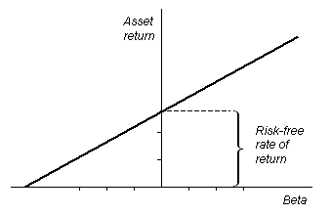
Capital Structure: Funding the Business Operations and Growth
Sources of Capital
2. Equity and Equity Valuation CAPM and SML:
A project plotted below the SML would have a low expected return and a high price: This is attractive from the perspective of a company raising capital; but would not make sense for a rational investor.
Security Market Line SML
The security market line is the theoretical line on which all capital investments lie.
Investors want higher expected returns for more risk.
The SML displays the expected rate of return of a security as a function of systematic, non-diversifiable risk.
The location of a financial instrument above, below, or on the security market line will lead to consequences for a company’s cost of capital.
Yes
No
courses.lumenlearning.com

Slide 22
Capital Structure: Funding the Business Operations and Growth
Sources of Capital
3. Bonds and Bond Valuation – Interest rates and taxes
Companies obtain debt financing privately through source new funds by issuing debt to the public:
Debt financing: the issuer (borrower) issues debt securities like corporate bonds or notes.
Companies are borrowers because they exchange securities for cash needed to execute projects.
The issuer will be repaying the debt (capital and interest) according to the specified schedule.
The drawback of borrowing money through debt is that borrowers need to make interest payments, as well as principal repayments, on time - failure to do so may lead the borrower to default or bankruptcy.
Firms can deduct their interest payments before paying taxes, but dividends are not tax deductible.

Slide 23
Capital Structure: Funding the Business Operations and Growth
Sources of Capital
3. Bonds and Bond Valuation – Interest rates and taxes
Issuing Debt – Debt Financing: Cost considerations
Example
The Vessel Elul Manufacturing Corp. (VEMC) issued €100 million of debt with a 7% interest (coupon) in Nov. 19 to finance the acquisition of a new facility. Today, management wants to finance the facility expansion with a new issue of bonds, but the interest rates had increased (bond prices decreased), and bonds yield 8%. What is the cost of the new debt?
If the old bonds are selling at 8%t, the new debt will not sell at a lower yield, and the cost of the new debt must be around 8%
The 7% is a historical number with no relevance today
If a business issues debt for the first time, management should seek advise on the yield from an expert, and the yield is considered the cost of debt

Slide 24
Capital Structure: Funding the Business Operations and Growth
Sources of Capital
3. Bonds and Bond Valuation – Interest rates and taxes
The cost of debt financing is related to the bond interest YTM, or the reference of the industry by one of the rating agencies like S&P or Fitch Rating.

Slide 25
Capital Structure: Funding the Business Operations and Growth
Deciding among sources: The impact of the Cost of Capital decision for Business Financial Success
Debt (Bonds) vs Equity (Stock) Financing – which is best for a particular business and why?
Debt and equity financing are two very different ways of financing businesses.
Pros and Cons of Equity Financing
` Pros:
No obligation to pay dividends on equity.
Possible industry experience and connections from right investors.
Investors’ money doesn’t have to be returned if business fails.
Improves financial health of business by reducing leverage.
Cons:
Having to give up a portion of ownership.
Higher equity issuing costs.
Attracting investors can be harder than getting a loan.

Slide 26
Capital Structure: Funding the Business Operations and Growth
Deciding among sources: The impact of the Cost of Capital decision for Business Financial Success
Debt (Bonds) vs Equity (Stock) Financing – which is best for a particular business and why?
Debt and equity financing are two very different ways of financing businesses.
Pros and Cons of Debt Financing
Pros:
Doesn’t dilute owner’s portion of ownership.
Lender doesn’t have claim on future profits.
Debt obligations are predictable and can be planned.
Interest is tax deductible.
Debt financing offers flexible alternatives for collateral and repayment options.
Cons:
Debt must be repaid.
Can be difficult to qualify for, depending on financial status and credit score.
Some debt instruments restrict businesses from pursuing alternative financing options.
Higher debt-equity ratios increase the financial risk of the company.
Assets could be seized in case of default.

Slide 27
Capital Structure: Funding the Business Operations and Growth
Deciding among sources: The impact of the Cost of Capital decision for Business Financial Success
The decision relies on a large number of factors like the current economic climate, the business’ existing capital structure, or the business’ lifecycle stage.
As a rule, in obtaining external financing, the issuance of debt is usually considered to be a less expensive source of financing than the issuance of equity.
The decision between debt or equity financing depends on the type of business and whether the advantages outweigh the risks, but most companies use a mix of both types of financing, in which case you can use a formula called the weighted average cost of capital, or WACC, to assess the cost of debt and equity financing.

Slide 28
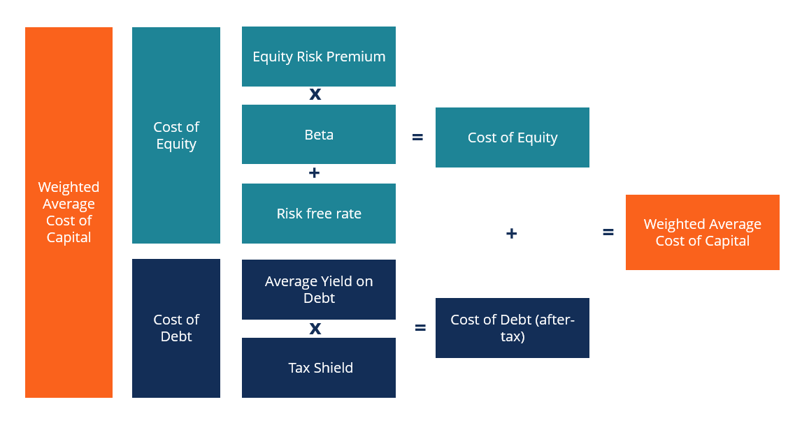
Capital Structure: Funding the Business Operations and Growth
WACC
The Cost of Capital:
The concept of Weight Average Cost of Capital (WACC) as a tool for decision-making.
The company cost of capital is the right discount rate only for investments that have the same risk as the company’s overall business.
Project can be financed by debt, equity or with a blend of both debt and equity.
A firm’s Weighted Average Cost of Capital (WACC) represents the blended cost of capital across all sources: common shares, preferred shares, or debt.
The cost of each type of capital is weighted by its percentage of total capital.
corporatefinanceinstitute.com

Slide 29
Capital Structure: Funding the Business Operations and Growth
WACC
The concept of Weight Average Cost of Capital (WACC) as a tool for decision-making.
The purpose of WACC is to determine the cost of each part of the company’s capital structure based on the proportion of equity and debt - each component has a cost to the company.
If a firm uses debt and equity to finance its investments its pays Rd for its debt financing and Re for its equity, the overall or average cost of its capital is a the weighted average:
WACC = (E/V x Re) + ((D/V x Rd) x (1 – T))
E = market value of the firm’s equity D = market value of the firm’s debt V = total value of capital (equity plus debt) E/V = percentage of capital that is equity D/V = percentage of capital that is debt Re = cost of equity (required rate of return) Rd = cost of debt (yield to maturity on existing debt) T = tax rate

Slide 30
Capital Structure: Funding the Business Operations and Growth
WACC
Capital Structure
Firm’s Opportunity Cost
corporatefinanceinstitute.com for educational purpose only

Slide 31
Capital Structure: Funding the Business Operations and Growth
WACC
Example: Elul Corp has a debt market value of $40 million, and a stock has a market value of $60 million (3 million outstanding shares of stock selling @$20 /share). The firm pays a 5% coupon on its new debt, has a beta of 1.41, a corporate tax rate bracket of 34%, the risk premium on the market is 9.5%, and the US T-bill rate is 1%. Elul’s WACC is:
Tax adjusted debt cost is Rd 5% * (1-.34) = 3.30%
Cost of equity capital Rs = 1% + (1.41 × 9.5%) = 14.40%
Market Value of Elul = $40 million + $60 million = $100 million (40% debt and 60% equity)
WACC = (E/V x Re) + ((D/V x Rd) x (1 – T))
Components | MV ($) | Weight | Cost of Capital | WACC
Debt | 40,000,000 | 40% | 3.30% | 1.32%
Equity | 60,000,000 | 60% | 14.40% | 8.64%
 | 100,000,000 | 100% |  | 9.96%
Rwacc = 9.96%
Elul must pay its investors an average of $0.0996 in return for every $1 in extra funding

Slide 32
Capital Structure: Funding the Business Operations and Growth
WACC
The weighted average cost of capital is the rate that a company is expected to pay on average to all its security holders to finance its assets.
Tests if a return on investment can exceed or meet an asset, project, or company's cost of invested capital.
The Weighted Average Cost of Capital serves as the discount rate for calculating the Net Present Value (NPV) of a business.
It represents the firm’s opportunity cost - used to evaluate investment opportunities.
The weighted average cost of capital (WACC) is a financial ratio that calculates a company’s cost of financing and acquiring assets by comparing the debt and equity structure of the business.
It measures the weight of debt and the true cost of borrowing money or raising funds through equity to finance new capital purchases and expansions based on the company’s current level of debt and equity structure.
Management typically uses this ratio to decide whether the company should use debt or equity to finance new purchases.
This ratio is very comprehensive because it averages all sources of capital; including long-term debt, common stock, preferred stock, and bonds; to measure an average cost of borrowing funds.

Slide 33
Thank You

