Slide 1
Lesson 9
Finance for Management

Slide 2
Lesson Topics and Content
Risk and Return:
The Concept of Business and Risk
Types of Risks: Systematic and Unsystematic Risk
Expected Returns of a Portfolio of Investments
The Importance of Portfolio Diversification for a Business
The Beta of a Company (β)
BARCELONA | MADRID | MALTA | ONLINE

Slide 3
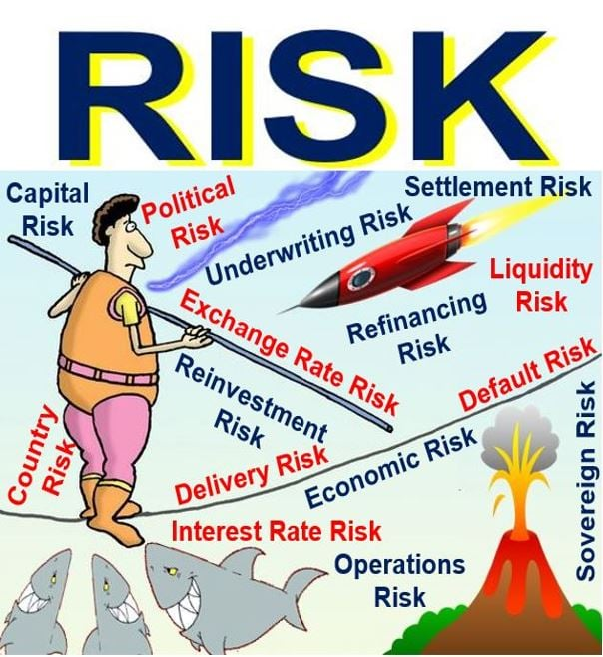
Risk and Return
The Concept of Business Risk
Expected returns (profits) on common stocks (this firm value) depends on various factors
One of the most important is the industry in which a company operates - For example, according to Morningstar, average expected return for department stores (Sears and Kohl’s) is 14.47%, air transportation (Delta and Southwest) is 11%, Computer software (Microsoft and Oracle) 11.61%.
Risk:
Risk can be referred to the possibility of a business making inadequate profits or losses due to uncertainties.
Actions taken by business enterprises themselves in order to maximize shareholder value and profits – for example, companies undertake high-cost risks in marketing to launch a new product in order to gain higher sales.
Financial Risk is the risk that involves financial loss to firms
Financial risk generally arises due to instability and losses in the financial market caused by movements in stock prices, currencies, or interest rates.
The higher the wanted return on an investment means a higher risk involved in the operation.
www.marketbusinessnews.com

Slide 4
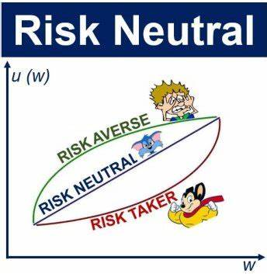
Risk and Return
Risk and Return
Types of Risks: Systematic and Unsystematic Risk
Systematic Risk: Market risk or non-diversifiable risk – affects all the market and are not controllable by the business.
Relates to any risk that affects a large number of assets, each to a greater or lesser degree.
Caused by factors that affect all assets like macroeconomics: tax/regulations, inflation, interest rates or currency fluctuations, environmental like earthquakes, or Covid-19, and social like wars or riots.
It is not possible to eliminate but it can be mitigated by diversifying investments so that even if one investment fails, the return from others will make up for it. A well diversified portfolio consists of different types of assets from different industries with varying degrees of risk.
Example: General Electric operates in 130 countries and has diverse lines of businesses: Financial Power, Renewable Energy, Aviation, and Healthcare lines of businesses.
www.marketbusinessnews.com

Slide 5
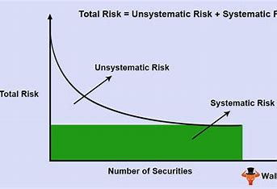
Risk and Return
Risk and Return
Types of Risks: Systematic and Unsystematic Risk
Unsystematic Risk: Relates to the risk that is inherent in a specific company or industry, an is diversifiable.
The presence of unsystematic risk means that the owner of a company's securities is at risk of adverse changes in the value of those securities because of the risk associated with that organization.
An investor’s who only holds stock in the transport industry would have to face high unsystematic risk.
Examples: death of a key manager, the entry of a new competitor into a market, company is forced to recall one of its products, a business is found to have fraudulent financial statements.
www.wallstreetmojo.com

Slide 6
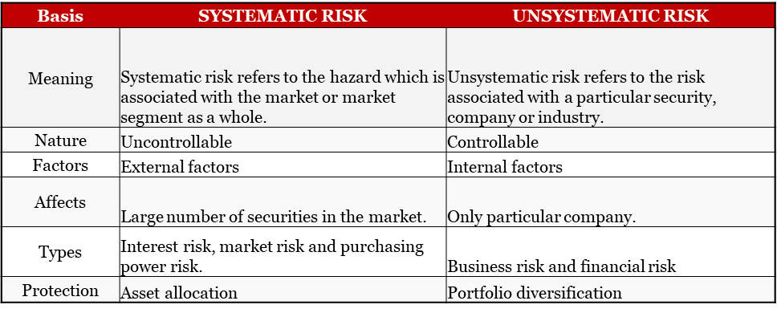
Risk and Return
Risk and Return – the higher the required return the higher the risk involved.
Types of Risks: Systematic and Unsystematic Risk
Systematic risk relates to the probability of a loss that is associated with the entire market.
Unsystematic risk refers to the probability of a loss within a specific industry or security.
www.wallstreetmojo.com

Slide 7
Risk and Return
Risk and Return
Expected Returns of Portfolio of Investments
It is important as a tool for analyzing business decisions as to whether an investment has a positive or negative average net outcome.
It's calculated as the expected value of an investment given its potential returns in different scenarios.
Expected return is based on historical data and is therefore not guaranteed; it is merely a long-term weighted average of historical returns.
Expected Rate of Return (ERR) = R1 x W1 + R2 x W2 … Rn x Wn
R = Rate of return
W = Asset weight

Slide 8
Risk and Return
Risk and Return
Expected Returns of Portfolio of Investments
Expected return is the profit or loss an business anticipates on an investment that has a known or an expected rates of return.
Case: Lago Jeep Parts, LLC is valuating an important purchase of parts to service the Jeep® Grand Cherokee customers. The business policy is accepting all projects with returns greater than 7%. Based in similar operations, the business CFO forecast that the investment has a 50% chance of gaining 20%, and a 50% change of losing 10%
The business expected return < required return on the investment; therefore, the business will reject the purchase operation or 5% < 7% reject.
Is the absolute minimum return on investment a business would accept for that investment to be worthwhile.
Expected return = (50% * 20%) + (50% * -10%) Expected return = 5%.

Slide 9
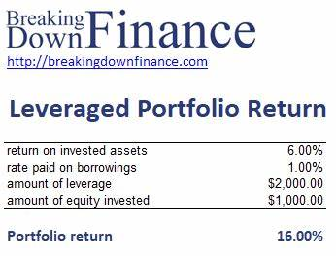
Risk and Return
Risk and Return:
Expected Returns of Portfolio of Investments
Limitations
It is risky make investment decisions based on expected returns alone.
It is a tool, there are no guarantees.
Before making any investment decisions, analyst should assess the risks of the investments, including systematic and unsystematic, to determine if the investments align with their business portfolio goals.

Slide 10
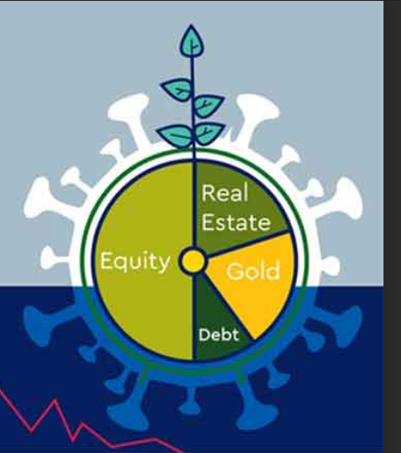
Risk and Return
The Importance of Portfolio Diversification for a Business
Risk and return are highly positive correlated: increased returns on investment go hand-in-hand with increased risk.
There are different types of risks include project-specific risk, industry-specific risk, competitive risk, international risk, or market risk.
The most basic – and effective – strategy for minimizing risk is diversification.
Diversification reduce the overall risk associated with portfolios but also limits potential returns.
Making investments in only one market sector may, if that sector significantly outperforms the overall market, generate superior returns, but should the sector decline then opposite will occur.

Slide 11
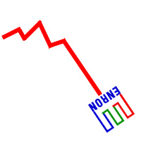
Risk and Return
The Importance of Portfolio Diversification for a Business
A well-diversified portfolio of investments consists of different types of assets from diverse industries, with varying degrees of risk, in different geographies, and classes.
Portfolio diversification will lower the volatility because not all asset categories, industries, or stocks move together.
Case: Enron scandal, series of events that resulted in the bankruptcy of the U.S. energy, commodities, and services company Enron Corporation and the dissolution of Arthur Andersen LLP, which had been one of the largest auditing and accounting companies in the world. The collapse of Enron, which held more than $60 billion in assets, involved one of the biggest bankruptcy filings in the history of the United States, generated long-lasting repercussions in the financial world. source: https://www.britannica.com/
R// The business was highly concentrated (not diversified) in highly risk and financial engineered and sophisticated strategies, not following any risk management policy regarding the optimal amount of concentration.

Slide 12
Risk and Return
Risk and Return
The Beta of a Company (β)
The beta (β) of an investment security (i.e. a stock) is a measurement of its volatility of returns relative to the entire market
It is used as a measure of risk and is an integral part of the Capital Asset Pricing Model (CAPM)*
A company with a higher beta has greater risk and also greater expected returns
A stock's beta compares its movements to the overall market - or a stock index for example the S&P 500
β =1 exactly as volatile as the market
β >1 more volatile than the market
β <1>0 less volatile than the market
β =0 uncorrelated to the market
β <0 negatively correlated to the market
*Method - model that describes the relationship between expected return and risk of a security

Slide 13
Risk and Return
Risk and Return
The Beta of a Company (β) and the stock price fluctuations - cases
High β – A company with a β > 1 is more volatile than the market. For example, a high-risk technology company with a β of 1.75 would have returned 175% of what the market returned in a given period like Marathon Oil Corporation (NYSE: MRO), 2.31 beta
Low β – A company with a β < 1 is less volatile than the whole market. For example, an electric utility company with a β of 0.45, which would have returned only 45% of what the market returned in a given period like Coca-Cola's beta (5 year) is 0.63
Negative β – A company with a negative β is negatively correlated to the returns of the market. For example, a gold company with a β of -0.2, which would have returned -2% when the market was up 10% Like Zoom Video Communications with a beta -1.48

Slide 14
Risk and Return
The Importance of Portfolio Diversification for a Business – unrelated diversification
Cases - Two lines of business are so vaguely correlated they become part unrelated diversification.
Businesses can mitigate risks, and earned the expected returns for their investment with the appropiate portfolio of investments diversification, and risk management policy.
Washing Machines and Jet Engines
Soft Drinks and Sport Tournaments

Slide 15
Thank You

