Slide 1
Lesson 8
Finance for Management

Slide 2
Lesson Topics and Content
Long-Term Financial Planning and Growth for Business Sustainability:
The Long-Term concept in Financial Planning and Decision-Making
The Importance of Long-Term Financial Planning for Businesses – Corporate Finance Perspective
Sustainable and Internal Growth Rates
Building a Business Long-Term Financial Plan Goals: Considerations

Slide 3
Long-Term Financial Planning and Growth for
Business Sustainability
The Long-Term Concept in Financial Planning and Decision-Making
Financial decisions refer to decisions concerning financial matters of a business concern, decisions regarding: the magnitude of funds to be invested to enable a firm to accomplish its goal, kind of assets to be acquired, pattern of capitalization, pattern of distribution of firm’s, income and similar other matters.
Long-term financial planning combines financial forecasting with strategizing, it is a highly collaborative process that considers future scenarios and helps business navigate challenges, and is part of an overall strategic plan.
Long-term financial planning is the process of aligning the business financial capacity (or expected capacity) with long-term objectives (business strategy).
The main objective of financial planning is that sufficient fund should be available in the company for different purposes such as for purchase of long-term assets, to meet day-to- day expenses, etc. It ensures timely availability of finance.

Slide 4
Long-Term Financial Planning and Growth for
Business Sustainability
Long-Term Financial Planning
The Long-Term concept in Financial Planning and Decision-Making:
Financial decisions refer to decisions concerning financial matters of a business regarding: the magnitude of funds to be invested to enable a firm to accomplish their ultimate goals, kind of assets to be acquired, pattern of capitalization, pattern of distribution of firm’s income, among others.
Long-term financial planning combines financial forecasting with strategizing, it is a highly collaborative process that considers future scenarios and helps business navigate challenges, and is part of an overall strategic plan.
Long-term financial planning is the process of aligning the business financial capacity (or expected capacity) with long-term objectives (business strategy).

Slide 5
Long-Term Financial Planning and Growth for
Business Sustainability
Long-Term Financial Planning
The Long-Term concept in Financial Planning for Business Sustainability – Corporate Finance Perspective
A long-term financial plan involves more uncertainty than a short-term because, market trends and information can be more accurately forecasted in the short-term.
The concept of long-term actions involves uncertainty and puts additional risk to the projects, or decisions.
In order to business to competitive the business must tailor a Long-Term Financial Sustainability Strategy like:
Applying a prudent and integrated financial planning approach that identifies and manages risks of the business long-term financial health and credit rating.
Deciding how to approach the business survival among competitors by: applying business, operational or transformational strategies.

Slide 6
Long-Term Financial Planning and Growth for
Business Sustainability
Long-Term Financial Planning
The Long-Term concept in Financial Planning-Factors affecting Long -Term Financial Decisions
The finance manager has to exercise skill and prudence while taking long-term financial decisions since they effect the financial health of the enterprise over a long period of time.
External factors: Environmental factors that are beyond the control and influence of management: State of economy-i.e., phase of trade cycle, Institutional structures of capital markets (Developed or undeveloped), regulations in financing (Debt Equity Norms, Dividend Payment Restrictions among others, taxation policy. Investor's expectations in terms of safety, liquidity and profitability, or lending policies of financial institutions.
Internal Factors - related with internal conditions of the firm: Nature, age, and size of business, ownership and asset structure, liquidity position of the firm, expected return, cost and risk, attitude of management.
A prudent and skillful manager strives to strike a proper balance among these factors in the light of income, risk, control and flexibility factors.

Slide 7
Long-Term Financial Planning and Growth for
Business Sustainability
Long-Term Financial Planning:
The Importance of Long-Term Financial Planning for Businesses – Corporate Finance Perspective
Long term financial planning provides tools and information that will help management deciding in advance:
The total capital requirements for the new projects for business sustainability.
Assessment exercise to invest in the right projects according to the long-term business strategy.
Provide managers the resources to come with the right capital mix: bonds, equity, bank loan, or retained earnings.
Helps to prevent or anticipate future challenges.
The efficient use of the financial resources means more resources to other investments or increase the value of the business shares.
https://corporatefinanceinstitute.com/

Slide 8
Long-Term Financial Planning and Growth for
Business Sustainability
Long-Term Financial Planning:
Formulas for Sustainable and Internal Growth Rates
The internal growth rate (IGR) refers to the sales growth rate that can be supported with no external financing – the business funds its operations solely from retained earnings.
A company’s maximum internal growth rate is the highest level of business operations that can continue to fund and grow the company.
The internal growth rate is important for start-ups, since it measures the company’s ability to increase sales and profit without issuing more stock or debt.
Internal growth can be generated by organic growth: adding new product lines or expanding existing ones.
ROA=Return of Assets
r= retention rate (1-Dividend payout ratio)
Drivers of the Internal Growth Rate: increased in r or decrease of dividend payout ratio or if ROA increases.
The IGR shows companies how they can use their existing resources more efficiently and effectively to generate internal growth: For example, manufacturing companies may look at their production process to optimize the use of machinery and labor hours and reduce any idle time to boost productivity.
https://corporatefinanceinstitute.com/

Slide 9
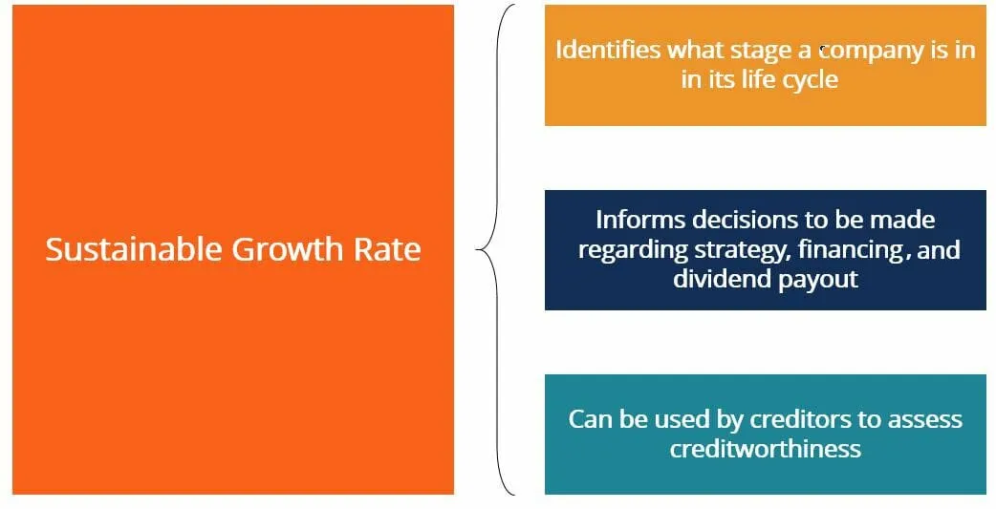
Long-Term Financial Planning and Growth for
Business Sustainability
Long-Term Financial Planning and Sustainable growth rate:
The sustainable growth rate is the rate of growth that a company can expect to see in the long term.
The sustainable growth rate is an indicator of what stage a company is in, during its life cycle.
Understanding where a company is in its life cycle is important in determining the corporate finance objectives: sources of financing to use, dividend payout policies, and overall competitive strategy.
The growth ratio is used by creditors to determine the likelihood of a company defaulting on its loans: A high growth rate may indicate the company is focusing on investing in R&D and NPV-positive projects, which may delay the repayment of debt.
A high-growth-rate company is generally considered riskier, as it likely sees greater earnings volatility from period to period.
Retention Rate – [ (Net Income – Dividends) / Net Income) ]
the percentage of earnings that the company has not paid out in dividends
ROE – Return of Equity
https://corporatefinanceinstitute.com/

Slide 10
Long-Term Financial Planning and Growth for
Business Sustainability
Long-Term Financial Planning:
Formulas for Sustainable and Internal Growth Rates
Internal Growth Rate vs. Sustainable Growth Rate – a concept associated with Internal Growth Rate: Sustainable Growth Rate
Sustainable Growth Rate refers to the maximum sales growth rate a company can achieve without external equity financing while using the internally generated funds and borrowing just enough to maintain a constant debt/equity ratio.
External financing is allowed but only in the proportion of its current capital mix.
The formula for the sustainable growth rate is similar to the formula for IGR - the main difference is that the return on equity (ROE)is used instead of the return on assets (ROA).
ROE=Return of Equity
r= retention rate (1-Dividend payout ratio)
While the internal growth rate assumes no external financing, the sustainable growth rate assumes that some external financing is used.
https://corporatefinanceinstitute.com/

Slide 11
Long-Term Financial Planning and Growth for
Business Sustainability
Long-Term Financial Planning and Sustainable Growth Rate
Case: BigBowBaby, Inc. Retail Store was created in 2017, and Upper Management is interested in knowing the business sustainable growth rate for the paste years. The following selected financial data was provided by Neni, the CFO of the Business.
To further understand the financial health of the business, its sustainable growth rate should be compared with a number of companies that operate in the same industry.
If some other firms operating in this industry see ratios that are, lower than BBB, the business is growing quickly and outperforming its competition.
It may be best for BBB’s to utilize equity financing over debt financing due to the cash flow constraints that come with interest payments.
BBB may also choose to pursue a more aggressive corporate development strategy in order to sustain its growth and further penetrate the market like M&A strategy.
Sustainable Growth Rate is around 10% YoY
https://corporatefinanceinstitute.com/

Slide 12
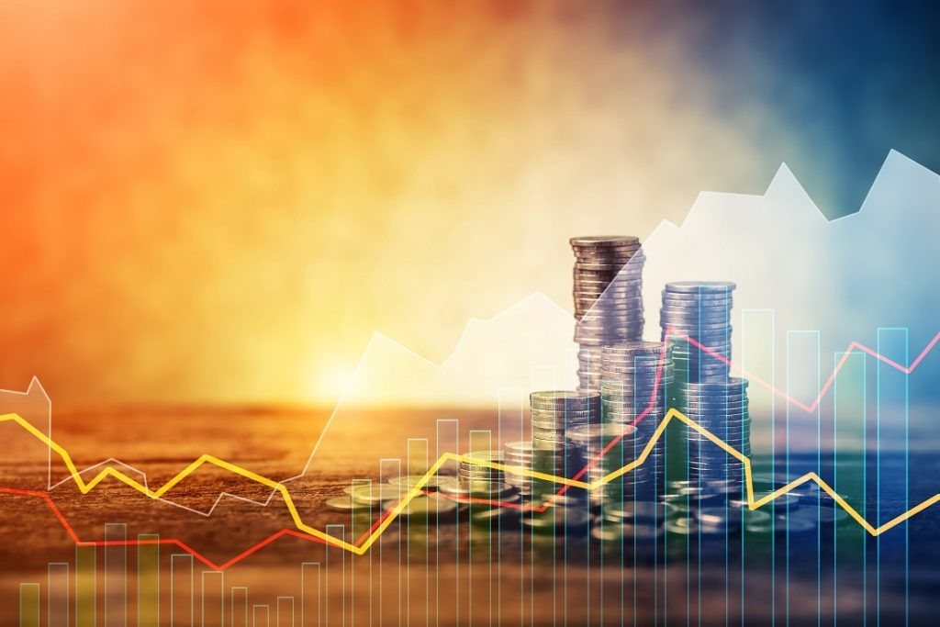
Long-Term Financial Planning and Growth for
Business Sustainability
Long-Term Financial Planning:
Building a Business Long-Term Financial Plan Goals: Considerations
The total capital requirements for the projects for sustainability.
Assessment exercise to invest in the right projects according to the long-term business strategy.
Provide managers the resources to come with the right capital mix: bonds, equity, bank loan, or retained earnings.
The efficient use of the financial resources means more resources to other investments or increase the value of the business shares, and helps to prevent or anticipate future challenges.
www.corporatefinance institute.com
https://corporatefinanceinstitute.com/

Slide 13
Long-Term Financial Planning and Growth for
Business Sustainability
Long-Term Financial Planning:
A long-term financial plan should include:
Time Horizon from > 1Y ideally from 5Y to 10Y in the timeline (depending in the industry).
Dimension/Scope: A plan should consider all appropriated funds to execute the strategic plan. Funds from equity, bonds, or bank loans.
Control and Monitoring: Business should update long-term planning activities (not the goals) as needed in order to provide direction to the budget process by using monitoring mechanisms, such as scorecard of key indicators of financial health.
Internal and external analysis of the financial environment for the business, revenue and expenditure forecasts, debt position and affordability analysis, strategies for achieving and maintaining financial balance, and plan.
Visibility: All stakeholders in the organization must be involved and aware of the business direction and how upper management is planning to execute the plan.
Detailed as to where the funds go, and how they are returned.

Slide 14
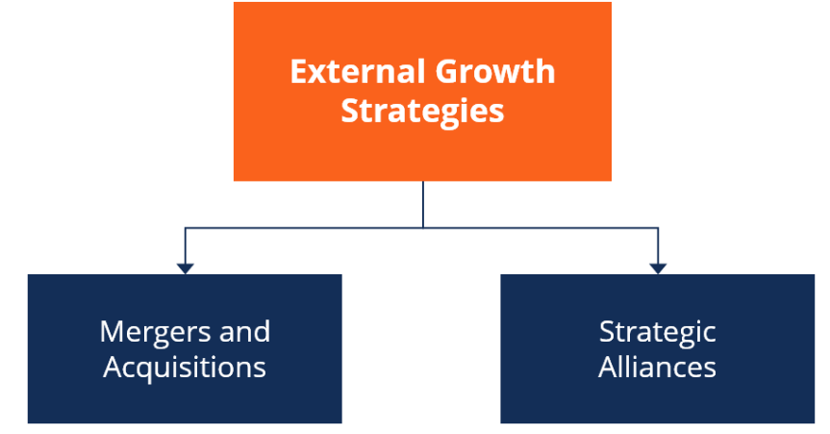
Long-Term Financial Planning and Growth for
Business Sustainability
Internal Growth Rate is the maximum growth rate it can be achieved with no external financing.
Sustainable Growth Rate is the maximum growth rate it can be achieved with no external equity financing while maintaining a constant D/E ratio.
www.corporatefinance institute.com

Slide 15
Thank You

