Slide 1
Lesson 6
Finance for Management
Prof. Belkis M Reyes-Fernandez

Slide 2
Lesson Topics and Content
Case Study: Fundamental and Financial Statements Analysis for Business Decision-Making – Practical Exercise
Financial Statement and Ratio analysis
Industry analysis
Understanding the business, from its financial statements
Creating value for a business: Making informed business decisions

Slide 3
Case Study: Fundamental and Financial Statements Analysis for Business Decision-Making – Practical Exercise

Slide 4
Case Study: Fundamental and Financial Statements Analysis for Business Decision-Making – Practical Exercise

Slide 5
Case Study: Fundamental and Financial Statements Analysis for Business Decision-Making – Practical Exercise

Slide 6
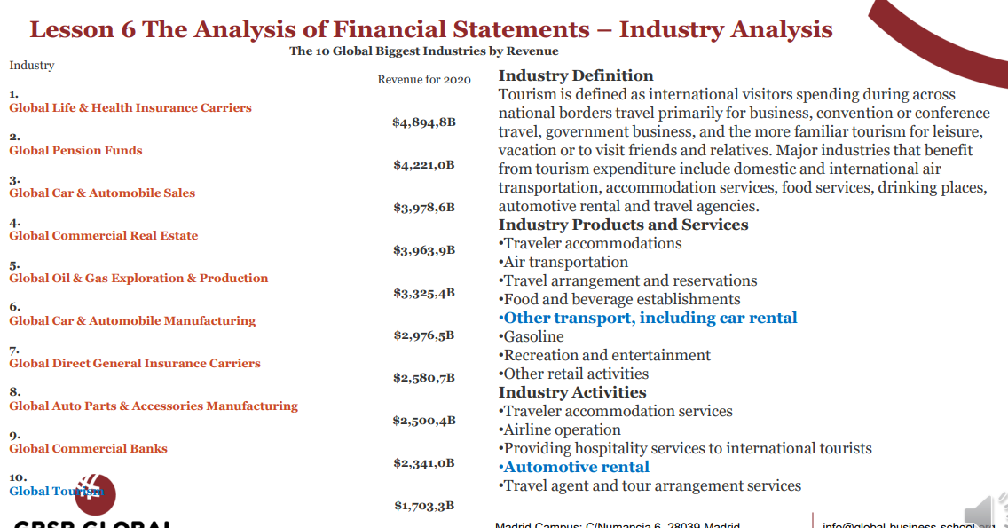
Case Study: Fundamental and Financial Statements Analysis for Business Decision-Making – Practical Exercise

Slide 7
Case Study: Fundamental and Financial Statements Analysis for Business Decision-Making – Practical Exercise

Slide 8
Case Study: Fundamental and Financial Statements Analysis for Business Decision-Making – Practical Exercise

Slide 9
Case Study: Fundamental and Financial Statements Analysis for Business Decision-Making – Practical Exercise
Industry Analysis

Slide 10
Case Study: Fundamental and Financial Statements Analysis for Business Decision-Making – Practical Exercise

Slide 11
Case Study: Fundamental and Financial Statements Analysis for Business Decision-Making – Practical Exercise

Slide 12
Case Study: Fundamental and Financial Statements Analysis for Business Decision-Making – Practical Exercise

Slide 13
Case Study: Fundamental and Financial Statements Analysis for Business Decision-Making – Practical Exercise

Slide 14
Case Study: Fundamental and Financial Statements Analysis for Business Decision-Making – Practical Exercise
Creating Value for a Business – Making Informed Decisions
From the Managerial Perspective, what can the business do to be competitive?

Slide 15
Thank You

