Slide 1
Lesson 5
Finance for Management
Prof. Belkis M Reyes-Fernandez

Slide 2
Lesson Topics and Content
Tools to Understand Financial Information for Decision-Making
Interpreting the Business Financial Performance
Comparative Financial Statement Analysis
Financial Ratios, the connection between Financial Statements:
Liquidity Ratios
Activity Ratios
Leverage Ratios
Profitability Ratios
Market Ratios
Industry Specific Ratio Analysis and Assessment

Slide 3
Tools to Understand Financial Information for Decision-Making
Comparative Financial Statement Analysis

Slide 4
Tools to Understand Financial Information for Decision-Making
Comparative Financial Statement Analysis

Slide 5
Tools to Understand Financial Information for Decision-Making
Comparative Financial Statement Analysis

Slide 6
Tools to Understand Financial Information for Decision-Making
Comparative Financial Statement Analysis

Slide 7
Tools to Understand Financial Information for Decision-Making
Comparative Financial Statement Analysis

Slide 8
Tools to Understand Financial Information for Decision-Making
Comparative Financial Statement Analysis

Slide 9
Tools to Understand Financial Information for Decision-Making
Comparative Financial Statement Analysis

Slide 10
Tools to Understand Financial Information for Decision-Making
Comparative Financial Statement Analysis

Slide 11
Tools to Understand Financial Information for Decision-Making
Financial Ratios

Slide 12
Tools to Understand Financial Information for Decision-Making
Financial Ratios

Slide 13
Tools to Understand Financial Information for Decision-Making
Financial Ratios

Slide 14
Tools to Understand Financial Information for Decision-Making
Financial Ratios

Slide 15
Tools to Understand Financial Information for Decision-Making
Financial Ratios

Slide 16
Tools to Understand Financial Information for Decision-Making
Financial Ratios

Slide 17
Tools to Understand Financial Information for Decision-Making
Financial Ratios

Slide 18
Tools to Understand Financial Information for Decision-Making
Financial Ratios

Slide 19
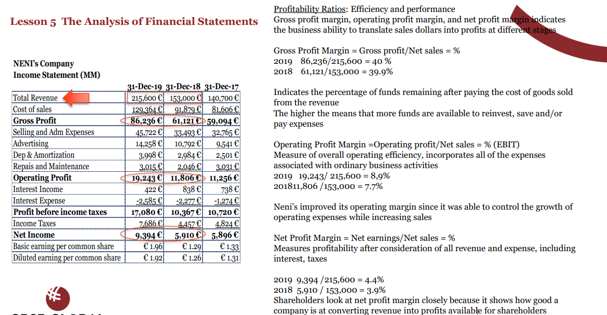
Tools to Understand Financial Information for Decision-Making
Financial Ratios

Slide 20
Tools to Understand Financial Information for Decision-Making
Financial Ratios

Slide 21
Tools to Understand Financial Information for Decision-Making
Financial Ratios

Slide 22
Tools to Understand Financial Information for Decision-Making
Industry Specific Ratio Analysis and Assessment

Slide 23
Tools to Understand Financial Information for Decision-Making
Industry Specific Ratio Analysis and Assessment
Occupancy ratio for hoteling industry.
Capital adequacy ratio for banks.
Monetary reserve requirement for banks.
Sales per square foot for companies in retail business.
Revenue per employee for service companies.

Slide 24
Thank You

