Slide 1
Lesson 4
Finance for Management
Prof. Belkis M Reyes-Fernandez

Slide 2
Lesson Topics and Content
Understanding the Business from its Financial Statements
The Four Financial Statements: Structure and Components
Cash Flow Statement
Statement of Changes in Equity
- Users of the Financial Statement Information

Slide 3
Understanding the Business from its Financial Statements
The Four Financial Statements: Structure and Components

Slide 4
Understanding the Business from its Financial Statements
The Four Financial Statements: Structure and Components

Slide 5
Understanding the Business from its Financial Statements
The Four Financial Statements: Structure and Components

Slide 6
Understanding the Business from its Financial Statements
The Four Financial Statements: Structure and Components

Slide 7
Understanding the Business from its Financial Statements
The Four Financial Statements: Structure and Components

Slide 8
Understanding the Business from its Financial Statements
The Four Financial Statements: Structure and Components

Slide 9
Understanding the Business from its Financial Statements
The Four Financial Statements: Structure and Components

Slide 10
Understanding the Business from its Financial Statements
The Four Financial Statements: Structure and Components

Slide 11
Understanding the Business from its Financial Statements
The Four Financial Statements: Structure and Components

Slide 12
Understanding the Business from its Financial Statements
The Four Financial Statements: Structure and Components

Slide 13
Understanding the Business from its Financial Statements
The Four Financial Statements: Structure and Components

Slide 14
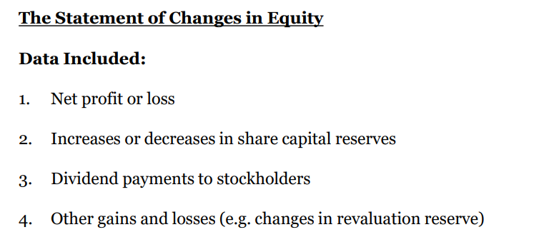
Understanding the Business from its Financial Statements
The Four Financial Statements: Structure and Components

Slide 15
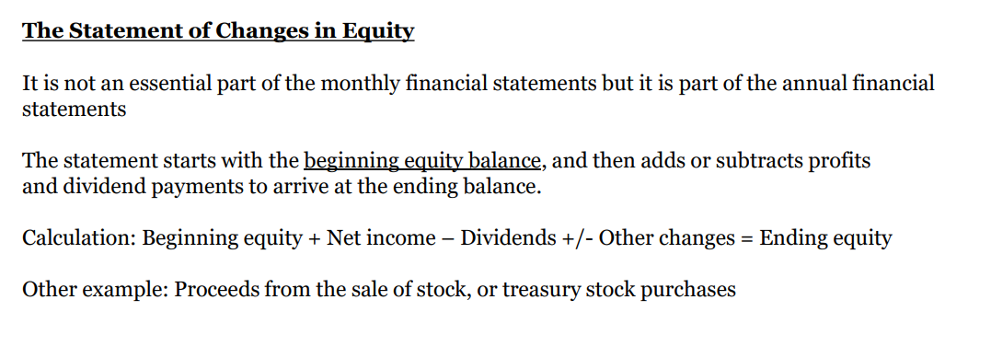
Understanding the Business from its Financial Statements
The Four Financial Statements: Structure and Components

Slide 16
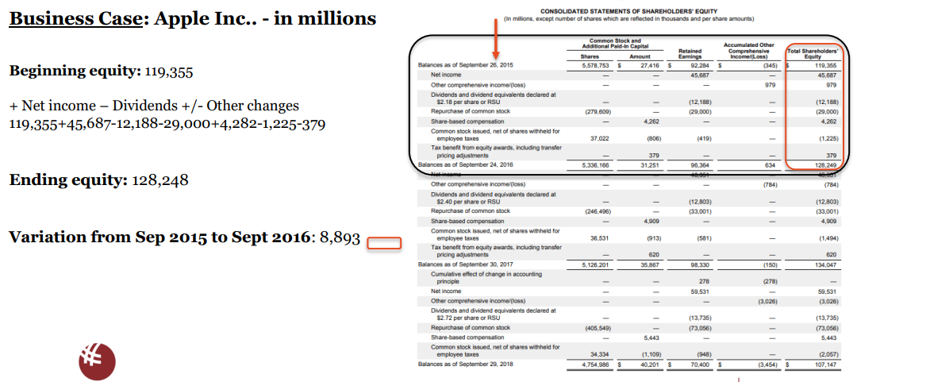
Understanding the Business from its Financial Statements
The Four Financial Statements: Structure and Components

Slide 17
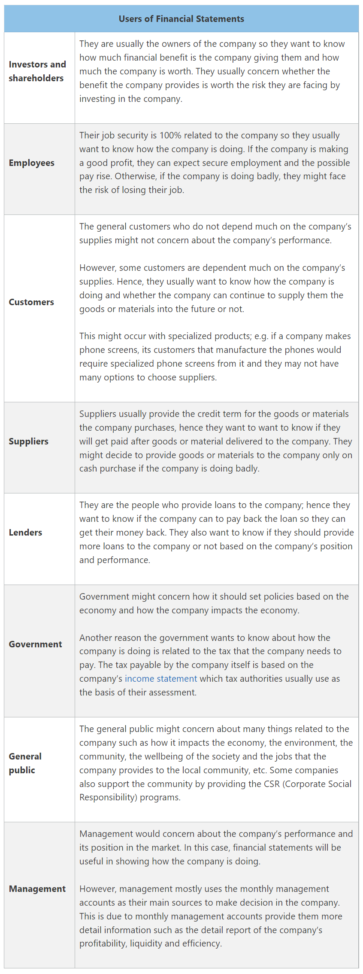
Understanding the Business from its Financial Statements
The Four Financial Statements: Structure and Components
Users of the Financial Statement Information – End Users
www.accountinguide.com

Slide 18
Thank You

