Slide 1
Lesson 3
Finance for Management
Prof. Belkis M Reyes-Fernandez

Slide 2
Lesson Topics and Content
Understanding the Business from its Financial Statements
The Four Financial Statements: Structure and Components
The Income Statement Sheet
Practical Exercise (Income Statement of a real company) Managerial Accounting

Slide 3
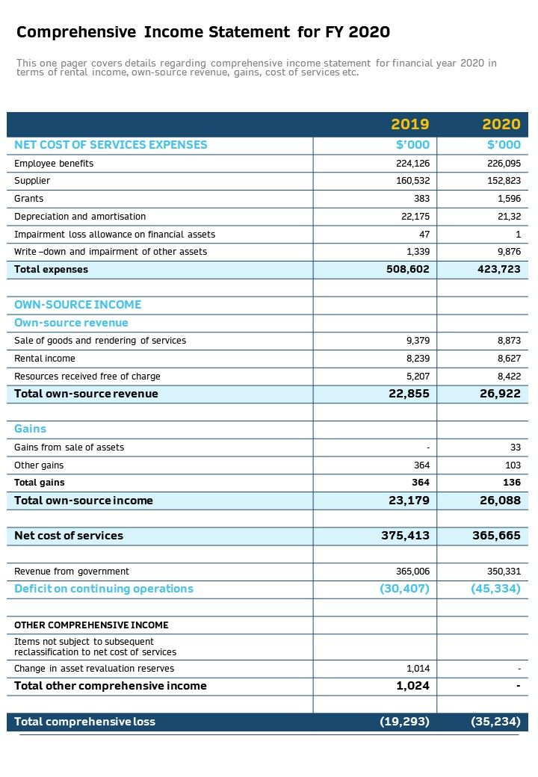
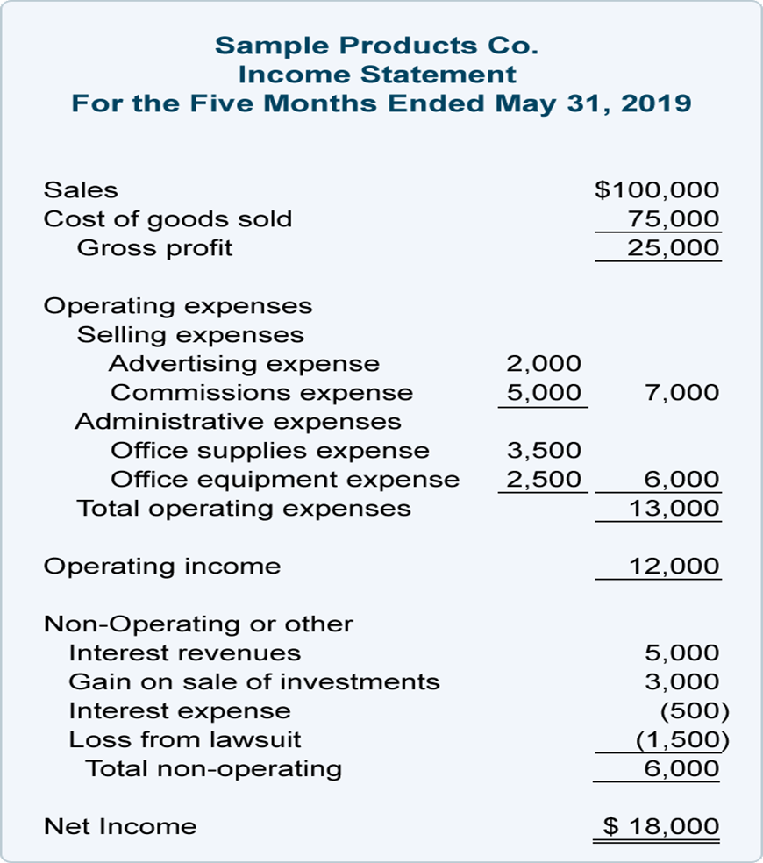
Understanding the Business from its Financial Statements
The Four Financial Statements: Structure and Components
Income Statement

Slide 4
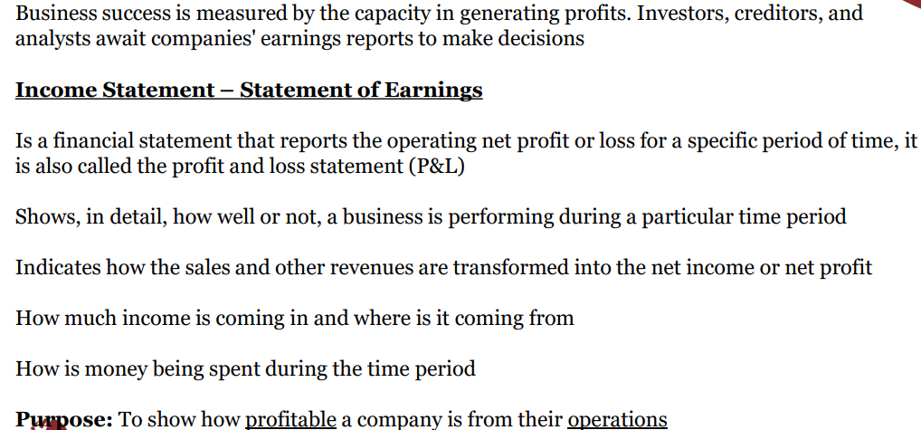
Understanding the Business from its Financial Statements
The Four Financial Statements: Structure and Components

Slide 5
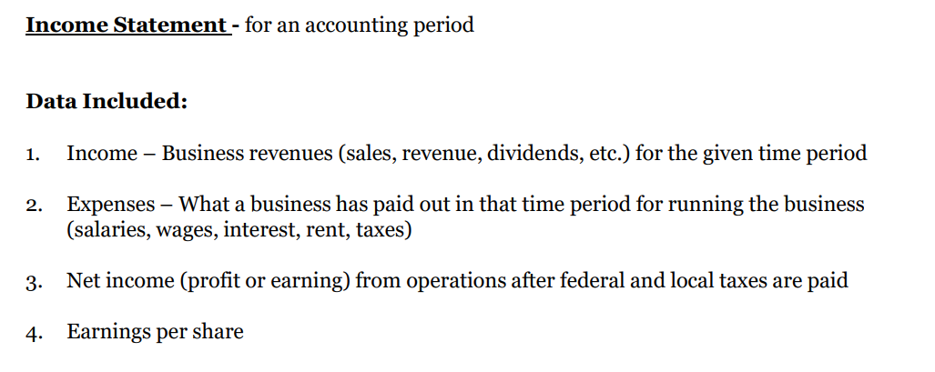
Understanding the Business from its Financial Statements
The Four Financial Statements: Structure and Components

Slide 6
Understanding the Business from its Financial Statements
The Four Financial Statements: Structure and Components

Slide 7
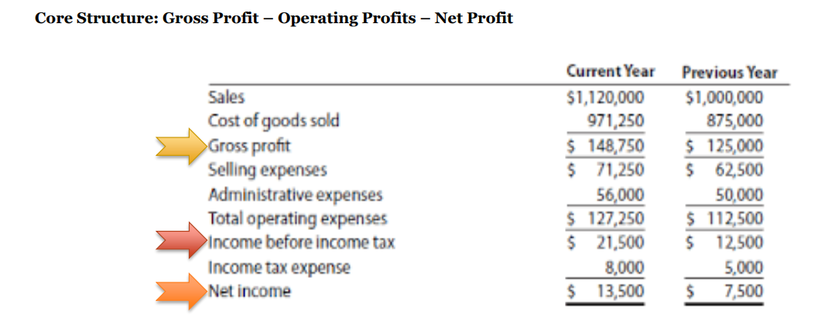
Understanding the Business from its Financial Statements
The Four Financial Statements: Structure and Components
Income Statement

Slide 8
Understanding the Business from its Financial Statements
The Four Financial Statements: Structure and Components
Income Statement

Slide 9
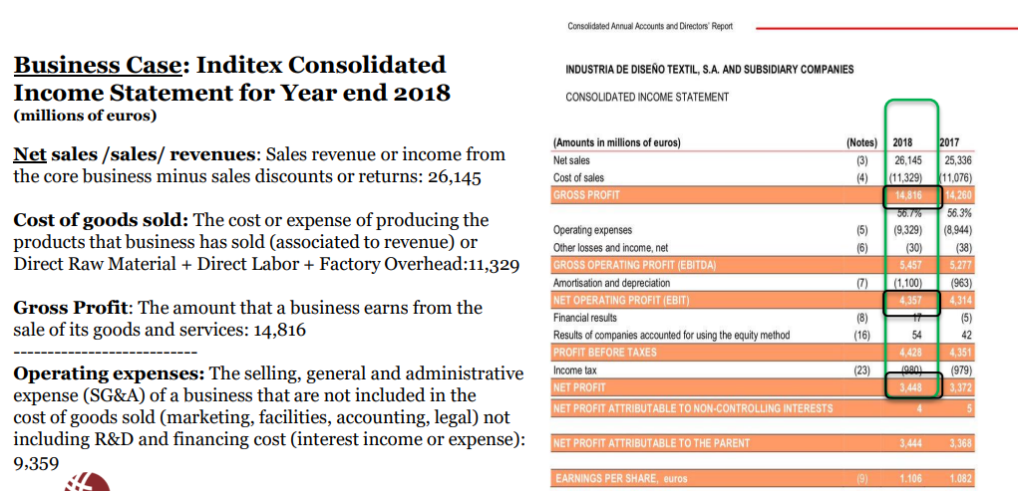
Understanding the Business from its Financial Statements
The Four Financial Statements: Structure and Components
Income Statement

Slide 10
Understanding the Business from its Financial Statements
The Four Financial Statements: Structure and Components
Income Statement

Slide 11
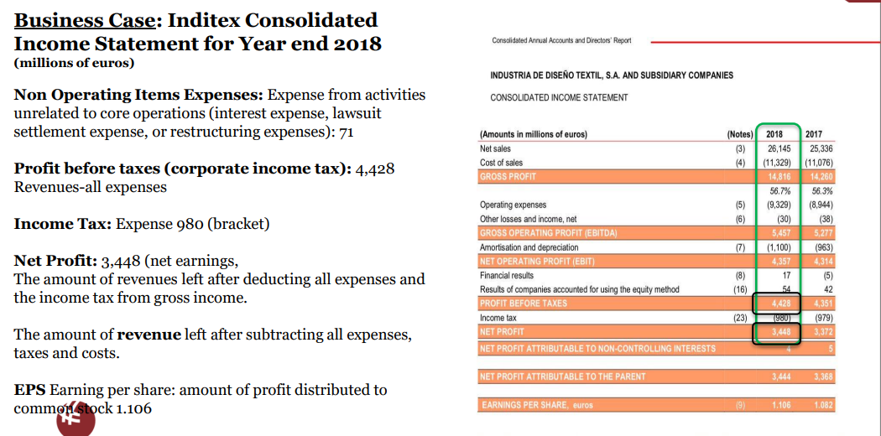
Understanding the Business from its Financial Statements
The Four Financial Statements: Structure and Components
Income Statement

Slide 12
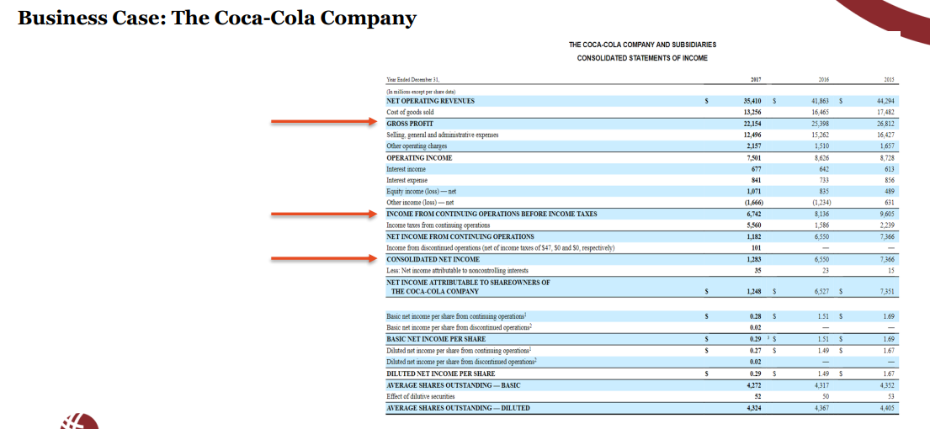
Understanding the Business from its Financial Statements
The Four Financial Statements: Structure and Components
Income Statement

Slide 13
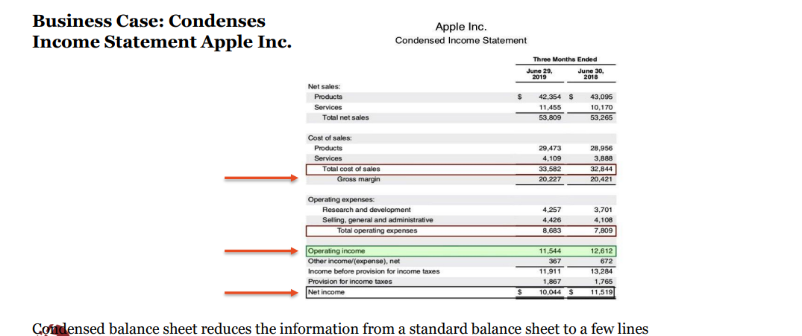
Understanding the Business from its Financial Statements
The Four Financial Statements: Structure and Components
Income Statement

Slide 14
Understanding the Business from its Financial Statements
The Four Financial Statements: Structure and Components
Income Statement

Slide 15
Thank You

