Slide 1
Lesson 2
Finance for Management
Prof. Belkis M Reyes-Fernandez

Slide 2
Lesson Topics and Content
Understanding the Business from its Financial Statements
The Four Financial Statements: Structure and Components
The Balance Sheet
Practical Exercise (Balance Sheet of a real company) Managerial Accounting

Slide 3
Understanding the Business from its Financial Statements
The Four Financial Statements: Structure and Components
Financial statements are written records that convey the business activities and the financial performance of a company.
They corporate annual report contains four basic financial statements available from several sources like regulators SEC, CNMV, Financial Conduct Authority or their own websites.
Most of the business required those statements to be audited by external auditors, government agents, or other bodies to ensure accuracy and for regulatory, tax, financing, or investing purposes.
Financial statements included:
The balance sheet or statement of financial position shows the financial position: assets, liabilities, and stockholders' equity-of the firm on a particular date.
The income statement presents the results of operations: revenues, expenses, net profit or loss, and net profit or loss per share-for the accounting period.

Slide 4
Understanding the Business from its Financial Statements
The Four Financial Statements: Structure and Components
Financial statements are written records that convey the business activities and the financial performance of a company, or a corporate annual report contains four basic financial statements.
Financial statements includes:
The balance sheet
The income statement
The statement of stockholders' equity details the transactions that affect the balance sheet equity accounts during an accounting period
The statement of cash flows provides information about the cash inflows and outflows from operating, financing, and investing activities during an accounting period

Slide 5
Understanding the Business from its Financial Statements
The Four Financial Statements: Structure and Components
Financial statements and their notes, serves as a route, and the lead to a determination of the
financial health of a business: they contain valuable information regarding the financial position of a company, the success of its operations, the policies and strategies of management, and its future performance.
Depending on the end user: investor, creditor, employee, competitor, supplier, regulator the financial statement report can find and interpret the information to answer questions about the company:
• Would an investment generate the expected returns?
• What is the degree of risk associated with the the investment?
• Should existing investment holdings be liquidated?
• Will cash flows be sufficient to service cash needs? (debt payment)
• Is the company providing a good employer? (future advancement or employee benefits)
• How well does this company compete in its operating environment?
• Is this firm a good prospect as a customer?

Slide 6
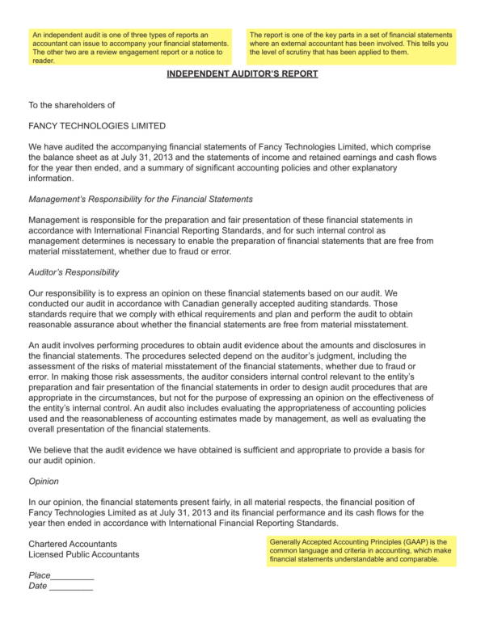
Understanding the Business from its Financial Statements
The Four Financial Statements: Structure and Components
Auditor’s Report - Independent or external auditor that will attest to the fairness of the presentation

Slide 7
Understanding the Business from its Financial Statements
The Four Financial Statements: Structure and Components
Balance Sheet – the statement of condition – statement of financial position
It is a summary of the financial position or condition of a business or organization at a specific moment in time.
Provides valuable information about a business firm, particularly when examined over a period of several years and evaluated in relation to the other financial statements.
A financial statement that reports a company's assets, liabilities and shareholders' equity at a specific point in time, and provides a basis for computing rates of return and evaluating its capital structure.
To add the appropiate value, the balance sheet should be compared with those of previous periods or businesses in the same industry.

Slide 8
Understanding the Business from its Financial Statements
The Four Financial Statements: Structure and Components
Balance Sheet
The statement is a summary of what the firm owns (assets) and what the firm owes to outsiders (liabilities) and to internal owners (stockholders' equity).
Most businesses use the calendar year with the accounting period ending on December 31, and prepare interim statements for each quarter Q, ending March 31, June 30, and September 30.
Purpose: To demonstrate a company’s financial position and its solvency (i.e. its ability to meet long-term financial obligations).
The account balances on a balance sheet must balance total of all assets must equal the sum of liabilities and stockholders' equity. The balancing equation is expressed as:
Assets = Liabilities + Stockholders' equity

Slide 9
Understanding the Business from its Financial Statements
The Four Financial Statements: Structure and Components
Balance Sheet
The balance sheet answers questions like: Is the business being well managed? Are there enough assets to pay off all liabilities if needed?. It reveals the business’s current strengths and weaknesses and is useful for future financial planning.
Data Included:
Assets – In financial accounting, an asset is any resource owned by the business, tangible or intangible that can be owned or controlled to produce value and that is held by a company to produce positive economic value. (cash, inventory, equipment)
Liabilities – Are defined as a company's legal financial debts or obligations that arise during the course of business operations. (bank loans)
Equity or Stockholder’s Equity– Is ownership. In the accounting and corporate lending world, equity (or shareholders‘ equity) refers to the amount of capital contributed by the owners or the difference between a company's total assets and its total liabilities.

Slide 10
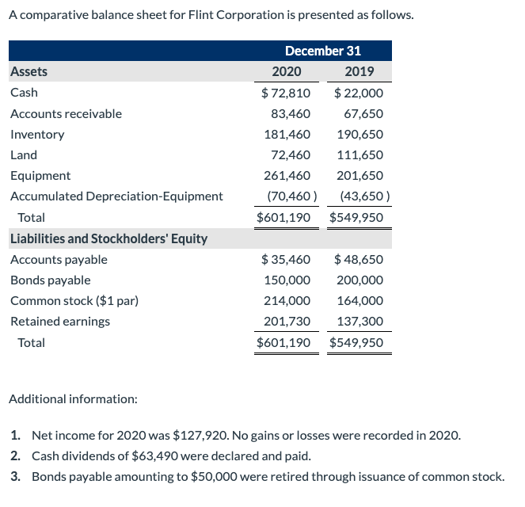
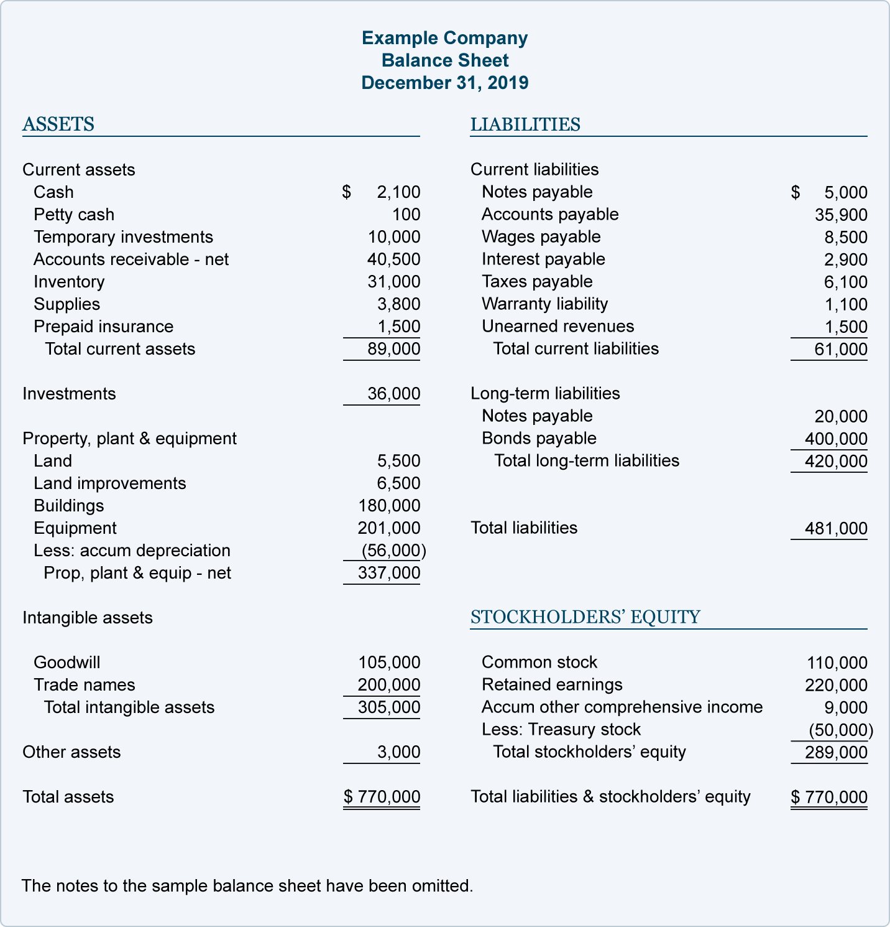
Understanding the Business from its Financial Statements
The Four Financial Statements: Structure and Components
Balance Sheet - Example

Slide 11
Understanding the Business from its Financial Statements
The Four Financial Statements: Structure and Components
Business success is measured by the capacity to generate profits. Investors, creditors, and analysts await companies' earnings reports to make decisions.
Income Statement – Statement of Earnings
Is a financial statement that reports the operating net profit or loss for a specific period of time, it is also called the profit and loss statement (P&L). The Income Statement shows how well a business is performing during a particular time period in detail.
It indicates how the sales and other revenues are transformed into the net income or net profit. How much income is coming in and where is it coming from, How is money being spent during the time period.
Purpose: To show how profitable a company is from their operations.

Slide 12
Understanding the Business from its Financial Statements
The Four Financial Statements: Structure and Components
Income Statement - for an accounting period
Data Included:
Income – Business revenues (sales, revenue, dividends, etc.) for the given time period
Expenses – What a business has paid out in that time period for running the business. (salaries, wages, interest, rent, taxes)
Net income (profit or earning) from operations after federal and local taxes are paid.
Earnings per share.

Slide 13
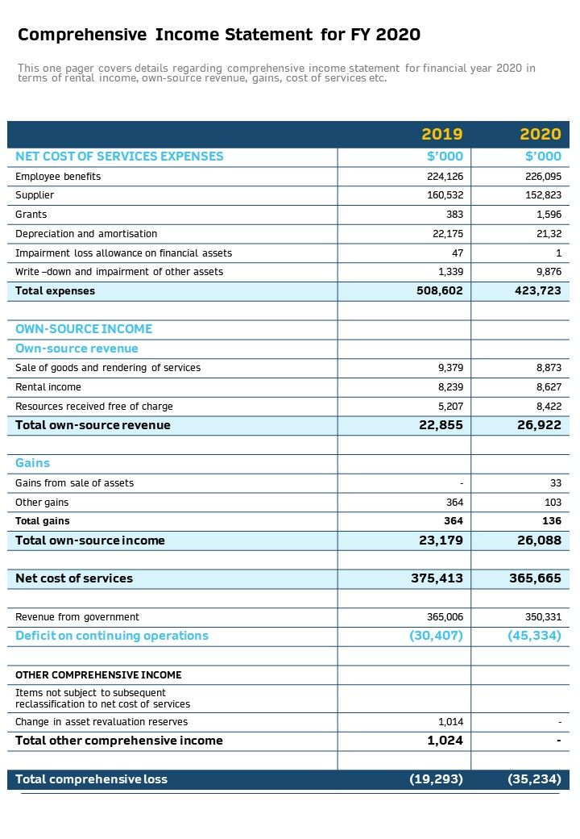
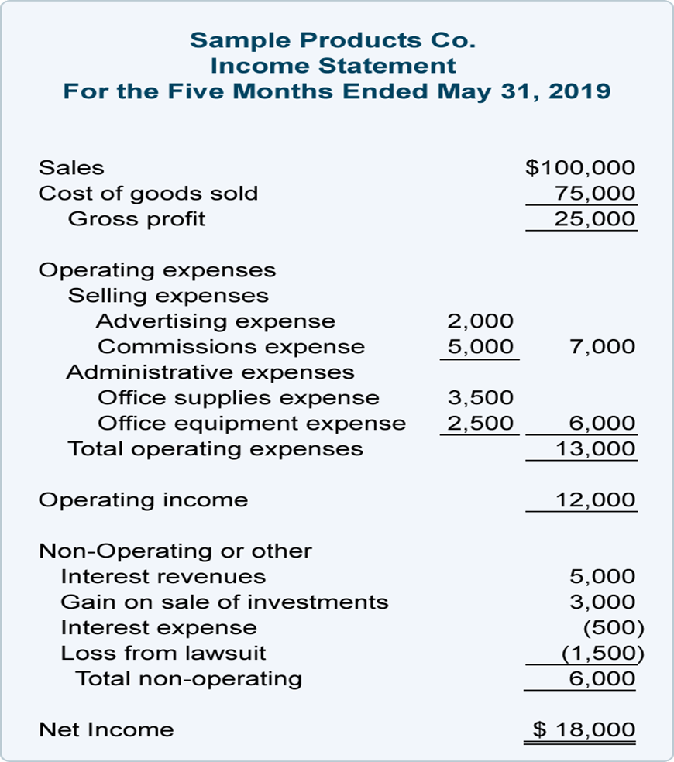
Understanding the Business from its Financial Statements
The Four Financial Statements: Structure and Components
Income Statement - Example

Slide 14
Understanding the Business from its Financial Statements
The Four Financial Statements: Structure and Components
Income Statement and Balance Sheet
The difference between the balance sheet and income statement:
The balance sheet reports assets, liabilities, and equity, while the income statement reports revenues and expenses that net to a profit or loss.

Slide 15
Understanding the Business from its Financial Statements
The Four Financial Statements: Structure and Components
Statement of Cash Flows
Summary:
The primary purpose of the statement of cash flows is to provide information about cash receipts, cash payments, and the net change in cash resulting from the operating, investing, and financing activities of a company during a particular period.
Purpose:
To display cash inflows and cash outflows from activities such as operating, investing and financing.
Importance: Generating sufficient cash is the key to a healthy business. This report shows how well the business is doing in that venture. The statement of cash flows can also be used in developing a business strategy and long-term planning.

Slide 16
Understanding the Business from its Financial Statements
The Four Financial Statements: Structure and Components
Statement of Cash Flows
Data included:
• Operating activities – Cash generated from the sale of products or services in the core business.
• Investing activities – Cash spent on investments e.g. new equipment.
• Financing activities – Cash flow from financing such as cash from a new debt or dividends paid to investors.

Slide 17
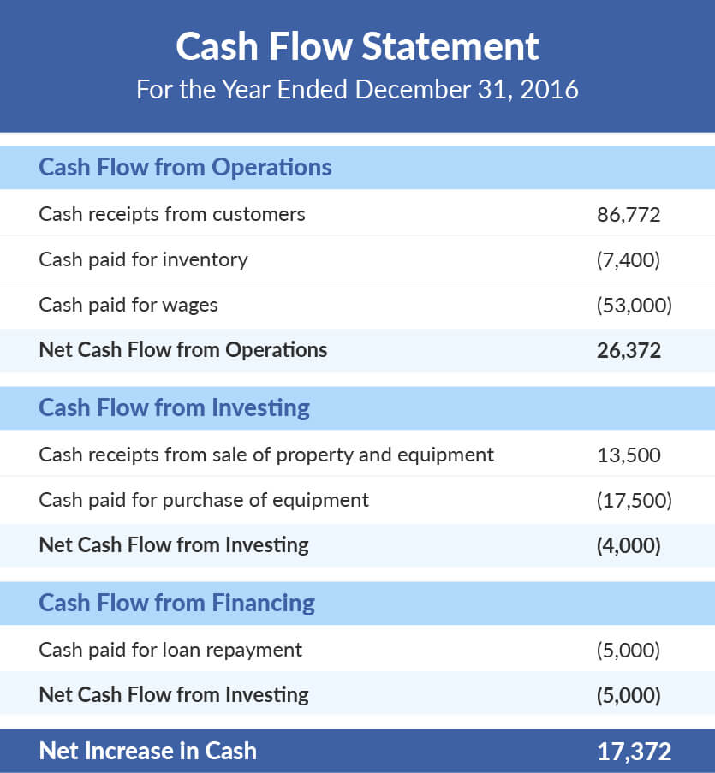
Understanding the Business from its Financial Statements
The Four Financial Statements: Structure and Components
Cash Flow Statement - Example

Slide 18
Understanding the Business from its Financial Statements
The Four Financial Statements: Structure and Components
The Statement of Changes in Equity
Summary: The equity statement gives details about the movement of owner’s equity over a period of time.
Purpose: To explain changes in retained earnings between the prior and current balance sheet dates.
Importance: Owners invest in a business for a return and to maximize their wealth.
This statement demonstrates how the financial performance of the business has affected their interest during the given time period (end-user investor).

Slide 19
Understanding the Business from its Financial Statements
The Four Financial Statements: Structure and Components
The Statement of Changes in Equity
Data Included:
Net profit or loss.
Increases or decreases in share capital reserves.
Dividend payments to stockholders.
Other gains and losses (e.g. changes in revaluation reserve).

Slide 20
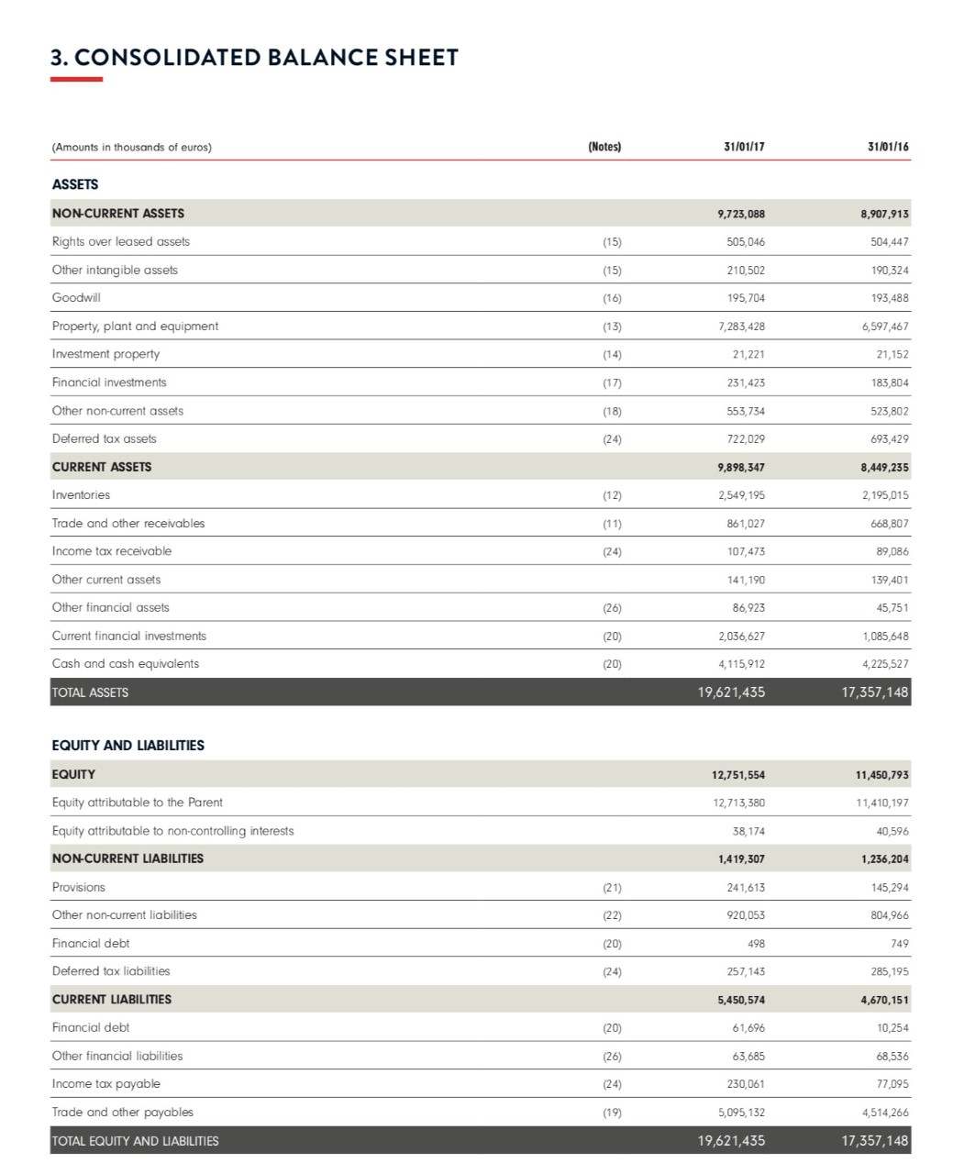
Understanding the Business from its Financial Statements
The Four Financial Statements: Structure and Components
The Balance Sheet
The types of accounts used by a business will vary by industry, applicable regulations, and government requirements.

Slide 21
Understanding the Business from its Financial Statements
The Four Financial Statements: Structure and Components
The Balance Sheet
Prepared at a specific point in time: 2016 and 2017
Interim statements are prepared monthly or quarterly
Must Reconcile: Assets = Liabilities + Stockholder’s Equity
Consolidated* Balance Sheet 2017 in thousands of euros
€19,621,435 = €6,869,881+ €12,751,554
€19,621,435 = € 19,621,435
*sums all INDITEX businesses and subsidiaries balance sheets: Zara, Bershka, etc.
Comparative data: at least periods or two years
Numbers, without a comparative date, are useless

Slide 22
Understanding the Business from its Financial Statements
The Four Financial Statements: Structure and Components
The Balance Sheet
ASSETS - OWN:
Current Assets
Current – ongoing operations of business.
Presented in order of liquidity.
Cash, convertibles in cash in the operating cycle <1Y
Working Capital = current assets – current liabilities.
Cash and cash equivalents.
Marketable Securities: short-term investment (<1Y).
Inventories: the cost of a merchandiser's products awaiting to be sold.
Prepaid expenses: future expenses paid in advance but are not yet used up (insurance or rent) – prorated.
Account receivables: the proceeds or payment which the company will receive from its customers who have purchased its goods and services.
OCA (other current assets): the assets of the business that are not very common and significant for simplicity.

Slide 23
Understanding the Business from its Financial Statements
The Four Financial Statements: Structure and Components
The Balance Sheet
ASSETS - OWN:
Other Assets: long-term assets
Investments: funds held (e.g. construction,), the cash surrender value of a life insurance policy owned by the company, and long-term investments in securities.
Property, plant, and equipment: land, buildings, leasehold improvements, equipment, furniture, tuck fleet, automobiles that are owned by the company*.
Intangible assets: copyrights, patents, goodwill**, trade names, trademarks.
Other Assets: Long term assets that are not classified as investments, property, plant, equipment, or intangible assets.
*Less depreciation: a reduction in the value of an asset over time due to wear and tear.
** The value of a company’s brand name, solid customer base, good customer relations, good employee relations, and any patents or proprietary technology:
purchase price > than the sum of the fair value of all visible solid assets and intangible assets purchased in the acquisition and the liabilities assumed in the process.

Slide 24
Understanding the Business from its Financial Statements
The Four Financial Statements: Structure and Components
The Balance Sheet
LIABILITIES – OWE (Obligations)
Current Liabilities
Current – ongoing operations of business.
Claims that must be satisfied in one operating cycle​ <1Y
Working Capital = current assets – current liabilities.
Accounts payable: obligations from credit extended by suppliers for the purchases or money lent by financial institution.
Short-term loan: obligations in the form of promissory notes to suppliers of financial institutions (credit or line of credit).
Taxes payable: refers to one or more liability accounts that contain the current balance of taxes owed to government entities.
Payroll taxes payable: taxes withheld from employee pay, or additional taxes related to employee compensation.
Interest payable: interest owed to lenders but not yet paid.
Current maturities of long-term debt: portion of long-term debt that is due within the next operating cycle​ <1Y months.
​

Slide 25
Understanding the Business from its Financial Statements
The Four Financial Statements: Structure and Components
The Balance Sheet
LIABILITIES – OWE (Obligations)
Non-current – Long-term liabilities
Debts or obligations that are due in over a year’s time.
Long-term liabilities are an important part of a company’s long-term financing.
Long-term liabilities are crucial in determining a company’s long-term solvency. If unable to repay their long-term liabilities as they become due, then the company will face a solvency crisis.
Bonds payable.
Long-term notes payable.
Deferred tax liabilities arises to the company due to the timing difference between the accrual of the tax and the date when the taxes are actually paid (i.e., taxes get due in one accounting period but are not paid in that period).
Mortgage payable.
Capital leases.
​
Contingency/Provision: Legal expenses or warranties.

Slide 26
Understanding the Business from its Financial Statements
The Four Financial Statements: Structure and Components
The Balance Sheet
OWNERS - STOCKHOLDER’S EQUITY– Worth
Is an account on a company’s balance sheet that consists of share capital plus retained earnings
Represents the residual value of assets minus liabilities Stockholders Equity = Assets – Liabilities.
Share Capital – amounts received by the reporting entity from transactions with its owners are referred to as share capital.
Retained Earnings – profits not distributed to the shareholders but rather reinvest in the business.
Dividends: Profits distribution to the shareholders, and they are completely discretionary.
Net Income & Dividends – Net income increases retained earnings while dividend payments reduce retained earnings.

Slide 27
Understanding the Business from its Financial Statements
The Four Financial Statements: Structure and Components
The Balance Sheet
Analysis 2016 2017
Asset – Increased €2,264,307M or 13.05%
Non-current assets increased €815,155M: PP&E, Financial Investments
Current assets increased €1,449,112M: Inventories, other financial assets, current financial investment
Liabilities – Increased €963,526M or 16%
Non-current liabilities increased: provisions €96,321, other non-current liabilities (note), financial debt decreased €250MM
Current liabilities increased: financial debt (6X), income tax payment increase €152,966
Equity – Increased €1,300,761M or 11.36%
$$\% ChangeΔ=\frac{\left(2017 Value−2016 Value\right)}{2016 Value}$$

Slide 28
Understanding the Business from its Financial Statements
The Four Financial Statements: Structure and Components
The Balance Sheet
The types of accounts used by a business will vary by industry, applicable regulations, and government requirements.
INDITEX: World’s largest fashion retailer with seven brands
Industria de Diseño Textil, S.A. is a Spanish multinational clothing company headquartered in Arteixo, Galicia, in Spain. Inditex, the biggest fast fashion group in the world, operates over 7,200 stores in 93 markets worldwide. The company's flagship store is Zara, also owns other brands such as Zara Home, Bershka, Massimo Dutti, Oysho, Pull&Bear, Stradivarius, Uterqüe and Lefties.
INDITEX
MARKET CAP $76B
INDUSTRY Fashion Retailer
FOUNDED 1963
COUNTRY/TERRITORY Spain
CEO Marta Ortega
EMPLOYEES 174,386
SALES $30.7B
HEADQUARTERS Artexo
Yahoo Finance – Nov 20, 2022
INDUSTRY:
GAP INC.
H&M
AMERICAN EAGLE OUTFITTERS
UNIQLO
FOREVER 21
MANGO
VF CORPORATION (Vans, Timberland, NorthFace)
PHV (TH, CK, Izod)

Slide 29
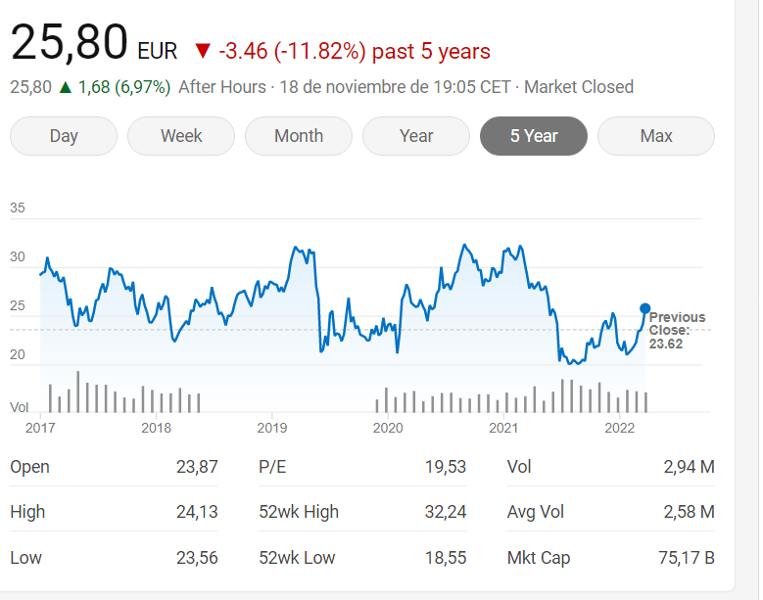
INDITEX: World’s largest fashion retailer with seven brands – Value for the Investors Nov 18, 2022
Relevant News:
Inditex falls sharply on the stock market due to its exposure to Russia CE Noticias Financieras (Latin America)
Inditex, Zara’s parent company, recorded losses of 5% in the Ibex 35 due to its high exposure in Russia and Ukraine. The Spanish textile company has 606 stores in both countries for all its brands, which represents 9.1% of its total business.

Slide 31
Thank You

