Slide 1
Lesson 1
Finance for Management
Prof. Belkis M Reyes-Fernandez

Slide 2
Lesson Topics and Content
Module Introduction
The Role of Financial Information for Decision-Making:
Financial Accounting
Managerial Accounting
The Annual Report

Slide 3
Introduction to Finance for Management
Introduction to the course
This course aims at contemporary frameworks for analyzing and making financial decisions to support operations and business strategy by examining and learning:
How corporate financial policy is enacted in various operating and business strategy decisions, including managing working capital and cash flow, capital budgeting and investment decisions, and maintaining long-term capital structure.
Several techniques of financial economics such as time value of money, financial risk, cost of capital, discounted cash flow, valuation of financial instruments, return on investment, and risk management in investment decisions.
To apply financial principles, concepts, and analytical tools in practical assignments that will simulate the reality of the marketplace and provide the opportunity to make recommendations after examining key financial issues and their strategic consequences.
The content of this module is regulated by the Malta Further and Higher Education Authority (MFHEA).

Slide 4
Introduction to Finance for Management
Course Teaching Methods:
Lessons
Weekly Activities
6 Formative Assessments
2 Individual Summative Assessments
Grading:
Formative | Summative
22 hours | 18 hours
Quizzes 10% | Case Study (2000 words) – 50%
Case Study 70% | Case Study / Report (2000 words) – 50%
Practical Skills Assessment 10%

Slide 5
Introduction to Finance for Management
The Role of Information for Business Decision-Making
Information plays a vital role in business decision-making:
Decision-making in for businesses is a process that involves the following stages:
Beginning with identifying and assessing the problem/situation/occurrence that affects or will be affecting the business operations or strategy in the future and put it in a structure manner.
Putting the situation of study within a context in which occurred to properly define the real business problem.
Generation of alternatives for possible solutions including alternatives like the opportunity costs and trade offs.
Select the best alternative based on the business interests, mission while providing the best value.
Making quality managerial decisions is the most important task for leaders of organizations; therefore, they require the right kind of information.
All businesses, to be economically sustainable in the long-term, must understand financial information.

Slide 6
Introduction to Finance for Management
The Role of Information for Business Decision-Making
Information for business decision-making is required to have quality, meaning:
Accurate, reliable fair and free from bias.
Complete where facts and figures should not be missing or concealed.
Cost-beneficial - Information should be analyzed for its benefits against the cost of obtaining it.
User-targeted, information should be communicated in the style, format, detail and complexity which address the needs of users of the information. For example, senior managers need brief reports which enable them to understand the position and performance of the business at a glance, while operational managers need detailed information which enable them to make day to day decisions.
Relevant to the situation and the end user needs.
Sourced from reliable source.
Delivered in a timely manner.
Easy to use and understand.

Slide 7
Introduction to Finance for Management
The Role of Financial Information for Business Decision-Making
Reaching good decisions is vital for organizations, but the implementation of such decisions is equally crucial.
Decision-makers need to commit to the decisions taken to reach the goals of the organizations.
The most important financial information needed for business decision comes from accounting and financial statements.
Accounting is a service function to management - processes and studies “raw data” and converts them into suitable information in the process of decision-making.
Financial information have different end-users like investors, managements, creditors, suppliers or regulators and financial statement interpretation knowledge to “reading” those financial statements.
A well-established process of management on the basis of the financial statements and financial in-formation is one of the most significant presumptions of the quality business.

Slide 8
Introduction to Finance for Management
Financial Accounting
Financial accounting refers to the figures, balances and accounts that a business must produce to demonstrate how the business is performing.
The main tasks for financial accountants are:
Keeping accurate records like ledgers, books and accounts
Ensuring invoices are raised and bills paid
Controlling and monitoring spending and balances
It needs to be clear and properly allocated so that the business managers or regulators have clear information about the costs and profits of the business within a specific period.
Legal requirement of companies requires reporting figures like:
Balance sheets, showing a snapshot of what a business owns and owes at a specific point in time
P & L account, showing the profit or loss the company has made in a specific period of time
Cashflow statement, showing where cash has come from and how it has been spent over the past year
Financial accounts relate to the past performance of the business and are an important baseline of financial information for managers.
Managers need to see how the business has performed in the past to enable them to look to the future.

Slide 9
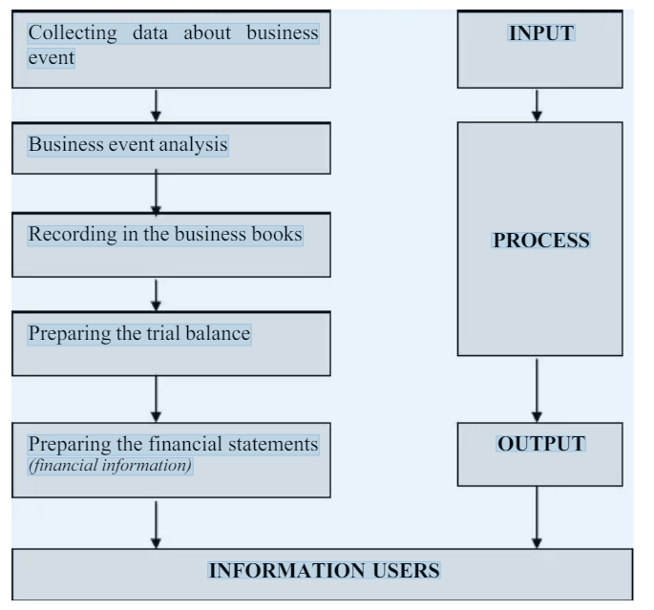
Introduction to Finance for Management
Financial Accounting
Recording Events Process
Source: https://www.academia.edu/15056580/THE_ROLE_OF_FINANCIAL_INFORMATION_IN_DECISION_MAKING_PROCESS

Slide 10
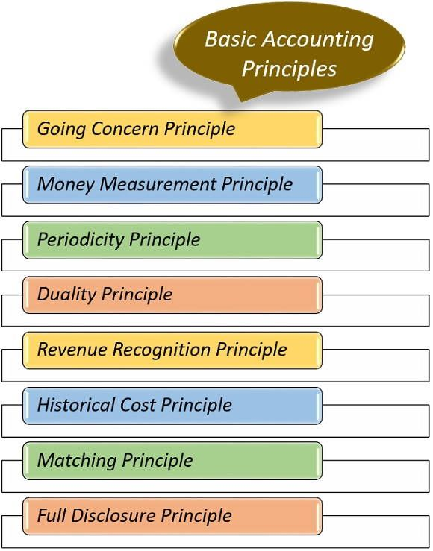
Reporting - Basic Accounting Principles
Interpreting financial statements is challenging because of the complexities inherent in the accounting choices and the underling rules.
Accounting principles are the rules and guidelines that companies must follow when reporting financials to improve the quality of financial information reported by companies, and to make it understandable to all users.
The Financial Accounting Standards Board(FASB) issues a standardized set of accounting principles in the U.S. referred to as generally accepted accounting principles (GAAP) for uniformity. Some of the most fundamental accounting principles include the following:

Slide 11
Introduction to Finance for Management
Managerial Accounting
Management accountants focus on analyzing performance and planning, forecasting and decision-making.
Management accountants need to be able to produce accurate analysis, correct forecasts and a detached and professional overview to a company’s performance
They use information for strategic planning to advise on how the business creates value or generates more revenues like merging or acquiring another business, investing in new technology, facilities expansion or expanding to new markets.
Involves using the internal financial information available to managers, as well as that information which companies must publish by law.
They have several tools to produce information to assess aspects of a company’s performance that will be used for decision-making like:
Ratio analysis measuring one variable in terms of another
Budget, P&L or Financial plan – showing where the revenues costs comes from
Forecasts, like cash flow forecasts look at likely future flows of costs and revenues anticipate funding
Variance analysis showing the difference between the planned budget and what actually happened to analyze the reasons why the variance occurred

Slide 12
Introduction to Finance for Management
Financial vs Managerial Accounting
Financial Accountants maintain a business’ balances and accounts, they keep the business’ records legal and financially stable.
Managerial Accountants focus on forecasting - they have an exciting and forward-looking strategic role in many types of organizations using various tools, such as ratio analysis and investment appraisal, to identify, measure and analyze the financial performance of a company at a particular point in time.

Slide 13
Introduction to Finance for Management
The Annual Report
A business Annual Report is a comprehensive report detailing a company’s activities throughout the preceding year – provides significant amount of information to the user.
The purpose is to provide users like managers, creditors, suppliers, shareholders or potential investors with information about the company’s operations and financial performance.
The reports contain information like performance highlights, a letter from the CEO, financial information, and objectives and goals for future years.
The structure of annual reports varies according to each company’s preferences.
Source: https://investor.starbucks.com/financial-data/annual-reports/default.aspx

Slide 14
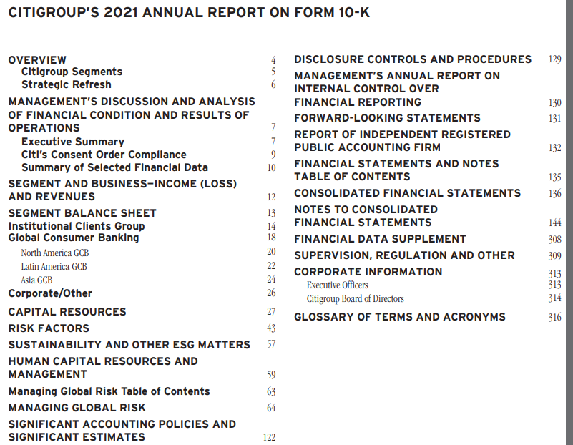
Introduction to Finance for Management
The Annual Report - Components
Across global markets, Annual reports have different formats and components; this happens due to statutory requirements in different economies.
Some of the common components are:
Director’s message to shareholders
Information on corporate governance
Financial highlights
Management discussion and analysis
Shareholding pattern, management/board of directors’ information
Detailed and audited financial statements
Statement of financial position
Income statement
Statement of Cashflows
Statement of Changes in Equity
Notes to financial statements – to back up the FS data
Usage of accounting policies and changes
Other information or disclosure.
In the United States, Annual Reports
can also be presented in a 10-K format
Financial Statements
Source https://www.citigroup.com/citi/investor/quarterly/2022/ar21_en.pdf

Slide 15
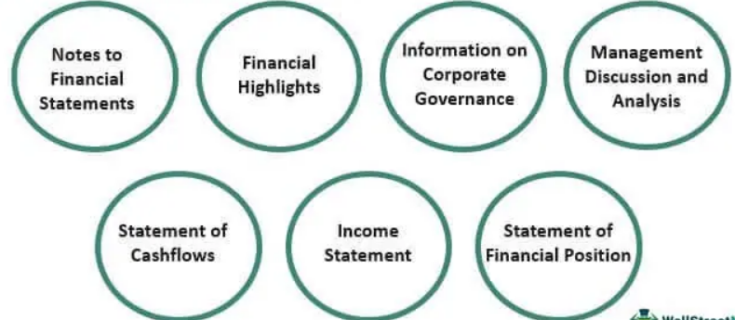
Introduction to Finance for Management
The Annual Report - Components
Source: https://www.wallstreetmojo.com/annual-report/

Slide 16
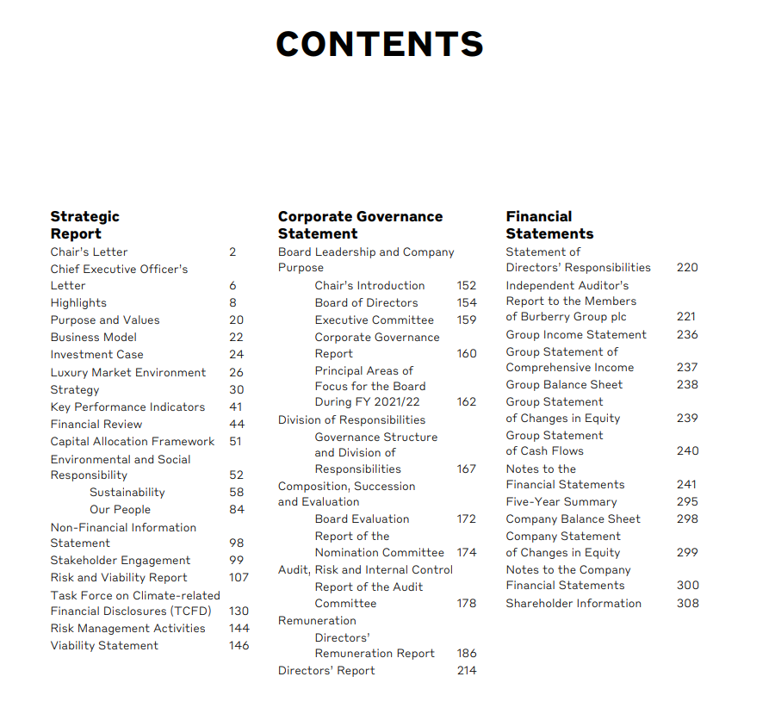
Introduction to Finance for Management
The Annual Report – Financial Statement Notes
Explain with detail the account – For example: Note 15 details de computation and rationale for Deferred Taxes Account
Source: https://investor.starbucks.com/financial-data/annual-reports/default.aspx

Slide 17
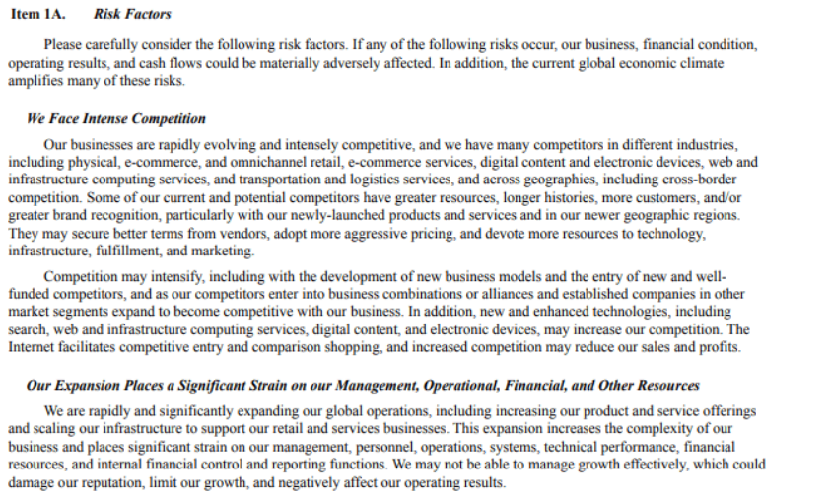
Introduction to Finance for Management
The Annual Report - Components
Example - Amazon Annual Report describing its competition landscape:
Source: https://ir.aboutamazon.com

Slide 18
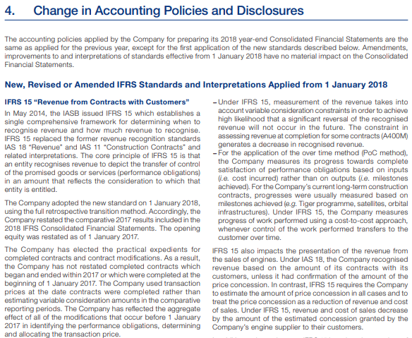
Introduction to Finance for Management
The Annual Report - Components
Example – Airbus Annual Report highlighting the changes in their Accounting Policies and Disclosures.
Source: https://airbus.com

Slide 19
Introduction to Finance for Management
The Annual Report - Users
Annual reports are often publicly available and cater to a large external audience, including shareholders, potential investors, employees, and customers:
Shareholders and Potential Investors to get a better understanding of the current position of the company in order to make investing decisions - to purchase or not stock, gives insight into the future plans of the company along with the goals and objectives.
Employees to understand some of a company’s different focus areas.
Customers to get an overview of different companies and help them decide on which one to build a relationship and enables companies to emphasize its core values and objectives.
Source: https://www.lvmh.com/shareholders/agenda/2021-full-year-results/

Slide 20
Introduction to Finance for Management
The Annual Report
Benefits
Annual reports are intended to provide information and disclosure on business prospects and financial performance, its stakeholders, which include investors, creditors, auditors, government officials, employees, suppliers, customers, among others.
Institutional and individual investors use them to analyze and forecast financial statements to evaluate the company’s prospects.
They standardize the businesses performances helping government authorities in taxation and audit purposes.
Limitations
Annual reports are comprehensive but are not always fulfilling in terms of completeness as they are used with other regulatory filings. In the United States, SEC requires also corporate press releases, management notes or proxy statements.
They are sometimes released to attract investors and supply-chain parties; therefore, the prospective expenditures and income are projected in a way that makes the business appealing.
They are based on historical performance. Hence, the estimation of future performance is not always best measured.

Slide 21
Introduction to Finance for Management
The Annual Report – key notes
Annual reports contain financial information for the past several years, but financial data are subject to changes in the future.
Besides these Annual reports, companies also release Quarterly reports (Q).
Annual report is helpful for its stakeholders in understanding the strengths and weaknesses of the business.
This document is prepared for different purposes and serves different users.
In preparing this document, companies must follow accounting standards and depict business to its investors and creditors as clearly as possible.
Independent teams of auditors verify this report, and credibility depends on the report’s accuracy.
These reports are published and released online and made available in hard print to stakeholders.

Slide 22
Thank You

